Slide 1
計算物理
積分問題

Slide 2

Problem
Calculate the formula with two following method
Simpson’s rule
Gaussian Quadrature

Slide 3


Definite integral answer
$\int_{0}^{5}{e^{x}}+e^{x}\sin\left(x\right)dx=\frac{1}{2}{(e}^{x}sin\left(x\right)−e^{x}cos⁡(x))+e^{x}$

Slide 4
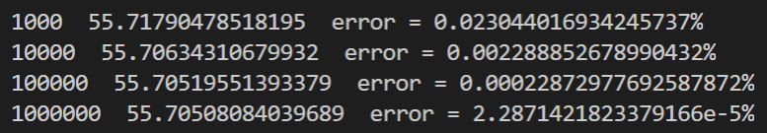
Simpson’s rule
N answer error (%)

Slide 5
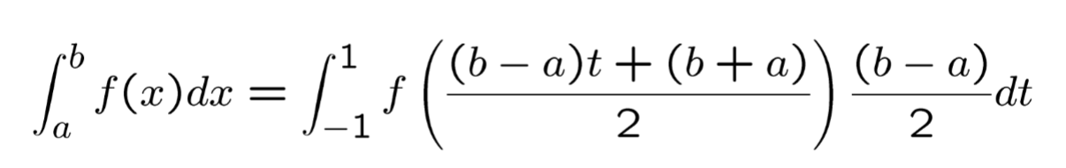
Gaussian Quadrature
We will use 15 different number of node
[6,8,10,12,14,16,24,28,32,36,40,44,48,64,80]

Slide 6
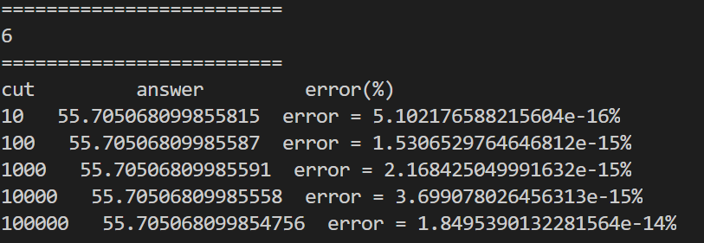
6

Slide 7
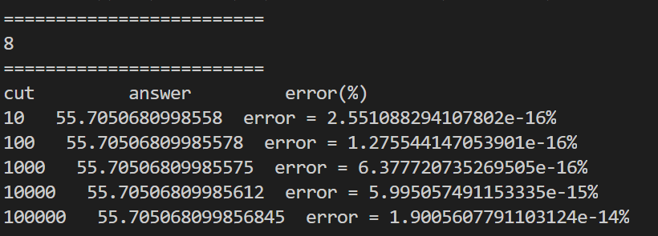
8

Slide 8
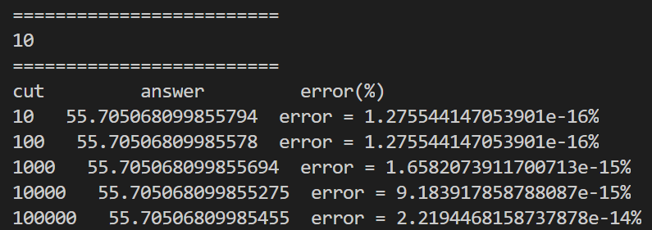
10

Slide 9
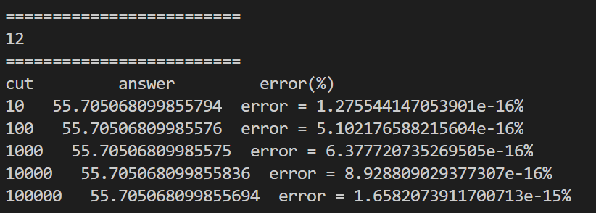
12

Slide 10
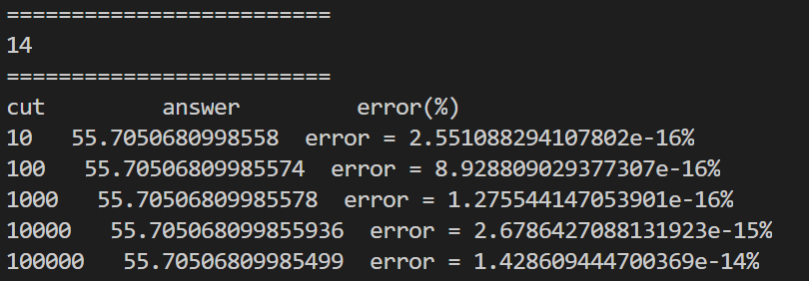
14

Slide 11
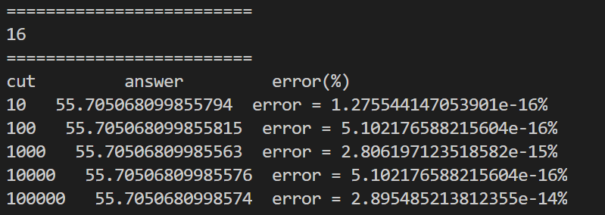
16

Slide 12
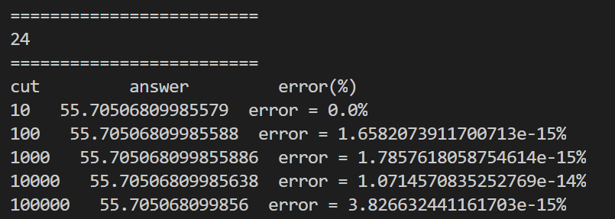
24

Slide 13
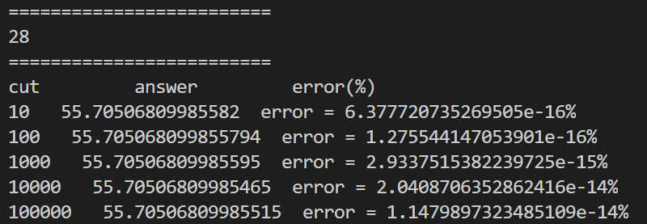
28

Slide 14
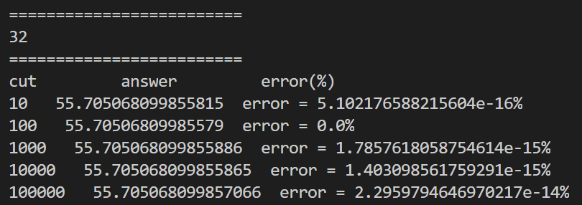
32

Slide 15
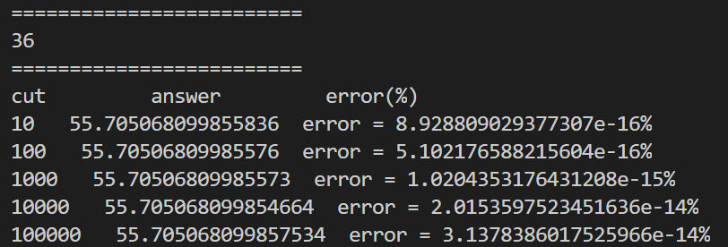
36

Slide 16
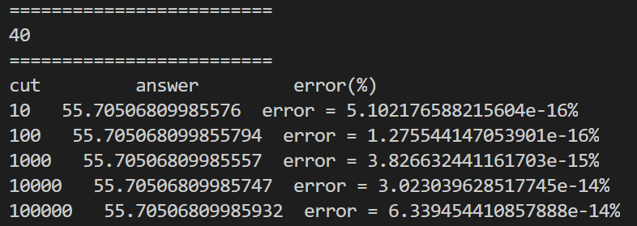
40

Slide 17
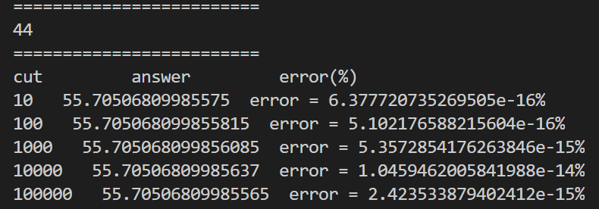
44

Slide 18
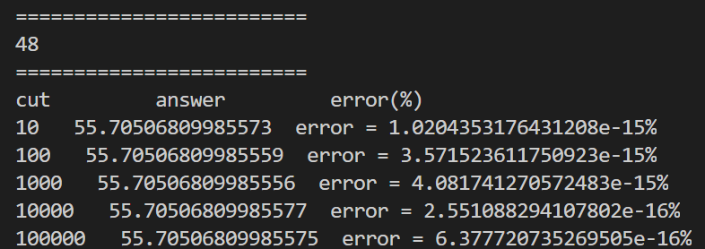
48

Slide 19
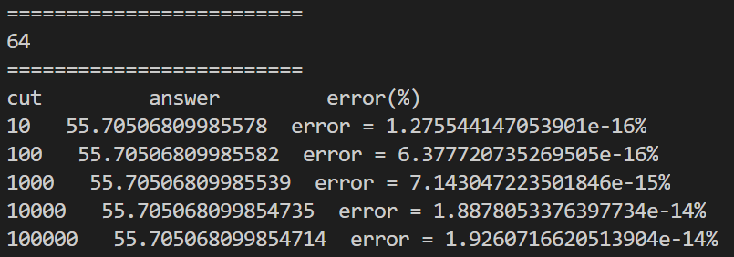
64

Slide 20
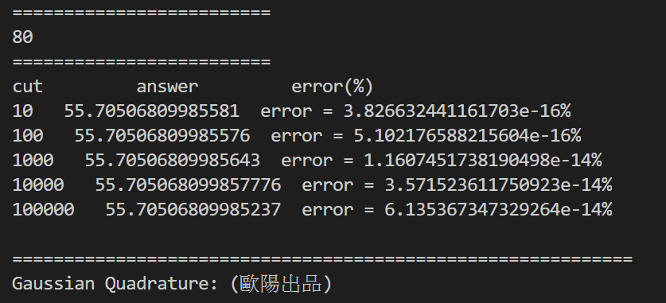
80

Slide 21
Conclusions
Gaussian Quadrature is very accurate.

