Slide 1
計算物理
二階微分方程

Slide 2
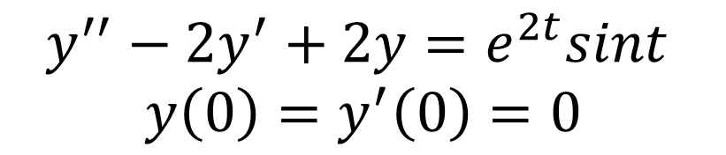

problem
Solve the initial value problem and Find $y\left(2\right)$
$$y^{′′}−2y^{′}+2y=e^{2t}sint$$
$$y\left(0\right)=y^{′}\left(0\right)=0$$

Slide 3
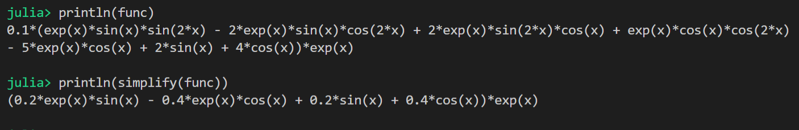

The excact Function
Oringinal = $0.1(e^{x}\sin\left(x\right)\sin\left(2x\right)−2e^{x}\sin\left(x\right)\cos\left(2x\right)+2e^{x}\sin\left(2x\right)\cos\left(x\right)+e^{x}\cos\left(x\right)\sin\left(2x\right)−5e^{x}cos(x)$
Simplify = $\left(0.2e^{x}\sin\left(x\right)−0.4e^{x}\cos\left(x\right)+0.2\sin\left(x\right)+0.4\cos\left(x\right)\right)e^{x}$

Slide 4
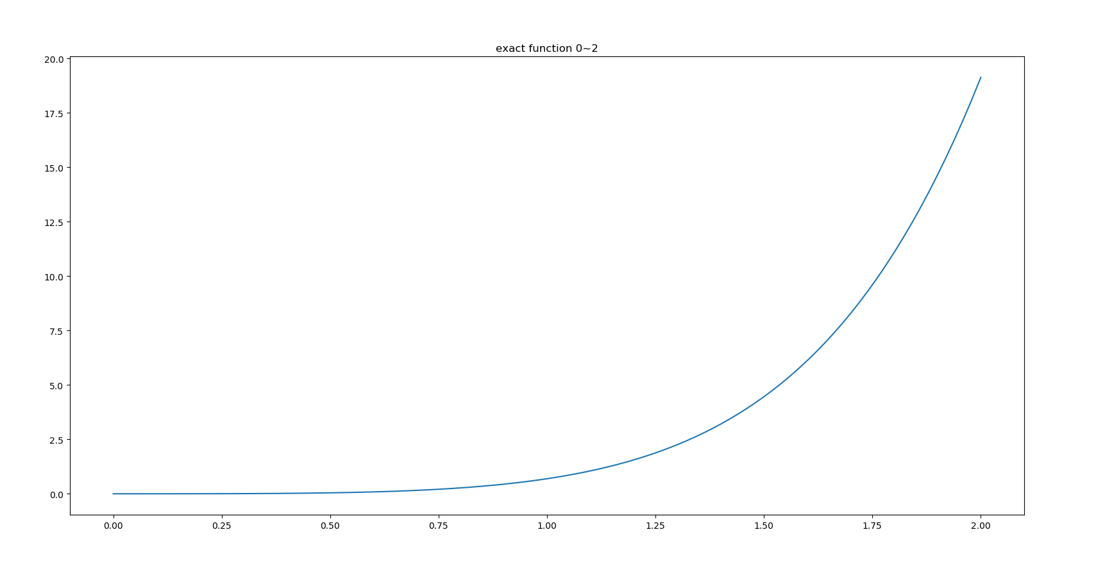
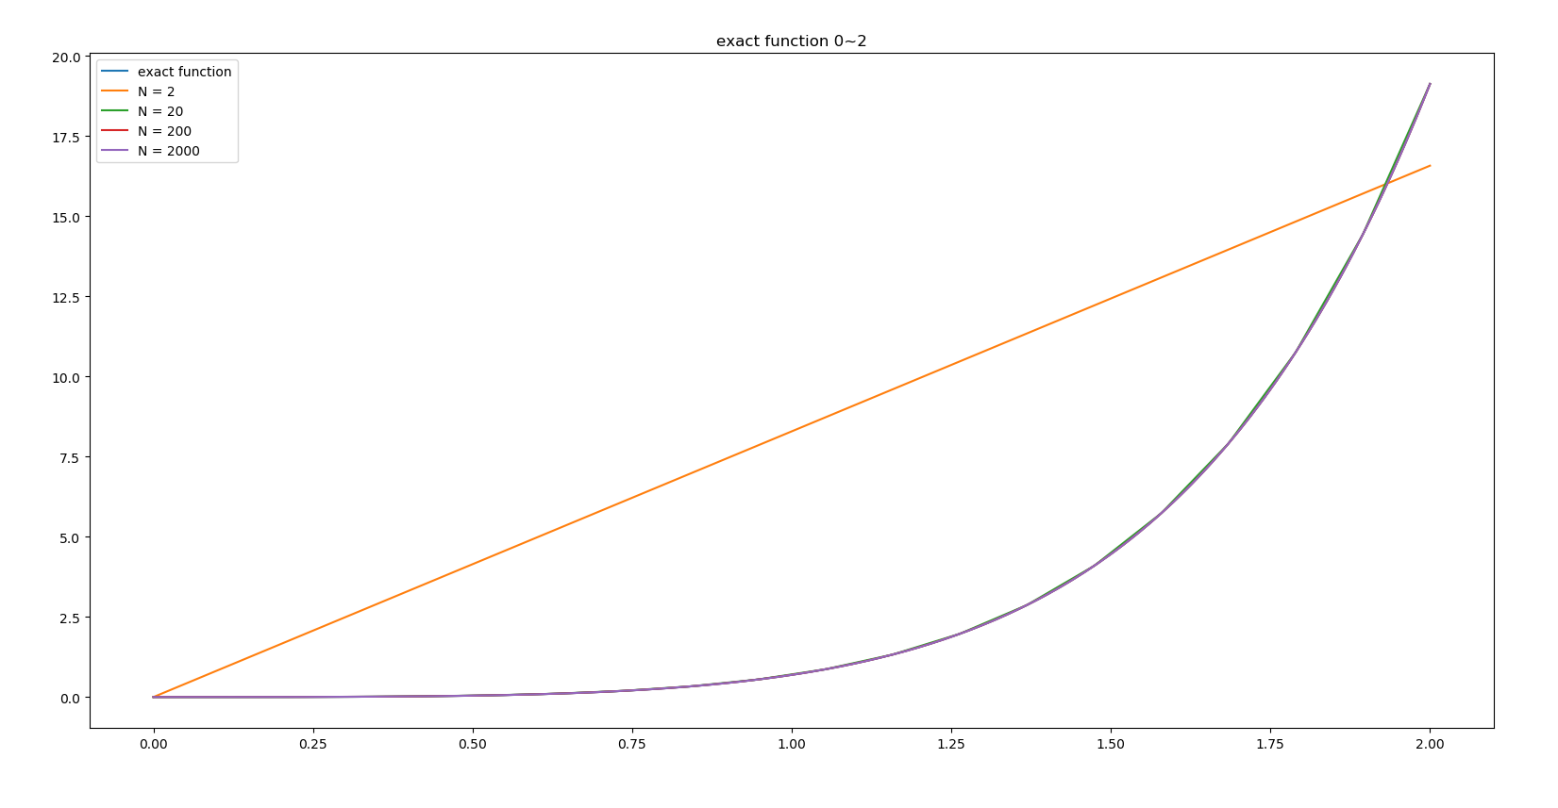

Slide 5
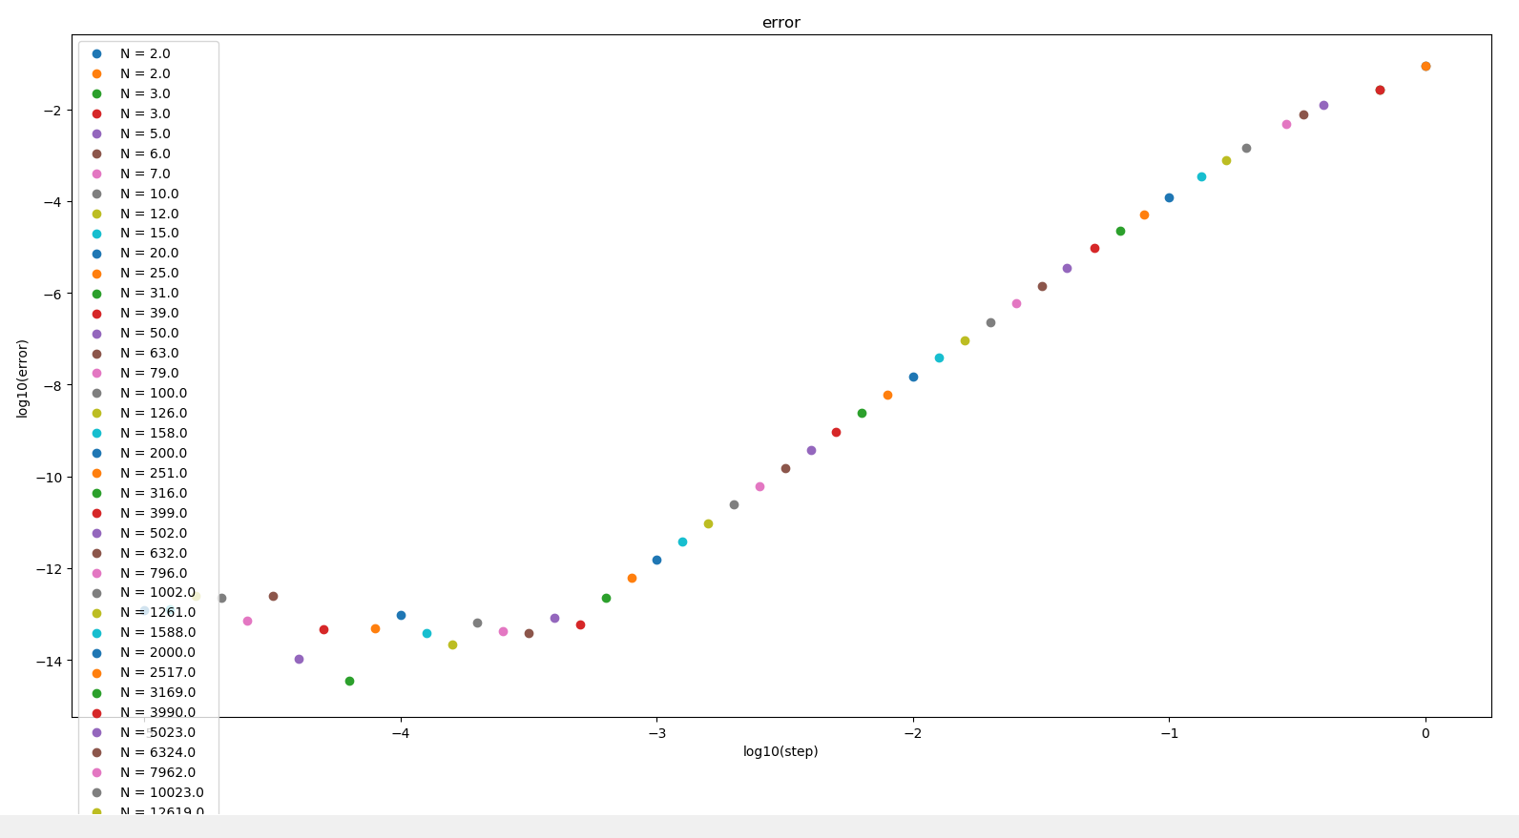
誤差分析

Slide 6
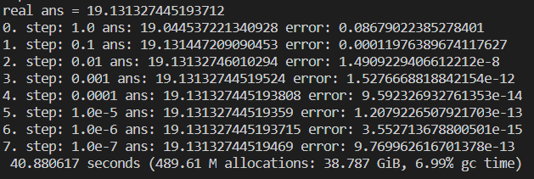

Slide 7
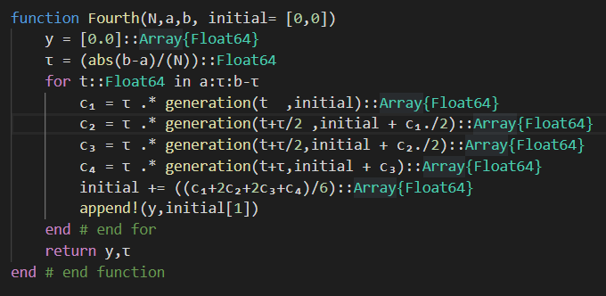
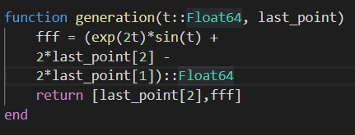
Code

Slide 8
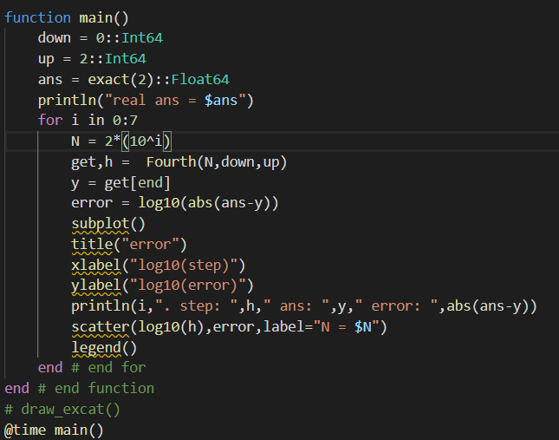
Main

