Slide 1
計算物理
薛丁格方程式

Slide 2
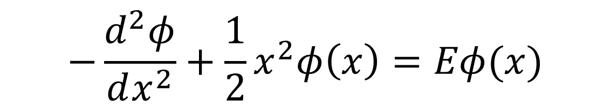
problem
Solve the eigenvalue problem
$$−\frac{d^{2}φ}{dx^{2}}+\frac{1}{2}x^{2}φ\left(x\right)=Eφ(x)$$

Slide 3
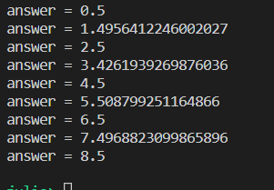
Energy

Slide 4
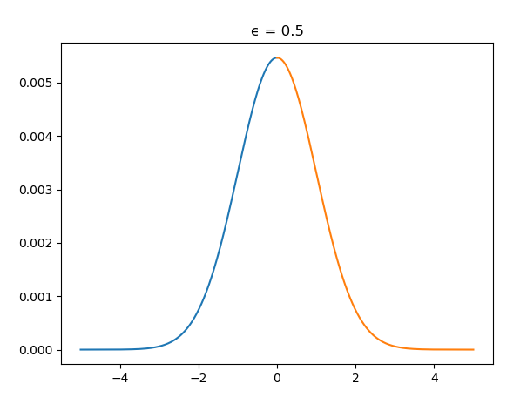

Slide 5
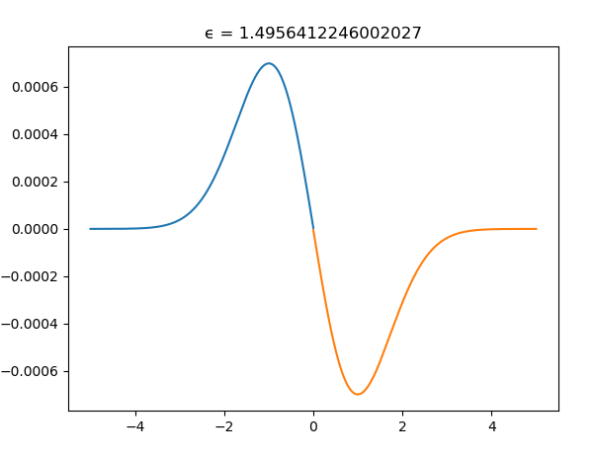

Slide 6
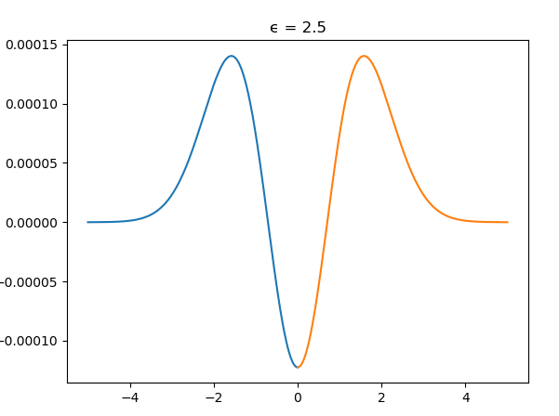

Slide 7
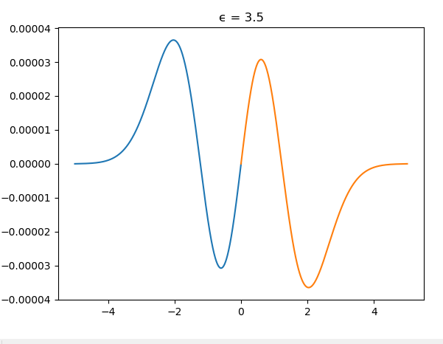

Slide 8
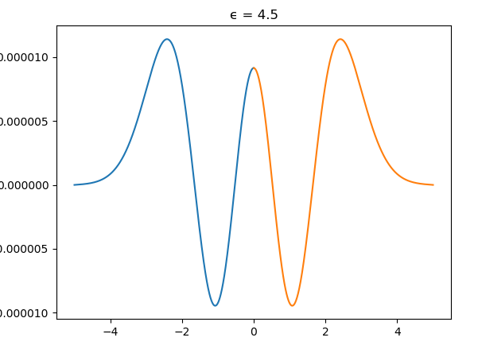

Slide 9
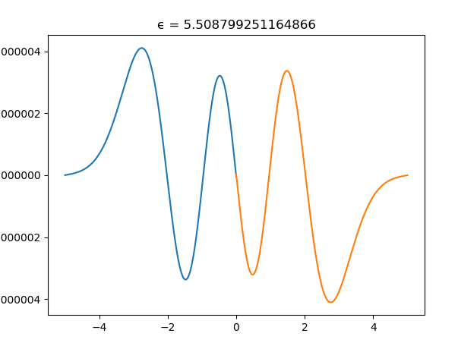

Slide 10
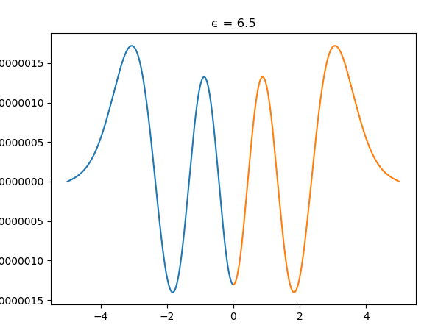

Slide 11
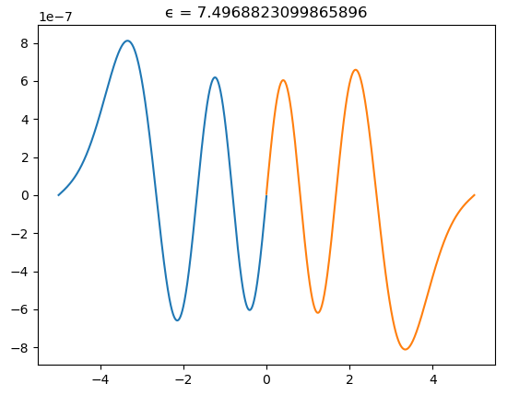

Slide 12
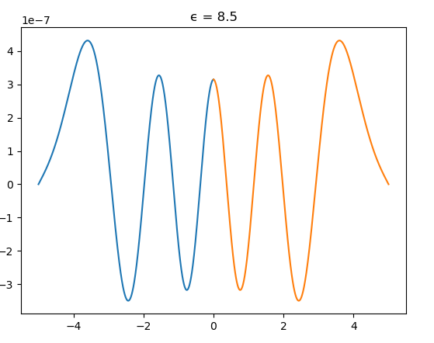

Slide 13
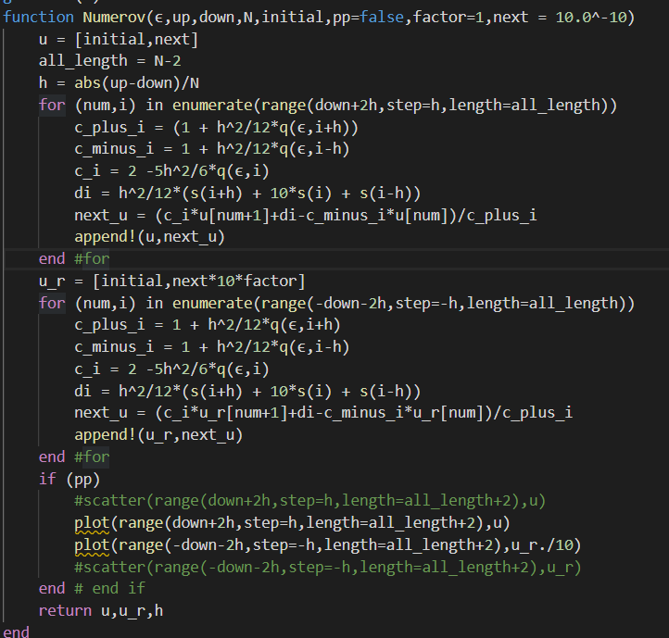
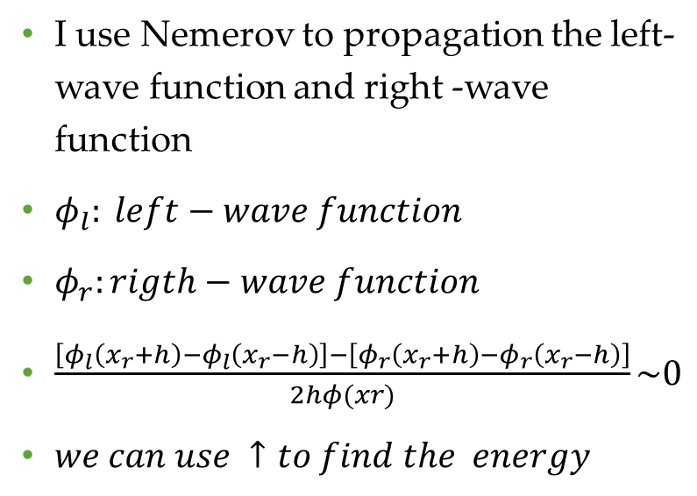
Method
I use Nemerov to propagation the left-wave function and right -wave function
$φ_{l}: left−wave function$
$φ_{r}:rigth−wave function$
$\frac{\left[φ_{l}\left(x_{r}+h\right)−φ_{l}\left(x_{r}−h\right)\right]−\left[φ_{r}\left(x_{r}+h\right)−φ_{r}\left(x_{r}−h\right)\right]}{2hφ(xr)}\sim 0$
$we can use ↑to find the energy$

Slide 14
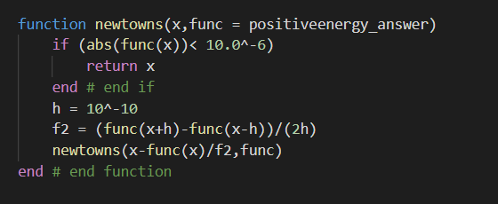
Newtown’s method
And use Newtown’s method to find the ϵ

Slide 15
Summary
We use the continuity of the wave function to judge whether is it or not the eigenvalue。
I think the method is complex and Annoying, is there any more straight forward solution?

