Slide 1
計算物理
FFT vs DFT

Slide 2
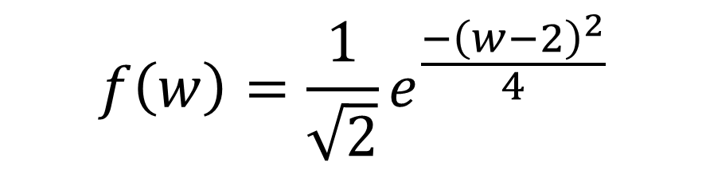

Problem
Design my testing case to compare the computing time and results.
$$f\left(w\right)=\frac{1}{\sqrt{2}}e^{\frac{−{\left(w−2\right)}^{2}}{4}}$$
$$f\left(x\right)=e^{−t^{2}}∙e^{2itx}$$
Fourier transform

Slide 3
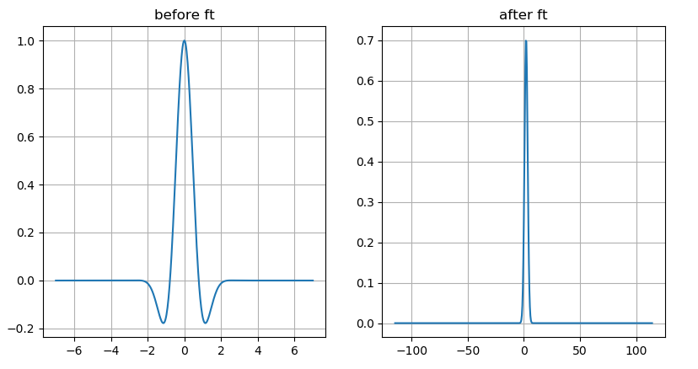

function
$$f\left(w\right)=\frac{1}{\sqrt{2}}e^{\frac{−{\left(w−2\right)}^{2}}{4}}$$
$$f\left(x\right)=e^{−t^{2}}∙e^{2itx}$$

Slide 4
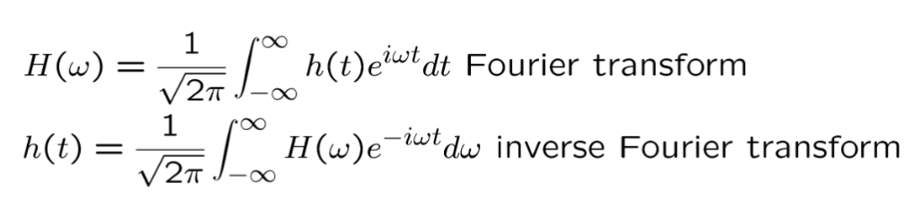
Fourier transform

Slide 5
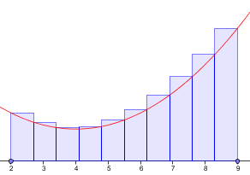
DFT

Slide 6
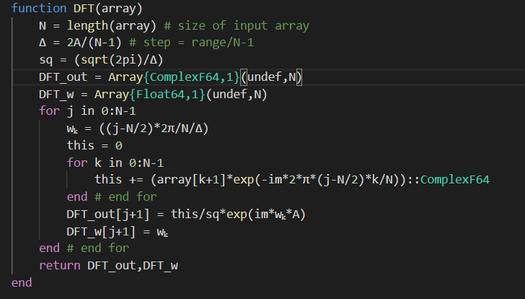
DFT code

Slide 7
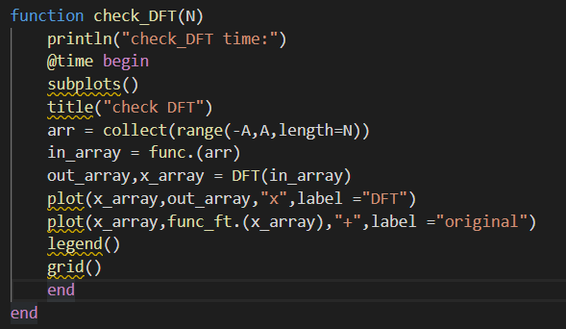
Checking DFT

Slide 8
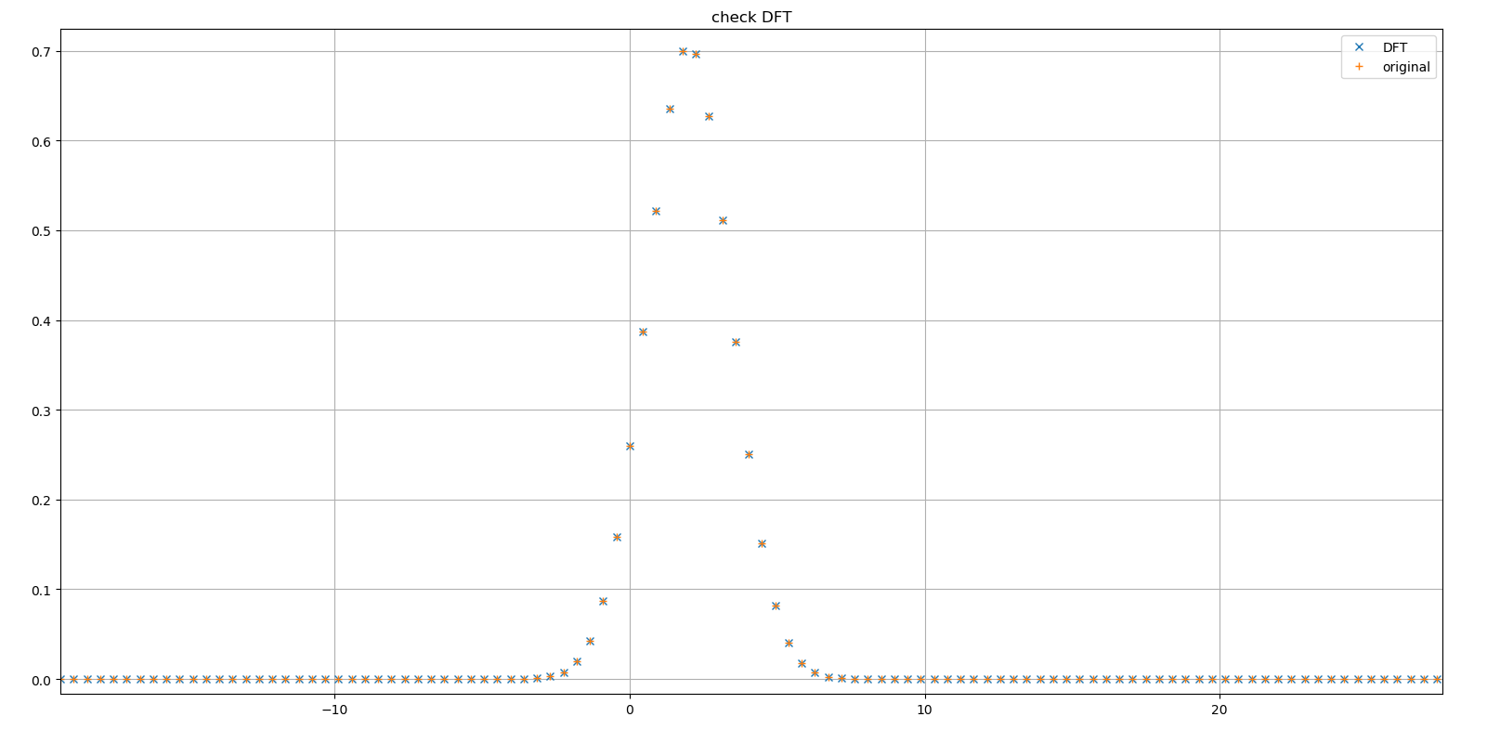
consistent

Slide 9
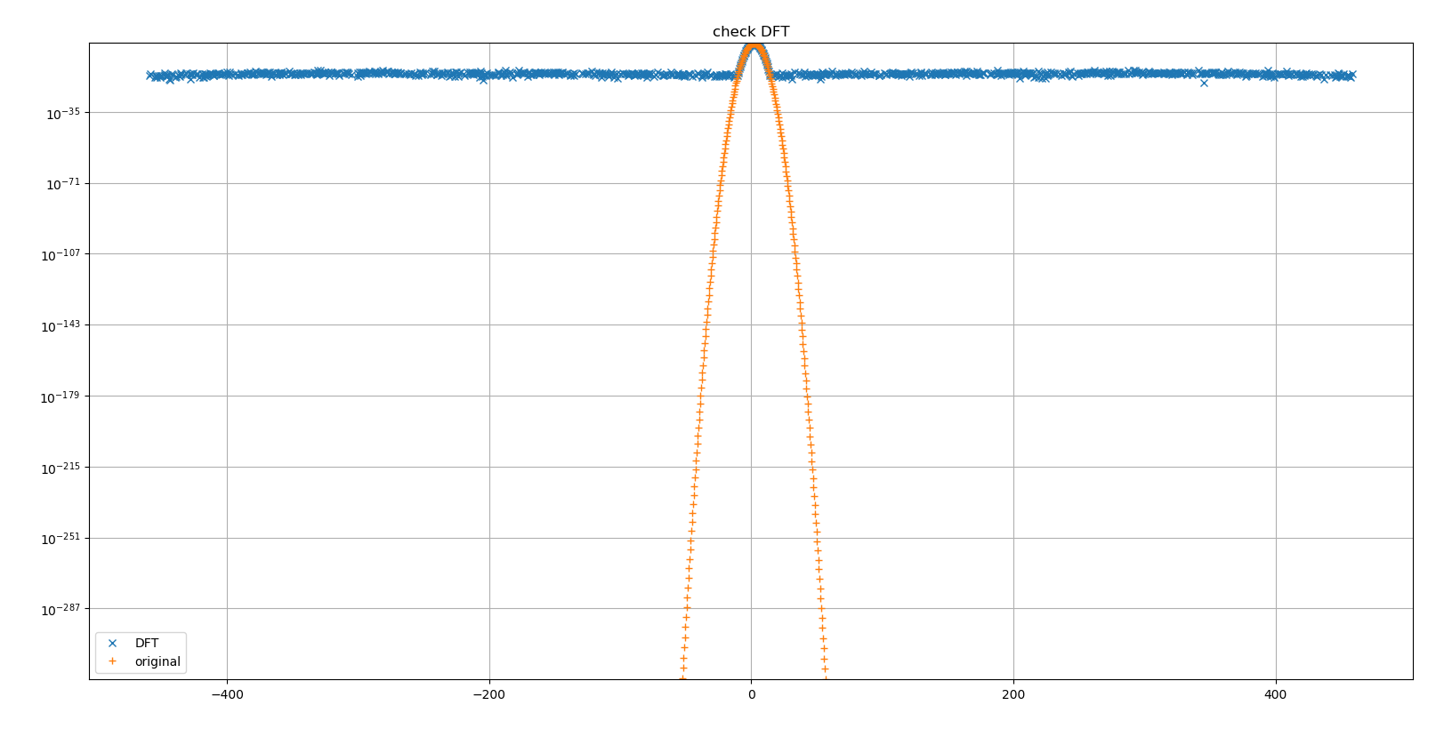
Error (log scale)

Slide 10

FFT
FFTW is a C subroutine library for computing the discrete Fourier transform
FFTW received the 1999 J. H. Wilkinson Prize for Numerical Software,
"best addresses all phases of the preparation of high quality numerical software.“
Our paper "A Fast Fourier Transform Compiler" (in PLDI 1999) received the Most Influential PLDI Paper award in 2009.

Slide 11
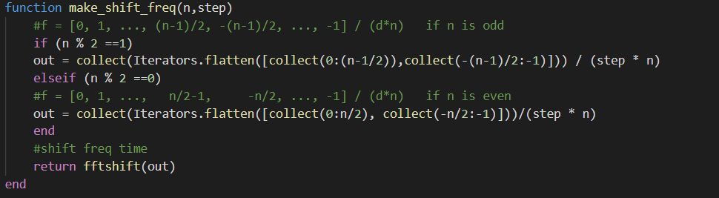
fft freq

Slide 12
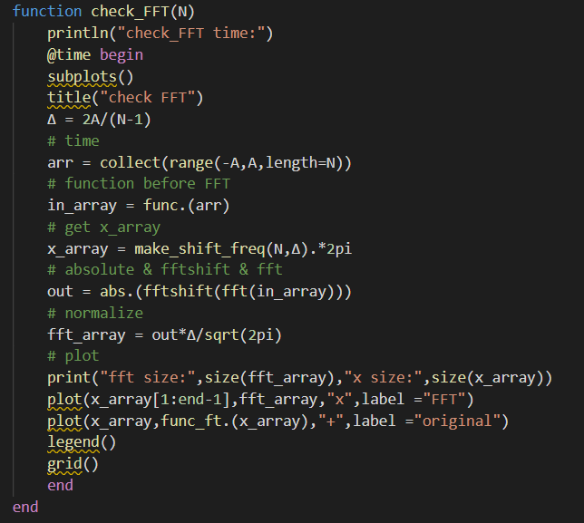
Checking FFT

Slide 13
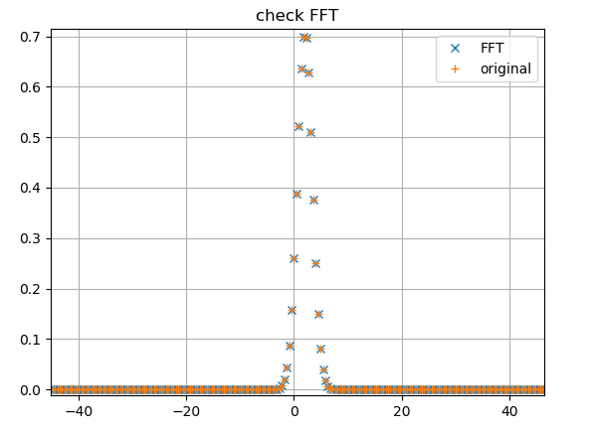
consistent

Slide 14
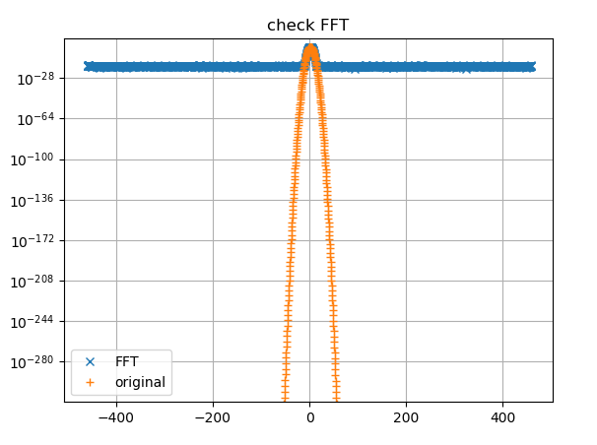
Error (log scale)

Slide 15

time
$N=2^{5}\sim 2^{15}$
A = 7

Slide 16
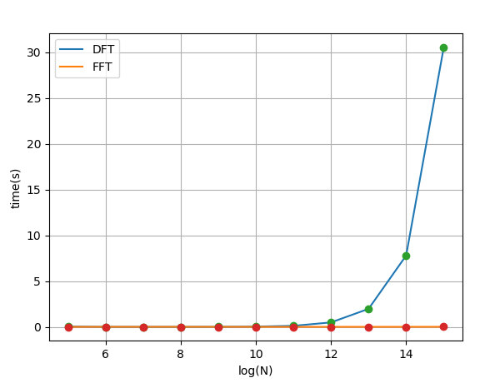
Time vs N

Slide 17
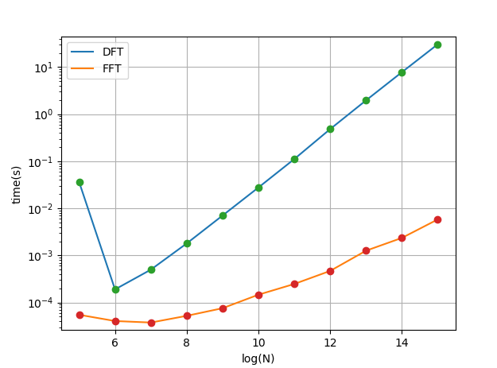
Log scale

Slide 18
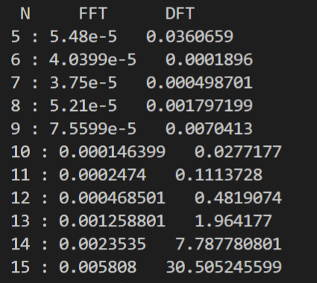
data

