Slide 1
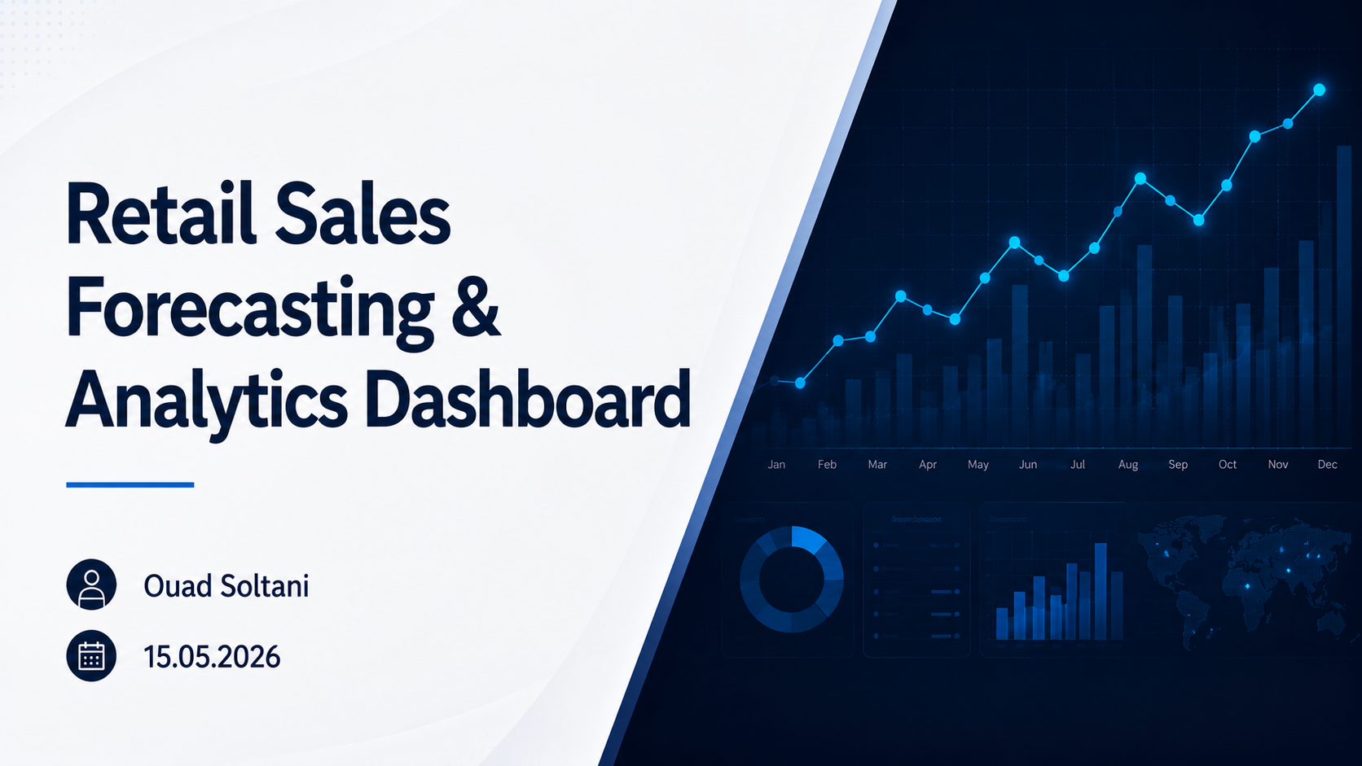
Notes:
Hi.
Today I’ll present my project on Retail Sales Forecasting and Analytics Dashboard.

Slide 2
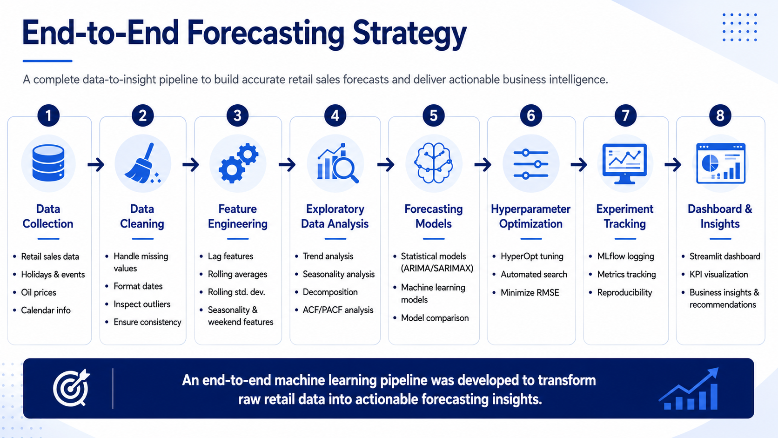
Notes:
This slide summarizes the end-to-end workflow I used in the project.
I started with data collection and cleaning,
then created time-series features such as lag variables, rolling statistics, and seasonal indicators.
Next, I performed exploratory data analysis to identify trends, seasonality, and autocorrelation patterns.
Multiple forecasting models were then developed and optimized using HyperOpt,
while MLflow was used to track experiments and compare performance.
Finally, the best model and insights were deployed through an interactive Streamlit dashboard for business analysis and forecasting.”

Slide 3
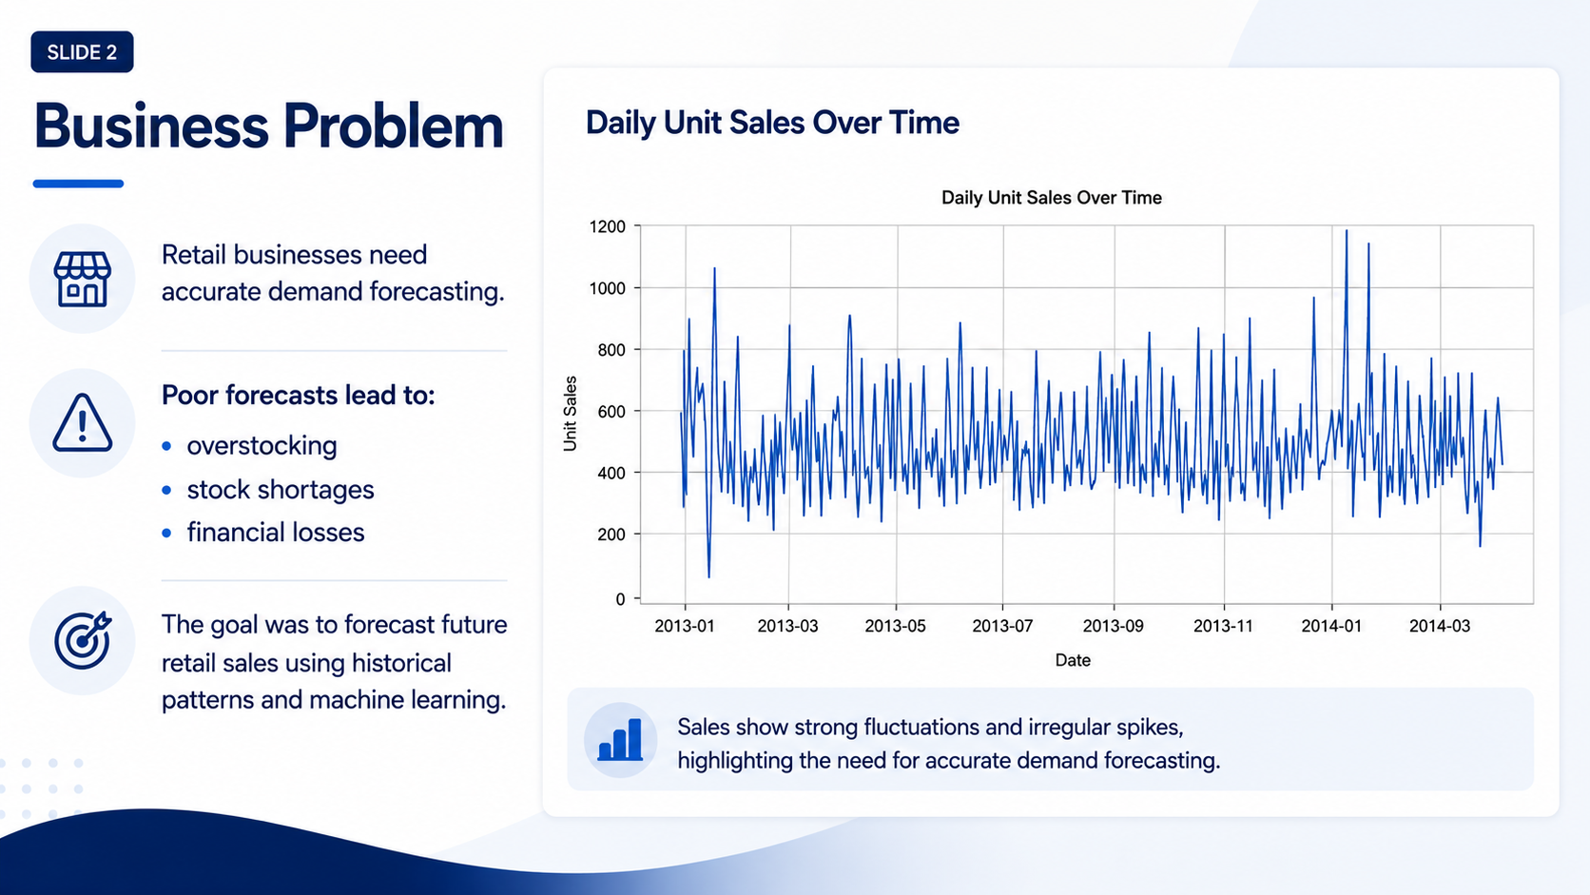
Notes:
Retail businesses rely heavily on accurate demand forecasting to manage inventory and operations efficiently.
Poor forecasting can lead to several issues, including overstocking, stock shortages, and financial losses.
→ The dataset showed strong fluctuations and irregular sales spikes over time, which made forecasting challenging.
→ Because of this volatility, the main goal of the project was to forecast future retail sales using historical sales behavior and machine learning techniques.

Slide 4
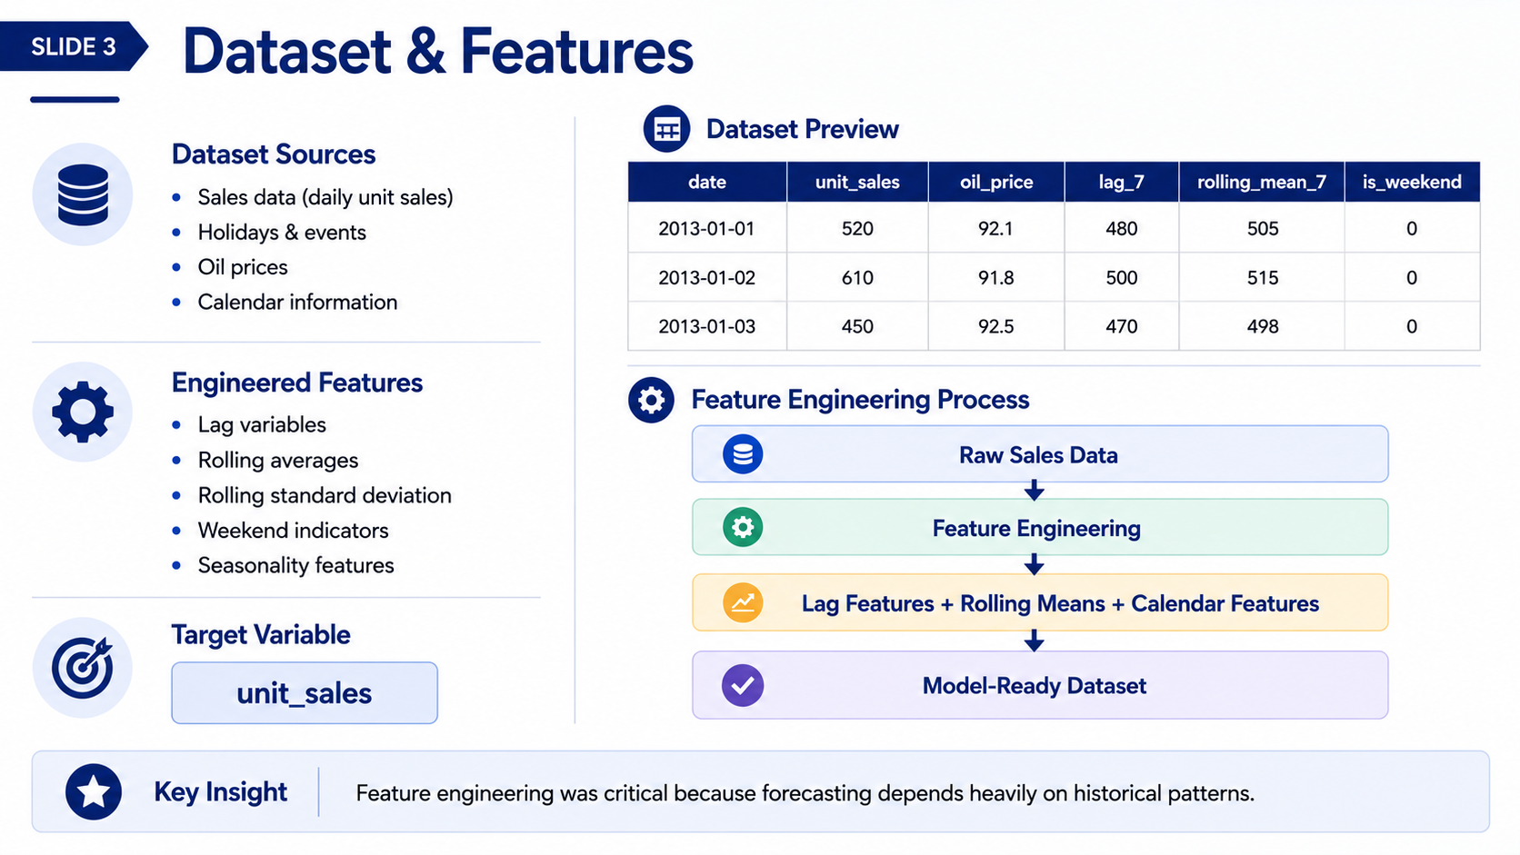
Notes:
This slide summarizes the dataset and the feature engineering process.
The project used multiple data sources, including daily unit sales, holidays and events, oil prices, and calendar information.
Feature engineering was a critical part of the project because time-series forecasting depends heavily on historical behavior.
→ Several engineered features were created:
lag variables,
rolling averages,
rolling standard deviations,
weekend indicators,
and seasonal calendar features.
The target variable for prediction was unit sales.
The overall pipeline transformed raw sales data into a model-ready dataset.

Slide 5
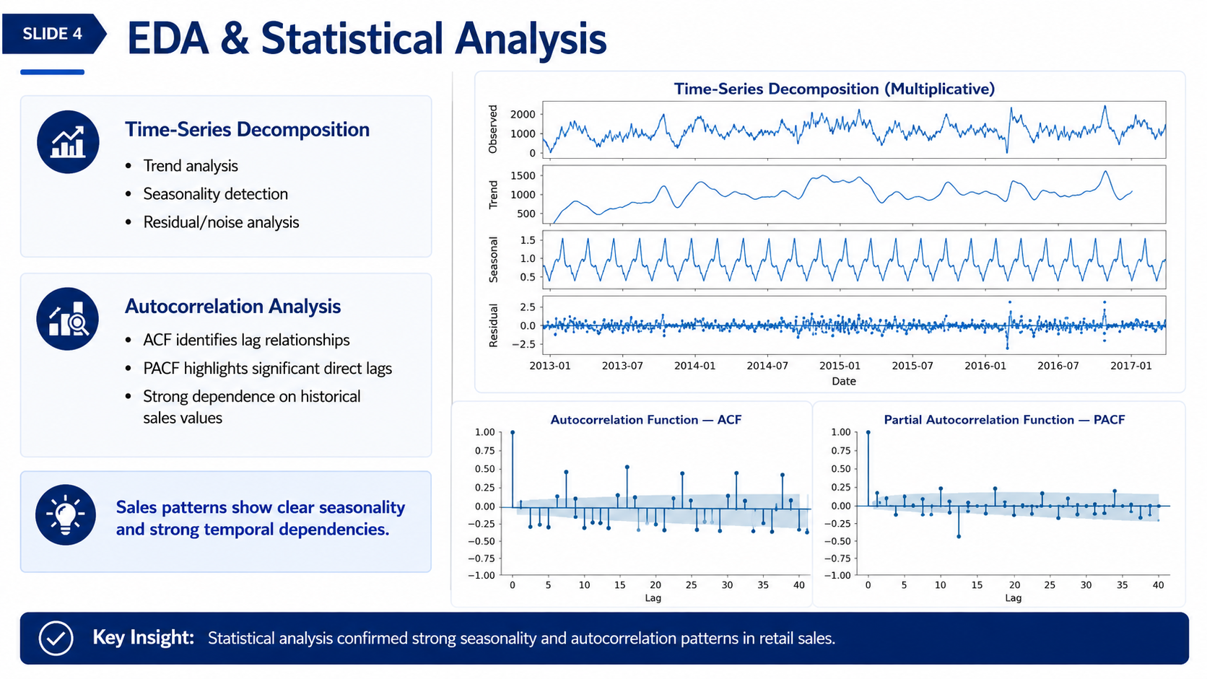
Notes:
Next, I performed exploratory data analysis and statistical analysis on the time series.
- The decomposition plot helped separate the data into:
trend,
seasonal,
and residual components.
- This confirmed that the sales data contains strong seasonality patterns.
I also analyzed autocorrelation using ACF and PACFplots.
- The ACF plot showed strong lag relationships, while the PACF plot identified significant direct lags.
→ Overall, the statistical analysis confirmed that historical sales values strongly influence future demand, which justified the use of lag-based forecasting models.

Slide 6
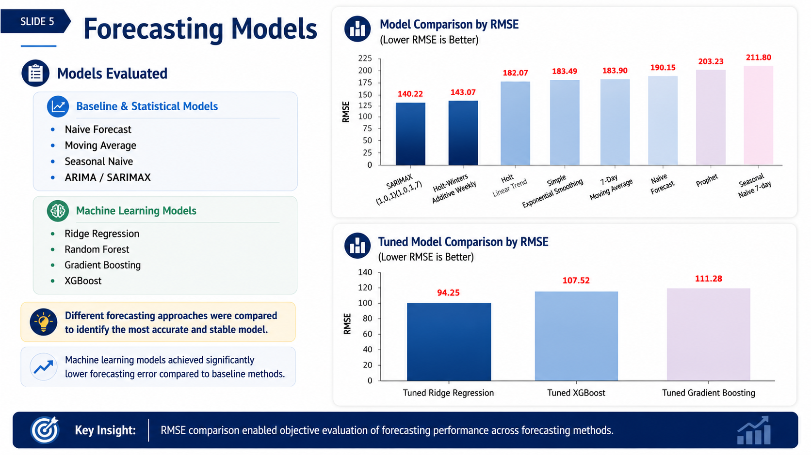
Notes:
In this stage, multiple forecasting models were evaluated and compared.
- The baseline and statistical models included:
Naive Forecast,
Moving Average,
Seasonal Naive,
and ARIMA/SARIMAX.
- The machine learning models included:
Ridge Regression,
Random Forest,
Gradient Boosting,
and XGBoost.
- The RMSE comparison chart on the right summarizes forecasting performance across all models.
- The results clearly showed that machine learning approaches achieved significantly lower forecasting error compared to traditional baseline methods.
→ Among all evaluated approaches, Ridge Regression achieved the strongest performance.

Slide 7
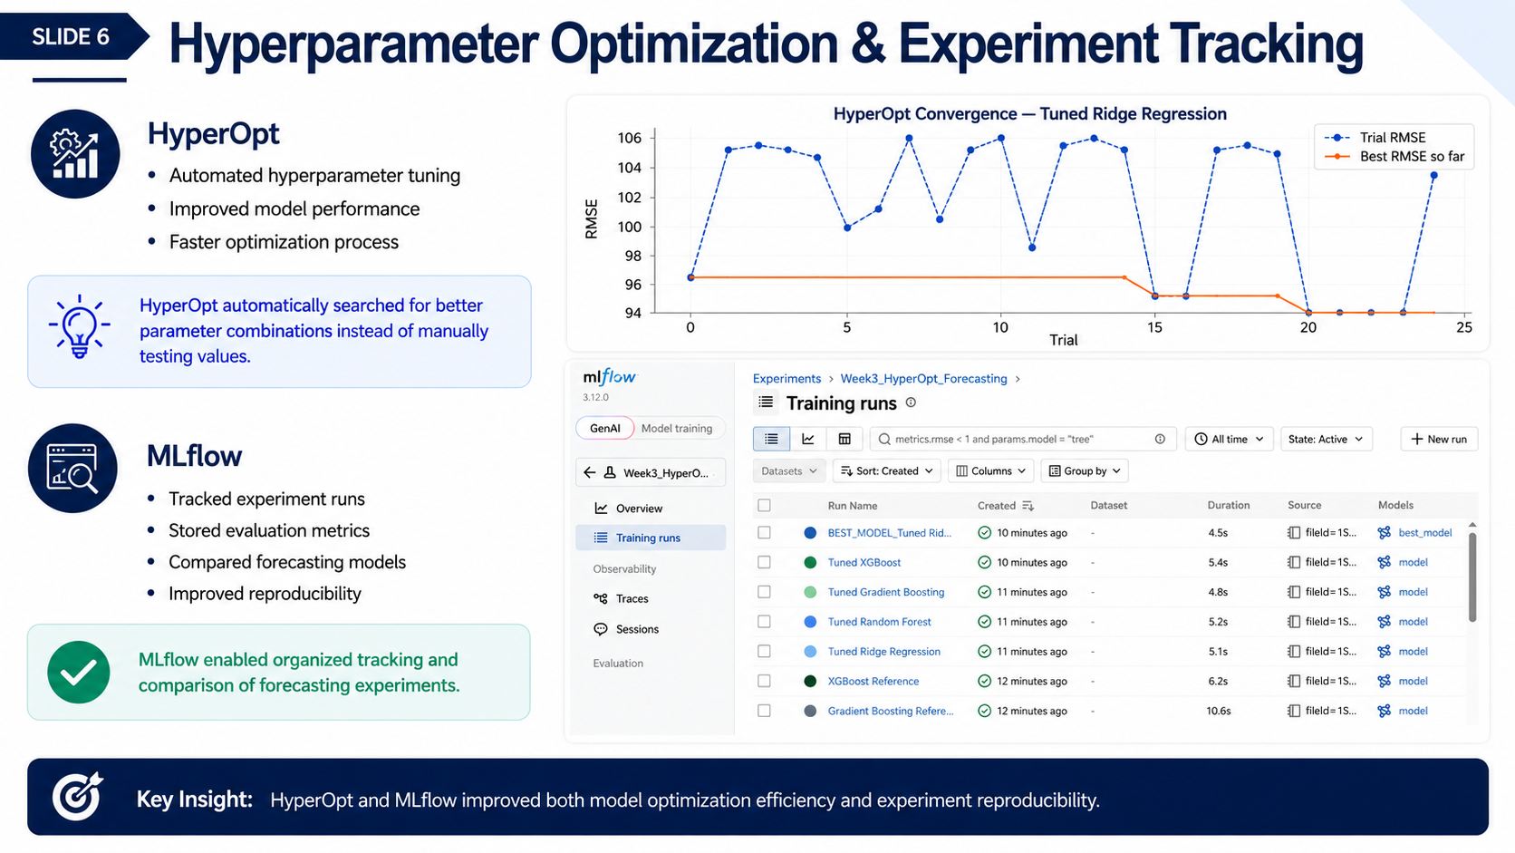
Notes:
“This slide presents the optimization and experiment tracking workflow.
- HyperOpt was used for automated hyperparameter tuning.
→ Instead of manually testing parameter values, HyperOpt automatically searched for better parameter combinations to improve forecasting performance.
- The convergence plot shows how RMSE improved over multiple optimization trials.
- MLflow was then used for experiment tracking and reproducibility.
It tracked:
experiment runs,
evaluation metrics,
model parameters,
and forecasting results.
- The MLflow interface shown here contains the real experiment runs generated during the project.
→ Together, HyperOpt and MLflow improved both optimization efficiency and reproducibility.”

Slide 8
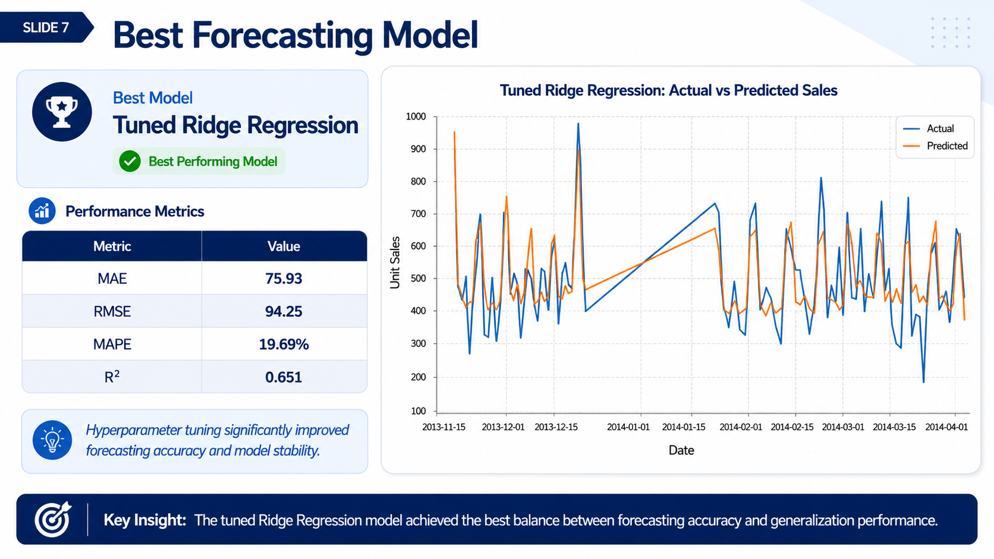
Notes:
“This was the best-performing forecasting model in the project.
The tuned Ridge Regression model achieved:
MAE of 75.93,
RMSE of 94.25,
MAPE of 19.69%,
and an R² score of 0.651.
- The Actual versus Predicted Sales plot demonstrates that the model successfully captured the main sales trends and fluctuations.
-Although some volatility remains difficult to predict perfectly, the model achieved a strong balance between forecasting accuracy and generalization performance.
- Hyperparameter tuning also contributed significantly to improving model stability.”

Slide 9
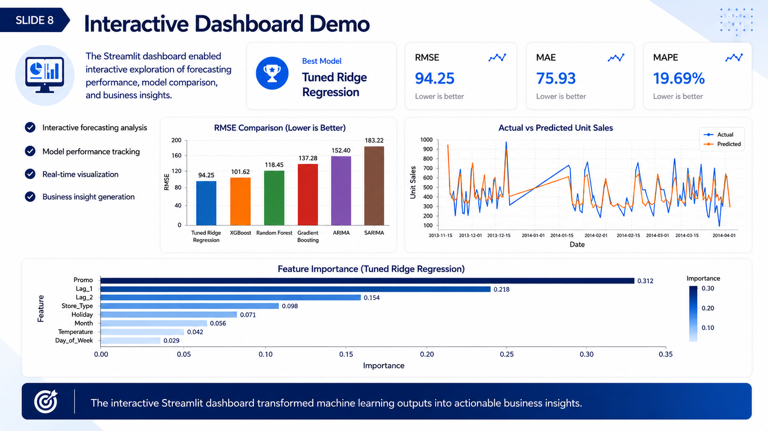
Notes:
“To make the forecasting system more practical and business-oriented, I developed an interactive Streamlit dashboard.
The dashboard enabled:
interactive forecasting analysis,
model performance tracking,
real-time visualization
Business insight generation.
- The KPI cards summarize the best-performing model metrics.
- The dashboard also includes:
RMSE comparison charts,
Actual versus Predicted Sales visualizations,
and Feature Importance analysis.
→ This transformed the machine learning outputs into actionable business insights for decision-making.”

Slide 10
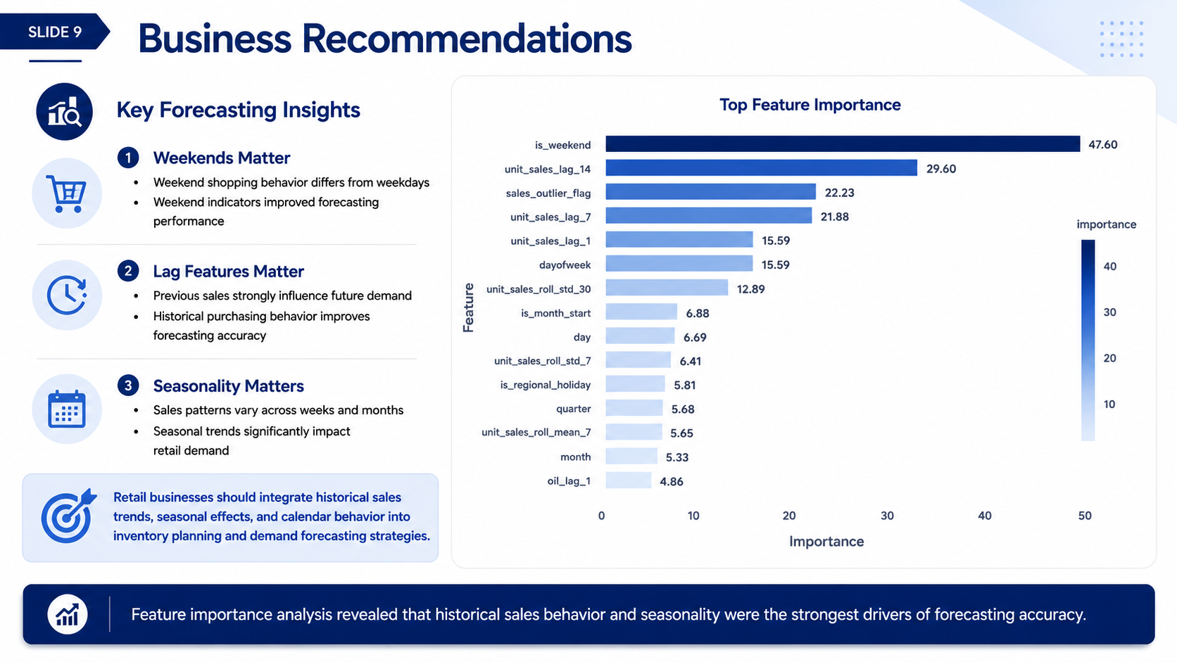
Notes:
This slide summarizes the main business recommendations generated from the analysis.
- The Feature Importance chart revealed that lag-based variables and seasonal indicators were the strongest forecasting drivers.
Three key insights emerged:
1-First, weekends matter because customer shopping behavior differs significantly between weekdays and weekends.
2-Second, lag features matter because previous sales strongly influence future demand.
3-Third, seasonality matters because retail demand changes across weeks and months.
→ Based on these findings, retail businesses should integrate historical sales patterns, seasonal effects, and calendar behavior into inventory planning and demand forecasting strategies.

Slide 11
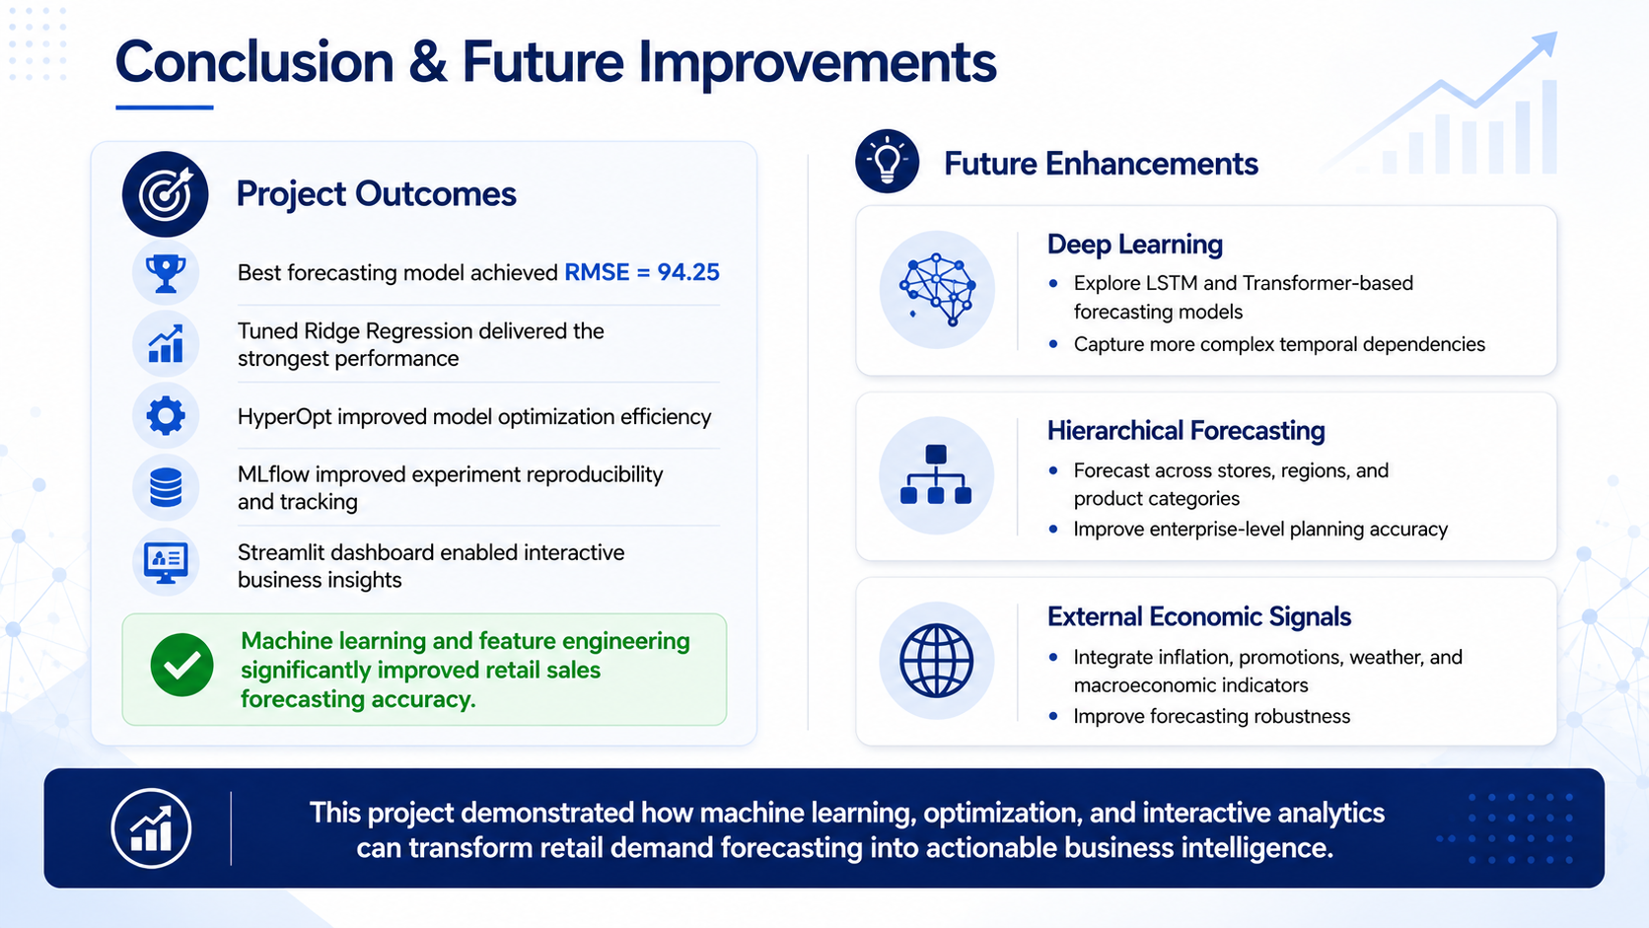
Notes:
1) “In conclusion, this project demonstrated how machine learning, optimization, and interactive analytics can improve retail demand forecasting.
The tuned Ridge Regression model achieved the best performance with an RMSE of 94.25.
HyperOpt improved model optimization efficiency,
while MLflow improved reproducibility and experiment tracking.
The Streamlit dashboard converted forecasting outputs into practical business intelligence.
2) For future improvements, the project could be extended using:
deep learning models such as LSTMs or Transformers,
hierarchical forecasting across stores and product categories,
and external economic indicators such as inflation, promotions, and weather data.
→ Overall, this project showed how advanced analytics can support more accurate and data-driven retail decision-making.
Thank you.”

