Slide 1
Σύστημα Φασματοσκοπίας Εμπέδησης για Βιολογικές Εφαρμογές Brief intro November 2019

Slide 2
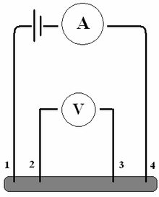
System description
Provide samples with a constant (alternating) current excitation (A)
Measure the occurring voltage (V)
The functions are controlled from a PC running a host application
The user will be able to define the current waveform and different other settings (?)

Slide 3
Block Diagram
Host PC
5 VDC
Power Supply
USB/UART
± 2.5 VDC
SPI
Microcontroller
Function Generator
Interface
Electronics
± 0.3V AC
Constant Current Source
ADC
SINE: 0…0.6V
TRIANG: 0…0.6V
SQUARE: 0…4V
DC Voltage
Target AC Current
Interface
Electronics
AC Voltage
Sample under test

Slide 4
Block Diagram …so far
Host PC
5 VDC
Power Supply
USB/UART
± 2.5 VDC
SPI
Microcontroller
Function Generator
Interface
Electronics
± 0.3V AC
Constant Current Source
ADC
SINE: 0…0.6V
TRIANG: 0…0.6V
SQUARE: 0…4V
DC Voltage
Target AC Current
Interface
Electronics
AC Voltage
Sample under test

Slide 5
Rough to-do
Interface
Electronics
ADC
Power Supply
Symmetrical supply from VUSB (± 2.5 from +5 V DC)
Tests for interference with measurements etc.
Unified voltage amplitude from waveform generator
Drive constant current source from waveform generator
AC voltage generated on sample to ADC
Is 10bit enough?
VREF on the fly tests and so on…

