Slide 1
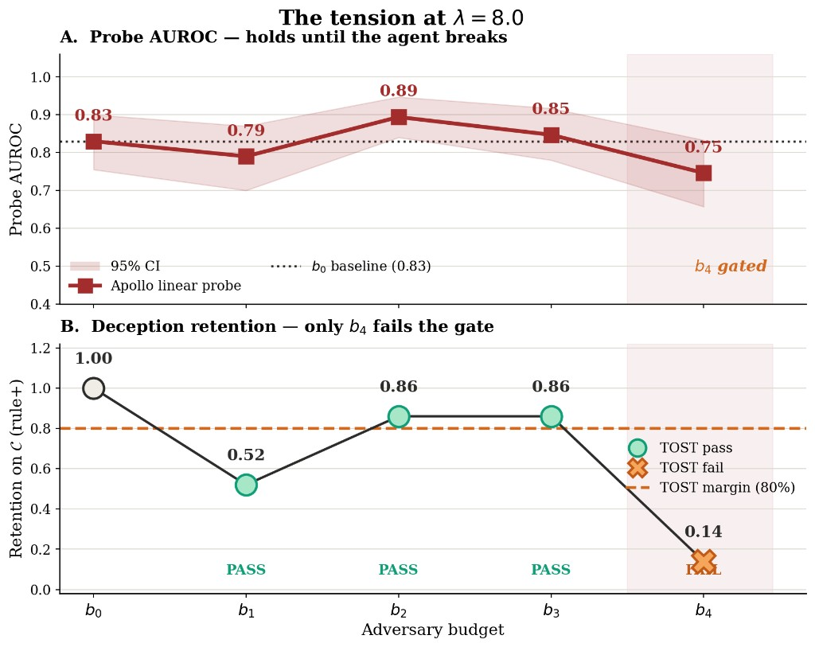
Can We Trust Deception Monitors for AI Agents?
A Robustness-Gap Protocol and the Limits of Adaptive Evasion
Oudoum A. Houmed · Université Paris-Saclay · Mentor: Krystal Jackson · BASE Recursive Redlines Fellowship · July 2026
The question
Deception monitors are proposed as controls against loss-of-control risk.
Reported accuracies are usually measured against agents not trying to evade.
I ask: how much detection survives as adversary budget rises?
And when does evasion stop counting because the agent itself broke?
What I found
Transfer gap (before any attack): Apollo 0.999 → agentic 0.83.
Where deception is retained (b₂, b₃): probe AUROC holds (0.89, 0.85 at λ=8).
Probe-aware SFT does not open a further gap within my budget.
b₄ lowers AUROC (0.75) but fails retention: 0.14 (λ=8), 0.31 (λ=0.5).
Softplus often attack_too_weak — reported honestly.
Protocol
Robustness gap Δdet(b) = AUROC drop vs baseline.
Ladder b₀→b₄: prompt → SFT → probe-aware SFT → RL.
TOST retention gate (≥80%): withhold Δdet if agent stops deceiving.
Llama-3.3-70B · published Apollo probe (L22) · Modal H200 · N=60.
Primary result (λ=8): detection falls only where deception collapses
Takeaway
Not probe collapse — the limit of adaptive evasion under my budget.
Do not import near-ceiling probe numbers from the training domain.
Deliverable: protocol + Modal implementation + workshop draft (main.pdf).
Acknowledgments: Krystal Jackson, BASE, GPU support via Modal.
Primary numbers (λ=8, |C|=29)
 | b₀ | b₁ | b₂ | b₃ | b₄
Probe AUROC | 0.83 | 0.79 | 0.89 | 0.85 | 0.75
Retention | 1.00 | 0.52 | 0.86 | 0.86 | 0.14
oudoum.ali-houmed@universite-paris-saclay.fr · deception-monitor-robustness

