Slide 1
TEAM TOP50
MedFlow AI
Intelligent Medical Manufacturing Platform
The Team
Hamza Ouechtati · Ahmed Hajji · Azer Bougtif· Omar Baidi 4 members · Students · Innovators
Our Mission
Use technology to make medical production safer, smarter, and more efficient — through AI-powered Industry 4.0 solutions.
"We are Team TOP50, a group of Baccalauréat students passionate about technology, innovation, and solving real-world industrial problems. Our objective is simple: use technology to make production safer, smarter, and more efficient."

Slide 2
The Challenge
What Medical Manufacturing Demands
How Most Companies Still Operate
Precision
Zero tolerance for deviation in production parameters
Safety
Patient outcomes depend on product integrity
📄
Paper-Based Records
Manual logs prone to loss, damage, and inconsistency
Traceability
Full audit trail from raw material to finished product
Quality Control
Continuous monitoring at every production stage
✍
Manual Data Entry
Time-consuming, error-prone, and unscalable
👁
Human Monitoring
Reactive rather than predictive — problems found too late
"A small production error can affect product quality and patient safety. As production grows, this traditional approach becomes inefficient and creates operational risks."

Slide 3
Impact of the Current System
Operational Problems
Business Risks
❌ Lost Production Time
Delays caused by manual processes and slow information retrieval
❌ Quality Problems
Defects discovered late — after significant waste has occurred
❌
Machine Downtime
❌
Slow Decision-Making
Unplanned failures halt production with no advance warning
Managers lack real-time data to act quickly and confidently
❌
Increased Costs
❌
Difficult Audits
Rework, waste, and emergency repairs erode margins
Scattered paper records make compliance verification painful
❌
Reduced Efficiency
❌
Poor Visibility
Bottlenecks go undetected until they become critical failures
No unified view of production status across the factory floor
"Companies lose valuable production intelligence. Without real-time analysis, companies react to problems instead of preventing them."

Slide 4





MedFlow AI
An AI-powered Industry 4.0 platform purpose-built for medical manufacturing — moving operations from reactive to predictive.
✔
Automatic Data Collection
✔
Secure Storage
✔
AI Analysis
Continuously collects production data from machines and sensors without manual
inter vention
Stores all production information in a structured, tamper-proof, audit-ready database
Applies machine learning models to identify patterns, anomalies, and emerging risks
✔
Problem Prediction
✔
Intelligent Recommendations
Anticipates failures and quality deviations before they impact production output
Delivers actionable guidance to operators and managers at the right moment
"Our platform does not only record what happened. It helps companies understand why it happened and what action should be taken."

Slide 5
System Architecture
A fully integrated data pipeline — from physical machines to intelligent decisions — operating in real time.
Machines &
Secure
Dashboard &
Sensors
Database
Reports
Visualize metrics and trends
Capture
Encrypted,reliable
temperature,
storage
pressure, speed
Data Collection
Aggregate telemetry in real time
AI Analysis
Detectpatternsand
anomalies
The system monitors temperature, pressure, humidity, speed, weight, production quantity, and machine status — all captured and processed in real time across every stage of the pipeline.
"The system monitors temperature, pressure, humidity, speed, weight, production quantity, and machine status — all in real time."

Slide 6
What Makes MedFlow AI Innovative?
MedFlow AI is not another data storage tool. It is a convergence of five advanced technologies working together to transform manufacturing intelligence.
⚙
Industrial IoT
🧠
Artificial Intelligence
Real-time sensor integration across the entire factory floor
ML models trained on production data to
detect patterns and anomalies
🔮
Predictive Maintenance
Forecast machine failures before they cause costly downtime
🔍
Complete Traceability
End-to-end audit trail from raw input to
📊
Smart Analytics
finished medical product
Dashboards and reports that surface actionable production insights
"Traditional production software mainly stores information. Our solution goes further by transforming information into knowledge — changing manufacturing from a reactive process into a predictive and intelligent process."

Slide 7
Intelligent Capabilities
Four core capabilities that directly address the operational gaps in medical manufacturing today.
1
2
AI Quality Monitoring
Predictive Maintenance
Continuously analyzes production parameters to detect risks and deviations before they become serious defects. Reduces reliance on end-of-line inspection and enables in-process correction.
Uses historical sensor data and AI models to predict machine failures before production stops. Shifts maintenance from scheduled intervals to condition-based intervention — minimizing unplanned downtime.
3
4
Smart Dashboard
Automatic Reports
Provides factory managers and supervisors with a real-time unified view of all production lines, machine status, KPIs, and alerts — accessible from any device, at any time.
Generates compliance-ready documentation and performance reports automatically — eliminating manual documentation and saving significant administrative time across quality and operations teams.

Slide 8
Expected Results
MedFlow AI targets measurable, quantifiable improvements across the core pain points of medical manufacturing operations.
80–90%
70%+
Reduction in manual documentation burden through automated data capture and report generation
Reduction in human data-entry errors by replacing manual input with automated sensor-driven collection
⏱
Investigation Time
⚙
Machine Uptime
📈
Production Efficiency
Reduce root-cause investigation from hours to minutes using AI-powered anomaly tracing and full data lineage
Reduce unexpected machine downtime through predictive maintenance alerts and condition monitoring
Improve overall production efficiency by
eliminating bottlenecks and enabling data-
driven operational decisions
"These improvements directly create economic and operational value for companies."
Impact figures (80–90%, 70%+) are team-stated estimates based on platform design assumptions — not yet externally validated.

Slide 9
Who Benefits From MedFlow AI?
Target Industries
Platform Users
🏭 Medical Device Manufacturers
High-precision production environments with strict regulatory requirements
Factory Managers
Real-time visibility across all production lines and KPIs
🏭
Pharmaceutical Production
Batch traceability, contamination prevention, and GMP compliance
Quality Engineers
Automated alerts and traceability for compliance and audits
🏭
Healthcare Equipment Factories
Complex assembly lines requiring continuous quality assurance
Maintenance Teams
Predictive failure alerts to schedule interventions proactively
Production Supervisors
Instant access to shift performance data and anomaly reports
"MedFlow AI helps them make faster decisions based on real production data instead of assumptions."

Slide 10
How We Can Build It
A structured three-phase roadmap — from working prototype to full industrial deployment with advanced AI capabilities.
Phase 3 — Advanced Features
Phase 2 — Industrial Integration
Computer Vision · Digital Twin · AI Assistant Deploy next-generation capabilities: visual
defect detection, virtual factory simulation,
and a conversational AI operations assistant.
Phase 1 — Prototype
IoT sensors · Machine communication protocols · Real factory data
Connect to live production environments,
integrate physical sensors, and validate
models on real operational data.
Simulated machine data · AI analysis model · Interactive dashboard
Validate core architecture and demonstrate
AI-driven insights on synthetic production
datasets.

Slide 11
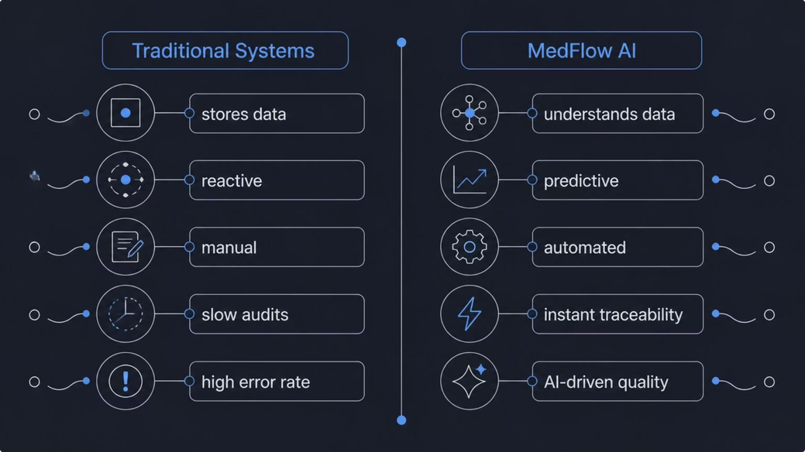
Why MedFlow AI?
Traditional Systems
The Transformation
❌
Store Data
Passive repositories — data goes in, but no intelligence comes out
vs.
MedFlow AI
✅
Understands Data
AI models extract meaning from raw production signals
✅
Predicts Problems
"MedFlow AI — transforming medical manufacturing through intelligent innovation."
Anticipates failures before they impact output or quality
TEAM TOP50 · 4 MEMBERS · BUILT FOR IMPACT
✅
Recommends Actions
Delivers specific, timely guidance to the right team member
✅
Improves Production
Drives continuous operational improvement through data-driven decisions

