Slide 1


Mindreadr
Analyzing EEG data with R shiny

Slide 2
What we are trying to accomplish
Create a web application with the R package, Shiny.
Enable the user to manipulate the EEG data through the user interface.
Facilitate the customization of parameters such thresholds and intervals.
Create a Dynamic network graph that shows the connections between electrodes.

Slide 3
Methods and Characteristics
Using the Package “astsa” to do spectral analysis of the EEG data.
A function to get the spectral matrix of a chosen frequency band.
A function to get the coherence coefficients for the coherence matrix
A function to build the adjacency matrix based on the threshold chosen by the user.
A function to show the evolution of the dynamic graph given the user’s interval.
Network graph built with the package “igraph”.

Slide 4
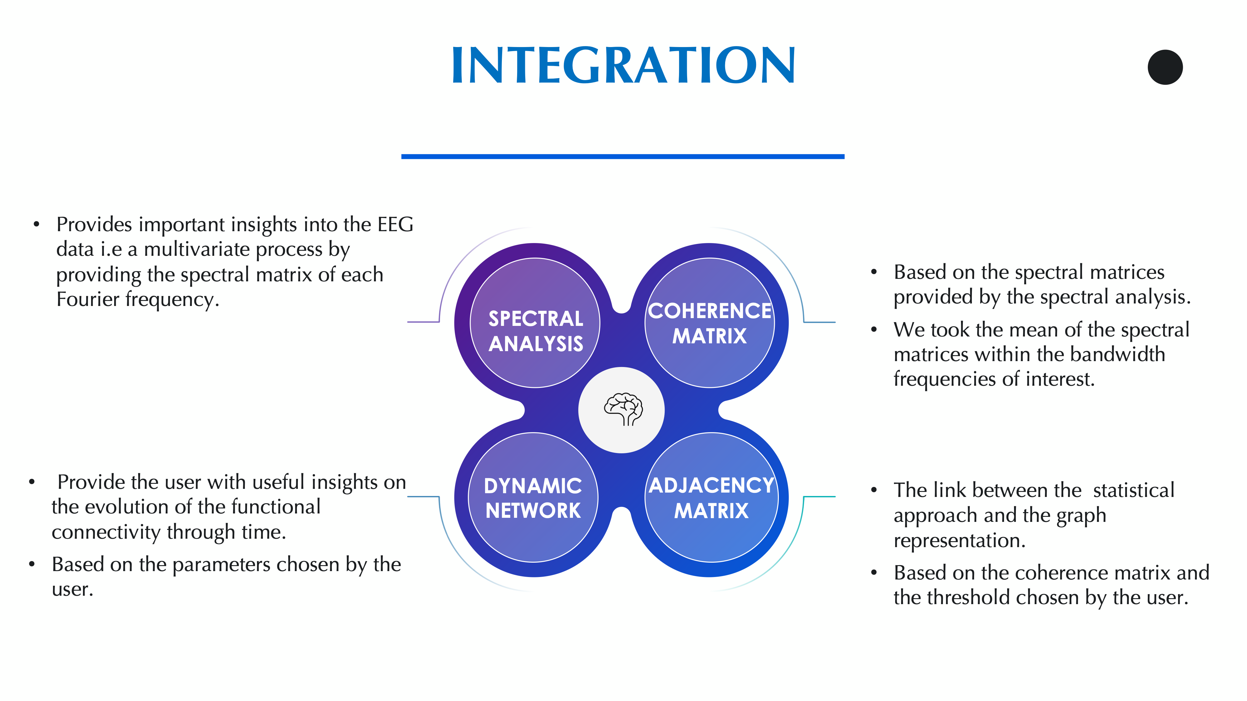
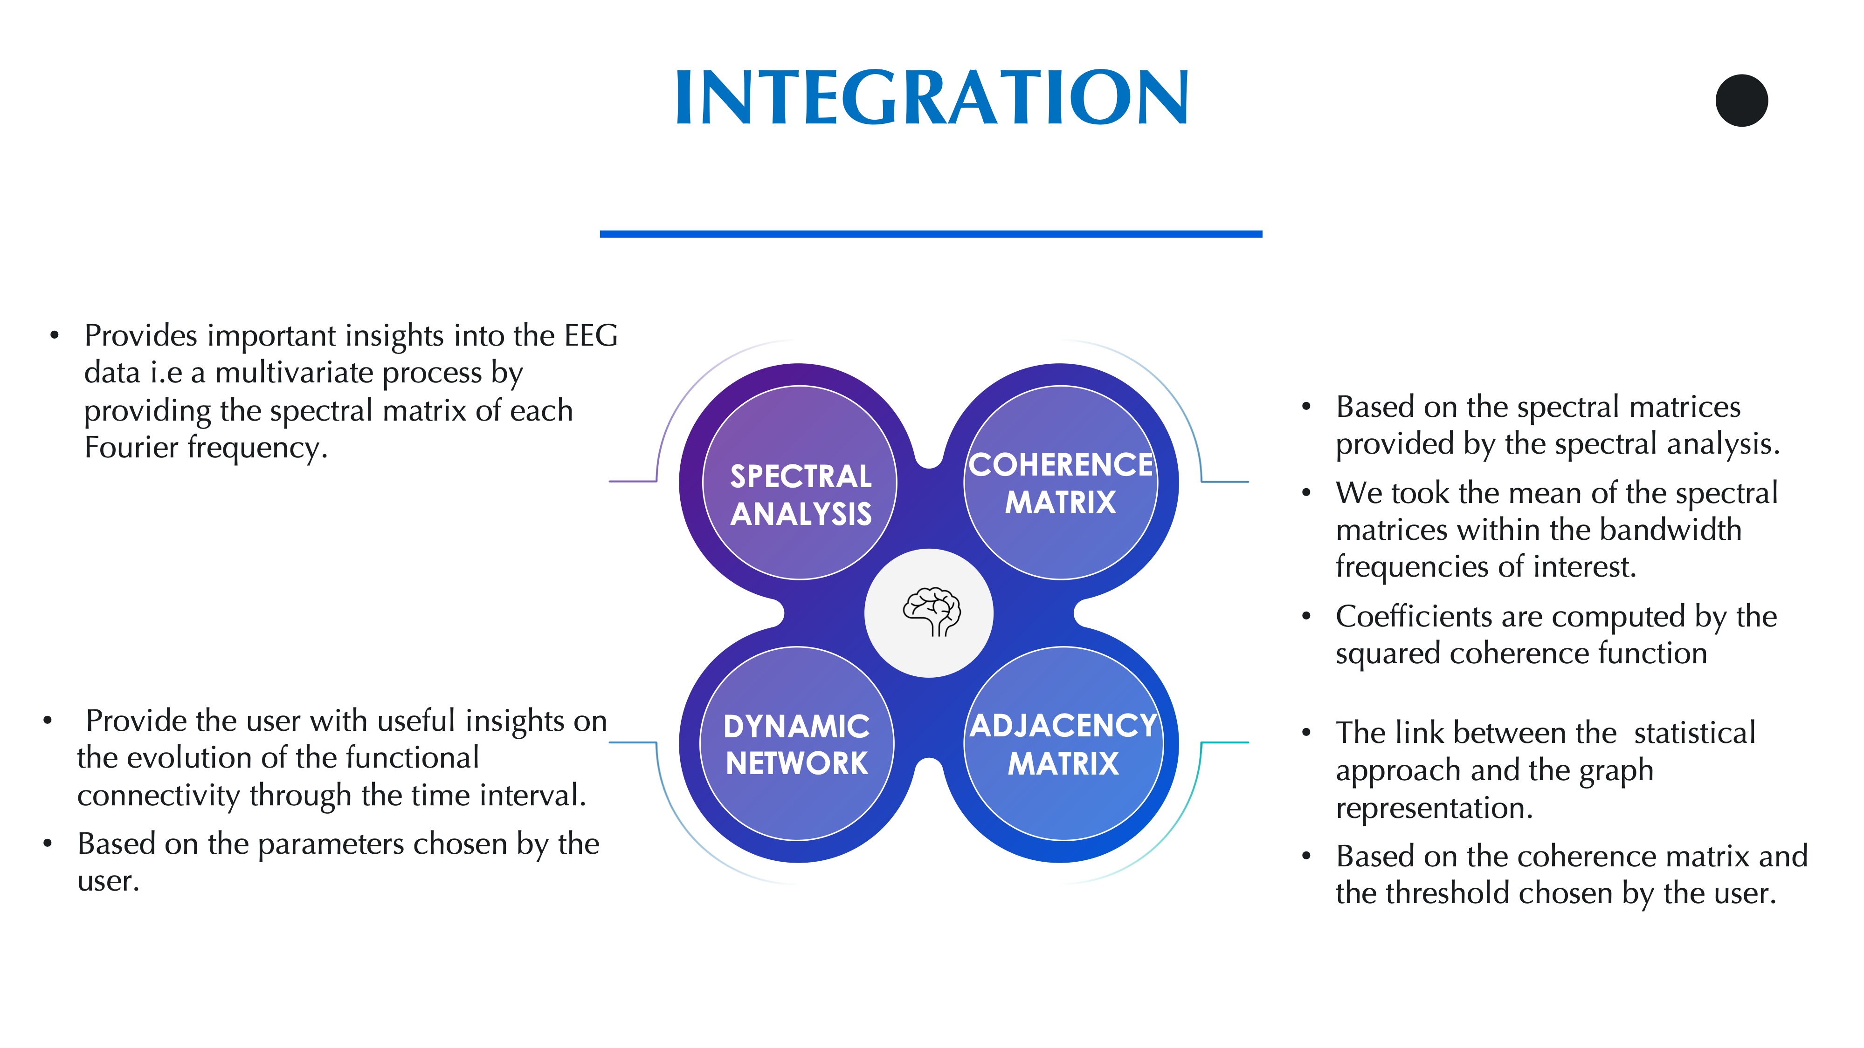

Slide 5
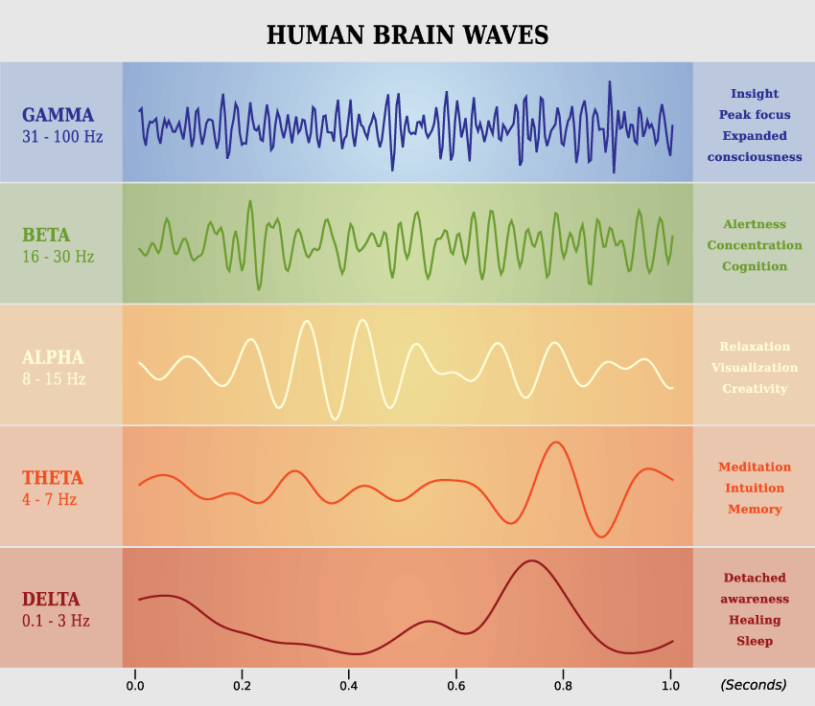
Experience
Eyes Closed: Sitting with eyes closed and normally breathing.
Eyes Open: Eyes open with the breath following the pattern dictated by a ball going up and down for 5 seconds each.
Emotiv EPOC+ headset

Slide 6
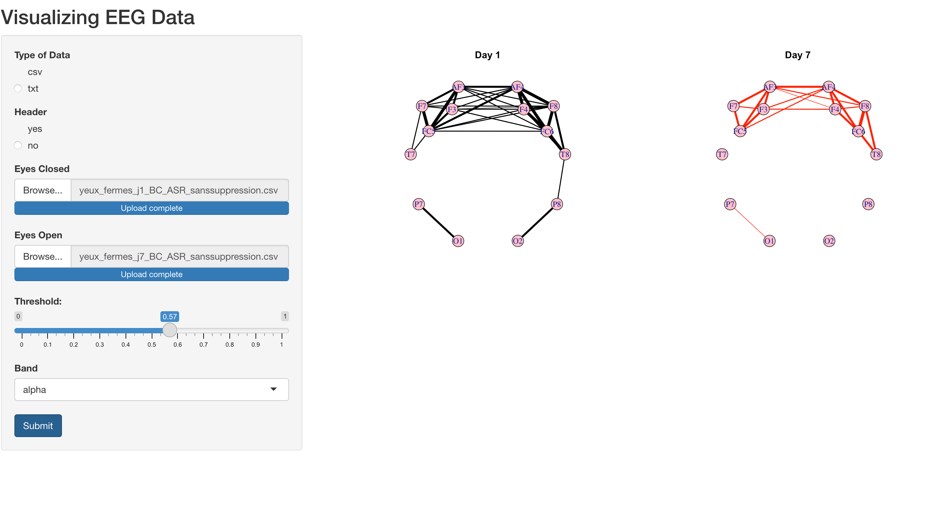
Results:

Slide 7
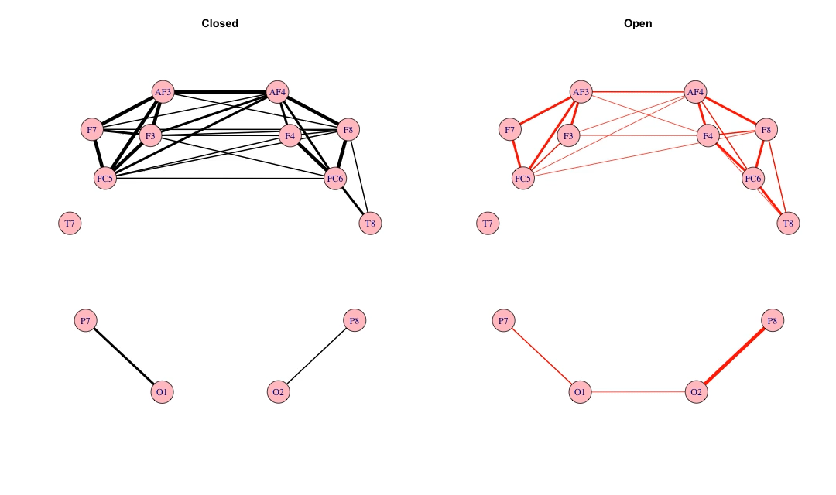
Results for Alpha wave:

Slide 8
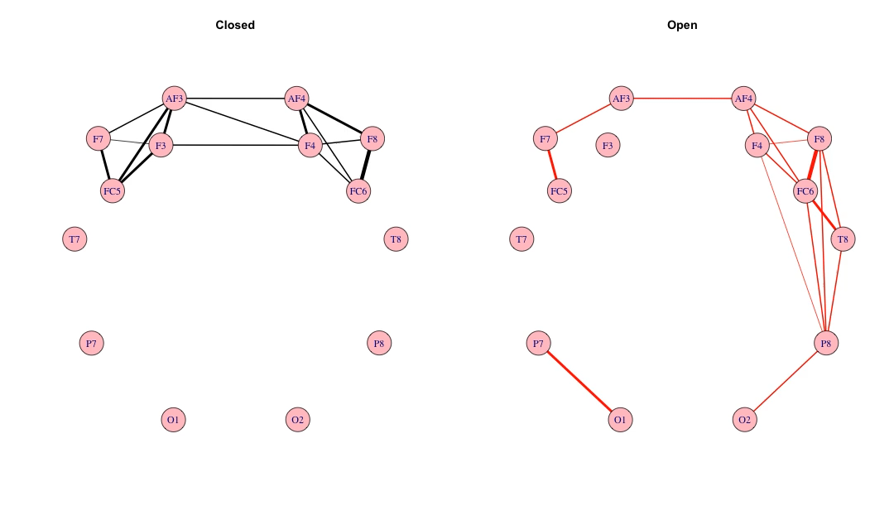
Results for Theta wave:

Slide 9
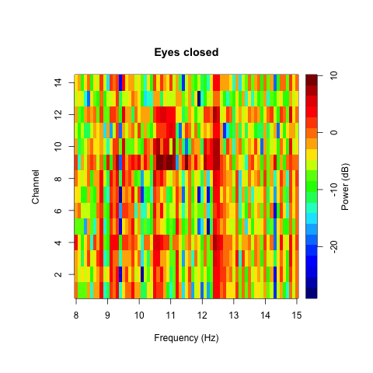
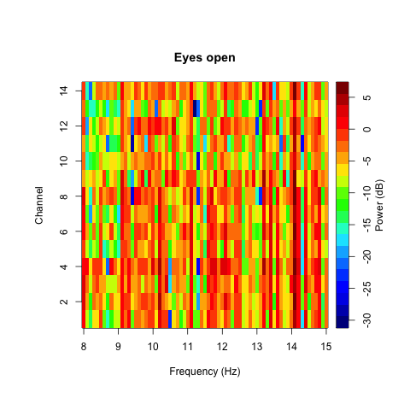
Results:

Slide 10
Thank You !

