Slide 1


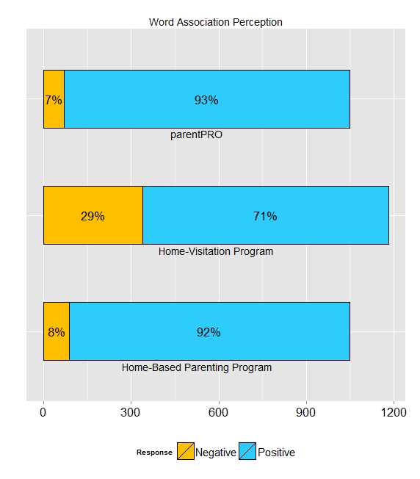
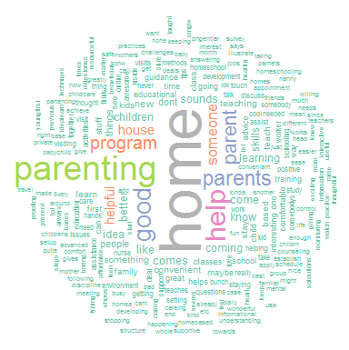
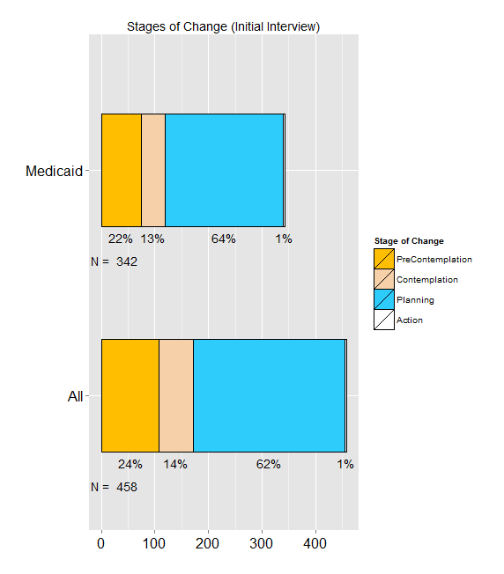
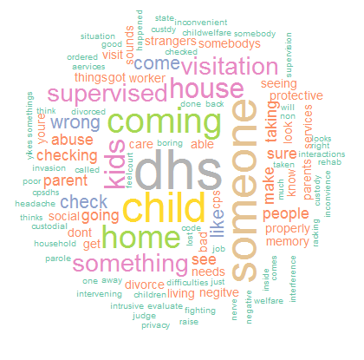
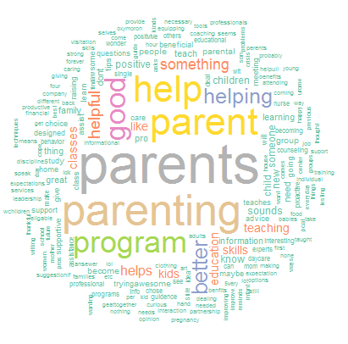

Evaluating the Marketability of Home-Visitation Programs
Thomas Wilson, David E. Bard, William H. Beasley
OUHSC, Developmental and Behavioral Pediatrics
What are Home Visitation (HV) programs?
RESULTS – Overall
RESULTS – Home-Based Parenting Program
Programs that provide services and support for families with new babies and young children
Services provided in family’s home for convenience
Address issues such as:
Maternal and child health
Positive parenting practices
Safe home environments
Reduction in crime or domestic violence
Improved economic self-sufficiency
School preparedness
Access to social support services
HV programs touted by the American Academy of Pediatrics as a promising approach for flattening the socioeconomic gradient in health.¹
844 surveys completed
99% female participants
86.2% Non-Hispanic
10.6% American Indian or Alaska Native
2% Asian
35.5% Black or African American
61% White
0.9% Native Hawaiian or Other Pacific Islander
91% positive perception
Response of “Positive” or “Very Positive”
Most prevalent positive association was “Home”
Other common positive associations were:
Variations of the word “Parent”
“Good”
Variations of the word “Help”
RESULTS – Stages of Change
PURPOSE
458 Total respondents
342 Medicaid respondents
Among those not enrolled, a large majority
reported intention to enroll in parentPRO
62% planning stage
1% action stage
Involvement is typically voluntary; thus, HV must market effectively to reach target populations. Unfortunately, evidence to date suggests populations who could benefit most are underserved.²
The current study evaluates:
Aspects of existing HV marketing content
Appeal of program descriptions
Appeal of collective nomenclature
Appeal of alternate HV program descriptions
RESULTS – Home-Visitation
Home-Visitation Program
29% negative reactions
Response of “Very-Negative” or “Negative”
Most common negative association was “DHS” (Department of Human Services)
Other common negative associations were:
“Wrong”
“Supervised”
“Taking”
“Check”
“Abuse”
“Bad”
“CPS” (Child Protective Services)
METHODS
CONCLUSIONS
Results suggest, for marketing purposes, the catch-all “home-visitation” may be a deterrent to recruitment
Perceptions much more favorable for phrases that simply dropped “visitation” and replaced it with words related to “parenting” skills.
While HV services not heavily utilized in this sample, parentPRO descriptions were appealing to most participants.
75+% willing to contemplate enrollment.
60+% stated intention to enroll soon.
Recruitment
Caregivers of young children from four Oklahoma counties
Must meet qualification requirements for HV programs
Participation
Study participants complete an online REDCap survey
Survey elicits perceptions on the terms:
Home-Visitation Program
parentPRO Program
Home-Based Parenting Program
Each term shown separately to participant
Participants asked to provide up to four free-associations
Also recorded whether the respondent considered the association:
Very Negative-------Negative-------Neutral-------Positive-------Very Positive
Participants not enrolled in an HV program guided through a parentPRO flier and asked Stages of Change (Transtheoretical Model^{3,4}) questions about their enrollment intentions
When parents need help, parentPRO Delivers.
parentPRO is a free service that links families to home-based parenting programs designed to strengthen families and help Oklahoma’s children grow healthy and strong…
RESULTS – parentPRO
REFERENCES
93% positive perception
Response of “Positive” or “Very Positive”
Most prevalent positive associations were variations on “parent”
Other common positive associations were:
“Good”
Variations of the word “Help”
Council on Community Pediatrics. The Role of Preschool Home-Visiting Programs in Improving Children's Developmental and Health Outcomes. Pediatrics. 2009;123(2):598-603.
Goyal NK, Hall ES, Jones DE, et al. Association of Maternal and Community Factors With Enrollment in Home Visiting Among At-Risk, First-Time Mothers. American Journal of Public Health. 2013;104(S1):S144-S151.
Prochaska JO, DiClemente CC. Stages and processes of self-change of smoking: Toward an integrative model of change. Journal of Consulting and Clinical Psychology. 1983;51(3):390-395.
McConnaughy EA, Prochaska JO, Velicer WF. Stages of change in psychotherapy: Measurement and sample profiles. Psychotherapy: Theory, Research & Practice. 1983;20(3):368-375.

