Slide 1


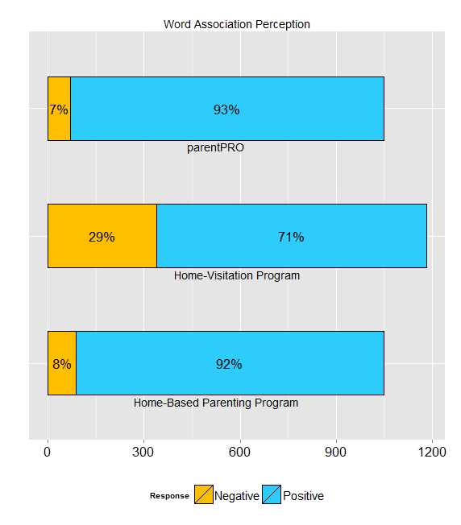
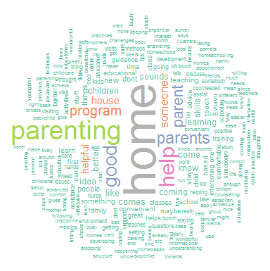
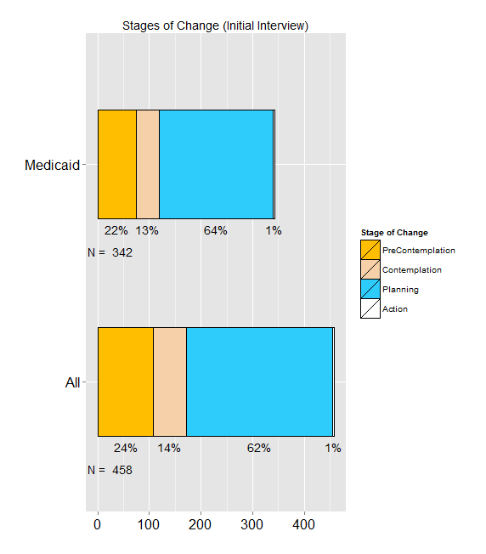
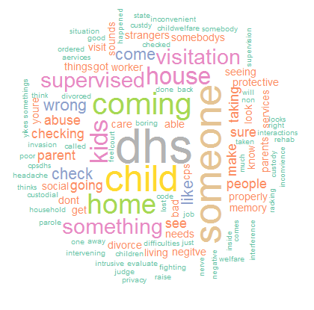
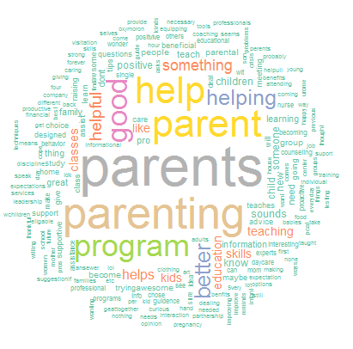
Community Perception of Home-Visitation (HV) Programs
Thomas Wilson, David E. Bard, William H. Beasley
OUHSC, Developmental and Behavioral Pediatrics
What are Home Visitation (HV) programs?
RESULTS – Overall
RESULTS – Home-Based Parenting Program
Voluntary programs that provide services and support for families with new babies and young children
Services Provided in family’s home for convenience
Address issues such as:
Maternal and child health
Positive parenting practices
Safe home environments
Reduction in crime or domestic violence
Improved economic self-sufficiency
School preparedness
Access to social support services
844 surveys completed
99% Female participants
86.2% Non-Hispanic
10.6% American Indian or Alaska Native
2% Asian
35.5% Black or African American
61% White
0.9% Native Hawaiian or Other Pacific Islander
91% positive perception
Response of “Positive” or “Very Positivie”
Most prevalent positive association was “Home”
Other common positive associations were:
Variations of the word “Parent”
“Good”
Variations of the word “Help”
RESULTS – Stages of Change
PURPOSE
Usually, HV involvement is voluntary. In order to be successful, these voluntary services must market themselves effectively. Unfortunately, studies have shown that HV programs often perform well below peak levels of operational capacity.
The current study evaluates:
Aspects of existing HV marketing content
Appeal of program descriptions
Appeal of collective nomenclature
Appeal of alternate HV program descriptions
RESULTS – Home-Visitation
458 Total respondents
342 Medicaid respondents
Among those not enrolled, a large
majority of the participants reported
Intentions for enrolling in a
home based parenting program
62% planning stage
1% action stage
Home-Visitation Program
29% negative reactions
Response of “Very-Negative” or “Negative”
Most prevalent negative association was “DHS” (Department of Human Services)
Other common negative associations were:
“Wrong”
“Supervised”
“Taking”
“Check”
“Abuse”
“Bad”
“CPS” (Child Protective Services)
METHODS
Recruitment
Caregivers of young children from four Oklahoma counties
Must meet qualification requirements for HV programs
Participation
Study participants complete an online REDCap survey
Survey elicits perceptions on the terms:
Home-Visitation Program
parentPRO Program
Home-Based Parenting Program
Each term shown separately to participant
Participants asked to provide up to four free-associations
Also recorded whether the respondent considered the association:
Very Negative
Negative
Neutral
Positive
Very Positive
Participants not enrolled in an HV program guided through a parentPRO flier and asked Stages of Change (Transtheoretical Model) questions about their enrollment intentions
Participants have follow-up interviews annually
CONCLUSIONS
These results strongly indicate that the use of language other than “home-visitation” to describe the program will enhance engagement of families and stake holders.
RESULTS – parentPRO
REFERENCES
93% positive perception
Response of “Positve” or “Very Positive”
Most prevalent positive associations were variations on the
word “parent”
Other common positive associations were:
“Good”
Variations of the word “Help”
Szalay LB, Deese J. Subjective Meaning and Culture: An Assessment Through Word Associations. Hillsdale, NJ: Erlbaum; 1978.
Transtheoretical Model; Prochaska & DiClemente, 1983; Prochaska, DiClemente, & Norcross, 1992

