Slide 1


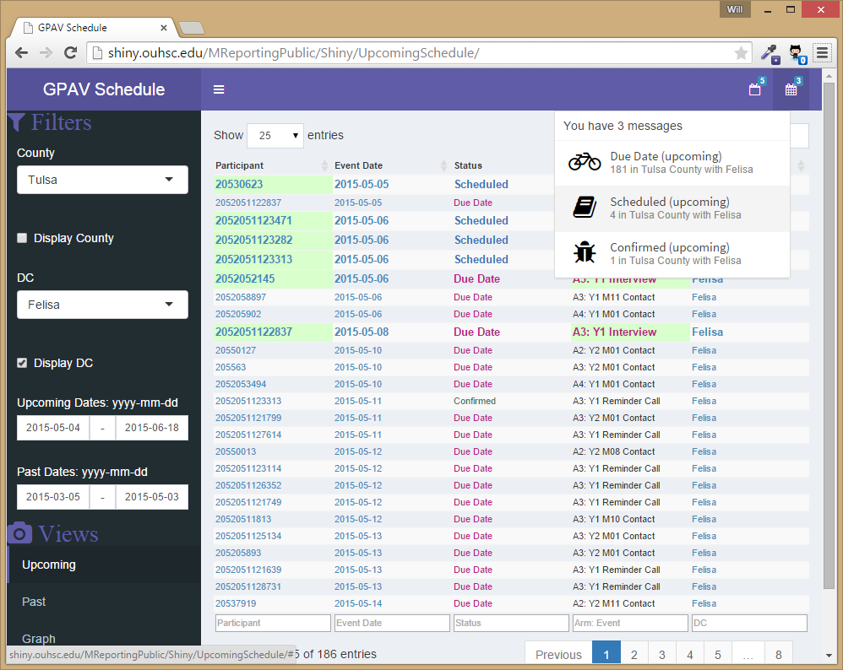
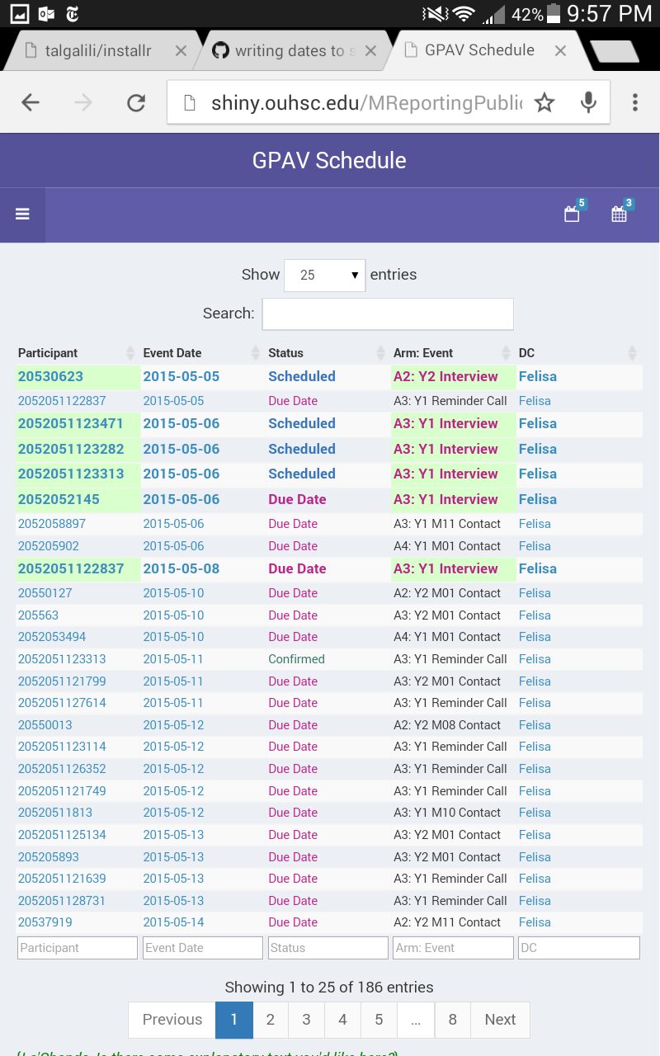
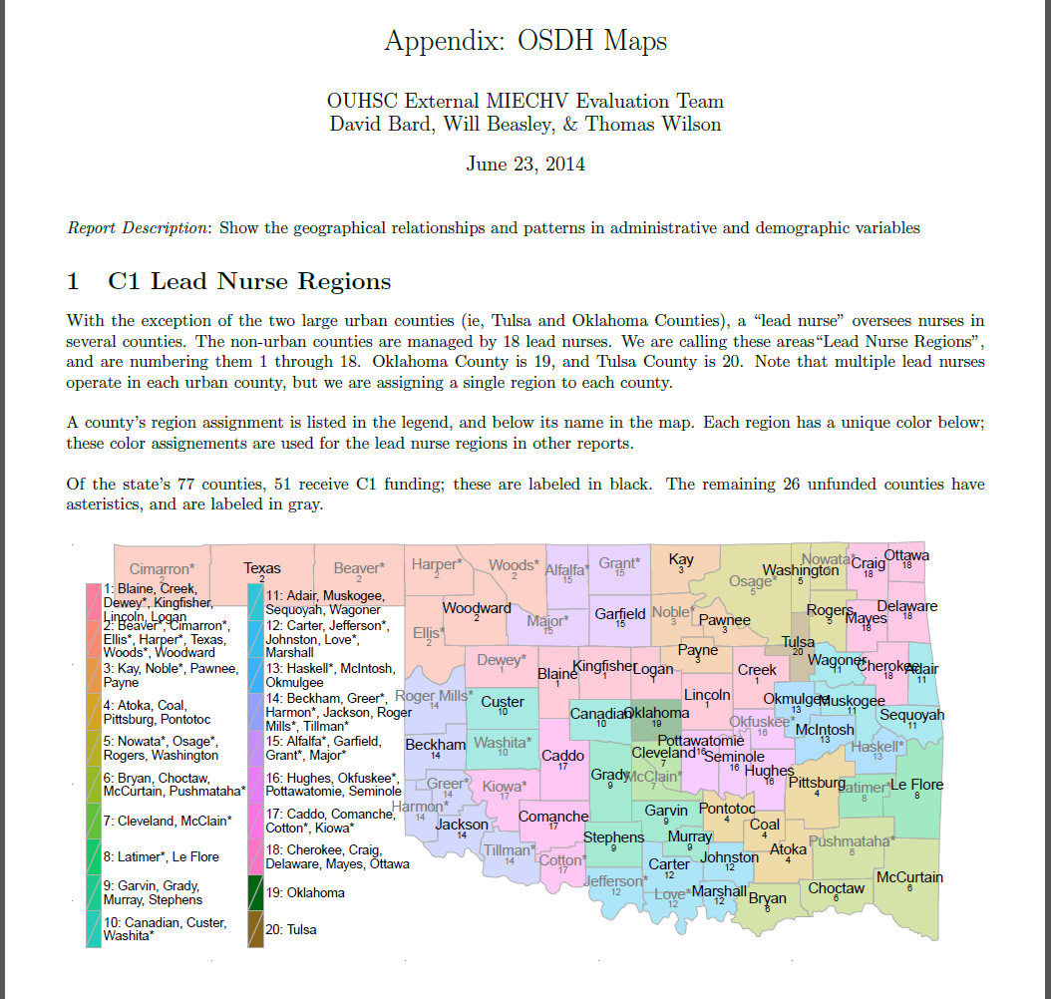
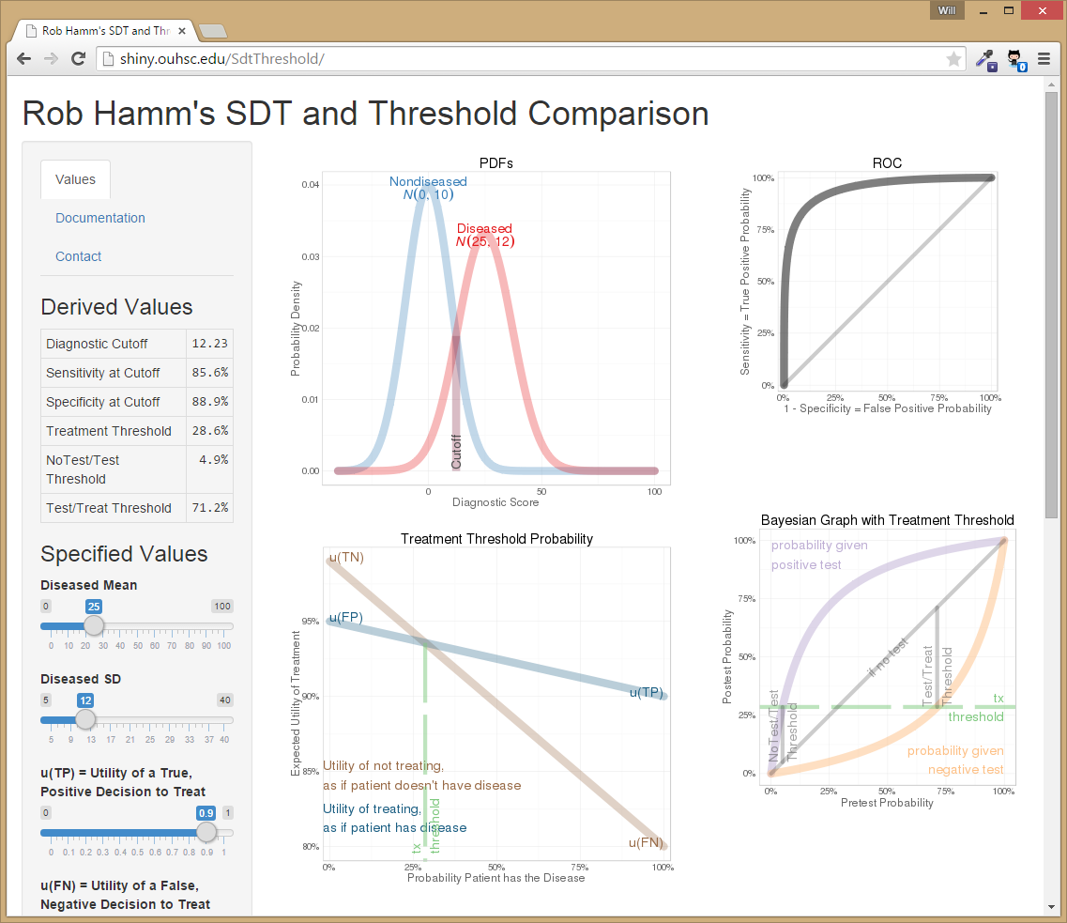
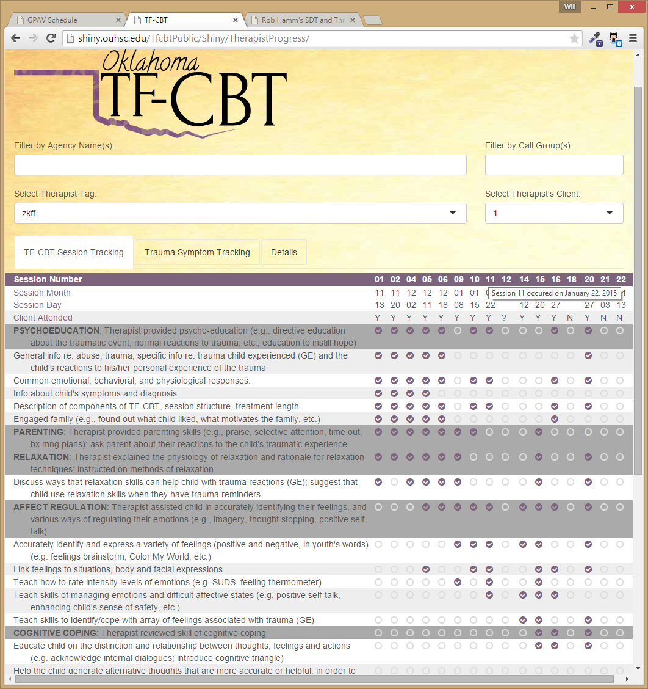
Continuous Quality Improvement (CQI) with REDCap and R William H Beasley, David E Bard, & Thomas Wilson; OUHSC, Biomedical and Behavioral Research Core (BBMC)
CQI Goal and Framework
Patterns
Continuous quality improvement (CQI) is defined by HRSA as “a continuous process that employs rapid cycles of improvement”, which can be accomplished with REDCap and literate programming.
Literate programming tools can combine statistical text, tables, and graphs in a coherent document that is accessible to unfamiliar audiences. The automation of these tools eliminates the need to repeatedly copy and paste analytic results after underlying data sources are updated. After logging in, hyperlinks in the report quickly redirect a user from a report row to a specific record in REDCap, facilitating further inspection and modification.
We decompose our system into a handful of software patterns in the hopes that other REDCap adopters can increase the (a) speed of development, (b) consistency of implementation, (c) adherence to recommended security practices, (d) complexity of statistical analyses, (e) breadth of audience, and (f) frequency of informative CQI cycles. The patterns are demonstrated with the system used during Oklahoma’s MIECHV (Maternal, Infant, and Early Childhood home Visiting) external evaluation.
Static and Dynamic Reports
Desktop & mobile rendering
Our system uses R (which is a versatile statistical software program with many complementary packages) and the REDCapR package to query the API of a REDCap database and produce reports. After being exported from REDCap, the rectangular data are groomed, transformed, and statistically analyzed. For static reports, the ‘knitr’ engine then embeds the text and graphics into a formatting language (LaTeX or Markdown) and renders a report (in PDF or HTML) for distribution.
For dynamic reports, the Shiny framework employs R, HTML, and JavaScript to provide an interactive experience with the user. Reports range from dense dashboards (monitored by data collectors) to sophisticated analyses (consumed by project investigators) to professional-quality publications (distributed to politicians, policy makers, and interagency collaborators).
Workflows with REDCap and Other Databases
Tools
Statistical Analysis & Data Manipulation: R & RStudio
Secured Databases: REDCap, MySQL, & SQL Server
Reporting: Shiny, Bootstrap, & JavaScript; knitr
Parallel Collaboration & Archiving: GitHub
Further Information
If you have questions, or would like assistance applying this system (or a subset of its tools) to current or future projects, please contact: william-beasley@ouhsc.edu, thomas-wilson@ouhsc.edu, or david-bard@ouhsc.edu.

