Slide 1


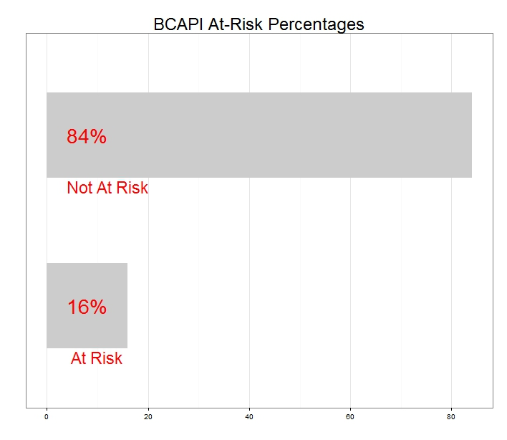
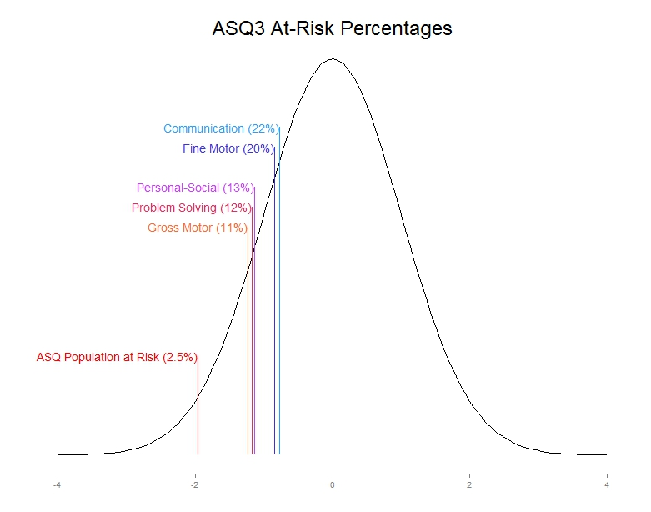
Epidemiological Study of Developmental Progress in Vulnerable Oklahoma Families
Thomas Wilson, David Bard, William Beasley
OUHSC, Developmental and Behavioral Pediatrics
INTRODUCTION
RESULTS: ASQ-3
RESULTS: BCAPI
Developmental and Behavioral Difficulties (DBDs) are costly
Estimated $250 billion per year
DBDs predominantly persist among two groups of vulnerable children
Those susceptible to child abuse and neglect due to insufficient care or nurturance
Those, who despite adequate care, suffer developmental and/or behavioral delays or disorders from a very early age
When unnoticed and untreated, the price of DBDs and the number of ensuing negative impacts increases
ASQ-3 Cutoff Scores for the developmental areas indicating that a child should be referred for additional assessment are located two standard deviations below the mean. For the ASQ-3 this represents approximately 2.5% of the population. Our sample population had percentages well above the expected 2.5% in all 5 developmental areas.
Based on the responses from the survey,
16% of the sample fell into the “at-risk”
category. On the BCAPI, an individual
falls in the at-risk classification after
receiving a score of 12 or greater on
the 34 question child abuse
potential inventory.
PURPOSE
Early interventions for children with DBDs have proven effective at remediation and prevention, but resources available for early identification are limited. This present study examines DBD prevalence among a sample of highly vulnerable Oklahoma children, and attempts to build the case for wise use of resources aimed at targeted therapeutic efforts.
RESULTS: CBCL
Our survey incorporated 5 questions from the CBCL related to child sexual behavior problems. The percentages of parents acknowledging these specific behavior problems ranged from 0% to 4%. These percentages did not vary significantly from the national rates.
METHODS
CONCLUSIONS
Recruitment
Caregivers of young children from four Oklahoma counties
Must meet qualification requirements for Home-Based Parenting Programs
Qualification determined by Medicaid and WIC eligibility
Participation
1,204 Study participants complete an online REDCap survey
Participants answered screen questions about the following areas of concern:
General Developmental and Emotional Delays
Ages and Stages Questionnaire (ASQ3)
Autism Spectrum Disorder
Autism Spectrum Rating Scale (ASRS)
Modified Checklist for Autism in Toddlers (MCHAT)
Communication and Symbolic Behavior Skills (CSBS)
Child Sexual Behavior Problems
Select items from the Child Behavior Checklist (CBCL)
Child Abuse Potential
Brief Child Abuse Potential Inventory (BCAPI)
With the exception of the results from the CBCL, all screeners indicated that the at-risk proportion from the sample of four Oklahoma counties exceeds the normative expectations. These findings suggest that screening and subsequent referrals for this population would be a cost-effective use of early identification resources.
RESULTS: ASD
Three measures were used to assess ASD in our sample: ASRS (ages 24-60 months), MCHAT (ages 16-24 months), and CSBS (ages 6-24 months)
ASRS: 26% of the sample were in the “very elevated risk” category. This is in
the 98th percentile nationally.
MCHAT: 17% of the eligible participants were classified as “at risk”. Nationally, 7% of respondents are in this category.
CSBS: 18% of the sample fell into the “at risk” category. Nationally,
this result is in the 90th Percentile.
REFERENCES
The National Academies. Preventing Mental, Emotional, and Behavioral Disorders Among Young People. Report Brief. 2009.
Centers for Disease Control and Prevention. Morbidity and Mortality Weekly Report 2013;62 (Supple 2); 1-2
Barnett, W. S. (2000). The Economics of Early Intervention. In S. J. Meisels & J. P. Shonkoff (eds.), Handbook of Early Childhood Intervention. 2nd Edition (pp. 589-612). Cambridge: Cambridge University Press.

