Slide 1




A Clinical Data Warehouse Ecosystem to Support Research & QAQI
David E. Bard, PhD¹
William H. Beasley, PhD¹
Zsolt Nagykaldi, PhD²
¹Department of Pediatrics
²Department of Family and Preventive Medicine
University of Oklahoma Health Sciences Center

Slide 2
Objectives
Define and describe clinical data warehouses
Provide examples of data warehouse uses in medicine and public health
Describe the connection between data warehousing and Big Data
Challenges of building a clinical data warehouse (legal, architectural, procedural)
Limitations of warehouse projects
Birth and development of an OUHSC CDW
Brief demonstration of current CDW design and process
Future directions for the OUHSC CDW

Slide 3
What is a Clinical Data Warehouse?
A data warehouse is a repository of historical data organized for reporting and analysis. It facilitates data access by having data from many sources in one place, linked together, and easily searchable.
Common CDW Characteristics
A database containing data from multiple sources
Data extracted from the databases of clinical software packages
A database containing data related to each other with some unique identifier
A database that is only as good as the data entered
Slide courtesy of BUMC Rozen & Saitz
http://www.bumc.bu.edu/crro/files/2010/01/Rosen-4-11-07.pdf

Slide 4
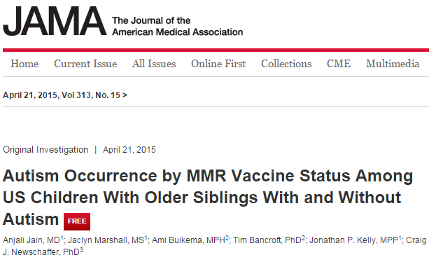
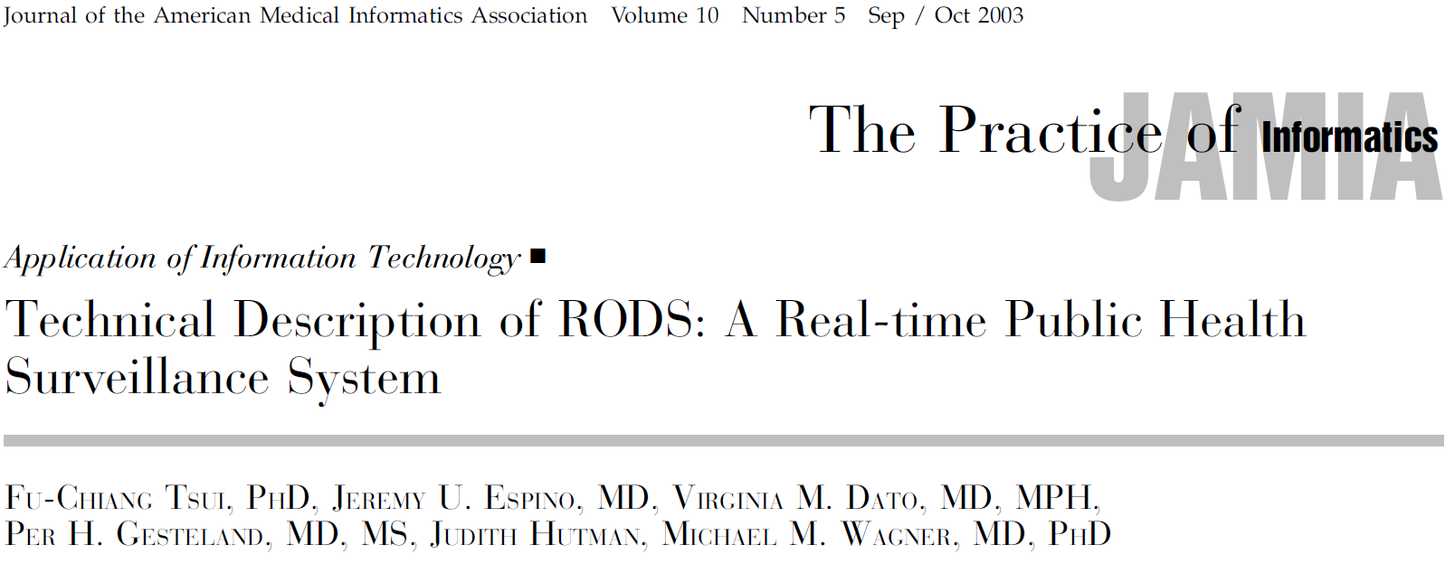
Examples of CDW Uses
Notes:
Autism study used a health care claims database, n = 97K+

Slide 5
Recent publications using RODS
Ye, Y., Tsui, F. R., Wagner, M., Espino, J. U. and Li, Q. (2014), Influenza detection from emergency department reports using natural language processing and Bayesian network classifiers, J Am Med Inform Assoc.
Wagner, M. M., Levander, J. D., Brown, S., Hogan, W. R., Millett, N. and Hanna, J. (2013), Apollo: giving application developers a single point of access to public health models using structured vocabularies and Web services, AMIA Annu Symp Proc, 2013: 1415--1424.
Liu, T. Y., Sanders, J. L., Tsui, F. C., Espino, J. U., Dato, V. M. and Suyama, J. (2013), Association of over-the-counter pharmaceutical sales with influenza-like-illnesses to patient volume in an urgent care setting, PLoS ONE, 8, 3: e59273.
Lee, B. Y., Tai, J. H., McGlone, S. M., Bailey, R. R., Wateska, A. R., Zimmer, S. M., Zimmerman, R. K. and Wagner, M. M. (2012), The potential economic value of a 'universal' (multi-year) influenza vaccine, Influenza Other Respi Viruses, 6, 3: 167--175.
Wagner, M., Cooper, G., Tsui, Fuchiang, Espino, J.U., Harkema, H., Levander, J., Villamarin, R., Millett, N., Brown, S.T. and Gallaggher, A. (2012), A Decision-Theoretic Model of Disease Surveillance and Control and a Prototype Implementation for the Disease Influenza, Data Engineering Workshops (ICDEW), 2012 IEEE 28th International Conference on: 49-54.
Lee, B. Y., Stalter, R. M., Bacon, K. M., Tai, J. H., Bailey, R. R., Zimmer, S. M. and Wagner, M. M. (2011), Cost-effectiveness of adjuvanted versus nonadjuvanted influenza vaccine in adult hemodialysis patients, Am. J. Kidney Dis., 57, 5: 724--732.

Slide 6
Marrying CDW and Big Data
One step in the process of whipping “Big Data” into shape for analysis
Aggregates data from various sources
Data is usually not real-time (but not too far behind)
Standardization, cleansing, and relational restructuring are common tasks that immediately precede CDW storage
Raghupathi and Raghupathi Health Information Science and Systems 2014 2:3

Slide 7
Big Data Analytics
What is Big Data?
Extremely large data sets (usually containing raw data) that may be analyzed computationally to reveal patterns, trends, and associations, especially relating to human behavior and interactions.
Why is it important?
Improve care, save lives, and lower costs (some estimates reach $300 Billion/year in U.S.)
The promise of predictive analytics
Predict cost-effective best practices, disease surveillance, etc.
The promise of prescriptive analytics
Adaptive interventions that redirect patient health trajectories that drift off-course
Enables personalized medicine via advanced clinical decision support
What is the future of Big Data?
As data capture technologies (e.g,. fitness monitoring devices, the eventual Internet of Things) continue to evolve, we be accumulating more and more Big Data
Healthcare isn’t really at the Big Data stage, yet, but with the advent of medical devices and cloud data capture technologies, we are certainly on the doorstep

Slide 8
Examples of Big Data Analytics Use in Healthcare
Columbia University Medical Center’s “complex correlations” project
Using physiological data from patients with brain injuries, provides information to aggressively treat complications
Reputedly diagnoses serious complications 48 hours earlier in patients suffering a bleeding stroke from a ruptured brain aneurysm
California-based Kaiser Permanente discovery of adverse drug effects and subsequent withdrawal of Vioxx

Slide 9
PCOR Context
The potential of fully functional EHRs that are aggregated in a CDW- all members of the clinical team have ready access to the ~latest information allowing for more coordinated, patient-centered care.
The information gathered by the primary care provider tells the emergency department clinician about the patient’s life threatening allergy, so that care can be adjusted appropriately, even if the patient is unconscious.
A patient can log on to his own record and see the trend of the lab results over the last year, which can help motivate him to take his medications and keep up with the lifestyle changes that have improved the numbers.
The lab results run last week are already in the record to tell the specialist what she needs to know without running duplicate tests.
The clinician’s notes from the patient’s hospital stay can help inform the discharge instructions and follow-up care and enable the patient to move from one care setting to another more smoothly.

Slide 10
Challenges of building a CDW
Legal
Data protection (consenting policies)
Data security (HIPAA, FERPA, FISMA regs)
Ethical dilemmas (revealing previously unknown Dx)
Architectural
Interoperability of existing systems
Record linkage (Master patient index)
Record anonymization, pseudonymization
Standardization
Data security
Updating, version control, adjudication decisions
Notes:
“The standardization process is best performed by the people who collect or manage the data. These are the clinicians or data managers of a particular treatment unit or clinical trial. However, the process is far from trivial, and they may make mistakes in this process that leads to incomplete or erroneous integration with the other data in the warehouse. It cannot be reasonably expected that busy clinicians and data managers are trained to completely understand the mapping process such that they rarely or never make mistakes. Therefore, it is useful for the contributors to be able to see how their data have been integrated, and work with curators familiar with the database to correct errors or make integration more complete.”
Jefferys et al., Interface Focus, 3, 2013.

Slide 11
Challenges of building a CDW
Procedural
Governance
Maintenance of institutional support
Team of custodians
Training and education
Regulatory compliant uses of the data
Notes:
“The standardization process is best performed by the people who collect or manage the data. These are the clinicians or data managers of a particular treatment unit or clinical trial. However, the process is far from trivial, and they may make mistakes in this process that leads to incomplete or erroneous integration with the other data in the warehouse. It cannot be reasonably expected that busy clinicians and data managers are trained to completely understand the mapping process such that they rarely or never make mistakes. Therefore, it is useful for the contributors to be able to see how their data have been integrated, and work with curators familiar with the database to correct errors or make integration more complete.”
Jefferys et al., Interface Focus, 3, 2013.

Slide 12
Limitations of CDW Research
All the usual quasi-experimental (lack of randomization) threats to validity (ala Cook & Campbell, 1979)
Selection bias (understand the sample and population from which data were drawn; differs across site, clinic, database)
Missing data bias (patient “drop-out” issues)
Data entry errors (garbage in, garbage out)
Vagaries of standardization decisions and measurement bias
Non-commensurate measures (How was the source data collected and coded)
Crudeness of measurement
Typical limitations of archival analysis
Availability of information
Changes in measurement procedures and instruments over time, places, & persons
Statistical anomalies with large data
Statistical vs Clinical significance
Data fishing influences on Type I error
Notes:
In general, the time spent collecting fresh data in a primary data collection study may be equivalent to the time spent understanding old data in a secondary data collection study. Data sets originally created with no intention of being archived for others’ later use (probably most studies) may have spotty documentation that will require good sleuthing skills.

Slide 13
Strengths of CDW Research
Share many of the advantages of Integrative Data Analysis (if you’re careful; see Curran & Hussong, Psychological Methods, 14, 2009; Hofer & Piccinin, Psychological Methods, 14, 2009)
Larger sample sizes and increased statistical power
Increased sample heterogeneity
Increased frequency of low bas-rate outcomes
Breadth of measurement
Longitudinal hypotheses
CDW team establishes procedures for data sharing and data use so you can concentrate on the hypotheses and analysis
Cost effective research (even for projects collecting new data but requiring EMR information for recruitment)
Notes:
. The Integrative Analysis of Longitudinal Studies on Aging (IALSA) ), described as an international collaborative research network, focuses on changes in health and cognition and encourages researchers associated with the incorporated studies to use old measures or administer new measures in a way to maximize comparability.

Slide 14
The Birth of an OUHSC CDW
Dr. Zsolt Nagykaldi has been advocating for years
NagyKaldi & Shay initial HSC CDW sketch
Conversation changed when EHR came asking for assistance
Important for OUHSC's ability to
compete for grants
care for patients
Present needs assessed: Warehouses for Research and QAQI
identification and recruitment of potential research participants
epidemiologic evaluation of clinical information
surveillance of disease
quality of care assessments
cost-effectiveness of prevention and treatment strategies

Slide 15
Progress to Date
OSCTR funding secured for initial development and deployment
Initial design complete
Computing infrastructure up and running
Product security review is complete
Product support plan is complete
CDW development team is assembled
3 data science faculty members
Campus IT support personnel identified
New dedicated DBA hired
New dedicated system navigator hired

Slide 16
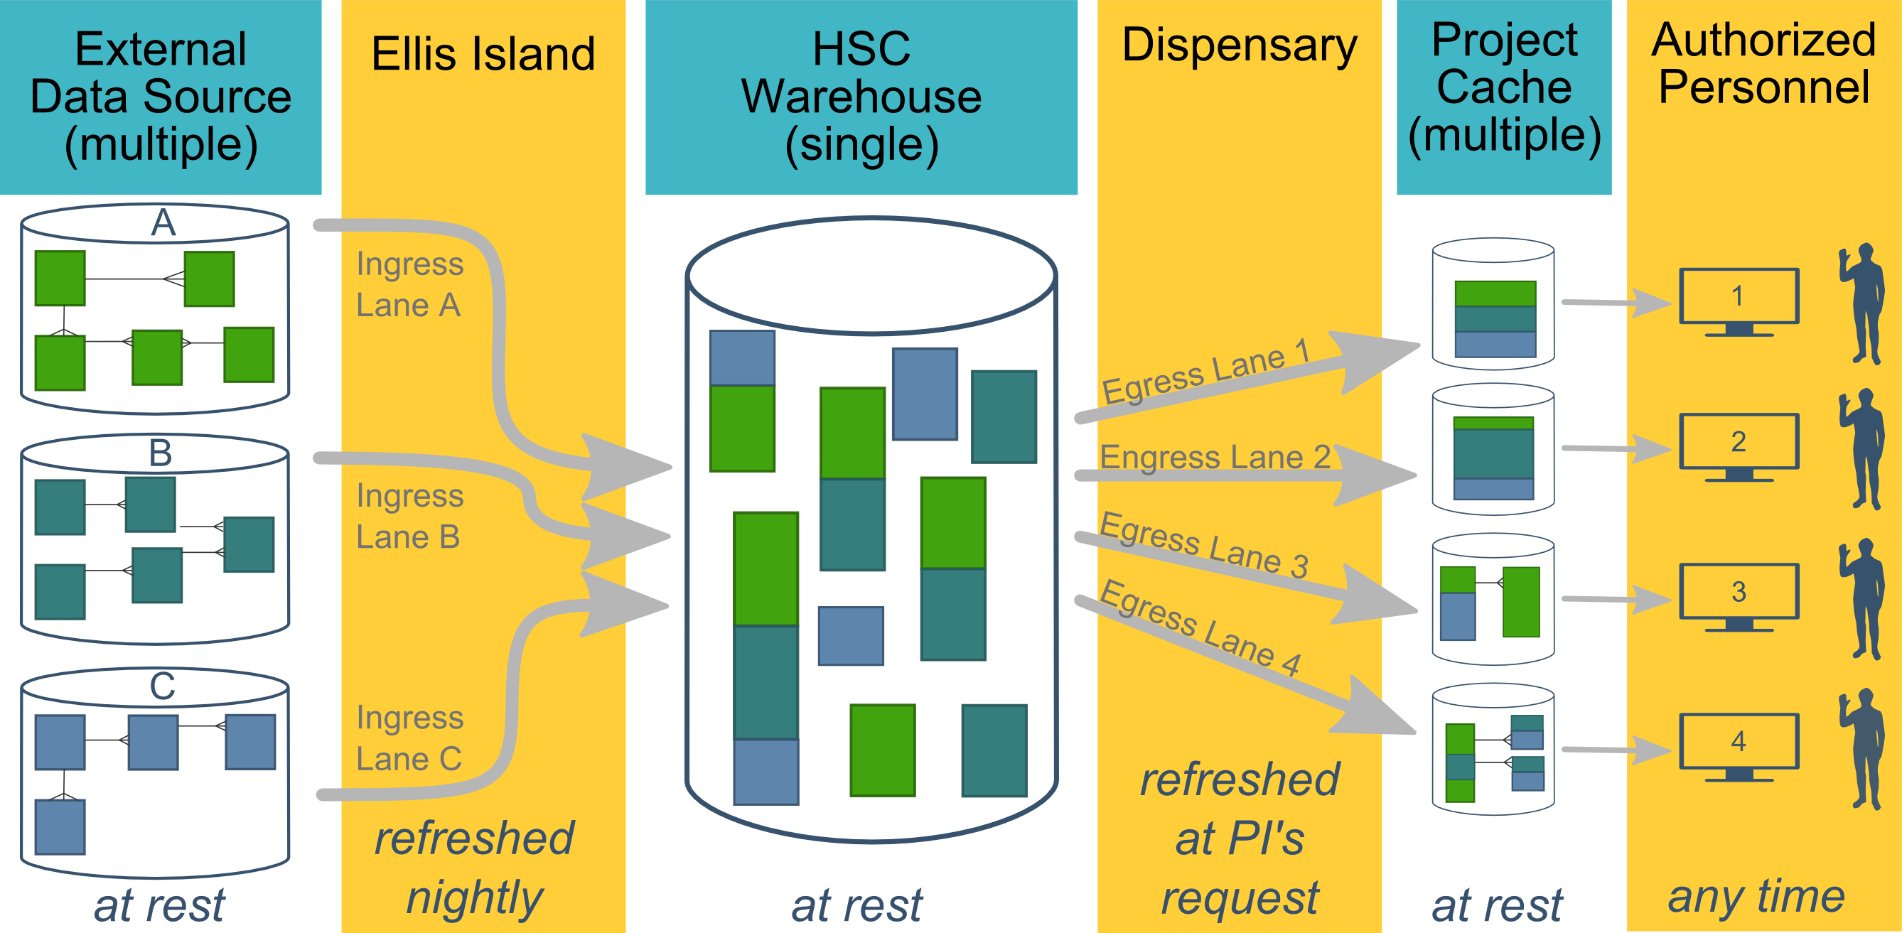
Ecosystem Architecture
Data Source (column 1): contains unique info
Warehouse (column 3): contains copy after manipulation
Project Cache (column 5): contains copy of copy after a lot of manipulation
Notes:
The entire ecosystem can be represented by these six columns. The EMR and other collection databases sit in the 1st column and feed the warehouse in the third. This movement is automated. Inside the warehouse, the info from the different sources are combined. Different patients can be placed in the same table. Perhaps more importantly, records for a single patient that are scattered across different sources are linked.

Slide 17
Notes:
When a investigation is approved by the IRB, we can develop a tiny database in REDCap that contains the dataset needed for their analysis (5th column). There are a few reasons why REDCap is preferred. First, it’s more secure and scalable than distributing loose Excel files. Second, REDCap has a lot of momentum and adoption, so it’s become familiar to a lot of people on campus. The same software system the clinical researcher learned (for example) for randomized trials is leverage here for these observational studies. Although the research/QA methodology is very different, the software is the same. We expect this familiarity to grow on campus, especially as systems like Qualtrics become less available.
After it’s in REDCap, the PI can treat it like their own database, and we’ll show examples with R and SAS later.

Slide 18
Benefits over ad-hoc EMR Extracts
In contrast to the current approach of using EMR data in research & QA, this new system will provide:
Coordinated datasets across sources (combining patients and variables)
Automated updates to datasets (important for on-going QA)
More streamlined IRB approval (hopefully)
More secure delivery through REDCap (instead of loose Excel files)
More consistent experience for multiple research/QA investigations
Notes:
The only current capability on campus is to request individual extracts from the data source stewards.

Slide 19
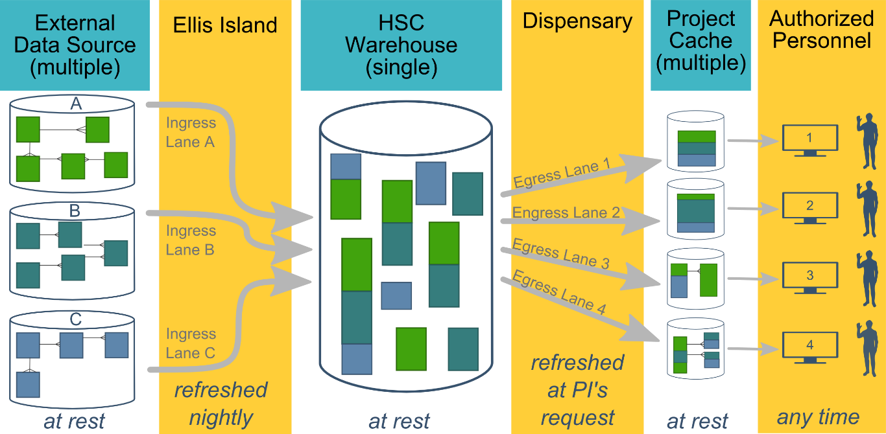
Overall Goals
Existing investigations can proceed quicker and more frequently.
The process is more user-friendly and consistent across different investigations & EMRs.
More complicated investigation are possible (by combining patients & measurements across data sources).
Notes:
We want (1) the things you were already planning to be more streamlined, and (2) provide richer data that were infeasible until now.

Slide 20
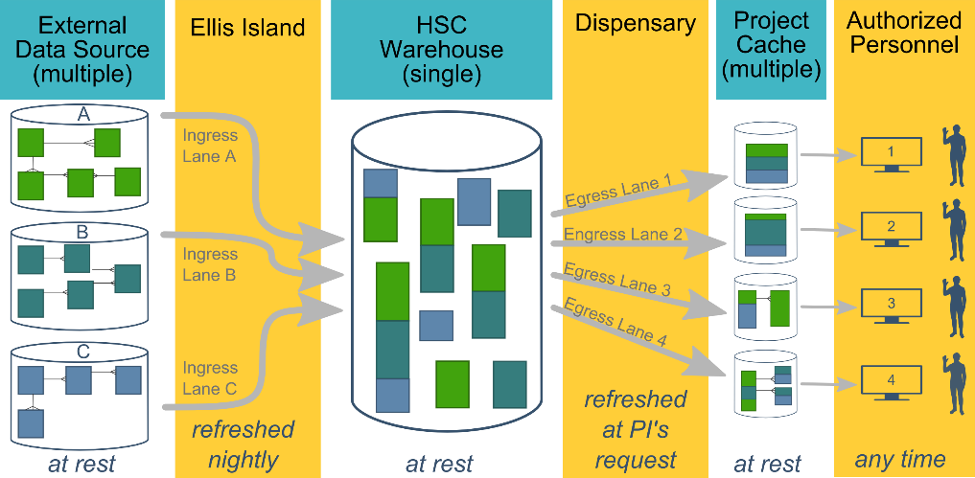
Instantiation Activities
Creating and maintaining the warehouse ecosystem involves three different levels:
Ecosystem (eg, configuring the database VM)
Data source (eg, connecting an EMR's feed to the warehouse)
Project (eg, processing data from specific patients for a single IRB-approved investigation)
Notes:
To start and continue this entire system, there are three levels of activities.

Slide 21
Requirements Per Ecosystem
These steps are required for the overall ecosystem. This work is required once for our campus, and doesn't need to be replicated for each additional data sources or investigation.
Planning meetings with Campus IT and shared services
Campus IT security review (and annual re-reviews)
Creating multiple VMs (virtual machines)
Installing and patching software on each machine
Establish and maintaining secure connections between the 2nd-5th cols.
Assembling team (DBA, EMR reporter, REDCap admin, statistician)
Notes:
This work is required once for our *campus*, and doesn't need to be replicated for each additional data sources or investigation.
{Read through slides, but not the sub-points.}
3. Creating multiple VMs (virtual machines)
* *HSC Warehouse*: One Windows Server VM hosting the SQL Server (figure's third column).
* *Ellis Island and Dispensary*: One Windows Server VM running R and C# (figure's second and fourth column).
* *Project Cache*: Two Windows Servers compose one REDCap instance (figure's fifth column).
4. Installing and patching software on each machine.
* OSes
* Database Servers (SQL Server and MySQL)
* Database admin tools (SQL Server Management Studio, MySQL Workbench, phpMyAdmin)
* Application software (R and C#)
5. Establish and maintaining secure connections between the 2nd, 3rd, 4th, and 5th columns.
* Network/firewall permissions between the different machines.
* Specific user accounts on each machine (eg, OS accounts plus DB accounts).
6. Assembling team
* DBA for warehouse (schema, performance, reliability & backups, security, communication w/ IT & S2).
* Former EMR report writer (expertise at the connections between a pt visit and a db record).
* REDCap administrator
* Statistician (manipulate and/or analyze data)

Slide 22

Requirements Per Data Source
Necessary for each data source (eg, once for Centricity, once for Meditech…)
Agreement with data source owner.
Establish a periodic automated data feed.
Secure licenses for GUI and specialized software (eg, Crystal Reports & Centricity front-end).
Learn data source.
Database schema
Sampling plan (and source of missingness)
Write code to:
Transform EAV schema into warehouse-friendly schema.
Combine measures from different data sources
Link clients from different data sources
Notes:
1. Agreement with data source owner.
1. Establish a periodic automated data feed.
* Configure transport layer & software
1. Secure licenses for GUI and specialized software (eg, Crystal Reports & Centricity front-end).
1. Learn data source.
* Database schema
* Which 15 tables (out of the 200) are relevant to the current goals)?
* How are these tables related to each other?
* Sampling plan (and sources of missingness)
* {Screenshot of part of Centricity schema}
1. Write code to:
* Transform EAV schema into warehouse-friendly schema.
* Combine measures from different data sources
* Link clients from different data sources
* {Screenshot of wide to long transformation}
* {Screenshot of warehouse schema}

Slide 23
Requirements Per Project/Investigation
Necessary for each investigation (eg, once for Gillaspy/Weedn, once for Miller…)
IRB approval for investigation
IRB approval for warehouse collaborators
Teach us research goals & specifics
Write code to transform warehouse into research-friendly schema.
Establish REDCap cache
Write code to transfer data from warehouse to cache
Educate researchers how REDCap & cache work
Notes:
{Go through 1-5}
5. Establish REDCap cache
* We create schema {Screenshot of REDCap project}
* Create user account
* Create API token
* Create starter script in R or SAS
For #8,
* to keep data secure once it's in the cache.
* their cache's schema relates to their research question.
* to analyze their data (if they're doing the analysis)
1. If BERD/BBMC is doing the analysis, keep the structure as reproducible as possible, while protecting PHI.
* {Screenshot of R}
* {Screenshot of GitHub}

Slide 24
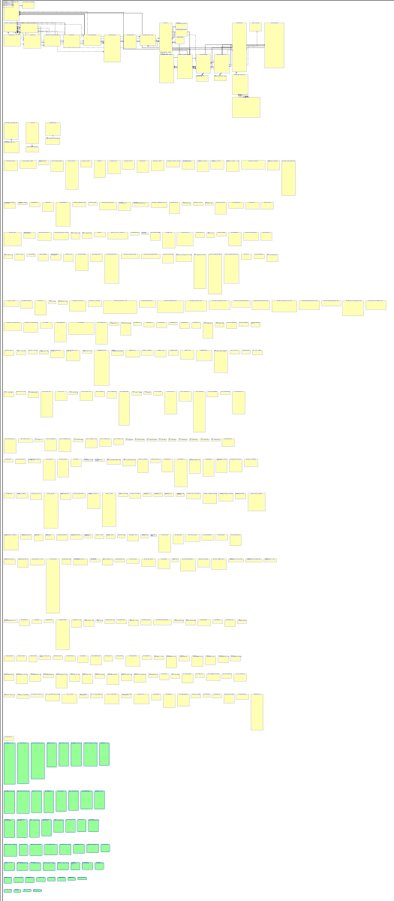
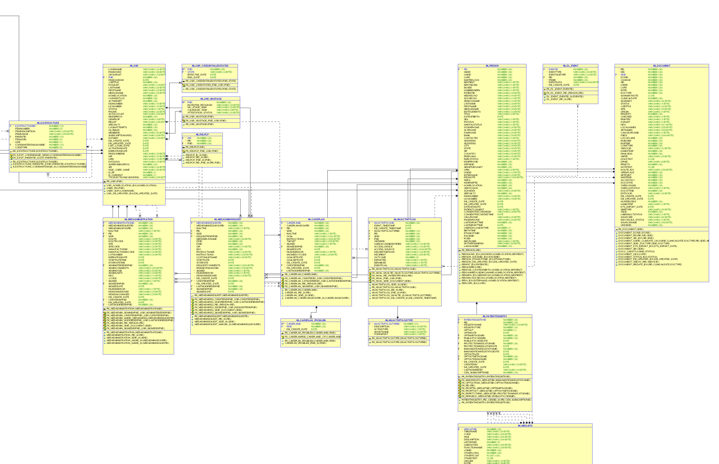
Part of Centricity

Slide 25
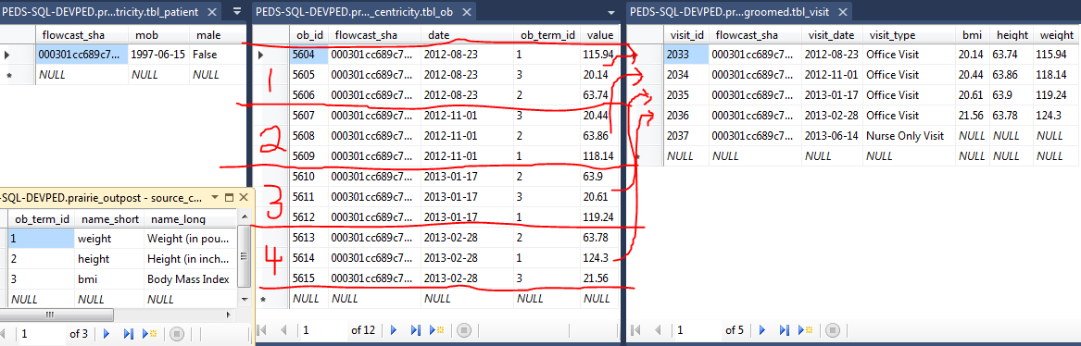
Transforming (one patient’s collection of) records for statistical software
From Centricity (one row per patient/measurement)
To REDCap Cache (one row per visit)

Slide 26
Live demo of REDCap Project Cache
REDCap GUI
Access data with R/SAS
Notes:
Include Benefits of using REDCap for the cache (if I didn’t already).

Slide 27
SAS Example
filename in "E:\encrypted_drive\aslan\apicall.csv";
filename out "E:\encrypted_drive\aslan\redcap.csv";
%let token = xxxxx;
"%NRStr(content=record&type=flat&format=csv&fields=last_first_mi&token=)&token%NRStr(&_x=1)";
%let url = "https://bbmc.ouhsc.edu/api/";
data _null_ ;
file in ;
put "%NRStr(content=record&type=flat&format=csv&token=)&token";
run;
proc http
in=in
out=out
url=&url
method="post";
run;
Adapted from Linda Carlin’s and Kevan Essmyer’s posts at https://groups.google.com/forum/#!topic/project-redcap/MS_4_l1q-WU

Slide 28
Open to any Campus Collaborators
With the appropriate IRB approval, this system is open to anyone on campus, including:
Statisticians analyzing the project caches (eg, BERD & BBMC)
Applied researchers or QA investigators (last column)
Departments adding their own data source to the ecosystem (first column)
Departments who want a separate warehouse & data sources, but want to reuse the distribution mechanism.
Notes:
we want the whole campus to benefit, and we're not possessive or worried we'll run out of work.

Slide 29
Possible Service Tiers
Tier 0: Education (free & composed of fake data)
Tier 1: Dept Cookie-cutter (free)
Tier 2: 3D box (hourly fee)
Tier 3: Multilevel (retainer + hourly fee)
Notes:
Here’s how we plan to provide a cheap or free product to those with simple needs, while still recovering costs to make the system possible. I’d like two free tiers: the 0 lacks PHI, while #1 has basic info that’s frequently used by a department (such as patient counts, or wait times). The last two tiers will accommodate more complicated research. This only applies to delivering the groomed data to the investigator.
Services like statistical analysis are considered separate. The BBMC has statisticians available for consulting, but it's not tightly bundled with the warehouse services. We want you to be free to analyze your own study, or include other statistical support groups (eg, BERD and RDAC).

Slide 30
Misc
Design benefits
For the subspecialties, a wider collection/net starts to escape limitation of case-control-like designs
Advantages of starting small, compared to MyHealthNet
Pitfalls of relying on standardization that exists in those biggies
NOT missing context of a standardized tag
Not a black box. We'll share the code that took the data from datasource to project cache
Notes:
Context (were they fasting before the blood test)?
Sampling (who didn't the measure -eg, Fields)

Slide 31
Future
Scalability
More projects
More data per project
More frequent updates per project
Federal reporting benefits of combining data sources
i2b2 possible (https://www.i2b2.org/)
Learn from/with other institutions
Cheaper code development & maintenance.

Slide 32
Long-term Vision

Slide 33
Immediate Next Steps
Finalize roster and convene the CDW governance body
Develop standard operating procedures for CDW access and use
Determine regulatory review processes for CDW projects
Obtain data sharing agreements with EHR systems
Build system components to accommodate a few more select pilot projects
Continually collect and monitor feedback from end-users and adapt system accordingly
Invite and select new CDW projects

Slide 34
OUHSC CDW Data Possibilities
Currently available
Centricity data from OKC-HSC clinics
Patient demographics
Visit information
Biometrics
Diagnoses
Lab results
Prescription information
Limited billing information
Planned additions in near future (negotiations pending)
Meditech data
CribNotes data (neonatal/perinatal specific EMR)
Select OSIIS data from OK State Dept of Health
HSC Pharmaceutical data
IDX billing information

Slide 35
Not the Only CDW in Town/State
Coming Soon: OSDH Health-e-Oklahoma system
Orion Health vendor
OPSR Data Systems & Coordination workgroup
http://smartstartok.org/opsr
OU Centricity maintains a business operations warehouse
MediTech participates in pooled warehouse
Health Information Exchanges (HIEs)
MyHealth Access Network
Coordinated Care Oklahoma
OSU Center for Health Systems Innovation pays for Cerner HIE

Slide 36

Current Collaborators
Design and Management Team
Will Beasley (BBMC)
David Bard (BBMC)
Zsolt Nagykaldi (HSC FPM)
Sreeharsha Mandem (BBMC & OU CS)
Sabrina Antry (BBMC)
Centricity Support
Kevin Elledge
Cynthia Proctor
Adam McGann
June Pearson
Institutional Support & Guidance
Judith James (OSCTR)
Tim VanWagoner (OSCTR)
Joel Guthridge (OSCTR)
Robert Roswell (COM)
Darrin Akins (COM)
OU IT
Mark Ferguson
Scott DeWitt
Cliff Mack
Tony Miller
Randy Moore
April Lee

