Slide 1
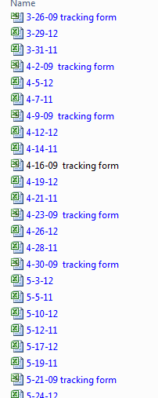
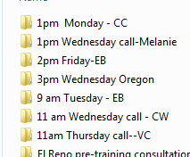
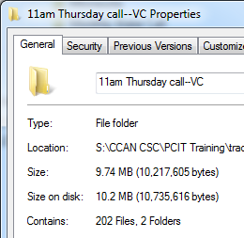
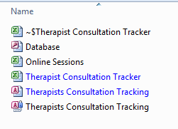
PCIT Training
X
Notes:
PCIT

Slide 2
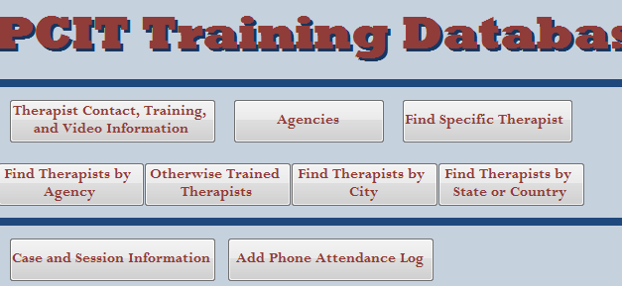
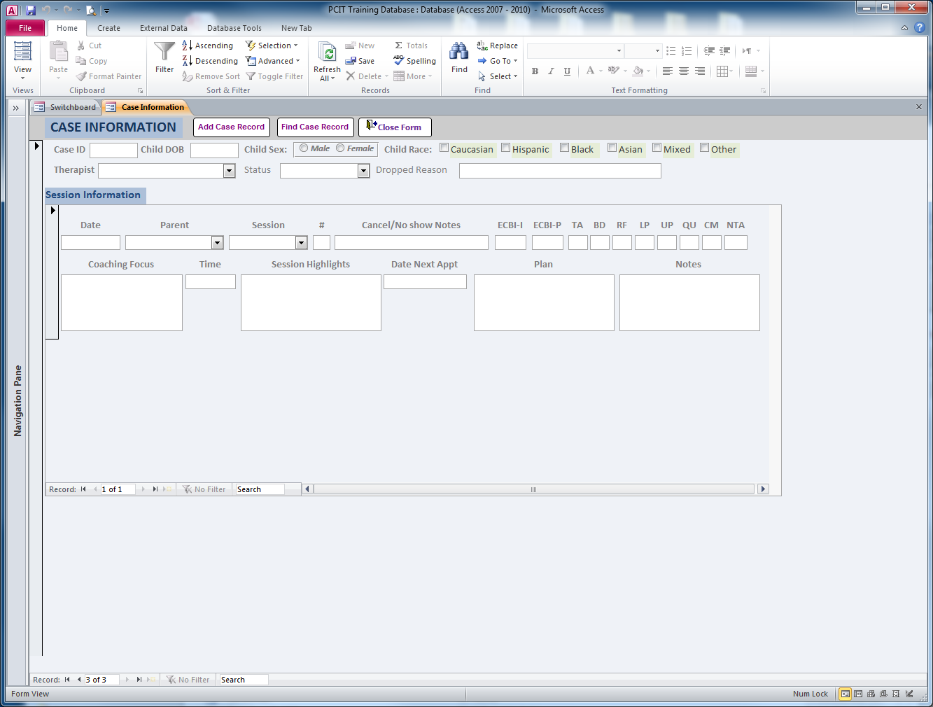
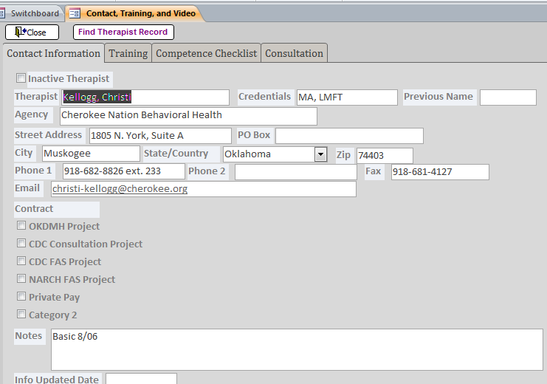
PCIT Training

Slide 3
New Directions
Electronic Database
Data Integrity

Slide 4
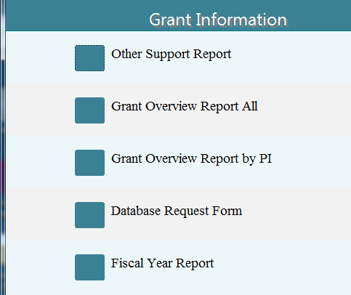
Departmental Grant Database
Hands down the database is better than our previous system. A database has parameters for organizing your data. Our previous methods had no structure or consistency. It changed from spreadsheet to spreadsheet, possibly due to different information being requested at different times. They were also spread out over multiple excel spreadsheets. There is no way to know what information overlaps or which spreadsheet contains the correct information. It’s too open ended. The database is a way to combine multiple tables/spreadsheets, provide more structured definitions, and query out any number of sets of data that would have taken someone days before.
~Angela
Sections

Slide 5
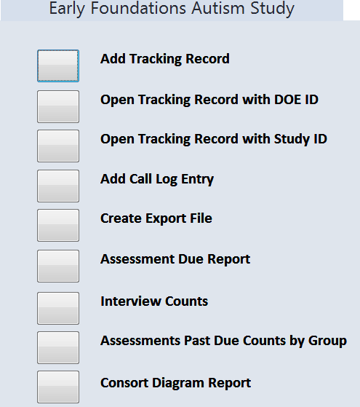
Autism Contacts Database
Project DATA Toddler Contacts Database
Study Status
Participant Demographics
Data Tracking
Study Management
Reporting

Slide 6
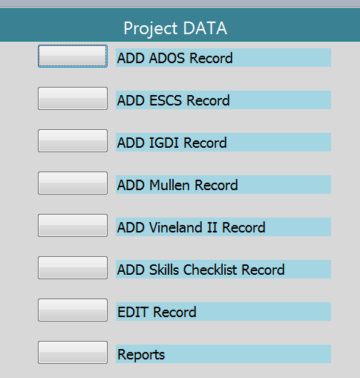
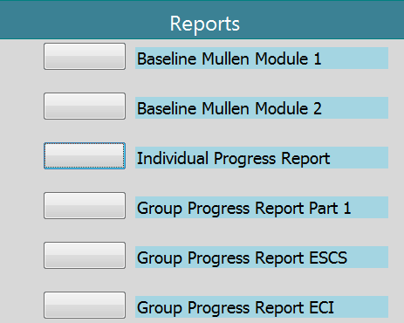
Autism-Toddler
Project DATA Toddler Assessment Database
Participant Progress Report
Assessment Outcomes

