Slide 1
REDCap Systems Integration
Breakout Session IV
REDCapCon 2015
Denise Snyder, Vijay Thirumalai, & Will Beasley

Slide 2
Agenda
Connecting REDCap to:
Upstream elements Denise (Duke University)
Other REDCap instances Vijay (Health Partners)
Downstream elements Will (University of Oklahoma)
Open discussion & questions (Denise)

Slide 3
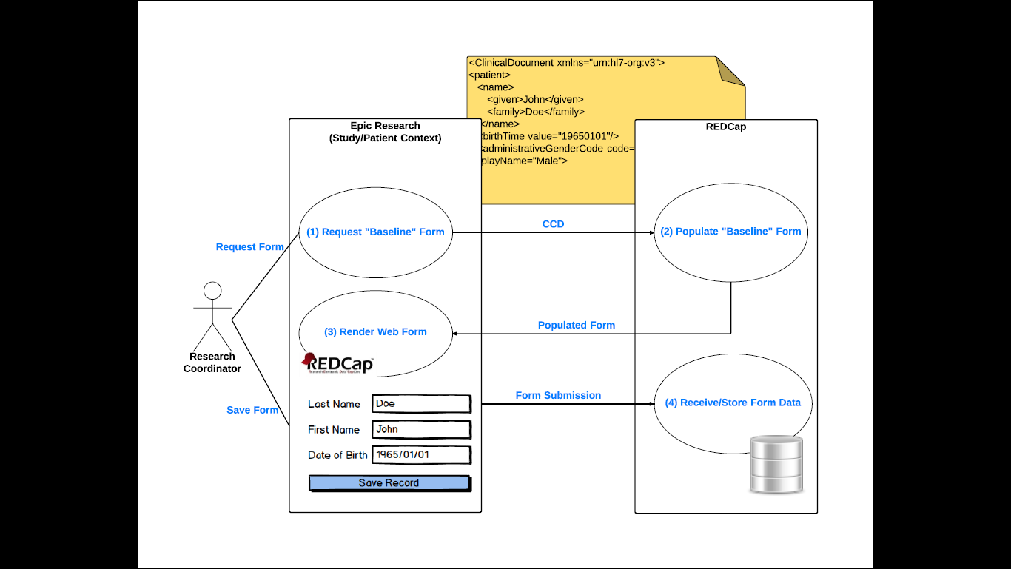
Connecting REDCap to Upstream Elements (1 of 3)

Slide 4
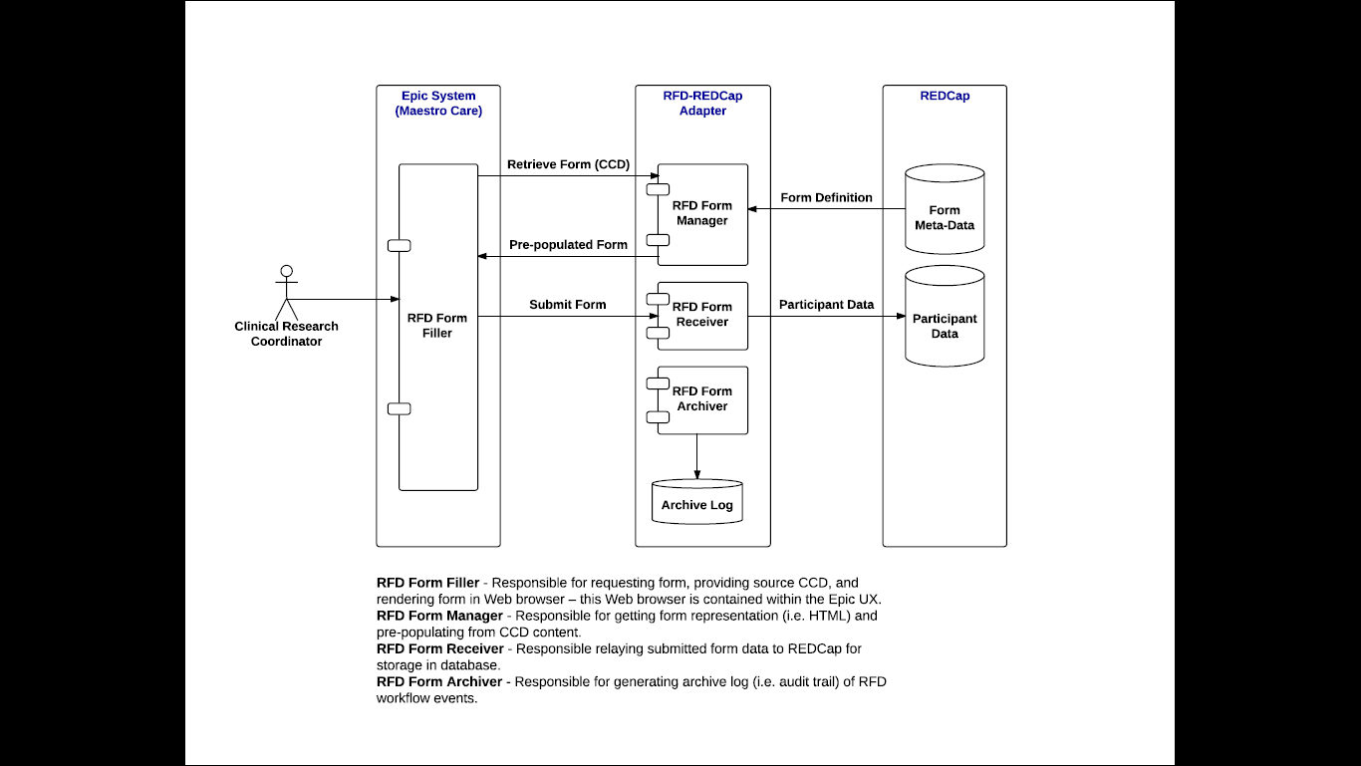
Connecting REDCap to Upstream Elements (2 of 3)

Slide 5
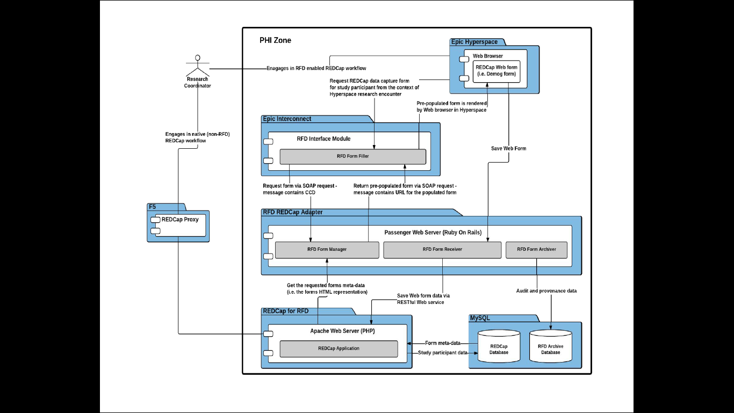
Connecting REDCap to Upstream Elements (3 of 3)

Slide 6
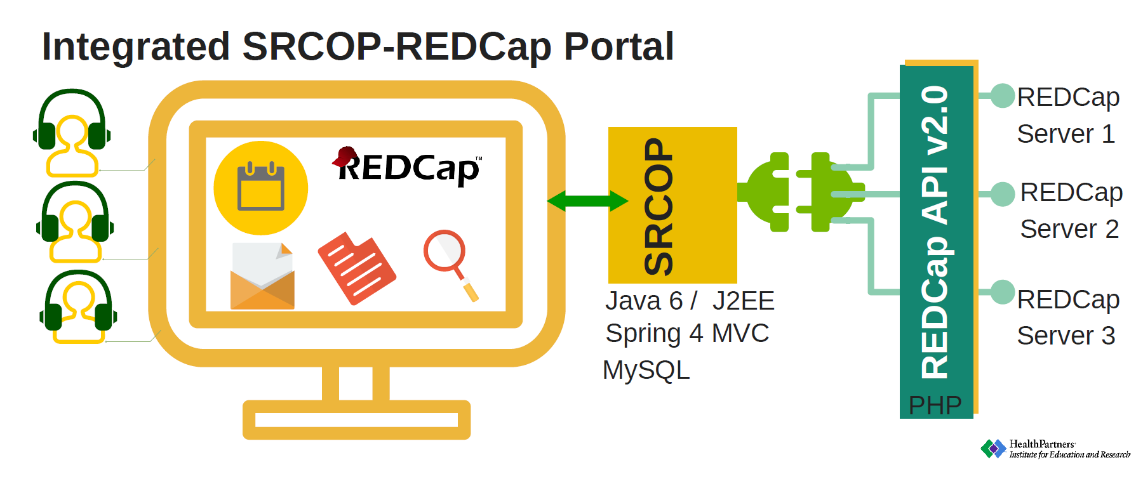
Connecting Sibling REDCap Instances

Slide 7
Connecting REDCap to Downstream Elements (1 of 4)

Slide 8
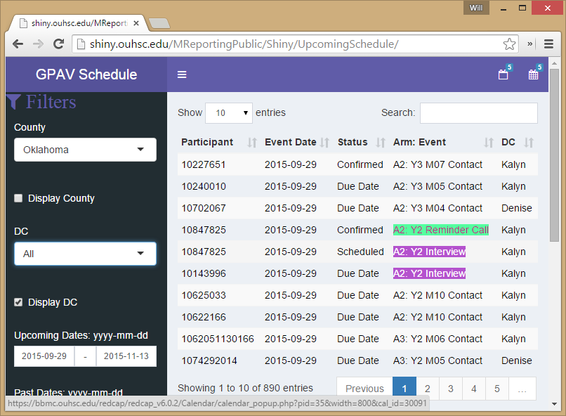
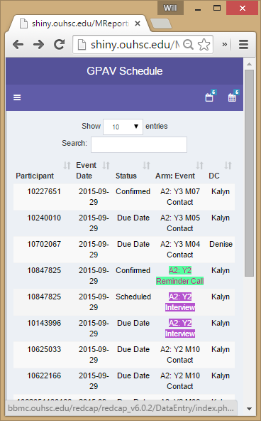
Connecting REDCap to Downstream Elements (2 of 4)
http://shiny.ouhsc.edu/MReportingPublic/Shiny/UpcomingSchedule/

Slide 9
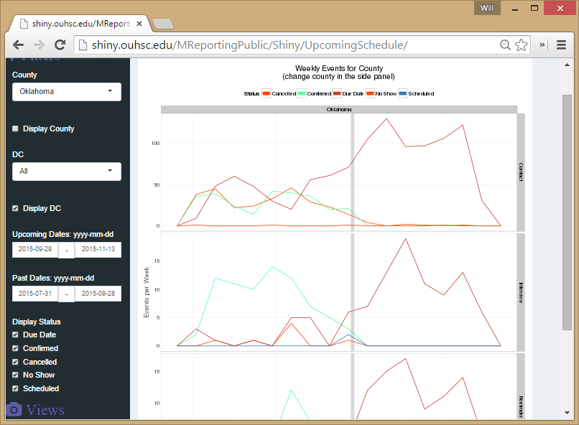
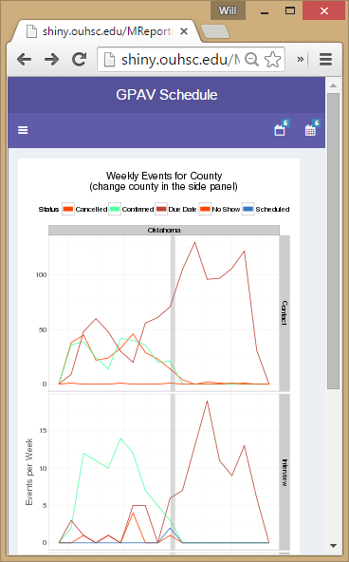
Connecting REDCap to Downstream Elements (3 of 4)
http://shiny.ouhsc.edu/MReportingPublic/Shiny/UpcomingSchedule/

Slide 10
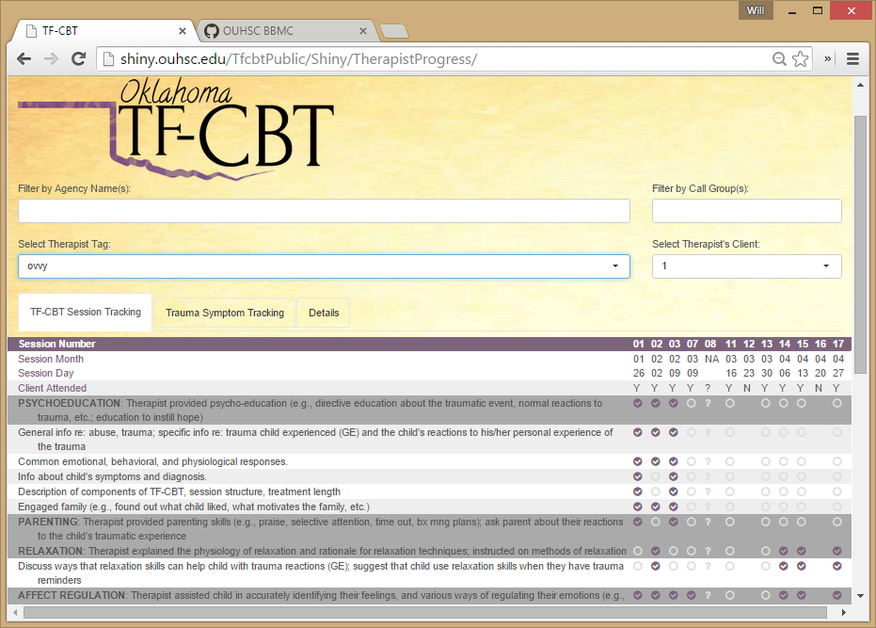
Connecting REDCap to Downstream Elements (4 of 4)
http://shiny.ouhsc.edu/TfcbtPublic/Shiny/TherapistProgress/

Slide 11
Open discussion & questions (Denise)

Slide 12
Thanks

