Slide 1
Literate Programming Patterns and Practices for Continuous Quality Improvement (CQI)
Will Beasley, Thomas Wilson, & David Bard University of Oklahoma Health Sciences Center Pediatrics Dept, Biomedical & Behavioral Methodology Core (BBMC)
REDCap Con
Sept 23, 2014
Notes:
Hi I’m Will from the University of Oklahoma, along with Thomas Wilson & David Bard. I’d like to describe some of the approaches we’ve employed when connecting REDCap with our statistical modeling and dynamic reporting workflows.

Slide 2
Literate programming
Literate programming tools can combine statistical text, tables, and graphs in a coherent document that is accessible to unfamiliar audiences.
The automation of these tools eliminates the need to repeatedly copy and paste analytic results after underlying data sources are updated.
Notes:
Literate programming began in the early 1980s by Donald Knuth when he started emphasizing the human aspect of a programming language. The term seems to have assumed some additional interpretations in 30 years. Right or wrong, in my circles it’s become almost synonymous with “dynamic reporting that’s done programmatically”, and emphasizes that humans are the consumers of your software, not other computers. The exemplar of literate programming is LaTeX.

Slide 3
Continuous Quality Improvement (CQI)
Defined by HRSA as “a continuous process that employs rapid cycles of improvement”
We provide a detailed, yet generalizable, illustration of CQI benefiting from REDCap and literate programming, which hopefully will increase the
speed of development,
consistency of implementation,
adherence to recommended security practices,
complexity of statistical analyses,
breadth of audience, and
frequency of informative CQI cycles.
Notes:
Continuous Quality Improvement (CQI) exists by various names in many fields, and has become even more visible in our medical-ish world thanks to more interest in evidence-based medicine and also health care reform.
To do it well, you’ve got to have a system that pump out reports on fresh data. To be feasible, automation is critical, because you won’t have the time or money for someone to manually run analyses and copy and format tables and graphs every few days or weeks.
Literate programming tools are a great fit for CQI.

Slide 4
MIECHV Evaluation Overview
Technical Requirements
Provide data collectors with fresh recruiting pool (through REDCap).
Collect data in rural Oklahoma (potentially off-line) (through REDCap).
Analyze the programs’ self-collected outcomes (not through REDCap).
Stakeholders & Collaborators
State Health Dept & State Medicaid Agency
State Politicians & Federal Funders
48 other states conducting MIECHV evaluations
MIECHV was the impetus for bringing REDCap to Oklahoma
REDCap had the best tradeoffs for the data collection component.
It could integrate with our other data systems.
It’s been a good fit new investigations we didn’t anticipate.
Motivation to be more disciplined when integrating … such as the patterns described here.
Notes:
Let me describe a current project that benefits (a) from CQI, (b) from dynamic reporting, and (c) from REDCap. “MIECHV” -the “Maternal, Infant, and Early Childhood Home Visiting” program helps new mothers and their kids by providing services in their own home. To evaluate program efficacy, our data collectors in the field use one very tall REDCap project (we’ll top 100k individuals) to select recruits, and a second very wide REDCap project to collect monthly information (over 2k columns). Additionally, there are dozens of datasets from different agencies that we need to analyze; this third part isn’t a good fit for REDCap (because there’s no real user interaction), but still needs to be somewhat connected.
There are multiple agencies and stakeholders sending us batches of data, and expecting analyses. All of this is a good fit for using automation to programmatically move data in & out of REDCap, and then to generate reports.

Slide 5
An Extraverted System
Notes:
Like many REDCap projects, this one isn’t an isolated. In the center is the proper database, which talks to humans through a website and talks to other computers through an API. We mostly use the API to import large datasets from collaborators, and later to export results destined for reports.

Slide 6
Software Patterns
Describe the essential structure of a common solution to a common problem. (eg, hinged door)
Here’s what we use, but we’d like to hear from you and improve and disseminate them. Demos: http://github.com/OuhscBbmc/RedcapExamplesAndPatterns.
“Patterns aren’t original ideas; they’re very much observations of what happens in the field. As a result, we pattern authors don’t say we ‘invented’ a pattern but rather that we ‘discovered’ one.” -Martin Fowler (2002, p. 10)
Notes:
Now I’ll be more theoretical and abstract. A pattern describes the basic solution to a problem that’s repeatedly encountered in a field. It dates back to at least building architecture & construction. Suppose your problem is that you have two different spaces in a building that you sometimes want connected, and sometimes want separated. Furthermore, you want it to swing sideways and latch. Architects could repeated say, “here we want something that sometimes connects these two rooms, and sometimes separates them”. Or they could say, “here we want a door”. The name of the pattern is ‘door’. (pause) And there can be variations of this pattern.
Not only do patterns improve communication between people, they help advance the field, because it’s easier to take previous work and improve it. At the very least, patterns make it easier to replicate previous success. There are so many moving parts and choices in software. When you eventually find a good solution after multiple iterations, it would be nice to avoid reinventing it every time a similar scenario arises.
My favorite pattern authors usually joke in their preface the reader won’t see much new in their book.

Slide 7
Many Previous Good Examples
Secondary use of clinical data: The Vanderbilt approach (2013)
CHOP’s Harvest with django-redcap
2013 REDCap Days
Data Entry Trigger and API: Two Good Things That Go Great Together - Bob Wong
2011 REDCap Days
Integrating REDCap Data and the Duke Health System Data Warehouse - Bill Gilbert
REDCap + API = BOLD CTMS - Chris Nefcy
Using the API to Populate a REDCap Project From a Telephone System - Bob Wong
2009 REDCap Days
External Data Access - Adrian Nida
Notes:
If we may be so bold, today I’ll describe some helpful patterns we observed while reviewing (a) solutions used in our work, (b) solutions used by other developers in non-REDCap work, and (c) solutions from you guys in the last 5+ years.

Slide 8
Layers
3-Tier: prototypical architecture since 1990s.
Organize conceptually similar components.
Encapsulate complexity so callers are shielded.
Each layer is dependent only on those below it.
Presentation (eg, reports)
Domain Logic (eg summary & stat analysis)
Data (eg, communication w/ REDCap and DBs)
REDCap
Other DBs
External CSVs
Notes:
These patterns can be categorized with a three-tier architecture. This first/purple layer of code imports/exports information from the data sources (such as REDCap and flat files from the Health Dept). In Enterprise software terminology, this is where are ‘gateways’ and ‘table modules’ live. Of course an arrow represents a code dependency, and not necessarily the flow of data, which can be two-way.
The Domain Logic layer is where the statistical analyses and serious aggregations occur. The three of us are statisticians, and this is where we’d like to live as much as possible. Some of the code in this layer execute multi-level Bayesian models. But other important reports need simple things like, verifying that a data collectors has completed the necessary follow up appointments. If you’re migrating your researchers from an Excel-based solution, all their pivot table junk most likely belongs here. Not in the data layer intended for plumbing, and not in the presentation layer.
It’s conventional advice to keep the presentation layer as ‘thin’ as possible, by which they mean that the presentation code shouldn’t do very little analysis, or thinking. It sounds weird at first, but I’d argue that graphing code doesn’t even belong in the presentation layer, and I’ll show an example why in a few slides.

Slide 9
Data Layer Patterns (part 1)
Extractor: exports through the REDCap API into R, and lightly manipulates, such as
calculates timespans,
applies metadata (eg, value labels)
converts categories levels into factors, and
cleans up missing values (eg, a “” becomes NA)
It is called by reporting workflows and sanitizers.
Arch: exports/pulls SQL Server data to R and lightly munge. (A one-way version of Fowler’s “Table Gateway”)
It is called by reports and other gateways.
Notes:
The ‘Extractor’ is a good pattern to start for us. It uses the API to pull records into R, and returns it to some other code in R that called. It’s not a destination. It converts and prepares the dataset so R can work with it more naturally later, such as translating empty characters to explicit missing values. An example responsibility is to rename variables from those multiselect checkboxes so they’re more natural to reference in R code.

Slide 10
DemographicsExtractor <- function( ) {
### Retrieve token and REDCap URL #############################
#With projects containing PHI, load token from a 2nd database
token <- REDCapR:::retrieve_token_mssql(dsn="Security", project_name="demo2")
uri <- "https://bbmc.ouhsc.edu/redcap/api/"
### Query REDCap API with batching #############################
result_1 <- REDCapR::redcap_read(redcap_uri=uri, token=token)
testit::assert("The call was unsuccessful. Inspect the values of `result_1` for more details.", result_1$success )
ds <- result_1$data #Assign data.frame to 'ds'.
### Rename variables if necessary #############################
ds <- plyr::rename(ds, replace=c(
"comments" = "comments_participant",
"height" = "height_in_cm"
))
### Convert variable types ####################################
ds$dob <- as.Date(ds$dob, "%Y-%m-%d") # character to date
### Convert to factor variables ###############################
ds$ethnicity <- factor(ds$ethnicity, levels=0:2, labels=c(“Latino","NOT Latino","Not Reported"))
ds$ethnicity <- ReplaceNAsWithFactorLevel(ds$ethnicity, addUnknownLevel=TRUE)
### Return the dataset to the caller ##########################
return( ds )
}
github.com/OuhscBbmc/ RedcapExamplesAndPatterns
Notes:
The extractor is one of two patterns I’ll show code for. Notice that executing the file doesn’t actually run anything, but instead it defines a function that will execute later. The function first retrieves the token (which is I’ll discuss later). Second, it uses that token to export from REDCap. Third, it does things like renames and cleans up variables. And finally, the dataset set is returned to the caller.
There’s nothing amazing in this file. I kinda wish I had a mind-blowing slide, but I suppose that’s the goal of good architecture? Organizing and compartmentalizing code so that each piece is simple in itself, and each the different pieces fit most naturally which each other.
The only two operations with any mystery (ie, retrieving the token and then retrieving the dataset) has been encapsulated and refactored out of the code. We placed that API code somewhere else, because we wanted this to be focused on the dataset, and not the retrieval mechanics. If we didn’t use a library and we called the API directly, more than half of the file would be about retrieval. On top of that, that 50 lines of retrieval code would need to be replicated many places, which is undesirable to maintain.

Slide 11
DemographicsExtractor <- function( ) {
### Retrieve token and REDCap URL #############################
#With projects containing PHI, load token from a 2nd database
token <- REDCapR:::retrieve_token_mssql(dsn="Security", project_name="demo2")
uri <- "https://bbmc.ouhsc.edu/redcap/api/"
### Query REDCap API with batching #############################
result_1 <- REDCapR::redcap_read(redcap_uri=uri, token=token)
testit::assert("The call was unsuccessful. Inspect the values of `result_1` for more details.", result_1$success )
ds <- result_1$data #Assign data.frame to 'ds'.
### Rename variables if necessary #############################
ds <- plyr::rename(ds, replace=c(
"comments" = "comments_participant",
"height" = "height_in_cm"
))
### Convert variable types ####################################
ds$dob <- as.Date(ds$dob, "%Y-%m-%d") # character to date
### Convert to factor variables ###############################
ds$ethnicity <- factor(ds$ethnicity, levels=0:2, labels=c(“Latino","NOT Latino","Not Reported"))
ds$ethnicity <- ReplaceNAsWithFactorLevel(ds$ethnicity, addUnknownLevel=TRUE)
### Return the dataset to the caller ##########################
return( ds )
}
github.com/OuhscBbmc/ RedcapExamplesAndPatterns
Notes:
The extractor is one of two patterns I’ll show code for. Notice that executing the file doesn’t actually run anything, but instead it defines a function that will execute later. The function first retrieves the token (which is I’ll discuss later). Second, it uses that token to export from REDCap. Third, it does things like renames and cleans up variables. And finally, the dataset set is returned to the caller.
There’s nothing amazing in this file. I kinda wish I had a mind-blowing slide, but I suppose that’s the goal of good architecture? Organizing and compartmentalizing code so that each piece is simple in itself, and each the different pieces fit most naturally which each other.
The only two operations with any mystery (ie, retrieving the token and then retrieving the dataset) has been encapsulated and refactored out of the code. We placed that API code somewhere else, because we wanted this to be focused on the dataset, and not the retrieval mechanics. If we didn’t use a library and we called the API directly, more than half of the file would be about retrieval. On top of that, that 50 lines of retrieval code would need to be replicated many places, which is undesirable to maintain.

Slide 12
DemographicsExtractor <- function( ) {
### Retrieve token and REDCap URL #############################
#With projects containing PHI, load token from a 2nd database
token <- REDCapR:::retrieve_token_mssql(dsn="Security", project_name="demo2")
uri <- "https://bbmc.ouhsc.edu/redcap/api/"
### Query REDCap API with batching #############################
result_1 <- REDCapR::redcap_read(redcap_uri=uri, token=token)
testit::assert("The call was unsuccessful. Inspect the values of `result_1` for more details.", result_1$success )
ds <- result_1$data #Assign data.frame to 'ds'.
### Rename variables if necessary #############################
ds <- plyr::rename(ds, replace=c(
"comments" = "comments_participant",
"height" = "height_in_cm"
))
### Convert variable types ####################################
ds$dob <- as.Date(ds$dob, "%Y-%m-%d") # character to date
### Convert to factor variables ###############################
ds$ethnicity <- factor(ds$ethnicity, levels=0:2, labels=c(“Latino","NOT Latino","Not Reported"))
ds$ethnicity <- ReplaceNAsWithFactorLevel(ds$ethnicity, addUnknownLevel=TRUE)
### Return the dataset to the caller ##########################
return( ds )
}
github.com/OuhscBbmc/ RedcapExamplesAndPatterns
Notes:
The extractor is one of two patterns I’ll show code for. Notice that executing the file doesn’t actually run anything, but instead it defines a function that will execute later. The function first retrieves the token (which is I’ll discuss later). Second, it uses that token to export from REDCap. Third, it does things like renames and cleans up variables. And finally, the dataset set is returned to the caller.
There’s nothing amazing in this file. I kinda wish I had a mind-blowing slide, but I suppose that’s the goal of good architecture? Organizing and compartmentalizing code so that each piece is simple in itself, and each the different pieces fit most naturally which each other.
The only two operations with any mystery (ie, retrieving the token and then retrieving the dataset) has been encapsulated and refactored out of the code. We placed that API code somewhere else, because we wanted this to be focused on the dataset, and not the retrieval mechanics. If we didn’t use a library and we called the API directly, more than half of the file would be about retrieval. On top of that, that 50 lines of retrieval code would need to be replicated many places, which is undesirable to maintain.

Slide 13
DemographicsExtractor <- function( ) {
### Retrieve token and REDCap URL #############################
#With projects containing PHI, load token from a 2nd database
token <- REDCapR:::retrieve_token_mssql(dsn="Security", project_name="demo2")
uri <- "https://bbmc.ouhsc.edu/redcap/api/"
### Query REDCap API with batching #############################
result_1 <- REDCapR::redcap_read(redcap_uri=uri, token=token)
testit::assert("The call was unsuccessful. Inspect the values of `result_1` for more details.", result_1$success )
ds <- result_1$data #Assign data.frame to 'ds'.
### Rename variables if necessary #############################
ds <- plyr::rename(ds, replace=c(
"comments" = "comments_participant",
"height" = "height_in_cm"
))
### Convert variable types ####################################
ds$dob <- as.Date(ds$dob, "%Y-%m-%d") # character to date
### Convert to factor variables ###############################
ds$ethnicity <- factor(ds$ethnicity, levels=0:2, labels=c(“Latino","NOT Latino","Not Reported"))
ds$ethnicity <- ReplaceNAsWithFactorLevel(ds$ethnicity, addUnknownLevel=TRUE)
### Return the dataset to the caller ##########################
return( ds )
}
github.com/OuhscBbmc/ RedcapExamplesAndPatterns
Notes:
The extractor is one of two patterns I’ll show code for. Notice that executing the file doesn’t actually run anything, but instead it defines a function that will execute later. The function first retrieves the token (which is I’ll discuss later). Second, it uses that token to export from REDCap. Third, it does things like renames and cleans up variables. And finally, the dataset set is returned to the caller.
There’s nothing amazing in this file. I kinda wish I had a mind-blowing slide, but I suppose that’s the goal of good architecture? Organizing and compartmentalizing code so that each piece is simple in itself, and each the different pieces fit most naturally which each other.
The only two operations with any mystery (ie, retrieving the token and then retrieving the dataset) has been encapsulated and refactored out of the code. We placed that API code somewhere else, because we wanted this to be focused on the dataset, and not the retrieval mechanics. If we didn’t use a library and we called the API directly, more than half of the file would be about retrieval. On top of that, that 50 lines of retrieval code would need to be replicated many places, which is undesirable to maintain.

Slide 14
DemographicsExtractor <- function( ) {
### Retrieve token and REDCap URL #############################
#With projects containing PHI, load token from a 2nd database
token <- REDCapR:::retrieve_token_mssql(dsn="Security", project_name="demo2")
uri <- "https://bbmc.ouhsc.edu/redcap/api/"
### Query REDCap API with batching #############################
result_1 <- REDCapR::redcap_read(redcap_uri=uri, token=token)
testit::assert("The call was unsuccessful. Inspect the values of `result_1` for more details.", result_1$success )
ds <- result_1$data #Assign data.frame to 'ds'.
### Rename variables if necessary #############################
ds <- plyr::rename(ds, replace=c(
"comments" = "comments_participant",
"height" = "height_in_cm"
))
### Convert variable types ####################################
ds$dob <- as.Date(ds$dob, "%Y-%m-%d") # character to date
### Convert to factor variables ###############################
ds$ethnicity <- factor(ds$ethnicity, levels=0:2, labels=c(“Latino","NOT Latino","Not Reported"))
ds$ethnicity <- ReplaceNAsWithFactorLevel(ds$ethnicity, addUnknownLevel=TRUE)
### Return the dataset to the caller ##########################
return( ds )
}
github.com/OuhscBbmc/ RedcapExamplesAndPatterns
Notes:
The extractor is one of two patterns I’ll show code for. Notice that executing the file doesn’t actually run anything, but instead it defines a function that will execute later. The function first retrieves the token (which is I’ll discuss later). Second, it uses that token to export from REDCap. Third, it does things like renames and cleans up variables. And finally, the dataset set is returned to the caller.
There’s nothing amazing in this file. I kinda wish I had a mind-blowing slide, but I suppose that’s the goal of good architecture? Organizing and compartmentalizing code so that each piece is simple in itself, and each the different pieces fit most naturally which each other.
The only two operations with any mystery (ie, retrieving the token and then retrieving the dataset) has been encapsulated and refactored out of the code. We placed that API code somewhere else, because we wanted this to be focused on the dataset, and not the retrieval mechanics. If we didn’t use a library and we called the API directly, more than half of the file would be about retrieval. On top of that, that 50 lines of retrieval code would need to be replicated many places, which is undesirable to maintain.

Slide 15
DemographicsExtractor <- function( ) {
### Retrieve token and REDCap URL #############################
#With projects containing PHI, load token from a 2nd database
token <- REDCapR:::retrieve_token_mssql(dsn="Security", project_name="demo2")
uri <- "https://bbmc.ouhsc.edu/redcap/api/"
### Query REDCap API with batching #############################
result_1 <- REDCapR::redcap_read(redcap_uri=uri, token=token)
testit::assert("The call was unsuccessful. Inspect the values of `result_1` for more details.", result_1$success )
ds <- result_1$data #Assign data.frame to 'ds'.
### Rename variables if necessary #############################
ds <- plyr::rename(ds, replace=c(
"comments" = "comments_participant",
"height" = "height_in_cm"
))
### Convert variable types ####################################
ds$dob <- as.Date(ds$dob, "%Y-%m-%d") # character to date
### Convert to factor variables ###############################
ds$ethnicity <- factor(ds$ethnicity, levels=0:2, labels=c(“Latino","NOT Latino","Not Reported"))
ds$ethnicity <- ReplaceNAsWithFactorLevel(ds$ethnicity, addUnknownLevel=TRUE)
### Return the dataset to the caller ##########################
return( ds )
}
github.com/OuhscBbmc/ RedcapExamplesAndPatterns
Notes:
The extractor is one of two patterns I’ll show code for. Notice that executing the file doesn’t actually run anything, but instead it defines a function that will execute later. The function first retrieves the token (which is I’ll discuss later). Second, it uses that token to export from REDCap. Third, it does things like renames and cleans up variables. And finally, the dataset set is returned to the caller.
There’s nothing amazing in this file. I kinda wish I had a mind-blowing slide, but I suppose that’s the goal of good architecture? Organizing and compartmentalizing code so that each piece is simple in itself, and each the different pieces fit most naturally which each other.
The only two operations with any mystery (ie, retrieving the token and then retrieving the dataset) has been encapsulated and refactored out of the code. We placed that API code somewhere else, because we wanted this to be focused on the dataset, and not the retrieval mechanics. If we didn’t use a library and we called the API directly, more than half of the file would be about retrieval. On top of that, that 50 lines of retrieval code would need to be replicated many places, which is undesirable to maintain.

Slide 16
### Calling Code ###
#Read the fx definition into memory
source("./Dal/ExampleExtractor.R")
#Retrieve the dataset
ds <- ExampleExtractor( )
#Explore the dataset
summary(ds)
plot(ds)
github.com/OuhscBbmc/ RedcapExamplesAndPatterns
Notes:
The calling code is pretty simple. It just points to the function’s definition, and then runss the function. This small degree of duplication is easy to maintain across different files.

Slide 17
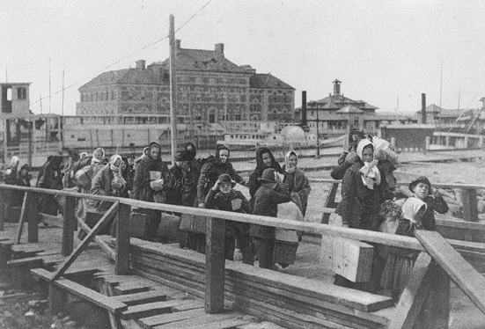
Data Layer Patterns (part 2)
Ellis Island (Immigrant Inspection Station): moves external data to SQL Server (eg, from Health Dept)
Light manipulation.
Dataset not guaranteed entry.
Verify structure matches previous import.
Reduces loose CSVs. (that aren’t secured or audit-able)
Ferry: moves data from SQL Server to REDCap
eg, so recruiters view in REDCap, instead of SQL Server. It’s a lot cheaper/quicker to set up a two-way bound GUI in REDCap than in other databases.
"Ellis island 1902" by Unknown - This image is available from the United States Library of Congress's Prints and Photographs division under the digital ID cph.3a14957. Licensed under Public domain via Wikimedia Commons
Notes:
Here are some more patterns. Datasets from our collaborators must pass an Ellis Island, like immigrants 100 years ago. The pattern does things like verify that the column names are the same, and the primary keys are unique. It transfers information from CSV files into SQL Server, where it’s better secured and managed. For some datasets, there are a few loops of retrieving, manipulating, and saving back into a different downstream SQL Server table. Many times subjects are matched from other datasets in the process.
When that is completed, a smaller set of ‘healthy’ records are ferried into REDCap, for the data collectors to use as a recruiting pool.
These two patterns are far from novel, and commonly called ETL code (extract, transform, and load), and we probably didn’t need to give them flowery distinctions. But the distinction helps to remind us that this involves going from other sovereign nations into SQL Server, and this one involves going from SQL Server into REDCap.

Slide 18
Data Layer Patterns (part 3)
Redactor: Removes PHI from a dataset
Pulls from a gateway or extractor
Necessary before publicly exposing.
Required before copying data to Shiny.
Record Set: “An in-memory representation of tabular data”. (Fowler 2002)
Called a ‘data.frame’ in R.
Not strongly-typed, unfortunately.
Notes:
Datasets need to be redacted before releasing them publically. Even if we’re not releasing the dataset itself, we use redactors before sending datasets to an interactive webpage (that I’ll discuss later) in case the user drills down enough to potentially reveal subject identities.

Slide 19
Domain and Presentation Layer Patterns
Presentation (eg, reports)
Domain Logic (eg summary & stat analysis)
Data (eg, communication w/ REDCap and DBs)
Report Patterns (Presentation Layer)
Thin layer on top of a ‘Code Behind’ file.
LaTeX→PDF or Markdown→HTML.
Only presents info, and doesn’t manipulate or calculate.
3 Classes:
Quick & dirty for internal use within our research team
Polished for external use (eg, policy makers)
Interactive in a browser
Analysis & Code Behind Patterns (Domain Layer)
R file that analyzes data
Located in the domain logic layer
Common Report Components: Contains code and graph templates that are used by multiple reports. The results are typically more consistent, and higher quality.
Notes:
Even though the Domain Layer is my favorite, I’m going to skim it and the Presentation Layer because the distinctions are probably the least interesting and useful for this crowd. I want to stress that they’re both like pampered celebrities. Most of the mucky reality needs to be tidied in the Data Layer, before they can do their thing.
The Domain Layer is almost entirely R files, and it runs stat models, and creates tables and graphs. The Presentation Layer takes those results and mixes words with them to construct a unified report.

Slide 20
knitr
Executes R code, and presents results, tables, & graphs in a coherent document.
Eliminates the need to repeatedly copy & paste:
Multiple descriptives, graphs, and model results.
Updated results after more data trickles in.
Can produce markdown reports that can be quickly produced internal audiences.
Can produce LaTeX reports that can be beautifully crafted for external audiences.
Notes:
knitr is the library we use for reporting, and it’s tough to overstate its importance, or overstate the huge gap it has over all the other reporting tools available. It can do quick and dirty reports that resemble Mathematica or IPython notebooks. Or it can tap into the full power of LaTeX and produce professional quality typesetting.

Slide 21
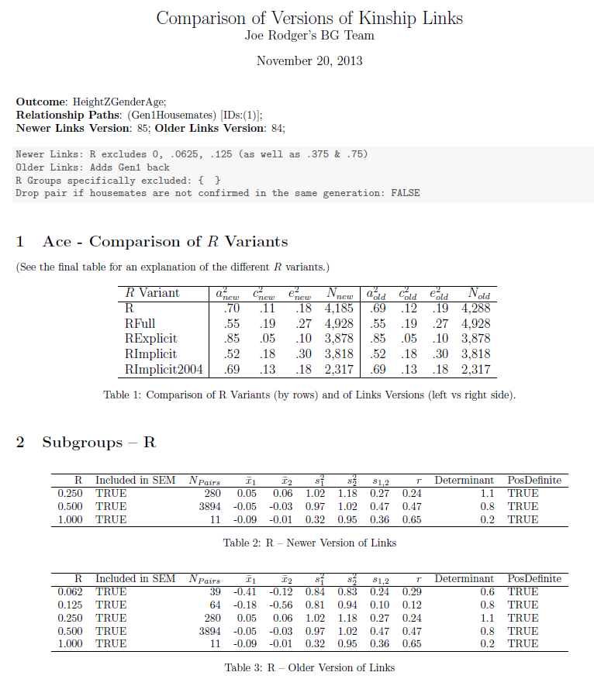
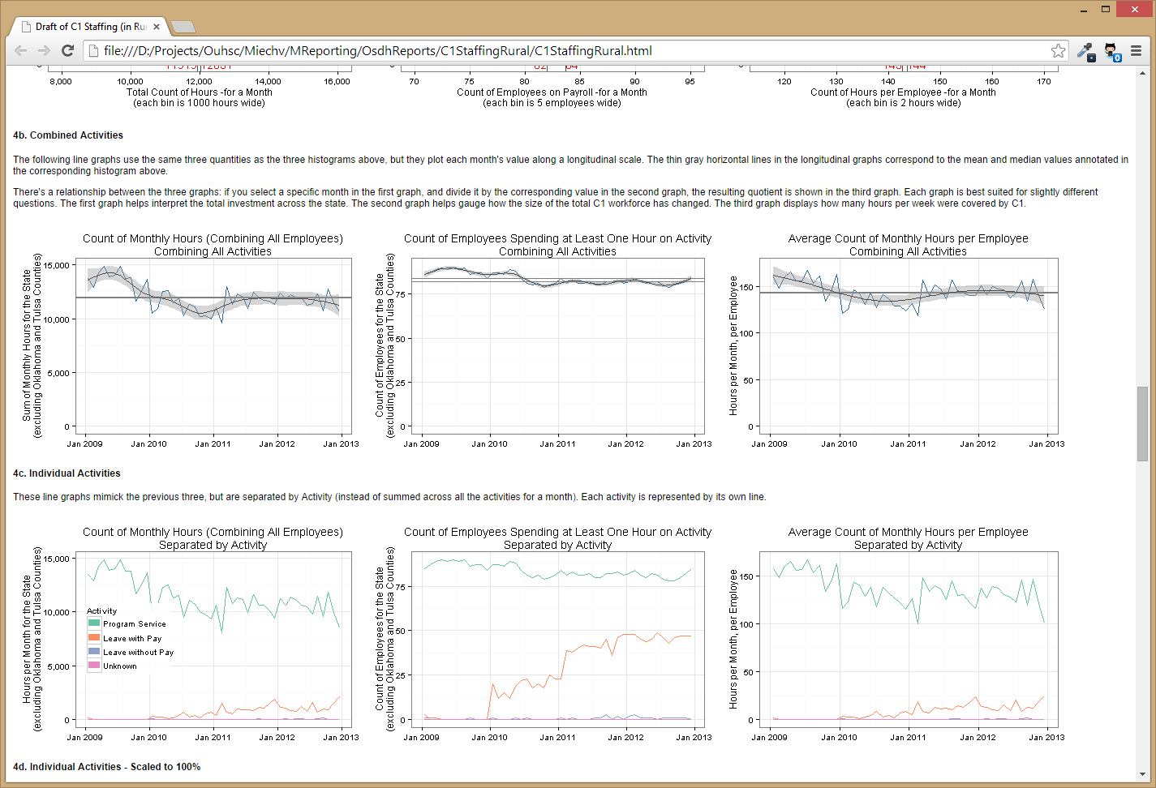
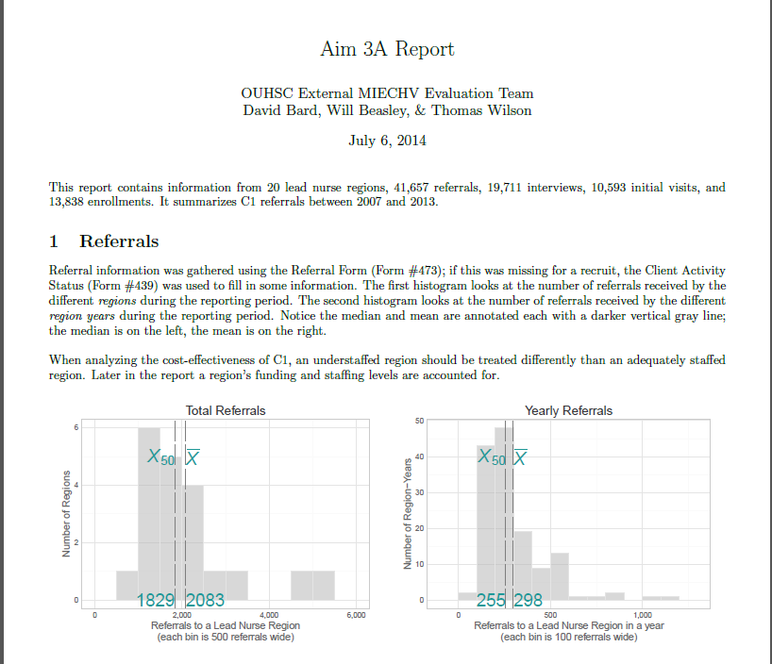
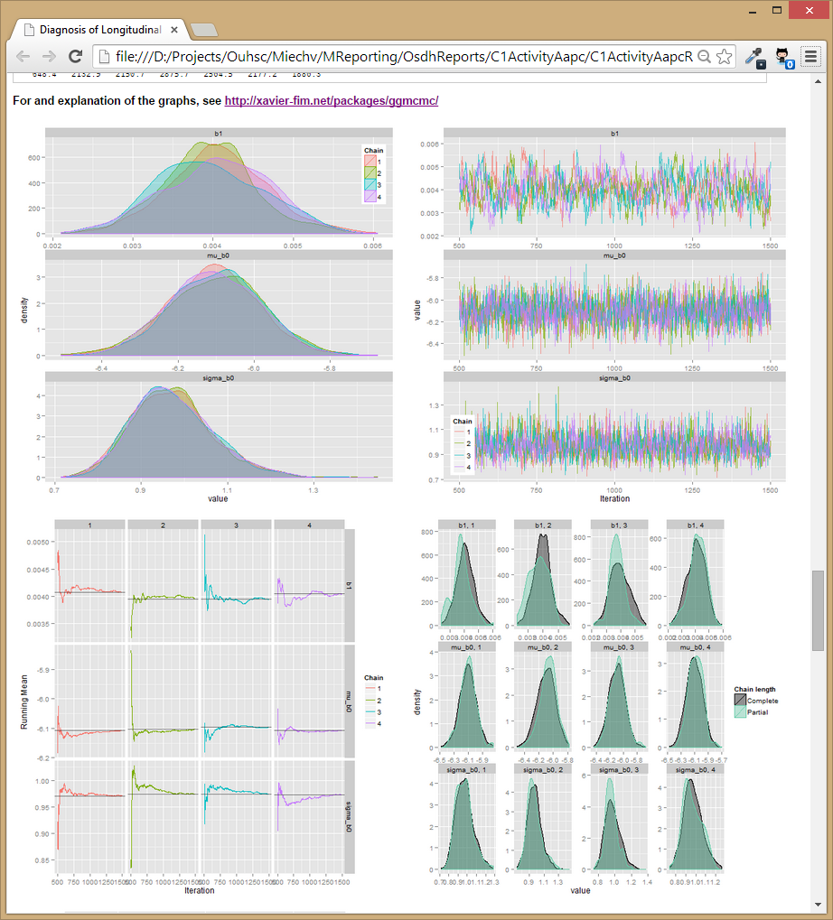
knitr Examples
Notes:
To demonstrate, the two on the left are externally-facing paper reports, where we wanted to invest in slick & self-explanatory reports for outsiders. The bottom right is a quick & dirty report. We wanted to provide ourselves with lots of info, and we weren’t concerned about providing context. The top left is from a report to a stakeholder, and is a hybrid of polished and quick&dirty.
If you look at the bottom left, not only can the graphs update automatically with fresh data, but so can the text,

Slide 22
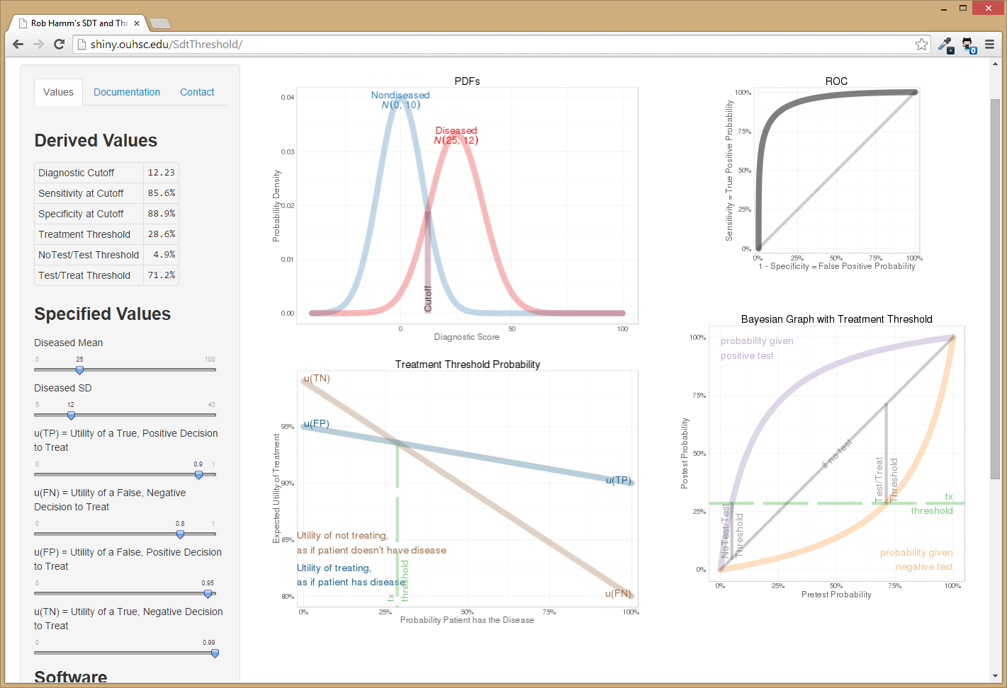
Shiny
Web framework for interactive graphs, stats & tables. eg, shiny.ouhsc.edu/SdtThreshold/
Currently our server is configured only for public information, not PHI data.
Consequently, it can’t pull data from REDCap, but csv data can be pushed to it.
Notes:
Shiny is a web framework, developed by RStudio (the same small group of guys who support knitr). Our server was finally established this week, and here’s a toy example we created in a few days that’s a glimpse of one way we want to use it.
The user can manipulate input values in this left panel, and see how the expected probabilities and treatment recommendations change.

Slide 23
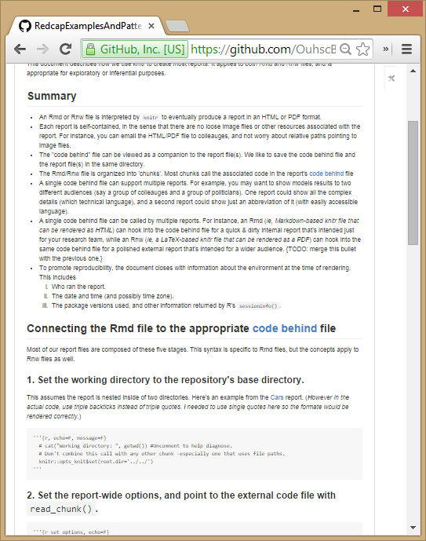
Domain and Presentation Layer Patterns
Patterns are described & demonstrated (or soon will be) github.com/OuhscBbmc/ RedcapExamplesAndPatterns
<!-- Specify the report's official name, goal & description. -->
# REDCap Demo
**Report Goal**: Results of Demo Psychopathic Tendencies Survey
**Report Description**: Results of this survey are not real. This was only a demo.
```{r, echo=FALSE, message=F}
#Set the chunks' working directory to the repository's base directory; this assumes the report is nested inside of two directories.
opts_knit$set(root.dir='../../') #Don't combine this call with any other chunk -especially one that uses file paths.
```
<!-- Point knitr to the underlying code file so it knows where to look for the chunks. -->
```{r, echo=FALSE, message=FALSE}
options(width=180)
opts_chunk$set(comment="", warning=FALSE, echo=TRUE, tidy=FALSE, size="small")
library(xtable)
pathSourceCode <- "./Demo/PsychopathDemo/DemoSurvey.R"
#This allows knitr to call chunks tagged in the underlying PrototypeCode.R file.
read_chunk(pathSourceCode)
```
<!-- Load the packages. Suppress the output when loading packages. -->
```{r LoadPackages, echo=FALSE, message=FALSE}
```
Notes:
For two years we’ve been building examples and prototypes of these patterns. Initially this repository was intended just for us, as we were planning and iterating, and reading what you guys were doing. Recently we’ve tried to make it more accessible and self-explanatory with more text explaining the examples.

Slide 24
Spectrum of Complexity
→ Complex & Powerful: require for stable and critical applications
← Simple & Unstructured:
Good for isolated needs
three examples
Manual Export
The Patterns We Described Today
CHOP’s
Django
Approach
https://github.com/ OuhscBbmc/ RedcapExamplesAndPatterns
https://github.com/ cbmi/ django-redcap
Notes:
I like thinking about where a software solution falls on the spectrum of complexity. For instance, (a) a manual export is super-simple and appropriate for isolated needs, (b) something like CHOP’s Django approach is potentially much heavier and more stable, and appropriate connecting REDCap to something heavy, such as an EMR. While (c) most API/DET solutions fall in between those two boundaries. We have 8 or 10 new REDCap projects a year that don’t have the time/money to justify a full ORM, but want to be informed by the new data being entered.
CUT/DONTREAD:
Even though most of our needs fall here, but I’m not advocating that this approach should always be taken. For instance, if you’re importing into an EMR, you’ll want to be as far right as feasible.
The first presentation describes the approach we use to integrate REDCap into a larger system, such as databases and reports. Programmatic connections can provide several advantages over ad-hoc connections (such as manually exporting and importing csv or xml files). But there is some upfront cost to establishing automation, and I'll discuss which scenarios that we think are worth the investment.

Slide 25
This Approach might Work Well If…
Consumers are researchers & program evaluators
not IT/developers
Focused on dynamic reports
Focused on research & analysis, more than manipulation & transport
Desire separation plumbing vs analysis code
Using a REDCap project for 2+ reports/analyses
Need API for authorization & auditing
Need API for long-term stability
Facilitating reproducible research
Notes:
Today’s collections of patterns are well suited if you’re dealing with research & analysis. Or if you want to provide your researchers with templates that encourage good practices.

Slide 26
This Approach might NOT Work Well If…
Connecting frequently with an EMR
Need transactions when persisting data
Trying to reduce the load on your webserver
Need a strongly-typed dataset for OO
Notes:
But I strongly advise going right on that spectrum if your goal (a) is strictly plumbing, or (b) requires transactions & rollbacks. Also, trafficking large datasets through the API can really stress your webserver.

Slide 27
GitHub: Version Control Software
Think MS Word’s ‘Track Changes’ feature, but
Retains the entire history of each document.
Allows parallel development between people.
Synchronizes changes among different contributors.
A central repository exists on the server.
Each developer maintains her own local repository.
You can establish your first repository and learn the essentials within two hours.
Notes:
GitHub is another foundational piece in our practices. It allows all of us to share updated code without managing a bunch of loose files. Which is related to the last pattern.

Slide 28
Token Storage Pattern (part 1)
Wish List:
Code is portable across computers.
Code is entirely contained in Git repository.
Git repository contains no PHI, passwords, or tokens.
Local machine contains no PHI, passwords, or tokens.
Tokens are stored, so user doesn’t have to retype 9A81268476645C4E5F03428B8AC3AA7B every operation.
Two feasible options:
Encrypt and store on local machine (like ssh-agent), so violates #4.
Use LDAP credentials calling SQL Server. Requires ODBC DSN on local computer, so violates #2.
Notes:
Five security constraints when storing and retrieve tokens.

Slide 29
Token Storage Pattern (part 2)
We feel option B is the best for OU’s LDAP infrastructure:
LDAP credentials passed to SQL Server through an ODBC DSN on local computer.
User needs to maintain only a Windows/LDAP password.
Password is required only once at OS login.
That single password is managed securely by the OS, and transmitted across the wire, where the SQL Server database then uses it.
Unauthenticated users can’t even get into the database, much less retrieve an unauthorized token.
Git repository contains no passwords, tokens, or database server names.
REDCap user audit logs are more valid (b/c difficult to spoof user).
→ We host a small database dedicated to serving tokens.

Slide 30
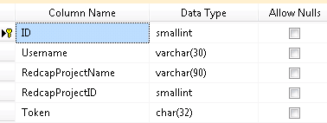
Token Storage Pattern (part 3)
Table:
Stored Procedure: system_user returns LDAP username (eg, ‘OUHSC/krichards’)
R Code: references the DSN TokenSecurity and requests user’s token for Project2 REDCap project.
SELECT Token FROM [RedcapPrivate].tblToken
WHERE Username = system_user AND RedcapProjectName = @RedcapProjectName
token <- retrieve_token(dsn="TokenSecurity", project="Project2")

Slide 31
Token Storage Pattern (part 4)
Safeguards & Concerns:
Admins for SQL Server are the same for REDCap server, so the threat envelope isn’t larger.
Table’s accessibility is tighter than the stored procedure’s
SQL Server works most naturally on our campus, but any database should work if it supports LDAP and something like DSNs.
Future plans:
User inserts their own token through REDCapR.
REDCapR::set_token(dsn="TokenSecurity", project="Project2", token=prompt_input("Enter Token:")
)

Slide 32
Other Storage Practices (part 5)
Use pattern for any content too sensitive for repo.
Works best for meta-data, not subject-data.
eg, URL of REDCap Server.
eg, File path of CSV on file server containing PHI.
Possible to redirect different users to different values.
If 5 users have API access to a single REDCap project, the database table will have 5 rows, each with a unique token.

Slide 33
Goals
Continuous Quality Improvement (CQI).
Evaluated programs need fresh & frequent feedback.
Collaborative Development.
Reproducible research.
Facilitates scientific replication.
Disseminates techniques to other subfields.
Promotes cumulative research.
Notes:
In many scenarios we face, REDCap and R have big advantages over competitors. But many of the traditional software patterns don’t exactly apply here. REDCap’s different than traditional databases and R’s different than enterprise-like programming languages. Hopefully this architecture exploits the strengths of each, and provides as a starting point to help develop your CQI faster.

Slide 34
Important OU Personnel
Cliff Mack, Tony Miller, Pravina Kota
REDCap, VM, & database support
Randy Moore & April Lee
security specialists
Donna Wells
everything specialist
Julie Stoner; Zsolt Nagykaldi
Director of CTS Biostat/Epi core; EHR expert
David Horton; Becki Trepagnier
Assoc VP, Shared Services; Assoc VP, IT
Robert Roswell; Darrin Akins
Sr. Assoc Dean, College of Medicine; Assoc Dean, Research
Notes:
Many people on campus were necessary to make this possible

Slide 35
Thanks to Funders
HRSA/ACF D89MC23154
OUHSC CCAN Independent Evaluation of the State of Oklahoma Competitive Maternal, Infant, and Early Childhood Home Visiting (MIECHV) Project.
Evaluates MIECHV expansion and enhancement of Evidence-based Home Visitation programs in four Oklahoma counties.
Notes:
…especially our federal funders.

Slide 37
Possible REDCap Workflows

Slide 38
Security Patterns & Practices
Could spend 4 hours discussing security details.
Consult REDCap IT staff and/or our team.
Use a private GitHub repository. (free for academics)
Be careful with REDCap tokens. (ie, passwords)
Get PHI into REDCap & SQL as early as possible.
We regularly receive CSVs & XLSXs from partners.
DB files aren’t accidentally copied or emailed.
And try to store derivative datasets in REDCap & SQL instead of on the file server.

Slide 39
Underlying Security Concepts Part 1
Principle of least privilege: expose as little as possible.
Limit the number of team members.
Limit the amount of data (consider rows & columns).
Obfuscate values and remove unnecessary PHI in derivative datasets.
Redundant layers of protection.
A single point of failure shouldn’t be enough to breach PHI security.

Slide 40
Underlying Security Concepts Part 2
Simplify when possible.
Store data in only two houses. (REDCap & SQL Server)
Easier to identify & manage than a bunch of PHI CSVs scattered across a dozen folders, with versions.
Manipulate your data programmatically, not manually.
Windows AD account controls everything, indirectly or directly. (VPN, Odyssey, file server, SQL Server, & REDCap)
Lock out team members where possible. It’s not that you don’t trust them with a lot of unnecessary data, it’s that you don’t trust their ex-boyfriend and their coffee shop hacker.

Slide 41
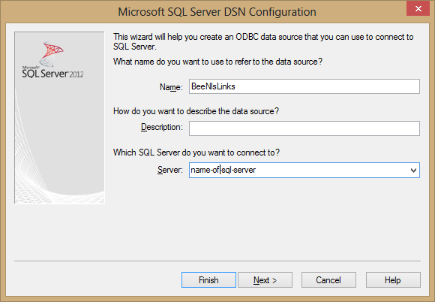
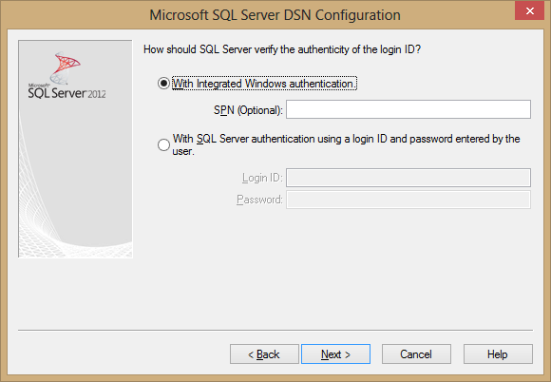
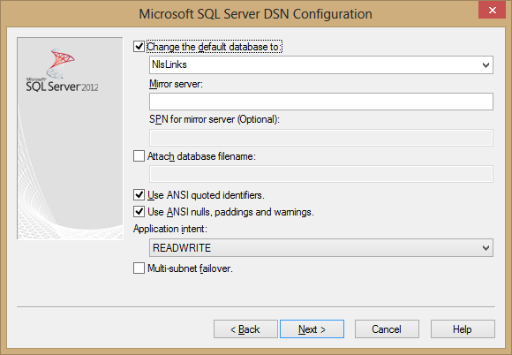
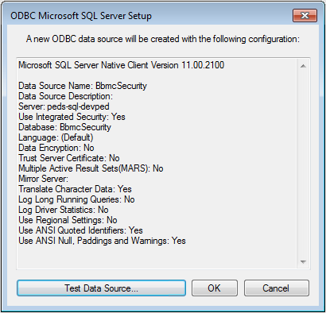
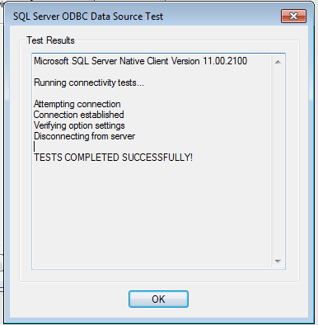
Establish DSN
Download most recent driver
Set server name
Set to “Integrated Security”
Set database name
Verify connection
-No passwords-

Slide 42
Focus
Ideally code is encapsulated and fully reusable (ie, a library in Python/R/C#).
Some code will have to be rewritten every time, and I’d like to describe the patterns that have worked for us, and listen to what’s worked for you.

