Slide 1
REDCap Needs Assessment

Slide 2
BBMC REDCap Use Statistics
188 Production Projects
132 Research
5 Basic or Bench Research
42 Clinical Research Study or Trial
6 Translational Research
71 Behavioral or Psychosocial Research Studies
4 Repository
8 Other
27 Operational Support
18 Quality Improvement
10 Other

Slide 3
BBMC REDCap Use Statistics
Users
266 Active Users
2,398,142 Total Logged Events
6,658 in the past 7 days
48,015 in the past 30 days

Slide 4
REDCap Training Statistics
Training 2015
12 Sessions
78 Individuals Trained
19 Hours of Training
Training Sessions 2016 (2016-01-01 to 2016-03-03)
2 Sessions
30 Individuals Trained
2.5 Hours of Training

Slide 5
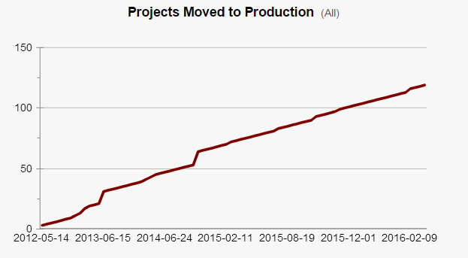
BBMC REDCap Use Statistics

Slide 6
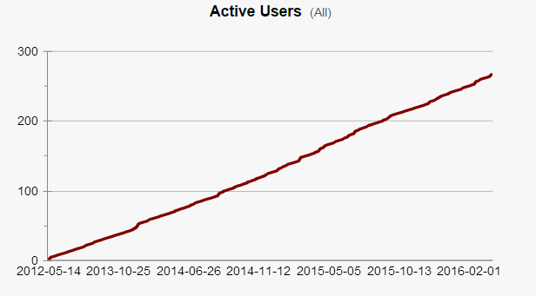
BBMC REDCap Use Statistics

Slide 7
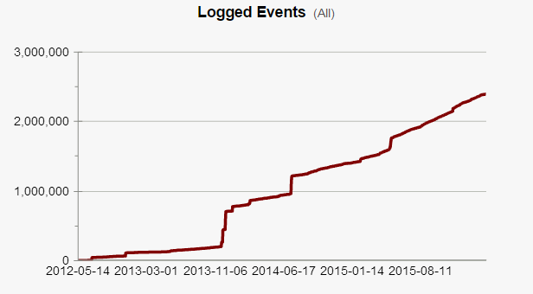
BBMC REDCap Use Statistics

Slide 8
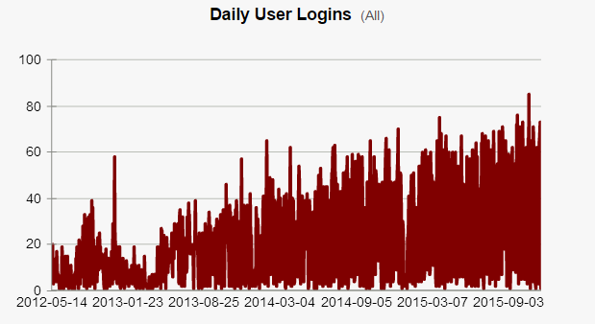
BBMC REDCap Use Statistics

Slide 9
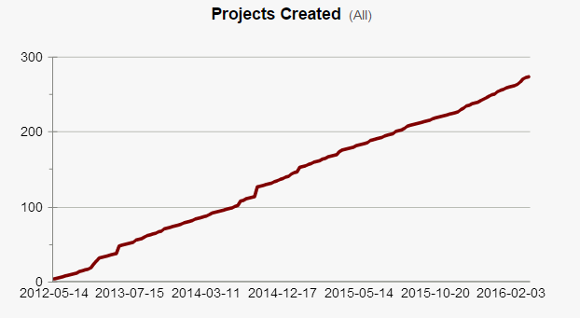
BBMC REDCap Use Statistics

Slide 10
Enterprise REDCap Use Statistics
47 Production Projects
29 Research
32 Operational Support

Slide 11
Enterprise REDCap Use Statistics
Users
108 Active Users
58,527 Total Logged Events
3,645 in the past 7 days
13,159 in the past 30 days

Slide 12
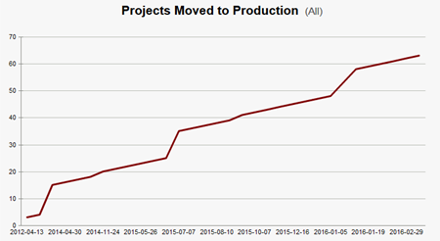
Enterprise REDCap Use Statistics

Slide 13
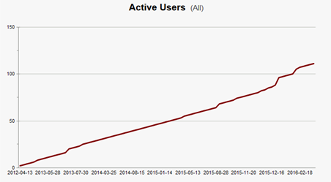
Enterprise REDCap Use Statistics

Slide 14
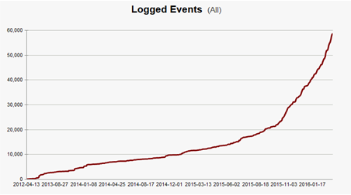
Enterprise REDCap Use Statistics

Slide 15
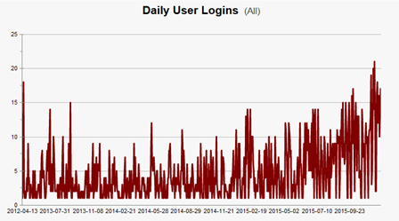
Enterprise REDCap Use Statistics

Slide 16
BBMC REDCap Use Statistics
New Support Needs
Hooks and Plugins: PHP scripts utilized by REDCap, that are placed on the REDCap web server so they can be utilized by REDCap
Hook: a PHP function with a designated name, in which the hook gets executed in a predetermined location inside REDCap
Plugin: a custom PHP script or collection of PHP scripts that exist independently of, but work in conjunction with, the REDCap base code
Responsibility for Hooks and Plugs is solely on the host institution (OUHSC) and Vanderbilt provides no official support for these capabilities.

Slide 17
Things to add
Plug-in development protocol
Broadcast marketing
Current FTE support (by category)
Weekly webinar or offices hours
Website updates, training videos & Ed Tech-like talks
Thomas Wilson’s Twitter account
Urology, bottleneck & transition
Service and maintenance contract
InCommon federation for off-site access
???Encryption policy for off-site access???
Table-based alternative (would need more FTE to implement this)

