Slide 1



REDCap Governance Meeting
April 26, 2016

Slide 2
Review of Past Governance Meetings
July 30, 2013
Introduction to REDCap
Finalize Membership Body
Laid out need for Appropriate Use Policy
November 12, 2013
Finalized Appropriate Use Policy documents
Finalized auditing plan
Introduce ideas for training series
Review plans for administration and maintenance of 3 RC instances
Update on REDCap website and project tracker
April 6, 2015
Revision of new support contract
Sustaining REDCap growth
New clinical data warehouse project

Slide 3
Today’s Agenda
Quick review infrastructure and management
Update on the HSC Clinical Data Warehouse
REDCapCon 2015 review
2015-16 REDCap training schedule and use statistics
Quick review of the current support contract
New business
Sustaining REDCap
Protocols for development and use of Plug-ins and Hooks
Offsite access capabilities
Opening REDCap to wider community of users

Slide 4
Infrastructure and Management
Three REDCap instances:
Development Box- testing and development instance jointly managed by BBMC & BERD
Enterprise Box- a production instance managed by the OSCTR BERD Core and available to all
BBMC Box- production instance managed by BBMC and primarily used by Peds colleagues
Enterprise and Dev Boxes funded through OSCTR funds; BBMC box funded through Peds grant and contracts monies
BBMC and BERD management teams collaborate and coordinate on high level issues (e.g., upgrading reqs) but production boxes operate somewhat independently

Slide 5
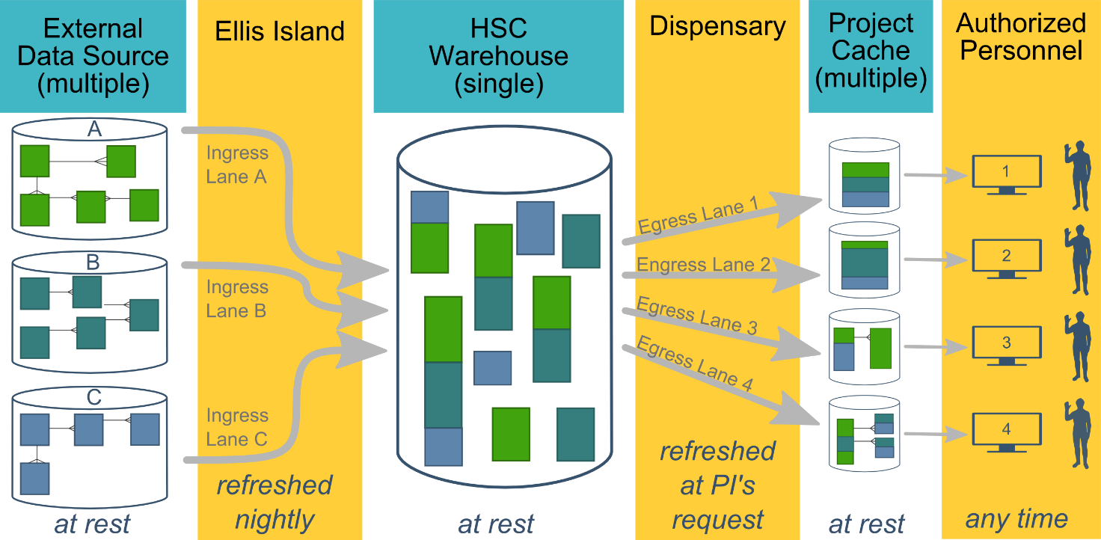
The Prairie Outpost A CDW Ecosystem

Slide 6
Prairie Outpost Progress Report
Fully staffed
Project leads: Beasley, Bard, Nagykaldi
Database Admin: Sreeharsha Mandem
Investigator liaison: Zabrina Antry
Security reviews complete
Software infrastructure complete
Centricity data feeds now accessible
Three pilot projects underway
epidemiology of obesity among adolescents
Cost-effectiveness of Dx genetics testing protocols
ADHD Rx management and patient compliance
Meditech feeds?

Slide 7
REDCapCon 2015 in Portland, OR
Three OUHSC attendees last year
(Wilson, Kota, & Beasley)
New Features Since Version 6.0, Real Experiences (Wilson moderated)
REDCap Systems Integration (Beasley moderated)
OUHSC placed 2nd in natl training website competition
New Offline REDCap technology maturing
Launch national repository for training material
Committee Memberships
(Wilson on Training Committee; Beasley on Development Committee)

Slide 8
REDCap Training Statistics
Training 2015
12 Sessions
78 Individuals Trained
19 Hours of Training
Training Sessions 2016 (2016-01-01 to 2016-04-22)
4 Sessions
32 Individuals Trained
5 Hours of Training

Slide 9
BBMC REDCap Use Statistics
106 Production, 99 Development, 1 Inactive, 1 Archived Projects
144 Research
7 Basic or Bench Research
42 Clinical Research Study or Trial
6 Translational Research
81 Behavioral or Psychosocial Research Studies
4 Repository
8 Other
29 Operational Support
19 Quality Improvement
14 Other

Slide 10
BBMC REDCap Use Statistics
Users
300 Active Users
2,592,243 Total Logged Events
11,031 in the past 7 days
65,671 in the past 30 days

Slide 11
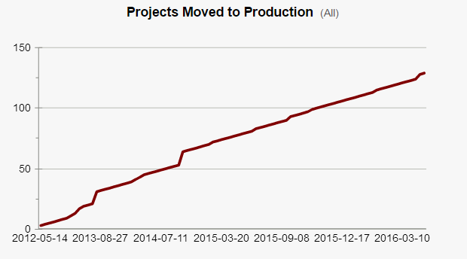
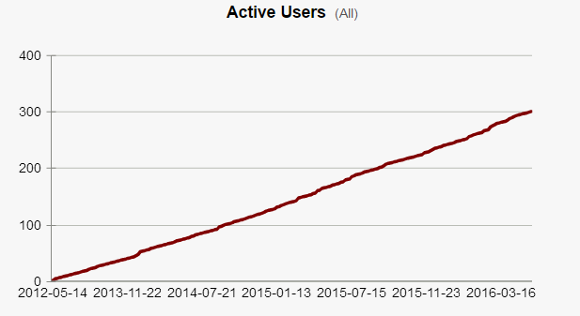
BBMC REDCap Use Statistics

Slide 12
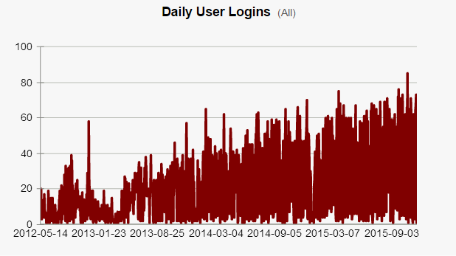
BBMC REDCap Use Statistics

Slide 13
Enterprise REDCap Use Statistics
47 Production Projects
29 Research
32 Operational Support
Users
108 Active Users
58,527 Total Logged Events
3,645 in the past 7 days
13,159 in the past 30 days

Slide 14
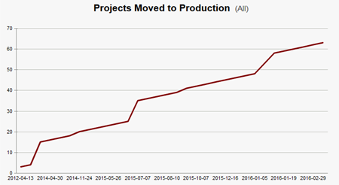
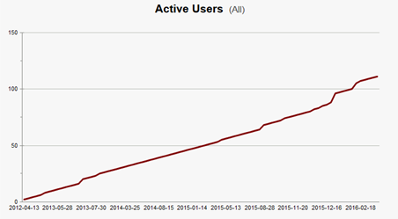
Enterprise
REDCap Use Statistics

Slide 15
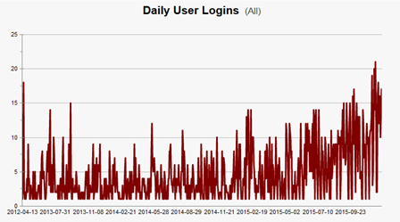
Enterprise
REDCap Use Statistics

Slide 16
Finalized Support Contract Highlights
REDCap team (BBMC & BERD) manages application operation and access
IT Service Desk troubleshoots HSC account issues
Daily backups performed using VM snapshots (15-day retention)
REDCap team monthly update/patching process for application
IT manages updates to the application stack
Monthly OS patches, patches/updates/upgrades to PHP & MySQL, routine vulnerability scans
Backup &recovery tested annually by IT and REDCap teams

Slide 17
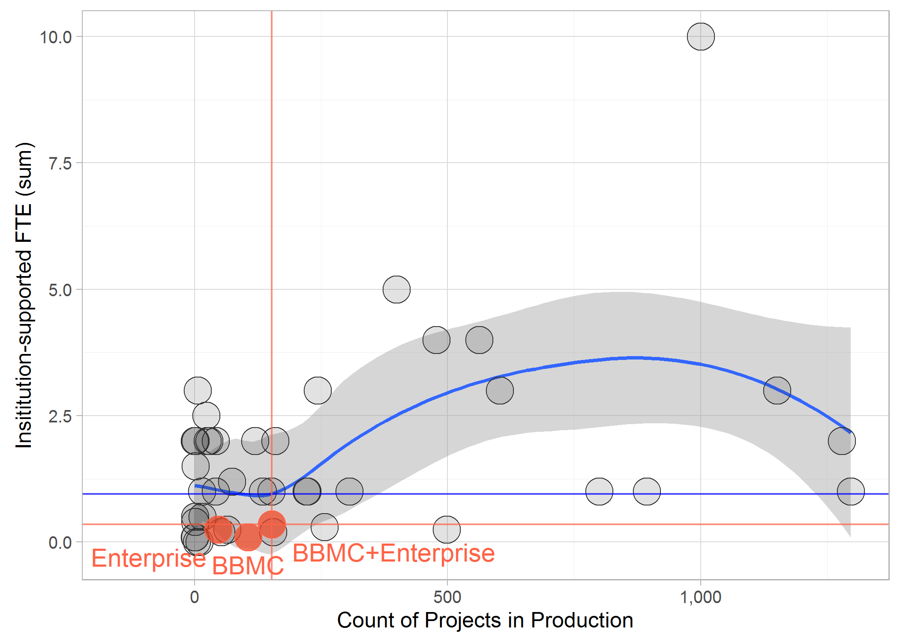
REDCap Support Across Institutions

Slide 18
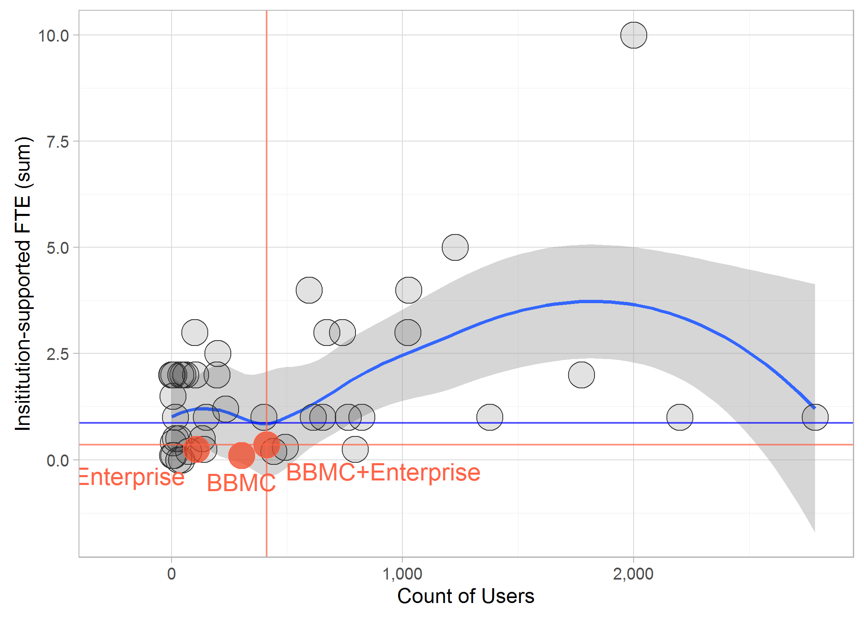
REDCap Support Across Institutions

Slide 19
Support Contract Changes:
Change “Enterprise (operated by College of Public Health)” with “Enterprise (operated by OSCTR BERD)”
Include costs: BBMC owes $273.32/month ($3279.84/year); BERD owes $546.63/month ($6559.56/year)
Specify how frequently software will be updated for regular patches (and specify that critical patches will be updated immediately).
Window OS (webserver and DB by Campus IT)
IIS webserver (webserver by Campus IT)
MySQL (DB by Campus IT)
MySQL Workbench (DB by Campus IT)
REDCap (webserver and DB by Thomas/Pravina)

Slide 20
Support Contract Changes (Cont.):
Include language that addresses these questions from recent IT security review:
Do you support secure deletion (ex. degaussing / cryptographic wiping) of archived data as determined by the tenant?
Is physical protection against damage from natural causes and disasters as well as deliberate attacks anticipated, designed and countermeasures applied?
Are physical security perimeters (fences, walls, barriers, guards, gates, electronic surveillance, physical authentication mechanisms, reception desks and security patrols) implemented?
Are ingress and egress points such as service areas and other points where unauthorized personnel may enter the premises monitored, controlled and isolated from data storage and process?
Are policies and procedures established and mechanisms implemented to protect network environment perimeter and configured to restrict unauthorized traffic?
Are policies and procedures established and mechanisms implemented to ensure proper security settings enabled with strong encryption for authentication and transmission, replacing vendor default settings? (e.g., encryption keys, passwords, SNMP community strings, etc.)
Are policies and procedures established and mechanisms implemented to protect network environments and detect the presence of unauthorized (rogue) network devices for a timely disconnect from the network?
Is access to systems with shared network infrastructure restricted to authorized personnel in accordance with security policies, procedures and standards. Networks shared with external entities shall have a documented plan detailing the compensating controls used to separate network traffic between organizations?

Slide 21
Proposed FTE Support Changes
Dedicated central IT budget
MySQL back-end support (~5%?)
Networking and other system issues (~10%?)
Supplemental funding (above OSCTR and Peds investments) for front-end support (~50%?)
Troubleshooting calls/office hours
Updates/patches
Website maintenance
Outreach
Training
Committee meetings and activities
Local team meetings
Major project-specific development activities charged to Dept/PI

Slide 22
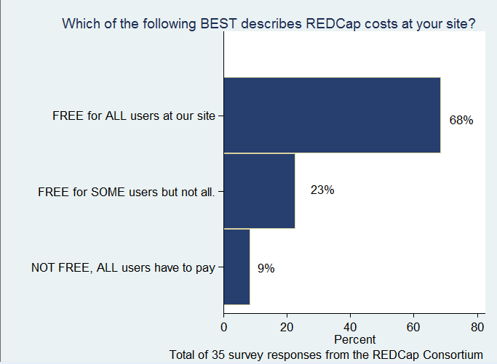
REDCap 2014 Consortium Survey

Slide 23
REDCap 2014 Consortium Survey
 | Funding source(s)
Model | CTSA | Institution | Monthly charge | One-time fee | Percent effort | Other
Free for all users (n=24) | 41% | 67% | 0% | 0% | 8% | 8%
Free for some users (n=8) | 63% | 63% | 25% | 38% | 25% | 13%
Not free (n=3) | 0% | 0% | 100% | 33% | 0% | 0%
There can be multiple funding sources selected for a site.

Slide 24
New Support Needs: Hooks and Plugins
PHP scripts utilized by REDCap, that are placed on the REDCap web server so they can be utilized by REDCap
Hook: a PHP function with a designated name, in which the hook gets executed in a predetermined location inside REDCap
Plugin: a custom PHP script or collection of PHP scripts that exist independently of, but work in conjunction with, the REDCap base code
Responsibility for Hooks and Plugs is solely on the host institution (OUHSC) and Vanderbilt provides no official support for these capabilities.
Test case (enabling REDCap ACASI) under development (Kota, Geller, Beasley, Wilson) for OTRC

Slide 25
Better Off-site Access Capabilities
Demand is growing fast
Recent large requests, e.g., PEM CRC multi-site trial (http://www2.aap.org/sections/pem/PEM-pemcrc.htm)
Resolutions
Status quo (affiliate accounts untenable)
InCommon Federation (https://www.incommon.org/)
Table-based authentication
Encryption policy for off-site access???

Slide 26
Marketing REDCap
Advantages
More efficient project coordination
Enhanced regulatory compliance
Infrastructure capacity for grant proposals
Higher quality research
Marketing outreach
Campus email
Local REDCap research symposium
Routine campus Q&A sessions

Slide 27
Thank you for your time and support!
Please direct correspondence to David-Bard@ouhsc.edu

Slide 28
REDCap 2014 Consortium Survey
 | INCLUDED Services (no charge)
Model | Build forms | Build entire project | Manage entire project | User Training | User Support | Custom program
Free for all users (n=24) | 25% | 21% | 21% | 88% | 100% | 21%
Free for some users (n=8) | 38% | 38% | 25% | 88% | 88% | 25%
Not free (n=3) | 0% | 0% | 0% | 33% | 100% | 0%

Slide 29
REDCap 2014 Consortium Survey
Summary of site information (n=35 responses)
Average persons on REDCap team | 3.05 persons
Average FTE per site | 1.37 FTE
Average number of REDCap users per site | 1,665 users
Average number of REDCap projects per site | 1,414 projects
Monthly rates charged (n=3) | $100, $105, $130
One-time rates charged (n=2) | $300

