Slide 1
REDCap Governance Meeting
April 26, 2016

Slide 2
Review of Past Governance Meetings
July 30, 2013
Introduction to REDCap
Finalize Membership Body
Laid out need for Appropriate Use Policy
November 12, 2013
Finalized Appropriate Use Policy documents
Finalized auditing plan
Introduce ideas for training series
Review plans for administration and maintenance of 3 RC instances
Update on REDCap website and project tracker
2015

Slide 3
Today’s Agenda
Quick review infrastructure and management
Quick review of Appropriate Use Policy
Reasoning behind a new support contract
REDCapCon 2014 review
New business
Sustaining REDCap long-term
Opening REDCap to wider community of users
Unveil blueprints to new OU Clinical Data Warehouse

Slide 4
Infrastructure and Management
Three REDCap instances:
BBMC Box- production instance managed by BBMC and primarily used by Peds colleagues
Enterprise Box- a production instance managed by the OSCTR BERD Core and available to all
Development Box- testing and development instance jointly managed by BBMC & BERD
BBMC box funded through Peds grant and contracts monies; Enterprise and Dev Boxes funded through OSCTR funds
BBMC and BERD management teams collaborate and coordinate on high level issues (e.g., upgrading reqs) but production boxes operate somewhat independently

Slide 5
REDCapCon 2015 in Portland OR
Three OU attendees last year
(Wilson, Kota, & Beasley)
Need titles & awards
New Offline REDCap technology mature
Launch national repository for training material
Committee Memberships (Wilson in Training Committee; Beasley in Development Committee)

Slide 6
REDCap Training Statistics
Training 2015
12 Sessions
78 Individuals Trained
19 Hours of Training
Training Sessions 2016 (2016-01-01 to 2016-04-22)
4 Sessions
32 Individuals Trained
5 Hours of Training

Slide 7
BBMC REDCap Use Statistics
106 Production, 99 Development, 1 Inactive, 1 Archived Projects
144 Research
7 Basic or Bench Research
42 Clinical Research Study or Trial
6 Translational Research
81 Behavioral or Psychosocial Research Studies
4 Repository
8 Other
29 Operational Support
19 Quality Improvement
14 Other

Slide 8
BBMC REDCap Use Statistics
Users
300 Active Users
2,592,243 Total Logged Events
11,031 in the past 7 days
65,671 in the past 30 days

Slide 9
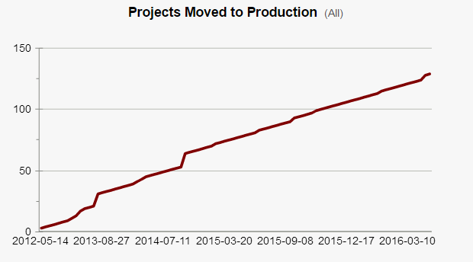
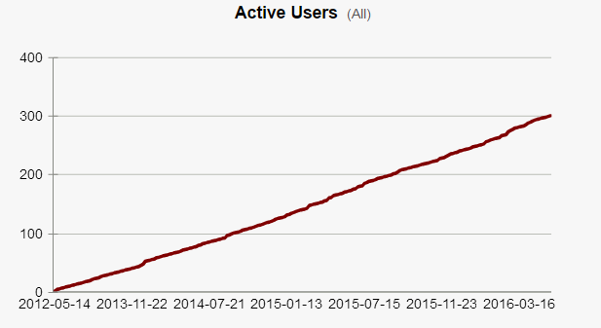
BBMC REDCap Use Statistics

Slide 10
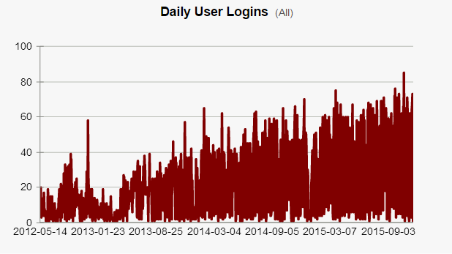
BBMC REDCap Use Statistics

Slide 11
Enterprise REDCap Use Statistics
47 Production Projects
29 Research
32 Operational Support
Users
108 Active Users
58,527 Total Logged Events
3,645 in the past 7 days
13,159 in the past 30 days

Slide 12
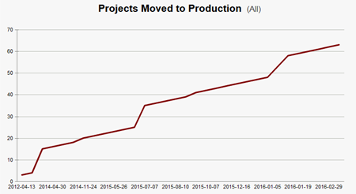
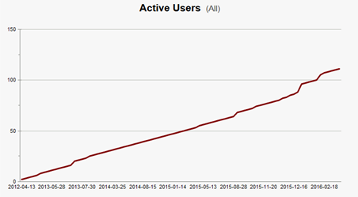
Enterprise
REDCap Use Statistics

Slide 13
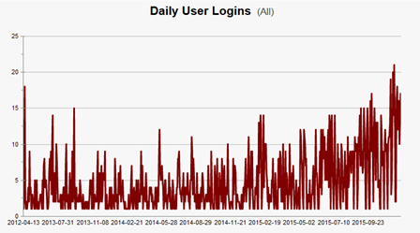
Enterprise
REDCap Use Statistics

Slide 14
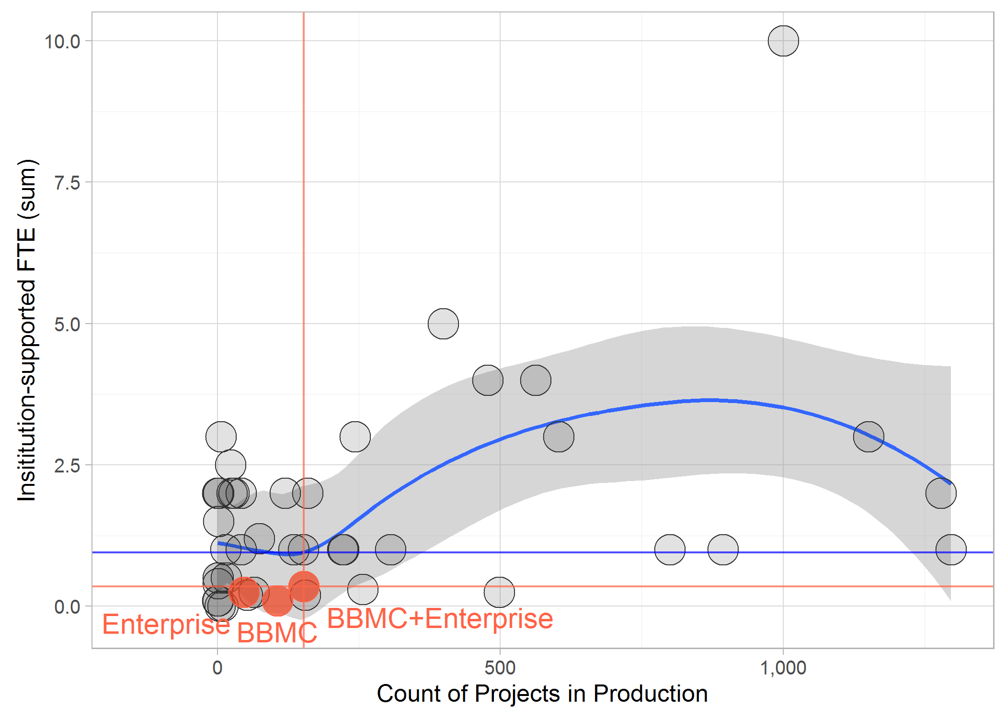
REDCap Support Across Institutions

Slide 15
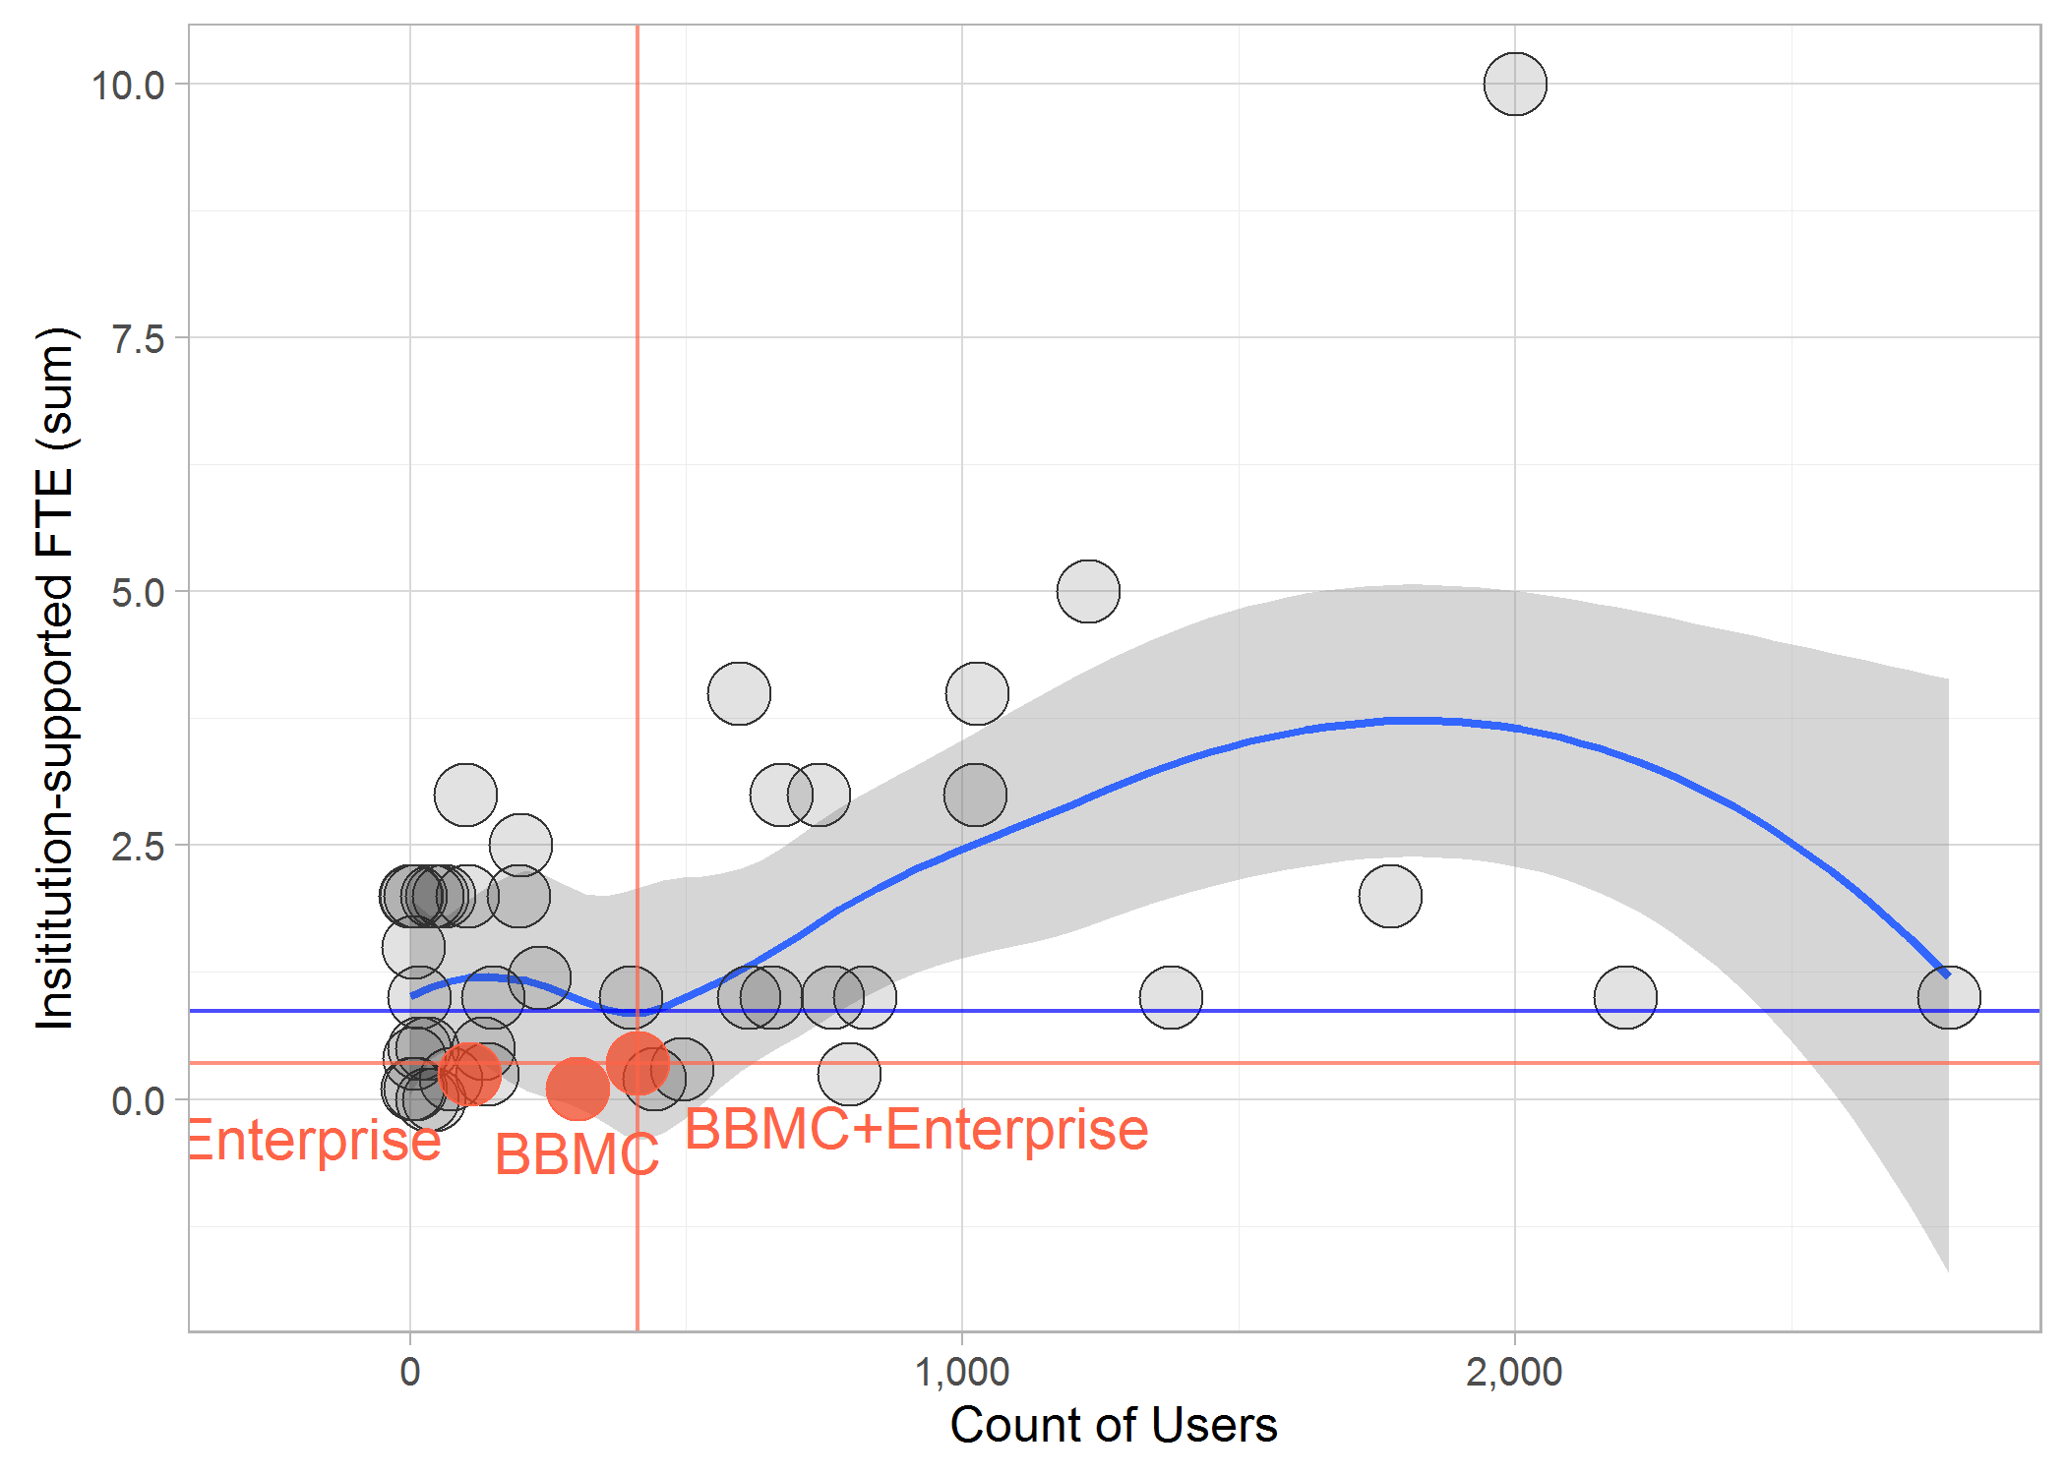
REDCap Support Across Institutions

Slide 16
BBMC REDCap Use Statistics
New Support Needs
Hooks and Plugins: PHP scripts utilized by REDCap, that are placed on the REDCap web server so they can be utilized by REDCap
Hook: a PHP function with a designated name, in which the hook gets executed in a predetermined location inside REDCap
Plugin: a custom PHP script or collection of PHP scripts that exist independently of, but work in conjunction with, the REDCap base code
Responsibility for Hooks and Plugs is solely on the host institution (OUHSC) and Vanderbilt provides no official support for these capabilities.

Slide 17
REDCap 2013 Consortium Survey

Slide 18
REDCap 2013 Consortium Survey

Slide 19
REDCap 2013 Consortium Survey

Slide 20
REDCap 2013 Consortium Survey

Slide 21
REDCap 2013 Consortium Survey

Slide 22
REDCap Con 2013 Number of Full Time Employees Supporting REDCap
Frequency

Slide 23
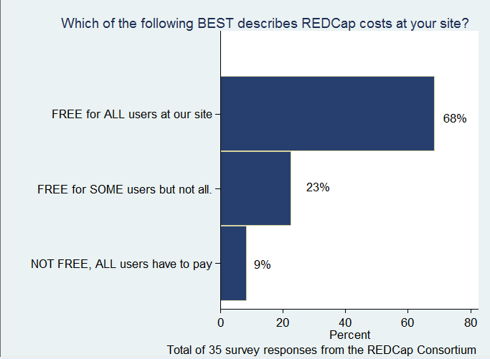
REDCap 2014 Consortium Survey

Slide 24
REDCap 2014 Consortium Survey
 | Funding source(s)
Model | CTSA | Institution | Monthly charge | One-time fee | Percent effort | Other
Free for all users (n=24) | 41% | 67% | 0% | 0% | 8% | 8%
Free for some users (n=8) | 63% | 63% | 25% | 38% | 25% | 13%
Not free (n=3) | 0% | 0% | 100% | 33% | 0% | 0%
There can be multiple funding sources selected for a site.

Slide 25
REDCap 2014 Consortium Survey
 | INCLUDED Services (no charge)
Model | Build forms | Build entire project | Manage entire project | User Training | User Support | Custom program
Free for all users (n=24) | 25% | 21% | 21% | 88% | 100% | 21%
Free for some users (n=8) | 38% | 38% | 25% | 88% | 88% | 25%
Not free (n=3) | 0% | 0% | 0% | 33% | 100% | 0%

Slide 26
REDCap 2014 Consortium Survey
Summary of site information (n=35 responses)
Average persons on REDCap team | 3.05 persons
Average FTE per site | 1.37 FTE
Average number of REDCap users per site | 1,665 users
Average number of REDCap projects per site | 1,414 projects
Monthly rates charged (n=3) | $100, $105, $130
One-time rates charged (n=2) | $300

Slide 27
REDCap Charge per use fee
Alex Peshansky- $4000 per REDCap project and $150/hour if they develop the project or do any extra programming
Susan C Guerrero-$500 for groups who want to build their own project. Large projects or those who don’t want to build it themselves $100/programmers $125 project management. With 10%-15% increase per year
University of Minnesota: Sue Lowry $100/hour to help people setup project or develop
Georgetown: Clinton Finch $70/hour
Andy Martin: No charge for REDCap with 3-4 hours of assistance.

Slide 28
REDCap avoiding HIPAA violations

Slide 29
OUHSC IT FTE request questions
How will the support add up to the 10% and 5% FTE’s? This is an estimate
How often have you had to submit tickets for these types of requests? 4-5 times
Have you been submitting these to ouitservices@service-now.com or to individual contacts at IT? ouitservices@service-now.com

