Slide 1
An Intro to R Packages for SAS Users
Summer Frank, PhD Candidate
Department of Biostatistics & Epidemiology

Slide 2
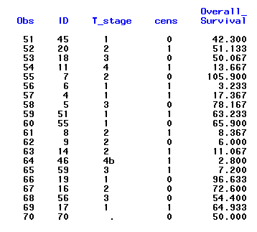
Survival Data

Slide 3
How to Partition Tumor Stage into Two Groups?
Intro to R package called kaps
Partition an ordered prognostic factor
Optimal set of cut-off points
Optimal number of subgroups
R package documentation
Provides code
Includes examples

Slide 4
How to Import SAS Dataset?
R package to import SAS datasets
Imports .sas7bdat files
Allows those more familiar with SAS to perform data manipulation in SAS
Time for R programming
Remainder of talk outlined in R code

