Slide 1
Optimizing Study Management using REDCap, R, and other software tools (2nd time)
Will Beasley, David Bard, Thomas Wilson CCAN, Pediatrics
OUHSC SAS/R User Group
March 18, 2013

Slide 2
Presentation Outline
REDCap overview
Scenarios favoring REDCap
Downloading REDCap datasets manually
Accessing REDCap programmatically
Reporting & analysis
Overall goals
GitHub
Security practices

Slide 3
Collaboration among
The 4 statisticians on the project. sharing software development.
The 20 people on the project. exchanging participant-level data.
The 3 partnering organizations. (OSDH, WIC, OHCA) -receiving their subject-level & agency-level data. -distributing our results –fresh & frequently.
Academics in different areas. (particularly at OUHSC) exchanging tools and workflows.
Researchers in other states pursuing similar goals. publishing ideas and replicating previous work.

Slide 4
REDCap overview (http://project-redcap.org/)
Secure web application for building and managing surveys and databases.
Developed by informatics core at Vanderbilt with support from NCRR and NIH.
Designed for academic biomedical researchers.
Provides:
A centralized, back-end storage component.
Tools to create an interactive front-end html GUI.
An API to import & export data.
Example templates.
Instructional videos for training.
User-group network of institutional researchers.
Also included: built-in project calendar, scheduling module, ad hoc reporting tools, and advanced features, such as branching logic, file uploading, and calculated fields.
It can reduce
Developing a lot of new software applications.
Anxieties related to security of home-grown software.

Slide 5
REDCap Software Features
Availability - Software available at no cost for REDCap partners.
Secure and web-based - Input data or build online survey anywhere in the world over secure web connection with authentication and data logging.
Fast and flexible - Conception to production-level database or survey in less than one day.
Multi-site access - REDCap databases/surveys can be used by researchers from multiple sites and institutions.
Autonomous utilization - Research groups have complete autonomy and control to add new users.
Export data to common data analysis packages - Exports raw data and syntax files for SAS, Stata, R, and SPSS.
Fully customizable - You are in total control of shaping your database or survey.
Advanced features - Mid-study modifications, auto-validation, branching logic, and calculated fields.

Slide 6
REDCap Project Types
https://redcap1.mayo.edu/redcap/index.php?action=training
Traditional Database classic model
Parent-Child Linking linking together multiple databases
Operations use case for non-study/non-trial
Longitudinal Database multi-use forms with time points

Slide 7
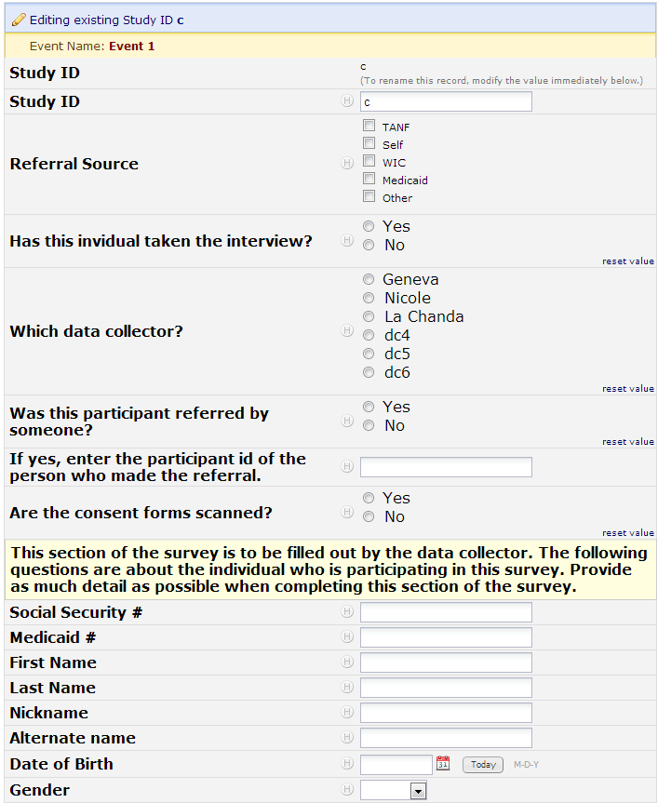
Example data entry

Slide 8
Thomas’ Demonstration for Overview
Go to https://zzzzzzzzz.ouhsc.edu/
Login
Select project “testing123”
Enter some more test data
Create a calendar entry
(Note: the exact address has been changed for security purposes.)

Slide 9
Possible REDCap Workflows

Slide 10
Scenarios favoring REDCap
Project requires a centralized data store, but multiple locations for data entry. - Avoid syncing different locations manually.
You want a flexible, universal framework to create consistent data systems for multiple clinical projects (research and possibly operations). - Reduces your development time & your staff’s training time. - Reduces writing new text for grant proposals and IRB?
Project has a relatively flat data structure.
Typically accommodates 2 or 3 levels well, but is clumsy beyond that. County, Practice, Provider, Patient, Time, Family.

Slide 11
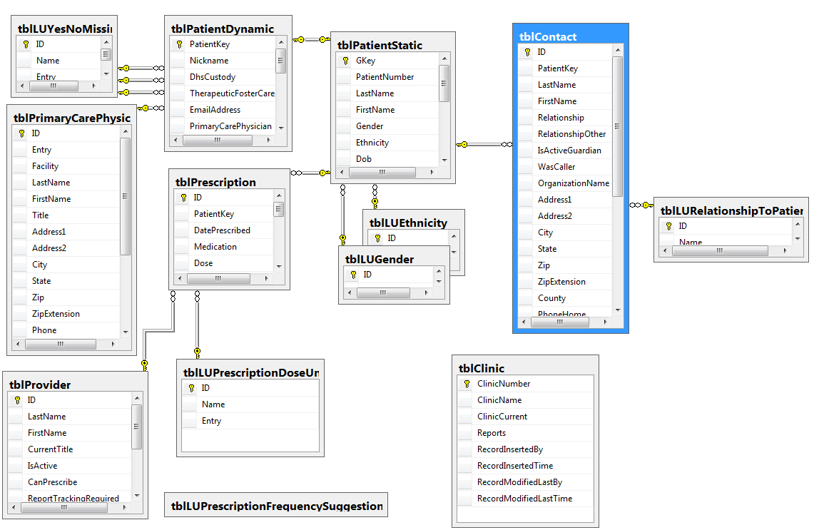
Scenario NOT favoring REDCap

Slide 12
Scenarios favoring REDCap
Manual data entry.
The interface is good for humans.
The I/O performance is very slow for programs.
Not suited for genetics and tissue samples.
Project doesn’t require a publically-exposed interface.
ie, users have access to OUHSC VPN.
Campus IT favors this practice.
ie, each project uses a pool of trained users.
You can program the GUI to prevent most silly mistakes,
But it isn’t completely locked down and idiot-proof.

Slide 13
Scenarios favoring REDCap
No professional software developer on the project
There’s nothing magical about REDCap; it accommodates the designs and needs of many clinical projects.
To develop a comparable system from scratch, you’d need experience with several technologies.
Relational databases (eg, MySQL or SQL Server).
Mildly-interactive web technology (eg, HTML and PHP).
Data transport between the GUI and database.
Security implementations of:
User input.
Data transport.
Data storage.
Authentication & authorization.

Slide 14
Scenarios NOT favoring REDCap
REDCap doesn’t natively support offline data entry. (But it might within the year.)
Doesn’t easily support animations or complex graphical interactions. (It’s not good for perception or cognitive psych.)
It’s difficult to perform automated unit/integration/regression tests. (Validating the branching logic is trial-and-error.)

Slide 15
Scenarios favoring REDCap
There are lots of dimensions and trade-offs when designing clinical research, and REDCap is close to the sweet spot for most designs.
Access, SQL Server, Survey Monkey, Qualtrics, Concerto, E-prime, Excel, EMR.

Slide 16
Feature | REDCap | Qualtrics
Data Dictionary | Y | ?
Data Import | Y | n
Data Export & Summaries | Y | Y
E-mail survey | Only using a survey form, not a data collection form. | Y
Copy other surveys | Y | n
Survey templates | n | Y
Branching logic | Branching logic for individual Qs. | Branching for individual Qs and for groups of Qs.
Audio capabilities | Done via html | ?
Expiration capabilities: (eg, 1 week to respond) | n | Y
Spell check | n | Y
API | Y | n
Free to academic institutions | Y | n?
Offline data capture | Currently, there is not an official REDCap offline data capture component. However, CCAN has created an "in-house" off-line version of REDCap that is currently in use.
Our exposure to Qualtrics is limited. Please don’t interpret this as the authoritative guide.

Slide 17
Downloading REDCap datasets manually
Manually downloading is one of two sanctioned approaches to transport data from REDCap to R/SAS.
It’s easy to do, but it takes some time, and may be cumbersome if reports are run frequently.
It’s good place to start learning.

Slide 18
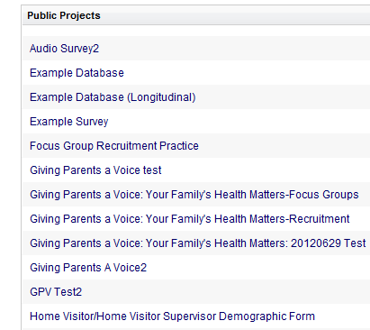


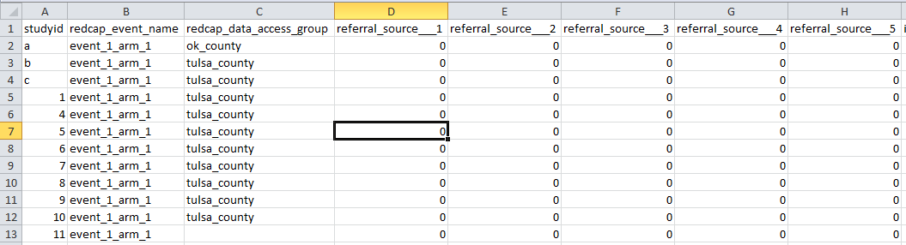
Demo: Steps for Manual Download
Open REDCap in browser.
Select your project.
Click ‘Data Export Tool’.
Click ‘Export all data now’.
Visually inspect downloaded file.
Open RStudio and read the CSV.

Slide 19
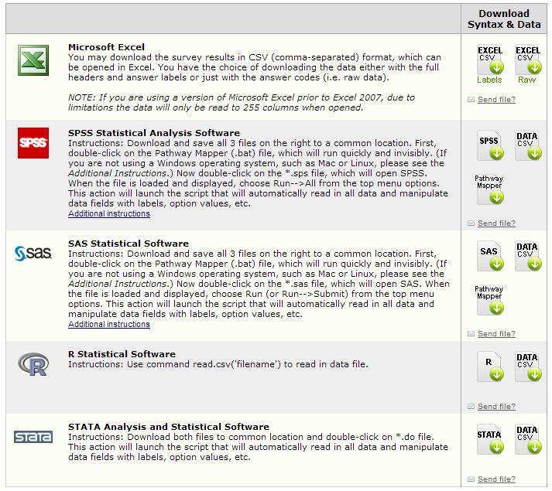
Downloading REDCap datasets manually: Available Export Formats

Slide 20
Example data storage (after exported to a CSV)

Slide 21
Accessing REDCap programmatically
R calls REDCap’s API (application programming interface)
An API allows nonhumans to interact with each other directly.
Requires coding, but saves time if reports are run frequently.
It’s the other sanctioned approach to transport data from REDCap to R/SAS.

Slide 22
Required pieces of information for API
The URL of the REDCap server.
A “token”, which is a hash representing:
A specific REDCap project (within the REDCap server).
A specific user.
The user’s password.

Slide 23
Calling the API
### Load packages
require(RCurl)
### Query REDCap API
rawCsvText <- RCurl::postForm(
uri="https://zzzzzzz.ouhsc.edu/zzzzzzzzz/API/",
token="39ZZZZZZZZZZ377009A4434F3D86E363", #Be careful w/ real tokens.
content='record',
format='csv',
type='flat',
.opts=curlOptions(ssl.verifypeer=FALSE)
)
### Convert raw text into a data.frame
head(rawCsvText) #Inspect the raw data, if desired.
ds <- read.csv(text=rawCsvText, stringsAsFactors=FALSE)
head(ds) #Inspect the new data.frame, if desired.

Slide 24
Demo: Download Data with API
Open ‘DemonstrationApi.R’ in RStudio.
Execute code.
Browse dataset.

Slide 25
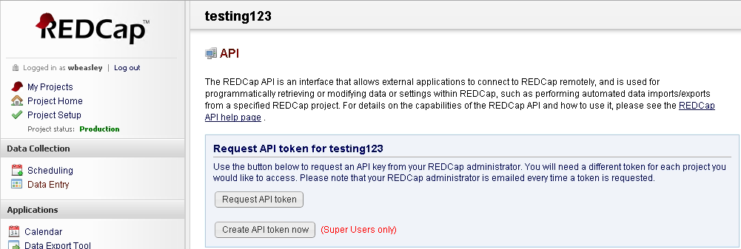
Requesting an API token
Request your token for a specific project.
Then wait for the Admin’s approval.

Slide 26
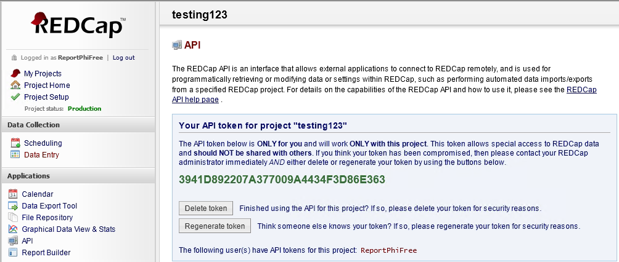
Retrieve a token
Copy the green text into your code.
(This token has been regenerated for security purposes. It won’t work anymore. In a sense, we changed the password.)

Slide 27
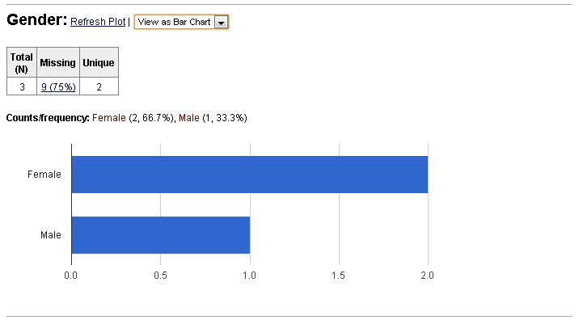
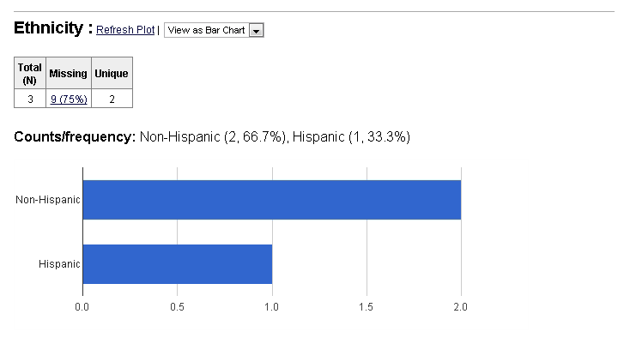
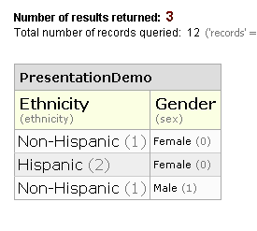
Demo: REDCap ‘Graphical Data View’ and ‘Report Builder’
Integrated into REDCap.
Accommodates basic descriptives & graphs, but not much more.

Slide 28
knitr
Executes R code, and presents results in a coherent document.
Eliminates the need to repeatedly copy & paste:
Multiple descriptives, graphs, and model results.
Updated results after more data trickles in.
Can produce markdown reports that can be quickly produced internal audiences.
Can produce LaTeX reports that can be beautifully crafted for external audiences.

Slide 29
Will’s demonstration of knitr-produced reports
Descriptives & graphs in markdown.
Descriptives & graphs in LaTeX.
Inferential model results in LaTeX.
markdown report on GitHub. https://github.com/OuhscCcanMiechvEvaluation/MReporting/blob/master/OhcaReports/OhcaReport1/OhcaReport1.md

Slide 30
Will’s demonstration of Shiny
Web interface for interactive graphs, stats & tables.
http://glimmer.rstudio.com/wibeasley/Oneway/
Select DV.
Manipulate values.

Slide 31
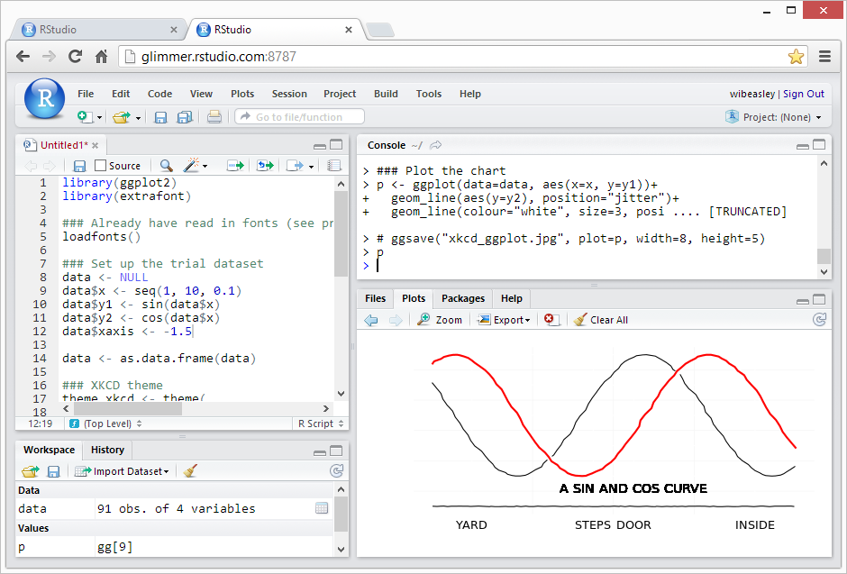
RStudio Server -access R through a browser

Slide 32
Goals
Reproducible research.
Facilitates scientific replication.
Disseminates techniques to other subfields.
Promotes cumulative research.
Literate programming.
Evaluated programs need fresh & frequent feedback.
Collaborative Development.

Slide 33
Collaboration among
The 4 statisticians on the project. sharing software development.
The 20 people on the project. exchanging participant-level data.
The 3 partnering organizations. (OSDH, WIC, OHCA) -receiving their subject-level & agency-level data. -distributing our results –fresh & frequently.
Academics in different areas. (particularly at OUHSC) exchanging tools and workflows.
Researchers in other states pursuing similar goals. publishing ideas and replicating previous work.

Slide 34
GitHub: Version Control Software
Think MS Word’s ‘Track Changes’ feature, but
Retains the entire history of each document.
Allows parallel development among people.
Synchronizes changes among different contributors.
A central repository exists on the server.
Each developer maintains her own local repository.
You can establish your first repository and learn the essentials within two hours.

Slide 35
Thomas’ demonstration for GitHub
Create an issue in the GitHub webpage.
Create a meaningful title & description.
Assign the issue a developer, a milestone, and some labels.
Modify a file in RStudio.
In the GitHub client,
“Commit” the change to the local repository.
“Sync” the change with the central repository.
Verify the change in the GitHub webpage.
“Close” the GitHub issue.

Slide 36
Security
Could spend 4 hours discussing security details.
Consult REDCap IT staff and/or our team.
Pay for a private GitHub repository. ($25/mo)
Be careful with REDCap tokens. (ie, passwords)
Get PHI into REDCap & SQL as early as possible.
We regularly receive CSVs & XLSXs from partners.
DB files aren’t accidentally copied or emailed.
And try to store derivative datasets in REDCap & SQL instead of on the file server.

Slide 37
Underlying Security Concepts Part 1
Principle of least privilege: expose as little as possible.
Limit the number of team members.
Limit the amount of data (consider rows & columns).
Obfuscate values and remove unnecessary PHI in derivative datasets.
Redundant layers of protection.
A single point of failure shouldn’t be enough to breach PHI security.

Slide 38
Underlying Security Concepts Part 2
Simplify when possible.
Store data in only two houses. (REDCap & SQL Server)
Easier to identify & manage than a bunch of PHI CSVs scattered across a dozen folders, with versions.
Manipulate your data programmatically, not manually.
Windows AD account controls everything, indirectly or directly. (VPN, Odyssey, file server, SQL Server, & REDCap)
Lock out team members where possible. It’s not that you don’t trust them with a lot of unnecessary data, it’s that you don’t trust their ex-boyfriend and their coffee shop hacker.

Slide 39
Presentation Outline
REDCap overview
Scenarios favoring REDCap
Downloading REDCap datasets manually
Accessing REDCap programmatically
Reporting & analysis
Overall goals
GitHub
Security practices

