Slide 1
Interactive reports and webpages with R & Shiny
OUHSC Statistical Computing User Group
October 6 2015
Will Beasley

Slide 2
Flow from Databases to Shiny Report

Slide 3
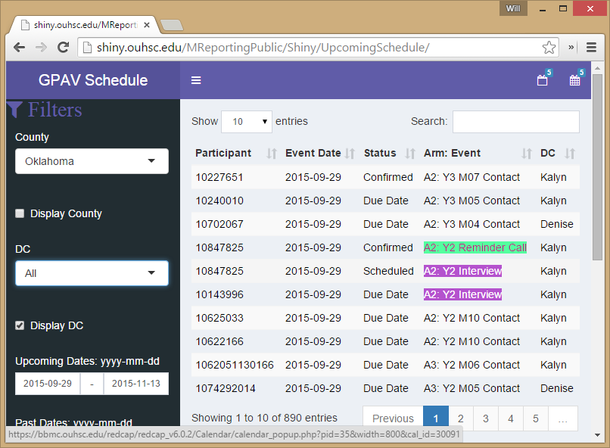
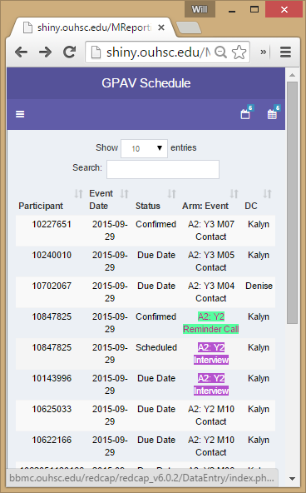
Searchable & Hyperlinked Scheduling App
http://shiny.ouhsc.edu/MReportingPublic/Shiny/UpcomingSchedule/

Slide 4
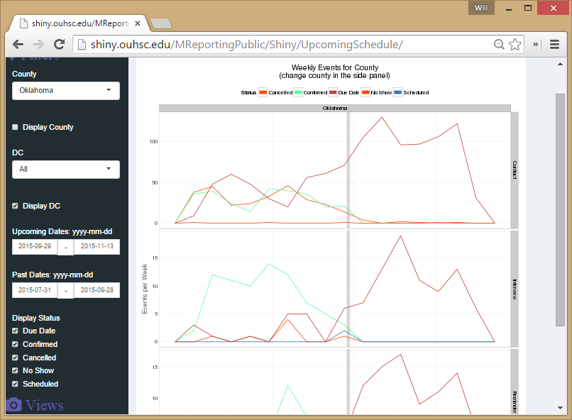
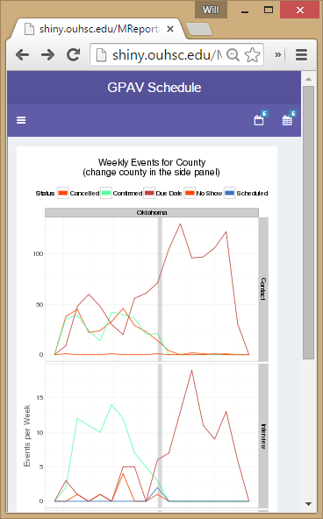
Resize Logic Leverages Bootstrap Library
http://shiny.ouhsc.edu/MReportingPublic/Shiny/UpcomingSchedule/

Slide 5
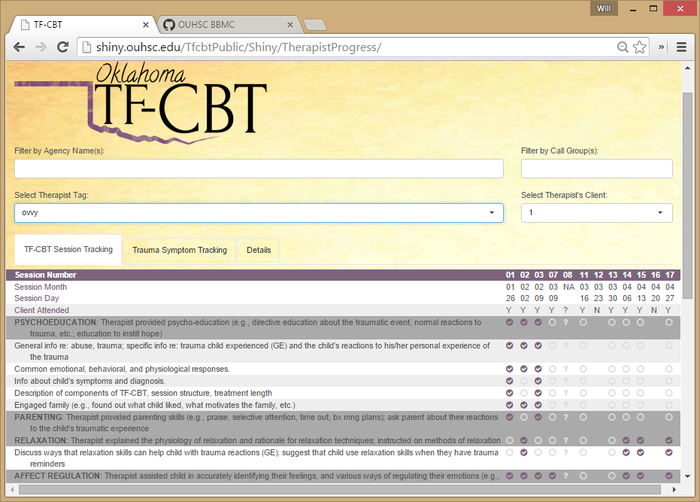
Get Cutesy with HTML5, JavaScript, & CSS
http://shiny.ouhsc.edu/TfcbtPublic/Shiny/TherapistProgress/

Slide 6
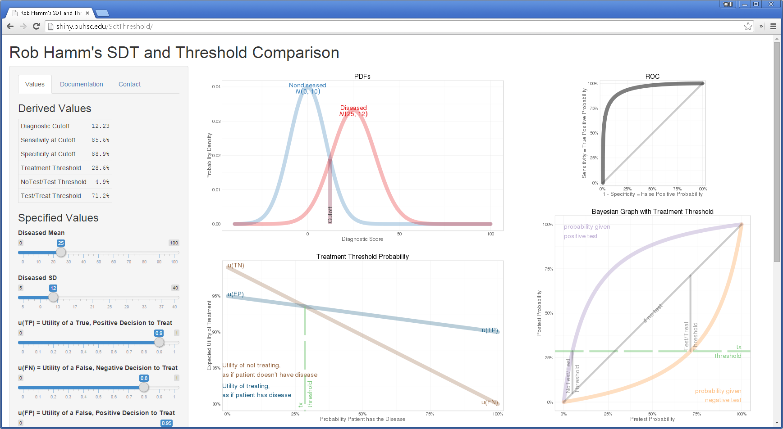
Exploit R Statistical & Graphical Capabilities
http://shiny.ouhsc.edu/SdtThreshold/

Slide 7
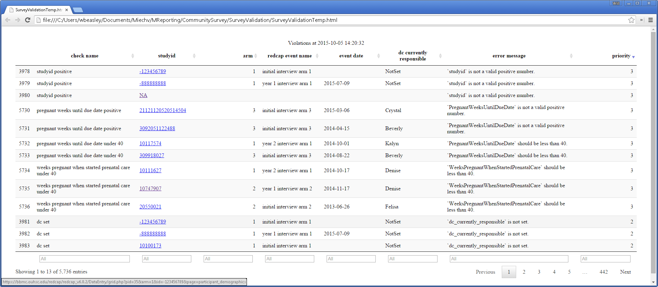
Validate Data after Collection, but before Analysis
(Internal Report, but easily convertible to Shiny)

Slide 8
Return to Slides of Code (https://rawgit.com/OuhscBbmc/StatisticalComputing/master/2015_Presentations/10_October/beasley-scug-shiny-2015-10.html#/)

