Slide 1
Extending Semiparametric AUC Model with Discrete Covariates into General Framework
Presenter
Som B. Bohora, MS
OUHSC Department of Pediatrics
Thesis advisor
Yan Daniel Zhao, PhD
OUHSC Department of Biostatistics and Epidemiology

Slide 2
Presentation Outline
Introduction
Objective
Methods – model, examples, estimation, data simulation
Results – Simulation results and application of proposed method on FAS/FASD clinical trial data
Discussion and limitations

Slide 3
Introduction
Linear models – advantages and disadvantages

Slide 4
Introduction
Linear models – advantages and disadvantages
Nonparametric statistical methods
Wilcoxon-Mann-Whitney test
Two sample t-test for non-normal data
Cannot adjust for any covariates

Slide 5
Introduction
Linear models – advantages and disadvantages
Nonparametric statistical methods
Wilcoxon-Mann-Whitney test
Two sample t-test for non-normal data
Cannot adjust for any covariates
Van Elteren test (stratified version of Wilcoxon rank sum)
When stratum effect exists, this can be used to compare two groups adjusting for stratum effect.
However, no longer useful for more complex scenarios
Cannot handle interaction

Slide 6
Introduction contd.
In Clinical Trials, adjusting for covariates important for the precision of the treatment comparisons and for effect modification

Slide 7
Introduction contd.
In Clinical Trials, adjusting for covariates important for the precision of the treatment comparisons and for effect modification
The area under the curve (AUC) -- commonly used summary index of receiver operating characteristic (ROC) curve & useful when classifying the continuous responses into two categorical groups to evaluate the performance of the treatment groups.
Two clinical trials of Tobramycin (treatment-placebo) (Covariates = trial type and age categorized)
AUC: Area Under the ROC Curve
.5 for a useless marker
1 for a perfect marker
WMW test: H₀: AUC=.5

Slide 8
Introduction contd.
A non-parametric method developed by Dodd and Pepe (2003) uses the area under the curve (AUC) regression model to compare two treatment groups.

Slide 9
Introduction contd.
A non-parametric method developed by Dodd and Pepe (2003) uses the area under the curve (AUC) regression model to compare two treatment groups.
Their method is also applicable to models with both discrete and continuous covariates -- however, involves an arbitrary grouping on continuous covariates. It does not handle interaction.

Slide 10
Introduction contd.
A non-parametric method developed by Dodd and Pepe (2003) uses the area under the curve (AUC) regression model to compare two treatment groups.
Their method is also applicable to models with both discrete and continuous covariates -- however, involves an arbitrary grouping on continuous covariates. It does not handle interaction.
Brumback et al. (2006) extended the Wilcoxon rank-sum or equivalently Mann-Whitney test by adapting ROC curve regression to develop a non-parametric method that accounts for the covariates and their interaction with the treatment.

Slide 11
Introduction contd.
A non-parametric method developed by Dodd and Pepe (2003) uses the area under the curve (AUC) regression model to compare two treatment groups.
Their method is also applicable to models with both discrete and continuous covariates -- however, involves an arbitrary grouping on continuous covariates. It does not handle interaction.
Brumback et al. (2006) extended the Wilcoxon rank-sum or equivalently Mann-Whitney test by adapting ROC curve regression to develop a non-parametric method that accounts for the covariates and their interaction with the treatment.
However, these methods involve heavy computation and require bootstrapping method to estimate the s.e. of the AUC and the model parameters.

Slide 12
Introduction contd.
Zhang, Zhao, & Tubbs (2011) proposed a non-parametric method that uses a set of AUC estimates to obtain parameter estimates and combine Delong’s method and the delta method for computing parameter standard errors, which is computationally simple and provides correct standard errors for the model parameters.

Slide 13
Introduction contd.
Zhang, Zhao, & Tubbs (2011) proposed a non-parametric method that uses a set of AUC estimates to obtain parameter estimates and combine Delong’s method and the delta method for computing parameter standard errors, which is computationally simple and provides correct standard errors for the model parameters.
However, they applied this method for the AUC regression model with only two discrete covariates.

Slide 14
Objective
To generalize or extend the semiparametric AUC regression model with only two discrete covariate developed by Zhang, Zhao, & Tubbs (2011) to the general framework that can adjust for any number of categorical covariates with any levels and their interaction with the treatment group

Slide 15

Methods - Model
Compare non-normal responses (continuous or ordinal) between two groups (A and B) while adjusting for k categorical covariates ($X_{1},X_{2},…, X_{k}$).

Slide 16
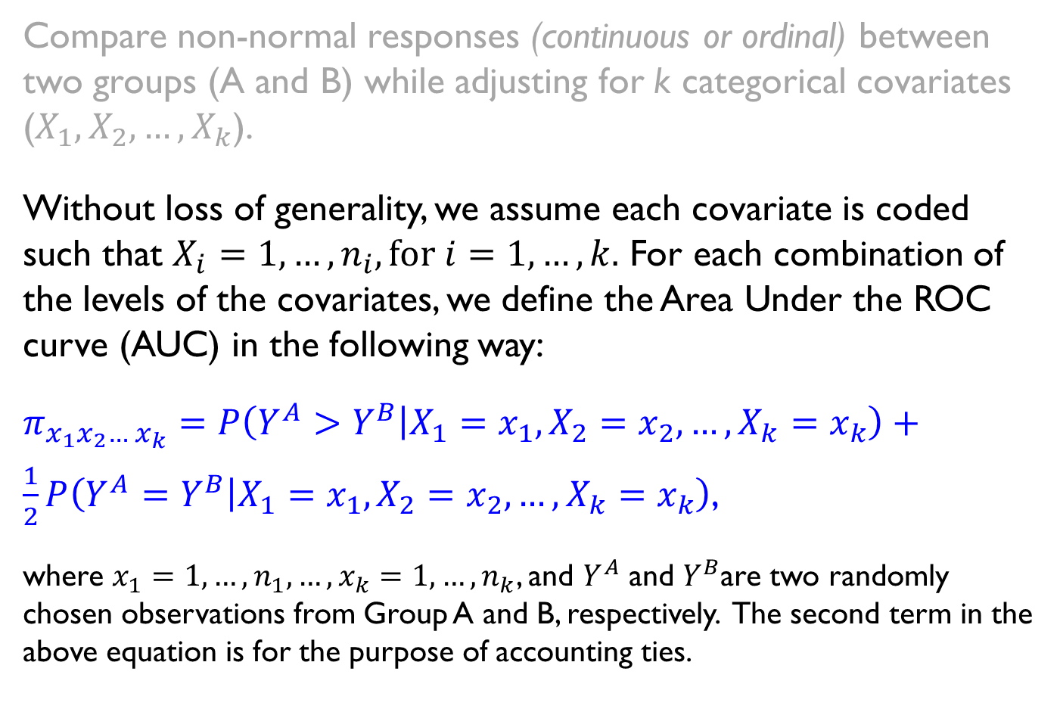
Methods - Model
Compare non-normal responses (continuous or ordinal) between two groups (A and B) while adjusting for k categorical covariates ($X_{1},X_{2},…, X_{k}$).
Without loss of generality, we assume each covariate is coded such that $X_{i}=1,…,n_{i}, for i=1,…, k.$ For each combination of the levels of the covariates, we define the Area Under the ROC curve (AUC) in the following way:
$$π_{x_{1}x_{2}…{ x}_{k}}=P\left(Y^{A}>Y^{B} | X_{1}=x_{1}, X_{2}=x_{2},…,X_{k}=x_{k}\right)+$$
$\frac{1}{2}P\left(Y^{A}=Y^{B} | X_{1}=x_{1}, X_{2}=x_{2},…,X_{k}=x_{k}\right)$,
where $x_{1}=1,…,n_{1},…,x_{k}=1,…,n_{k}$, and $Y^{A}$ and $Y^{B}$are two randomly chosen observations from Group A and B, respectively. The second term in the above equation is for the purpose of accounting ties.

Slide 17
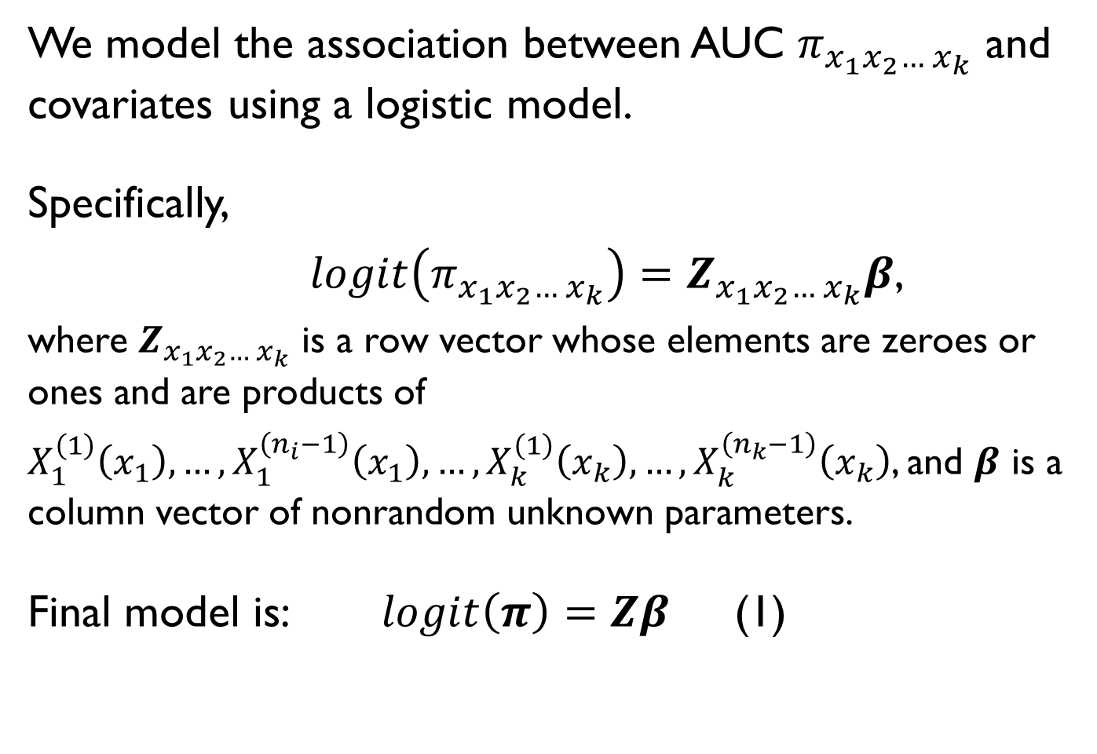
Methods : Model contd.
We model the association between AUC $π_{x_{1}x_{2}…{ x}_{k}}$ and covariates using a logistic model.
Specifically,
$logit\left(π_{x_{1}x_{2}…{ x}_{k}}\right)=Z_{x_{1}x_{2}…{ x}_{k}}β$,
where $Z_{x_{1}x_{2}…{ x}_{k}}$ is a row vector whose elements are zeroes or ones and are products of
$X_{1}^{\left(1\right)}\left(x_{1}\right),…,{X_{1}^{\left(n_{i}−1\right)}\left(x_{1}\right),…,X}_{k}^{\left(1\right)}\left(x_{k}\right),…,X_{k}^{\left(n_{k}−1\right)}\left(x_{k}\right)$, and $β$ is a column vector of nonrandom unknown parameters.
Final model is: $logit\left(π\right)=Zβ$ (1)

Slide 18
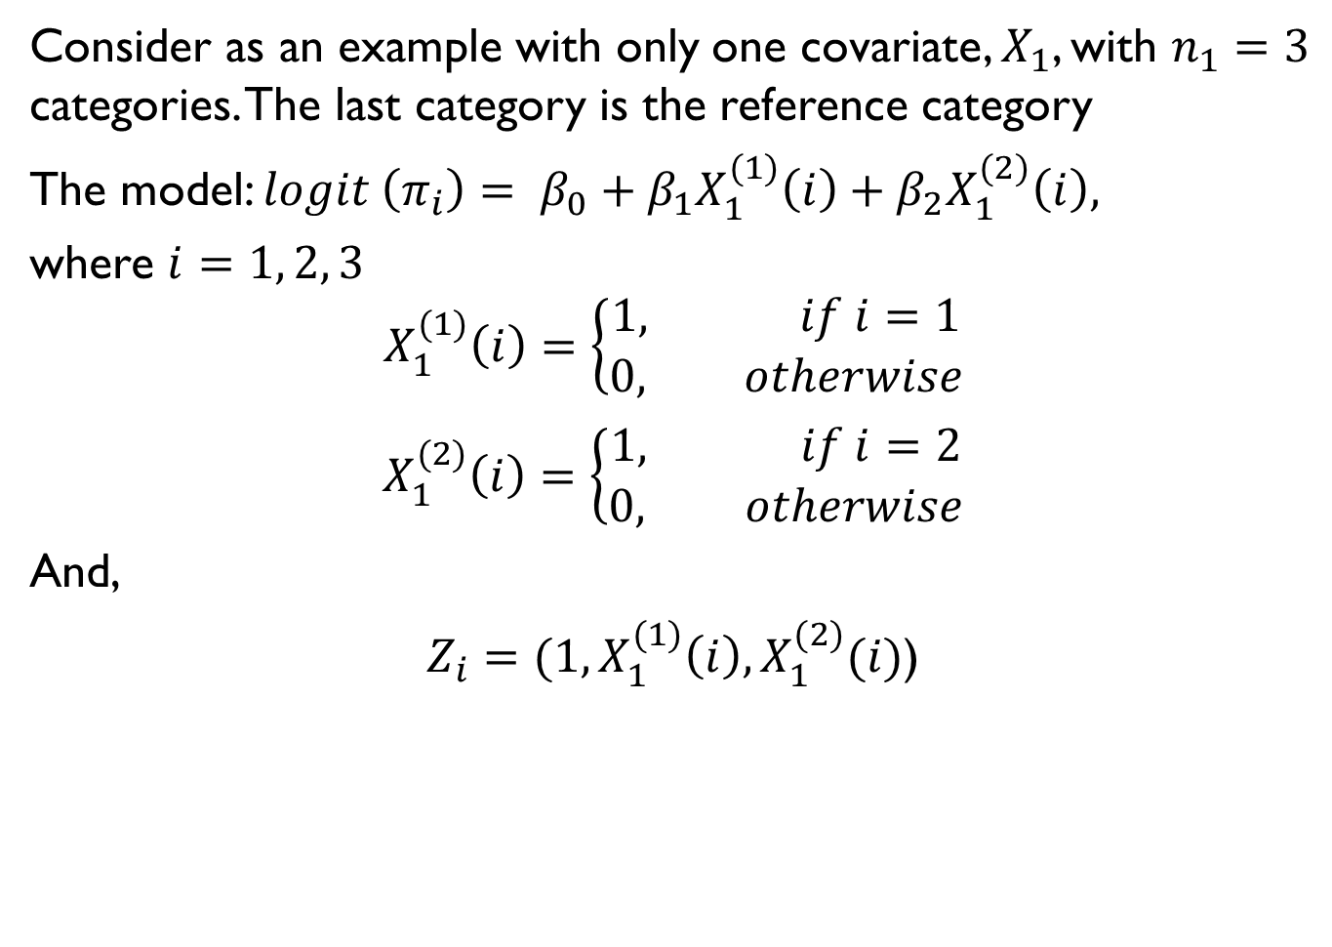
Methods : Examples
Consider as an example with only one covariate, $X_{1}$, with $n_{1}=3$ categories. The last category is the reference category
The model: $logit \left(π_{i}\right)= β_{0}+β_{1}X_{1}^{(1)}\left(i\right)+β_{2}X_{1}^{(2)}\left(i\right),$
where $i=1, 2, 3$
$$X_{1}^{(1)}\left(i\right)=\left\{\begin{aligned}1, if i=1 \\ 0, otherwise\end{aligned}\right.$$
$X_{1}^{(2)}\left(i\right)=\left\{\begin{aligned}1, if i=2 \\ 0, otherwise\end{aligned}\right.$
And,
$Z_{i}=(1,X_{1}^{(1)}\left(i\right),X_{1}^{(2)}(i)$)

Slide 19
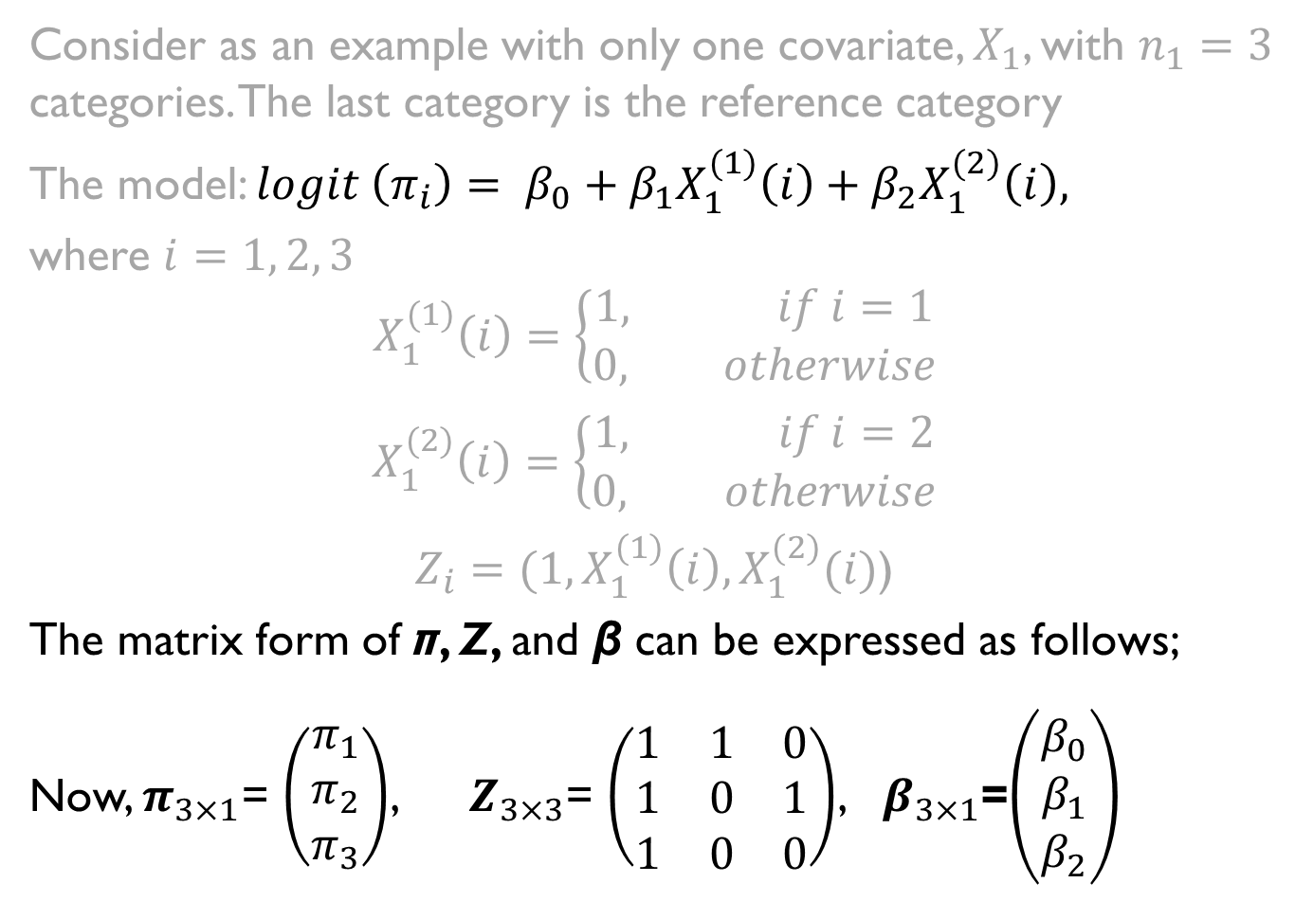
Methods : Examples
Consider as an example with only one covariate, $X_{1}$, with $n_{1}=3$ categories. The last category is the reference category
The model: $logit \left(π_{i}\right)= β_{0}+β_{1}X_{1}^{(1)}\left(i\right)+β_{2}X_{1}^{(2)}\left(i\right),$
where $i=1, 2, 3$
$$X_{1}^{(1)}\left(i\right)=\left\{\begin{aligned}1, if i=1 \\ 0, otherwise\end{aligned}\right.$$
$X_{1}^{(2)}\left(i\right)=\left\{\begin{aligned}1, if i=2 \\ 0, otherwise\end{aligned}\right.$
$Z_{i}=(1,X_{1}^{(1)}\left(i\right),X_{1}^{(2)}(i)$)
The matrix form of π, Z, and β can be expressed as follows;
Now, $π_{3×1}$= $\left(\begin{matrix}π_{1} \\ π_{2} \\ π_{3}\end{matrix}\right)$, $Z_{3×3}$= $\left(\begin{matrix}1 & 1 & 0 \\ 1 & 0 & 1 \\ 1 & 0 & 0\end{matrix}\right)$, $β_{3×1}$=$\left(\begin{matrix}β_{0} \\ β_{1} \\ β_{2}\end{matrix}\right)$

Slide 20
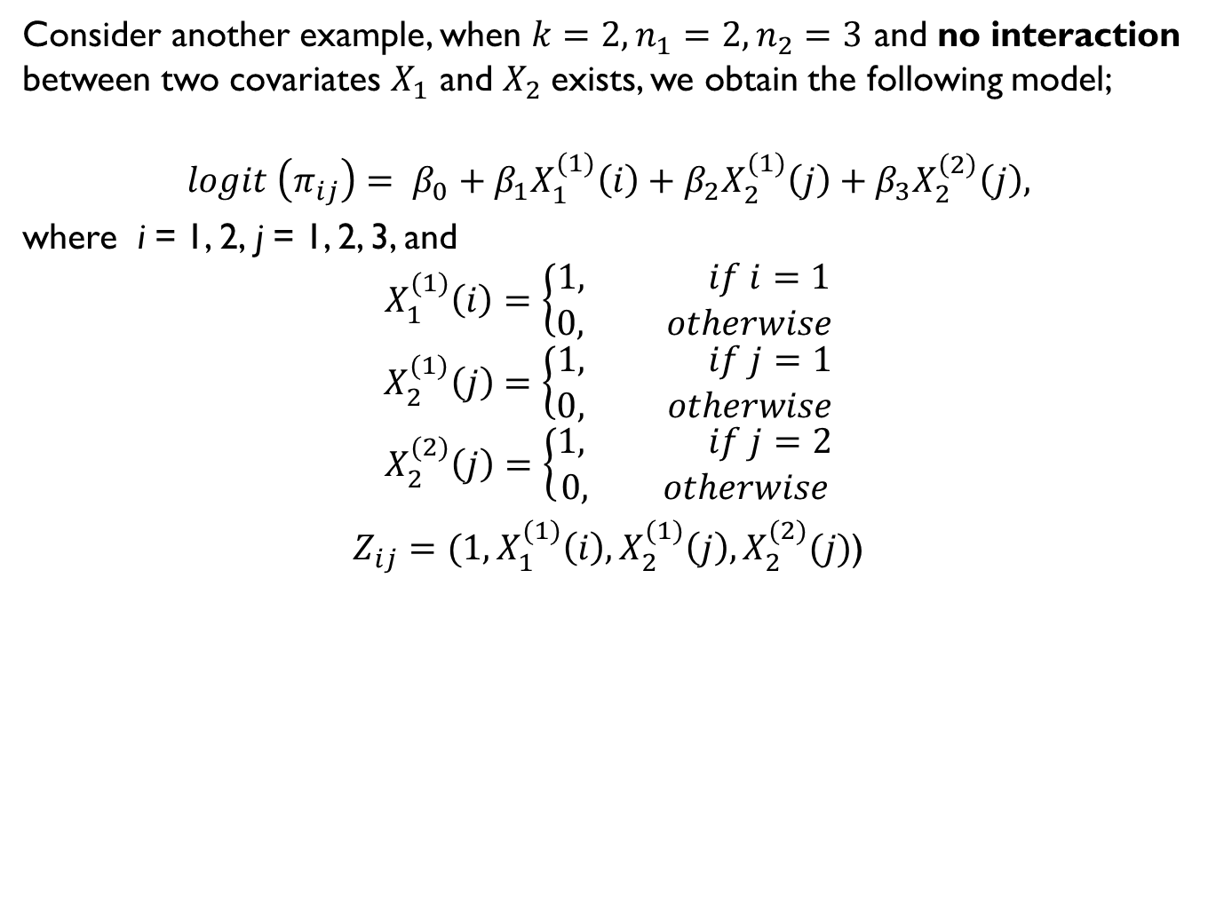
Methods : Example contd.
Consider another example, when $k=2, n_{1}=2,n_{2}=3$ and no interaction between two covariates $X_{1}$ and $X_{2}$exists, we obtain the following model;
$$logit \left(π_{ij}\right)= β_{0}+β_{1}X_{1}^{(1)}\left(i\right)+β_{2}X_{2}^{(1)}\left(j\right)+β_{3}X_{2}^{\left(2\right)}\left(j\right),$$
where i = 1, 2, j = 1, 2, 3, and
$$X_{1}^{(1)}\left(i\right)=\left\{\begin{aligned}1, if i=1 \\ 0, otherwise\end{aligned}\right.$$
$$X_{2}^{(1)}\left(j\right)=\left\{\begin{aligned}1, if j=1 \\ 0, otherwise\end{aligned}\right.$$
$$X_{2}^{(2)}\left(j\right)=\left\{\begin{aligned}1, if j=2 \\ 0, otherwise\end{aligned}\right.$$
$Z_{ij}=(1,X_{1}^{(1)}\left(i\right),X_{2}^{(1)}\left(j\right),X_{2}^{(2)}(j)$)

Slide 21
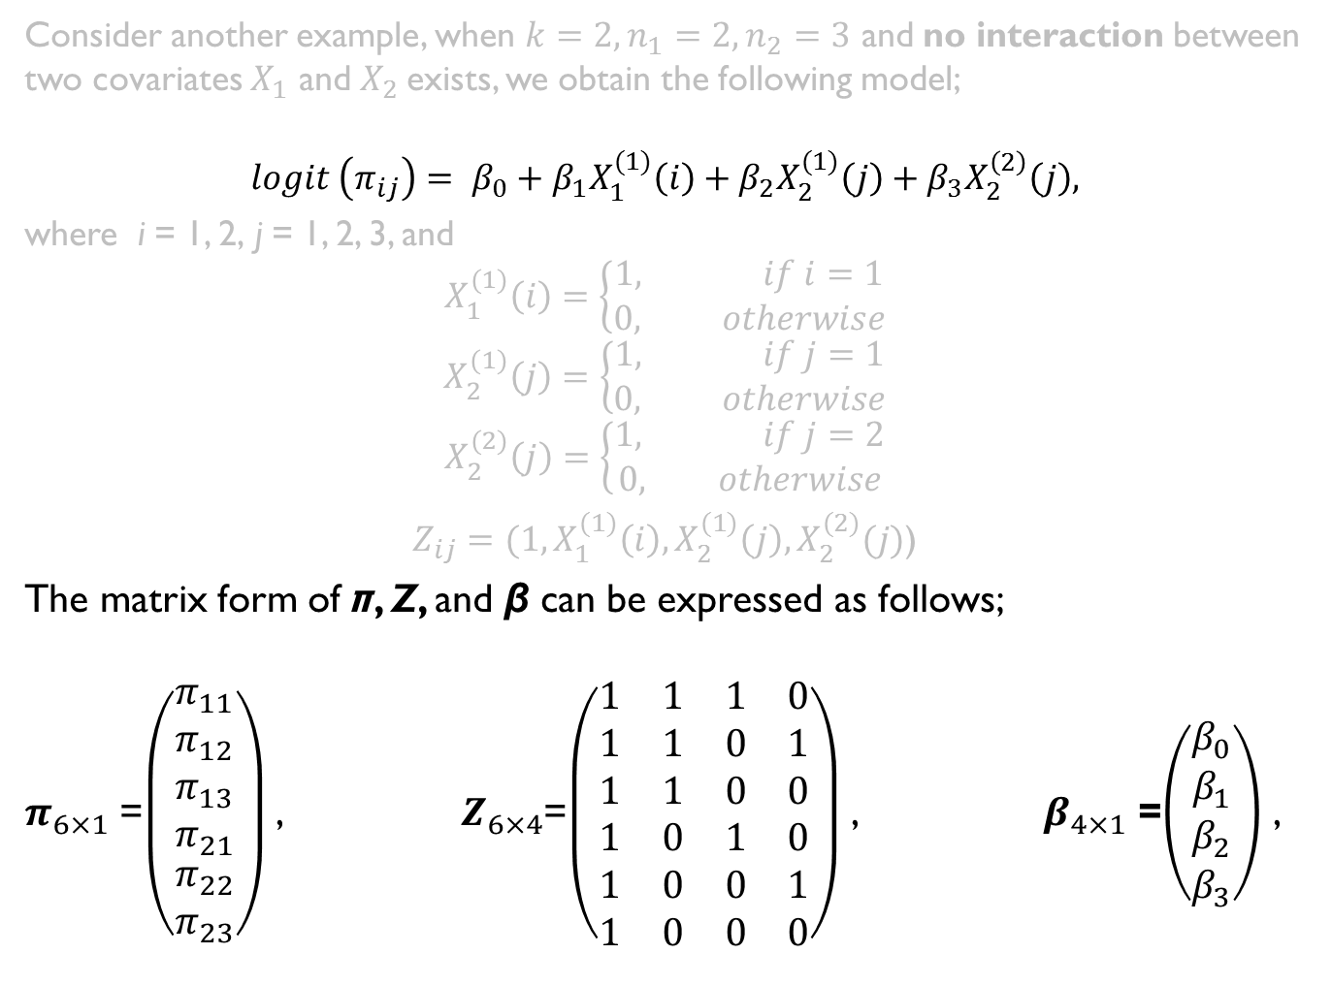
Methods : Examples contd.
Consider another example, when $k=2, n_{1}=2,n_{2}=3$ and no interaction between two covariates $X_{1}$ and $X_{2}$exists, we obtain the following model;
$$logit \left(π_{ij}\right)= β_{0}+β_{1}X_{1}^{(1)}\left(i\right)+β_{2}X_{2}^{(1)}\left(j\right)+β_{3}X_{2}^{\left(2\right)}\left(j\right),$$
where i = 1, 2, j = 1, 2, 3, and
$$X_{1}^{(1)}\left(i\right)=\left\{\begin{aligned}1, if i=1 \\ 0, otherwise\end{aligned}\right.$$
$$X_{2}^{(1)}\left(j\right)=\left\{\begin{aligned}1, if j=1 \\ 0, otherwise\end{aligned}\right.$$
$$X_{2}^{(2)}\left(j\right)=\left\{\begin{aligned}1, if j=2 \\ 0, otherwise\end{aligned}\right.$$
$Z_{ij}=(1,X_{1}^{(1)}\left(i\right),X_{2}^{(1)}\left(j\right),X_{2}^{(2)}(j)$)
The matrix form of π, Z, and β can be expressed as follows;
$π_{6×1}$ =$\left(\begin{aligned}\begin{matrix}π_{11} \\ π_{12} \\ π_{13} \\ π_{21}\end{matrix} \\ π_{22} \\ π_{23}\end{aligned}\right)$ , $Z_{6×4}$=$\left(\begin{matrix}1 & 1 & 1 & 0 \\ 1 & 1 & 0 & 1 \\ 1 & 1 & 0 & 0 \\ 1 & 0 & 1 & 0 \\ 1 & 0 & 0 & 1 \\ 1 & 0 & 0 & 0\end{matrix}\right)$ , $β_{4×1}$ =$\left(\begin{matrix}β_{0} \\ β_{1} \\ β_{2} \\ β_{3}\end{matrix}\right)$ ,

Slide 22
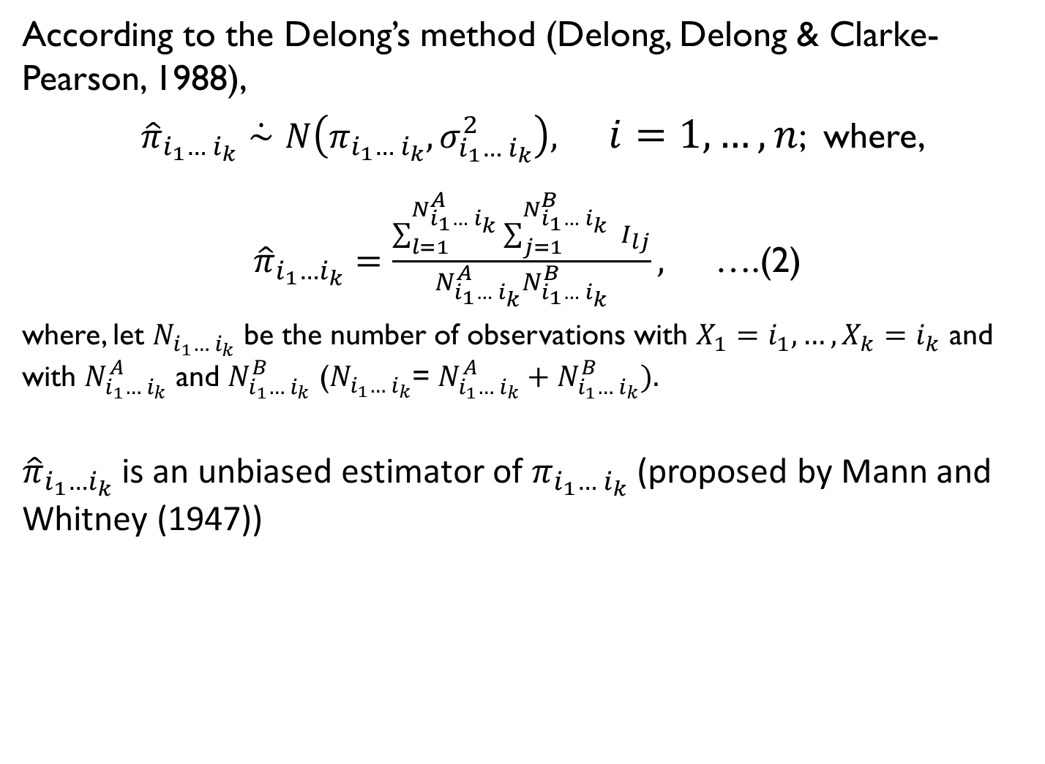
Methods : Estimation
According to the Delong’s method (Delong, Delong & Clarke-Pearson, 1988),
${\hat{π}}_{i_{1}…{ i}_{k}}\dot{∼}N\left(π_{i_{1}…{ i}_{k}}, σ_{i_{1}…{ i}_{k}}^{2}\right),$ $i=1,…,n$; where,
${\hat{π}}_{i_{1}…i_{k}}=\frac{\sum_{l=1}^{N_{i_{1}…{ i}_{k}}^{A}}{\sum_{j=1}^{N_{i_{1}…{ i}_{k}}^{B}}{ }}I_{lj}}{N_{i_{1}…{ i}_{k}}^{A}N_{i_{1}…{ i}_{k}}^{B}},$ ….(2)
where, let $N_{i_{1}…{ i}_{k}}$ be the number of observations with $X_{1}=i_{1},…,X_{k}=i_{k}$ and with $N_{i_{1}…{ i}_{k}}^{A}$ and $N_{i_{1}…{ i}_{k}}^{B}$ ($N_{i_{1}…{ i}_{k}}$= $N_{i_{1}…{ i}_{k}}^{A}+N_{i_{1}…{ i}_{k}}^{B}).$
${\hat{π}}_{i_{1}…i_{k}}$ is an unbiased estimator of $π_{i_{1}…{ i}_{k}}$ (proposed by Mann and Whitney (1947))

Slide 23
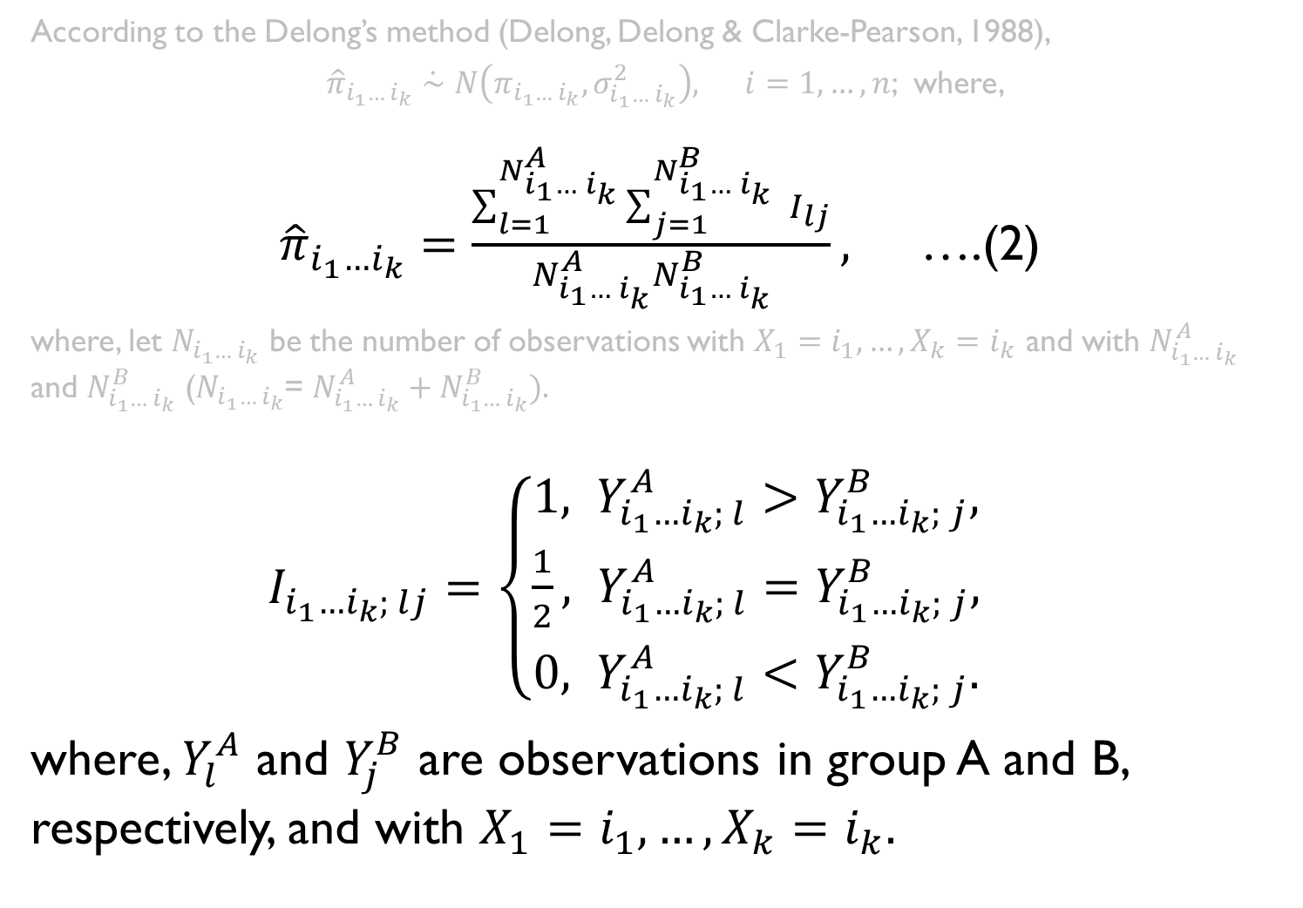
Methods : Estimation
According to the Delong’s method (Delong, Delong & Clarke-Pearson, 1988),
${\hat{π}}_{i_{1}…{ i}_{k}}\dot{∼}N\left(π_{i_{1}…{ i}_{k}}, σ_{i_{1}…{ i}_{k}}^{2}\right),$ $i=1,…,n$; where,
${\hat{π}}_{i_{1}…i_{k}}=\frac{\sum_{l=1}^{N_{i_{1}…{ i}_{k}}^{A}}{\sum_{j=1}^{N_{i_{1}…{ i}_{k}}^{B}}{ }}I_{lj}}{N_{i_{1}…{ i}_{k}}^{A}N_{i_{1}…{ i}_{k}}^{B}},$ ….(2)
where, let $N_{i_{1}…{ i}_{k}}$ be the number of observations with $X_{1}=i_{1},…,X_{k}=i_{k}$ and with $N_{i_{1}…{ i}_{k}}^{A}$ and $N_{i_{1}…{ i}_{k}}^{B}$ ($N_{i_{1}…{ i}_{k}}$= $N_{i_{1}…{ i}_{k}}^{A}+N_{i_{1}…{ i}_{k}}^{B}).$
$I_{i_{1}…i_{k}; lj}=\left\{\begin{aligned}1, Y_{i_{1}…i_{k}; l}^{A}>Y_{i_{1}…i_{k}; j}^{B}, \\ \frac{1}{2}, Y_{i_{1}…i_{k}; l}^{A}=Y_{i_{1}…i_{k}; j}^{B}, \\ 0, Y_{i_{1}…i_{k}; l}^{A}<Y_{i_{1}…i_{k}; j}^{B}.\end{aligned}\right.$
where, $Y_{l}^{A}$ and $Y_{j}^{B}$ are observations in group A and B, respectively, and with $X_{1}=i_{1},…,X_{k}=i_{k}.$

Slide 24
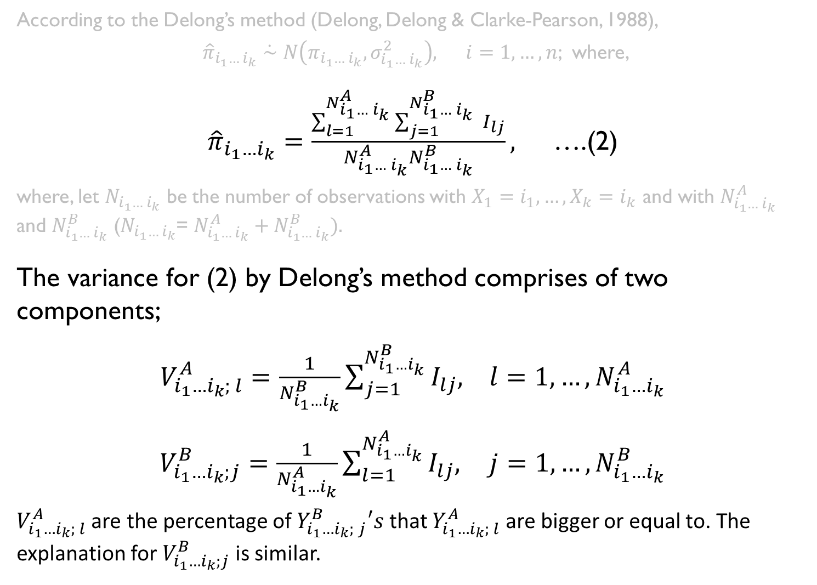
Methods : Estimation
According to the Delong’s method (Delong, Delong & Clarke-Pearson, 1988),
${\hat{π}}_{i_{1}…{ i}_{k}}\dot{∼}N\left(π_{i_{1}…{ i}_{k}}, σ_{i_{1}…{ i}_{k}}^{2}\right),$ $i=1,…,n$; where,
${\hat{π}}_{i_{1}…i_{k}}=\frac{\sum_{l=1}^{N_{i_{1}…{ i}_{k}}^{A}}{\sum_{j=1}^{N_{i_{1}…{ i}_{k}}^{B}}{ }}I_{lj}}{N_{i_{1}…{ i}_{k}}^{A}N_{i_{1}…{ i}_{k}}^{B}},$ ….(2)
where, let $N_{i_{1}…{ i}_{k}}$ be the number of observations with $X_{1}=i_{1},…,X_{k}=i_{k}$ and with $N_{i_{1}…{ i}_{k}}^{A}$ and $N_{i_{1}…{ i}_{k}}^{B}$ ($N_{i_{1}…{ i}_{k}}$= $N_{i_{1}…{ i}_{k}}^{A}+N_{i_{1}…{ i}_{k}}^{B}).$
The variance for (2) by Delong’s method comprises of two components;
$V_{i_{1}…i_{k}; l}^{A}=\frac{1}{N_{i_{1}…i_{k}}^{B}}\sum_{j=1}^{N_{i_{1}…i_{k}}^{B}}{I_{lj},}$ $l=1,…,N_{i_{1}…i_{k}}^{A}$
$V_{i_{1}…i_{k};j}^{B}=\frac{1}{N_{i_{1}…i_{k}}^{A}}\sum_{l=1}^{N_{i_{1}…i_{k}}^{A}}{I_{lj},}$ $j=1,…,N_{i_{1}…i_{k}}^{B}$
$V_{i_{1}…i_{k}; l}^{A}$ are the percentage of $Y_{i_{1}…i_{k}; j}^{B}′s$ that $Y_{i_{1}…i_{k}; l}^{A}$ are bigger or equal to. The explanation for $V_{i_{1}…i_{k};j}^{B}$ is similar.

Slide 25
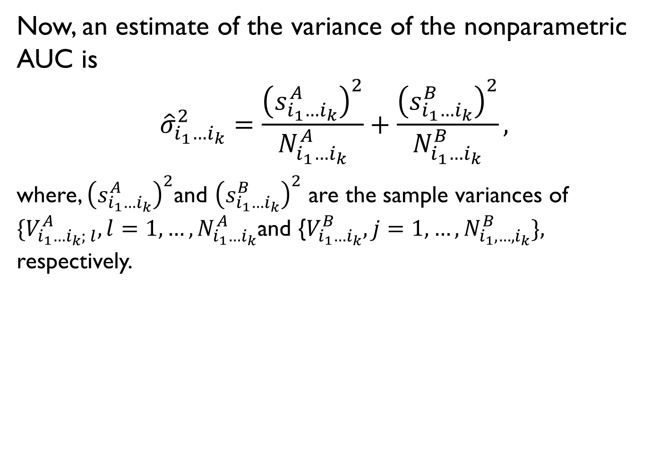
Methods : Estimation contd.
Now, an estimate of the variance of the nonparametric AUC is
$${\hat{σ}}_{i_{1}…i_{k}}^{2}=\frac{{\left(s_{i_{1}…i_{k}}^{A}\right)}^{2}}{N_{i_{1}…i_{k}}^{A}}+\frac{{\left(s_{i_{1}…i_{k}}^{B}\right)}^{2}}{N_{i_{1}…i_{k}}^{B}},$$
where, ${\left(s_{i_{1}…i_{k}}^{A}\right)}^{2}$and ${\left(s_{i_{1}…i_{k}}^{B}\right)}^{2}$ are the sample variances of $\{V_{i_{1}…i_{k}; l}^{A}, l=1,…,N_{i_{1}…i_{k}}^{A}$and {$V_{i_{1}…i_{k}}^{B}, j=1,…,N_{i_{1},…,i_{k}}^{B}\},$ respectively.
x1
x11 | x12
x21 | x22
x2

Slide 26



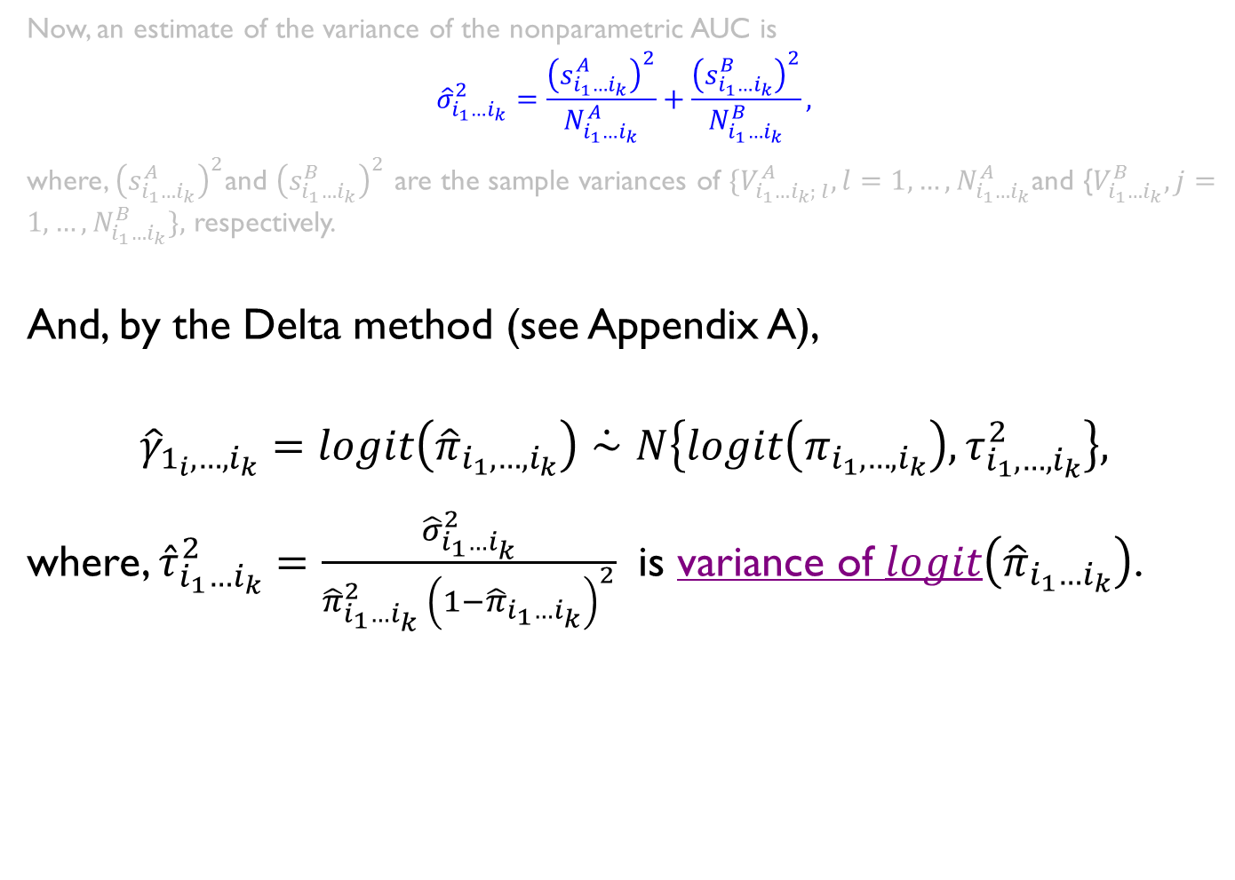
Methods : Estimation contd.
Now, an estimate of the variance of the nonparametric AUC is
$${\hat{σ}}_{i_{1}…i_{k}}^{2}=\frac{{\left(s_{i_{1}…i_{k}}^{A}\right)}^{2}}{N_{i_{1}…i_{k}}^{A}}+\frac{{\left(s_{i_{1}…i_{k}}^{B}\right)}^{2}}{N_{i_{1}…i_{k}}^{B}},$$
where, ${\left(s_{i_{1}…i_{k}}^{A}\right)}^{2}$and ${\left(s_{i_{1}…i_{k}}^{B}\right)}^{2}$ are the sample variances of $\{V_{i_{1}…i_{k}; l}^{A}, l=1,…,N_{i_{1}…i_{k}}^{A}$and {$V_{i_{1}…i_{k}}^{B}, j=1,…,N_{i_{1}…i_{k}}^{B}\},$ respectively.
And, by the Delta method (see Appendix A),
$${\hat{γ}}_{1_{i},…,i_{k}}=logit\left({\hat{π}}_{i_{1},…,i_{k}}\right)\dot{∼}N\left\{logit\left(π_{i_{1},…,i_{k}}\right),τ_{i_{1},…,i_{k}}^{2}\right\},$$
where, ${\hat{τ}}_{i_{1}…i_{k}}^{2}=\frac{{\hat{σ}}_{i_{1}…i_{k}}^{2}}{{\hat{π}}_{i_{1}…i_{k}}^{2} {\left(1−{\hat{π}}_{i_{1}…i_{k}}\right)}^{2}}$ is variance of $logit\left({\hat{π}}_{i_{1}…i_{k}}\right)$.
Variance of $\hat{AUC}$
Variance of $logit \hat{AUC}$
$$\hat{AUC}$$

Slide 27
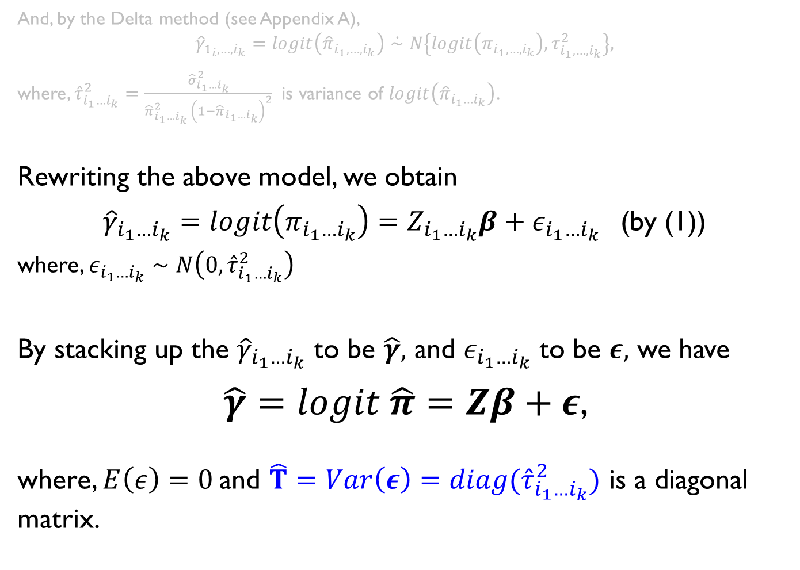
Methods : Estimation contd.
And, by the Delta method (see Appendix A),
$${\hat{γ}}_{1_{i},…,i_{k}}=logit\left({\hat{π}}_{i_{1},…,i_{k}}\right)\dot{∼}N\left\{logit\left(π_{i_{1},…,i_{k}}\right),τ_{i_{1},…,i_{k}}^{2}\right\},$$
where, ${\hat{τ}}_{i_{1}…i_{k}}^{2}=\frac{{\hat{σ}}_{i_{1}…i_{k}}^{2}}{{\hat{π}}_{i_{1}…i_{k}}^{2} {\left(1−{\hat{π}}_{i_{1}…i_{k}}\right)}^{2}}$ is variance of $logit\left({\hat{π}}_{i_{1}…i_{k}}\right)$.
Rewriting the above model, we obtain
${\hat{γ}}_{i_{1}…i_{k}}=logit\left(π_{i_{1}…i_{k}}\right)=Z_{i_{1}…i_{k}}β+ε_{i_{1}…i_{k}}$ (by (1))
where, $ε_{i_{1}…i_{k}}∼N\left(0,{\hat{τ}}_{i_{1}…i_{k}}^{2}\right)$
By stacking up the ${\hat{γ}}_{i_{1}…i_{k}}$ to be $\hat{γ},$ and $ε_{i_{1}…i_{k}}$ to be $ε,$ we have
$\hat{γ}=logit \hat{π}=Zβ+ε$,
where, $E\left(ε\right)=0$and $\hat{T}=Var\left(ε\right)=diag({\hat{τ}}_{i_{1}…i_{k}}^{2})$ is a diagonal matrix.

Slide 28

Methods : Estimation contd.
By using the generalized least squares method, we estimate the parameters as follows;
$\hat{β}={\left(Z^{′} {\hat{T}}^{−1} Z\right)}^{−1}Z^{′} {\hat{T}}^{−1} \hat{γ}$ (3)
and $\hat{V}\left(\hat{β}\right)={\left(Z^{′} {\hat{T}}^{−1}Z\right)}^{−1}$,

Slide 29
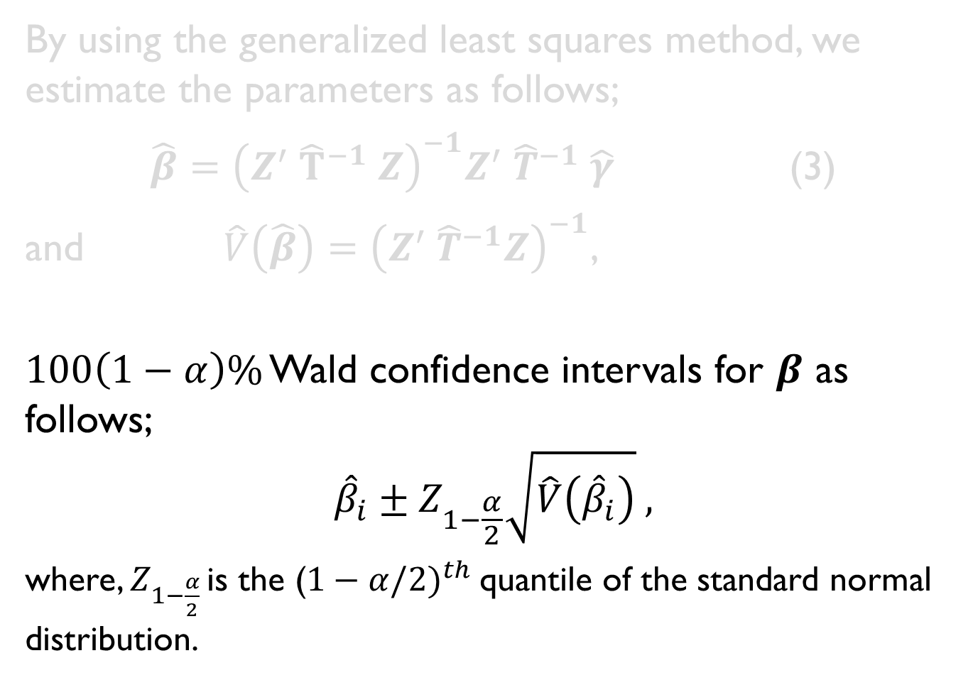
Methods : Estimation contd.
By using the generalized least squares method, we estimate the parameters as follows;
$\hat{β}={\left(Z^{′} {\hat{T}}^{−1} Z\right)}^{−1}Z^{′} {\hat{T}}^{−1} \hat{γ}$ (3)
and $\hat{V}\left(\hat{β}\right)={\left(Z^{′} {\hat{T}}^{−1}Z\right)}^{−1}$,
$100\left(1−α\right)\%$ Wald confidence intervals for $β$ as follows;
$${\hat{β}}_{i}±Z_{1−\frac{α}{2}}\sqrt{\hat{V}\left({\hat{β}}_{i}\right)} ,$$
where, $Z_{1−\frac{α}{2} }$is the ($1−α/{2)}^{th}$quantile of the standard normal distribution.

Slide 30
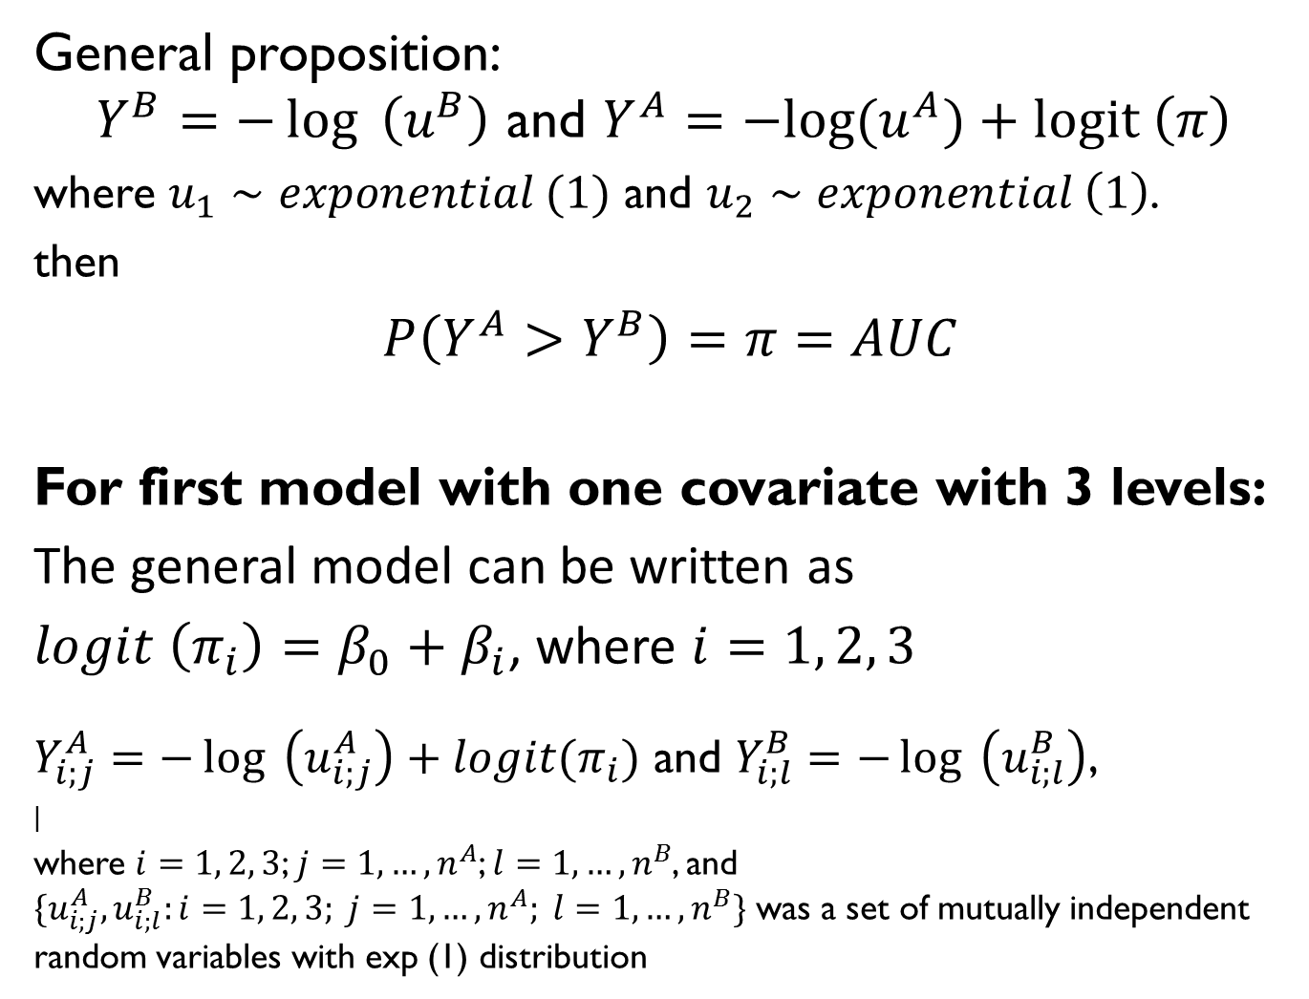
Simulation : Data Generation
General proposition:
$$Y^{B}=−\log{ \left(u^{B}\right) \text{and} Y^{A}=−log⁡(u^{A})+logit \left(π\right)}$$
where $u_{1}∼exponential (1)$ and $u_{2}∼exponential \left(1\right)$.
then
$P\left(Y^{A}>Y^{B}\right)=π=AUC$
For first model with one covariate with 3 levels:
The general model can be written as
$logit \left(π_{i}\right)=β_{0}+β_{i}$, where $i=1, 2, 3$
$Y_{i;j}^{A}=−\log{ \left(u_{i;j}^{A}\right)}+logit(π_{i})$ and $Y_{i;l}^{B}=−\log{ \left(u_{i;l}^{B}\right)}$,
|
where $i=1, 2, 3$; $j=1,…,n^{A}$; $l=1,…,n^{B}$, and $\{u_{i;j}^{A}, u_{i;l}^{B}:i=1, 2, 3; j=1,…,n^{A}; l=1,…,n^{B}\}$ was a set of mutually independent random variables with exp (1) distribution

Slide 31
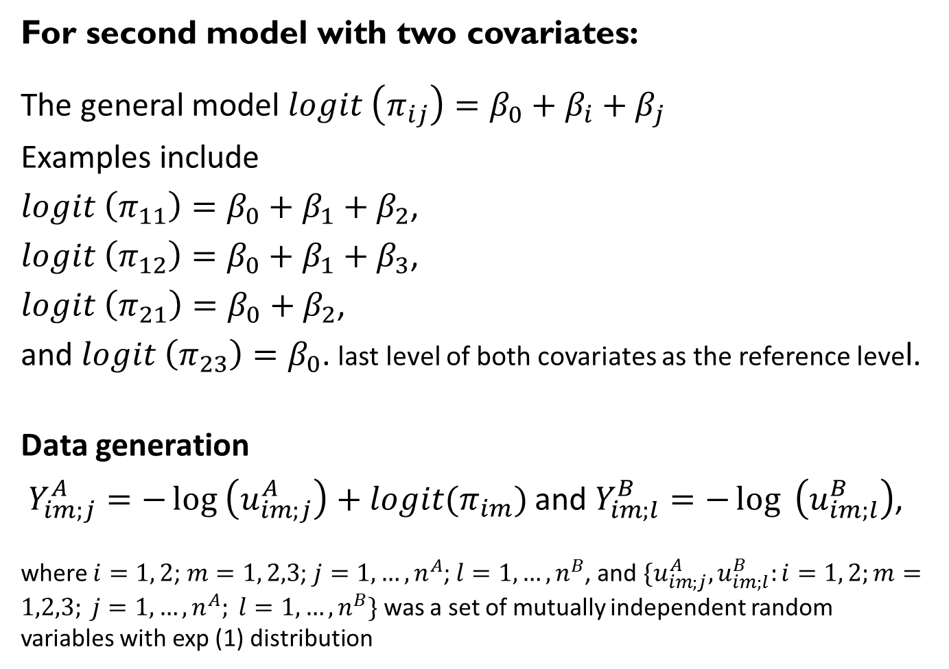
Simulation : Data Generation
For second model with two covariates:
The general model $logit \left(π_{ij}\right)=β_{0}+β_{i}+β_{j}$
Examples include
$logit \left(π_{11}\right)=β_{0}+β_{1}+β_{2}$,
$logit \left(π_{12}\right)=β_{0}+β_{1}+β_{3}$,
$logit \left(π_{21}\right)=β_{0}+β_{2}$,
and $logit \left(π_{23}\right)=β_{0}$. last level of both covariates as the reference level.
Data generation
$Y_{im;j}^{A}=−\log\left(u_{im;j}^{A}\right)+logit(π_{im})$ and $Y_{im;l}^{B}=−\log{ \left(u_{im;l}^{B}\right)}$,
where $i=1, 2$; $m=1, 2,3$; $j=1,…,n^{A}$; $l=1,…,n^{B}$, and $\{u_{im;j}^{A}, u_{im;l}^{B}:i=1, 2;m=1,2,3; j=1,…,n^{A}; l=1,…,n^{B}\}$ was a set of mutually independent random variables with exp (1) distribution

Slide 32
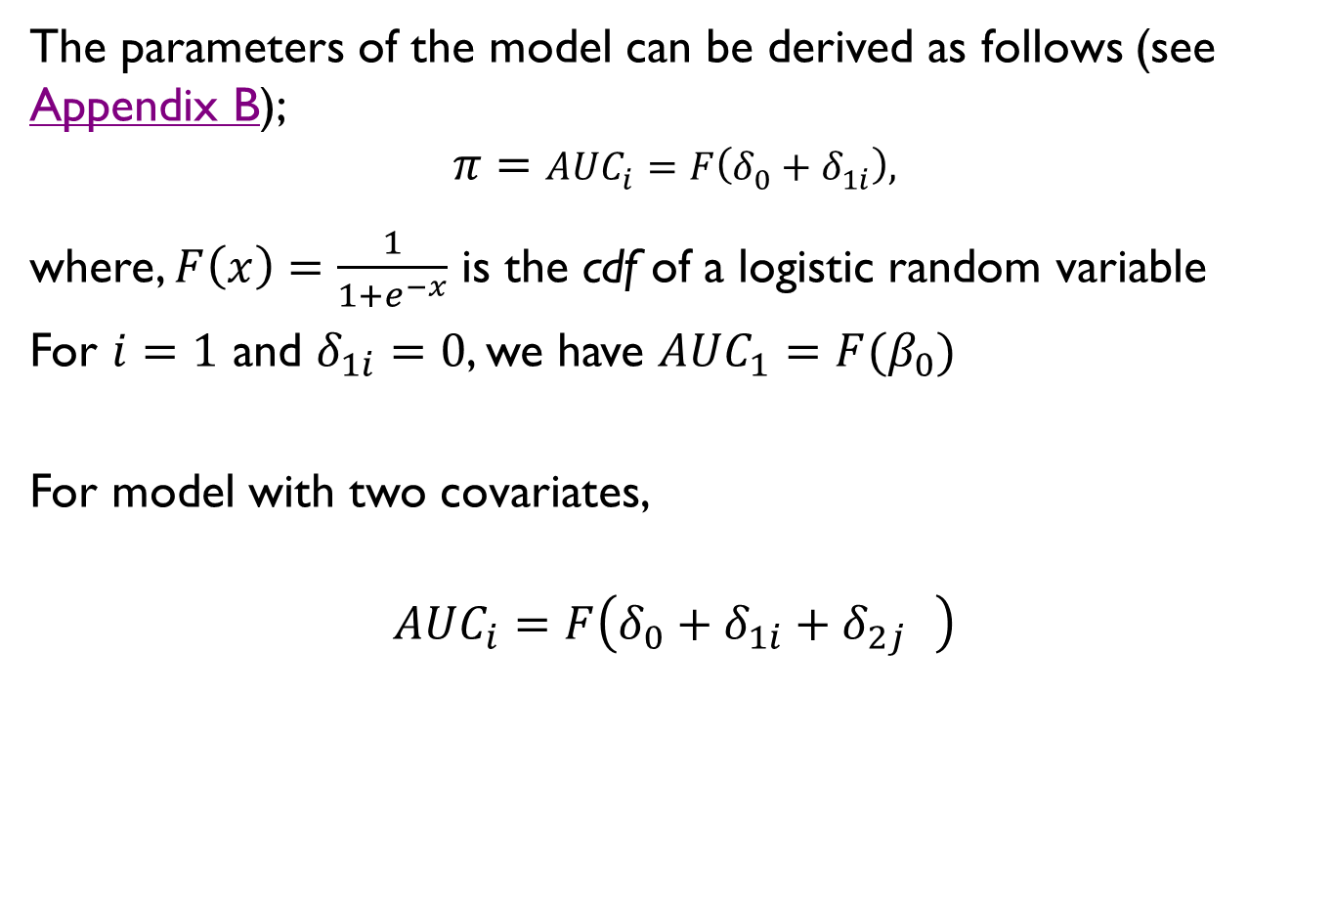
Simulation : Data Generation
The parameters of the model can be derived as follows (see Appendix B);
$$π=AUC_{i}=F\left(δ_{0}+δ_{1i}\right),$$
where, $F\left(x\right)=\frac{1}{1+e^{−x}}$ is the cdf of a logistic random variable
For $i=1$ and $δ_{1i}=0$, we have $AUC_{1}=F(β_{0})$
For model with two covariates,
$$AUC_{i}=F\left(δ_{0}+δ_{1i}+δ_{2j} \right)$$

Slide 33
Measure of Performance of Estimates
Bias
-Parameter estimates (calculated as the average of the 10,000 simulations)
Standard error
95% coverage probability
R was used for all computations

Slide 34
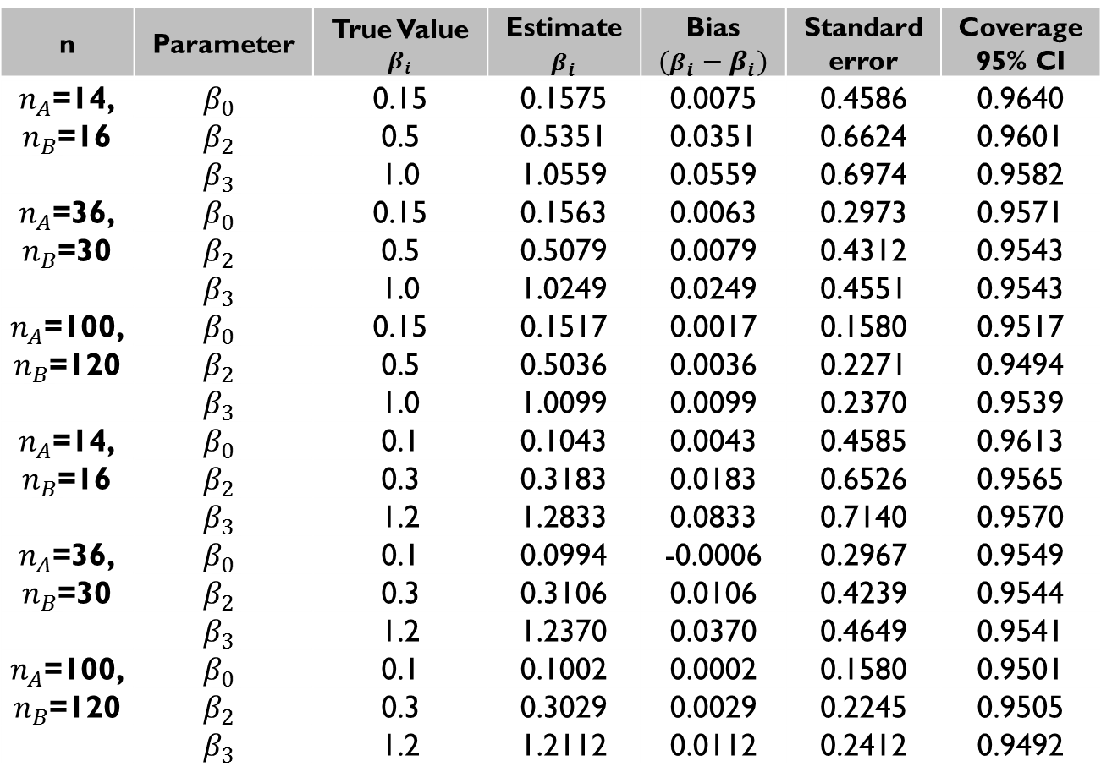
Results : Simulation Study – one covariate
n | Parameter | True Value $$β_{i}$$ | Estimate $${\overline{β}}_{i}$$ | Bias $$({\overline{β}}_{i}−β_{i})$$ | Standard error | Coverage 95% CI
$n_{A}$=14, $n_{B}$=16 | $$β_{0}$$ | 0.15 | 0.1575 | 0.0075 | 0.4586 | 0.9640
 | $$β_{2}$$ | 0.5 | 0.5351 | 0.0351 | 0.6624 | 0.9601
 | $$β_{3}$$ | 1.0 | 1.0559 | 0.0559 | 0.6974 | 0.9582
$n_{A}$=36, $n_{B}$=30 | $$β_{0}$$ | 0.15 | 0.1563 | 0.0063 | 0.2973 | 0.9571
 | $$β_{2}$$ | 0.5 | 0.5079 | 0.0079 | 0.4312 | 0.9543
 | $$β_{3}$$ | 1.0 | 1.0249 | 0.0249 | 0.4551 | 0.9543
$n_{A}$=100, $n_{B}$=120 | $$β_{0}$$ | 0.15 | 0.1517 | 0.0017 | 0.1580 | 0.9517
 | $$β_{2}$$ | 0.5 | 0.5036 | 0.0036 | 0.2271 | 0.9494
 | $$β_{3}$$ | 1.0 | 1.0099 | 0.0099 | 0.2370 | 0.9539
$n_{A}$=14, $n_{B}$=16 | $$β_{0}$$ | 0.1 | 0.1043 | 0.0043 | 0.4585 | 0.9613
 | $$β_{2}$$ | 0.3 | 0.3183 | 0.0183 | 0.6526 | 0.9565
 | $$β_{3}$$ | 1.2 | 1.2833 | 0.0833 | 0.7140 | 0.9570
$n_{A}$=36, $n_{B}$=30 | $$β_{0}$$ | 0.1 | 0.0994 | -0.0006 | 0.2967 | 0.9549
 | $$β_{2}$$ | 0.3 | 0.3106 | 0.0106 | 0.4239 | 0.9544
 | $$β_{3}$$ | 1.2 | 1.2370 | 0.0370 | 0.4649 | 0.9541
$n_{A}$=100, $n_{B}$=120 | $$β_{0}$$ | 0.1 | 0.1002 | 0.0002 | 0.1580 | 0.9501
 | $$β_{2}$$ | 0.3 | 0.3029 | 0.0029 | 0.2245 | 0.9505
 | $$β_{3}$$ | 1.2 | 1.2112 | 0.0112 | 0.2412 | 0.9492
Table 1. Parameter estimates, standard errors, and 95% CIs for the model with different set of samples from each group each level under different set of true parameters. Results presented are the mean from the 10000 realizations using a single covariate with 3 levels (first category is the reference category).

Slide 35
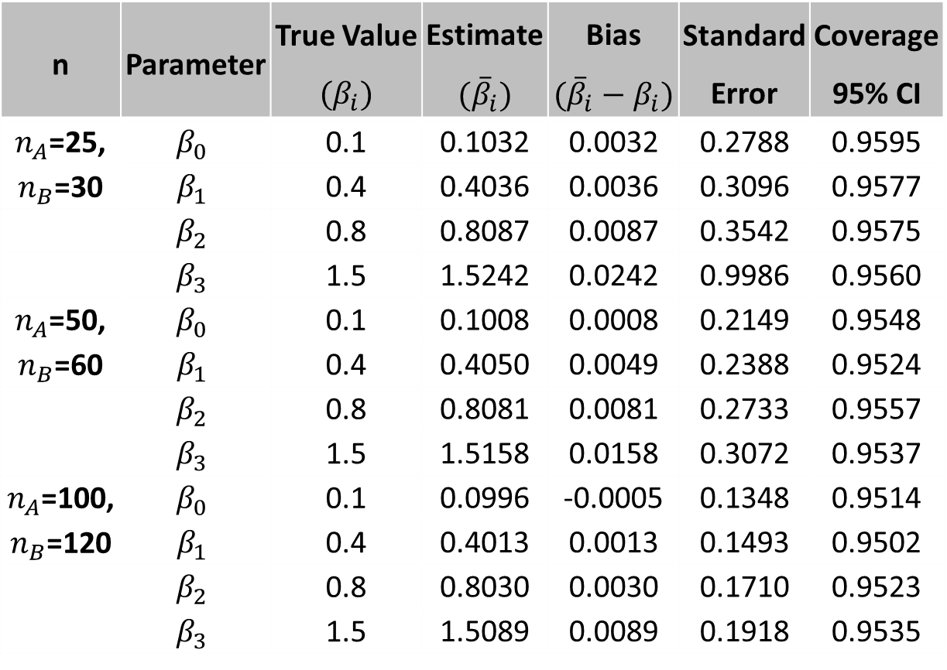
Results : Simulation Study – two covariates
n | Parameter | True Value $${(β}_{i})$$ | Estimate $${(\overline{β}}_{i})$$ | Bias $$({\overline{β}}_{i}−β_{i})$$ | Standard Error | Coverage 95% CI
$n_{A}$=25, $n_{B}$=30 | $$β_{0}$$ | 0.1 | 0.1032 | 0.0032 | 0.2788 | 0.9595
 | $$β_{1}$$ | 0.4 | 0.4036 | 0.0036 | 0.3096 | 0.9577
 | $$β_{2}$$ | 0.8 | 0.8087 | 0.0087 | 0.3542 | 0.9575
 | $$β_{3}$$ | 1.5 | 1.5242 | 0.0242 | 0.9986 | 0.9560
$n_{A}$=50, $n_{B}$=60 | $$β_{0}$$ | 0.1 | 0.1008 | 0.0008 | 0.2149 | 0.9548
 | $$β_{1}$$ | 0.4 | 0.4050 | 0.0049 | 0.2388 | 0.9524
 | $$β_{2}$$ | 0.8 | 0.8081 | 0.0081 | 0.2733 | 0.9557
 | $$β_{3}$$ | 1.5 | 1.5158 | 0.0158 | 0.3072 | 0.9537
$n_{A}$=100, $n_{B}$=120 | $$β_{0}$$ | 0.1 | 0.0996 | -0.0005 | 0.1348 | 0.9514
 | $$β_{1}$$ | 0.4 | 0.4013 | 0.0013 | 0.1493 | 0.9502
 | $$β_{2}$$ | 0.8 | 0.8030 | 0.0030 | 0.1710 | 0.9523
 | $$β_{3}$$ | 1.5 | 1.5089 | 0.0089 | 0.1918 | 0.9535
Table 2. Parameter estimates, standard errors, and 95% CIs for the model with different set of samples from each group each level under different set of true parameters. Results presented are the mean from the 10000 realizations using two covariates with one with 3 and another with 2 levels (last category is the reference)

Slide 36
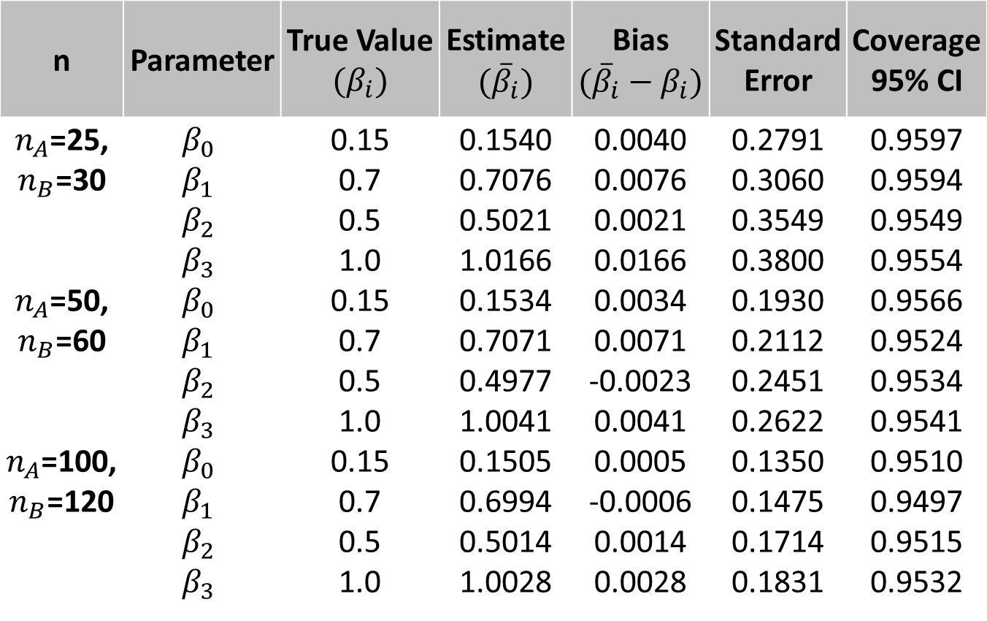
Results : Simulation Study - two covariates contd.
n | Parameter | True Value $${(β}_{i})$$ | Estimate $${(\overline{β}}_{i})$$ | Bias $$({\overline{β}}_{i}−β_{i})$$ | Standard Error | Coverage 95% CI
$n_{A}$=25, $n_{B}$=30 | $$β_{0}$$ | 0.15 | 0.1540 | 0.0040 | 0.2791 | 0.9597
 | $$β_{1}$$ | 0.7 | 0.7076 | 0.0076 | 0.3060 | 0.9594
 | $$β_{2}$$ | 0.5 | 0.5021 | 0.0021 | 0.3549 | 0.9549
 | $$β_{3}$$ | 1.0 | 1.0166 | 0.0166 | 0.3800 | 0.9554
$n_{A}$=50, $n_{B}$=60 | $$β_{0}$$ | 0.15 | 0.1534 | 0.0034 | 0.1930 | 0.9566
 | $$β_{1}$$ | 0.7 | 0.7071 | 0.0071 | 0.2112 | 0.9524
 | $$β_{2}$$ | 0.5 | 0.4977 | -0.0023 | 0.2451 | 0.9534
 | $$β_{3}$$ | 1.0 | 1.0041 | 0.0041 | 0.2622 | 0.9541
$n_{A}$=100, $n_{B}$=120 | $$β_{0}$$ | 0.15 | 0.1505 | 0.0005 | 0.1350 | 0.9510
 | $$β_{1}$$ | 0.7 | 0.6994 | -0.0006 | 0.1475 | 0.9497
 | $$β_{2}$$ | 0.5 | 0.5014 | 0.0014 | 0.1714 | 0.9515
 | $$β_{3}$$ | 1.0 | 1.0028 | 0.0028 | 0.1831 | 0.9532
Continued Table 2

Slide 37
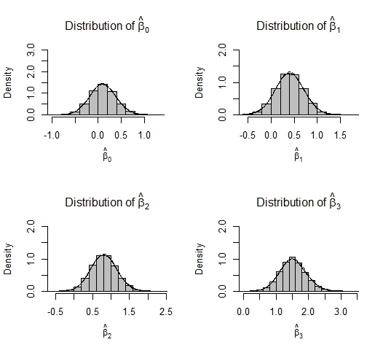
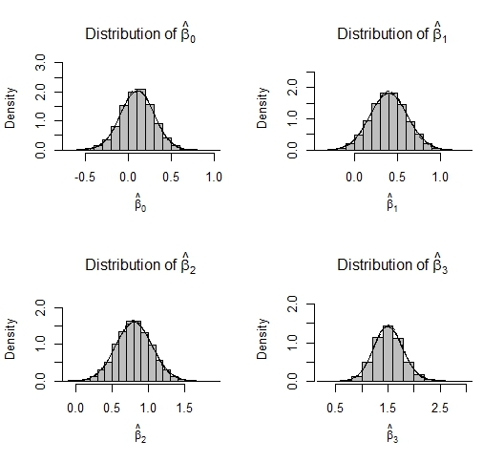
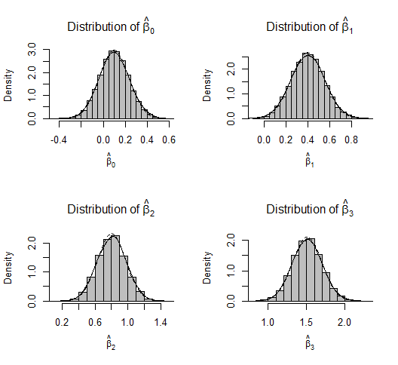



Distribution of Parameter Estimates
$$n_{A}=25;n_{A}=30$$
$$n_{A}=50;n_{A}=60$$
$$n_{A}=100;n_{A}=120$$

Slide 38
Example : FAS/FASD Randomized Controlled Trial
This trial was conducted in a pre-post design to evaluate effects of FASD education brochures (PG & CG) with different types of information and visual images on FASD related knowledge, attitudes and alcohol consumption among Russian childbearing age women (n=458).

Slide 39
Example : FAS/FASD Randomized controlled Trial
This trial was conducted in a pre-post design to evaluate effects of FASD education brochures (PG & CG) with different types of information and visual images on FASD related knowledge, attitudes and alcohol consumption among Russian childbearing age women (n=458).
Treatment GROUP: Positive and Control
Response : (CHANGE_DRINK) on average in last 3 months from one month follow-up to baseline and non-normal (p<0.001)
(After - Before)
Covariates : Two discrete (Y/N) covariates considered were “In the last 30 days, have you smoked cigarettes?” (SMOKE) and “In the last 30 days, did you take any other vitamins?” (OVITAMIN).

Slide 40
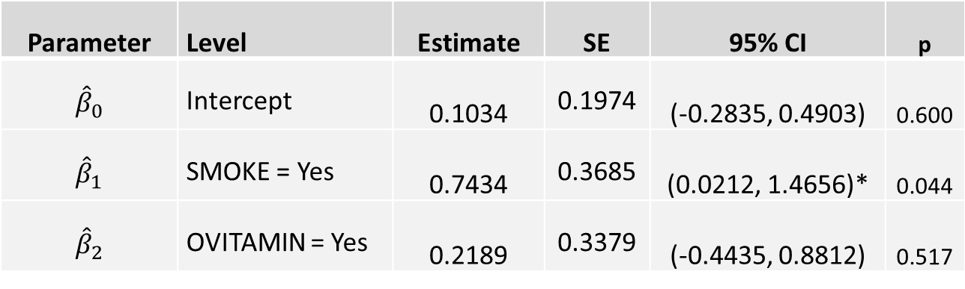
Results : FAS/FASD Trial
Model with two covariates
Parameter | Level | Estimate | SE | 95% CI | p
$${\hat{β}}_{0}$$ | Intercept | 0.1034 | 0.1974 | (-0.2835, 0.4903) | 0.600
$${\hat{β}}_{1}$$ | SMOKE = Yes | 0.7434 | 0.3685 | (0.0212, 1.4656)* | 0.044
$${\hat{β}}_{2}$$ | OVITAMIN = Yes | 0.2189 | 0.3379 | (-0.4435, 0.8812) | 0.517
* Significant

Slide 41
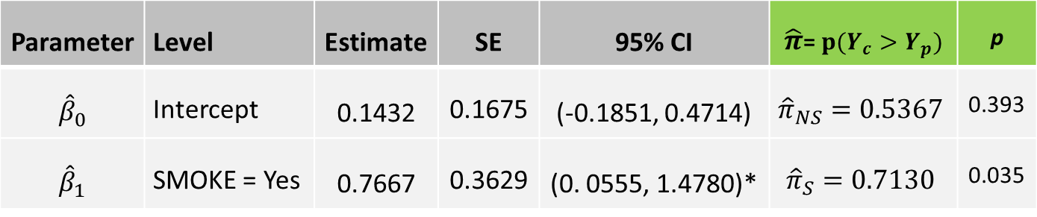

Results : FAS/FASD Trial
Model with a significant covariate only
Parameter | Level | Estimate | SE | 95% CI | $\hat{π}$=$p(Y_{c}>Y_{p})$ | p
$${\hat{β}}_{0}$$ | Intercept | 0.1432 | 0.1675 | (-0.1851, 0.4714) | $${\hat{π}}_{NS}=0.5367$$ | 0.393
$${\hat{β}}_{1}$$ | SMOKE = Yes | 0.7667 | 0.3629 | (0. 0555, 1.4780)* | $${\hat{π}}_{S}=0.7130$$ | 0.035
Final model: $logit\left(\hat{π}(SMOKE\right))={\hat{β}}_{0}+{\hat{β}}_{1}I\left(SMOKE=Yes\right)$
Predicted probability: ${\hat{π}}_{SMOKE}=\frac{e^{{\hat{β}}_{0}+{\hat{β}}_{1}∗SMOKE}}{1+e^{{\hat{β}}_{0}+{\hat{β}}_{1}∗SMOKE}}=0.7130$
$${\hat{π}}_{NO SMOKE}=0.5367$$
For e.g., $e^{0.7667}=2.1527$ is the odds ratio that the control group has smaller change in the number of drinks per day than the positive group for smokers

Slide 42
Discussion and Limitations
Linear models and Dodd & Pepe’s method suffer in absence of the reasonable amount of observations at each combination and so does this method.

Slide 43
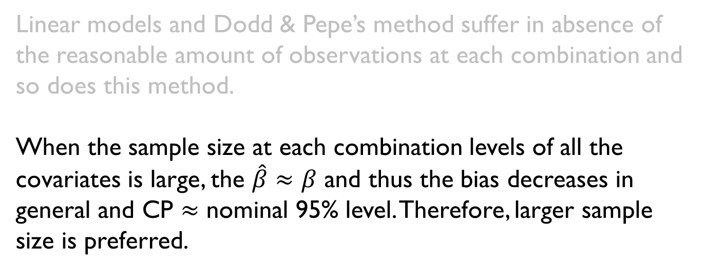
Discussion and Limitations contd.
Linear models and Dodd & Pepe’s method suffer in absence of the reasonable amount of observations at each combination and so does this method.
When the sample size at each combination levels of all the covariates is large, the $\hat{β}≈β$ and thus the bias decreases in general and CP $≈$ nominal 95% level. Therefore, larger sample size is preferred.

Slide 44
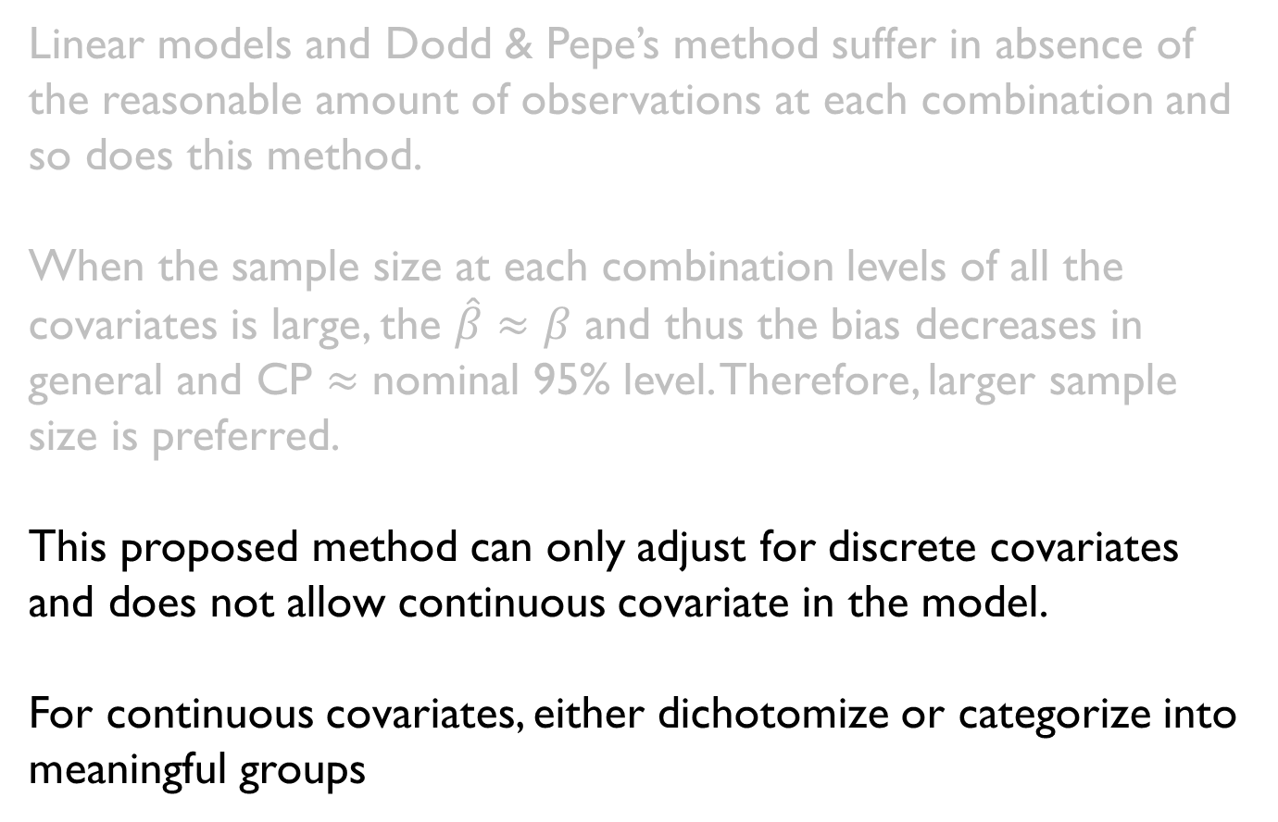
Discussion and Limitations contd.
Linear models and Dodd & Pepe’s method suffer in absence of the reasonable amount of observations at each combination and so does this method.
When the sample size at each combination levels of all the covariates is large, the $\hat{β}≈β$ and thus the bias decreases in general and CP $≈$ nominal 95% level. Therefore, larger sample size is preferred.
This proposed method can only adjust for discrete covariates and does not allow continuous covariate in the model.
For continuous covariates, either dichotomize or categorize into meaningful groups

Slide 45
Future Directions
The method proposed by Zhang, Zhao, & Tubbs (2011) can be expanded to models that can adjust for both discrete and continuous covariates.

Slide 46
Acknowledgement
Dr. Yan Daniel Zhao, Chair
Dr. Kai Ding
Dr. Tatiana Balachova
Drs. Tatiana Balachova and Barbara Bonner for FAS/FASD data
Dr. Michael Anderson
All BSE faculty, staff, and students

Slide 47
THANK YOU !
QUESTIONS?

Slide 48
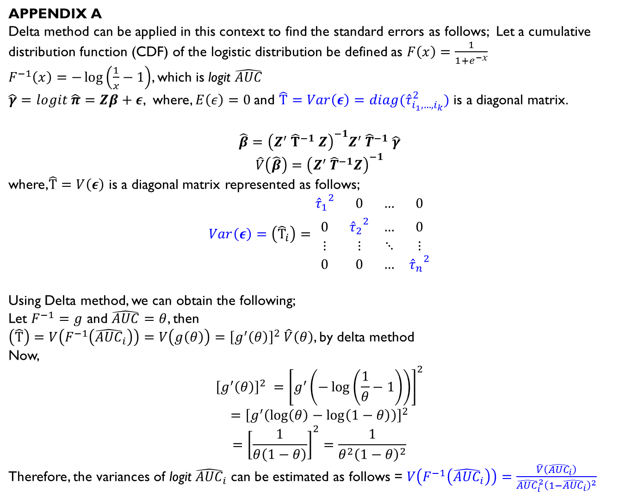
Appendix A
Delta method can be applied in this context to find the standard errors as follows; Let a cumulative distribution function (CDF) of the logistic distribution be defined as $F\left(x\right)=\frac{1}{1+e^{−x}}$
$F^{−1}\left(x\right)=−\log\left(\frac{1}{x}−1\right)$, which is logit $\hat{AUC}$
$\hat{γ}=logit \hat{π}=Zβ+ε$, where, $E\left(ε\right)=0$and $\hat{T}=Var\left(ε\right)=diag({\hat{τ}}_{i_{1},…,i_{k}}^{2})$ is a diagonal matrix.
$$\hat{β}={\left(Z^{′} {\hat{T}}^{−1} Z\right)}^{−1}Z^{′} {\hat{T}}^{−1} \hat{γ}$$
$$\hat{V}\left(\hat{β}\right)={\left(Z^{′} {\hat{T}}^{−1}Z\right)}^{−1}$$
where,$\hat{T}=V\left(ε\right)$ is a diagonal matrix represented as follows;
$$Var\left(ε\right)=\left({\hat{T}}_{i}\right)=\begin{matrix}{{\hat{τ}}_{1}}_{ }^{2} & 0 & … & 0 \\ 0 & {{\hat{τ}}_{2}}_{ }^{2} & … & 0 \\ ⋮ & ⋮ & ⋱ & ⋮ \\ 0 & 0 & … & {{\hat{τ}}_{n}}_{ }^{2}\end{matrix}$$
Using Delta method, we can obtain the following;
Let $F^{−1}=g$ and $\hat{AUC}=θ$, then
$\left(\hat{T}\right)=V\left(F^{−1}\left({\hat{AUC}}_{i}\right)\right)=V\left(g\left(θ\right)\right)={\left[g^{′}\left(θ\right)\right]}^{2} \hat{V}\left(θ\right)$, by delta method
Now,
$${\left[g^{′}\left(θ\right)\right]}^{2} ={\left[g^{′}\left(−\log\left(\frac{1}{θ}−1\right)\right)\right]}^{2}$$
$$={\left[g^{′}\left(\log\left(θ\right)−\log\left(1−θ\right)\right)\right]}^{2}$$
$$={\left[\frac{1}{θ\left(1−θ\right)}\right]}^{2}=\frac{1}{θ^{2}{\left(1−θ\right)}^{2}}$$
Therefore, the variances of logit ${\hat{AUC}}_{i}$ can be estimated as follows = $V\left(F^{−1}\left({\hat{AUC}}_{i}\right)\right)=\frac{\hat{V}\left({\hat{AUC}}_{i}\right)}{{\hat{AUC}}_{i}^{2}{\left(1−{\hat{AUC}}_{i}\right)}^{2}}$
Back to estimation

Slide 49
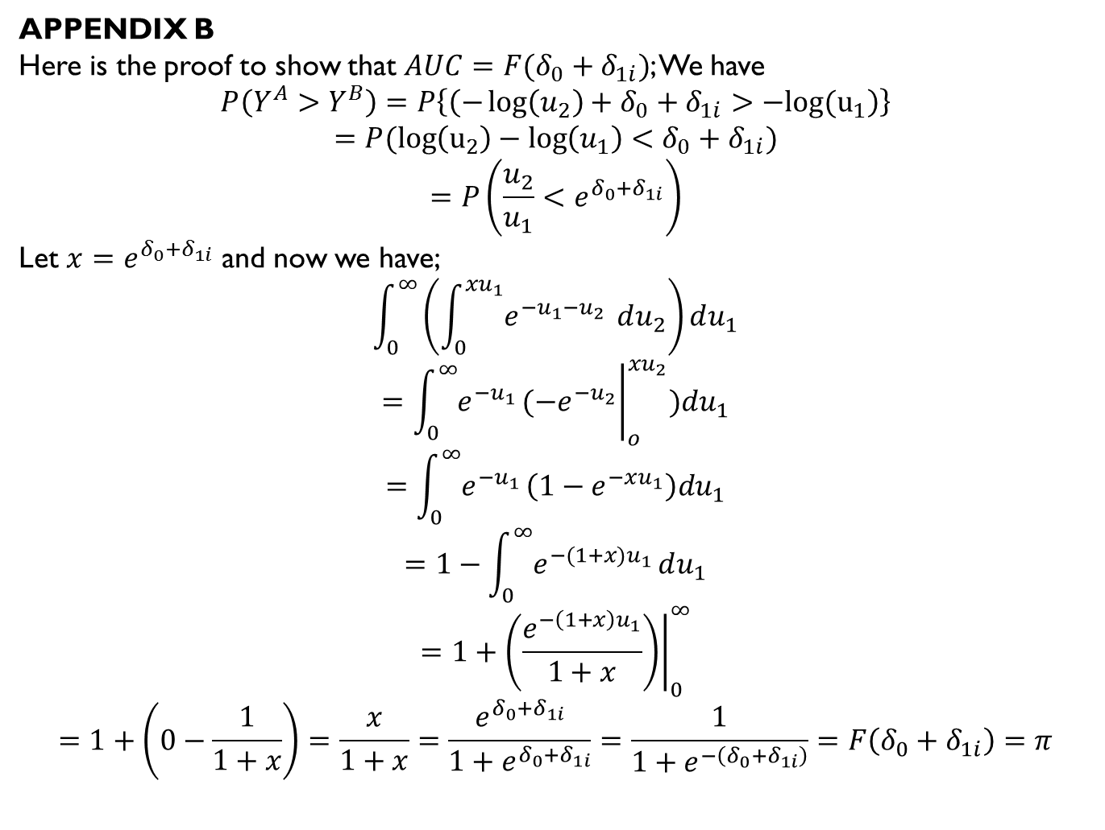
Appendix B
Here is the proof to show that $AUC=F(δ_{0}+δ_{1i})$; We have
$$P\left(Y^{A}>Y^{B}\right)=P\left\{\left(−\log\left(u_{2}\right)+δ_{0}+δ_{1i}>−log(u_{1}\right)\right\}$$
$$=P(\log\left(u_{2}\right)−\log\left(u_{1}\right)<δ_{0}+δ_{1i})$$
$$=P\left(\frac{u_{2}}{u_{1}}<e^{δ_{0}+δ_{1i}}\right)$$
Let $x=e^{δ_{0}+δ_{1i}}$ and now we have;
$$\int_{0}^{∞}{\left(\int_{0}^{xu_{1}}{e^{−u_{1}−u_{2}}} du_{2}\right)}du_{1}$$
$$={\left.\int_{0}^{∞}{e^{−u_{1}}}(−e^{−u_{2}}\right|}_{o}^{xu_{2}})du_{1}$$
$$=\int_{0}^{∞}{e^{−u_{1}}}\left(1−e^{−xu_{1}}\right)du_{1}$$
$$=1−\int_{0}^{∞}{e^{−{(1+x)u}_{1}}}du_{1}$$
$$=1+{\left.\left(\frac{e^{−\left(1+x\right)u_{1}}}{1+x}\right)\right|}_{0}^{∞}$$
$$=1+\left(0−\frac{1}{1+x}\right)=\frac{x}{1+x}=\frac{e^{δ_{0}+δ_{1i}}}{1+e^{δ_{0}+δ_{1i}}}=\frac{1}{1+e^{−\left(δ_{0}+δ_{1i}\right)}}=F\left(δ_{0}+δ_{1i}\right)=π$$
Back to data generation

Slide 50
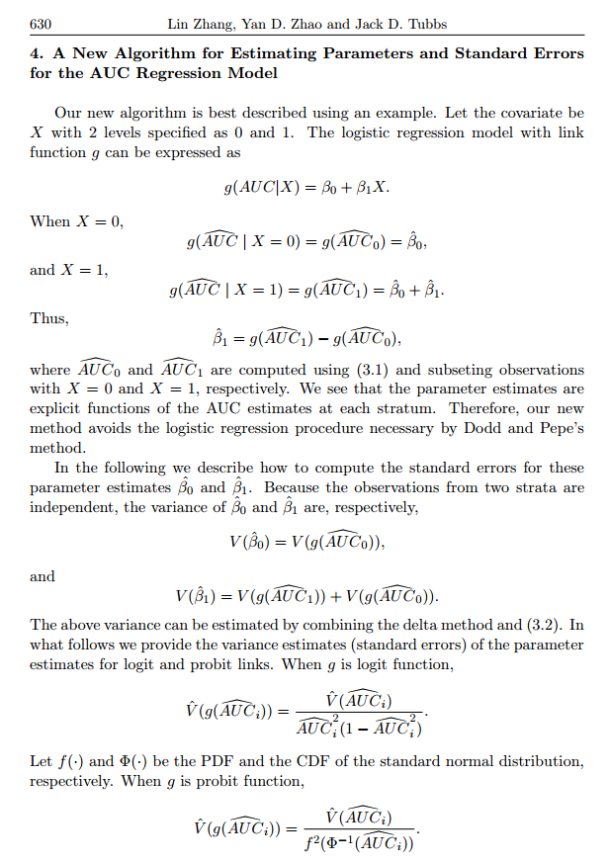
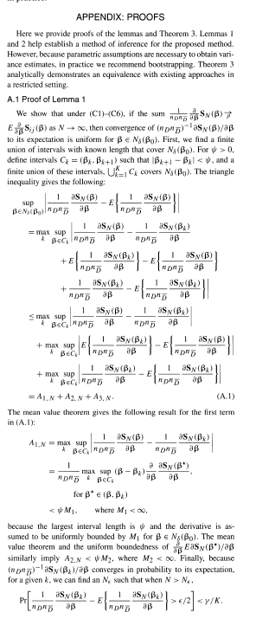
Compare zhang et al. (2011) & Dodd and pepe (2003)

Slide 51
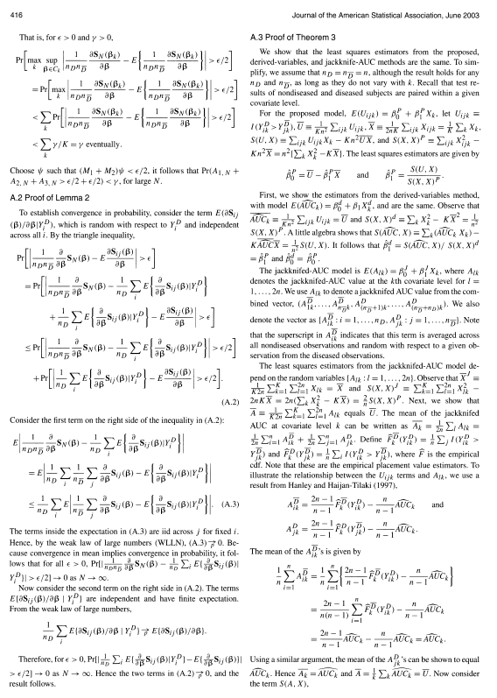
Compare zhang et al. (2011) & Dodd and pepe (2003)

