Slide 1
Literate Programming Patterns and Practices with REDCap and REDCapR
Will Beasley, Thomas Wilson, David Bard OUHSC Pediatrics,
Biomedical & Behavioral Methodology Core (BBMC)
Statistical Computing User Group (SCUG)
Sept 2, 2014

Slide 2
Differences in the past 1.5 years
Compared to the March 2013 presentation…
There’s less coverage of REDCap’s strengths & weaknesses.
No coverage of lower-level strategies, such as direct API calls or raw CSV export/imports.
More specifics about reporting.
More guidance on security strategies.

Slide 3
Continuous Quality Improvement (CQI)
Defined by HRSA as “a continuous process that employs rapid cycles of improvement”
We provide a detailed, yet generalizable, illustration of CQI benefiting from REDCap and literate programming, which hopefully will increase the
speed of development,
consistency of implementation,
adherence to recommended security practices,
complexity of statistical analyses,
breadth of audience, and
frequency of informative CQI cycles.

Slide 4
Literate programming
Literate programming tools can combine statistical text, tables, and graphs in a coherent document that is accessible to unfamiliar audiences.
The automation of these tools eliminates the need to repeatedly copy and paste analytic results after underlying data sources are updated.

Slide 5
Collaboration among
The 4 statisticians on the project. sharing software development.
The 20 people on the project. exchanging participant-level data.
The 3 partnering organizations. (OSDH, WIC, OHCA) -receiving their subject-level & agency-level data. -distributing our results –fresh & frequently.
Academics in different areas. (particularly at OUHSC) exchanging tools and workflows.
Researchers in other states pursuing similar goals. publishing ideas and replicating previous work.

Slide 6
REDCap overview (http://project-redcap.org/)
Secure web application for building and managing surveys and databases.
Developed by informatics core at Vanderbilt with support from NCRR and NIH, and designed for academic biomedical researchers.
Provides:
Auditing capabilities, and other HIPAA-friendly features by default.
A centralized, back-end storage component.
Tools to create an interactive front-end html GUI.
An API to import & export data.
Example templates.
Instructional videos for training.
User-group network of institutional researchers.
Also included: built-in project calendar, scheduling module, ad hoc reporting tools, and advanced features, such as branching logic, file uploading, and calculated fields.
It can reduce
Developing a lot of new software applications.
Anxieties related to security of home-grown software.

Slide 7
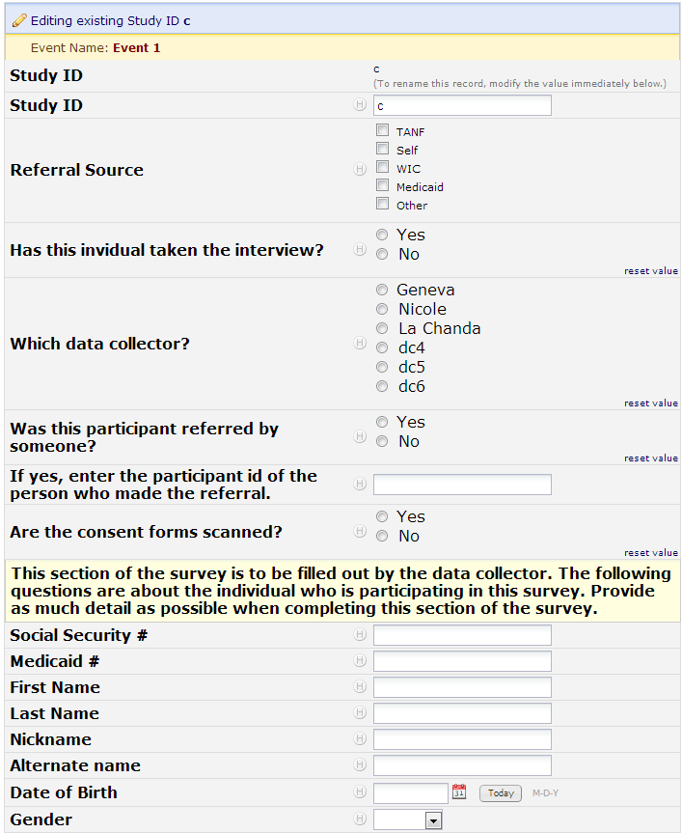
Example data entry

Slide 8
Possible REDCap Workflows

Slide 9
Scenarios favoring REDCap
Project requires a centralized data store, but multiple locations for data entry. - Avoid syncing different locations manually.
You want a flexible, universal framework to create consistent data systems for multiple clinical projects (research and possibly operations). - Reduces your development time & your staff’s training time. - Reduces writing new text for grant proposals and IRB?
Project has a relatively flat data structure.
Typically accommodates 2 or 3 levels well, but is clumsy beyond that. County, Practice, Provider, Patient, Time, Family.

Slide 10
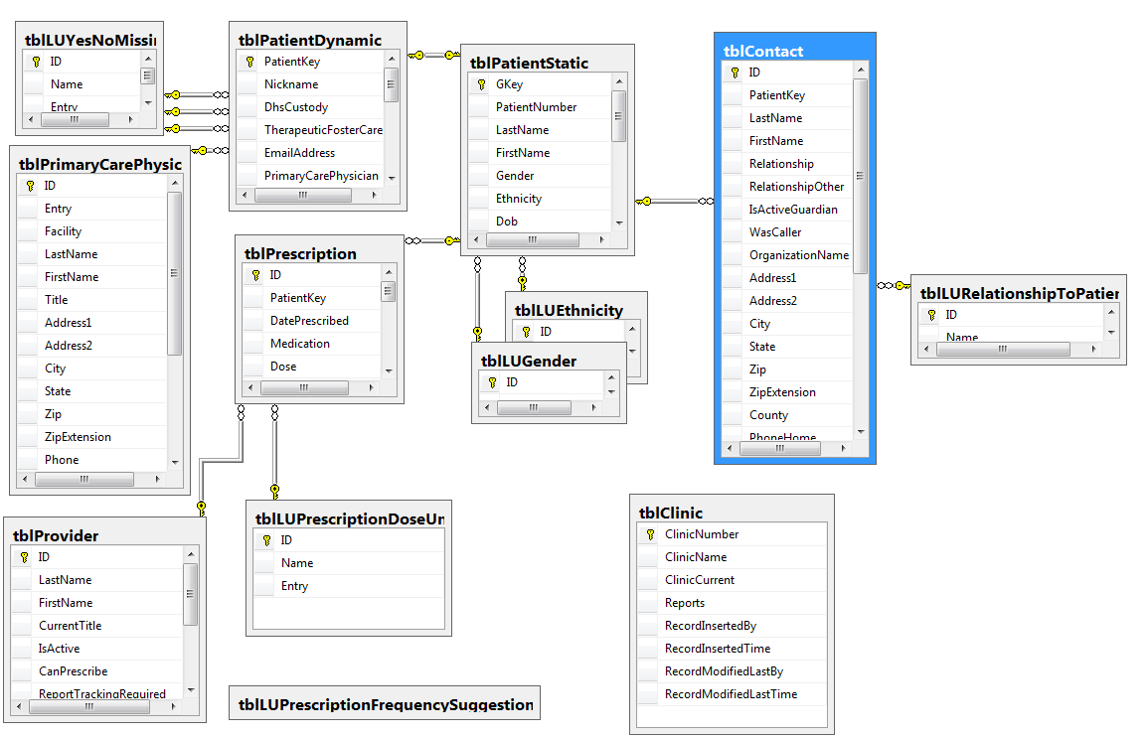
Scenario NOT favoring REDCap

Slide 11
Scenarios favoring REDCap
There are lots of dimensions and trade-offs when designing clinical research, and REDCap is close to the sweet spot for most designs.
Access, SQL Server, Survey Monkey, Qualtrics, Concerto, E-prime, Excel, EMR.

Slide 12
Accessing REDCap from R
Manual Import & Export (eg, through CSV files)
Require human interaction every time.
R calls REDCap’s API (application programming interface)
An API allows nonhumans to interact with each other directly.
REDCapR call REDCap’s API (an R library)
Provides functions that wrap around calls to API.
Write 1 line of R code instead of ~40 lines.

Slide 13
Required pieces of information for API
The URL of the REDCap server.
A “token”, which is a hash that combines:
The specific REDCap project (within the REDCap server).
The specific user.
The user’s password.

Slide 14
Security
Could spend 4 hours discussing security details.
Consult REDCap IT staff and/or our team.
Use a private GitHub repository. (free for academics)
Be careful with REDCap tokens. (ie, passwords)
Get PHI into REDCap & SQL as early as possible.
We regularly receive CSVs & XLSXs from partners.
DB files aren’t accidentally copied or emailed.
And try to store derivative datasets in REDCap & SQL instead of on the file server.

Slide 15
Underlying Security Concepts Part 1
Principle of least privilege: expose as little as possible.
Limit the number of team members.
Limit the amount of data (consider rows & columns).
Obfuscate values and remove unnecessary PHI in derivative datasets.
Redundant layers of protection.
A single point of failure shouldn’t be enough to breach PHI security.

Slide 16
Underlying Security Concepts Part 2
Simplify when possible.
Store data in only two houses. (REDCap & SQL Server)
Easier to identify & manage than a bunch of PHI CSVs scattered across a dozen folders, with versions.
Manipulate your data programmatically, not manually.
Windows AD account controls everything, indirectly or directly. (VPN, Odyssey, file server, SQL Server, & REDCap)
Lock out team members where possible. It’s not that you don’t trust them with a lot of unnecessary data, it’s that you don’t trust their ex-boyfriend and their coffee shop hacker.

Slide 17
Installing REDCapR
### Read short intro at
# https://github.com/OuhscBbmc/REDCapR
### Install the 'devtools' package from CRAN
install.packages("devtools")
### Install the 'REDCapR' package from GitHub
devtools::install_github(repo="OuhscBbmc/REDCapR")
### Load the 'REDCapR' package into R's memory
# so the functions are more easily accessible.
require(REDCapR)

Slide 18
Minimal Code without REDCapR
### This is if you DO NOT use REDCapR, or some similar package.
### Query REDCap API
rawCsvText <- RCurl::postForm(
uri="https://bbmc.ouhsc.edu/redcap/API/",
token="39ZZZZZZZZZZ377009A4434F3D86E363", #Be careful w/ real tokens.
content='record',
format='csv',
type='flat',
.opts=curlOptions(ssl.verifypeer=FALSE)
)
### Convert raw text into a data.frame
head(rawCsvText) #Inspect the raw data, if desired.
ds <- read.csv(text=rawCsvText, stringsAsFactors=FALSE)
head(ds) #Inspect the new data.frame, if desired.

Slide 19
Exporting records (less secure)
### Declare the address of the server and
# your token (ie, hash of project_id, username, password)
uri <- "https://bbmc.ouhsc.edu/redcap/api/"
token <- "9A81268476645C4E5F03428B8AC3AA7B"
### Call the server
result_read <- redcap_read(redcap_uri=uri, token=token)
### Extract the dataset from the results
ds <- result_read$data
ds
record_id first_name age
1 1 Nutmeg 10
2 2 Tumtum 11
3 3 Marcus 79
4 4 Trudy 61
5 5 John Lee 58

Slide 20
Exporting records (less secure)
### Inspect all returned content
$success
[1] TRUE
$status_code
[1] 200
$outcome_message
[1] "5 records and 3 columns were read from REDCap in 0.34 seconds. The http status code was 200."
$records_collapsed
[1] ""
$fields_collapsed
[1] "recordid,first_name,age"
$elapsed_seconds
[1] 0.3417

Slide 21
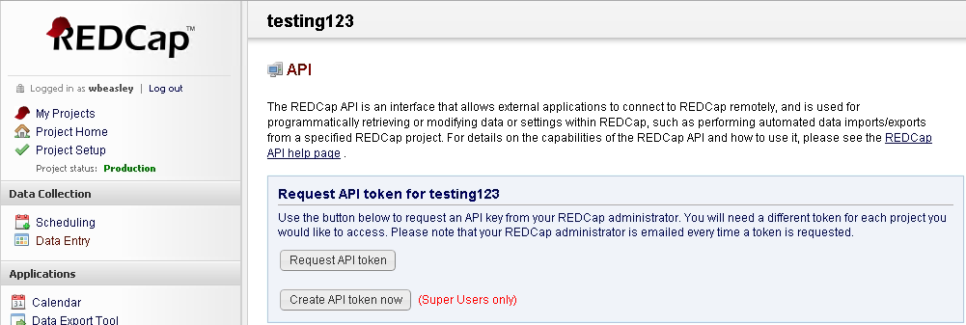
Requesting an API token
Request your token for a specific project.
Then wait for the Admin’s approval.

Slide 22
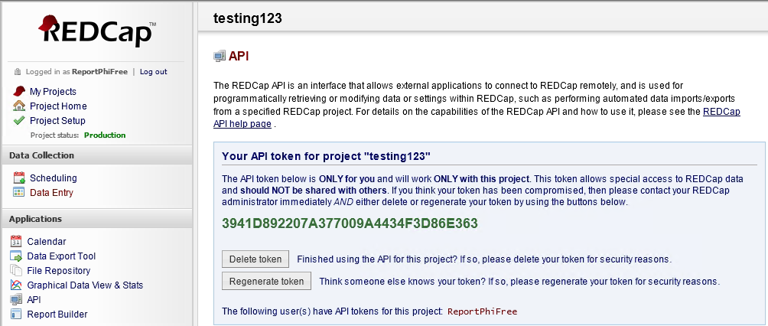
Retrieve a token
Copy the green text into your code.
(This token has been regenerated for security purposes. It won’t work anymore. In a sense, we changed the password.)

Slide 23
GitHub: Version Control Software
Think MS Word’s ‘Track Changes’ feature, but
Retains the entire history of each document.
Allows parallel development between people.
Synchronizes changes among different contributors.
A central repository exists on the server.
Each developer maintains her own local repository.
You can establish your first repository and learn the essentials within two hours.

Slide 24
Token Storage (part 1)
Wish List:
Code is portable across computers.
Code is entirely contained in Git repository.
Git repository contains no PHI, passwords, or tokens.
Local machine contains no PHI, passwords, or tokens.
Tokens are stored, so user doesn’t have to retype 9A81268476645C4E5F03428B8AC3AA7B every operation.
Two feasible options:
Encrypt and store on local machine (like ssh-agent). Violates #4.
Use Windows AD/LDAP credentials to call SQL Server. Requires ODBC DSN on local computer, so violates #2.

Slide 25
Token Storage (part 2)
We felt option #2 is the best for OUHSC’s LDAP infrastructure:
LDAP credentials passed to SQL Server through an ODBC DSN on local computer.
User needs to maintain only her Windows AD password.
Password is required only once at OS login.
That single password is managed securely by the OS, and transmitted across the wire, where the SQL Server database then uses it.
Unauthenticated users can’t even get into the database, much less retrieve an unauthorized token.
Git Repository contains no password, token, or even database server address.
→ We host a small database dedicated to serving tokens.

Slide 26
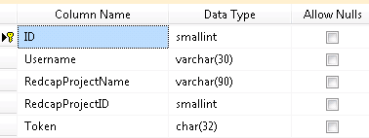
Token Storage (part 3)
Table:
Stored Procedure: system_user returns LDAP username (eg, ‘OUHSC/krichards’)
R Code: references the DSN TokenSecurity and requests user’s token for Project2 REDCap project.
SELECT Token FROM [RedcapPrivate].tblToken
WHERE Username = system_user AND RedcapProjectName = @RedcapProjectName
channel <- RODBC::odbcConnect(dsn="TokenSecurity")
token <- RODBC::sqlQuery(channel, "EXEC [Redcap].[prcToken] @RedcapProjectName = 'Project2'",
stringsAsFactors=FALSE)[1, 'Token']
RODBC::odbcClose(channel)

Slide 27
Token Storage (part 4)
Safeguards & Concerns:
Admins for SQL Server are the same for REDCap server, so the threat envelope isn’t larger.
Table’s accessibility is tighter than the stored procedure’s
Unfortunately, SQL Server and Windows AD discourage other OSes.
Future plans:
Wrap in a REDCapR function.
User inserts their own token through REDCapR.
token <- retrieve_token(dsn="TokenSecurity", project="Project2")
set_token(dsn="TokenSecurity", project="Project2", token=prompt_input("Enter Token:")
)

Slide 28
Other Storage (part 5)
Use pattern for any content too sensitive for repo.
Works best for meta-data, not subject-data.
eg, URL of REDCap Server.
eg, File path of CSV on file server containing PHI.
Possible to redirect different users to different values.
If 5 users have API access to a single REDCap project, the database table will have 5 rows, each with a unique token.

Slide 29
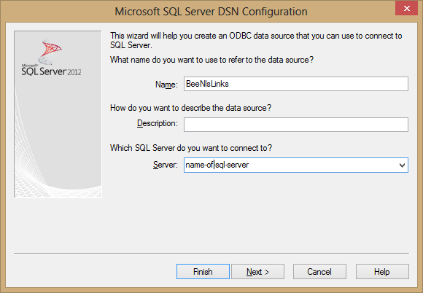
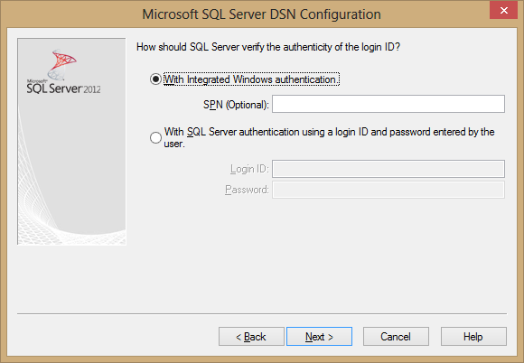
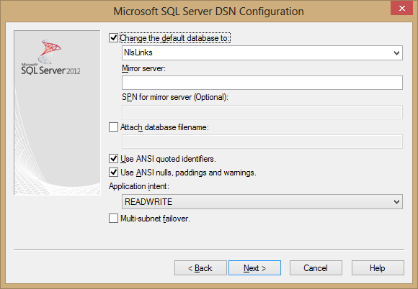
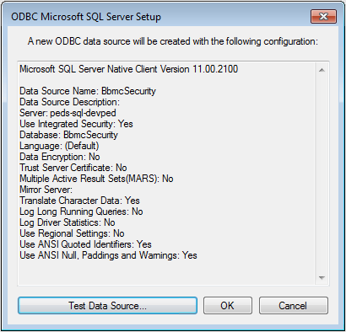
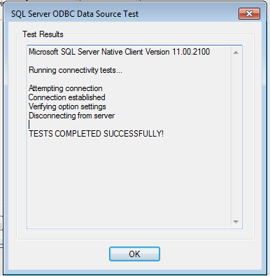
Establish DSN
Download most recent driver
Set server name
Set to “Integrated Security”
Set database name
Verify connection
-No passwords-

Slide 30
Possible REDCap Workflows

Slide 31
Perks of REDCapR (part 1)
Batching: making smaller calls to server, and combining the results to appear as if only one call was made.
Avoids server-time outs.
Can suspend between calls, to avoid tying up server.
Translates: resolves differences between API and R.
eg, R stores IDs as a vector c(10, 20, 30), while the API needs a string "10,20,30"
Validates: proactively looks for common mistakes.
Helps catch errors sooner,
Better error messages b/c it’s closer to error’s source.
Subset: easier to avoid retrieving an entire dataset.
Fewer rows.
Fewer columns.

Slide 32
Perks of REDCapR (part 2)
SSL: provides extra transport security, by default.
Assumes responsibility for updating certificates.
Unit & Integration Tested: 100+ checks before release.
Corner cases are being added every month.
Wider Adoption: Library is used across multiple projects.
More assurances than evolving code that’s copy & pasted.
Builds on experience within and between libraries (eg, PyCap Python package and redcap R package).

Slide 33
knitr
Executes R code, and presents results in a coherent document.
Eliminates the need to repeatedly copy & paste:
Multiple descriptives, graphs, and model results.
Updated results after more data trickles in.
Can produce markdown reports that can be quickly produced internal audiences.
Can produce LaTeX reports that can be beautifully crafted for external audiences.

Slide 34
knitr Examples
Descriptives & graphs in markdown.
Descriptives & graphs in LaTeX.
Inferential model results in LaTeX.
markdown report on GitHub. https://github.com/OuhscCcanMiechvEvaluation/MReporting/blob/master/OhcaReports/OhcaReport1/OhcaReport1.md

Slide 35
Shiny
Web interface for interactive graphs, stats & tables.
https://wibeasley.shinyapps.io/SdtThreshold/
Currently our BBMC server is configured only for public information, not PHI data.
Consequently, it can’t pull data from REDCap, but csv data can be pushed to it.

Slide 36
Pattern List (part 1)
Extractor: exports/pulls REDCap data to R, and lightly munge, such as
calculate timespans,
convert categories levels into factors, and
clean up missing values.
It is called by reports and sanitizers.
Gateway: exports/pulls SQL Server data to R and lightly munge. (Subset of Fowler 2002)
It is called by called by reports and other gateways.

Slide 37
Pattern List (part 2)
Transfer 1: moves external data (eg, sent from OSDH) to SQL Server, where it is audit-able.
read CSV into R
verify structure is the same as the previous import.
lightly munge.
Transfer 2: moves data from SQL Server to REDCap
eg, so recruiters view in REDCap, instead of SQL Server. It’s a lot cheaper/quicker to set up a two-way bound interface in REDCap than in other databases.
¿Any recommendations for distinguishing names?

Slide 38
Pattern List (part 3)
Sanitizer: pulls from a gateway or extractor, and removes PHI and anything else that we don’t want publicly exposed. Sanitizers are required before copying data to Shiny.
Data Access Layer (DAL): collection of the previous 5 patterns. (Fowler 2002)

Slide 39
Pattern List (part 4)
Code Behind: R file that does all the heavy lifting in an analysis
Report: Rmd file that’s a thin layer on top of the ‘Code Behind’ file. It only presents info, and doesn’t manipulate or calculate.
Common Report Components?: Contains code and graph templates that are used by multiple reports. The results are typically more consistent, and higher quality.

Slide 40
Goals
Reproducible research.
Facilitates scientific replication.
Disseminates techniques to other subfields.
Promotes cumulative research.
Literate programming.
Evaluated programs need fresh & frequent feedback.
Collaborative Development.

Slide 41
Beyond REDCap
Today’s mechanics were specific to REDCap, but the goals aren’t.
Regardless of the database chosen,
Minimize the repetition code within & between projects.
Use tested code where possible.
Use code instead of manual operations.
Use automated reports instead of ad-hoc reports.

Slide 42
Thanks to Funders
HRSA/ACF D89MC23154
OUHSC CCAN Independent Evaluation of the State of Oklahoma Competitive Maternal, Infant, and Early Childhood Home Visiting (MIECHV) Project.
Evaluates MIECHV expansion and enhancement of Evidence-based Home Visitation programs in four Oklahoma counties.

