Slide 1
Adding Graph Visualization on SAS® ODS Output
Yu Fu, Shirmeen Virji, Miriam McGaugh, Goutam Chakraborty

Slide 2

Introduction
Graphviz is open source graph visualization software. It can represent structural information in the form of various diagrams such as networking, cluster, and process flows.
Using Graphviz in Base SAS (PUT,FILE and X Statment)

Slide 3
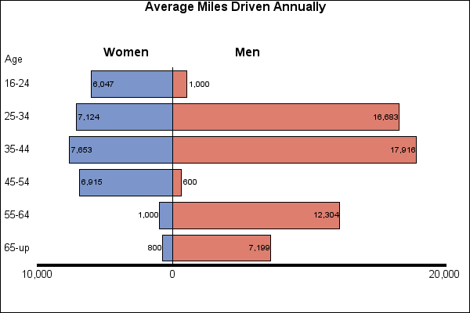
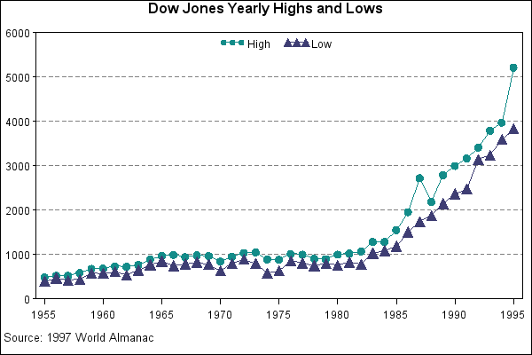
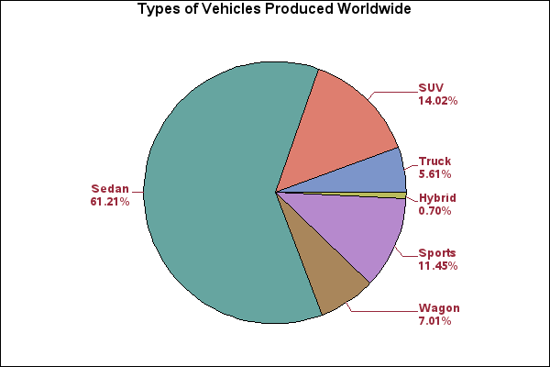
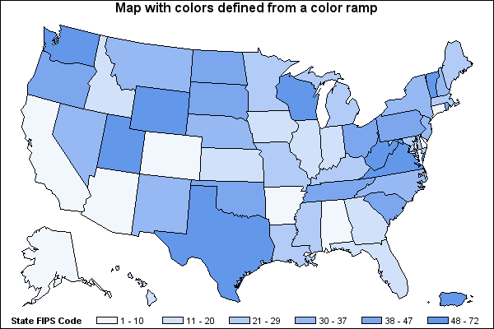
What we can do with SAS
support.sas.com

Slide 4
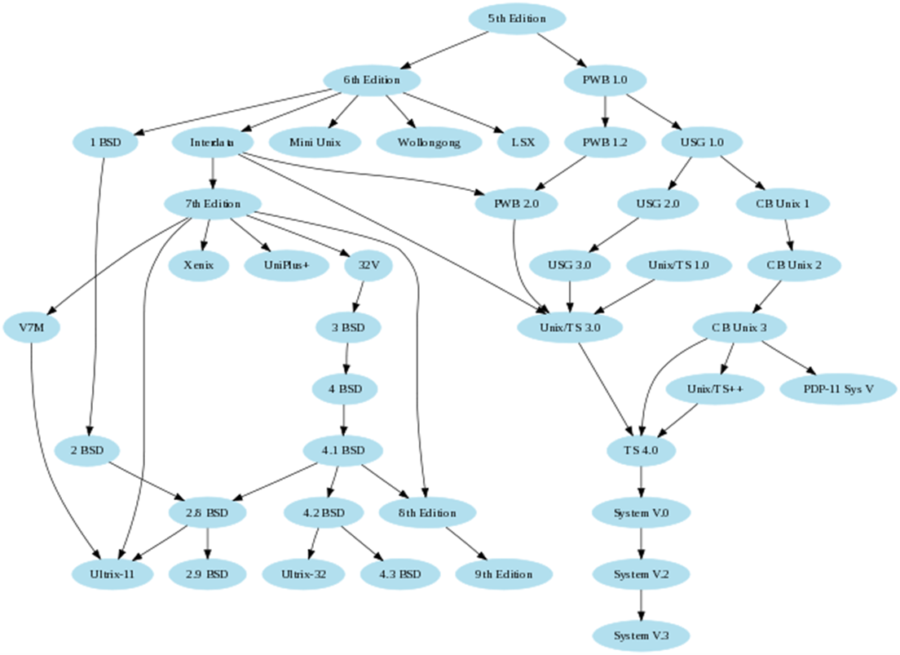
Can we do more?
www.graphviz.org

Slide 5
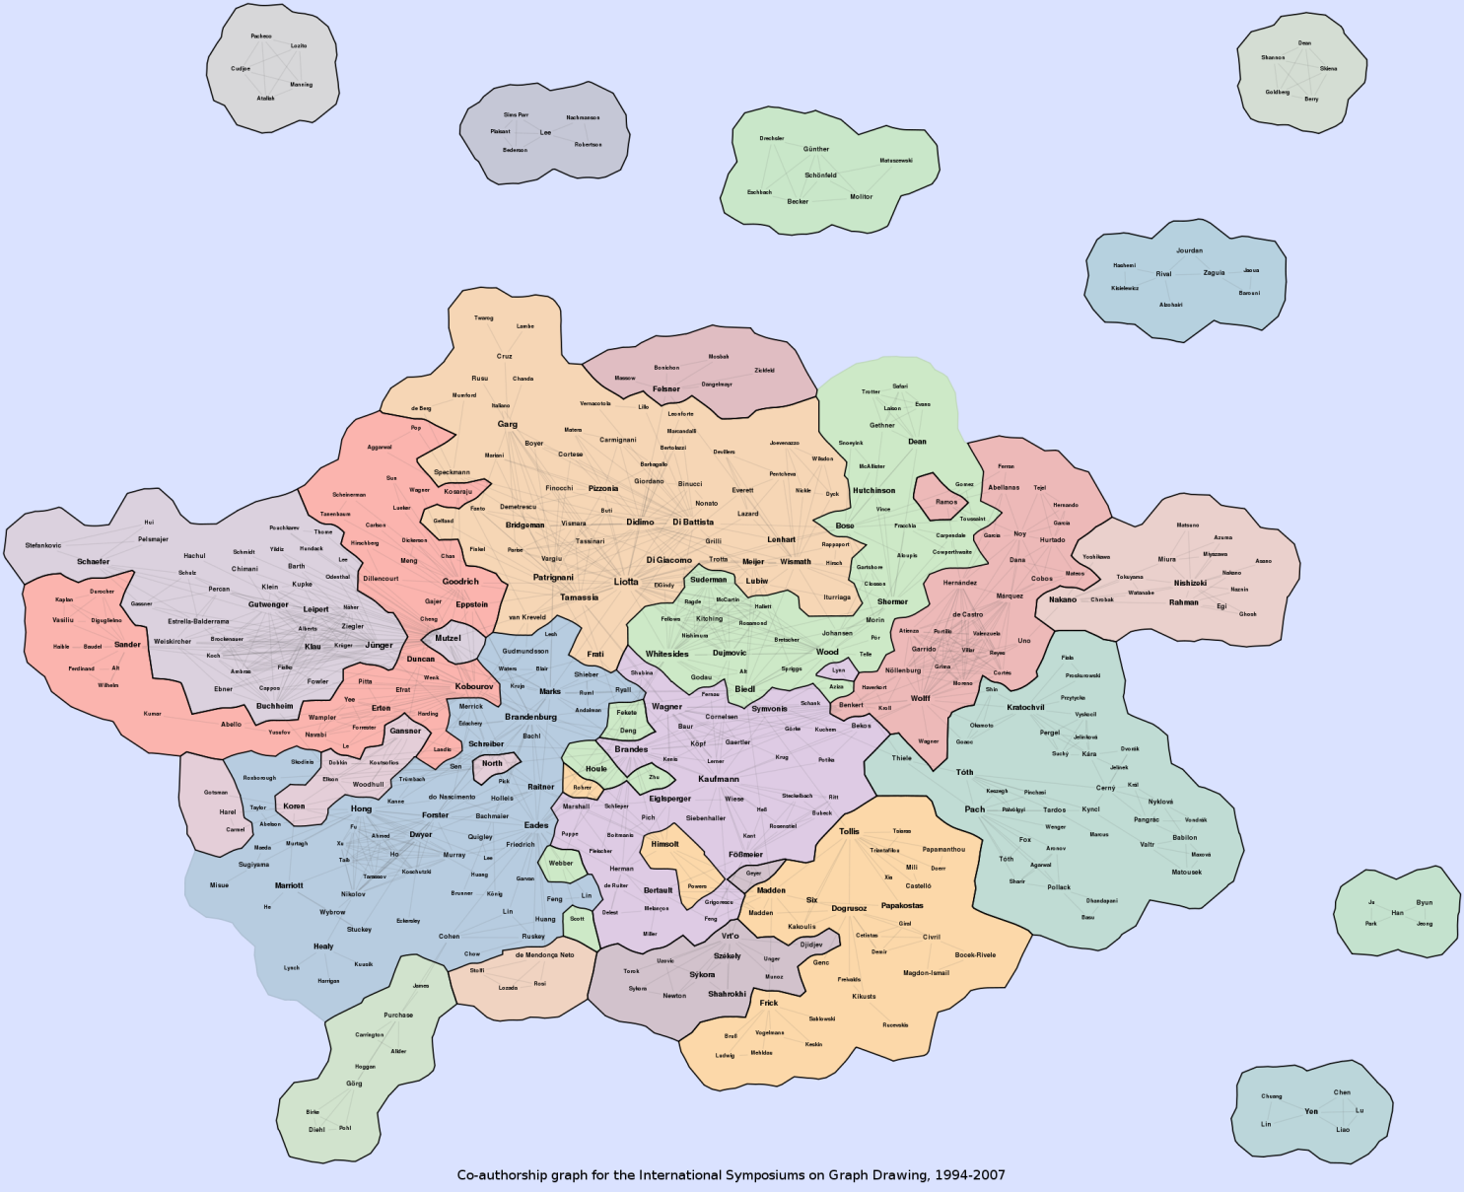
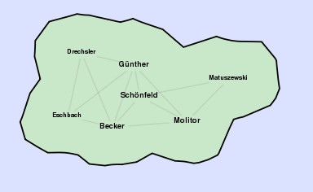
Can we do more?
www.graphviz.org

Slide 6
Graphviz Code
digraph G {
P1->P2[label=Friend];P1->P3[Label=Son];
P1->P4[label=Father];P1->P5[label=Husband];
}

Slide 7
Methods
Generate the Graphviz program
Call the Graphviz program to create image
Merge the image with ODS output
Generate the Graphviz program by FILE and PUT Statement
Call the Graphviz program to create image by X Statement
Merge the image with ODS output

Slide 8

















Scenario
What’s the relationship among
these data sets?

Slide 9
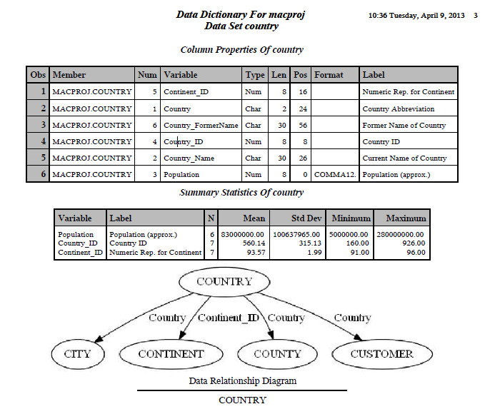
Relationship Diagram in ODS Output

Slide 10
Conclusion
BASE SAS can add specific graph visualization in an ODS output by interacting with an open source software “Graphviz
This method provides a complement to the current SAS graph system and let SAS users have more options to visualize their results generated in SAS.

