Slide 1
A Quick Survey of R Usage:
Some of Our Favorite Programming, Graphical, Reporting, and Analysis Features
David Bard, Will Beasley, Thomas Wilson

Slide 2
Objectives
Caveat: Quick Survey of R
Focus on breadth, minimal depth
Brief intro to R
History
Concept and Purpose
Programming language
Support
Text Editors & Integrated Development Environments
Survey of Analytics
Survey of Graphs
Analytic & Graphical Application
Literate Programming
Summary

Slide 3
History and Purpose of R
Historical Timeline
Researchers at Bell Labs Developed S from 1976 to 1998
The commercial version of S-Plus is sold by Insightful.
Researchers in New Zealand started R in mid-1990s
R and S have a compatible syntax, but a different implementation underneath
Purpose
Free, open source statistics and graphics environment
Large user community
Ubiquitous help
CRAN: for documentation and vignettes
JSS (Journal of Statistical Software)
R-Forge

Slide 4
Getting Started
Download it from http://www.r-project.org

Slide 5
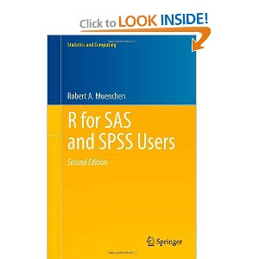
Programming Essentials
Basic Architecture
Two programming languages
S/S-Plus
Scheme (Lisp dialect; functional programming)
“The R language completely integrates accessing and managing data, running analytic procedures, performing repetitive “macros”, managing output (as SAS ODS or SPSS OMS) and adding new functions through matrix algebra functions all in a single consistent style of programming. Other software typically uses a different language for each of those steps.” (Muenchen http://www.et.bs.ehu.es/~etptupaf/pub/R/RforSAS&SPSSusers.pdf)
Basic R Objects
vector
array
matrix
data.frame
list

Slide 6
Code Development Essentials
R is a command-line shell application
Do NOT program directly in R!!!
Need a text editor or IDE that calls or embeds R console
Integrated Development Environments
Software applications that provide comprehensive facilities to computer programmers for software development
Source code editor
Build automation tools (scripting tasks, documentation, etc.)
Debugger
Compiler
Interpreter

Slide 7
Some of Our Favorite IDEs
Eclipse
Advantages
Familiar set-up to software development IDEs like Visual Studio
Multi-screen use of R console
Hover help support
Version control
Disadvantages
Difficult to learn, install, and troubleshoot
RStudio
Advantages
Highly intuitive
Easy visualization of objects
Version control
Interactive plotting with Manipulate feature
Disadvantages
No multi-monitor support, except for pop-out windows for graphics

Slide 8
Functional & Object Oriented Programming Capabilities
Functional programming similar to SAS/IML
R comes with plethora of pre-existing functions written in R, C, Fortran, …
Can view source code for functions; adapt them to your liking
Do most everything in R using plain declarative statements.
Most operations work element-wise; no need to loop through vector
Can operate selectively on indexed elements
Or operate on elements meeting specified demands
R capable of fully general Object-Oriented Programming (OOP) features based on generic functions instead of class hierarchies (see Mertz http://www.ibm.com/developerworks/linux/library/l-r3/index.html)

Slide 9
Some of Our Favorite Data Manipulation Advantages
Attaching mean or any group-level calculation to each observation
Using and Customizing functions
Standardizing variables
ds <- ddply(ds, c("Gender", "Yob"), transform, HeightZGenderYob=scale(Height))
Creating and running simulations
Simulation studies
Decent parallel processing capability
Bootstrapping SE’s
See also Zelig package
Easy exchange through ODBC

Slide 10
Data Analysis Essentials
Installing and loading libraries/packages
Sophisticated new analyses are available
When a methodologist develops a new procedure, the articles is sometimes accompanied by an R package. The readers are more likely to apply it to their research, especially if it has adequate documentation.
Examples
spdep: http://cran.r-project.org/web/packages/spdep/
lme4: http://cran.r-project.org/web/packages/lme4/
NlsyLinks: http://cran.r-project.org/web/packages/NlsyLinks/

Slide 11
Some of Our Favorite Analytic Packages
GLM
lm, glm (for the general and the generalized linear model, respectively)
Mixed effects models
Bates packages: lme4, nmle
http://glmm.wikidot.com/faq
Structural Equation Modeling and Factor Analysis
lavaan
OpenMx
MplusAutomation (the R package is a wrapper/decorator for Mplus)
Bayesian statistics
rjags (wrapper for JAGS)
R2OpenBUGS and R2WinBUGS (wrappers for OpenBugs and WinBUGS)
Spatial Analysis
sp, spdep, rgdal
glmmBUGS (prepares WinBUGS files)
R-INLA
Graphing: ggplot2, colorspace
Manipulation: RODBC, plyr, lubridate, stringr

Slide 12
Graphing in R
Types of graphs
Programming options

Slide 13
Multilevel Analysis & Graphical Application
Beasley covers multilevel plotting exercise

Slide 14
Quick Survey of R Graphs
Show Beasley EDA graphs

Slide 15
Literate Programming
Donald Knuth (think the John Tukey of software) started the movement with TeX (which has evolved into LaTeX).
For statisticians, the goal is to weave together tools for statistics and cosmetics.
Adopted by the ‘Reproducible Research’ community.
<Quick demonstration>

Slide 16
For example, the Garfield County Navigator assisted \Sexpr{sum(dsFamily$FHomeCounty=="Garfield" & dsFamily$FCountyResidence=="Blaine")} families from Blaine County,
\Sexpr{sum(dsFamily$FHomeCounty=="Garfield" & dsFamily$FCountyResidence=="Garfield")} families from Garfield, and
\Sexpr{sum(dsFamily$FHomeCounty=="Garfield" & dsFamily$FCountyResidence=="Grant")} families from Grant. Similarly, the Tulsa County Navigator assisted
\Sexpr{sum(dsFamily$FHomeCounty=="Tulsa" & dsFamily$FCountyResidence=="Creek")} families from Creek County,
\Sexpr{sum(dsFamily$FHomeCounty=="Tulsa" & dsFamily$FCountyResidence=="Tulsa")} families from Tulsa County,
\Sexpr{sum(dsFamily$FHomeCounty=="Tulsa" & dsFamily$FCountyResidence=="Wagoner")} families from Wagoner, and
\Sexpr{sum(dsFamily$FHomeCounty=="Tulsa" & dsFamily$FCountyResidence=="Washington")} families from Washington.\\

Slide 17
Quick Survey of Literate Programming in R
Sweave (“S” + “weave”) merges R with LaTeX to produce PDF
knitr (“knit” + “R”) merges R with many tools, like LaTeX & HTML
markdown merges R with HTML –much simpler than LaTeX
pandoc converts these to other formats, like MS Word

Slide 18
Summary
R advantages
Free, open source
Highly Flexible data manipulation programming
Access to avant-garde analytics
High-level graphics
Literate Programming
R disadvantages
Learning curve is steep
Quality of help and support varies
Some memory limits (typically over-exaggerated limitation)

Slide 19

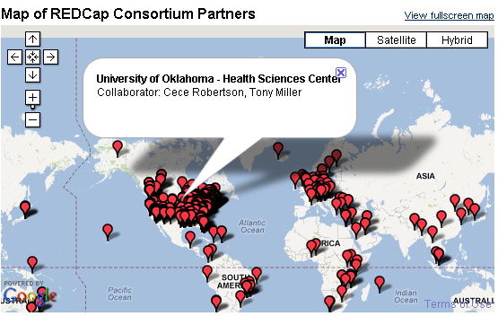
REDCap & R
REDCap
Free, open source electronic data capture system and all-purpose clinical and translational research database
Connecting REDCap & R through API Reporting
Would be great if the basic outline of the report stayed the same over time, but the “output” automatically updated itself to reflect the most current data in the project.
Would be great if didn’t have to manually export the data (from REDCap) each time.

Slide 20
library(RCurl)
#Dummy password token (for demonstration slide)
secret <- 'CCCCDDDDDDDD312865F3007D21ACBCCC'
ds <- postForm( 'https://miechvprojects.ouhsc.edu/…/API/',
token = secret, content='record', format='csv', type='flat', opts=curlOptions(ssl.verifypeer=TRUE))
head(ds)
summary(ds)
## write(ds, file="C:/RedcapExample/out.csv")

