Slide 1
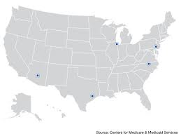
Let’s start to do a little group exploring work … Problem for Everyone for fun
Interested in evaluating the performance of a medical procedure in a multicenter study. They randomly select five centers for inclusion. One of the study goals is to compare the survival benefit of the medical procedure. In each center, trtN patients are randomly selected and assigned the treatment procedure, and trt deaths are recorded. In this example, only the treatment arm of the data is used. The following statements create a SAS data set for that portion of the data:
data trt; input trt trtN; datalines;
2 86
2 69
1 71
1 113
1 103 ;
RESEARCH QUESTIONS?
Are there differences between each center? (is the probability of death at each location different or same?
What is the probability of death?
Want to run another trial, but want to find probability that more than 4 people will die in trial given a specific number of people in the trial.
(from SAS Global Forum Talk)

Slide 2
Part I. Introduction (questions to audience)
Who here feels somewhat confortable with Bayesian?
Who here uses Bayesian in their research/work?
What do you do with data that you have low counts or low signal compared to variation (i.e. large Coefficient of Variation)… is there anything you can say?

Slide 3
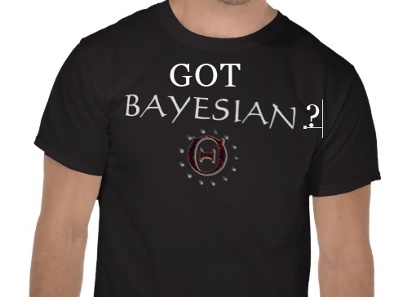
Bayesian?

Slide 4
This talk neither proposes to advocates for Bayesian vs Frequentist opinions
Bayesian is becoming more available and potentially more becoming more popular. Then add skills to the already existing frequentist approaches?
Goal for this talk: -> Provide a forum for working on your statistical intuition and have an informed opinion (for those that don’t use Bayesian). Consider talking to our local experts Drs Anderson, Carabin.
Likely, given your data, training and resources, sometimes your data analyses will ‘benefit’ from knowledge of different approaches such as Bayesian.

Slide 5
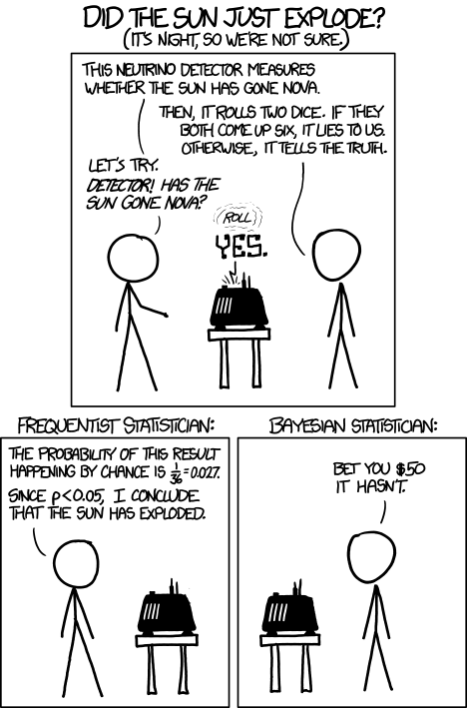
Humor: XKCD had this cartoon on Bayesian vs Frequentist (leave this to your own conclusions)

Slide 6
‘simply’
Frequentist | Bayesian
Parameter to be evaluated has a precise value (non-random) | Parameter to be evaluated has a density distribution (parameters are considered random variables)
Probabilities viewed as frequencies observed in the long run and concerns the DATA | Probabilities viewed as a measure of uncertainty for the PARAMETERS
 | This uncertainty must be based on scientific grounds and prior knowledge
Slide Courtesy of Dr.Carabin’s Concise Explanation

Slide 7
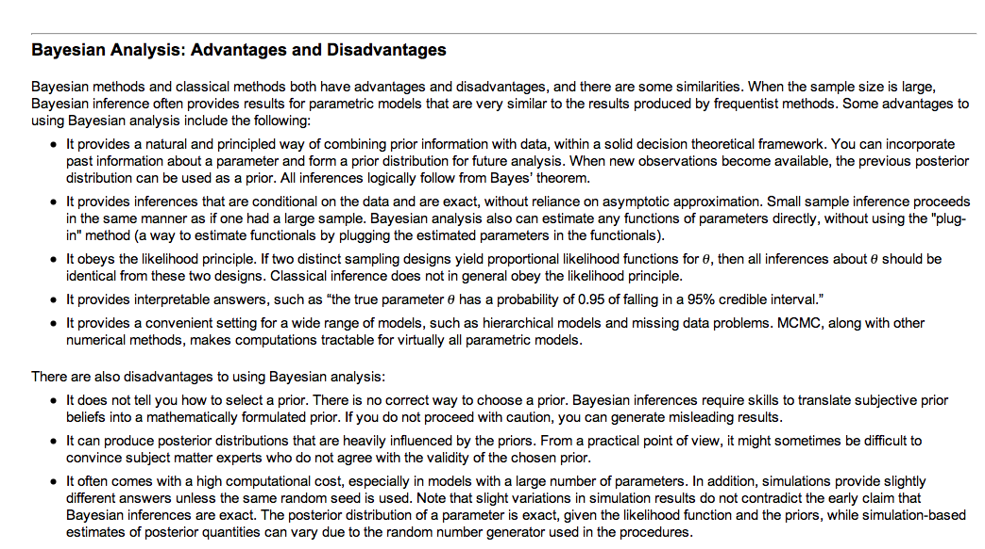
Part 2.
I think if you are Biostatically minded, you might be interested inthese opinions (from SAS)
http://support.sas.com/documentation/cdl/en/statug/63033/HTML/default/viewer.htm#statug_introbayes_sect003.htm

Slide 8
Website that helped:
http://www.r-bloggers.com/a-look-at-bayesian-statistics/
(copying down some key points:
Statisticians in action
As you learned more about the coin in my pocket, you probably went through a process similar to the Bayesians (though you probably allowed the initial 6 heads to have too much impact). The Bayesian way of thinking is more natural to a lot of people.
Yet Bayesian statistical analyses are in the minority. Why? Two reasons:
computing-power required to do calculations
necessity
Bayesian analyses of more than textbook interest tend to require substantial computing power. It is only recently that the requisite computing power has arrived.
For a lot of analyses, there is no need to be Bayesian. If there is enough data, then the prior distribution makes essentially no difference at all.
…
Bayes goes to the bank
Finance is different. While we have lots of numbers, we don’t necessarily have lots of information.
Finance is ripe for Bayesian statistics. We are often in the situation where our prior guesses do have a material effect on results.

Slide 9
Next thing to do is run your own experiments to increase your intuition.
http://support.sas.com/resources/papers/proceedings09/257-2009.pdf
Bayesian Modeling Using the MCMC Procedure.

Slide 10
MCMC (Markov Chain Monte Carlo)
Here’s an example in SAS
data trt; input trt trtN; datalines;
2 86
2 69
1 71
1 113
1 103 ;
ods graphics on;
proc mcmc data=trt seed=17 nmc=10000 outpost=out1;
parm p 0.2;
prior p ~ uniform(0,1);
model trt ~ binomial(trtN,p);
run; ods graphics off;

Slide 11

MCMC (Markov Chain Monte Carlo)
The simplest model is to ignore any center difference and treat the data as the realization of a shared model, with the same probability applied to all centers. You can use the following binomial model where p is the shared survival probability. The uniform prior distribution is a noninformative prior distribution on the parameter p.
data trt; input trt trtN; datalines;
2 86
2 69
1 71
1 113
1 103 ;
They randomly select five centers for inclusion. One of the study goals is to compare the survival benefit of the medical procedure. In each center, trtN patients are randomly selected and assigned the treatment procedure, and trt deaths are recorded.

Slide 12
Objective Priors versus Subjective Priors
Bayesian probability measures the degree of belief that you have in a random event. By this definition, probability is highly subjective. It follows that all priors are subjective priors. Not everyone agrees with this notion of subjectivity when it comes to specifying prior distributions. There has long been a desire to obtain results that are objectively valid. Within the Bayesian paradigm, this can be somewhat achieved by using prior distributions that are "objective" (that is, that have a minimal impact on the posterior distribution). Such distributions are called objective or noninformative priors (see the next section). However, while noninformative priors are very popular in some applications, they are not always easy to construct. See DeGroot and Schervish (2002, Section 1.2) and Press (2003, Section 2.2) for more information about interpretations of probability. See Berger (2006) and Goldstein (2006) for discussions about objective Bayesian versus subjective Bayesian analysis.

Slide 13
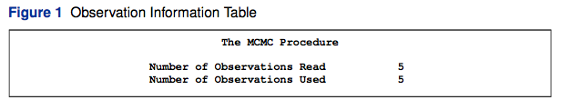
MCMC (Markov Chain Monte Carlo)

Slide 14
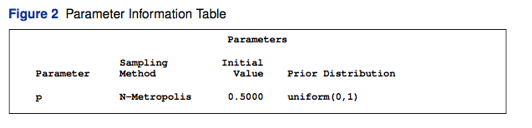
MCMC (Markov Chain Monte Carlo)
See: http://en.wikipedia.org/wiki/Metropolis–Hastings_algorithm

Slide 15
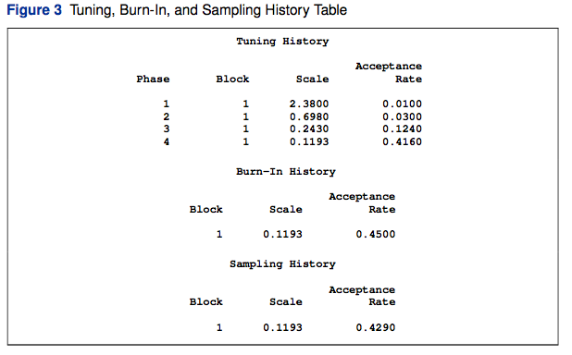
MCMC (Markov Chain Monte Carlo)

Slide 16
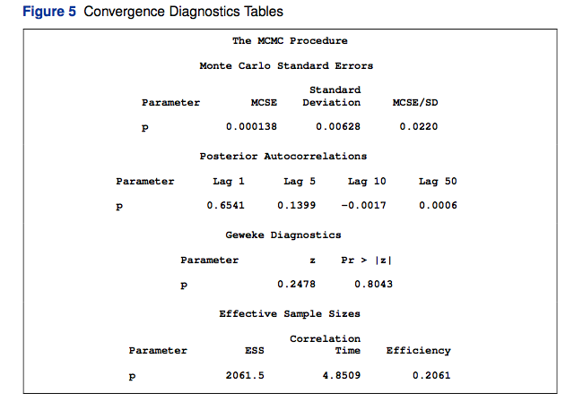
MCMC (Markov Chain Monte Carlo)

Slide 17
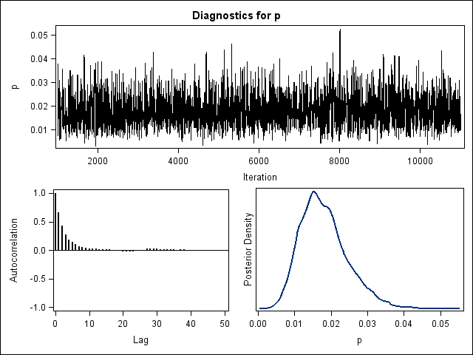
Diagnostics (how to read them)
Autocorrelation

Slide 18
MCMC (Markov Chain Monte Carlo)

Slide 19
Conclusions
TODAY: we didn’t really demonstrate why or when to use Bayesian today. That wasn’t the goal. We are not trying to convince you one way or the other to like it or not just try it like cauliflower.
Bayesian can appears complex, requires knowledge can appear daunting but lucky we have some great resources here on our campus.
One thing I know Bayesian is really effective is in Semantic Word-Analysis and Processing… I use that for Language Processing – But that is a whole other way of using Bayesian not talked about today.
WHAT’s NEXT STEP: NEED more talks sprinkled around for our group:on Bayesian . Maybe in this way people will have an opportunity to try it before they pass judgment.

Slide 20
MCMC (Markov Chain Monte Carlo)

Slide 21
Effect of Priors in Bayesian Analysis? (opportunity? Or risk?)
http://doingbayesiandataanalysis.blogspot.com/2013/01/bayesian-disease-diagnosis-with.html

Slide 22
In 1998, J Martin Bland, Bayesians and frequentists
“There are two competing philosophies of statistical analysis: the Bayesian and the frequentist. The frequentists are much the larger group, and almost all the statistical analyses which appear in the BMJ are frequentist. The Bayesians are much fewer and until recently could only snipe at the frequentists from the high ground of university departments of mathematical statistics. Now the increasing power of computers is bringing Bayesian methods to the fore.”

Slide 23
Some Syntax
f(x;θ) is the same as f(x|θ), simply meaning that θ is a fixed parameter and the function f is a function of x. f(x,Θ), OTOH, is an element of a family (set) of functions, where the elements are indexed by Θ. A subtle distinction, perhaps, but an important one, esp. when it comes time to estimate an unknown parameter θ on the basis of known data x; at that time, θ varies and x is fixed, resulting in the "likelihood function". Usage of "|" is more common among statisticians, ";" among mathematicians?

