Slide 1
Getting Started with Bayesian GLMM in R, SAS, Mplus, & WinBUGS
OUHSC SCUG Presentation on October 7, 2014
David Bard

Slide 2
Objectives
Brief intro to generalized linear mixed models (GLMM)
Even briefer intro to Bayesian estimation of random effect models
Intro to the MCMCglmm package in R
Comparison of MCMCglmm and WinBUGS/OpenBUGS, Mplus, and SAS proc mcmc

Slide 3
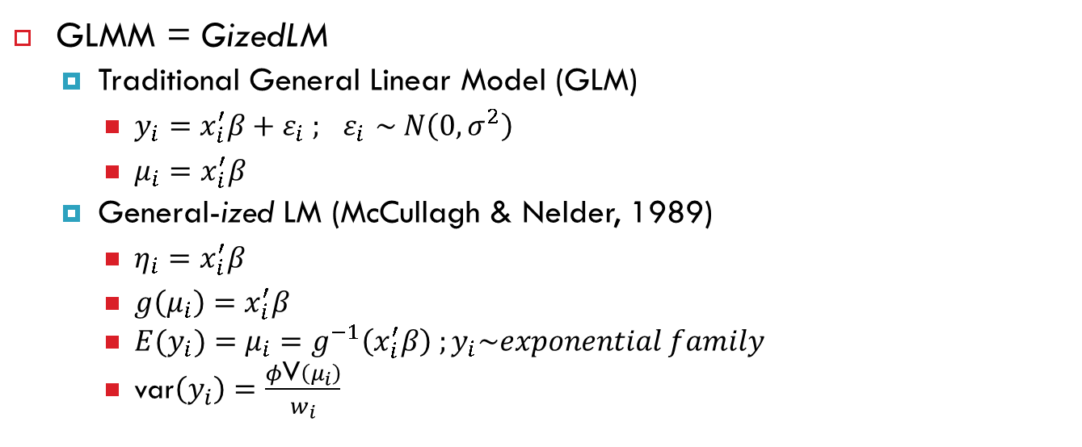
Unpacking GLMM
GLMM = GizedLM
Traditional General Linear Model (GLM)
$y_{i}=x_{i}^{′}β+ε_{i} ; { ε}_{i} \sim N\left(0,σ^{2}\right)$
$μ_{i}=x_{i}^{′}β$
General-ized LM (McCullagh & Nelder, 1989)
$η_{i}=x_{i}^{′}β$
$g\left(μ_{i}\right)=x_{i}^{′}β$
${E(y}_{i})={μ_{i}=g}^{−1}\left(x_{i}^{′}β\right) ;y_{i}\sim exponential family$
var$\left(y_{i}\right)=\frac{φ\text{V}\left(μ_{i}\right)}{w_{i}}$

Slide 4
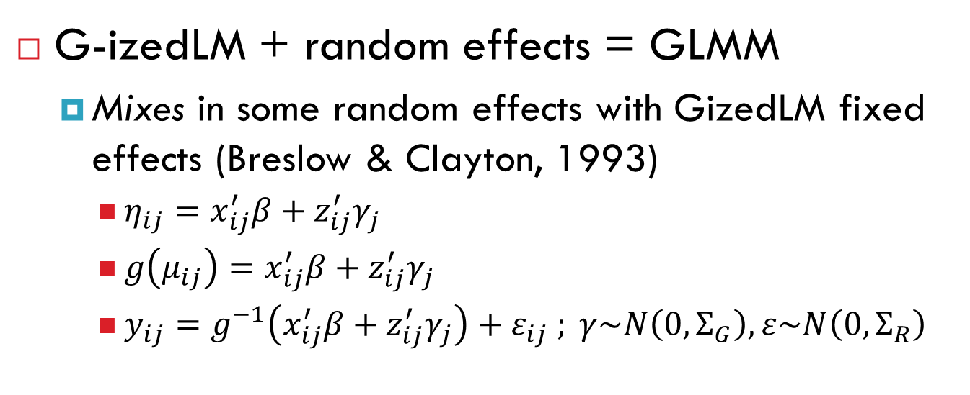
Unpacking GLMM continued
G-izedLM + random effects = GLMM
Mixes in some random effects with GizedLM fixed effects (Breslow & Clayton, 1993)
$η_{ij}=x_{ij}^{′}β+z_{ij}^{′}γ_{j}$
$g\left(μ_{ij}\right)=x_{ij}^{′}β+z_{ij}^{′}γ_{j}$
$y_{ij}=g^{−1}\left(x_{ij}^{′}β+z_{ij}^{′}γ_{j}\right)+ε_{ij} ; γ\sim N\left(0,Σ_{G}\right),ε\sim N\left(0,Σ_{R}\right)$

Slide 5
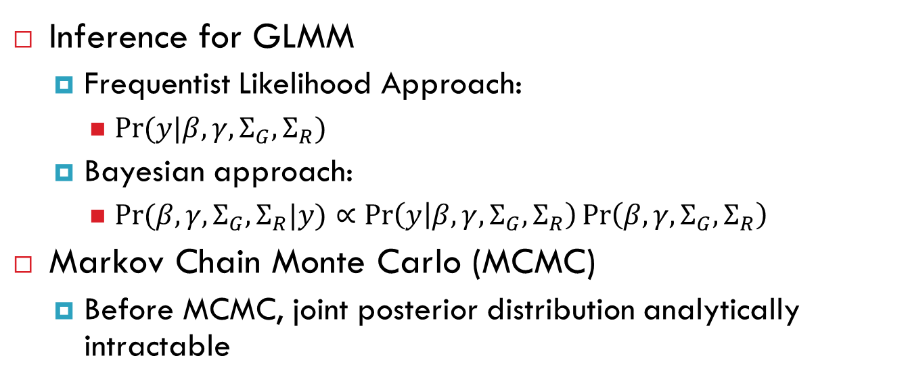
Bayesian Inference for GLMM
Inference for GLMM
Frequentist Likelihood Approach:
$Pr⁡(y|β,γ,Σ_{G},Σ_{R})$
Bayesian approach:
$\operatorname{Pr}{(β,γ,Σ_{G},Σ_{R}|y)}∝\operatorname{Pr}\left(y | β,γ,Σ_{G},Σ_{R}\right)\operatorname{Pr}\left(β,γ,Σ_{G},Σ_{R}\right)$
Markov Chain Monte Carlo (MCMC)
Before MCMC, joint posterior distribution analytically intractable
Notes:
Courtesy of SAS 9.3 Manual:
Bayesian methods offer an alternative approach; they treat parameters as random variables and define probability as "degrees of belief"
Bayesian philosophy states that parameters cannot be determined exactly, and uncertainty about a parameter is expressed through probability statements and distributions.
Simply put, Bayes’ theorem tells you how to update existing knowledge with new information. You begin with a prior belief , and after learning information from data , you change or update your belief about and obtain . These are the essential elements of the Bayesian approach to data analysis.
In practice, however, you can obtain the posterior distribution with straightforward analytical solutions only in the most rudimentary problems.

Slide 6
GLMM Inference in R
Several self-contained packages available
See http://glmm.wikidot.com/faq
I’ll focus on one today, MCMCglmm
Markov chain Monte Carlo Sampler for Multivariate Generalised Linear Mixed Models with special emphasis on correlated random effects arising from pedigrees and phylogenies (Hadfield 2010).
http://cran.r-project.org/web/packages/MCMCglmm/vignettes/CourseNotes.pdf

Slide 7
MCMCglmm function
MCMCglmm(fixed, random=NULL, rcov=~units, family="gaussian", mev=NULL, data,start=NULL, prior=NULL, tune=NULL, pedigree=NULL, nodes="ALL",scale=TRUE, nitt=13000, thin=10, burnin=3000, pr=FALSE,pl=FALSE, verbose=TRUE, DIC=TRUE, singular.ok=FALSE, saveX=TRUE, saveZ=TRUE, saveXL=TRUE, slice=FALSE, ginverse=NULL)

Slide 8
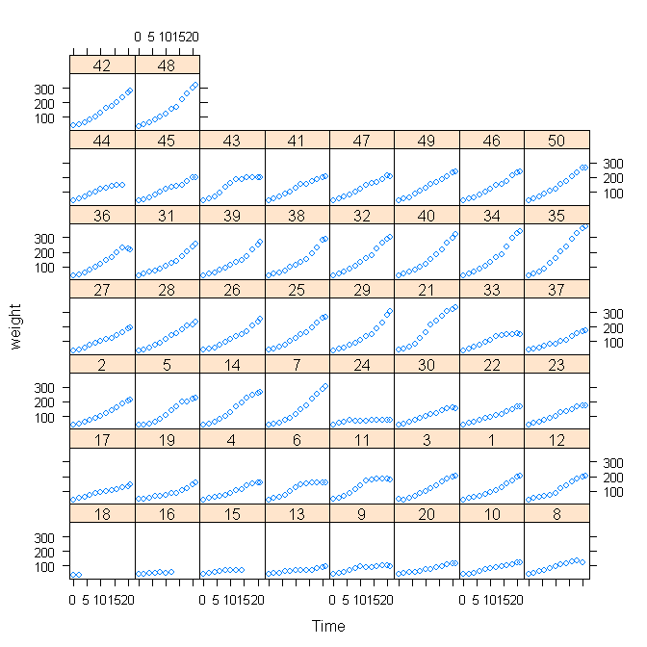
Example Dataset
data(ChickWeight)
The ChickWeight data frame has 578 rows and 4 columns from an experiment on the effect of diet on early growth of chicks.
xyplot(weight ~ Time | Chick, data = ChickWeight)

Slide 9
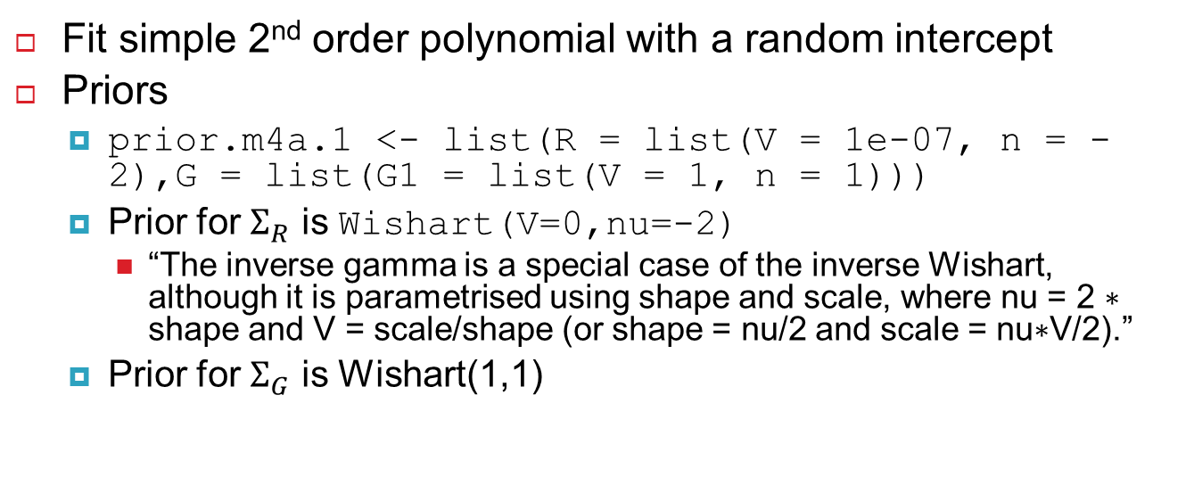
MCMCglmm fit to ChickWeight (See Chpt 4 of Hadfield course notes)
Fit simple 2nd order polynomial with a random intercept
Priors
prior.m4a.1 <- list(R = list(V = 1e-07, n = -2),G = list(G1 = list(V = 1, n = 1)))
Prior for $Σ_{R}$ is Wishart(V=0,nu=-2)
“The inverse gamma is a special case of the inverse Wishart, although it is parametrised using shape and scale, where nu = 2 ∗ shape and V = scale/shape (or shape = nu/2 and scale = nu∗V/2).”
Prior for $Σ_{G}$ is Wishart(1,1)

Slide 10
MCMCglmm fit to ChickWeight
Model statement
m4a.1 <- MCMCglmm(weight ~ Diet + poly(Time, 2,raw = TRUE), random = ~Chick, data = ChickWeight,verbose = FALSE, pr = TRUE, prior = prior.m4a.1,saveX = TRUE, saveZ = TRUE)
Visualize model predictions
W.1<-cBind(m4a.1$X, m4a.1$Z) # note X and Z are sparse so use cBind intstead of cbind
prediction.1<-W.1%*%posterior.mode(m4a.1$Sol)
xyplot(weight+prediction.1@x~Time|Chick, data=ChickWeight)

Slide 11
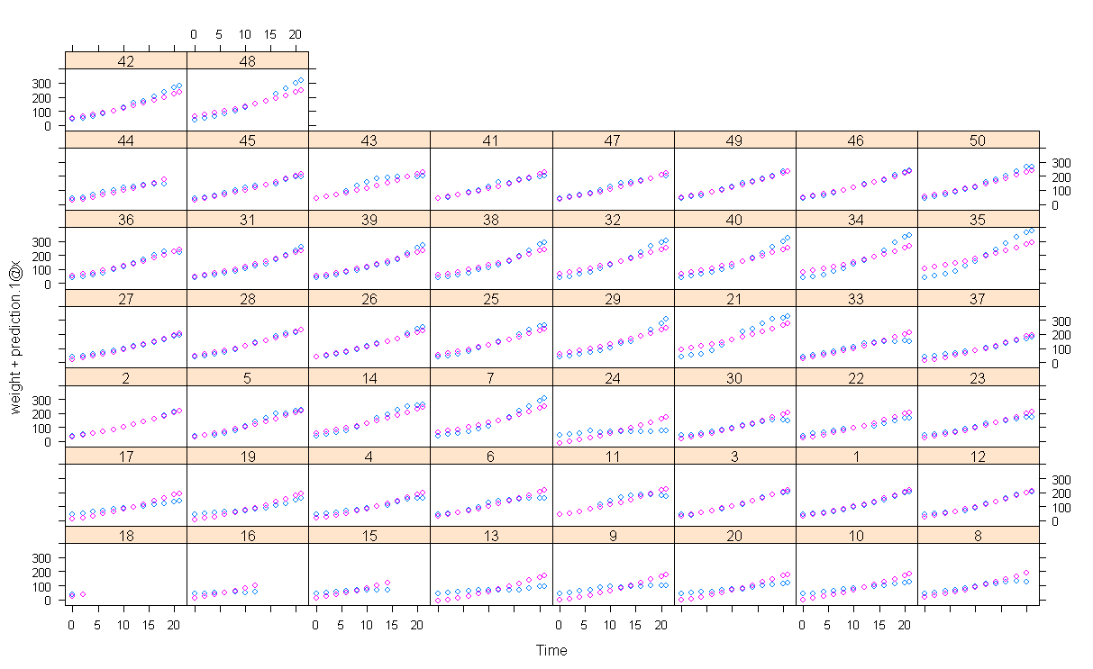
MCMCglmm fit to ChickWeight

Slide 12
MCMCglmm fit to ChickWeight
prior.m4a.3 <- list(R = list(V = 1, n = 0.002),G = list(G1 = list(V = diag(3), n = 3)))
m4a.3 <- MCMCglmm(weight ~ Diet + poly(Time, 2,raw = TRUE), random = ~us(1 + poly(Time, 2,raw = TRUE)):Chick, data = ChickWeight, verbose = FALSE, pr = TRUE, prior = prior.m4a.3, saveX = TRUE, saveZ = TRUE)

Slide 13
MCMCglmm Output for Quadratic Random Effect Model
Iterations = 3001:12991 Thinning interval = 10 Sample size = 1000
DIC: 3932.687
G-structure: ~us(1 + poly(Time, 2, raw = TRUE)):Chick
post.mean l-95% CI u-95% CI eff.samp
(Intercept):(Intercept).Chick 28.6006 10.80540 48.4596 591.4
poly(Time, 2)1:(Intercept).Chick -17.8679 -28.46534 -9.0170 897.1
poly(Time, 2)2:(Intercept).Chick 0.7339 0.08795 1.3298 1000.0
(Intercept):poly(Time, 2)1.Chick -17.8679 -28.46534 -9.0170 897.1
poly(Time, 2)1:poly(Time, 2)1.Chick 12.0861 6.97558 17.5365 1286.4
poly(Time, 2)2:poly(Time, 2)1.Chick -0.5198 -0.91008 -0.1562 1000.0
(Intercept):poly(Time, 2)2.Chick 0.7339 0.08795 1.3298 1000.0
poly(Time, 2)1:poly(Time, 2)2.Chick -0.5198 -0.91008 -0.1562 1000.0
poly(Time, 2)2:poly(Time, 2)2.Chick 0.1209 0.07670 0.1707 891.2
R-structure: ~units
post.mean l-95% CI u-95% CI eff.samp
units 43.9 39.1 49.95 1000
Location effects: weight ~ Diet + poly(Time, 2, raw = TRUE)
post.mean l-95% CI u-95% CI eff.samp pMCMC
(Intercept) 36.08622 33.58255 38.33466 1000.0 <0.001 ***
Diet2 1.42484 -1.63380 4.33774 1110.6 0.350
Diet3 1.38532 -1.76403 4.12476 1000.0 0.378
Diet4 3.94954 0.93236 7.19609 521.6 0.012 * poly(Time, 2)1 5.92471 4.96057 6.93158 1000.0 <0.001 *** poly(Time, 2)2 0.11233 0.01541 0.21158 1000.0 0.034 *
--Signif. codes: 0 '***' 0.001 '**' 0.01 '*' 0.05 '.' 0.1 ' ' 1

Slide 14
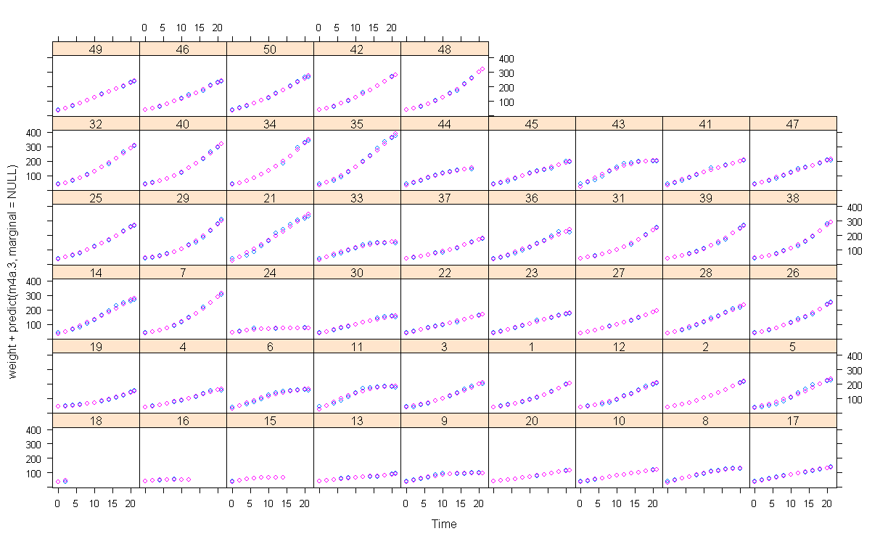
MCMCglmm fit to ChickWeight
> m4a.1$DIC
[1] 5525.262
> m4a.3$DIC
[1] 3932.774

Slide 15
REML fit to ChickWeight
m5a.3.REML <- lmer(weight ~ Diet + poly(Time, 2, raw = TRUE) + (poly(Time, 2, raw = TRUE) | Chick),
data = ChickWeight)
summary(m5a.3.REML)
Linear mixed model fit by REML ['lmerMod']
Random effects:
Groups Name Variance Std.Dev. Corr
Chick (Intercept) 31.15433 5.5816
poly(Time, 2, raw = TRUE)1 12.47343 3.5318 -1.00
poly(Time, 2, raw = TRUE)2 0.05408 0.2325 0.64 -0.64
Residual 43.73500 6.6132
Number of obs: 578, groups: Chick, 50
Fixed effects:
Estimate Std. Error t value
(Intercept) 36.07142 1.23192 29.281
Diet2 1.44948 1.40532 1.031
Diet3 1.36360 1.40532 0.970
Diet4 4.16271 1.40546 2.962
poly(Time, 2, raw = TRUE)1 5.90475 0.52667 11.212
poly(Time, 2, raw = TRUE)2 0.11580 0.03406 3.399

Slide 16
WinBUGS code
model.file <- file.path(tempdir(),"model.txt")
write.model(model, model.file)
require(R2WinBUGS)
model <- function(){
for (i in 1:n){
y[i] ~ dnorm (y.hat[i], tau.y)
y.hat[i] <- inprod(B[county[i],],Z[i,]) + inprod(beta[],X[i,])
}
tau.y <- pow(sigma.y, -2)
sigma.y ~ dunif (0, 100)
for (l in 1:3){beta[l]~dnorm(0,1.0E-6)}
for (j in 1:J){
for (k in 1:K){
B[j,k] <- xi[k]*B.raw[j,k]
}
B.raw[j,1:K] ~ dmnorm (mu.raw[],Tau.B.raw[,])
}
for (k in 1:K){
mu[k] <- xi[k]*mu.raw[k]
mu.raw[k] ~ dnorm (0, .0001)
xi[k] ~ dunif (0, 100)
}
Tau.B.raw[1:K,1:K] ~ dwish(W[,], df)
df <- K+1
Sigma.B.raw[1:K,1:K] <- inverse(Tau.B.raw[,])
for (k in 1:K){
for (k.prime in 1:K){
rho.B[k,k.prime] <- Sigma.B.raw[k,k.prime]/ sqrt(Sigma.B.raw[k,k] * Sigma.B.raw[k.prime,k.prime]
)
}
sigma.B[k] <- abs(xi[k])*sqrt(Sigma.B.raw[k,k])
}
}

Slide 17
WinBUGS code
bugsMod <- R2WinBUGS:::bugs (bugs.data, bugs.inits, bugs.parameters, model.file,n.chains=3, n.iter=2000, n.thin=10, #n.burnin=1000,
bugs.directory="F:\\Program Files\\WinBUGS14", clearWD=TRUE, debug=TRUE )
missObs <- !apply(is.na(ChickWeight[, c("Diet","Time","Chick")]),1,base::any)
bugDat <- ChickWeight[missObs,]
y <- bugDat$weight
dsgnMat <- as.matrix(model.matrix(weight ~ Diet+poly(Time, 2,raw = TRUE),data=bugDat))
#cbind(bugDat[,c("Diet","Time")],bugDat$Time^2))
Z <- dsgnMat[,-c(2:4)]
X <- dsgnMat[,c(2:4)]
county <- sapply(bugDat$Chick,function(x) which(unique(bugDat$Chick) %in% x))
J <- length(unique(county)) #nrow(X)
K <- ncol(X)
n <- nrow(bugDat)
W <- diag (3)
bugs.data <- list ("n", "J", "K", "Z", "X", "y", "county", "W")
bugs.inits <- function (){
list(B.raw=array(rnorm(J*K), c(J,K)), mu.raw=rnorm(K), sigma.y=runif(1), Tau.B.raw=rwish(K+1,diag(K)), xi=runif(K), beta=rnorm(3))
}
bugs.parameters <- c("B", "mu", "beta", "sigma.y", "sigma.B", "rho.B")

Slide 18
WinBUGS Output
> bugsMod$summary[!grepl("^B\\[",row.names(bugsMod$summary)),]
mean sd 2.5% 25% 50% 75% 97.5% Rhat n.eff
mu[1] 34.7888000 2.63619542 29.55408630 33.96499890 35.05500 36.1349990 38.1757471 1.232519 90
mu[2] 5.9312100 0.55340567 4.93427295 5.52424985 5.92450 6.3149991 7.0219244 1.013821 130
mu[3] 0.1170932 0.03387847 0.05346756 0.09427499 0.11895 0.1401245 0.1827151 1.006368 300
beta[1] 3.0466125 4.11195347 -1.03070000 1.24025000 2.45350 3.9942500 12.1322500 1.233420 73
beta[2] 4.1255903 4.67322899 -0.04247700 1.99250000 3.44450 5.0857500 12.5910000 1.232081 120
beta[3] 5.6563383 3.55086906 0.39663750 3.93650000 5.44800 6.8557500 12.1310000 1.176267 300
sigma.y 6.6822533 0.21928991 6.25432402 6.53349856 6.69550 6.8352500 7.0731989 1.009611 180
sigma.B[1] 6.8031400 1.59958897 4.78300732 5.91849994 6.63600 7.3562497 10.7334123 1.200988 17
sigma.B[2] 3.4715533 0.34714864 2.83274560 3.21224974 3.44800 3.7060000 4.2070000 1.004215 260
sigma.B[3] 0.2243653 0.02367226 0.18379497 0.20857489 0.22220 0.2381500 0.2793959 1.004949 300
rho.B[1,1] 1.0000000 0.00000000 1.00000000 1.00000000 1.00000 1.0000000 1.0000000 1.000000 1
rho.B[1,2] -0.8113147 0.10318901 -0.94616000 -0.88775000 -0.82275 -0.7583750 -0.5609825 1.746399 6
rho.B[1,3] 0.2960798 0.17634359 -0.05806150 0.18640000 0.31335 0.4164000 0.5962300 1.037619 59
rho.B[2,1] -0.8113147 0.10318901 -0.94616000 -0.88775000 -0.82275 -0.7583750 -0.5609825 1.746399 6
rho.B[2,2] 1.0000000 0.00000000 1.00000000 1.00000000 1.00000 1.0000000 1.0000000 1.000000 1
rho.B[2,3] -0.5923480 0.10052565 -0.76591000 -0.66230000 -0.59870 -0.5385250 -0.3749425 1.011282 250
rho.B[3,1] 0.2960798 0.17634359 -0.05806150 0.18640000 0.31335 0.4164000 0.5962300 1.037619 59
rho.B[3,2] -0.5923480 0.10052565 -0.76591000 -0.66230000 -0.59870 -0.5385250 -0.3749425 1.011282 250
rho.B[3,3] 1.0000000 0.00000000 1.00000000 1.00000000 1.00000 1.0000000 1.0000000 1.000000 1
deviance 3832.3566667 17.44449743 3801.00000000 3821.00000000 3831.00000 3844.0000000 3868.5249678 1.051326 40

Slide 19
Mplus code
require(MplusAutomation)
mpDat <- as.data.frame(cbind(county,dsgnMat[,-1],y))
head(dsgnMat[,-1])
colnames(mpDat) <- c(colnames(mpDat)[1:4],"time","time2","weight")
modelStem <- "mpQuad"
mpFiles1 <- mplusObject(
TITLE = "ChickWeight Quadratic Random Effect;",
VARIABLE = "CLUSTER = county;
WITHIN = Diet2 Diet3 Diet4 time time2;",
ANALYSIS = "Type = twolevel random; Estimator = Bayes;
proc = 4; fbiter = 13000; thin = 10;",
MODEL = "%WITHIN%
s1 | weight on time;
s2 | weight on time2;
weight on Diet2 Diet3 Diet4;
%BETWEEN%
weight with s1 s2;
s1 with s2;",
OUTPUT = "sampstat; tech1; TECH8;",
PLOT = "TYPE = PLOT2;",
rdata=mpDat,
usevariables = c("county","Diet2","Diet3","Diet4","time","time2","weight"))
base <- tempdir()
#cat(base,"\n")
mpInput <- paste0(modelStem,".inp")
mpData <- "chkwgtDat"
cd(base,pre="chickwgt",num="Q")
mpModel <- mplusModeler(mpFiles1,dataout=mpData,modelout=mpInput,run=1)
mpModel$results$summaries
mpModel$results$parameters$unstandardized

Slide 20
Mplus Output
Mplus.version Title AnalysisType DataType Estimator Observations Parameters DIC pD Filename
7.3 ChickWeight Quadratic Random Effect; twolevel random INDIVIDUAL BAYES 578 13 3925.949 105.498 mpQuad.out
paramHeader param est posterior_sd pval lower_2.5ci upper_2.5ci sig BetweenWithin
1 WEIGHT.ON DIET2 2.501 1.485 0.048 -0.468 5.407 FALSE Within
2 WEIGHT.ON DIET3 3.618 1.640 0.014 0.372 6.809 TRUE Within
3 WEIGHT.ON DIET4 5.466 1.575 0.000 2.394 8.544 TRUE Within
4 Residual WEIGHT 43.542 2.862 0.000 38.394 49.647 TRUE Within
5 WEIGHT.WITH S1 -24.181 7.313 0.000 -42.050 -14.033 TRUE Between
6 WEIGHT.WITH S2 0.579 0.372 0.029 -0.018 1.443 FALSE Between
7 S1.WITH S2 -0.576 0.199 0.000 -1.058 -0.291 TRUE Between
8 Means WEIGHT 35.165 1.399 0.000 32.362 37.906 TRUE Between
9 Means S1 5.895 0.581 0.000 4.756 7.036 TRUE Between
10 Means S2 0.118 0.037 0.001 0.045 0.190 TRUE Between
11 Variances WEIGHT 44.484 15.677 0.000 22.926 83.258 TRUE Between
12 Variances S1 14.789 3.781 0.000 9.637 24.082 TRUE Between
13 Variances S2 0.061 0.015 0.000 0.040 0.098 TRUE Between

Slide 21
Mplus Output
Mplus.version Title AnalysisType DataType Estimator Observations Parameters DIC pD Filename
7.3 ChickWeight Quadratic Random Effect; twolevel random INDIVIDUAL BAYES 578 13 3925.949 105.498 mpQuad.out
paramHeader param est posterior_sd pval lower_2.5ci upper_2.5ci sig BetweenWithin
1 WEIGHT.ON DIET2 2.501 1.485 0.048 -0.468 5.407 FALSE Within
2 WEIGHT.ON DIET3 3.618 1.640 0.014 0.372 6.809 TRUE Within
3 WEIGHT.ON DIET4 5.466 1.575 0.000 2.394 8.544 TRUE Within
4 Residual WEIGHT 43.542 2.862 0.000 38.394 49.647 TRUE Within
5 WEIGHT.WITH S1 -24.181 7.313 0.000 -42.050 -14.033 TRUE Between
6 WEIGHT.WITH S2 0.579 0.372 0.029 -0.018 1.443 FALSE Between
7 S1.WITH S2 -0.576 0.199 0.000 -1.058 -0.291 TRUE Between
8 Means WEIGHT 35.165 1.399 0.000 32.362 37.906 TRUE Between
9 Means S1 5.895 0.581 0.000 4.756 7.036 TRUE Between
10 Means S2 0.118 0.037 0.001 0.045 0.190 TRUE Between
11 Variances WEIGHT 44.484 15.677 0.000 22.926 83.258 TRUE Between
12 Variances S1 14.789 3.781 0.000 9.637 24.082 TRUE Between
13 Variances S2 0.061 0.015 0.000 0.040 0.098 TRUE Between

Slide 22
SAS proc mcmc
proc mcmc data=chkwgt nmc=10000 thin=10 outpost=postout
seed=17 init=random;
*ods select Parameters REParameters PostSummaries;
array theta[3] alpha beta1 beta2;
array theta_c[3];
array Sig_c[3,3];
array mu0[3] (0 0 0);
array Sig0[3,3] (1000 0 0
0 1000 0
0 0 1000);
array S[3,3] (1 0 0
0 1 0
0 0 1);
parms theta_c {36 5.9 .12} Sig_c {30 0 0 0 15 0 0 0 0.10} var_y { 44 };
parms d2 d3 d4;
prior theta_c ~ mvn(mu0, Sig0);
prior Sig_c ~ iwish(3, S);
prior var_y ~ igamma(0.001, scale=0.001);
prior d2 d3 d4 ~ normal(mean = 0, var = 1e6);
random theta ~ mvn(theta_c, Sig_c) subject=county;*monitor=(alpha_9 alpha_25 );
mu = alpha + d2 * diet2 + d3 * diet3 + d4 * diet4 + beta1 * time + beta2 * time2;
model weight ~ normal(mu, var=var_y);
run;
Notes:
PROC MCMC uses a self-tuning Metropolis algorithm

Slide 23
SAS Output
Posterior Summaries
Standard Percentiles
Parameter N Mean Deviation 25% 50% 75%
theta_c1 1000 36.2189 1.0712 35.4513 36.2101 36.9453
theta_c2 1000 5.9098 0.5058 5.5666 5.9097 6.2500
theta_c3 1000 0.1141 0.0390 0.0868 0.1143 0.1397
Sig_c1 1000 22.8357 8.4000 16.4569 21.6119 27.7463
Sig_c2 1000 -15.9086 4.5804 -18.5958 -15.3239 -12.4258
Sig_c3 1000 0.6524 0.2557 0.4721 0.6286 0.8105
Sig_c4 1000 -15.9086 4.5804 -18.5958 -15.3239 -12.4258
Sig_c5 1000 11.7026 2.6942 9.7744 11.3285 13.0261
Sig_c6 1000 -0.4965 0.1676 -0.5916 -0.4830 -0.3784
Sig_c7 1000 0.6524 0.2557 0.4721 0.6286 0.8105
Sig_c8 1000 -0.4965 0.1676 -0.5916 -0.4830 -0.3784
Sig_c9 1000 0.0755 0.0164 0.0638 0.0731 0.0852
var_y 1000 44.1617 3.0411 41.9688 43.9400 46.2062
d2 1000 1.4699 1.3118 0.5995 1.5305 2.4082
d3 1000 1.4207 1.4776 0.3806 1.4395 2.4819
d4 1000 3.2638 1.5504 2.2698 3.1260 4.2531
Posterior Intervals
Parameter Alpha Equal-Tail Interval HPD Interval
theta_c1 0.050 34.3190 38.3687 34.3133 38.3615
theta_c2 0.050 4.9527 6.8830 4.9186 6.8195
theta_c3 0.050 0.0368 0.1901 0.0348 0.1863
Sig_c1 0.050 9.9307 41.9441 8.6948 39.4294
Sig_c2 0.050 -26.6860 -8.7971 -25.0472 -8.0377
Sig_c3 0.050 0.2342 1.2554 0.1791 1.1490
Sig_c4 0.050 -26.6860 -8.7971 -25.0472 -8.0377
Sig_c5 0.050 7.5476 18.2496 7.0956 17.3317
Sig_c6 0.050 -0.8862 -0.2171 -0.8644 -0.2102
Sig_c7 0.050 0.2342 1.2554 0.1791 1.1490
Sig_c8 0.050 -0.8862 -0.2171 -0.8644 -0.2102
Sig_c9 0.050 0.0492 0.1126 0.0480 0.1096
var_y 0.050 38.8878 50.3790 38.7140 49.9304
d2 0.050 -1.1540 3.9506 -1.1086 3.9761
d3 0.050 -1.4888 4.0987 -1.4468 4.1170
d4 0.050 0.1898 6.5590 0.0331 6.3151

Slide 24
Comparison of parameter estimates
Fixed Effects: Posterior Mean Estimates
 | MCMCglmm | SAS | Mplus | WinBUGS | lmer
Intercept | 36.09 | 36.22 | 35.17 | 34.79 | 36.07
Diet2 | 1.42 | 1.47 | 2.50 | 3.05 | 1.45
Diet3 | 1.39 | 1.42 | 3.62 | 4.13 | 1.36
Diet4 | 3.95 | 3.26 | 5.47 | 5.66 | 4.16
linear | 5.92 | 5.91 | 5.90 | 5.93 | 5.90
quadratic | 0.11 | 0.11 | 0.12 | 0.12 | 0.12
Random Effect Variances: Posterior Mean Estimates
 | MCMCglmm | SAS | Mplus | WinBUGS | lmer
Intercept | 28.60 | 22.84 | 44.48 | 46.24 | 31.15
Linear | 12.09 | 11.70 | 14.79 | 12.04 | 12.47
Quadratic | 0.12 | 0.08 | 0.06 | 0.05 | 0.05
Residual | 43.9 | 44.16 | 43.54 | 44.65 | 43.74

Slide 25
Why the differences?
Posterior-mean, median, mode?
Not in this instance, but worth paying attention to across software/packages
Equivalence of convergence achieved?
Hard to know for certain, but seems to be equivalent
Differences in default/recommended prior distributions?
Yes. MCMCglmm/SAS, Mplus, and WinBUGS were all different in prior examples
Note: MCMCglmm prior below approx. reproduces Mplus output
prior_mg1_mplus <- list(R = list(V = 1e-16, n = -2),G = list(G1 = list(V = diag(1e-16,3), n = -4)))

Slide 26
Which prior should I use?
If your lucky, won’t matter
If your unlucky, explore the shape of the default distributions before deciding which feels most comfortable to you
VisCov Package in R can be helpful
MCMCglmm course notes provide overview of prior choice implications; see also Gelman & Hill (2006) chpt 16-17.

Slide 27
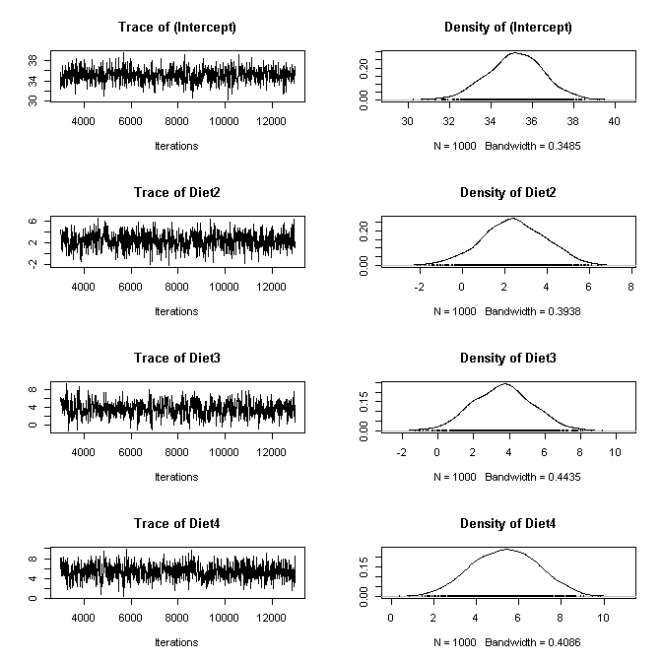
Examining MCMC Diagnostics
MCMCglmm:plot(m4a.3$Sol)
autocorr(m4a.3$Sol[,1])
Lag 0 1.0000000000
Lag 10 -0.0018215519
Lag 50 0.0379767609
Lag 100 0.0122456031
Lag 500 -0.0002609533
Uses coda package
bcoda <- as.mcmc.list(m4a.3$Sol)

Slide 28
Pros and Cons MCMCglmm
Pro
Straightforward extensions exist for common distributions like the logistic, Poisson, gamma, …
Highly efficient estimation time
Coda package handy
Handles highly complex pedigree and phylogeny data structures
Con
Prediction code underdeveloped
Can only run single chain at a time

Slide 29
More MCMCglmm info
http://cran.r-project.org/web/packages/MCMCglmm/vignettes/CourseNotes.pdf

