Slide 1







Leveraging OUHSC Clinical Data Warehouse to Inform Research & Practice
Will Beasley, PhD
Ashley Thumann, MHA
Geneva Marshall, MA
Lise DeShea, PhD
David Bard, PhD
University of Oklahoma HSC
Biomedical & Behavioral Methodology Core (BBMC)
Oct 2020
Award Numbers: UG1OD024950 U54GM104938
Notes:
Hi I’m Will, and part of the Clinical Data Warehouse effort on campus. I started as a conventional statistician and researcher, and based on experience with integrating our investigations with state agency data , our group moved into the world of EMRs and CDWs.
I think these experiences have allowed our group to relate well with current PIs, as well as build a CDW ecosystem that works well with research.

Slide 2
Terms
EMR (or EHR): Electronic Medical/Health Records A huge database with patient records used by providers
CDW: Clinical Data Warehouse A collection of databases (such as EMRs and project-specific datasets) that has been transformed to make research more efficient and complete
Notes:
Here are the data sources for the research projects that we’ve assisted with. Roughly in descending order of frequency.
Most of our projects involve inpatient EMRs, outpatient EMRs, and billing systems.
In some ways, our experience started with datasets from external collaborators, such as the Dept of Health, and grew from there.

Slide 3
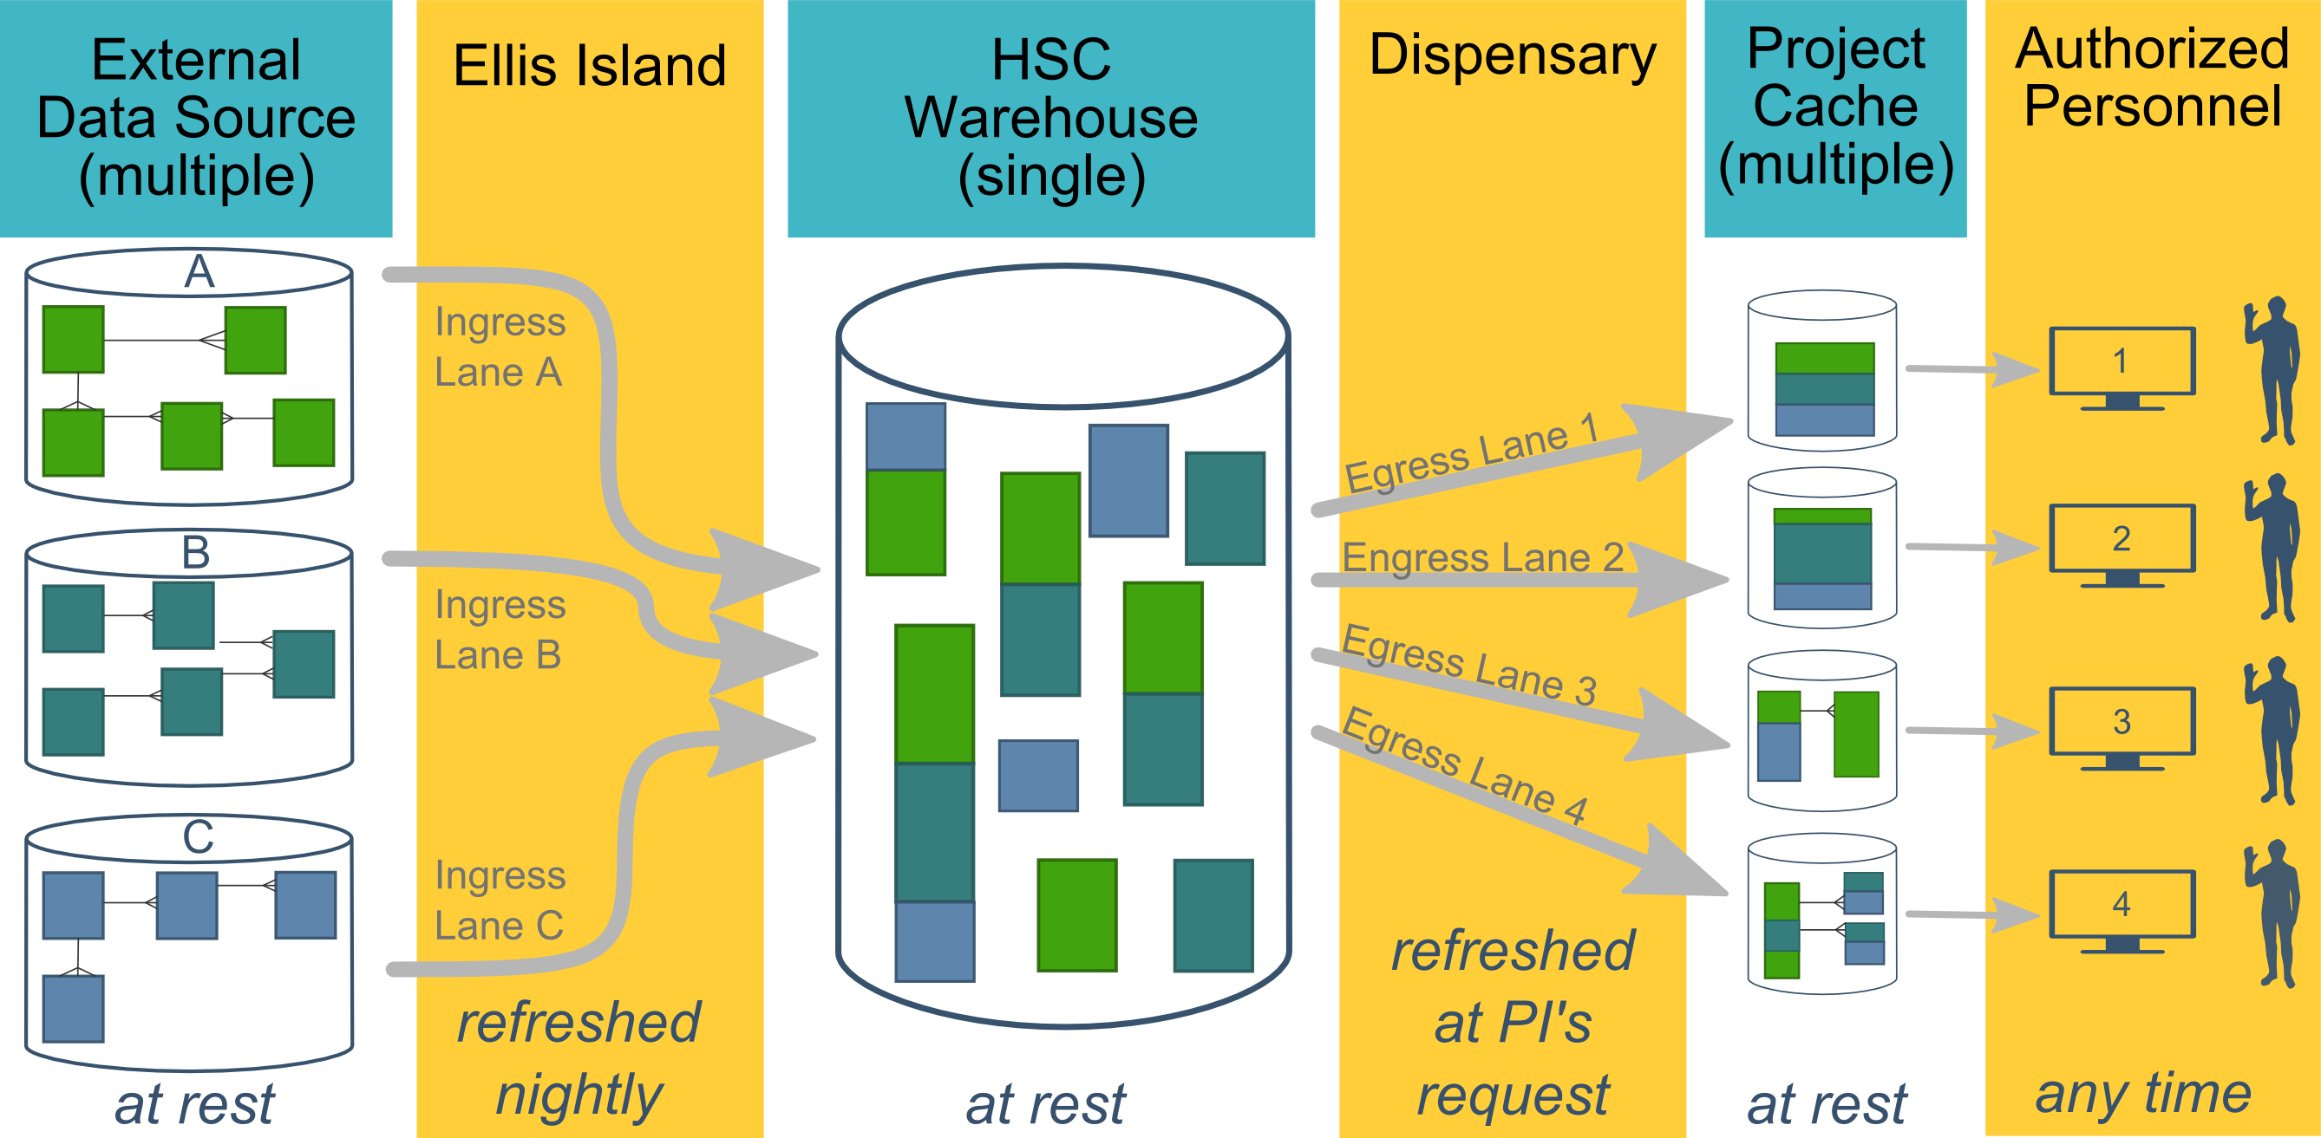
Ecosystem Architecture
Prairie Outpost – CDW (Clinical Data Warehouse)
https://github.com/OuhscBbmc/prairie-outpost-public
Data Source (column 1): contains unique info
Warehouse (column 3): contains copy after manipulation
Project Cache (column 5): contains copy of copy after a lot of manipulation
Notes:
The entire ecosystem can be represented by these six columns. The EMR and other collection databases sit in the 1st column and feed the warehouse in the third. This movement is automated. Inside the warehouse, the info from the different sources are staged & combined. Different patients can be placed in the same table. Perhaps more importantly, records for a single patient that are scattered across different sources are linked.
When a investigation is approved by the IRB, we can develop a tiny database in REDCap that contains the dataset needed for their analysis (5th column). There are a few reasons why REDCap is preferred. First, it’s more secure and scalable than distributing loose Excel files repeatedly for the same project. Second, REDCap has a lot of momentum and adoption, so it’s become familiar to a lot of people on campus --like those using it to collect research data.
We’ve always emphasized that we developed this to be as modular as possible. If someone could benefit from a few columns, they don’t have to commit to the whole thing. This modular approach has paid off, and I’ll return to that in the last few slides.

Slide 4
HSC Data Sources
Patient
Outpatient (Centricity)
Billing and Claims Data
Inpatient (Meditech)
Dozens of departmental sources
Biomedical Research Data
Epic (in ~1 year)
Provider
External Agencies
Service Provided (by the Health Dept of Oklahoma)
Child Protective Services (Oklahoma Dept of Human Services)
SoonerCare (Oklahoma Medicaid)
Immunization (Health Dept of Oklahoma)
Vital Records (Health Dept of Oklahoma)
…
Multi-state collaborations (in the future)
Administrative Cost
Employee & Student
Notes:
Here are the data sources for the research projects that we’ve assisted with. Roughly in descending order of frequency.
Most of our projects involve inpatient EMRs, outpatient EMRs, and billing systems.
In some ways, our experience started with datasets from external collaborators, such as the Dept of Health, and grew from there.

Slide 5
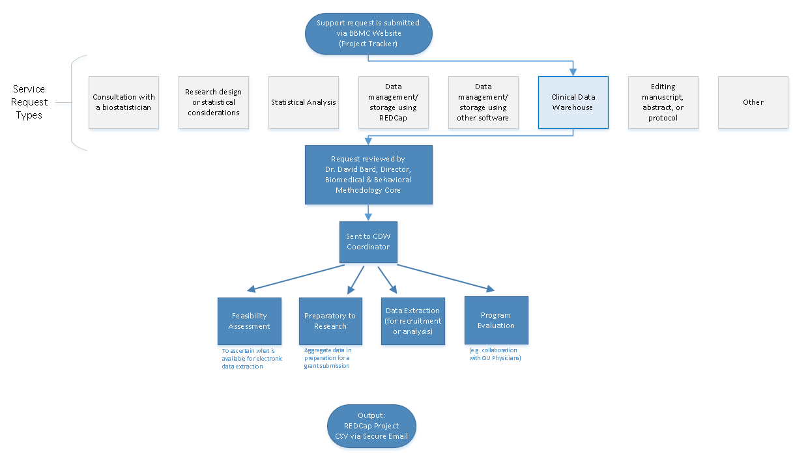
Typical Workflow for a
CDW Research project
by the BBMC
Submit a request at:
ouhsc.edu/bbmc/
then ‘Request Support’
Notes:
Our group, the BBMC, is a core of ~6 faculty statisticians and another ~10 staff with skills in health administration, analysis, research, and data science.
When we receive a request involving the CDW, it’s reviewed by a triage team and assigned to a mix of people. We assist with the project (ideally while the proposal is being written –not after it’s submitted). Some of the time we’re also the statisticians, and some of the time the PI has their own statistician or is collaborating with a group like Sara’s.
For a one-time retrospective research project, the output is usually a secured CSV. For a project requiring rolling enrollment, we deploy updates every morning with REDCap and dynamic html reports.
I have few friends managing the CDWs of other universities. When we compare our situations, the biggest differences arise from the fact that our CDW was created by a group that’s primarily statisticians & researchers, as opposed to being created by an IT group that brings in outside statisticians. Pros & cons to each origin story. If you see differences between our approach and other institutions, this is a big reason.

Slide 6
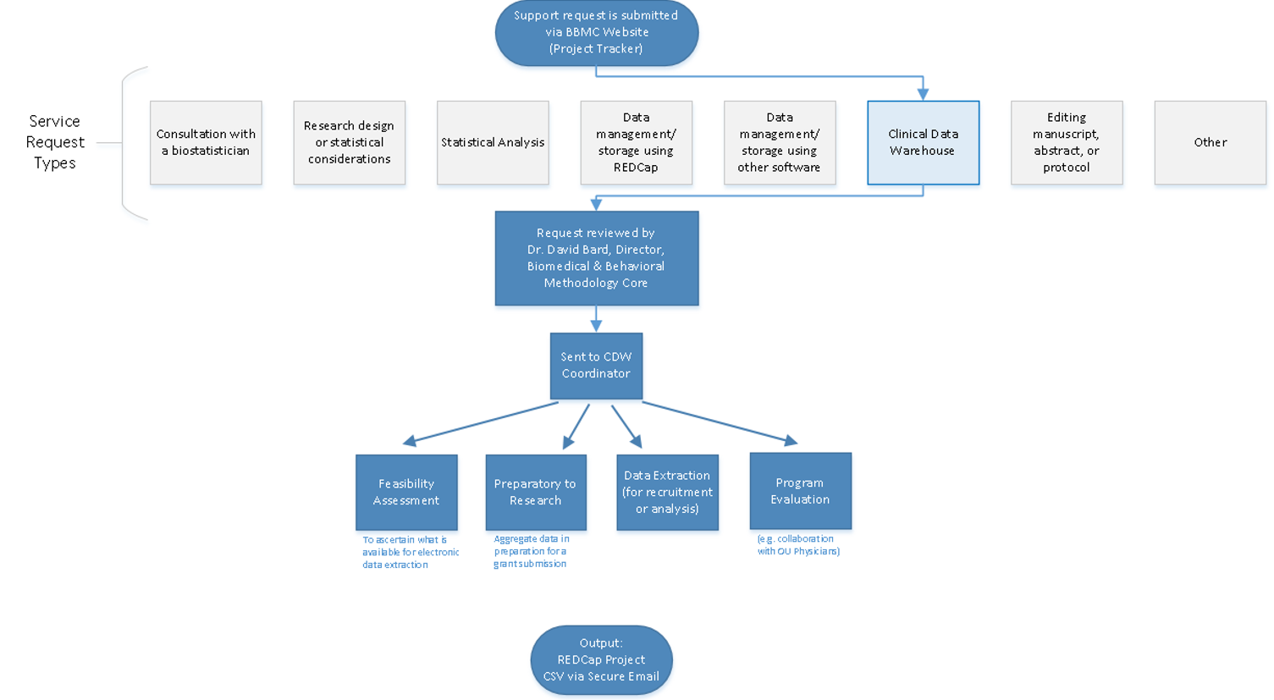
Commonly Requested CDW Support Services
Feasibility assessment in preparation for research (20% of projects; 10% of CDW staff time)
Static eligibility (70% of projects; 20% of CDW staff time)
Virtually all projects require identification of a patient pool
Rolling eligibility (30% of projects; 30% of CDW staff time)
Remember study team’s assessment of eligibility as well as the participant’s response
Daily automation requires stability & good logging; e.g., a 3 hour delay might mean zero subjects are enrolled
Clinical outcomes for retrospective investigations (50% of projects; 30% of CDW staff time)
Administrative outcomes for quality improvement (10% of projects; 2% of CDW staff time)
Program evaluation (20% of projects; 8% of CDW staff time)
Notes:
Here are the services we provide. This roughly reflects the needs of the campus, but it’s not one-to-one. For example, I’m sure there are still a lot of manual chart reviews to create eligibility lists. Also, there are several groups on campus, like BERD, that are great at analyzing the outcomes once the datasets is delivered in a suitable format.
As PIs decide how big of a bite to take, some come to us to get a feel for the counts of patients meeting the conditions of interest. These tasks typically not too heavy, so we can complete most within a day.
One-time eligibility is requested a lot, partly because we’ve built a little reputation around it. And virtually all projects need that patient pool defined. To create this pool our code doesn’t change much between active studies and retrospective studies. We’ve designed our pipeline to reuse a lot.
If it’s not a one-time enrollment, it’s typically then an ongoing recruitment. That takes more time because a lot of factors need to be incorporated to keep it efficient for humans to process. And even if it took zero seconds to develop, that daily automation inevitably requires some maintenance as those eligibility lists are deployed every morning. Although most mornings, the automation is smooth and it’s a simple check for a human to review everything passed.
Clinical outcomes is what I thought would soak up the majority of our time, but that’s been fairly manageable so far.
And occasionally we get administrative and program eval tasks that fit inside a larger research project.

Slide 7
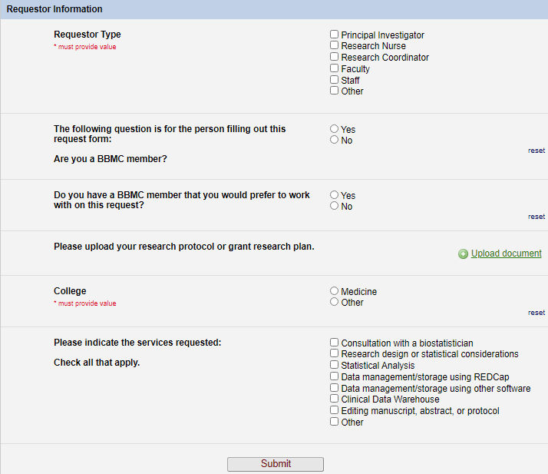
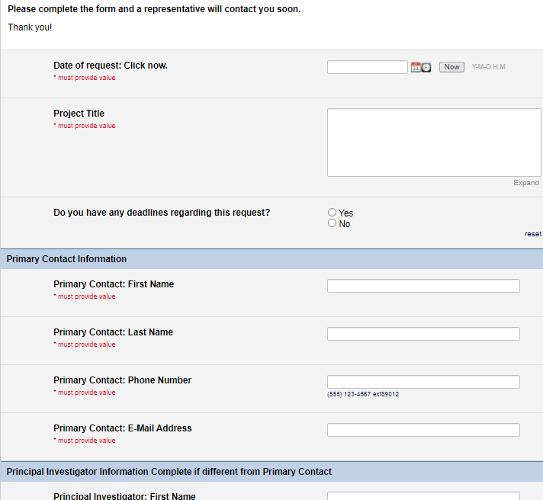
Starting a CDW Project
Submit a request at https://ouhsc.edu/bbmc/, then click “Request Support”
This helps us prep for the initial meeting w/ you
This box routes it to the CDW team

Slide 8
Rule of Thumb for Involving CDW Team
A one-time Meditech extract: contact OU Medicine directly or we’re happy to help structure the request Meditech request: https://ouhealth.service-now.com/sp?id=sc_cat_item&sys_id=79c250c74f652300ed7229dd0210c7d9
Recurring Meditech extracts for rolling recruitment: please contact the BBMC about the CDW (https://ouhsc.edu/bbmc/)
Research involving merged Centricity & Meditech: please contact the BBMC about the CDW (https://ouhsc.edu/bbmc/)
Research involving (a) data collection outside the EMRs or (b) supplementing chart review: please contact the BBMC about REDCap (https://ouhsc.edu/bbmc/)
Terms
Centricity EMR: clinical info for outpatients since ~2010
Centricity Business: scheduling & billing info for outpatient since ~2010
Meditech: EMR for ED & inpatients since the bronze age
Epic: Upcoming EMR that will replace Centricity, Meditech, and many others. May not be useful for your research (at least in time to start your fellowship research project)
REDCap: campus-recommended software for collecting PHI outside the EMRs (https://www.project-redcap.org/)

Slide 9
POPS Study
Pharmacokinetics of Understudied Drugs Administered to Children per Standard of Care
darden-pharmaco-2
Notes:
For the middle part of my talk, I’d like to summarize the prototypical studies that span our spectrum. And start with a big one that has lots of features we reuse in many smaller projects. Consequently their turn around is faster and thoroughness/quality is higher.
This POPS study …

Slide 10
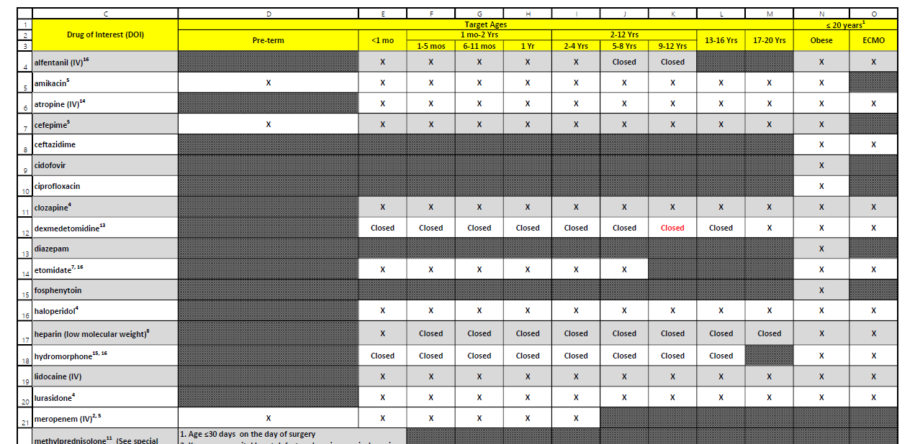
POPS Overview
Primary Aim: Evaluate PK of understudied drugs administered to children
Part of Oklahoma Pediatric Clinical Trial Network (OPCTN), a site for the NIH-funded ECHO IDeA States Pediatric Clinical Trials Network (ISPCTN)
Enrollment Criteria:
Child receiving understudied drug of interest (DOIs) per standard of care
meet age range or condition (pre-term, obese, ECMO) open for enrollment.
darden-pharmaco-2
Notes:
This multi-site project monitors kids prescribed with off label meds –with an important constraint. The researchers can’t perform any extra procedures on a patient. Some of these cells need spinal fluid, but the study can’t get it unless it’s already being collected. So it’s really important to get the info to the research nurses early in the morning to piggy back the collections. Information that is a day old is worthless, especially for the inpatients. The whole approach needs to be proactive and anticipatory, leveraging automation to deliver reports quickly.

Slide 11
Resource Efficiency: fewer patients, quicker review, less redundancy
Old System
New System
2019-01-12 Inpatient Extract
Finds patients who received a drug of interest
109 unique patients
Record review: ~15 min/pt
~1,635 minutes
2019-01-13 Inpatient Extract
112 unique patients @15 min/pt (forgets yesterday)
2019-01-12 Inpatient Screening Report
Finds patients who received a drug of interest and meet an age range or condition currently open for enrollment
31 unique patients
Record review: ~5 min/pt
~155 minutes
2019-01-13 Inpatient Screening Report
6 new patients @5 min/pt (remembers yesterday)
darden-pharmaco-2

Slide 12
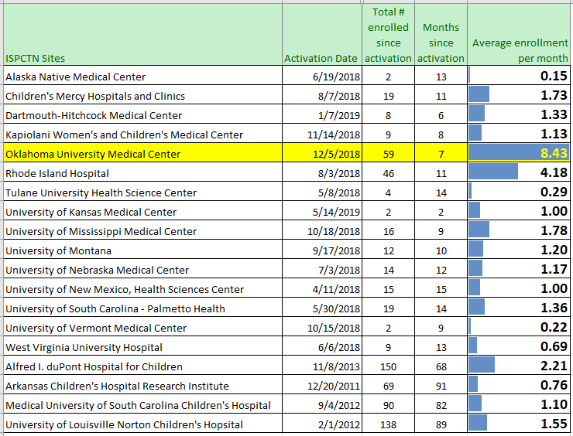
Enrollment Rate by Institution
darden-pharmaco-2
Notes:
Here’s a piece I’m proud of. It demonstrates that investing in the spiderweb’s breadth and the report’s ergonomics can translate into substantial gains.
Our pace in our first seven months was twice as large as the 2nd highest site. This is advantage of ours is independent from the brand of EMR. Many of these places have Epic.
~~Besides the pace, our total volume is 4th highest overall, even when considering locations that started years ago.~~

Slide 13
darden-pharmaco-2
Notes:
Here is the schematic of most elements in the daily pipeline. It
pulls from the inpatient EMR and outpatient EMR (several tables involved in each), then
identifies inclusion & exclusion criteria for each potential patient, then
determines if we’ve already approached the patient (and if they’ve consented or declined), and finally
sends output to REDCap and to an html report for the research staff to use.

Slide 14
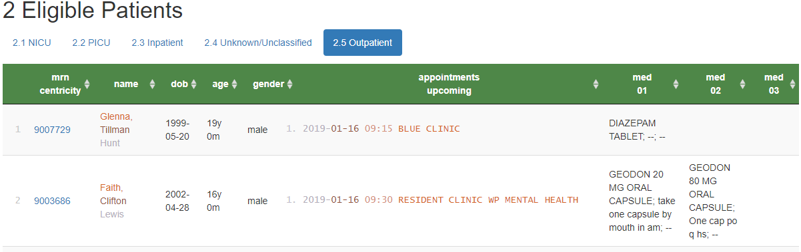
Screening Reports (for outpatients)
Shows upcoming appointments of potentially eligible patients
Location of care
Appt Date & time
Qualifying medication (e.g., Diazepam)
Qualifying condition (e.g., obese, 24 months old)
Similar inpatient process was developed
Eligible Patients for POPS
(Simulated patients)
darden-pharmaco-2

Slide 15
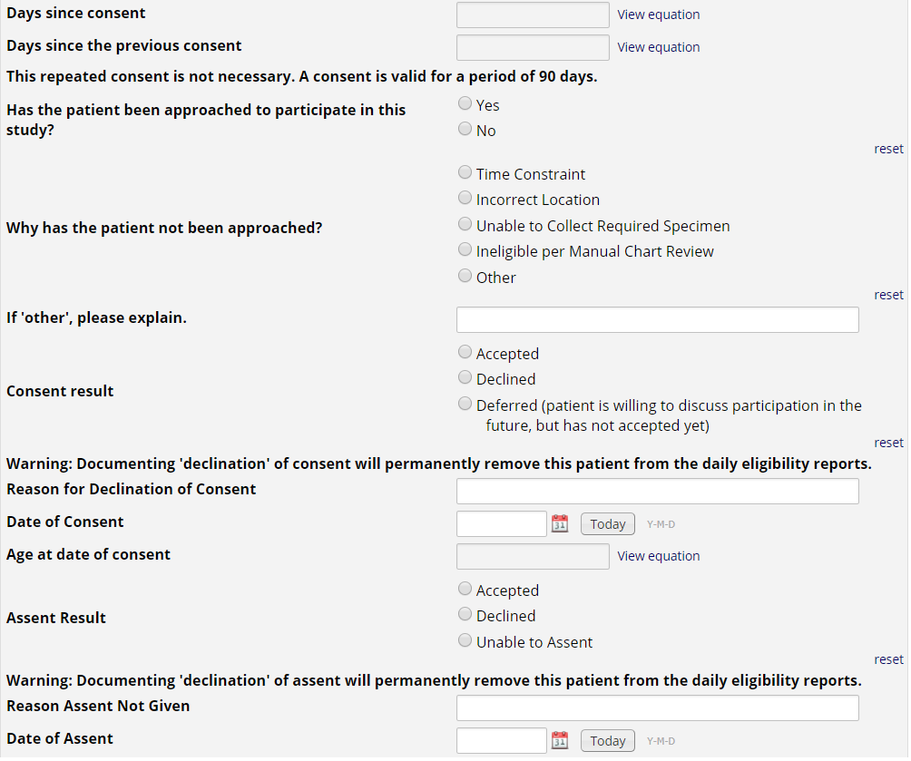
REDCap Project
Approached?
Consented?
Assented?
darden-pharmaco-2
Notes:
Research nurses use the MRN hyperlink on the eligibility report to document approached/consent/assent in REDCap.
If a patient or guardians ‘declines’ consent or assent, the patient is removed from future eligibility reports.
This also allows us to create summary stats for the investigators to monitor progress, address issues with resource allocation, etc.

Slide 16
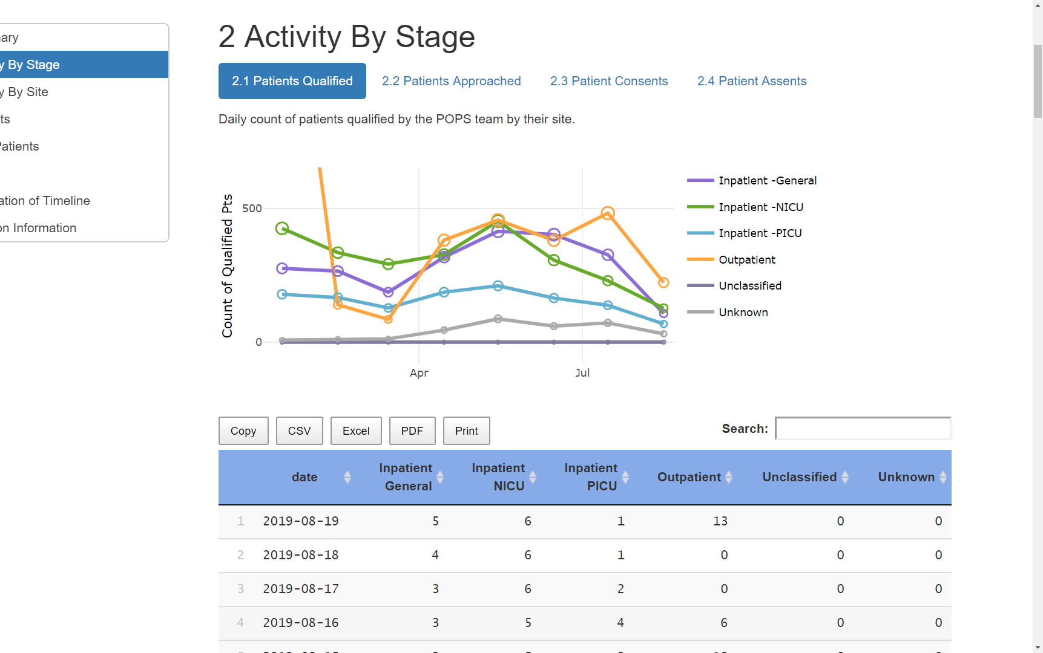
Progress Reports
See the forest.
3-way breakdowns of:
time
site
drug
age
gender
stage
qualified
approached
consented
assented
darden-pharmaco-2

Slide 17
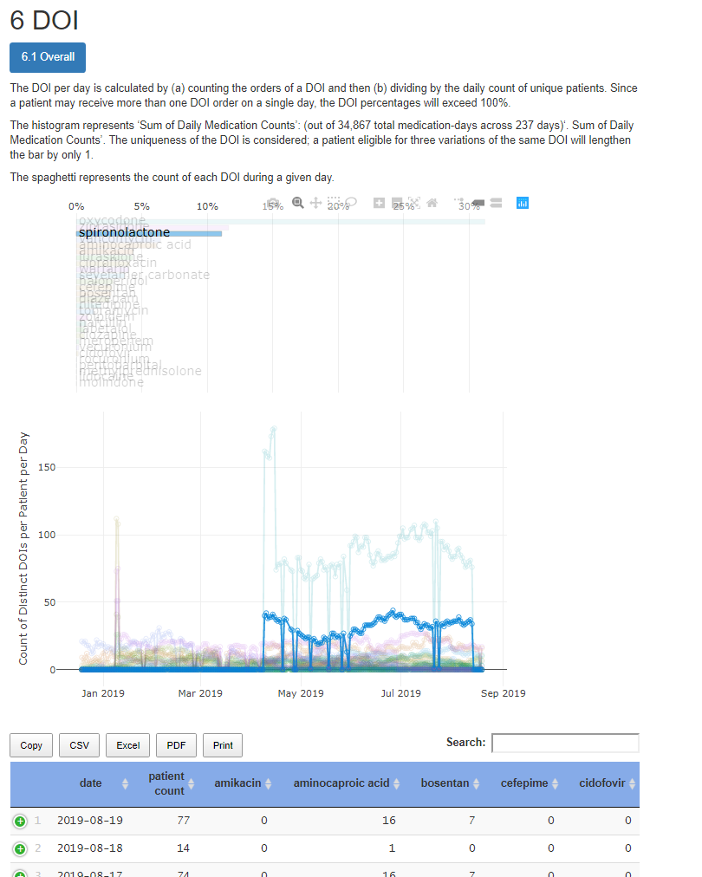
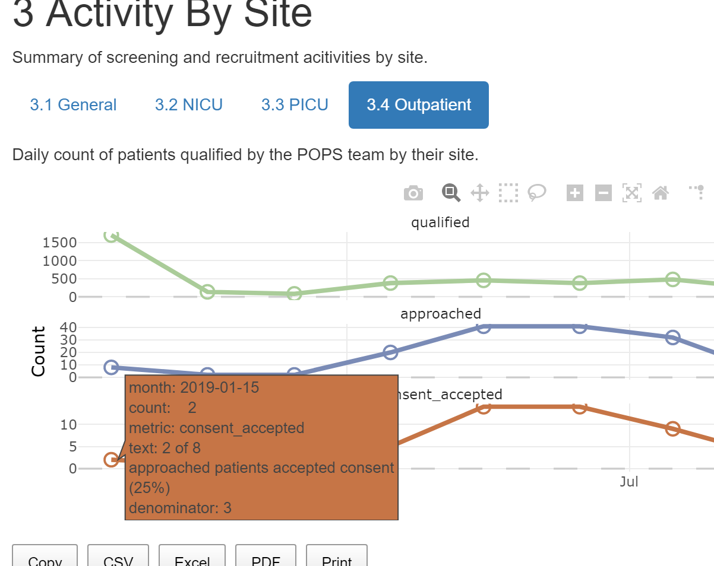
Progress Reports
darden-pharmaco-2
Notes:
[15 min cumulative]

Slide 18
National Registry Example: COVID-19 CDW Registry Based on OMOP
covid-registry

Slide 19
National Registry
Institutions from 20+ states combine covid data from their EMRs
There’s a national movement for investigations to be informed by multiple sites/institutions. Every research study and institution collects their data differently.
A CDM (common data model) is a standardized convention to store & describe data. Institutions extract and transform their EMR data
See https://ncats.nih.gov/ and https://ncats.nih.gov/n3c
covid-registry
Notes:
if you're hunting big funding, many people believe you'll need to include multiple sites/states. For example Cf registry, sickle cell registry

Slide 20
Thank you
Will Beasley, PhD
Ashley Thumann, MHA
Geneva Marshall, MA
Lise DeShea, PhD
David Bard, PhD
University of Oklahoma HSC
Biomedical & Behavioral Methodology Core (BBMC)
Award Numbers: UG1OD024950 U54GM104938

Slide 21
Extra Slides

Slide 22
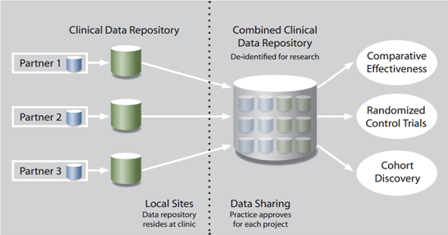
Where Other Universities are Headed
University of Washington:
Data Quest (https://dataquest.iths.org/)
Leaf- Integrates of Regulatory Oversight with Data Accession
De-identified prep to research
PHI access
TriNetX
Attract Industry-Sponsored Trials
Peer-institution Collaborations
University of Michigan
EMERSE (Electronic Medical Records Search Engine; http://project-emerse.org/)
Google for your free text EMR documents and notes
Similar to natural language processing (NLP)
Notes:
Also mention GIS capabilities and surveillance

Slide 23

LEAF
About LEAF
Self-service web application for querying and extracting clinical data
Flexible biomedical concept system to define hierarchical items and ontologies
Drag & drop user interface
Designed to seamlessly integrate with existing enterprise user authentication systems and clinical databases
Produces results which are identifiable (with IRB approval) or de-identified
Potential Uses
Cohort discovery: determine if enough patients meet a given set of conditions which match recruitment criteria
Statistics: quickly pull numbers, “How many patients were seen last month?”
Chart Abstraction: Generate a dataset for research or quality improvement purposes
https://www.iths.org/

Slide 24
Brief Summary of CDW Value

Slide 25
Brief Summary of CDW Value
POPS: dynamic recruitment
OxyContin: electronic sorting and merging/patient matching
ADHD studies: Apply standard clinical vocabulary to support interoperability to help information exchange; isolated retrieval of text documents for mining
Diabetes Management/Transition of Care: Sharing of data across various sources improves quality of care and efficiency; maximizes utility of data
Immunization: Harmonization of records for quality reporting and improved accuracy of record history

Slide 26
Tung-ibd-1
Tissue Eosinophil Count in IBD patients
tung-ibd-1
Notes:
This project pulls from sources that most researchers have never accessed, such as docdata, docimages, and ‘external references’. …in addition to the usual things like obs and dx.
So much patient data exists in free-text notes, but it’s almost never used. This includes text that humans type, but also includes all the labs that are dumped there without structure. Sometimes the EMR will parse the labs and translate them to a structured and research-friendly format; but many times the labs aren’t correctly identified, categorized, or parsed. When that happens, we resort to digging out the lab info from the notes.
{PI: Jeanne Tung; Fellow: Zahra Nouri; pediatrics}

Slide 27
Steps to Leverage EMR “documents”
CDW-level tasks
(Notes are stored as multiple rows --2k characters per “document”)
Concatenate the 2-4,000 rows per document
Strip the RTF. (RTF is a markup language that specifies cosmetics like font size and color.)
Include a search index (similar to a book index) that makes searches & parsing more efficient
Project-specific tasks
Identify keywords that might indicate the document contains a relevant lab.
Extract the stem and result
eg, “normal fecal flora (moderate growth)”
eg, “negative for salmonella, shigella, and campylobacter”
tung-ibd-1

