Slide 2
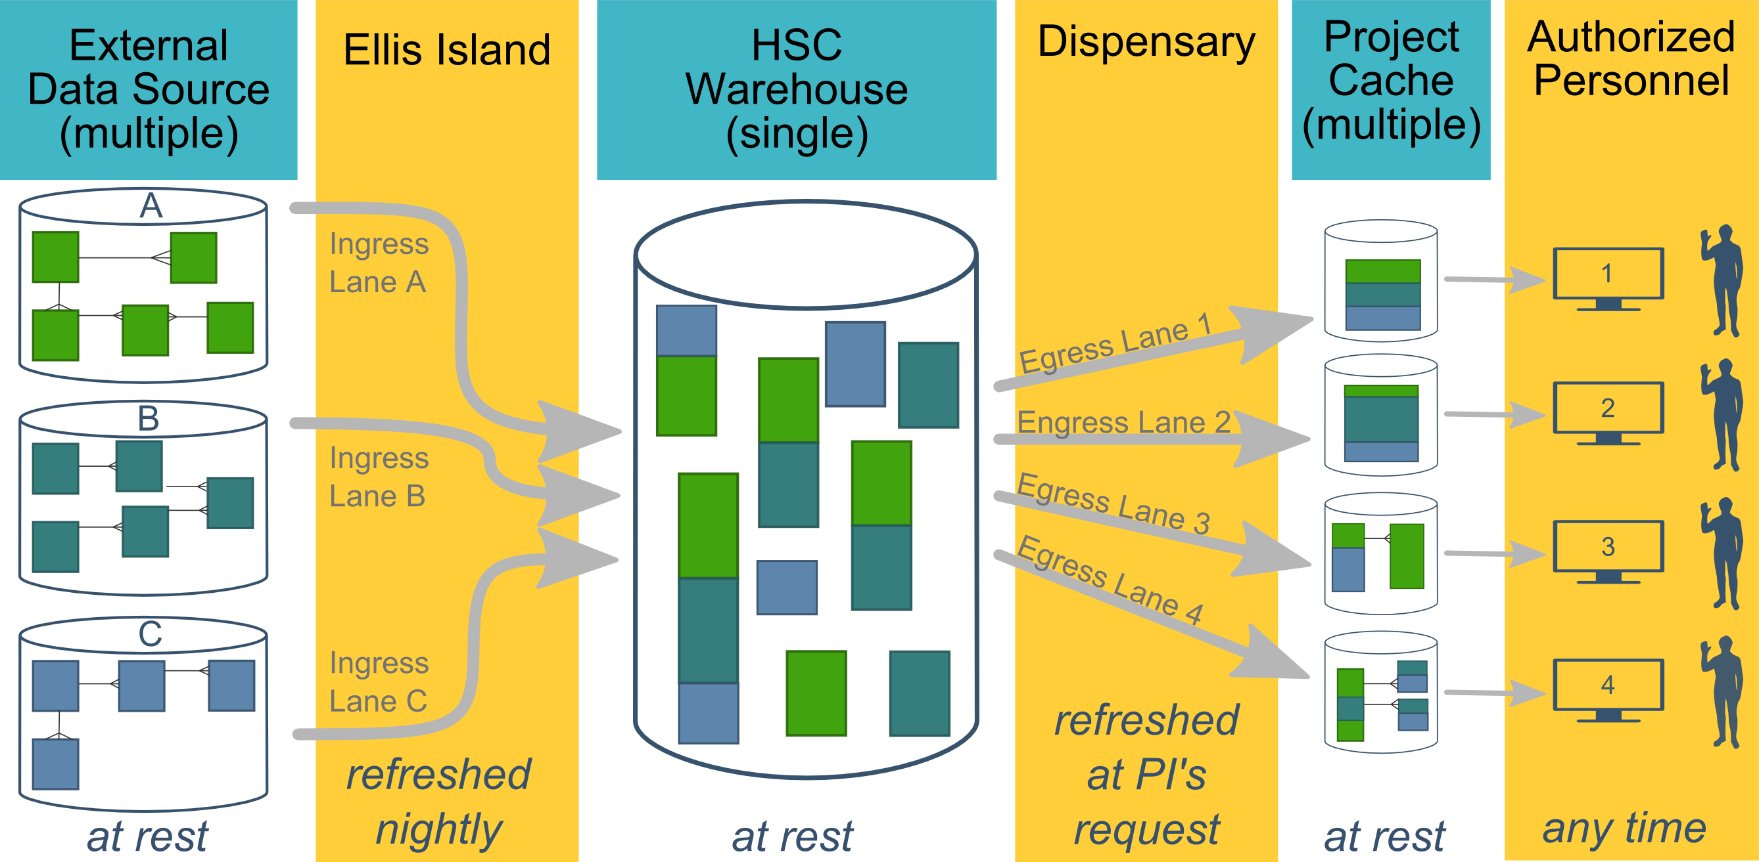
Ecosystem Architecture
Data Source (column 1): contains unique info
Warehouse (column 3): contains copy after manipulation
Project Cache (column 5): contains copy of copy after a lot of manipulation
Notes:
The entire ecosystem can be represented by these six columns. The EMR and other collection databases sit in the 1st column and feed the warehouse in the third. This movement is automated. Inside the warehouse, the info from the different sources are combined. Different patients can be placed in the same table. Perhaps more importantly, records for a single patient that are scattered across different sources are linked.
When a investigation is approved by the IRB, we can develop a tiny database in REDCap that contains the dataset needed for their analysis (5th column). There are a few reasons why REDCap is preferred. First, it’s more secure and scalable than distributing loose Excel files. Second, REDCap has a lot of momentum and adoption, so it’s become familiar to a lot of people on campus. The same software system the clinical researcher learned (for example) for randomized trials is leverage here for these observational studies. Although the research/QA methodology is very different, the software is the same. We expect this familiarity to grow on campus, especially as systems like Qualtrics become less available.

Slide 3

HSC DATA TYPES
Patient Data
Inpatient/Meditech
Outpatient/Centricity
Dozens of departmental sources
Billing and Claims Data
Biomedical Research Data
Employee Data
Administrative Cost Data
Student Data
Notes:
Growing data enterprise
Data integration is an important subject for our clinical operations and our research enterprise as we continue to evolve our methods for integrating data across our two largest data streams: clinic EMR and hospital EMR.
Two notable informatics tools have been developed to tackle this challenge: A CDW for quality improvement evaluations and research and through a partnership with the non-profit org MyHealth and OU’s Dept of Med Informatics in Tulsa, an HIE to facilitate point of care, data informed decision-making not only at OU but across the entire state.

Slide 4
HSC DATA ENTERPRISE
Prairie Outpost Clinical Data Warehouse (contact: Ashley Thumann)
Integrates patient data from dozens of sources which include Centricity and MediTech
REDCap (contact: Thomas Wilson, Pravina Kota)
Management tool that can be used for Big & Small data
Outpatient EMR: GE Centricity (contact: Matthew Atkins)
Inpatient EMR: MEDITECH (contact: Allen Smith)
MyHealth Access Network, Health Information Exchange System (contact: David Kendrick)
Integrates data from 4,000+ providers and 3+ million patients from all other the state of Oklahoma
Biospecimen repository (contact: OSCTR)
OK-INBRE Bioinformatics (contact: Dave Dyer)
Laboratory for Molecular Biology and Cytometry Research (contact: Allison Gillaspy)
IT Data Services (contacts: Jeff Wall, Melissa Nestor)
Notes:
Clinic + Hospital data: Clinic records from 2007 to present covering 1.3+ million unique clinic patients
Hospital records from 1995 to present approaching 1 million unique patients
Combined clinical and hospital visits of 41+ million
Growing data enterprise
Data integration is an important subject for our clinical operations and our research enterprise as we continue to evolve our methods for integrating data across our two largest data streams: clinic EMR and hospital EMR.
Two notable informatics tools have been developed to tackle this challenge: A CDW for quality improvement evaluations and research and through a partnership with the non-profit org MyHealth and OU’s Dept of Med Informatics in Tulsa, an HIE to facilitate point of care, data informed decision-making not only at OU but across the entire state.
Nestor’s group does the following:
Getting access to Tools
Helping with Power BI
Introducing User Groups
Assisting in the Creation of Reports, Dashboards, and Visualizations

Slide 5
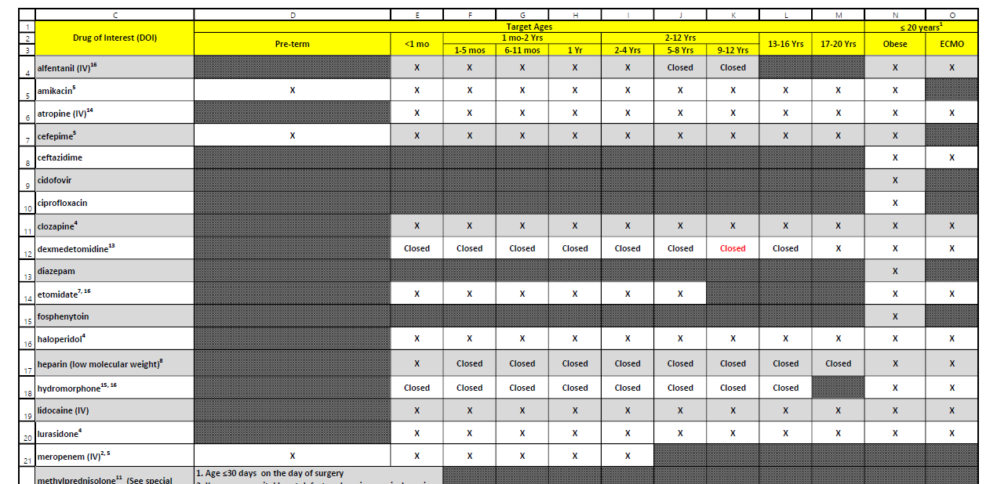
POPS: Pharmacokinetics of Understudied Drugs Administered to Children per Standard of Care
Primary Aim: Evaluate the PK of understudied drugs currently being administered to children
This study is part of the Oklahoma Pediatric Clinical Trial Network (OPCTN), which is a site for the NIH-funded ECHO IDeA States Pediatric Clinical Trials Network (ISPCTN).
Enrollment Criteria: Child must be receiving an understudied drug of interest (DOIs) per standard of care as prescribed by their treating caregiver, and meet an age range or condition (pre-term, obese, or on ECMO) open for enrollment.

Slide 6
Resource Efficiency: fewer patients, quicker review, less redundancy
2019-01-12 Inpatient Extract
Finds patients who received a drug of interest
109 unique patients
Record review: ~15 min/pt
~1,635 minutes
2019-01-13 Inpatient Extract
112 unique patients @15 min/pt (forgets yesterday)
2019-01-12 Inpatient Screening Report
Finds patients who received a drug of interest and meet an age range or condition currently open for enrollment
31 unique patients
Record review: ~5 min/pt
~155 minutes
2019-01-13 Inpatient Screening Report
6 new patients @5 min/pt (remembers yesterday)

Slide 7
Benefits of 20x Efficiency
Better efficiency allows us to spin and cover a larger web. (We should probably transition to the term “filter”.)
Instead of focusing on a subset of dx & location, our report covers the entire space.
We try to aggressively
Cover the entire space
Prune known ineligible cases (ie, Cut from 113 to 31 to 6 unique inpatients)

Slide 8
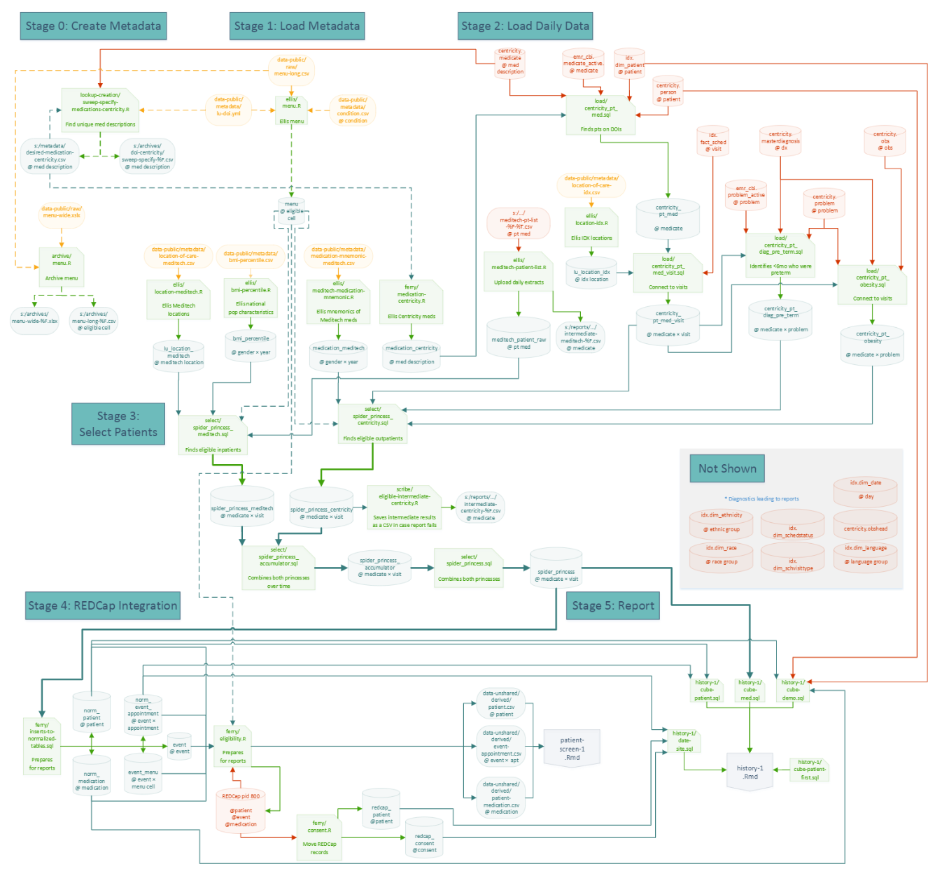

Slide 9
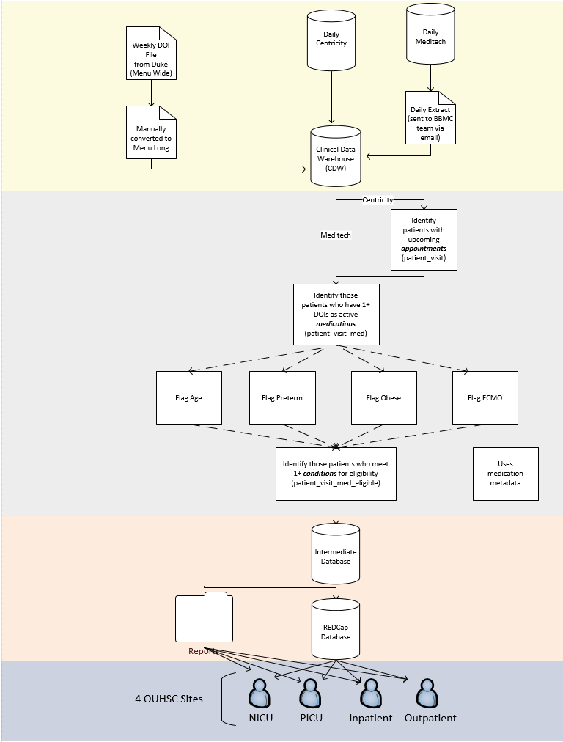

Slide 10
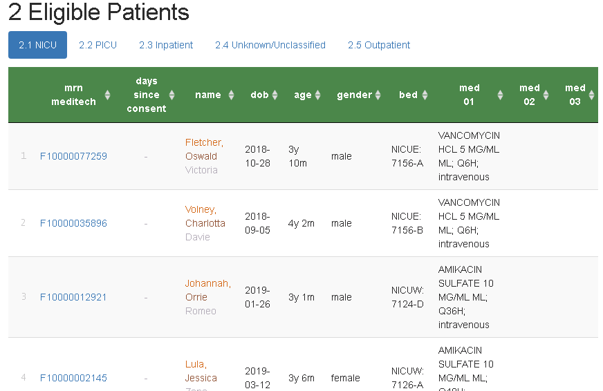
Screening Report (for inpatients)
Hyperlinks to REDCap
Consent stop watch
Filter, search, & sort
(← Fake patients)

Slide 11
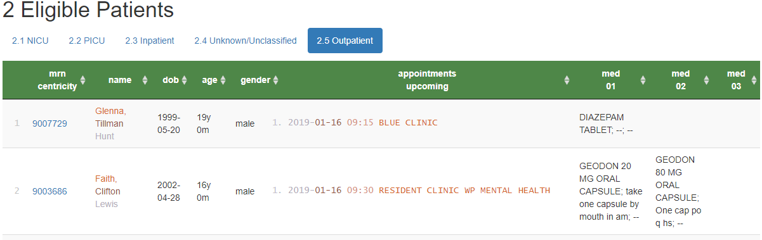
Screening Reports (for outpatients)
Shows upcoming appointments of potentially eligible patients
Location of care
Appt Date & time
Qualifying medication (e.g., Diazepam)
Qualifying condition (e.g., obese, 24 months old)
Similar inpatient process was developed
Eligible Patients for POPS

Slide 12
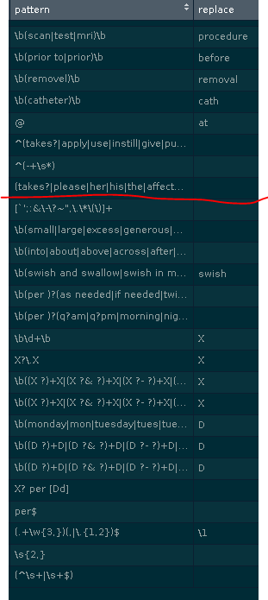
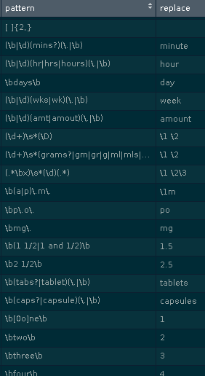
Collapsing/Standardizing Med Instructions
Use regular expressions to match free-text, and replaces with a ‘better’ value.
Correct misspellings
Remove junk
Standardize format (eg, space between `5mg`)
Standardize term (eg, `cap`, `caps`, &`capsule` to capsules`)
Remove info irrelevant to eligibility below the red line (eg, `1mg` and `2mg` becomes `X mg`)
Reduces 130k entries to 46k

Slide 13
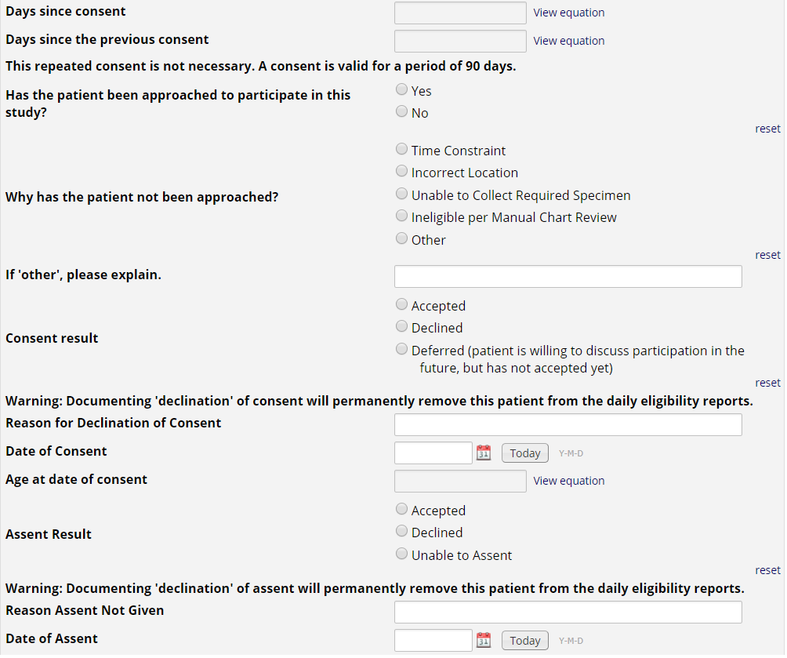
REDCap Project
Research nurses use the MRN hyperlink on the eligibility report to document approached/consent/assent in REDCap.
If a patient or guardians ‘declines’ consent or assent, the patient is removed from future eligibility reports.
This also allows us to create summary stats for the investigators to monitor progress, address issues with resource allocation, etc.

Slide 14
VDORA: Vitamin D Supplementation in Children With Obesity-Related Asthma
Objective: To determine the pharmacokinetics of Vitamin D supplementation in children who have asthma and are overweight or obese.
This study is part of the Oklahoma Pediatric Clinical Trial Network (OPCTN), which is a site for the NIH-funded ECHO IDeA States Pediatric Clinical Trials Network (ISPCTN).
Enrollment Criteria: Child must be between the ages of 6 and 17, have a diagnosis of asthma, documentation of obesity, and meet additional inclusion criteria such as ‘an ability to swallow pills’.

Slide 15
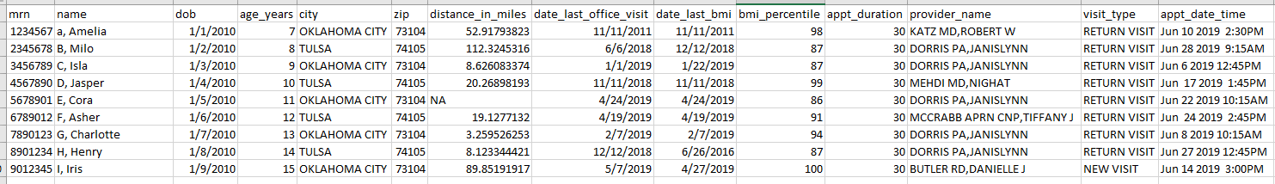
appt.csv
(Fake patients)

Slide 16
Resource Efficiency: fewer patients, quicker review, less redundancy
Manual Screening Process
Obtain a list of appointments scheduled the following week
Review each medical record using the inclusion/exclusion checklist:
Other criteria
Age
Diagnosis of asthma
Documentation of obesity
Email providers for review/input
Volume: 130 charts
Time: 240 minutes
Automated Screening Process
Review select medical records for:
Other criteria
Email providers for review/input
Volume: 24 charts (screened out 106)
Time: 45 minutes

Slide 17
PROSpect: PRone and OScillation PEdiatric Clinical Trial
Two-by-two factorial, response-adaptive multi-center randomized clinical trial.
Primary Aim: To provide evidence to support best ventilation practices in critically ill children with severe PARDS defined per PALICC guidelines.
Enrollment Criteria: Pediatric patients >= 2 weeks of age and <18 years of age, intubated and mechanically ventilated, with severe PARDS for <48 hours per PALICC guidelines.
henry-intubate-1

Slide 18
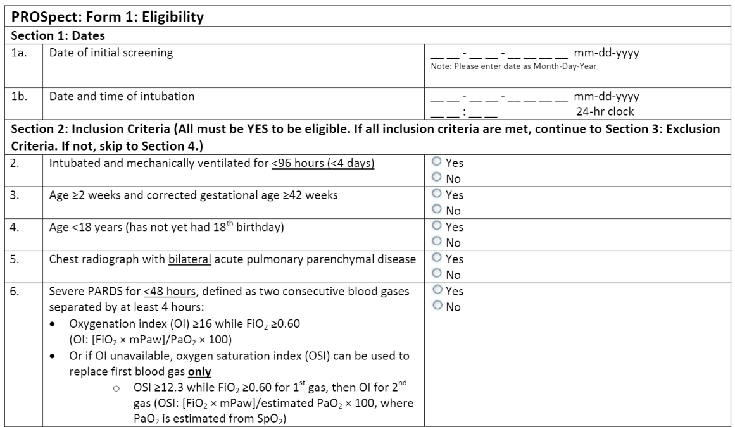
PROSpect: PRone and OScillation PEdiatric Clinical Trial
Exclusion criteria: previous enrollment in PROSpect, perinatal related lung disease, congenital diaphragmatic hernia or congenital/acquired diaphragm paralysis, respiratory failure explained by cardiac failure or fluid overload, cyanotic heart disease, cardiomyopathy, primary pulmonary hypertension, intubated for status asthmaticus, obstructive airway disease, active air leak, bronchiolitis obliterans, post hematopoietic stem cell transplant, post lung transplant, home ventilator or home oxygen dependent…

Slide 19
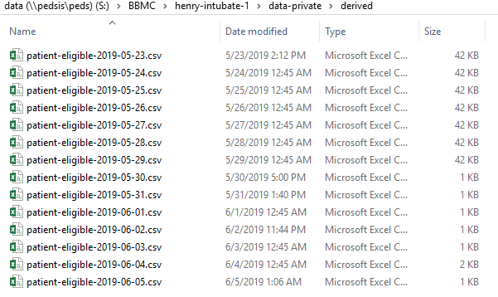
PROSpect: PRone and OScillation PEdiatric Clinical Trial

Slide 20
A Nationally Representative Drug Utilization Study of OxyContin in Children Age 17 Years and Younger
Multicenter retrospective, observational cohort study
Primary Aim: Conduct a nationally representative drug utilization study of sufficient detail to characterize OxyContin use in children.
Enrollment Criteria: Age < 18 years at the time of OxyContin prescription and prescribed at least one dose of OxyContin as an inpatient or outpatient between 01/01/2011 and 12/31/2017.

Slide 21
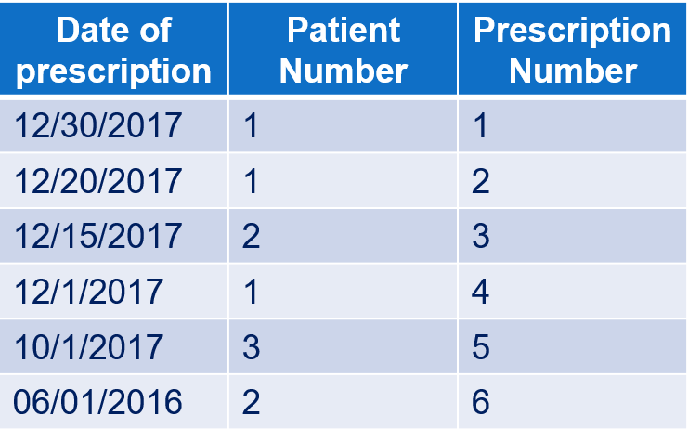
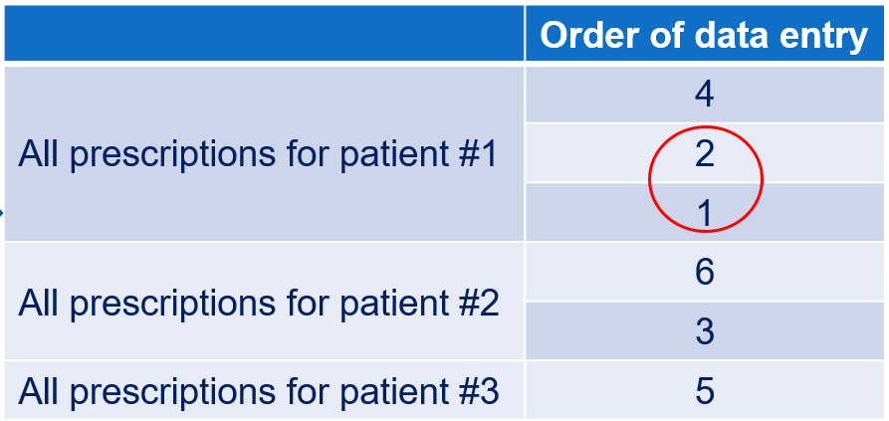
A Nationally Representative Drug Utilization Study of OxyContin in Children Age 17 Years and Younger
Inpatient EMR – Meditech
Outpatient EMR – Centricity
Data Manipulation was required to aid the study team in determining the order of participant and prescription data entry based on the following criteria:
Identify the most recent OxyContin prescription recorded for an inpatient or an outpatient, then
Identify the patient who received this prescription
Enter ALL OxyContin prescriptions the patient received in the study period
Proceed to the next most recent OxyContin prescription received by a different patient and repeat the process.

Slide 22
A Nationally Representative Drug Utilization Study of OxyContin in Children Age 17 Years and Younger
Describe process w/o CDW

Slide 23
Clinical Trials & Other Research Studies Supported by the CDW
CDW Project Short Title, PI Name, Department

Slide 24
Commonly Requested CDW Support Services
Daily reports for rolling eligibility
Generating a list of candidates
Remembering study team’s assessment of eligibility as well as the participant’s response
Clinical outcomes for retrospective investigations
Administrative outcomes for CQI

Slide 25
Advantages of using CDW instead of manual chart review
Time efficiency in the long-run
With established in-house expertise, we could deliver a list within two weeks.

