Slide 1







Leveraging OUHSC Clinical Research Data Warehouse to Inform Research & Practice
Will Beasley, PhD
Ashley Thumann, MHA
Geneva Marshall, MA
Lise DeShea, PhD
David Bard, PhD
University of Oklahoma HSC
Biomedical & Behavioral Methodology Core (BBMC)
April 2021
Award Numbers: UG1OD024950 U54GM104938
Notes:
Hi I’m Will, and part of the Clinical Research Data Warehouse effort on campus. I started as a conventional statistician and researcher, and based on experience with integrating our investigations with state agency data , our group moved into the world of EMRs and warehouses.
I think these experiences have allowed our group to relate well with current PIs, as well as build a CRDW ecosystem that works well with research.

Slide 2
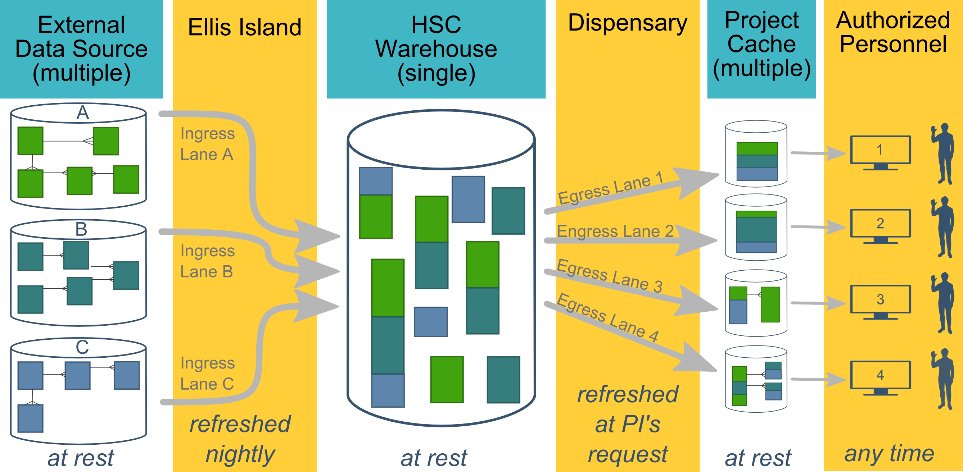
Ecosystem Architecture
Prairie Outpost – CRDW (Clinical Research Data Warehouse)
https://github.com/OuhscBbmc/prairie-outpost-public
Data Source (column 1): contains unique info
Warehouse (column 3): contains copy after manipulation
Project Cache (column 5): transformed to facilitate analyses of a specific research project
Notes:
The entire ecosystem can be represented by these six columns. The EMR and other collection databases sit in the 1st column and feed the warehouse in the third. This movement is automated. Inside the warehouse, the info from the different sources are staged & combined. Different patients can be placed in the same table. Perhaps more importantly, records for a single patient that are scattered across different sources are linked.
When a investigation is approved by the IRB, we can develop a tiny database in REDCap that contains the dataset needed for their analysis (5th column). There are a few reasons why REDCap is preferred. First, it’s more secure and scalable than distributing loose Excel files repeatedly for the same project. Second, REDCap has a lot of momentum and adoption, so it’s become familiar to a lot of people on campus --like those using it to collect research data.
We’ve always emphasized that we developed this to be as modular as possible. If someone could benefit from a few columns, they don’t have to commit to the whole thing. This modular approach has paid off, and I’ll return to that in the last few slides.

Slide 3
HSC Data Sources
Patient
Outpatient (Centricity)
Billing and Claims Data
Inpatient (Meditech)
Dozens of departmental sources
Biomedical Research Data
Epic (in ~1 year)
Provider
External Agencies
Service Provided (by the Health Dept of Oklahoma)
Child Protective Services (Oklahoma Dept of Human Services)
Immunization (Health Dept of Oklahoma)
Vital Records (Health Dept of Oklahoma)
…
Multi-state collaborations (in the future)
Administrative Cost
Employee & Student
Notes:
Here are the data sources for the research projects that we’ve assisted with. Roughly in descending order of frequency.
Most of our projects involve inpatient EMRs, outpatient EMRs, and billing systems.
In some ways, our experience started with datasets from external collaborators, such as the Dept of Health, and grew from there.

Slide 4
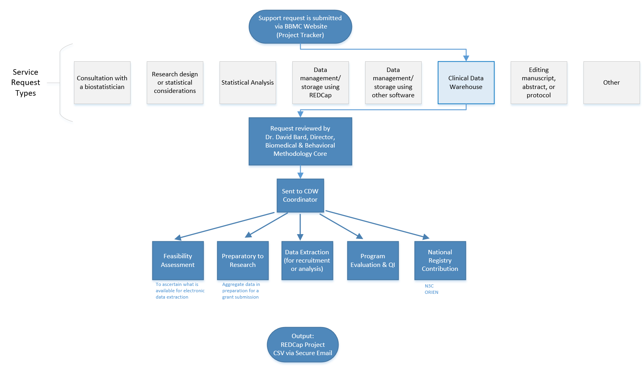
Typical Workflow for a
CRDW Research project
by the BBMC
Submit a request at:
ouhsc.edu/bbmc/
then ‘Request Support’
Notes:
Our group, the BBMC, is a core of ~6 faculty statisticians and another ~10 staff with skills in health administration, analysis, research, and data science.
When we receive a request involving the CRDW, it’s reviewed by a triage team and assigned to a mix of people. We assist with the project (ideally while the proposal is being written –not after it’s submitted). Some of the time we’re also the statisticians, and some of the time the PI has their own statistician or is collaborating with a group like BERD.
For a one-time retrospective research project, the output is usually a secured CSV. For a project requiring rolling enrollment, we deploy updates every morning with REDCap and dynamic html reports.
I have few friends managing the CRDWs of other universities. When we compare our situations, the biggest differences arise from the fact that our CDW was created by a group that’s primarily statisticians & researchers, as opposed to being created by an IT group that brings in outside statisticians. Pros & cons to each origin story. If you see differences between our approach and other institutions, this is a big reason.

Slide 5
Commonly Requested CRDW Support Services
Feasibility assessment in preparation for research (20% of projects; 10% of CRDW staff time)
Static eligibility (70% of projects; 20% of CRDW staff time)
Virtually all projects require identification of a patient pool
Rolling eligibility (30% of projects; 30% of CRDW staff time)
Remember study team’s assessment of eligibility as well as the participant’s response
Daily automation requires stability & good logging; e.g., a 3 hour delay might mean zero subjects are enrolled
Clinical outcomes for retrospective investigations (50% of projects; 30% of CRDW staff time)
Administrative outcomes for quality improvement (10% of projects; 2% of CRDW staff time)
Program evaluation (20% of projects; 8% of CRDW staff time)
Notes:
Here are the services we provide. This roughly reflects the needs of the campus, but it’s not one-to-one. For example, I’m sure there are still a lot of manual chart reviews to create eligibility lists. Also, there are several groups on campus, like BERD, that are great at analyzing the outcomes once the datasets is delivered in a suitable format.
As PIs decide how big of a bite to take, some come to us to get a feel for the counts of patients meeting the conditions of interest. These tasks typically not too heavy, so we can complete most within a day.
One-time eligibility is requested a lot, partly because we’ve built a little reputation around it. And virtually all projects need that patient pool defined. To create this pool our code doesn’t change much between active studies and retrospective studies. We’ve designed our pipeline to reuse a lot.
If it’s not a one-time enrollment, it’s typically then an ongoing recruitment. That takes more time because a lot of factors need to be incorporated to keep it efficient for humans to process. And even if it took zero seconds to develop, that daily automation inevitably requires some maintenance as those eligibility lists are deployed every morning. Although most mornings, the automation is smooth and it’s a simple check for a human to review everything passed.
Clinical outcomes is what I thought would soak up the majority of our time, but that’s been fairly manageable so far.
And occasionally we get administrative and program eval tasks that fit inside a larger research project.

Slide 6
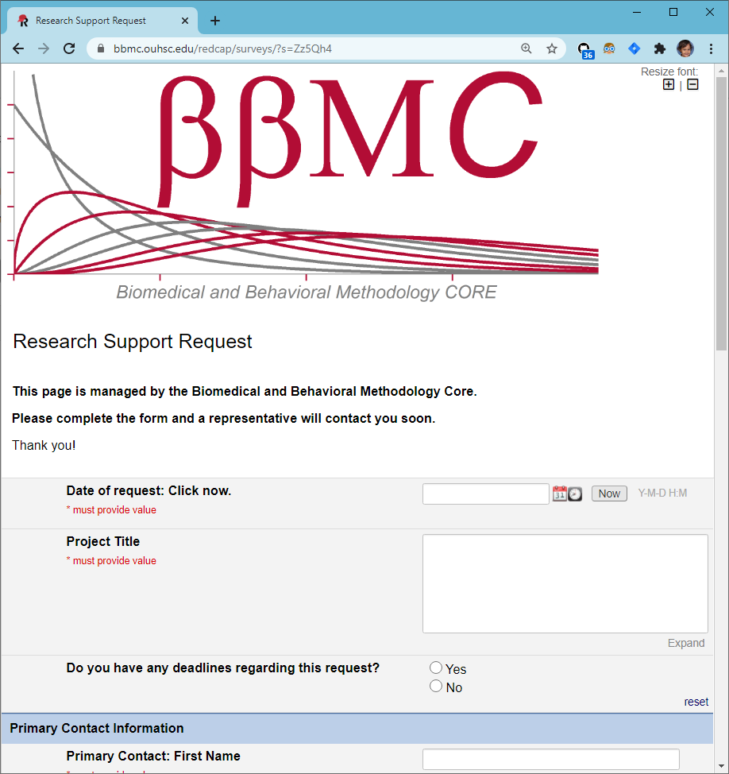
CRDW Typical Workflow
Intake via BBMC request form
Meet with investigator to determine data needs, feasibility
Back and forth with investigator
Develop Pipeline
Review with investigator and distribute via approved method
Structured vs. unstructured?
How well meet project needs with what’s available?
IRB considerations
Metadata files (such as identifying ICD codes, medications)
Verifying data formats
Automated daily data pulls
Varies vastly in complexity by project, data sources, etc.
CSV tables via SFT
Push to REDCap
Dashboards
Assign project to BBMC analyst based on skills, workload, & interests
Some projects may involve multiple analysts
Identifying locations and sources of data
SQL, R, & Python
Follows HIPAA & least privileges principles
BBMC Triage to services:
Feasibility
Program Evaluation
Recruitment
Retrospective Analysis
Facilitate Abstraction
Preparatory to Research
QI
Registry
Some may be very complex and/or rely on complicated code (e.g., Regular Expressions to extract structured data from unstructured notes, etc.). These requests can make completion take longer than usual.
Investigators are asked to add CRDW team to IRB application as KSP
CRDW team reviews & evaluates protocol to ensure data requested are authorized
Some have required modifications prior to release of data
This occasionally causes delays
Ideally, the IRB would implement a procedure to allow investigators to indicate utilization of CDRW upon initial approval without adding team as KSP (e.g., a check-box on the application indicating use of CDRW to extract data)

Slide 7
Since 2017, the CRDW has provided support for more than 120 projects.
There are 47 active projects, to include 5 new projects since mid-February (shown in blue on slide 6).
Most requests are submitted by the below departments or specialties.
Department/Specialty | Request Count
Pediatrics | 54
Orthopedics | 19
Cancer Center | 10
Urology | 9
Obstetrics & Gynecology | 6
Chart & table last updated Feb 2021
Notes:
Our projects have been spread across several research groups. We haven’t done much marketing, so it makes sense that the majority come from our own department.

Slide 8
Encouraging Secure Data Practices (Slide 1 of 2)
Our goal is to deliver the data extracts to researchers in a way that makes it easy for them to follow best practices.
Delivery of PHI, depending on the dataset and researcher
SFT for one-time transfers
HSC file servers for recurring transfers
REDCap for recruiting projects (users manually enter data as we refresh info daily)
Never email
Common mitigations include
Withholding PHI fields
Obfuscating PHI fields (e.g., birth year instead of birth date)
Pre-calculating fields to avoid PHI (e.g., we calculate the age at visit, instead of sending visit & birth dates)

Slide 9
Encouraging Secure Data Practices (Slide 2 of 2)
Roughly half of CRDW clients are barely comfortable with csv/Excel files. Increasing delivery through REDCap would require extensive training (1+ hour per person) as well as 2+ hours of CRDW staff time to establish projects and support users.
We delivered through REDCap exclusively in 2016. But most investigators just requested help exporting it to a csv, and never touched REDCap again.
REDCap’s audit logs are uninformative at that point (because the PHI was in csvs).
We didn’t know where the loose csvs were going.
We decided that it was better to directly & securely deliver the csv to an HSC file server (for recurring transfers).
Only study personnel can access their study-specific file folders.
If HSC offered a secure & isolated virtual environment, IT would need to develop and maintain the server and to train researchers.

Slide 10
CRDW Active Projects
At this committee’s request, we surveyed 42 PIs or study contacts associated with our active requests. Those results are below.
Category | Responses | Count (Proportion) Responded ‘Yes’
Quality Improvement | 22 | 6 (27.3%)
Scientific research that should produce 1 or more publications | 22 | 21 (95.5%)
Involves other scholarly activity for future publication | 22 | 10 (45.5%)
Involves program evaluation | 22 | 4 (18.2%)
Focuses on academic activities | 22 | 4 (18.2%)
In the area of health economics | 22 | 1 (4.5%)
Research on health systems | 22 | 6 (27.3%)
In the area of dissemination/implementation science | 22 | 4 (18.2%)
Focuses on outcomes research | 22 | 11 (50%)

Slide 11
Ecosystem Architecture
Prairie Outpost – CRDW (Clinical Research Data Warehouse)
https://github.com/OuhscBbmc/prairie-outpost-public
Data Source (column 1): contains unique info
Warehouse (column 3): contains copy after manipulation
Project Cache (column 5): transformed to facilitate analyses of a specific research project
Notes:
The entire ecosystem can be represented by these six columns. The EMR and other collection databases sit in the 1st column and feed the warehouse in the third. This movement is automated. Inside the warehouse, the info from the different sources are staged & combined. Different patients can be placed in the same table. Perhaps more importantly, records for a single patient that are scattered across different sources are linked.
When a investigation is approved by the IRB, we can develop a tiny database in REDCap that contains the dataset needed for their analysis (5th column). There are a few reasons why REDCap is preferred. First, it’s more secure and scalable than distributing loose Excel files repeatedly for the same project. Second, REDCap has a lot of momentum and adoption, so it’s become familiar to a lot of people on campus --like those using it to collect research data.
We’ve always emphasized that we developed this to be as modular as possible. If someone could benefit from a few columns, they don’t have to commit to the whole thing. This modular approach has paid off, and I’ll return to that in the last few slides.

Slide 12
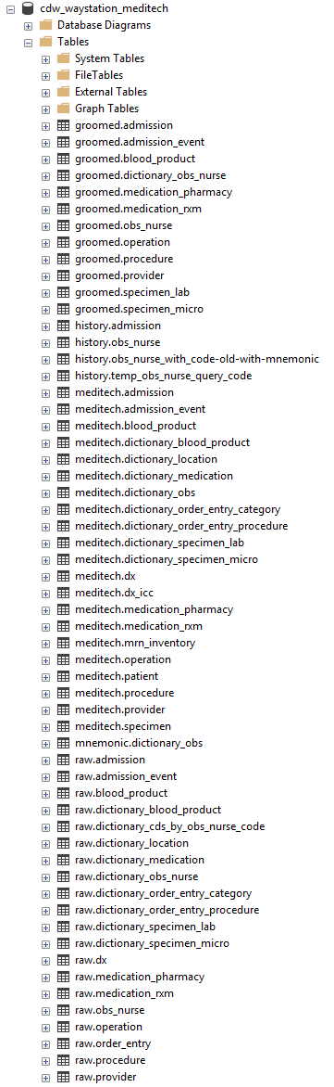
Meditech in the CRDW
Pipeline
Text files are saved to OUM’s ftp server around 1am.
CRDW downloads, grooms, & ingests them into the warehouse.
NEW: Data available by 4:30am every morning.
Tables/views available: patient, visit, visit event, diagnosis, lab, operation, procedure, blood product, obs, order entry, & medication (from pharmacy).
Tables to develop: images, room history, & medication (from ‘rxm’)
Role in the future Data Lake

Slide 13
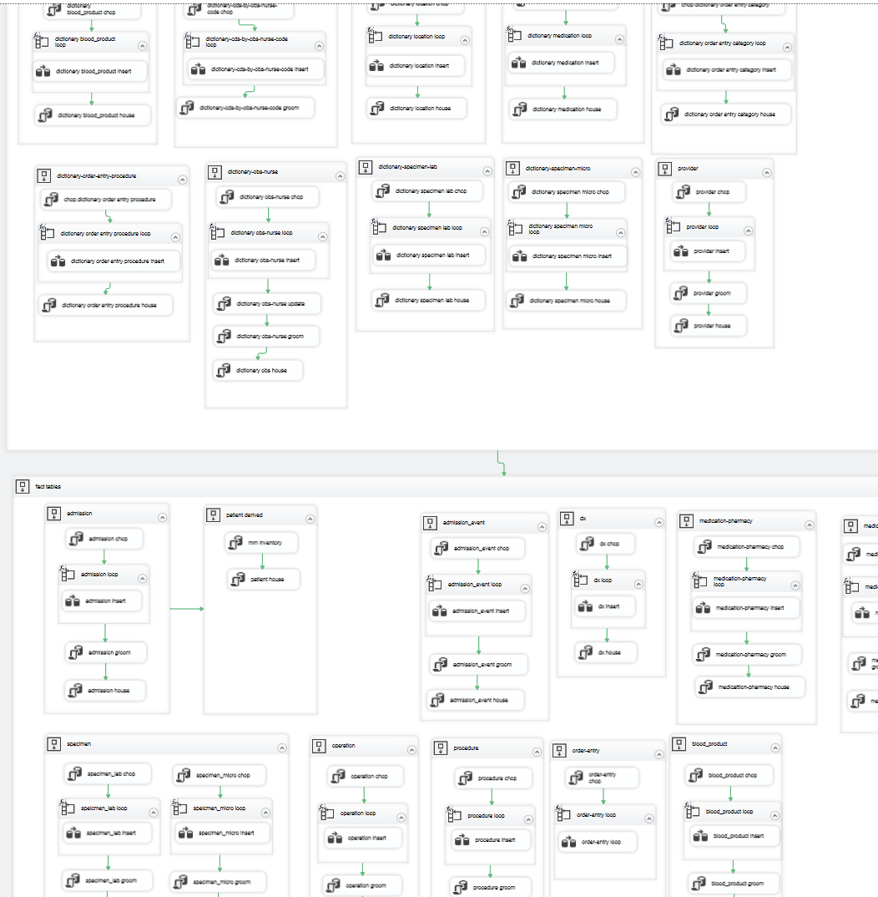
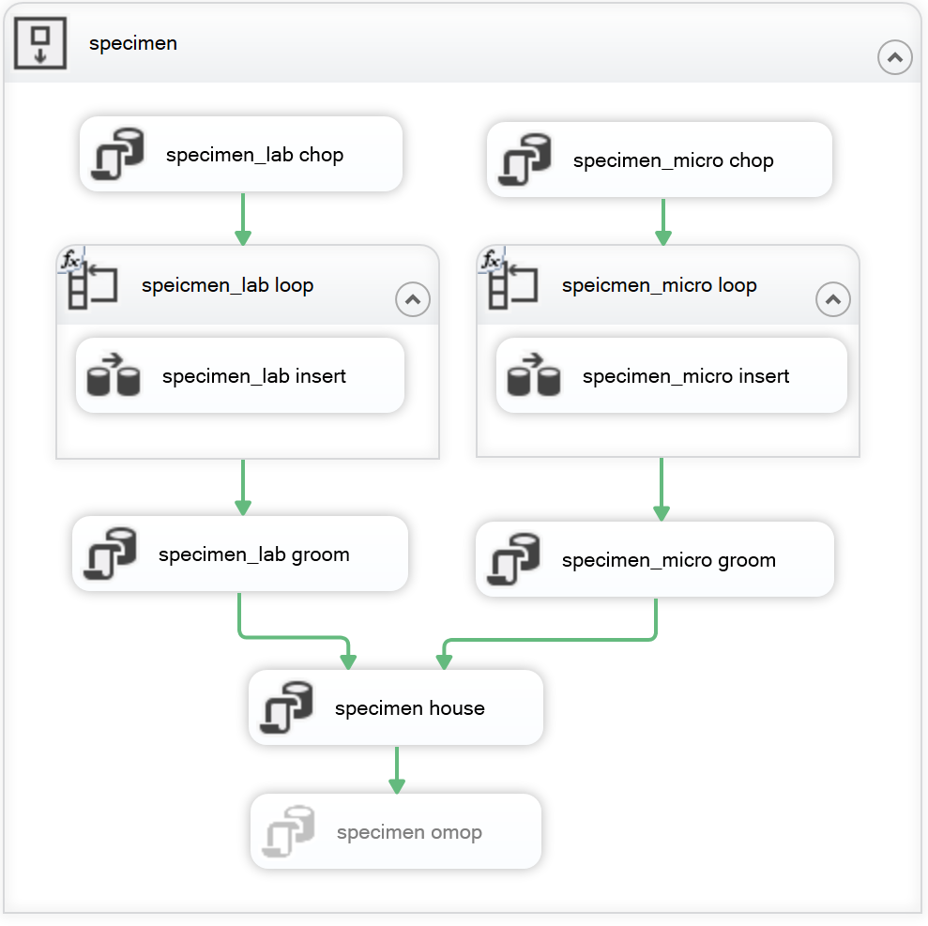
Meditech Warehouse ETL

Slide 14
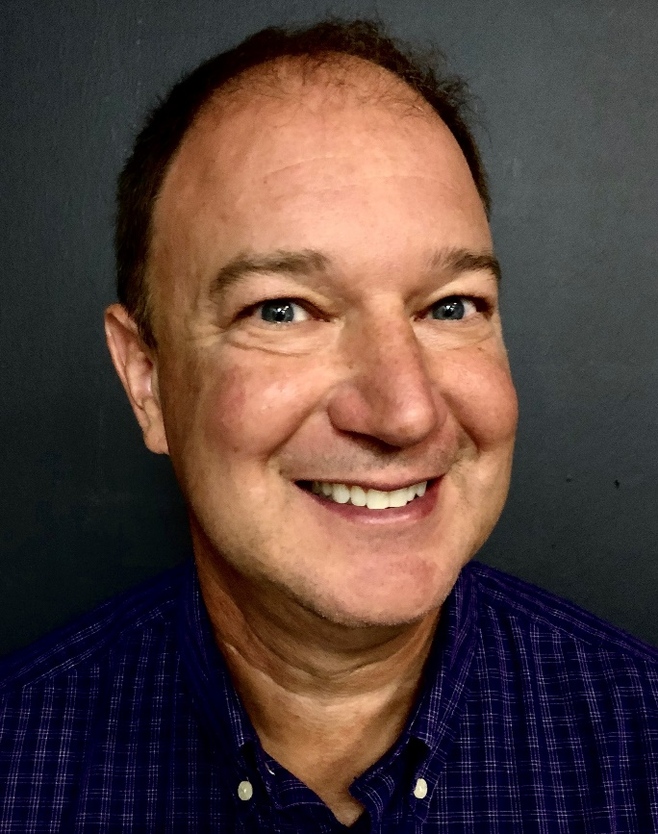
OUM BI Team
Jimmie Hackworth
Sr. Meditech Reporting Analyst in the Business Intelligence area of the Information Technology Department.
Meditech expert hired a few months ago to support Meditech while campus’s focus is pulled toward Epic.
Works with Ashley, Will, & Geneva to design daily extracts that populated the Meditech portion of the CRDW warehouse.
Since October, meets with us weekly to review our progress and discuss the upcoming week’s enhancements (eg, adding columns or tables)
For every 1 problem that he solves, there are probably another 10 that he anticipates that the CRDW team is never aware of.
His approach has become our model for how we want to ingest future data sources.
Notes:
Here are the data sources for the research projects that we’ve assisted with. Roughly in descending order of frequency.
Most of our projects involve inpatient EMRs, outpatient EMRs, and billing systems.
In some ways, our experience started with datasets from external collaborators, such as the Dept of Health, and grew from there.

Slide 15
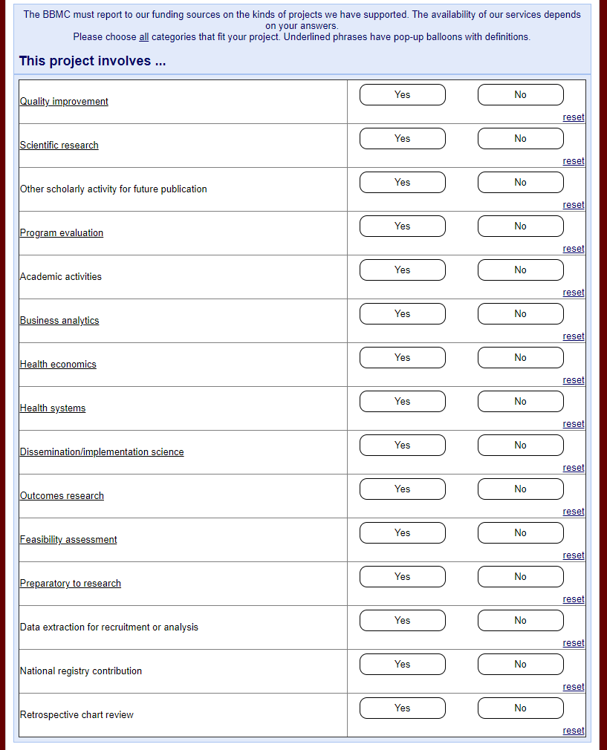
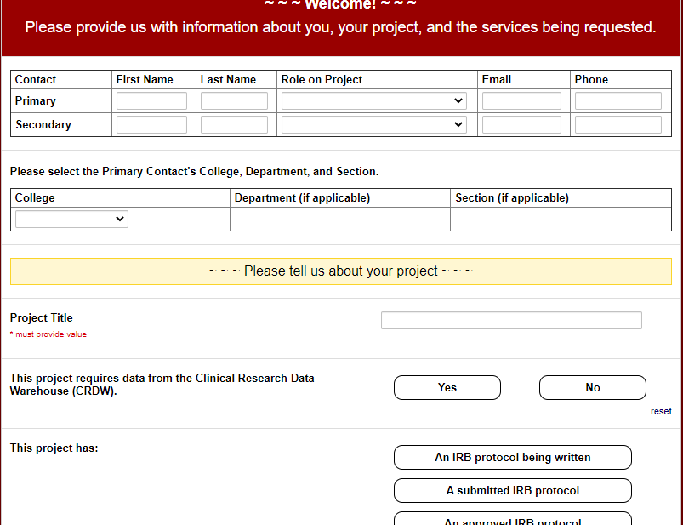
BBMC Research Support Request Form (Proposed Update)
https://redcap.link/bbmcrequest

Slide 16
CRDW Requests
February 2021:
Ideally, IRB would implement a procedure to allow for CDRW upon initial approval without adding staff to KSP (e.g., a check-box on the application indicating use of CDRW to obtain data)
We would like read-only access to the other Meditech warehouse (being developed by CereCore). This would help validate our version of the warehouse, and occasionally fill-in holes for requests not covered by our research-focused warehouse.
TriNetX (https://trinetx.com/)
March 2021:
Weekly ~1-hour meetings with an OUM Clinical Information Specialist / Application Analyst (someone like Megan Posada)
Meditech Compiled HTML Help
Ticketing system to manage incoming CRDW requests
Spark (https://spark.apache.org/)
OMOP’s Atlas Reporting Tool (https://www.ohdsi.org/atlas-a-unified-interface-for-the-ohdsi-tools/)

Slide 17
Health Economics
Recent increase research demand
Especially with the new program in COPH
We’re currently identifying what pieces we have and need
Please tell us if you’re interested
Cost analytics tool already developed for the hospitals

Slide 18
N3C: National COVID Cohort Collaborative
60+ US institutions contribute EMR data in an OMOP model
Datasets are accessible only through a browser to NIH’s cluster
Spark, Python, R
Lots of governance steps, but not as many as you’d think
We believe this type of collaboration will be important in the future
We’re recruiting OU collaborators
particularly statisticians, data scientists, and clinicians
tell us if anyone has a research question, or want to join an existing project

Slide 19
CDW Faculty & Staff
David Bard, PhD, Chief Research Information Officer
Will Beasley, PhD, BBMC Director of Informatics
Lise DeShea, PhD is a senior research biostatistician who has worked on the OUHSC campus for more than 10 years, following her employment with OHCA as a statistician analyzing claims data in Quality Assurance. She has authored 3 statistics textbooks, has years of teaching experience, and expertise related to manuscript writing and presentation development. Lise joined the CDW team in July 2020.
Geneva Marshall, MA joined the CRDW team in August 2020 after spending 8 years supporting academic research led by Drs. Bard and Beasley. Her experience includes the expansion and upkeep of a data pipeline using R and SQL to combine datasets for programs evaluation, as well as creating and streamlining a common set of procedures in R for data analysis. Geneva anticipates graduating OSU in May with a MS in Business Analytics specializing in Data Science.
Ashley Thumann, MHA has 15 years of healthcare administration experience. Prior to joining the CRDW team in October 2017, she served as a Clinics Administrator and Quality Manager for OU Physicians. Ashley has end-user experience with many of the data systems on campus and is the CRDW’s primary liaison with investigators.

Slide 20
Thank you
Will Beasley, PhD
Ashley Thumann, MHA
Geneva Marshall, MA
Lise DeShea, PhD
David Bard, PhD
University of Oklahoma HSC
Biomedical & Behavioral Methodology Core (BBMC)
Award Numbers: UG1OD024950 U54GM104938

Slide 21
Extra Slides

Slide 22
IRB and Privacy Review Guidance
Requests that are preparatory to research must be submitted to the IRB/University Privacy Board for review and approval.
Program Evaluation, CQI, & Feasibility Assessments:
If PHI is NOT included, it is generally not considered human subjects research.
A determination of human subjects research (DHSR) may be submitted to the IRB.
Aggregate data may be provided without an IRB submission.
The following activities are NOT human subjects research:
Classroom evaluation activities when assessment involves regular classroom activities and the results of the evaluation process are intended to be used for the sole purpose of enhancing teaching practices of the instructor
Quality improvement activities designed to enhance functionality of a department or campus program provided that results are not intended to be shared outside of the University
Program evaluations
Public health practice surveillance activities
Notes:
In short, we work closely with the oversight boards to maintain compliance & improve efficiency. A new governance board is being created that’s co-chair by the informatics heads of the hospital and of the clinics. I’m excited that this will speed up parts of our process for those studies that don’t require an IRB.
[8 min cumulative]

