Slide 1







Leveraging OUHSC Clinical Research Data Warehouse to Inform Research & Practice
Will Beasley, PhD
Ashley Thumann, MHA
Geneva Marshall, MA
Lise DeShea, PhD
David Bard, PhD
University of Oklahoma HSC
Biomedical & Behavioral Methodology Core (BBMC)
February 2021
Award Numbers: UG1OD024950 U54GM104938
Notes:
Hi I’m Will, and part of the Clinical Research Data Warehouse effort on campus. I started as a conventional statistician and researcher, and based on experience with integrating our investigations with state agency data , our group moved into the world of EMRs and warehouses.
I think these experiences have allowed our group to relate well with current PIs, as well as build a CRDW ecosystem that works well with research.

Slide 2
Since 2017, the CRDW has provided support for more than 120 projects.
There are 47 active projects, to include 5 new projects since mid-February (shown in blue on slide 6).
Most requests are submitted by the below departments or specialties.
Department/Specialty | Request Count
Pediatrics | 54
Orthopedics | 19
Cancer Center | 10
Urology | 9
Obstetrics & Gynecology | 6
Chart & table last updated Feb 2021
Notes:
Our projects have been spread across several research groups. We haven’t done much marketing, so it makes sense that the majority come from our own department.

Slide 3
Clinical Trials & Other Research Studies Supported by the CRDW since 2017; page 1
Short Name | PI | Department/Specialty
Asthma Outcomes | M. Naifeh | Pediatrics
Pediatric Diabetic Ketoacidosis | M. Marin | Pediatrics
Anxiety & Depression Education | A. Bax | Pediatrics
Obesity in Foster Care | N. Torres-Garcia | Pediatrics
Posterior Cruciate Ligament Avulsions | S. Algan | Orthopedics
Avulsion Fractures (Tibia & Fibula) | S. Algan | Orthopedics
Avulsion Fractures (Femur) | S. Algan | Orthopedics
STI Screening | R. Leasure | Infectious Disease
Interstitial Cystits Pain | L. Quiroz | Women's Health
Pharmacist-Led Care | T. Truong | Pharmacy
POPS | C. Allen | Pediatrics
NAMCS | S. Gillaspy | Pediatrics
Preschool Behavior | A. Bax | Pediatrics
Psychology Consults | S. Gillaspy | Pediatrics
Chronic Hypertension in Pregnancy | R. Edwards | Women's Health
High Blood Pressure in Children | N. Connolley | Pediatrics
Sickle Cell Disease Transition Program | A. Sinha | Pediatrics
Molecular Alterations in Brain Tumors | J. Battiste | Cancer Center
Pelvic Floor Disorders | L. Quiroz | Women's Health
Cancer Patient Navigation Program | J. Vidrine | Cancer Center
Medical Homes for Youth in Foster Care | S. Gillaspy | Pediatrics
Short Name | PI | Department/Specialty
Subtalar Arthrodesis | A. Haleem | Orthopedics
Pulmonary Hypertension | H. Bhardwaj | Cardiovasular
Pelvis & Acetabulum Fractures | D. Teague | Orthopedics
Spica Casting | W. Puffinbarger | Orthopedics
Fragile X Syndrome | L. Ethridge | Pediatrics
Splinting with Side Struts | T. Lewis | Orthopedics
Humeral Fractures | D. Chong | Orthopedics
Child Trauma Services | E. Risch | Pediatrics
Humeral Fractures | D. Teague | Orthopedics
Asthma Population Management | D. Hahn | Pediatrics
Tobacco Exposure in Pediatrics | S. Gillaspy | Pediatrics
Utility of Chest X-Rays for Asthma in the ED | A. Bogie | Pediatrics
OxyContin Study | D. Hahn | Pediatrics
Transition of Care Clinic | T. Truong | Pharmacy
Lipid Screening | S. Gillaspy | Pediatrics
Sickle Cell Port Placement | A. Sinha | Pediatrics
Tranexamic Acid in Ankle Replacement | A. Haleem | Orthopedics
Newborn Metabolic Screenings | J. Lees | Pediatrics
Scapula Fractures | C. Pasque | Orthopedics
Adrenal Insufficiency | J. Lim | Endocrinology
Brain Metastases with Ovarian Cancer | J. Gillen | Cancer Center
Sever's Disease | S. Algan | Pediatrics
Notes:
Here’s a quick list of the CDW projects so far. Some were wrapped up in less than a day. Some, like POPS, have been ongoing for 2 years.

Slide 4
Clinical Trials & Other Research Studies Supported by the CRDW since 2017; page 2
Short Name | PI | Department/Specialty
Brain Tumor Database | S. Sung | Cancer Center
Immunization Data Restructure | D. Bratzler | OUP
Off-Label Drug Use in Children | C. Allen | Pediatrics
Continuity of Care | P. Darden | Pediatrics
Prescribing Practices for Psychotropic Medications | S. Gillaspy | Pediatrics
Lactation Services for Diabetic Mothers | B. Mannel | Women’s Health
Supplementation of LPI | J. Dilley | Women’s Health
PCOS in Psoriasis | P. Allen | Dermatology
Assessment of Medication Problems | T. Truong | Pharmacy
Cancer Genetic Syndrome | J. Walker | Cancer Center
Maternal Depression Screening | M. Dunlap | Pediatrics
PROSpect Study | E. Henry | Pediatrics
Behavioral Health in the ED | R. Johnson | Pediatrics
Stem Cell Transplant Study | R. Shah | Pediatrics
Outcomes of Adalilumab in Colitis | J. Tung | Pediatrics
Mohs Surgery for High Risk cSCC | L. Collins | Dermatology
Electronic Cigarettes in Youth with Asthma | T. Wagener | Pediatrics
Vasoplegic Syndrome | C. Allen | Pediatrics
Patterns of Care Among Children with Cancer | Janitz | Epidemiology
Preoperative Airway Evaluation | D. Mann | ORL
Osteoporosis Prevention in Cancer Patients | J. Walker | Cancer Center
Short Name | PI | Department/Specialty
Radial Neck Fractures | TR Lewis | Orthopedics
High Grade VAIN | K. Smith | Women’s Health
E-Cigarette and Tobacco Use During Pregnancy | Cohn | Cancer Center
Analysis of C. Diff Toxins | P. Lang | Immunology
Inpatient Transition of Care Pharmacist | T. Truong | Pharmacy
Children with Medical Complexity | M. Akande | Pediatrics
Outcomes of Patients with Merkel Cell Carcinoma | C. Henson | Cancer Center
Glucocorticoid Receptor Antagonism in the Treatment of Cushing Syndrome | J. Lim | Endocrinology
Influenza A and Sialadenitis | R. Johnson | Pediatrics
Surgical Complications in Patients with Spinal Muscular Atrophy | Chong | Orthopedics
Tissue Eosinophil Count in IBD Patients | J. Tung | Pediatrics
Bone Health Study | S. Krishnan | Pediatrics
Association between Urinary Parameters and Urological Issues | Pal | Pediatrics
Synthetic Cartilage Implant vs Osteochondral Autologous Transfer for Advanced Hallux Rigidus | Haleem | Orthopedics
Outcomes of External Fixation with the Ilizarov Frame in Complex Ankle and Hindfoot Fusions | Haleem | Orthopedics
Effect of Surgical Treatment of Vesicoureteral Reflux on Stone Passage Rates | Rensing | Urology
Tobacco and Marijuana Exposure Among Youth | M. Naifeh | Pediatrics

Slide 5
Clinical Trials & Other Research Studies Supported by the CRDW since 2017; page 3
Short Name | PI | Department/Specialty
Hereditary thrombotic thrombocytopenic purpura (HTTP) | J. Journeycake | Pediatrics
Neonatal Venous Thromboembolism | J. Journeycake | Pediatrics
Evaluation of Hematologic Parameters in Patients on PARPi Therapy | K. Moore | Gyn Onc
Hip Fracture Repair | D. Teague | Orthopedics
Anterior Cruciate Ligament Reconstruction | S. Algan | Orthopedics
Bone-Grafting for Glenoid Deficiency | C. White | Orthopedics
Hospital Admission Rates for Children Living with Asthma | M. Akande | Pediatrics
Hearing Screens | J. Butcher | Pediatrics
Cesarean Scar Ectopic Pregnancy | H. Burks | Reproductive Medicine
Urologic Trauma Study | J. Furr | Urology
Oral Cavity Cancer | C. Henson | Cancer Center
Moberg Advancement Flap for Soft-Tissue Loss of the Thumb | T. Lehman | Orthopedics
Reduce Postoperative Hemorrhage | J. Sanclement | ORL
Anti-Incontinence Procedures | J. Furr | Urology
Acute Anosmia in Patients with COVID-19 | G. Krempl | ORL
Cervical Spondylotic Myelopathy (CSM) | Z. Smith | Neurosurgery
Sellar and Parasellar Tumors | I. Dunn | Neurosurgery
Short Name | PI | Department/Specialty
Detection and Management of Bladder Cancer | S. Patel | Urology
Survey of Patients Regarding Care Utilization During COVID-19 | D. Hahn | Pediatrics
Circumcision Complications Requiring Surgical Revision | D. Frimberger | Urology
Genetic Counseling Services for Children with Neurodevelopmental Disorders | Wadley | Genetics
ECO-RESET | R. Harty | Gastroenterology
Vasopressor Use in Microvascular Free-Flap Reconstruction of the Head and Neck | N. Vasan | ORL
Genetic Testing for the BRCA gene | I. Shim | Genetics
Bronchiolitis | A. Sparkman | Pediatrics
Mirikizumab in Patients with Moderately to Severely Active Crohn's Disease | H. Bitar | Gastroenterology
Renal Cell Carcinoma | J. Heinlen | Urology
Stress Hydrocortisone in Pediatric Septic Shock (SHIPSS) | C. Allen | Pediatrics
Severe Neurologic Injury Outcomes during COVID 19 Crisis (NCC COVID 19 OUTCOMES) | D. Masoom | Neurology
Implementation of pain protocol and outcome of sickle cell patients | L. Rooms | Pediatrics
ORIEN Project; Total Cancer Care Protocol | A. Tripathi | Cancer Center
Registry
Registry

Slide 6
Clinical Trials & Other Research Studies Supported by the CRDW since 2017; page 4
Short Name | PI | Department/Specialty
National COVID Cohort Collaborative (N3C): A National Resource for Shared Analytics | D. Bard | OUHSC
Predictors of Sever Sepsis in Patients with Intestinal Failure | C. Knoles | Pediatrics
Relationship Between Pretreatment Anxiety/Depression & Patient Decision-Making in Prostate Cancer Treatment | J. Heinlen | Urology
Quality of Life of Ethnically Diverse Black Prostate Cancer Survivors: Development of a Conceptual Model Using Grounded Theory | M. Ogunsanya | Pharmacy
Clinical Presentations, Laboratory Findings, Treatment, and Outcomes of Pediatric COVID-19 Patients | Bogie | Pediatrics
PEMCRC Anaphylaxis Study | Bogie | Pediatrics
Analysis of Pediatric Migraine Treatment | Bogie | Pediatrics
Impact of COVID-19 on Distress Levels in Cancer Patients | R. Funk-Lawler | Psychiatry
Pituitary Adenoma Patient Outcomes | I. Dunn | Neurosurgery
Oncologic Outcomes in Renal Cell Carcinoma | B. Cross | Urology
Using ML to Quantify Molecular Phenotypes | K. Jones | Harold Hamm Diabetes Center
Improving Detection & Management of Bladder Cancer | D. Parker | Urology
Neuromodulation of Inflammation to Treat Heart Failure with Preserved Ejection Fraction (TIN HF) | S. Stavrakis | Cardiology
Management of Asthma | M. Naifeh | Pediatrics
VTE Automated Surveillance | A. Wendelboe | Public Health
Oklahoma COVID19 Registry and Repository | N. Agudelo | Infectious Disease
Short Name | PI | Department/Specialty
Patterns of Clinical Deterioration in Critically Ill Children | S. Brown | Pediatrics
Incidence & Risk Factors of NSAID Use in Post-Operative Patients | H. Bitar | Gastroenterology
Tube Complications in Pediatric Patients with Congenital Heart Disease | C. Hunter | Pediatrics
Medical marijuana legalization in Oklahoma: effects on neonatal exposure to opiates | Makkar | Pediatrics
PROSpect: Prone and Oscillation Pediatric Clinical Trial COVID-19 Supplement | E. Henry | Pediatrics
Addressing Epidemiologic Gaps in Immune Thrombocytopenia: Pregnant and African American Patients | D. Terrell | Public Health
TBD | A. Paul | Neurology
TBD | H. Wu | Pulmonary, Critical Care, and Sleep Medicine
Promoting Human Papillomavirus Vaccine Uptake in High-Risk Adults (Uptake 2) | T. Bui | Family and Preventive Medicine
External Validation of an AI-Based ECG Tool to Identify Cardiomyopathy in Women of Reproductive Age | M. Williams | Obstetrics and Gynecology
Aggregate Counts of COVID-19/MIS-C Patients | P. Darden | Pediatrics
Fluid Management in Acute Respiratory Distress Syndrome due to COVID 19 | S. Dauok | Pulmonary, Critical Care, and Sleep Medicine
TBD | C. Cross | Pulmonary, Critical Care, and Sleep Medicine
Registry
Registry

Slide 7
Research Opt Out
We reached out to the following individuals: Trisha Reed, Allen Smith, Bob Bewley, Sally Duckett, Sandy Decker, and Amber Simpson.
We’ve been told there are no opt out lists for research.

Slide 8
Encouraging Secure Data Practices (Slide 1 of 2)
Our goal is to deliver the data extracts to researchers in a way that makes it easy for them to follow best practices.
Delivery of PHI, depending on the dataset and researcher
SFT for one-time transfers
HSC file servers for recurring transfers
REDCap for recruiting projects (users manually enter data as we refresh info daily)
Never email
Common mitigations include
Withholding PHI fields
Obfuscating PHI fields (e.g., birth year instead of birth date)
Pre-calculating fields to avoid PHI (e.g., we calculate the age at visit, instead of sending visit & birth dates)

Slide 9
Encouraging Secure Data Practices (Slide 2 of 2)
Roughly half of CRDW clients are barely comfortable with csv/Excel files. Increasing delivery through REDCap would require extensive training (1+ hour per person) as well as 2+ hours of CRDW staff time to establish projects and support users.
We delivered through REDCap exclusively in 2016. But most investigators just requested help exporting it to a csv, and never touched REDCap again.
REDCap’s audit logs are uninformative at that point (because the PHI was in csvs).
We didn’t know where the loose csvs were going.
We decided that it was better to directly & securely deliver the csv to an HSC file server (for recurring transfers).
Only study personnel can access their study-specific file folders.
If HSC offered a secure & isolated virtual environment, IT would need to develop and maintain the server and to train researchers.

Slide 10
CRDW Active Projects
At this committee’s request, we surveyed 42 PIs or study contacts associated with our active requests. Those results are below.
Category | Responses | Count (Proportion) Responded ‘Yes’
Quality Improvement | 22 | 6 (27.3%)
Scientific research that should produce 1 or more publications | 22 | 21 (95.5%)
Involves other scholarly activity for future publication | 22 | 10 (45.5%)
Involves program evaluation | 22 | 4 (18.2%)
Focuses on academic activities | 22 | 4 (18.2%)
In the area of health economics | 22 | 1 (4.5%)
Research on health systems | 22 | 6 (27.3%)
In the area of dissemination/implementation science | 22 | 4 (18.2%)
Focuses on outcomes research | 22 | 11 (50%)

Slide 11
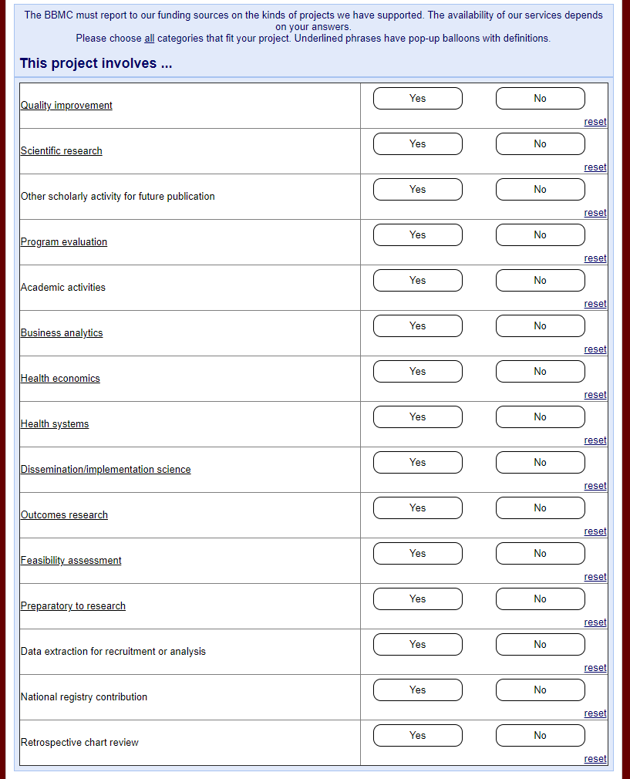
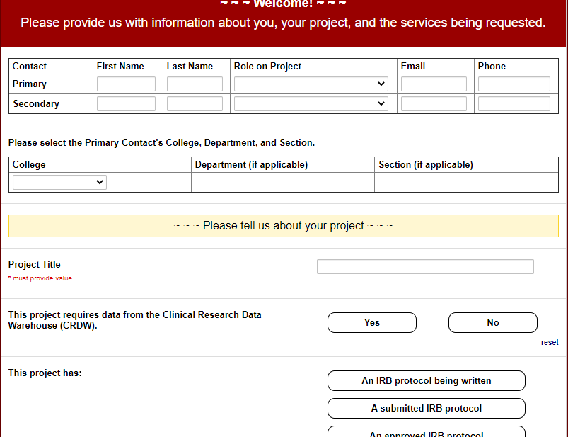
BBMC Research Support Request Form (Proposed Update)
https://redcap.link/bbmcrequest

Slide 12
CRDW Requests
February 2021:
Ideally, IRB would implement a procedure to allow for CDRW upon initial approval without adding staff to KSP (e.g., a check-box on the application indicating use of CDRW to obtain data)
We would like read-only access to the other Meditech warehouse (being developed by CereCore). This would help validate our version of the warehouse, and occasionally fill-in holes for requests not covered by our research-focused warehouse.
TriNetX (https://trinetx.com/)
March 2021:
Weekly ~1-hour meetings with an OUM Clinical Information Specialist / Application Analyst (someone like Megan Posada)
Meditech Compiled HTML Help
Ticketing system to manage incoming CRDW requests
Spark (https://spark.apache.org/)
OMOP’s Atlas Reporting Tool (https://www.ohdsi.org/atlas-a-unified-interface-for-the-ohdsi-tools/)

Slide 13
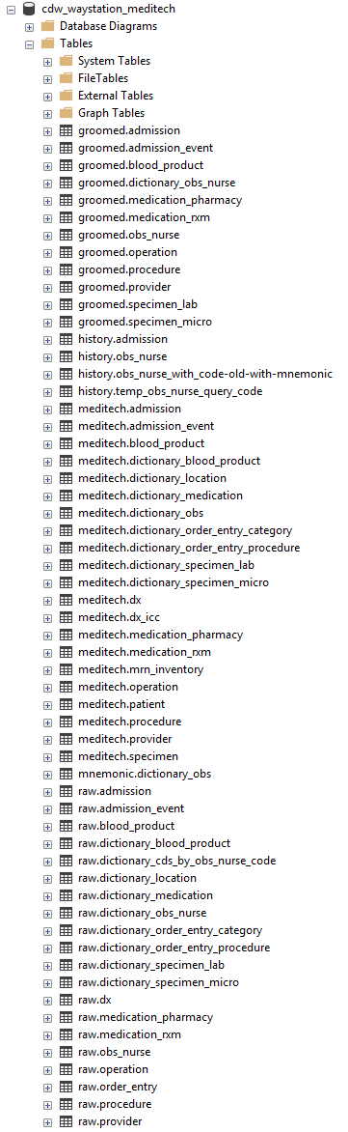
Meditech in the CRDW
Pipeline
Text files are saved to OUM’s ftp server around 1am.
CRDW downloads, grooms, & ingests them into the warehouse.
NEW: Data available by 4:30am every morning.
Tables/views available: patient, visit, visit event, diagnosis, lab, operation, procedure, blood product, obs, order entry, & medication (from pharmacy).
Tables to develop: images, room history, & medication (from ‘rxm’)
Role in the future Data Lake

Slide 14
Predictors of Severe Sepsis in Patients with Intestinal Failure (POSSIPIF)
Principal Investigator | Curtis Knoles
Department | Pediatrics
Section/Program | Emergency Medicine
Request Date | 9/22/2020
Status | In Process
Completion Date | 3/15/2021 (estimated)
Aims | To explore patient-level factors associated with CLABSI more generally, and severe sepsis more specifically, among children with intestinal failure requiring parenteral nutrition through a central line presenting to the ED with fever. To examine hospital-level factors associated with time to empiric antibiotic administration among children with intestinal failure requiring parenteral nutrition through a central line presenting to the ED with fever. To develop an evidence-based guideline for the care of febrile children with intestinal failure to reduce variation and improve clinical care.
Comments | The majority of this request has been fulfilled. The CRDW does not yet have Meditech extracts images. We are also pending feedback from the investigators regarding the Meditech forms/assessments used to document the requested obs.
Meditech
GE Centricity Business & EMR

Patient Demographics

Patient Demographics

Admission/Visit

Diagnosis

Admission Event
Doc Data (Unstructured Notes)
Blood Product
Document/Visit (EMR)

Diagnosis
Invoice/Transaction
Image Summary
Obs

Lab
Order

Medication
Provider

Obs

Schedule/Visit (GECB)
Operation/Surgery

Order

Procedure
Provider
Room/Bed
knoles-infection-ed-1

Slide 15
Relationship Between Pretreatment Anxiety/Depression and Patient Decision-Making in Prostate Cancer Treatment
Principal Investigator | Jonathan Heinlen
Department | Urology
Section/Program
Request Date | 9/10/2020
Status | In Process
Completion Date | 10/1/2020
Aims | To retrospectively and prospectively collect all relevant clinical data as listed below on patients with kidney cancer to describe the quality of life and determine the factors that can improve their quality of life as well as their treatment and chronic management of their disease and comorbidities. To describe the incidence treatment strategies and complications of these patients while continuing this study.
Comments
Meditech
GE Centricity Business & EMR
Patient Demographics

Patient Demographics
Admission/Visit

Diagnosis
Admission Event
Doc Data (Unstructured Notes)
Blood Product
Document/Visit (EMR)
Diagnosis
Invoice/Transaction
Image Summary

Medicate
Lab

Obs
Medication
Order
Obs
Provider
Operation/Surgery
Schedule/Visit (GECB)
Order
Procedure
Provider
Room/Bed
heinlen-cancer-depression-1

Slide 16
Clinical Presentations, Laboratory Findings, Treatment, and Outcomes of Pediatric COVID-19 Patients
Principal Investigator | Amanda Bogie
Department | Pediatrics
Section/Program | Emergency Medicine
Request Date | 10/22/2020
Status | In Process
Completion Date | 3/15/2021 (estimated)
Aims | Describe the clinical presentations, course of illness, treatments, and outcomes of pediatric patients who test positive for the COVID-19 virus at TCH at OU Medical Center. Correlate laboratory and radiographic findings to hospitalization duration and mortality.
Comments | The majority of this request has been fulfilled. The CRDW does not yet have Meditech extracts for images. We are also pending feedback from the investigators regarding the Meditech forms/assessments used to document the requested obs.
Meditech
GE Centricity Business & EMR

Patient Demographics
Patient Demographics

Admission/Visit
Diagnosis

Admission Event
Doc Data (Unstructured Notes)
Blood Product
Document/Visit (EMR)

Diagnosis
Invoice/Transaction

Image Summary
Obs

Lab
Order

Medication
Provider

Obs
Schedule/Visit (GECB)
Operation/Surgery

Order
Procedure
Provider
Room/Bed
bogie-ed-covid-1

Slide 17
PEMCRC Anaphylaxis Study Protocol: A Multicenter Cohort Study to Derive and Validate Clinical Decision Models for the Emergency Department Management of Children with Anaphylaxis
Meditech
GE Centricity Business & EMR
Principal Investigator | Amanda Bogie
Department | Pediatrics
Section/Program | Emergency Medicine
Request Date | 10/22/2020
Status | In Process
Completion Date | 3/31/2021 (estimated)
Aims | Determine the prevalence of, and risk factors for severe, persistent, and biphasic anaphylaxis. Derive and validate prediction models for ED discharge. Determine data driven lengths of ED and inpatient observation prior to discharge to home based on initial reaction severity.
Comments | Most query development is complete. Pending feedback from the study team.

Patient Demographics
Patient Demographics

Admission/Visit
Diagnosis

Admission Event
Doc Data (Unstructured Notes)
Blood Product
Document/Visit (EMR)

Diagnosis
Invoice/Transaction
Image Summary
Obs
Lab
Order

Medication
Provider

Obs
Schedule/Visit (GECB)
Operation/Surgery

Order

Procedure
Provider
Room/Bed
bogie-ed-anaphylaxis-1

Slide 18
Retrospective Descriptive Analysis of Pediatric Migraine Treatment in the Emergency Department
Meditech
GE Centricity Business & EMR
Principal Investigator | Amanda Bogie
Department | Pediatrics
Section/Program | Emergency Medicine
Request Date | 10/22/2020
Status | In Process
Completion Date | 3/15/2021 (estimated)
Aims | A multi-center study with the following aims: To determine the type of medications ordered by physicians working in the ED. To determine the patient’s disposition following the medication(s) administered in the ED. The goal of the study is to identify medications that are well-tolerated in patients and provide the greatest resolution of the migraine.
Comments | Initial files have been provided. Pending feedback from the study team.

Patient Demographics
Patient Demographics

Admission/Visit
Diagnosis

Admission Event
Doc Data (Unstructured Notes)
Blood Product
Document/Visit (EMR)

Diagnosis
Invoice/Transaction
Image Summary
Obs
Lab
Order

Medication
Provider
Obs
Schedule/Visit (GECB)
Operation/Surgery

Order
Procedure
Provider
Room/Bed
bogie-migraine-ed-1

Slide 19
Procalcitonin in Necrotizing Enterocolitis: The Search for a Biomarker
Meditech
GE Centricity Business & EMR
Principal Investigator | Catherine Hunter
Department | Surgery
Section/Program
Request Date | 10/15/2020
Status | Withdrawn
Completion Date | 3/31/2021 (estimated)
Aims | Identify if an elevated procalcitonin is predictive of an increased risk of surgical necrotizing enterocolitis. Determine if an elevated procalcitonin is predictive of complications from necrotizing enterocolitis such as strictures and short gut syndrome.
Comments | Requested data were obtained from OUM Lab Staff.

Patient Demographics
Patient Demographics

Admission/Visit
Diagnosis

Admission Event
Doc Data (Unstructured Notes)
Blood Product
Document/Visit (EMR)

Diagnosis
Invoice/Transaction
Image Summary
Obs

Lab
Order
Medication
Provider
Obs
Schedule/Visit (GECB)
Operation/Surgery
Order
Procedure
Provider
Room/Bed
hunter-enterocolitis-biomarker-1

Slide 20
Quality of Life of Ethnically Diverse Black Prostate Cancer Survivors: Development of a Conceptual Model Using Grounded Theory
Principal Investigator | M. Ogunsanya
College or Department | Pharmacy
Section or Program
Request Date | 10/15/2020
Status | Completed
Completion Date | 2/23/2021
Aims | Employ Grounded Theory to develop a conceptual QoL model for Black CaP survivors. Provide novel research training experiences to the principal investigator (PI) on Grounded Theory research, and implementation and dissemination science.
Comments
Meditech
GE Centricity Business & EMR

Patient Demographics

Patient Demographics

Admission/Visit
Diagnosis
Admission Event
Doc Data (Unstructured Notes)
Blood Product
Document/Visit (EMR)

Diagnosis
Invoice/Transaction
Image Summary
Obs
Lab
Order
Medication
Provider
Obs
Schedule/Visit (GECB)
Operation/Surgery
Order
Procedure
Provider
Room/Bed
ogunsanya-cancer-prostate-1

Slide 21
Levels of Distress in Cancer Patients Pre and Post COVID-19
Principal Investigator | Rachel Funk-Lawler
Department | Psychiatry and Behavioral Sciences
Section/Program
Request Date | 10/29/2020
Status | On Hold
Completion Date | TBD
Aims | To expand on studies looking at the impact of COVID-19 on distress levels in cancer patients, primarily using the PhQ9 to measure self-reported levels of distress. To examine any change in number of referrals to social work and behavioral health services pre and post COVID-19. To examine any correlation between number of referrals to psychiatry, behavioral health, and social work and level of distress.
Comments | This is pending IRB approval, but queries have been developed.
Meditech
GE Centricity Business & EMR
Patient Demographics

Patient Demographics
Admission/Visit

Diagnosis
Admission Event
Doc Data (Unstructured Notes)
Blood Product
Document/Visit (EMR)
Diagnosis

Invoice/Transaction
Image Summary

Obs
Lab

Order
Medication
Provider
Obs

Schedule/Visit (GECB)
Operation/Surgery
Order
Procedure
Provider
Room/Bed
funk-lawler-covid-1

Slide 22
Oncologic Outcomes in Renal Cell Carcinoma
Principal Investigator | Brian Cross
Department | Urology
Section/Program
Request Date | 12/1/2020
Status | In Process
Completion Date | 3/1/2021 (requested deadline)
Aims | To retrospectively and prospectively collect all relevant clinical data as listed below on patients with kidney cancer to describe the quality of life and determine the factors that can improve their quality of life as well as their treatment and chronic management of their disease and comorbidities. To describe the incidence treatment strategies and complications of these patients while continuing this study.
Comments | Received data extraction specifications from the study team on 2/25/2021.
Meditech
GE Centricity Business & EMR
Patient Demographics

Patient Demographics
Admission/Visit
Diagnosis
Admission Event
Doc Data (Unstructured Notes)
Blood Product
Document/Visit (EMR)
Diagnosis

Invoice/Transaction
Image Summary
Obs
Lab
Order
Medication
Provider
Obs
Schedule/Visit (GECB)
Operation/Surgery
Order
Procedure
Provider
Room/Bed
cross-renal-cancer-1

Slide 23
Pituitary Adenoma Patient Outcomes
Principal Investigator | Ian Dunn
Department | Neurosurgery
Section/Program
Request Date | 12/2/2020
Status | On Hold
Completion Date | TBD
Aims
Comments | This is pending IRB approval. We’ve had preliminary discussions with the study team to assess the feasibility of extracting desired variables.
Meditech
GE Centricity Business & EMR
Patient Demographics
Patient Demographics
Admission/Visit
Diagnosis
Admission Event
Doc Data (Unstructured Notes)
Blood Product
Document/Visit (EMR)
Diagnosis
Invoice/Transaction
Image Summary
Obs
Lab
Order
Medication
Provider
Obs
Schedule/Visit (GECB)
Operation/Surgery
Order
Procedure
Provider
Room/Bed
dunn-pituitary-adenoma-1

Slide 24
Using Machine Learning Models to Quantify Molecular Phenotypes and Personalized Therapeutic Strategies for Diabetic Patients
Principal Investigator | Ken Jones
Department | Cell Biology
Section/Program
Request Date | 12/7/2020
Status | In Process
Completion Date | TBD
Aims | To build and train a computer model using one half of the available retrospectively banked samples from diabetic and normal subjects. To use the last half of the available retrospectively banked samples to validate the model built in Aim 1 using a pseudo-blinded prospective approach.
Comments | This project was approved for de-identified data only. Initial files were provided on 1/22/2021. The PI has requested modifications.
Meditech
GE Centricity Business & EMR
Patient Demographics

Patient Demographics
Admission/Visit
Diagnosis
Admission Event
Doc Data (Unstructured Notes)
Blood Product
Document/Visit (EMR)
Diagnosis
Invoice/Transaction
Image Summary

Obs
Lab
Order
Medication
Provider
Obs
Schedule/Visit (GECB)
Operation/Surgery

Medicate
Order
Procedure
Provider
Room/Bed
jones-diabetes-1

Slide 25
Improving Detection & Management of Bladder Cancer
Principal Investigator | Daniel Parker
Department | Urology
Section/Program
Request Date | 12/7/2020
Status | In Process
Completion Date
Aims | To create a prospectively collected, comprehensive bladder cancer registry to better understand the detection and management of bladder cancer.
Comments | Received clarification from the study team regarding desired variables & file format. Will now begin query development.
Meditech
GE Centricity Business & EMR
Patient Demographics

Patient Demographics
Admission/Visit

Diagnosis
Admission Event
Doc Data (Unstructured Notes)
Blood Product
Document/Visit (EMR)
Diagnosis
Invoice/Transaction
Image Summary
Obs
Lab
Order
Medication
Provider
Obs
Schedule/Visit (GECB)
Operation/Surgery
Order
Procedure
Provider
Room/Bed
parker-bladder-cancer-1

Slide 26
Management of Asthma: Where have we been and where are we going?
Principal Investigator | Monique Naifeh
Department | Pediatrics
Section/Program | Hospitalist
Request Date | 12/10/2020
Status | In Process
Completion Date | 4/15/2021 (estimated)
Aims | Evaluate the use of evidence-based standards for inpatient asthma management for patients treated at the Children’s Hospital of Oklahoma including the ED, the inpatient wards, and the PICU. Evaluate the equity of care delivered and associated patient outcomes. Examine frequency of use of the asthma pathway and associated differences in treatment/ outcomes.
Comments | Initial files have been provided to the study team. However, this requests includes extracts not yet available in the CRDW (e.g. images and discharge medications). Attend regularly scheduled meetings with the study team.
Meditech
GE Centricity Business & EMR

Patient Demographics

Patient Demographics

Admission/Visit
Diagnosis

Admission Event
Doc Data (Unstructured Notes)
Blood Product
Document/Visit (EMR)

Diagnosis
Invoice/Transaction

Image Summary
Obs
Lab
Order

Medication
Provider
Obs

Schedule/Visit (GECB)
Operation/Surgery

Order
Procedure
Provider
Room/Bed
naifeh-asthma-2

Slide 27
Venous Thromboembolism (VTE) Automated Surveillance
Principal Investigator | Aaron Wendelboe
Department or College | Public Health
Section/Program | Biostatistics and Epidemiology
Request Date | 1/15/2021
Status | In Process
Completion Date | TBD
Aims
Comments | This is a fairly substantial request. Using the data collection form provided by the investigators, we’ve assessed both feasibility and ease of extraction for each variable requested. This is a CDC-funded project for which surveillance nurses are currently performing manual abstraction. https://github.com/OuhscBbmc/wendelboe-vte-1/blob/master/documentation/VTE-active-surveillance-variables.csv
Meditech
GE Centricity Business & EMR

Patient Demographics
Patient Demographics

Admission/Visit
Diagnosis

Admission Event
Doc Data (Unstructured Notes)
Blood Product
Document/Visit (EMR)

Diagnosis
Invoice/Transaction

Image Summary
Obs

Lab
Order

Medication
Provider

Obs
Schedule/Visit (GECB)

Operation/Surgery

Order

Procedure

Provider
Room/Bed
wendelboe-vte-1

Slide 28
Oklahoma COVID-19 Registry and Repository
Principal Investigator | Nelson Agudelo
Department or College | Medicine
Section/Program | Infectious Diseases
Request Date | 1/19/2021
Status | In Process
Completion Date | TBD
Aims | To prospectively collect outcomes in patients diagnosed with COVID-19 in both inpatient and outpatient settings. To determine factors that correlate with severity, mortality, duration of hospitalization, and other outcomes among COVID-19 positive patients. To assess the challenges, beliefs, and barriers patients may face during and after a positive COVID-19 diagnosis. To collect and store biospecimens from COVID-19 positive patients for future investigations of COVID-19 and other diseases. To establish if collection of oral swish/gargle sample is adequate for diagnosis of COVID, decreasing risk of collection of sample/swab requirements. To establish if current therapy strategies are more effective in individuals with cytokine/inflammatory upregulation (ie elevated IL-6, interferon, macrophage activation). To identify if current treatment therapies change microbiome and augment treatment outcomes. To identify the course of conversion to immunity through IgM and IgG serology, and identify clearance of virus.
Comments | The CRDW will proceed with extracting requested data upon receipt of the list of enrolled/consented patients.
Meditech
GE Centricity Business & EMR

Patient Demographics
Patient Demographics

Admission/Visit
Diagnosis
Admission Event
Doc Data (Unstructured Notes)

Blood Product
Document/Visit (EMR)

Diagnosis
Invoice/Transaction
Image Summary
Obs

Lab
Order

Medication
Provider

Obs
Schedule/Visit (GECB)
Operation/Surgery
Order
Procedure
Provider
Room/Bed
agudelo-covid-biorepository-1

Slide 29
Patterns of Clinical Deterioration in Critically Ill Children
Principal Investigator | Stephanie Brown
Department or College | Pediatrics
Section/Program | Critical Care
Request Date | 1/20/2021
Status | On Hold
Completion Date | TBD
Aims | To prospectively collect outcomes in patients diagnosed with COVID-19 in both inpatient and outpatient settings. To determine factors that correlate with severity, mortality, duration of hospitalization, and other outcomes among COVID-19 positive patients. To assess the challenges, beliefs, and barriers patients may face during and after a positive COVID-19 diagnosis. To collect and store biospecimens from COVID-19 positive patients for future investigations of COVID-19 and other diseases. To establish if collection of oral swish/gargle sample is adequate for diagnosis of COVID, decreasing risk of collection of sample/swab requirements. To establish if current therapy strategies are more effective in individuals with cytokine/inflammatory upregulation (ie elevated IL-6, interferon, macrophage activation). To identify if current treatment therapies change microbiome and augment treatment outcomes. To identify the course of conversion to immunity through IgM and IgG serology, and identify clearance of virus.
Comments | This is pending IRB approval. We’ve had preliminary discussions to evaluate feasibility.
Meditech
GE Centricity Business & EMR

Patient Demographics
Patient Demographics

Admission/Visit
Diagnosis

Admission Event
Doc Data (Unstructured Notes)
Blood Product
Document/Visit (EMR)
Diagnosis
Invoice/Transaction
Image Summary
Obs

Lab
Order

Medication
Provider

Obs
Schedule/Visit (GECB)

Operation/Surgery

Order

Procedure
Provider
Room/Bed
brown-patterns-of-deterioration-1

Slide 30
Gastrostomy Tube vs Nasogastric Tube Complications in Pediatric Patients with Congenital Heart Disease.
Principal Investigator | Catherine Hunter
Department or College | Surgery
Section/Program
Initial Correspondence or Request Date | 2/3/2021
Status
Completion Date | 3/15/2021 (requested deadline)
Aims | Determine the complications after G tube placement at this institution in pediatric patients with congenital heart disease. Compare the complications related to NGT vs G tube of pediatric patients with congenital heart disease within the first 6 months after discharge to conclude which patients may benefit from NGT vs G tube.
Comments | The study team is reviewing metadata files.
Meditech
GE Centricity Business & EMR
Patient Demographics
Patient Demographics
Admission/Visit
Diagnosis
Admission Event
Doc Data (Unstructured Notes)
Blood Product
Document/Visit (EMR)
Diagnosis
Invoice/Transaction
Image Summary
Obs
Lab
Order
Medication
Provider
Obs
Schedule/Visit (GECB)
Operation/Surgery
Order
Procedure
Provider
Room/Bed
liebe-intubation-pediatric-cardiac-1

Slide 31
PROSpect: Prone and Oscillation Pediatric Clinical Trial COVID-19 Supplement
Principal Investigator | Emilie Henry
Department or College | Pediatrics
Section/Program | Critical Care
Initial Correspondence or Request Date | 1/28/2021
Status | In Process
Completion Date | Estimated: 3/19/2021
Aims | In children with severe PARDS: To compare the effects of prone positioning with supine positioning on ventilator-free days. To compare the effects of HFOV with CMV on ventilator-free days.
Comments | A preliminary file has been provided to the study team. Once approved, this will be scheduled to run daily.
Meditech
GE Centricity Business & EMR

Patient Demographics
Patient Demographics

Admission/Visit
Diagnosis
Admission Event
Doc Data (Unstructured Notes)
Blood Product
Document/Visit (EMR)

Diagnosis
Invoice/Transaction
Image Summary
Obs

Lab
Order
Medication
Provider
Obs
Schedule/Visit (GECB)
Operation/Surgery
Order
Procedure
Provider
Room/Bed
henry-covid-supplement-1

Slide 32
Addressing Epidemiologic Gaps in Immune Thrombocytopenia: Pregnant and African American Patients
Principal Investigator | Deirdra Terrell
Department or College | College of Public Health
Section/Program | Biostatistics and Epidemiology
Initial Correspondence or Request Date | 2/3/2021
Status | In Process
Completion Date | TBD
Aims | Evaluate the management and outcomes of thrombocytopenia in pregnant women with primary immune thrombocytopenia (ITP)
Comments | Conducted an initial meeting with the study team. Will soon begin query development.
Meditech
GE Centricity Business & EMR

Patient Demographics
Patient Demographics

Admission/Visit

Diagnosis
Admission Event
Doc Data (Unstructured Notes)
Blood Product
Document/Visit (EMR)

Diagnosis
Invoice/Transaction
Image Summary
Obs

Lab
Order

Medication
Provider

Obs

Schedule/Visit (GECB)
Operation/Surgery
Order
Procedure
Provider
Room/Bed
terrell-immune-thrombocytopenia-1

Slide 33
Incidence and Risk Factors of Nonsteroidal Anti-Inflammatory Drug (NSAID) Use in Post-Operative Patients After the Oklahoma Senate Bill 1446 Limiting the Prescription of Narcotics for Acute Pain
Meditech
GE Centricity Business & EMR
Principal Investigator | Hussein Bitar
Department or College
Section/Program | Gastroenterology
Initial Correspondence or Request Date | 2/3/2021
Status | In Process
Completion Date | TBD
Aims | To identify emerging gaps in post-operative pain management due to the potential for increased use of NSAIDs and its associated adverse effects in an at-risk population.
Comments | This study has a pending IRB modification. Files are ready to send to the PI as soon as approval is obtained.

Patient Demographics
Patient Demographics
Admission/Visit
Diagnosis
Admission Event
Doc Data (Unstructured Notes)
Blood Product
Document/Visit (EMR)
Diagnosis
Invoice/Transaction
Image Summary
Obs
Lab
Order
Medication
Provider
Obs
Schedule/Visit (GECB)

Operation/Surgery
Order
Procedure
Provider
Room/Bed
bitar-operation-nsaid-1

Slide 34
NEW: Promoting Human Papillomavirus Vaccine Uptake in High-Risk Adults (Uptake 2)
Meditech
GE Centricity Business & EMR
Principal Investigator | Thanh Bui
Department or College | Family and Preventive Medicine
Section/Program
Initial Correspondence or Request Date | 3/1/2021
Status | In Process
Completion Date | TBD
Aims | To increase human papillomavirus (HPV) vaccination coverage in eligible adults (aged 18–45 years) in Oklahoma. To determine the feasibility and efficacy of an innovative, theory-based approach, chain partner referral, to increase HPV vaccination rates in these high-risk populations.
Comments | Conducted an initial meeting with the study team on 3/4/2021.
Patient Demographics
Patient Demographics
Admission/Visit
Diagnosis
Admission Event
Doc Data (Unstructured Notes)
Blood Product
Document/Visit (EMR)
Diagnosis
Invoice/Transaction
Image Summary
Obs
Lab
Order
Medication
Provider
Obs
Schedule/Visit (GECB)
Operation/Surgery
Order
Procedure
Provider
Room/Bed
bui-hpv-vaccine-1

Slide 35
NEW: External Validation of an AI-Based ECG Tool to Identify Cardiomyopathy in Women of Reproductive Age
Meditech
GE Centricity Business & EMR
Principal Investigator | Marvin Williams
Department or College | Obstetrics and Gynecology
Section/Program | Maternal-Fetal Medicine
Initial Correspondence or Request Date | 3/1/2021
Status | In Process
Completion Date | TBD
Aims | Evaluate the effectiveness of an existing AI algorithm in identifying LVD among women diagnosed with peripartum cardiomyopathy (PPCM) and or LVD in the pregnant and postpartum period using an existing patient database.
Comments | Conducted an initial meeting with the study team and sponsor site representatives on 3/4/2021.

Patient Demographics
Patient Demographics
Admission/Visit
Diagnosis
Admission Event
Doc Data (Unstructured Notes)
Blood Product
Document/Visit (EMR)
Diagnosis
Invoice/Transaction

Image Summary
Obs

Lab
Order
Medication
Provider
Obs
Schedule/Visit (GECB)
Operation/Surgery

Order
Procedure
Provider
Room/Bed
williams-cardiomyopathy-ai-1

Slide 36
NEW: Fluid Management in Acute Respiratory Distress Syndrome due to COVID 19
Meditech
GE Centricity Business & EMR
Principal Investigator | Salim Daouk
Department or College | Medicine
Section/Program | Pulmonary
Initial Correspondence or Request Date | 3/3/2021
Status | In Process
Completion Date | TBD
Aims | The primary aim is to determine the association between net fluid balance at 96 hours post initiation of mechanical ventilation and 60-day mortality. The association between net fluid balance and secondary outcomes will be assessed. Secondary outcomes will include 28-day mortality and ventilator and ICU free days at 28 days. Safety outcomes will include proportion requiring renal replacement therapy (RRT) by day 7, proportion developing shock by day 7 and highest daily mean vasopressor dose during the first 7 days post mechanical ventilation.
Comments | Our initial meeting with the study team is scheduled on 3/9/2021.
Patient Demographics
Patient Demographics
Admission/Visit
Diagnosis
Admission Event
Doc Data (Unstructured Notes)
Blood Product
Document/Visit (EMR)
Diagnosis
Invoice/Transaction
Image Summary
Obs
Lab
Order
Medication
Provider
Obs
Schedule/Visit (GECB)
Operation/Surgery
Order
Procedure
Provider
Room/Bed
daouk-covid-ards-1

Slide 37
NEW: Aggregate Counts of Children with COVID-19 or MIS-C
Meditech
GE Centricity Business & EMR
Principal Investigator | Paul Darden
Department or College | Pediatrics
Section/Program | General & Community Pediatrics
Initial Correspondence or Request Date | 3/2/2021
Status | In Process
Completion Date | Estimated: 3/12/2021
Aims | To include in a grant submission
Comments | No PHI will be provided.
Patient Demographics
Patient Demographics
Admission/Visit
Diagnosis
Admission Event
Doc Data (Unstructured Notes)
Blood Product
Document/Visit (EMR)
Diagnosis
Invoice/Transaction
Image Summary
Obs
Lab
Order
Medication
Provider
Obs
Schedule/Visit (GECB)
Operation/Surgery
Order
Procedure
Provider
Room/Bed
games: darden-covid-2021-1

Slide 38
CRDW Projects On the Horizon (pending submission of a request for support)
1/14/2021 - Nicholas Schweir, College of Pharmacy, Clinical and Administrative Sciences
A CRDW request has not been submitted.
1/21/2021 - Vadim Ivanov, Department of Pediatrics, Section of Neonatology
Anticipate receipt of a CRDW request following IRB approval.
2/3/2021 - Aruna Paul, Department of Medicine, Neurology
A CRDW request has not been submitted.
2/5/2021 - Huimin Wu, Department of Medicine, Section of Pulmonary, Critical Care & Sleep Medicine
Scheduling an initial meeting with the study team.
2/17/2021 – Cory Cross, Department of Medicine, Section of Pulmonary, Critical Care & Sleep Medicine
A CRDW request has not been submitted.
All of the above projects were recently referred to the CRDW by the OUMI IT team.

Slide 39
Thank you
Will Beasley, PhD
Ashley Thumann, MHA
Geneva Marshall, MA
Lise DeShea, PhD
David Bard, PhD
University of Oklahoma HSC
Biomedical & Behavioral Methodology Core (BBMC)
Award Numbers: UG1OD024950 U54GM104938

Slide 40
Extra Slides

Slide 41
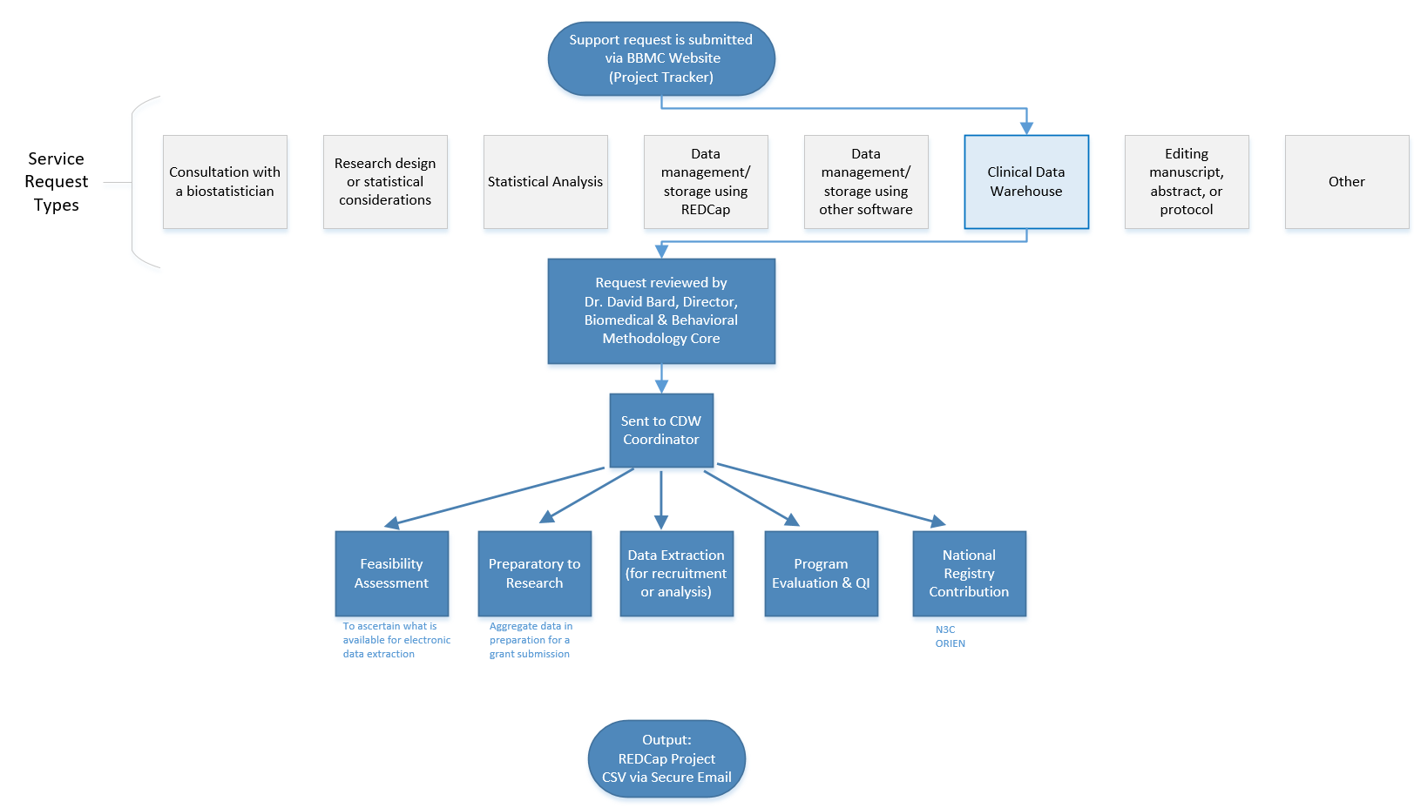
Commonly Requested CRDW Support Services
Feasibility assessment in preparation for research (20% of projects; 10% of CRDW staff time)
Static eligibility (70% of projects; 20% of CRDW staff time)
Virtually all projects require identification of a patient pool
Rolling eligibility (30% of projects; 30% of CRDW staff time)
Remember study team’s assessment of eligibility as well as the participant’s response
Daily automation requires stability & good logging; e.g., a 3 hour delay might mean zero subjects are enrolled
Clinical outcomes for retrospective investigations (50% of projects; 30% of CRDW staff time)
Administrative outcomes for quality improvement (10% of projects; 2% of CRDW staff time)
Program evaluation (20% of projects; 8% of CRDW staff time)
Notes:
Here are the services we provide. This roughly reflects the needs of the campus, but it’s not one-to-one. For example, I’m sure there are still a lot of manual chart reviews to create eligibility lists. Also, there are several groups on campus, like BERD, that are great at analyzing the outcomes once the datasets is delivered in a suitable format.
As PIs decide how big of a bite to take, some come to us to get a feel for the counts of patients meeting the conditions of interest. These tasks typically not too heavy, so we can complete most within a day.
One-time eligibility is requested a lot, partly because we’ve built a little reputation around it. And virtually all projects need that patient pool defined. To create this pool our code doesn’t change much between active studies and retrospective studies. We’ve designed our pipeline to reuse a lot.
If it’s not a one-time enrollment, it’s typically then an ongoing recruitment. That takes more time because a lot of factors need to be incorporated to keep it efficient for humans to process. And even if it took zero seconds to develop, that daily automation inevitably requires some maintenance as those eligibility lists are deployed every morning. Although most mornings, the automation is smooth and it’s a simple check for a human to review everything passed.
Clinical outcomes is what I thought would soak up the majority of our time, but that’s been fairly manageable so far.
And occasionally we get administrative and program eval tasks that fit inside a larger research project.

Slide 42
IRB and Privacy Review Guidance
Requests that are preparatory to research must be submitted to the IRB/University Privacy Board for review and approval.
Program Evaluation, CQI, & Feasibility Assessments:
If PHI is NOT included, it is generally not considered human subjects research.
A determination of human subjects research (DHSR) may be submitted to the IRB.
Aggregate data may be provided without an IRB submission.
The following activities are NOT human subjects research:
Classroom evaluation activities when assessment involves regular classroom activities and the results of the evaluation process are intended to be used for the sole purpose of enhancing teaching practices of the instructor
Quality improvement activities designed to enhance functionality of a department or campus program provided that results are not intended to be shared outside of the University
Program evaluations
Public health practice surveillance activities
Notes:
In short, we work closely with the oversight boards to maintain compliance & improve efficiency. A new governance board is being created that’s co-chair by the informatics heads of the hospital and of the clinics. I’m excited that this will speed up parts of our process for those studies that don’t require an IRB.
[8 min cumulative]

Slide 43
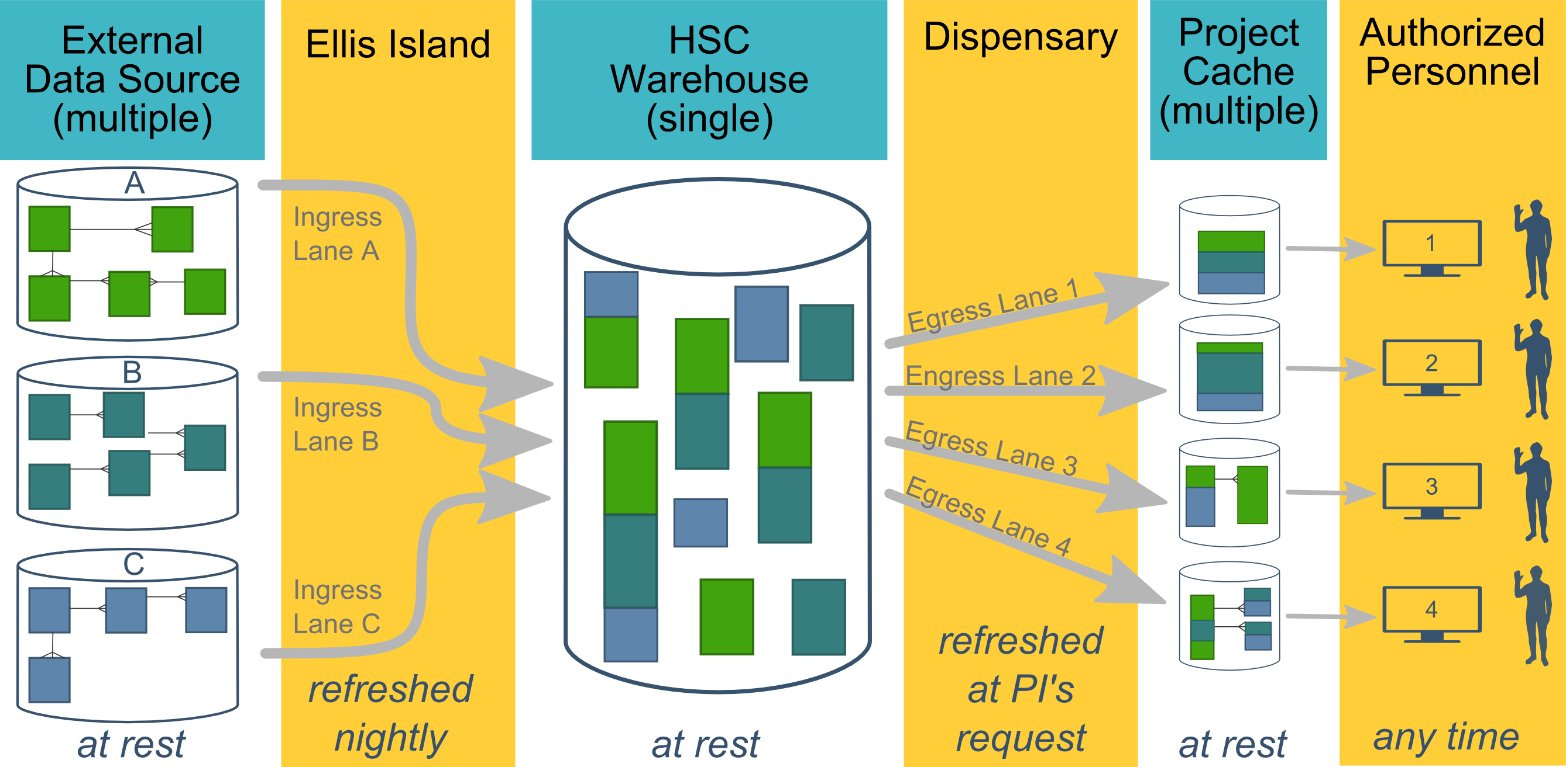
Ecosystem Architecture
Prairie Outpost – CRDW (Clinical Research Data Warehouse)
https://github.com/OuhscBbmc/prairie-outpost-public
Data Source (column 1): contains unique info
Warehouse (column 3): contains copy after manipulation
Project Cache (column 5): transformed to facilitate analyses of a specific research project
Notes:
The entire ecosystem can be represented by these six columns. The EMR and other collection databases sit in the 1st column and feed the warehouse in the third. This movement is automated. Inside the warehouse, the info from the different sources are staged & combined. Different patients can be placed in the same table. Perhaps more importantly, records for a single patient that are scattered across different sources are linked.
When a investigation is approved by the IRB, we can develop a tiny database in REDCap that contains the dataset needed for their analysis (5th column). There are a few reasons why REDCap is preferred. First, it’s more secure and scalable than distributing loose Excel files repeatedly for the same project. Second, REDCap has a lot of momentum and adoption, so it’s become familiar to a lot of people on campus --like those using it to collect research data.
We’ve always emphasized that we developed this to be as modular as possible. If someone could benefit from a few columns, they don’t have to commit to the whole thing. This modular approach has paid off, and I’ll return to that in the last few slides.

Slide 44
CDW Faculty & Staff
David Bard, PhD, Chief Research Information Officer
Will Beasley, PhD, BBMC Director of Informatics
Lise DeShea, PhD is a senior research biostatistician who has worked on the OUHSC campus for more than 10 years, following her employment with OHCA as a statistician analyzing claims data in Quality Assurance. She has authored 3 statistics textbooks, has years of teaching experience, and expertise related to manuscript writing and presentation development. Lise joined the CDW team in July 2020.
Geneva Marshall, MA joined the CRDW team in August 2020 after spending 8 years supporting academic research led by Drs. Bard and Beasley. Her experience includes the expansion and upkeep of a data pipeline using R and SQL to combine datasets for programs evaluation, as well as creating and streamlining a common set of procedures in R for data analysis. Geneva anticipates graduating OSU in May with a MS in Business Analytics specializing in Data Science.
Ashley Thumann, MHA has 15 years of healthcare administration experience. Prior to joining the CRDW team in October 2017, she served as a Clinics Administrator and Quality Manager for OU Physicians. Ashley has end-user experience with many of the data systems on campus and is the CRDW’s primary liaison with investigators.

Slide 45
Typical Workflow for a
CRDW Research project
by the BBMC
Submit a request at:
ouhsc.edu/bbmc/
then ‘Request Support’
Notes:
Our group, the BBMC, is a core of ~6 faculty statisticians and another ~10 staff with skills in health administration, analysis, research, and data science.
When we receive a request involving the CRDW, it’s reviewed by a triage team and assigned to a mix of people. We assist with the project (ideally while the proposal is being written –not after it’s submitted). Some of the time we’re also the statisticians, and some of the time the PI has their own statistician or is collaborating with a group like BERD.
For a one-time retrospective research project, the output is usually a secured CSV. For a project requiring rolling enrollment, we deploy updates every morning with REDCap and dynamic html reports.
I have few friends managing the CRDWs of other universities. When we compare our situations, the biggest differences arise from the fact that our CDW was created by a group that’s primarily statisticians & researchers, as opposed to being created by an IT group that brings in outside statisticians. Pros & cons to each origin story. If you see differences between our approach and other institutions, this is a big reason.

Slide 46
HSC Data Sources
Patient
Outpatient (Centricity)
Billing and Claims Data
Inpatient (Meditech)
Dozens of departmental sources
Biomedical Research Data
Epic (in ~1 year)
Provider
External Agencies
Service Provided (by the Health Dept of Oklahoma)
Child Protective Services (Oklahoma Dept of Human Services)
Immunization (Health Dept of Oklahoma)
Vital Records (Health Dept of Oklahoma)
…
Multi-state collaborations (in the future)
Administrative Cost
Employee & Student
Notes:
Here are the data sources for the research projects that we’ve assisted with. Roughly in descending order of frequency.
Most of our projects involve inpatient EMRs, outpatient EMRs, and billing systems.
In some ways, our experience started with datasets from external collaborators, such as the Dept of Health, and grew from there.

Slide 47
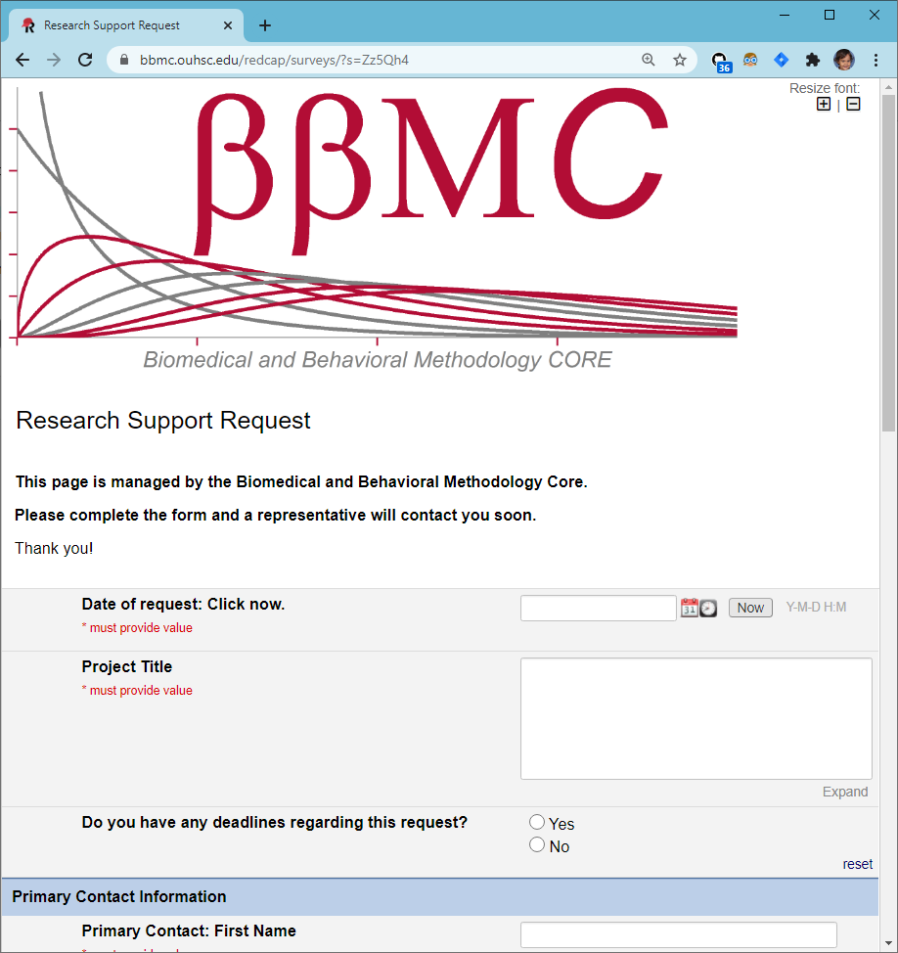
CRDW Typical Workflow
Intake via BBMC request form
Meet with investigator to determine data needs, feasibility
Back and forth with investigator
Develop Pipeline
Review with investigator and distribute via approved method
Structured vs. unstructured?
How well meet project needs with what’s available?
IRB considerations
Metadata files (such as identifying ICD codes, medications)
Verifying data formats
Automated daily data pulls
Varies vastly in complexity by project, data sources, etc.
CSV tables via SFT
Push to REDCap
Dashboards
Assign project to BBMC analyst based on skills, workload, & interests
Some projects may involve multiple analysts
Identifying locations and sources of data
SQL, R, & Python
Follows HIPAA & least privileges principles
BBMC Triage to services:
Feasibility
Program Evaluation
Recruitment
Retrospective Analysis
Facilitate Abstraction
Preparatory to Research
QI
Registry
Some may be very complex and/or rely on complicated code (e.g., Regular Expressions to extract structured data from unstructured notes, etc.). These requests can make completion take longer than usual.
Investigators are asked to add CRDW team to IRB application as KSP
CRDW team reviews & evaluates protocol to ensure data requested are authorized
Some have required modifications prior to release of data
This occasionally causes delays
Ideally, the IRB would implement a procedure to allow investigators to indicate utilization of CDRW upon initial approval without adding team as KSP (e.g., a check-box on the application indicating use of CDRW to extract data)

