Slide 1







CDW Involvement in OPCTN Studies
Will Beasley, PhD
Ashley Thumann, MHA
David Bard, PhD
University of Oklahoma HSC
Biomedical & Behavioral Methodology Core (BBMC)
August 2019
Award Numbers: UG1OD024950 U54GM104938
Notes:
Hi I’m Will, and part of the Clinical Data Warehouse effort on campus. I started as a conventional statistician and researcher, and based on experience with integrating our investigations with state agency data , our group moved into the world of EMRs and CDWs.
I think these experiences has allowed our group to relate well with current PIs, as well as build a CDW ecosystem that works well with statisticians and DBAs in other groups.

Slide 2
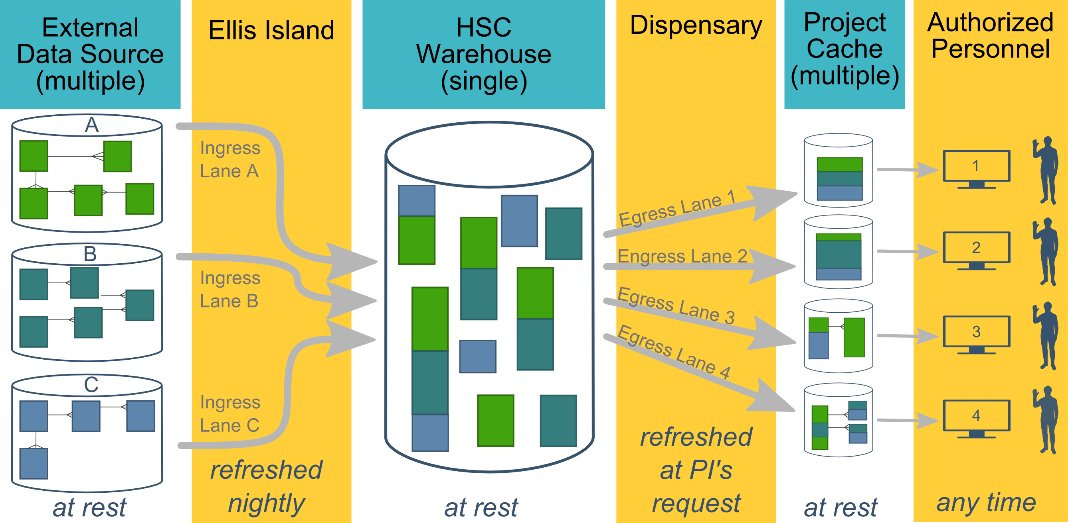
Ecosystem Architecture
Prairie Outpost – CDW (Clinical Data Warehouse)
https://github.com/OuhscBbmc/prairie-outpost-public
Data Source (column 1): contains unique info
Warehouse (column 3): contains copy after manipulation
Project Cache (column 5): contains copy of copy after a lot of manipulation
Notes:
The entire ecosystem can be represented by these six columns. The EMR and other collection databases sit in the 1st column and feed the warehouse in the third. This movement is automated. Inside the warehouse, the info from the different sources are staged & combined. Different patients can be placed in the same table. Perhaps more importantly, records for a single patient that are scattered across different sources are linked.
When a investigation is approved by the IRB, we can develop a tiny database in REDCap that contains the dataset needed for their analysis (5th column). There are a few reasons why REDCap is preferred. First, it’s more secure and scalable than distributing loose Excel files. Second, REDCap has a lot of momentum and adoption, so it’s become familiar to a lot of people on campus. The same software system the clinical researcher learned (for example) for randomized trials is leverage here for these observational studies. Although the research/QA methodology is very different, the software is the same.
We’ve always emphasized that we are developing this to be as modular as possible. If someone could benefit from a few columns, they don’t have to commit to the whole thing. This modular approach has paid off, and I’ll return to that in the last few slides.

Slide 3
HSC Data Sources
Patient
Outpatient (Centricity)
Scheduling & Registration (GECB)
Inpatient (Meditech)
Billing and Claims Data (GECB)
Dozens of departmental sources
Biomedical Research Data
Provider
External Agencies
Service Provided (by the Health Dept of Oklahoma)
Child Protective Services (Oklahoma Dept of Human Services)
Immunization (Health Dept of Oklahoma)
Vital Records (Health Dept of Oklahoma)
…
Administrative Cost
Employee & Student
Notes:
Here are the data sources for the research projects that we’ve assisted with. Roughly in descending order of frequency. (And maybe not coincidentally, by descending order of IRB involvement.)
Most of our projects involve inpatient EMRs, outpatient EMRs, and billing systems.

Slide 4
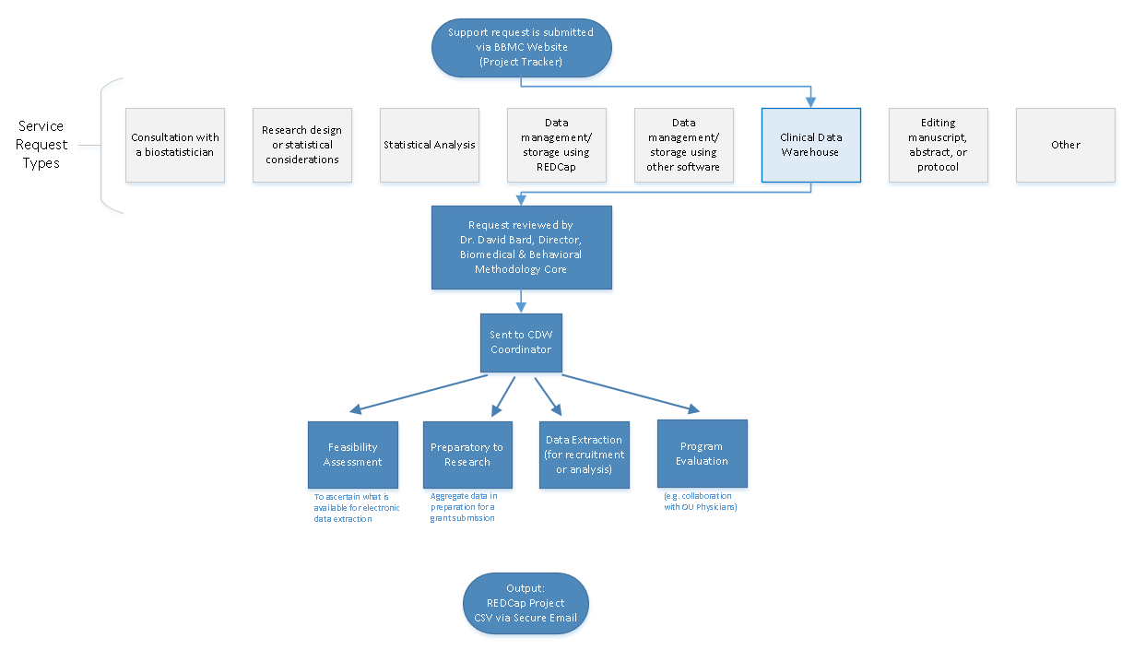
Typical Workflow for a
CDW Research project
by the BBMC
Notes:
Our group, the BBMC, is a core of ~6 faculty statisticians and another ~10 staff with skills in health administration, analysis, research, and data science.
When we get a request involving the CDW, it’s reviewed by a triage team and assigned to a mix of people. We assist with the project (ideally while the proposal is being written). Maybe half of the time we’re also the statisticians, and half the time the PI has their own statistician or is collaborating with a group like Julie’s.
For a one-time retrospective research project, the output is usually a secured CSV. For a project requiring rolling enrollment, we deploy updates every morning with REDCap and dynamic html reports.
I have few friends managing the CDWs of other universities. When we compare our situations, the biggest differences arise from the fact that our CDW was created by a group that’s primarily statisticians & researchers, as opposed to being created by an IT group that brings in outside statisticians. Pros & cons to each origin story. If you see differences between our approach and other institutions you’re reviewing, this is a big reason.

Slide 5
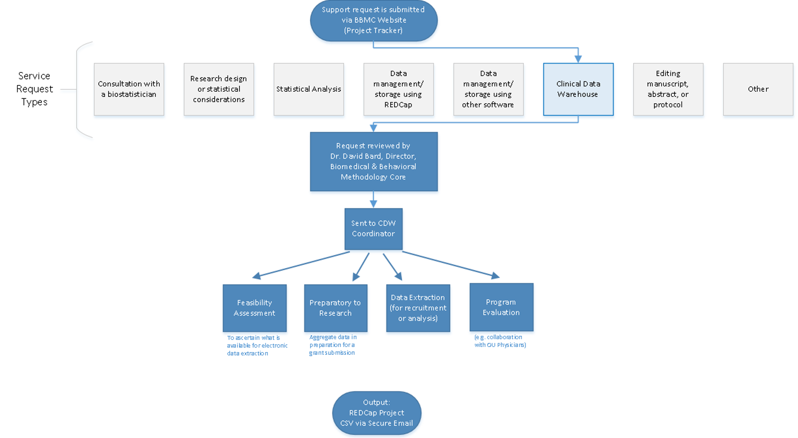
Commonly Requested CDW Support Services
Feasibility assessment in preparation for research (20% of projects; 10% of CDW staff time)
Static eligibility (70% of projects; 20% of CDW staff time)
Virtually all projects require identification of a patient pool
Rolling eligibility –Especially relevant to the OPCTN studies (30% of projects; 30% of CDW staff time)
Remember study team’s assessment of eligibility as well as the participant’s response
Daily automation requires stability & good logging; e.g., a 3 hour delay might mean zero subjects are enrolled
Clinical outcomes for retrospective investigations (50% of projects; 30% of CDW staff time)
Administrative outcomes for quality improvement (10% of projects; 2% of CDW staff time)
Program evaluation (20% of projects; 8% of CDW staff time)
Notes:
Here are the services we provide. This roughly reflects the needs of the campus, but it’s not one-to-one. For example, I’m sure there are still a lot of manual chart reviews to create eligibility lists. Also, there are several groups on campus, like Julie’s, that are great at analyzing the outcomes once the datasets is delivered in a suitable format.
As PIs decide how big of a bite to take, some come to us to get a feel for the counts of patients meeting the conditions of interest. These tasks typically not too heavy, so we can complete most within a day.
One-time eligibility is requested a lot, partly because we’ve built a little reputation around it, so we get word-of-mouth referrals. And virtually all projects need that patient pool defined. To create this pool our code doesn’t change much between active studies and retrospective studies. We’ve designed our pipeline to reuse a lot.
If it’s not a one-time enrollment, it’s typically then an ongoing recruitment. That takes more time because a lot of factors need to be incorporated to keep it efficient for humans to process. And even if it took zero seconds to develop, that daily automation inevitably requires some maintenance as those eligibility lists are deployed every morning. Although most mornings, the automation is smooth and it’s a simple check for a human to review everything passed.
Clinical outcomes is what I thought would soak up the majority of our time, but that’s been fairly manageable so far.
And occasionally we get administrative and program eval tasks that fit inside a larger research project.

Slide 6
POPS Study
Pharmacokinetics of Understudied Drugs Administered to Children per Standard of Care
darden-pharmaco-1
Notes:
For the middle part of my talk, I’d like to summarize the prototypical studies that span our spectrum. And start with a big one that has lots of features we reuse in many smaller projects. Consequently their turn around is faster and thoroughness/quality is higher.
This POPS study …

Slide 7
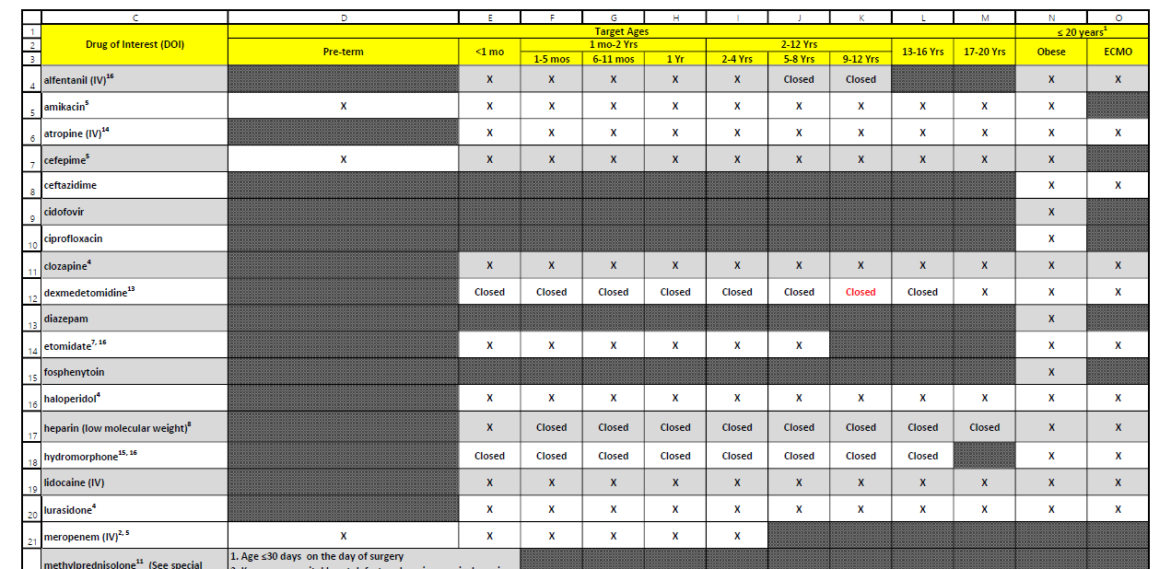
POPS Overview
Primary Aim: Evaluate PK of understudied drugs administered to children
Part of Oklahoma Pediatric Clinical Trial Network (OPCTN), a site for the NIH-funded ECHO IDeA States Pediatric Clinical Trials Network (ISPCTN)
Enrollment Criteria:
Child receiving understudied drug of interest (DOIs) per standard of care
meet age range or condition (pre-term, obese, ECMO) open for enrollment.
darden-pharmaco-1
Notes:
This multi-site project monitors kids prescribed with off label meds –with an important constraint. We can’t perform any extra procedures. Some of these cells need spinal fluid, but the study can’t get it unless it’s already being collected. So it’s really important to get the info to the research nurses early in the morning to piggy back the collections. Information that is a day old is worthless, especially for the inpatients. The whole approach needs to be proactive and anticipatory, leveraging automation to deliver reports quickly.

Slide 8
Resource Efficiency: fewer patients, quicker review, less redundancy
Old System
New System
2019-01-12 Inpatient Extract
Finds patients who received a drug of interest
109 unique patients
Record review: ~15 min/pt
~1,635 minutes
2019-01-13 Inpatient Extract
112 unique patients @15 min/pt (forgets yesterday)
2019-01-12 Inpatient Screening Report
Finds patients who received a drug of interest and meet an age range or condition currently open for enrollment
31 unique patients
Record review: ~5 min/pt
~155 minutes
2019-01-13 Inpatient Screening Report
6 new patients @5 min/pt (remembers yesterday)
darden-pharmaco-1

Slide 9
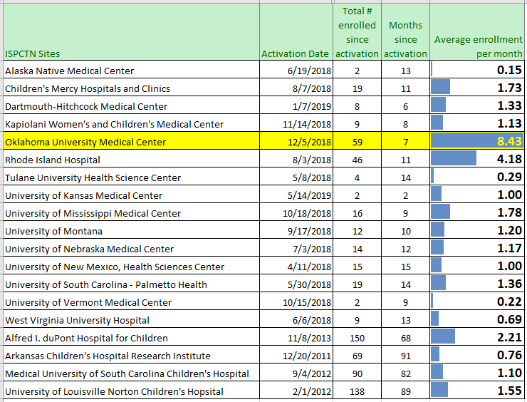
Enrollment Rate by Institution
darden-pharmaco-1
Notes:
Here’s a piece I’m proud of. It demonstrates that investing in the spiderweb’s breadth and the report’s ergonomics can translate into substantial gains.
Our pace in our first seven months is twice as large as the 2nd highest. Besides the pace, our total volume is 4th highest overall, even when considering locations that started years ago.

Slide 10
New Participant Enrollment (by Site and Month)
 | Outpatient | NICU | PICU | Inpatient | Grand Total
Dec 2018 |  |  | 1 |  | 1
Jan 2019 | 7 | 1 |  |  | 8
Feb 2019 | 1 |  |  |  | 1
Mar 2019 | 1 |  |  |  | 1
Apr 2019 | 7 |  | 2 |  | 9
May 2019 | 13 |  | 1 |  | 14
Jun 2019 | 13 | 1 | 2 | 2 | 18
Jul 2019 | 6 | 1 | 1 | 3 | 11
Aug 2019 | 5 | 1 | 3 |  | 9
Grand Total | 53 | 4 | 10 | 5 | 72
darden-pharmaco-1
Notes:
Breaking down the contributions of the sites over time, you’ll see the outpatients dominate. Some is attributable to their process, some is attributable to the volume of patients and types of typical drugs.
You’ll also notice that it took a few months to build up the pace, if you ignore the 50 days we lost due to an IRB reapplication. And our recent pace of 15/month is very favorable within the context of the previous table.

Slide 11
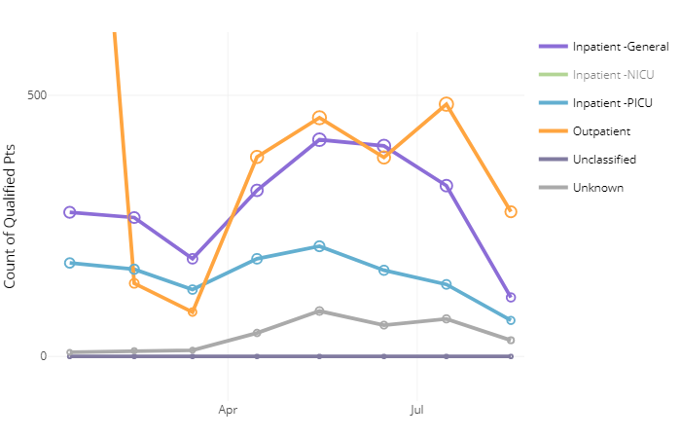
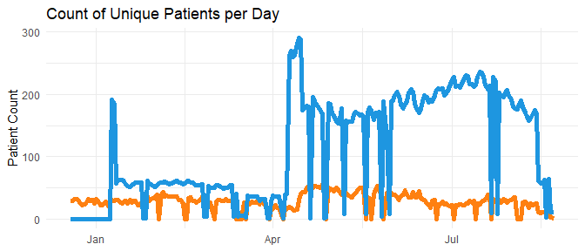
New Participant Enrollment (by Site and Month)
darden-pharmaco-1
Notes:
Breaking down the contributions of the sites over time, you’ll see the outpatients dominate. Some is attributable to their process, some is attributable to the volume of patients and types of typical drugs.
You’ll also notice that it took a few months to build up the pace, if you ignore the 50 days we lost due to an IRB reapplication. And our recent pace of 15/month is very favorable within the context of the previous table.

Slide 12
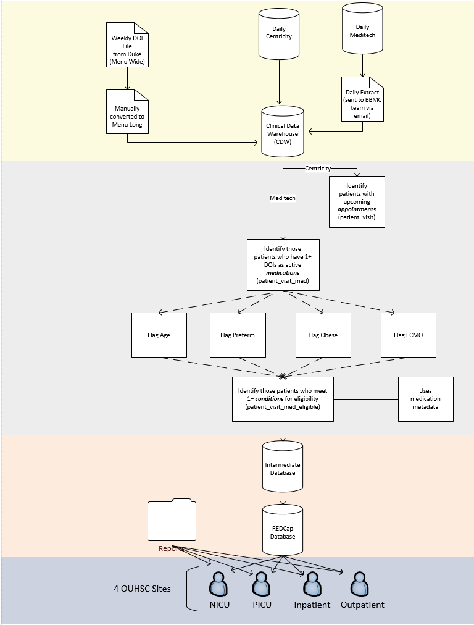
darden-pharmaco-1

Slide 13
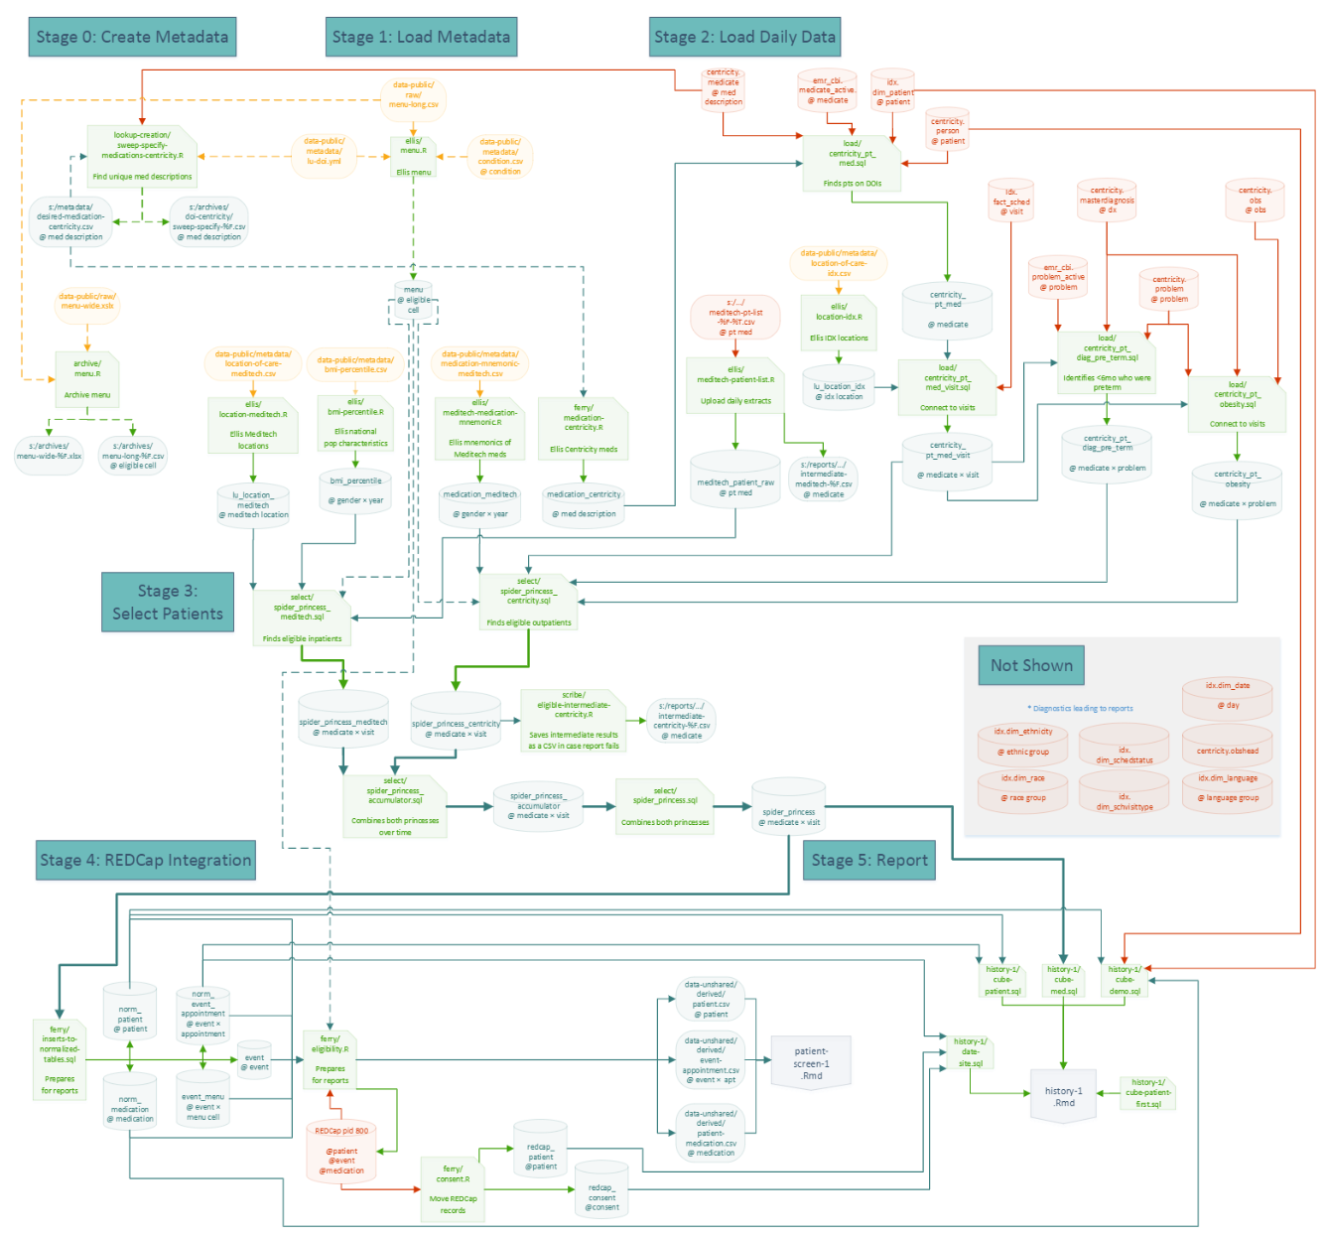
darden-pharmaco-1

Slide 14
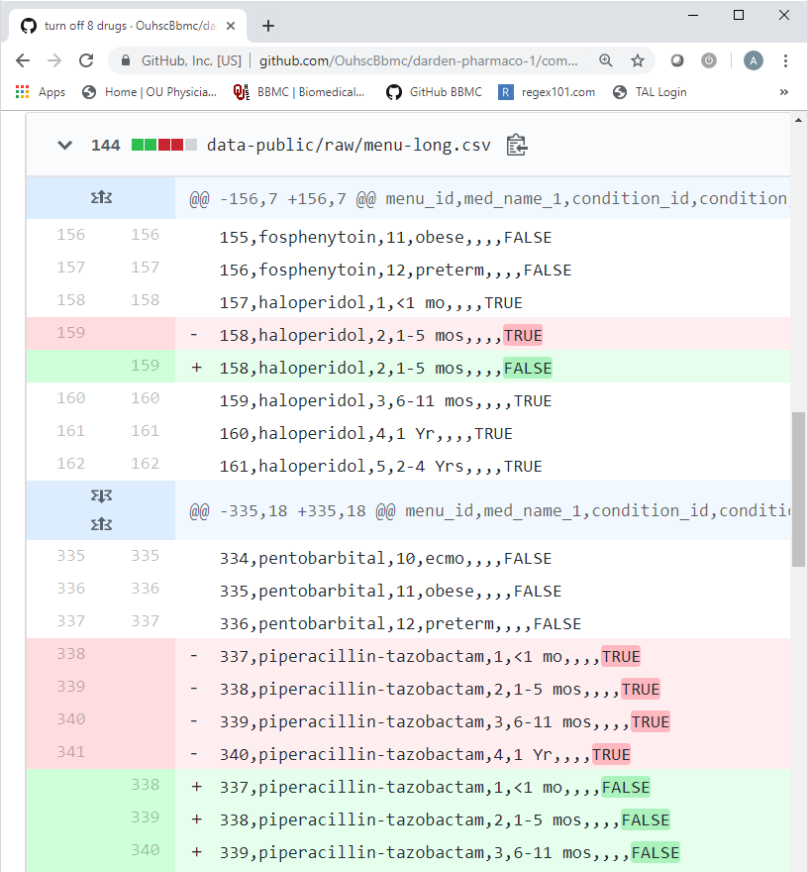
Agile Responses to Changes in the DOI List
When the new DOI list is released:
New drugs take ~20 min to add.
Old drugs take ~0.1 min to remove.
Only the CSV changes; the pipeline & report code is constant
darden-pharmaco-1

Slide 15
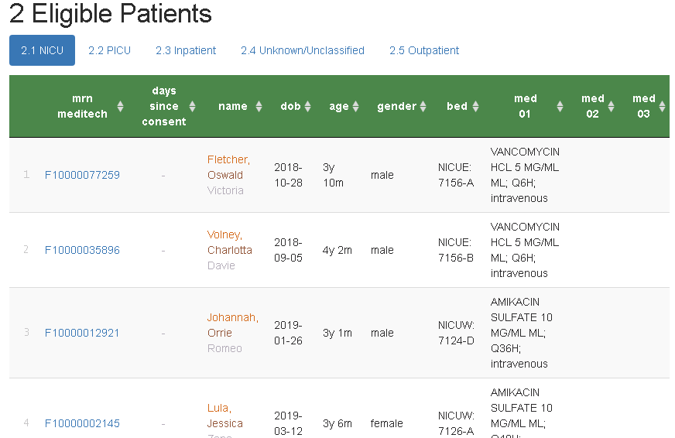
Screening Report (for inpatients)
Hyperlinks to REDCap
Consent stop watch
Filter, search, & sort
(Simulated patients)
darden-pharmaco-1

Slide 16
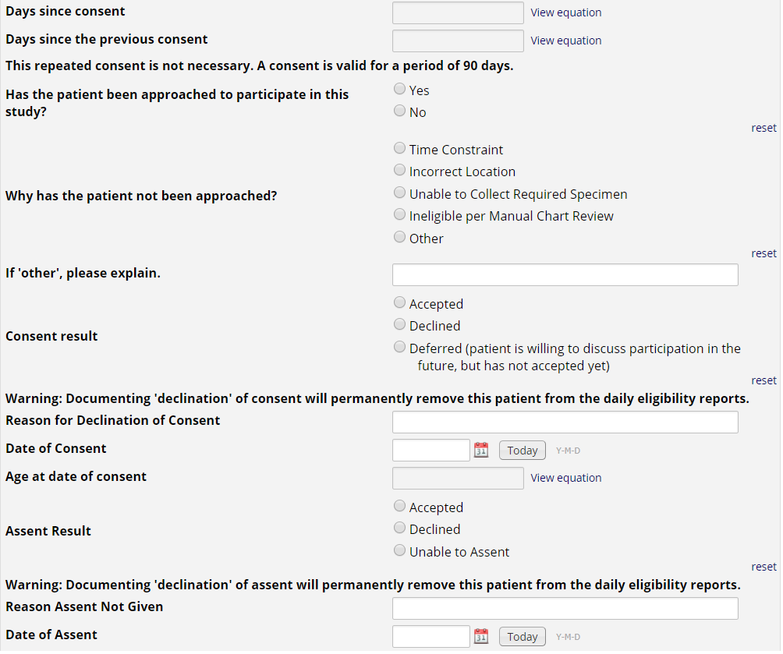
REDCap Project
Approached?
Consented?
Assented?
darden-pharmaco-1
Notes:
Research nurses use the MRN hyperlink on the eligibility report to document approached/consent/assent in REDCap.
If a patient or guardians ‘declines’ consent or assent, the patient is removed from future eligibility reports.
This also allows us to create summary stats for the investigators to monitor progress, address issues with resource allocation, etc.

Slide 17
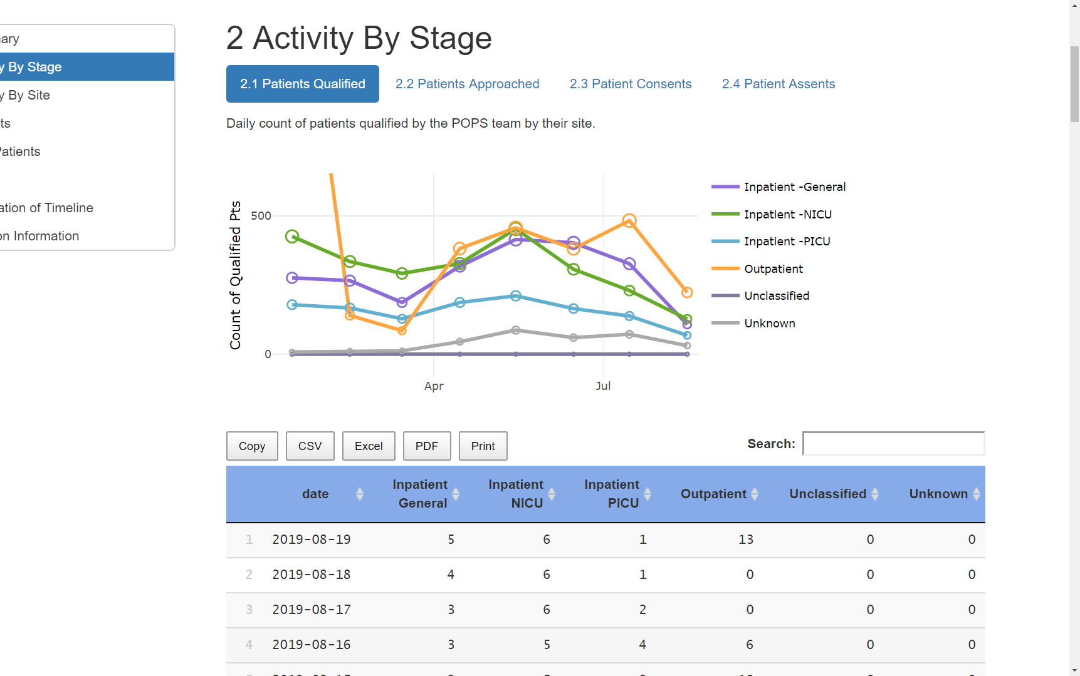
Progress Reports
See the forest.
3-way breakdowns of:
time
site
drug
age
gender
stage
qualified
approached
consented
assented
darden-pharmaco-1

Slide 18
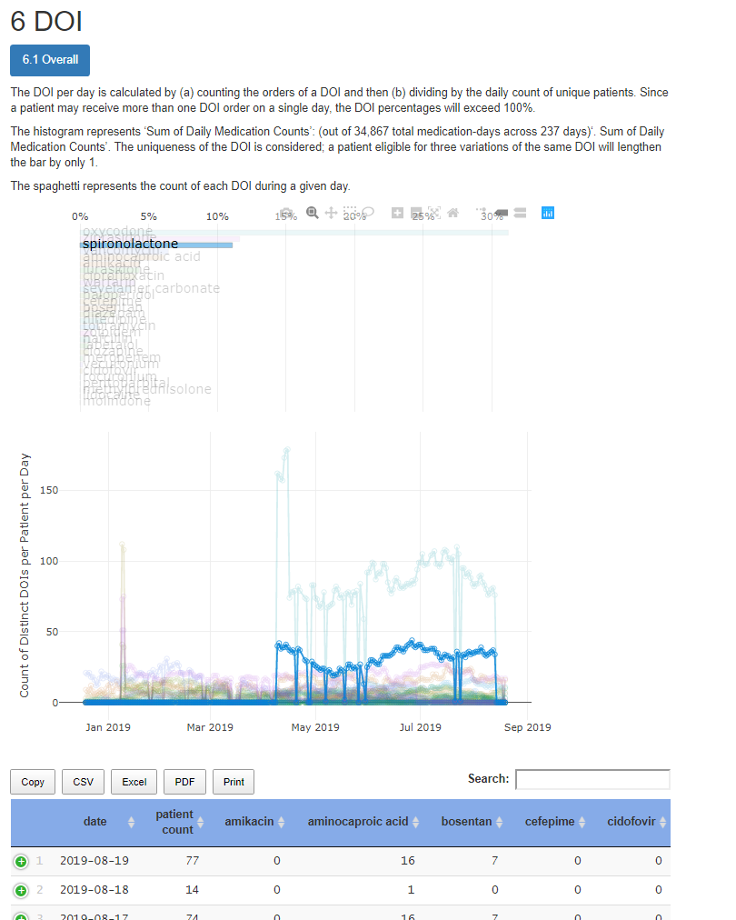
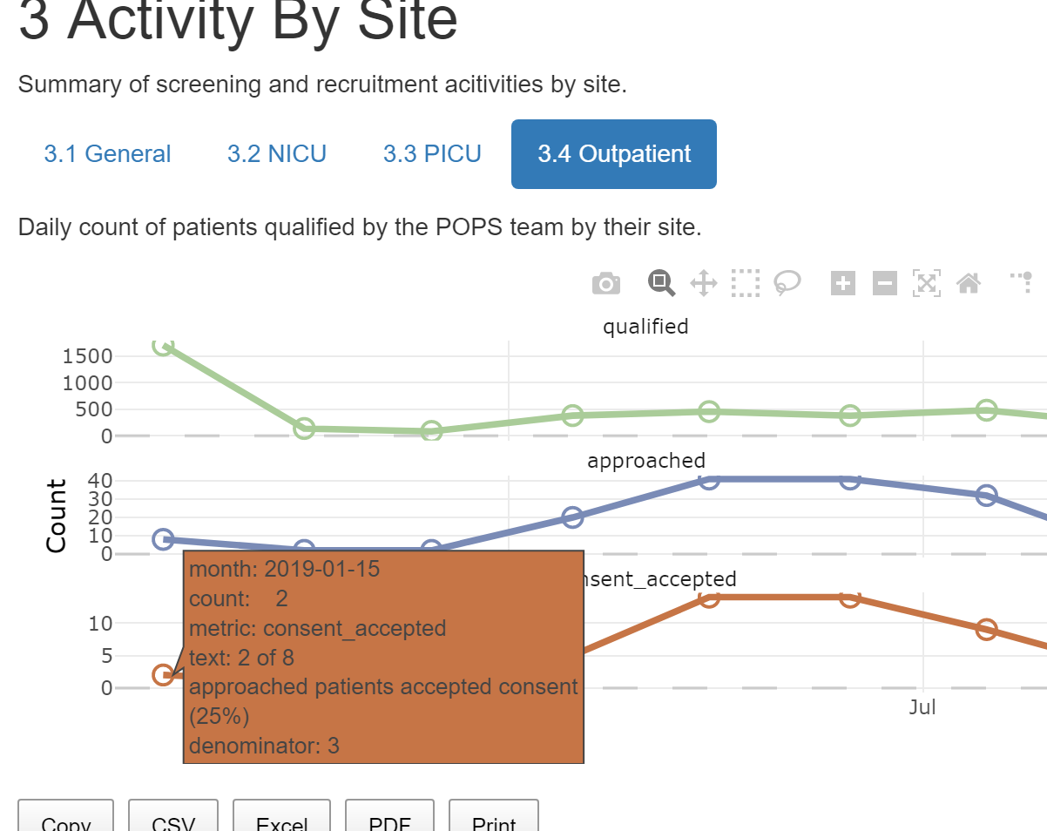
Progress Reports
darden-pharmaco-1
Notes:
[15 min cumulative]

Slide 19
CDW Strategy: don’t overbuild
Some studies don’t require a full reporting solution
Scenario 1: big study already has an established tracking pipeline
Scenario 2: small study has a tight focus; 2 part-time nurses can review the ~3 patients each morning
If only a CSV of daily patients is required, we can deliver within 10 man-hours.
This includes:
Pulling fresh info from inpatient & outpatient EMRs
Saving a CSV each morning to a file server
Logging of pipeline steps to a protected text files to facilitate quick diagnoses & fixes
Notes:
[

Slide 20
VDORA Study
Vitamin D Supplementation in Children With Obesity-Related Asthma
mehdi-vdora-1
Notes:
This second study is an example that’s essentially a subset of POPS.

Slide 21
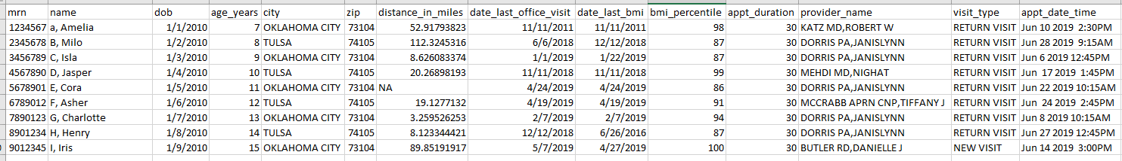
appt.csv
(Simulated patients)
mehdi-vdora-1

Slide 22
Resource Efficiency: fewer patients, quicker review, less redundancy
Manual Screening Process
Obtain a list of appointments scheduled the following week
Review each medical record using the inclusion/exclusion checklist:
Other criteria
Age
Diagnosis of asthma
Documentation of obesity
Email providers for review/input
Volume: 130 charts
Time: 240 minutes
Automated Screening Process
Review select medical records for:
Other criteria
Email providers for review/input
Volume: 24 charts (screened out 106)
Time: 45 minutes
mehdi-vdora-1

Slide 23
Brief Summary of CDW Value

Slide 24
Brief Summary of CDW Value
POPS: dynamic recruitment
OxyContin: electronic sorting and merging/patient matching
ADHD studies: Apply standard clinical vocabulary to support interoperability to help information exchange; isolated retrieval of text documents for mining
Diabetes Management/Transition of Care: Sharing of data across various sources improves quality of care and efficiency; maximizes utility of data
Immunization: Harmonization of records for quality reporting and improved accuracy of record history

Slide 25
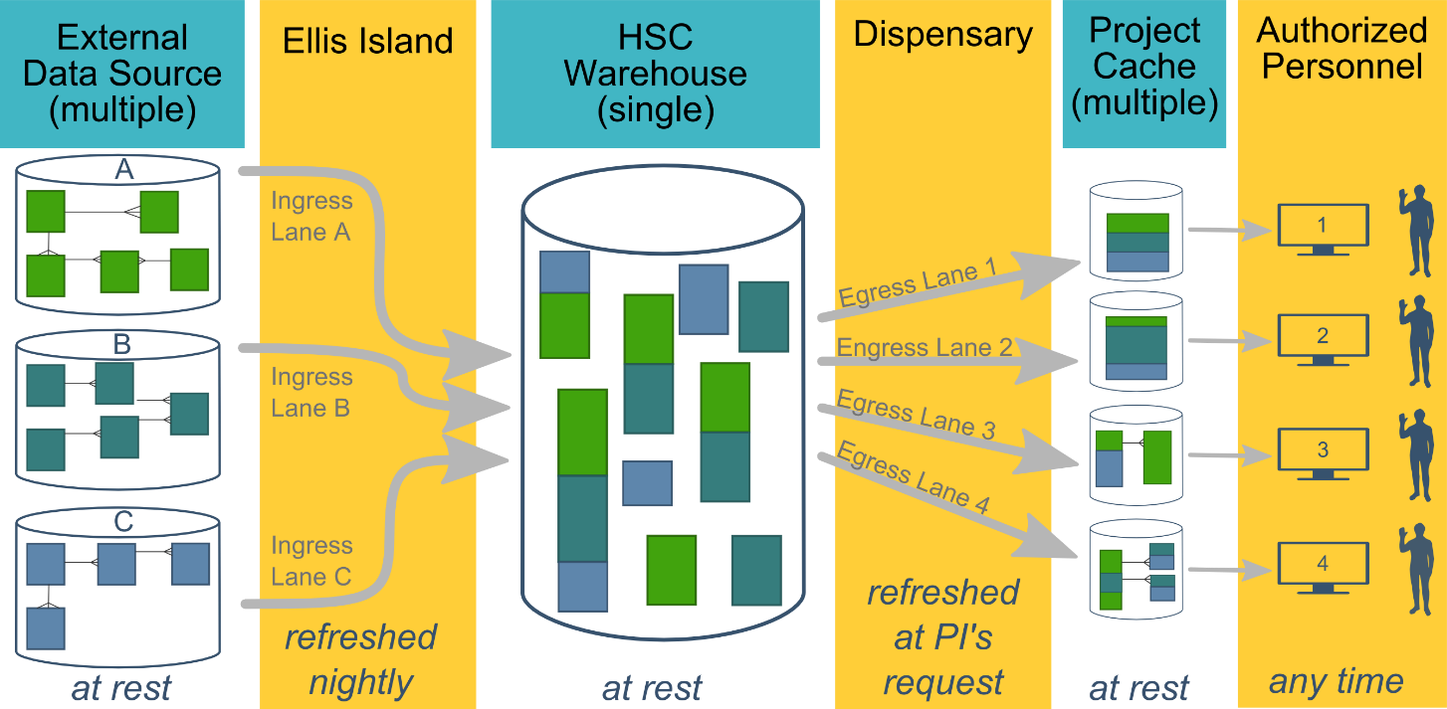
Current Developments: Common Campus-wide Warehouse
A tighter collaboration with
IT
BBMC
OU Physicians
Hospital
Notes:
We’re working with two informatics groups on camps to consolidate a lot of
It will be hosted and maintained by a new IT group, directed by vet of the OU EMR. They’re charged with building a warehouse for the whole campus, and they’ll likely take over the databases and pipeline code in the first three columns of our diagram. They’ll provide a project-agnostic warehouse to us, to OU Physicians, and to the hospital. The three groups will still develop our own downstream data lakes to support our specialized investigations. Some of our derived products and stable pipeline will provide a jump, and they have things we could benefit from too.

Slide 26
Thank you
Will Beasley, PhD
Ashley Thumann, MHA
David Bard, PhD
University of Oklahoma HSC
Biomedical & Behavioral Methodology Core (BBMC)
August 2019
Award Numbers: UG1OD024950 U54GM104938

Slide 27
Extras

Slide 28
OK HV-CoIIN
Oklahoma Home Visiting Collaborative Improvement and Innovation Network

Slide 29
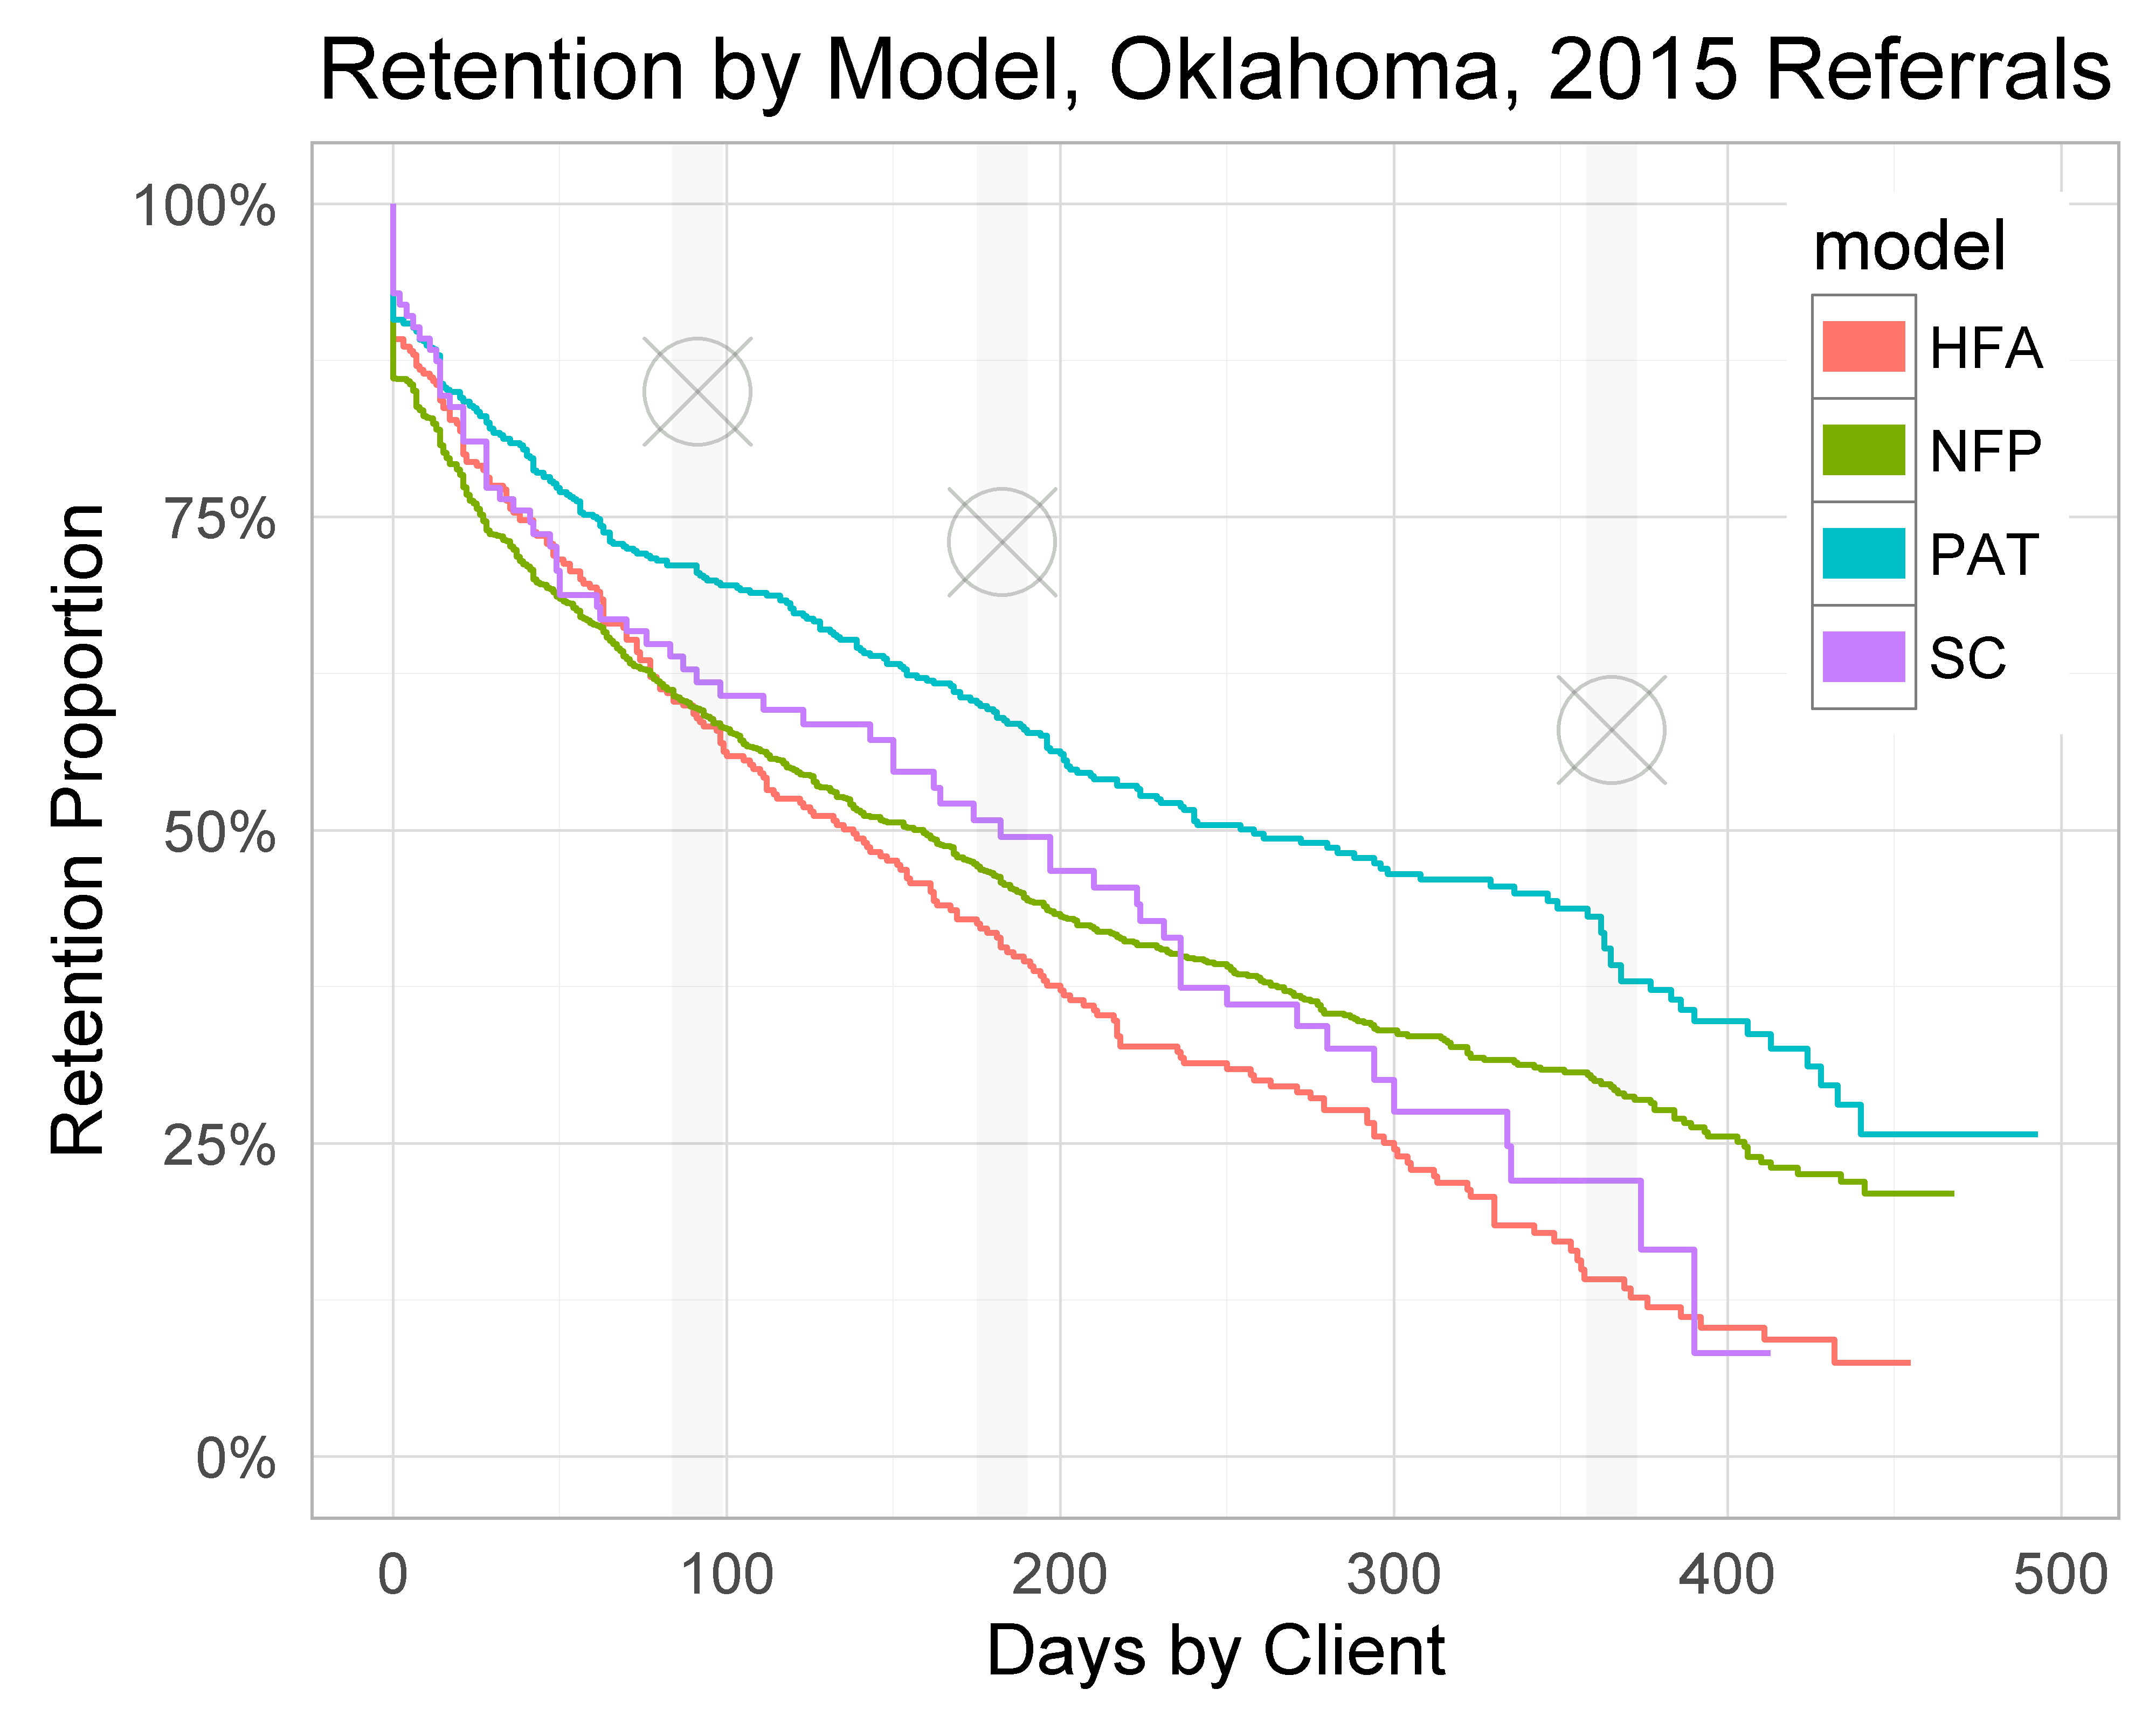

Slide 30
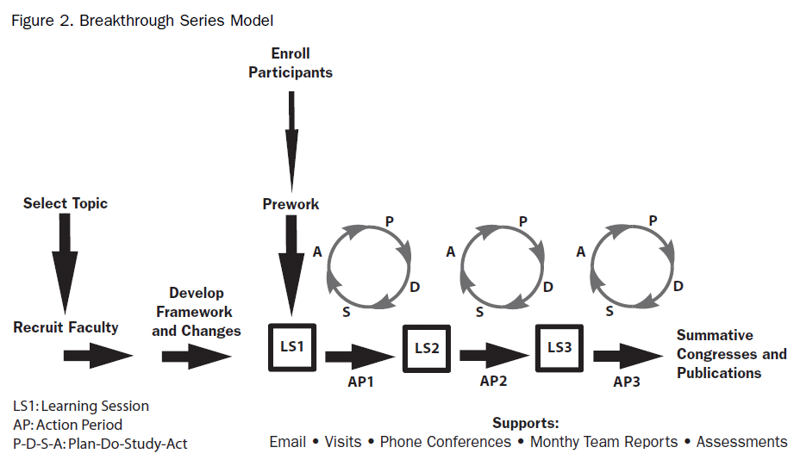
The IHI Breakthrough Series as the HV CoIIN Framework
Notes:
3
3
3

Slide 31
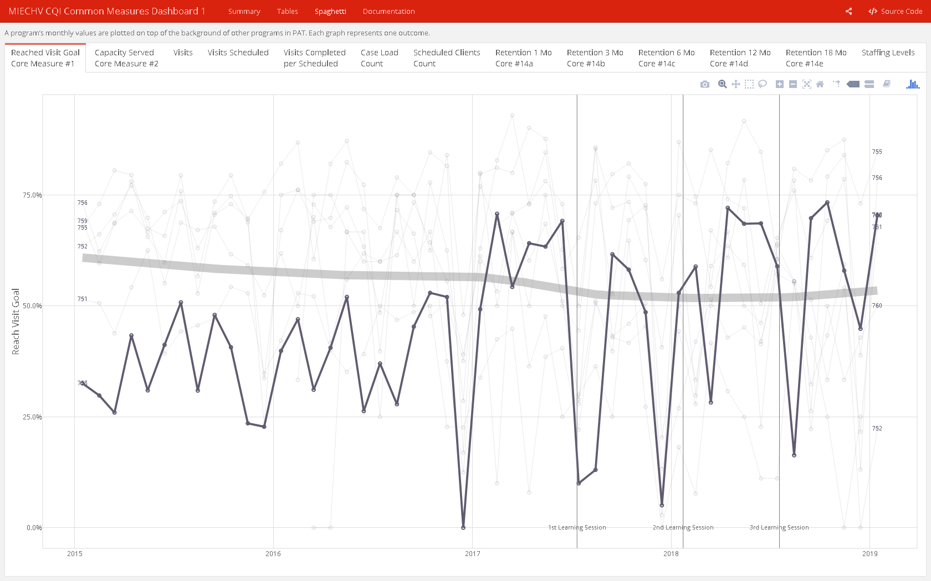
Dashboards
Two versions of a user-friendly dashboard were developed and administered weekly by team of analysts
Common measures
Individual

Slide 32
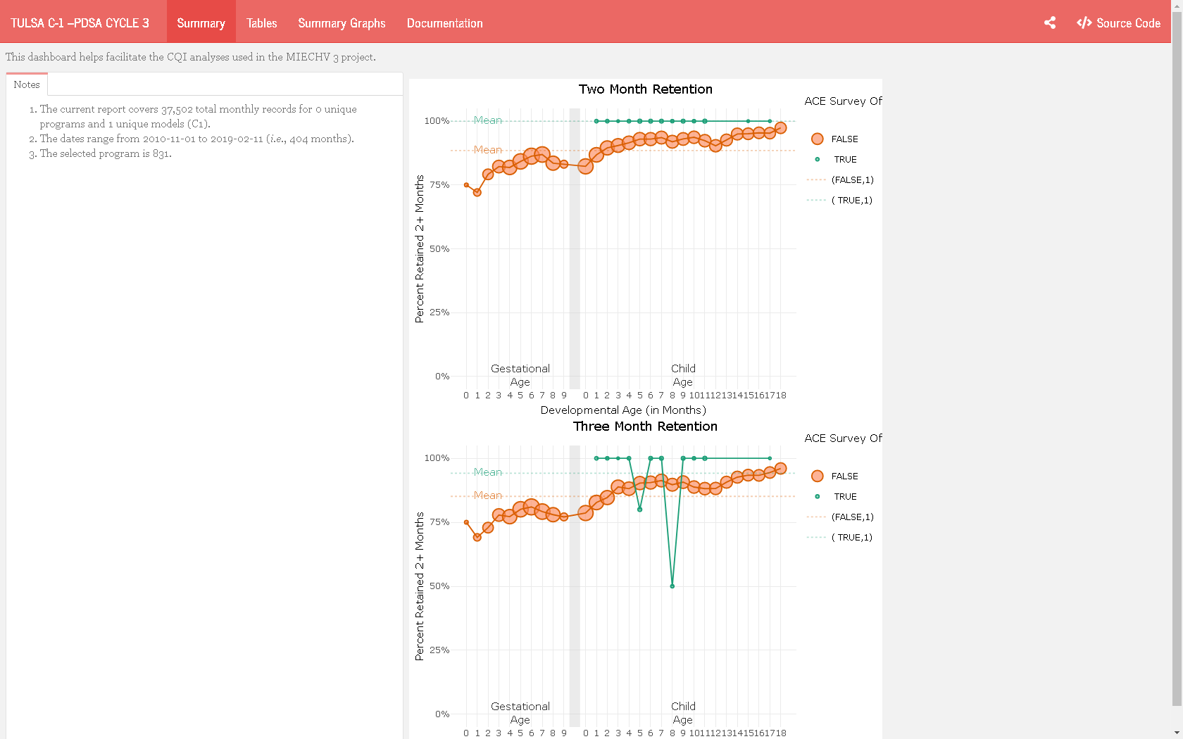
Dashboards
Two versions of a user-friendly dashboard were developed and administered weekly by team of analysts
Common measures
Individual

