Slide 1
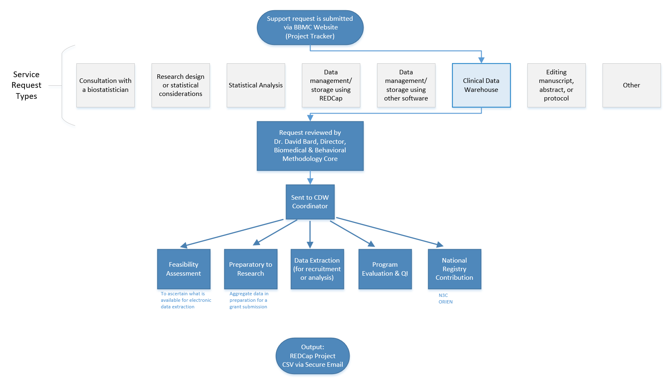
Example Slide 1
Feasibility assessment in preparation for research (20% of projects; 10% of CRDW staff time)
Static eligibility (70% of projects; 20% of CRDW staff time)
Virtually all projects require identification of a patient pool
Rolling eligibility (30% of projects; 30% of CRDW staff time)
Remember study team’s assessment of eligibility as well as the participant’s response
Daily automation requires stability & good logging; e.g., a 3 hour delay might mean zero subjects are enrolled
Clinical outcomes for retrospective investigations (50% of projects; 30% of CRDW staff time)
Administrative outcomes for quality improvement (10% of projects; 2% of CRDW staff time)
Program evaluation (20% of projects; 8% of CRDW staff time)
Notes:
Here are the services we provide. This roughly reflects the needs of the campus, but it’s not one-to-one. For example, I’m sure there are still a lot of manual chart reviews to create eligibility lists. Also, there are several groups on campus, like BERD, that are great at analyzing the outcomes once the datasets is delivered in a suitable format.
As PIs decide how big of a bite to take, some come to us to get a feel for the counts of patients meeting the conditions of interest. These tasks typically not too heavy, so we can complete most within a day.
One-time eligibility is requested a lot, partly because we’ve built a little reputation around it. And virtually all projects need that patient pool defined. To create this pool our code doesn’t change much between active studies and retrospective studies. We’ve designed our pipeline to reuse a lot.
If it’s not a one-time enrollment, it’s typically then an ongoing recruitment. That takes more time because a lot of factors need to be incorporated to keep it efficient for humans to process. And even if it took zero seconds to develop, that daily automation inevitably requires some maintenance as those eligibility lists are deployed every morning. Although most mornings, the automation is smooth and it’s a simple check for a human to review everything passed.
Clinical outcomes is what I thought would soak up the majority of our time, but that’s been fairly manageable so far.
And occasionally we get administrative and program eval tasks that fit inside a larger research project.

Slide 2
Example Slide 2
Requests that are preparatory to research must be submitted to the IRB/University Privacy Board for review and approval.
Program Evaluation, CQI, & Feasibility Assessments:
If PHI is NOT included, it is generally not considered human subjects research.
A determination of human subjects research (DHSR) may be submitted to the IRB.
Aggregate data may be provided without an IRB submission.
The following activities are NOT human subjects research:
Classroom evaluation activities when assessment involves regular classroom activities and the results of the evaluation process are intended to be used for the sole purpose of enhancing teaching practices of the instructor
Quality improvement activities designed to enhance functionality of a department or campus program provided that results are not intended to be shared outside of the University
Program evaluations
Public health practice surveillance activities
Notes:
In short, we work closely with the oversight boards to maintain compliance & improve efficiency. A new governance board is being created that’s co-chair by the informatics heads of the hospital and of the clinics. I’m excited that this will speed up parts of our process for those studies that don’t require an IRB.
[8 min cumulative]

Slide 3
Example Slide 3
ORIEN (Oncology Research Information Exchange Network) -Stephenson Cancer Center
This is a study designed to create a centralized clinical data and tissue repository. Clinical data, to include demographics, medical history, cancer classification, medical treatment, pathology records, long-term outcomes, quality of life, general health, laboratory, pathology, radiographic data/images, and cause of death, will be collected on all enrolled patients from the time of initial entry into the study and continue as long as the study remains in progress.
Given the scope, manual data abstraction proved to be very resource intensive. The CRDW team was consulted to explore the feasibility of extracting pathology records.
The data specifications required more than the pathology result value (e.g. reference range, critical value, etc.), which necessitated the use of ‘docdata’, regexes for text parsing,…
Oncologic Outcomes in Renal Cell Carcinoma -OUHSC Department of Urology
The primary objective of this study is to establish a kidney cancer registry to enable investigations of patients evaluated and treated for kidney cancer, with emphasis on efficacy of surgical technique, postoperative complication rates, response to immunotherapy, and utility of biomarkers/genomic tests.
The CDW was asked to assemble a list of patients diagnosed with kidney cancer since 2010. The study team will retrospectively populate a REDCap project with the desired clinical data for this cohort as well as prospectively enroll current and future patients.
N3C (National COVID Cohort Collaborative) -OUHSC

