Slide 1
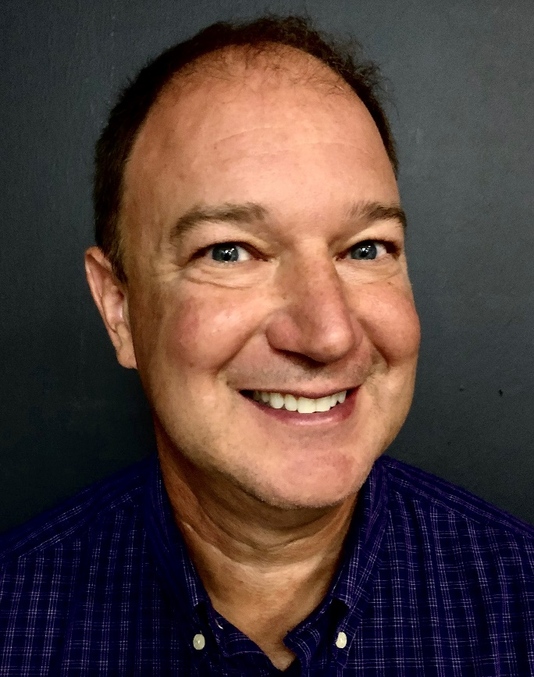
OUM BI Team
Jimmie Hackworth
Sr. Meditech Reporting Analyst in the Business Intelligence area of the Information Technology Department.
Meditech expert hired a few months ago to support Meditech while campus’s focus is pulled toward Epic.
Works with Ashley, Will, & Geneva to design daily extracts that populated the Meditech portion of the CRDW warehouse.
Since October, meets with us weekly to review our progress and discuss the upcoming week’s enhancements (eg, adding columns or tables)
For every 1 problem that he solves, there are probably another 10 that he anticipates that the CRDW team is never aware of.
His approach has become our model for how we want to ingest future data sources.
Notes:
Here are the data sources for the research projects that we’ve assisted with. Roughly in descending order of frequency.
Most of our projects involve inpatient EMRs, outpatient EMRs, and billing systems.
In some ways, our experience started with datasets from external collaborators, such as the Dept of Health, and grew from there.

