Slide 1







Leveraging OUHSC Clinical Data Warehouse for Emergency Medicine Research
Will Beasley, PhD
Ashley Thumann, MHA
University of Oklahoma HSC
Biomedical & Behavioral Methodology Core (BBMC)
July
2020
Award Numbers: UG1OD024950 U54GM104938
Notes:
We’re part of the Clinical Data Warehouse effort on campus.

Slide 2
Terms
EMR (or EHR): Electronic Medical/Health Records A huge database with patient records used by providers
CDW: Clinical Data Warehouse A collection of databases (such as EMRs and project-specific datasets) that has been transformed to make research more efficient and complete
Notes:
Here are the data sources for the research projects that we’ve assisted with. Roughly in descending order of frequency.
Most of our projects involve inpatient EMRs, outpatient EMRs, and billing systems.
In some ways, our experience started with datasets from external collaborators, such as the Dept of Health, and grew from there.

Slide 3
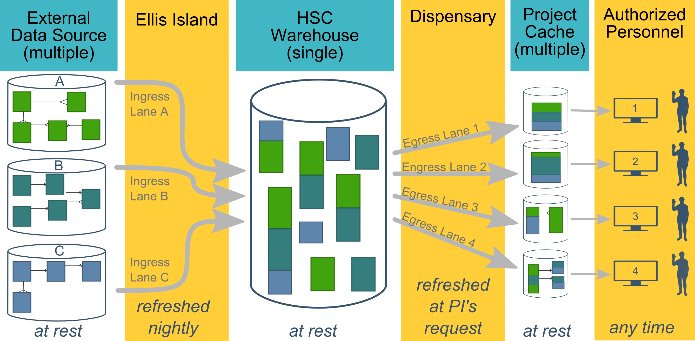
Ecosystem Architecture
Prairie Outpost – CDW (Clinical Data Warehouse)
https://github.com/OuhscBbmc/prairie-outpost-public
Data Source (column 1): contains unique info
Warehouse (column 3): contains copy after manipulation
Project Cache (column 5): contains copy of copy after a lot of manipulation
Notes:
The entire ecosystem can be represented by these six columns. The EMR and other collection databases sit in the 1st column and feed the warehouse in the third. This movement is automated. Inside the warehouse, the info from the different sources are staged & combined. Different patients can be placed in the same table. Perhaps more importantly, records for a single patient that are scattered across different sources are linked.
When a investigation is approved by the IRB, we can develop a tiny database in REDCap that contains the dataset needed for their analysis (5th column). There are a few reasons why REDCap is preferred. First, it’s more secure and scalable than distributing loose Excel files repeatedly for the same project. Second, REDCap has a lot of momentum and adoption, so it’s become familiar to a lot of people on campus --like those using it to collect research data.
We’ve always emphasized that we developed this to be as modular as possible. If someone could benefit from a few columns, they don’t have to commit to the whole thing. This modular approach has paid off, and I’ll return to that in the last few slides.

Slide 4
HSC Data Sources
Patient
Outpatient (Centricity)
Billing and Claims Data
Inpatient (Meditech)
Dozens of departmental sources
Biomedical Research Data
Epic (in ~1 year)
Provider
External Agencies
Service Provided (by the Health Dept of Oklahoma)
Child Protective Services (Oklahoma Dept of Human Services)
Immunization (Health Dept of Oklahoma)
Vital Records (Health Dept of Oklahoma)
…
Multi-state collaborations (in the future)
Administrative Cost
Employee & Student
Notes:
Here are the data sources for the research projects that we’ve assisted with. Roughly in descending order of frequency.
Most of our projects involve inpatient EMRs, outpatient EMRs, and billing systems.
In some ways, our experience started with datasets from external collaborators, such as the Dept of Health, and grew from there.

Slide 5
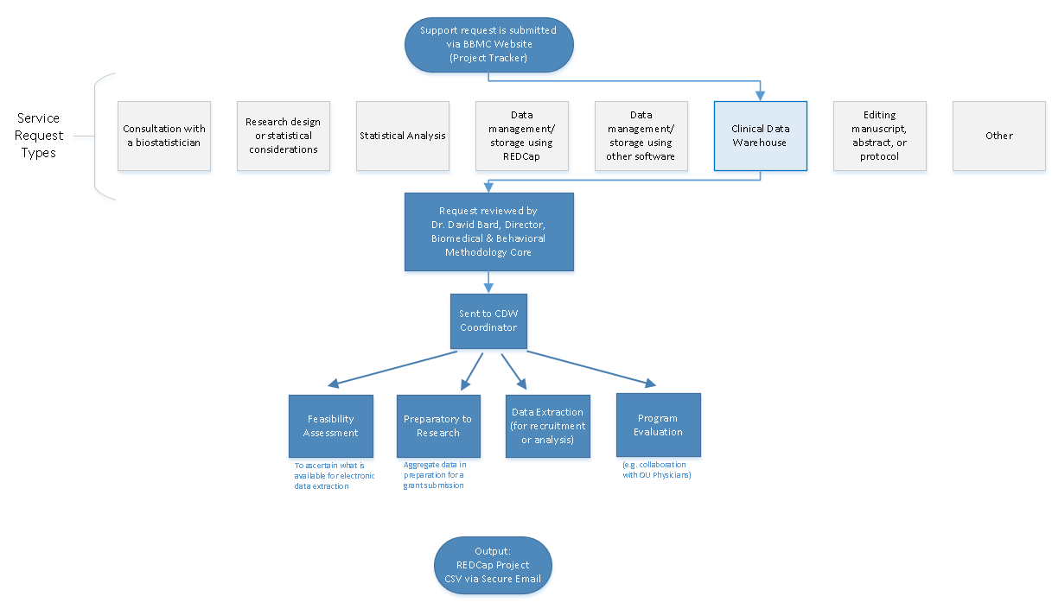
Typical Workflow for a
CDW Research project
by the BBMC
Submit a request at:
ouhsc.edu/bbmc/
then ‘Request Support’
Notes:
Our group, the BBMC, is a core of ~6 faculty statisticians and another ~10 staff with skills in health administration, analysis, research, and data science.
When we receive a request involving the CDW, it’s reviewed by a triage team and assigned to a mix of people. We assist with the project (ideally while the proposal is being written –not after it’s submitted). Some of the time we’re also the statisticians, and some of the time the PI has their own statistician or is collaborating with a group like Julie’s.
For a one-time retrospective research project, the output is usually a secured CSV. For a project requiring rolling enrollment, we deploy updates every morning with REDCap and dynamic html reports.
I have few friends managing the CDWs of other universities. When we compare our situations, the biggest differences arise from the fact that our CDW was created by a group that’s primarily statisticians & researchers, as opposed to being created by an IT group that brings in outside statisticians. Pros & cons to each origin story. If you see differences between our approach and other institutions, this is a big reason.

Slide 6
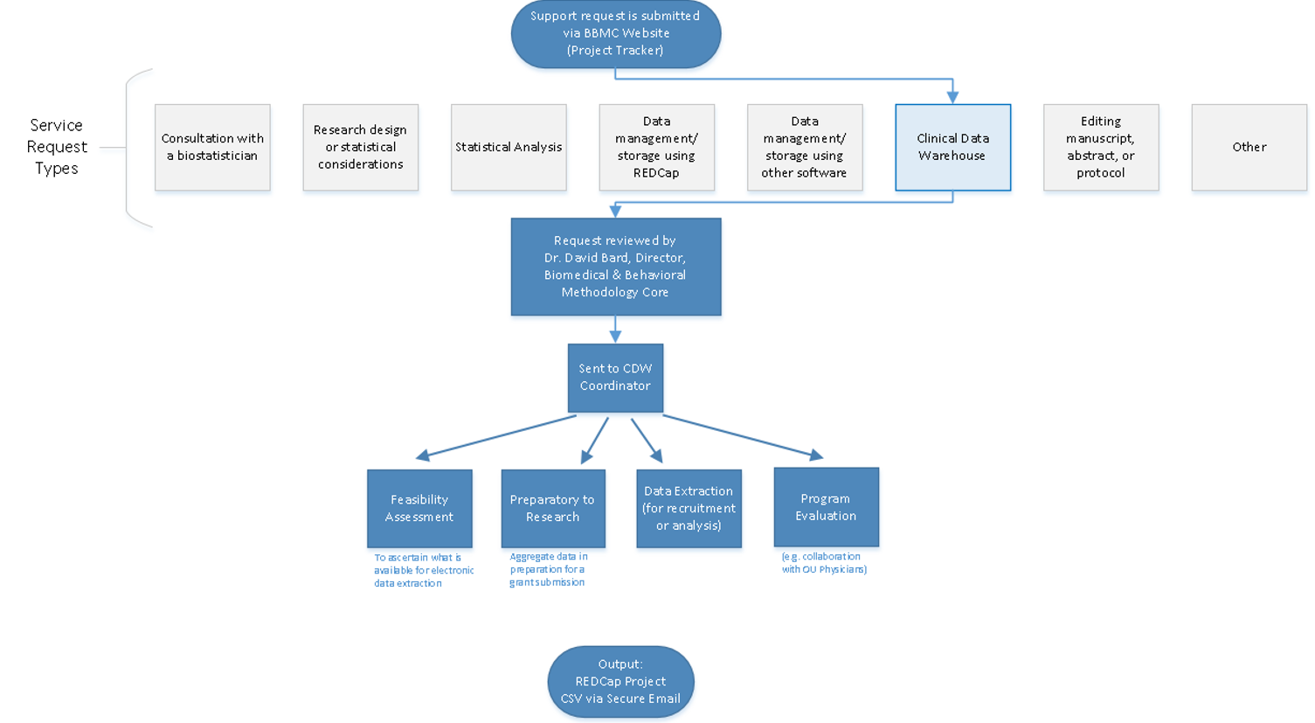
Commonly Requested CDW Support Services
Feasibility assessment in preparation for research (20% of projects; 10% of CDW staff time)
Static eligibility (70% of projects; 20% of CDW staff time)
Virtually all projects require identification of a patient pool
Rolling eligibility (30% of projects; 30% of CDW staff time)
Remember study team’s assessment of eligibility as well as the participant’s response
Daily automation requires stability & good logging; e.g., a 3 hour delay might mean zero subjects are enrolled
Clinical outcomes for retrospective investigations (50% of projects; 30% of CDW staff time)
Administrative outcomes for quality improvement (10% of projects; 2% of CDW staff time)
Program evaluation (20% of projects; 8% of CDW staff time)
Notes:
Here are the services we provide. This roughly reflects the needs of the campus, but it’s not one-to-one. For example, I’m sure there are still a lot of manual chart reviews to create eligibility lists. Also, there are several groups on campus, like BERD, that are great at analyzing the outcomes once the datasets is delivered in a suitable format.
As PIs decide how big of a bite to take, some come to us to get a feel for the counts of patients meeting the conditions of interest. These tasks typically not too heavy, so we can complete most within a day.
One-time eligibility is requested a lot, partly because we’ve built a little reputation around it. And virtually all projects need that patient pool defined. To create this pool our code doesn’t change much between active studies and retrospective studies. We’ve designed our pipeline to reuse a lot.
If it’s not a one-time enrollment, it’s typically then an ongoing recruitment. That takes more time because a lot of factors need to be incorporated to keep it efficient for humans to process. And even if it took zero seconds to develop, that daily automation inevitably requires some maintenance as those eligibility lists are deployed every morning. Although most mornings, the automation is smooth and it’s a simple check for a human to review everything passed.
Clinical outcomes is what I thought would soak up the majority of our time, but that’s been fairly manageable so far.
And occasionally we get administrative and program eval tasks that fit inside a larger research project.

Slide 7
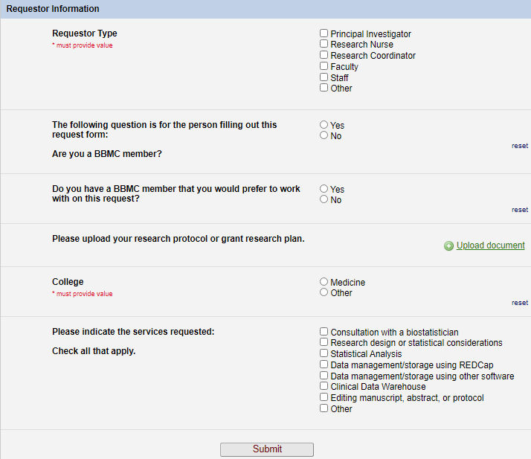
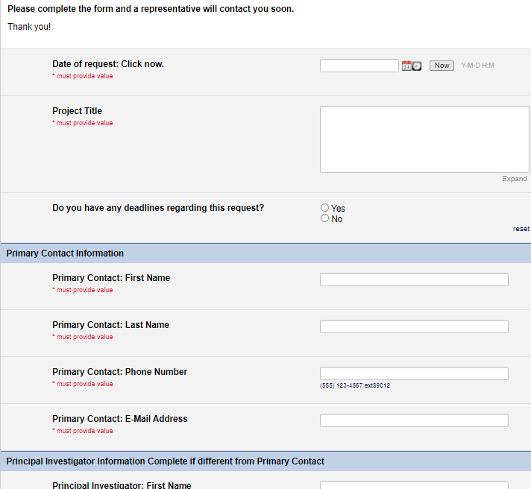
Starting a CDW Project
Submit a request at https://ouhsc.edu/bbmc/, then click “Request Support”
This helps us prep for the initial meeting w/ you
This box routes it to the CDW team

Slide 8
Rule of Thumb for Involving CDW Team
A one-time Meditech extract: contact OU Medicine directly or we’re happy to help structure the request Meditech request: https://ouhealth.service-now.com/sp?id=sc_cat_item&sys_id=79c250c74f652300ed7229dd0210c7d9
Recurring Meditech extracts for rolling recruitment: please contact the BBMC about the CDW (https://ouhsc.edu/bbmc/)
Research involving merged Centricity & Meditech: please contact the BBMC about the CDW (https://ouhsc.edu/bbmc/)
Research involving (a) data collection outside the EMRs or (b) supplementing chart review: please contact the BBMC about REDCap (https://ouhsc.edu/bbmc/)
Terms
Centricity EMR: clinical info for outpatients since ~2010
Centricity Business: scheduling & billing info for outpatient since ~2010
Meditech: EMR for ED & inpatients since the bronze age
Epic: Upcoming EMR that will replace Centricity, Meditech, and many others. May not be useful for your research (at least in time to start your fellowship research project)
REDCap: campus-recommended software for collecting PHI outside the EMRs (https://www.project-redcap.org/)

