Slide 2
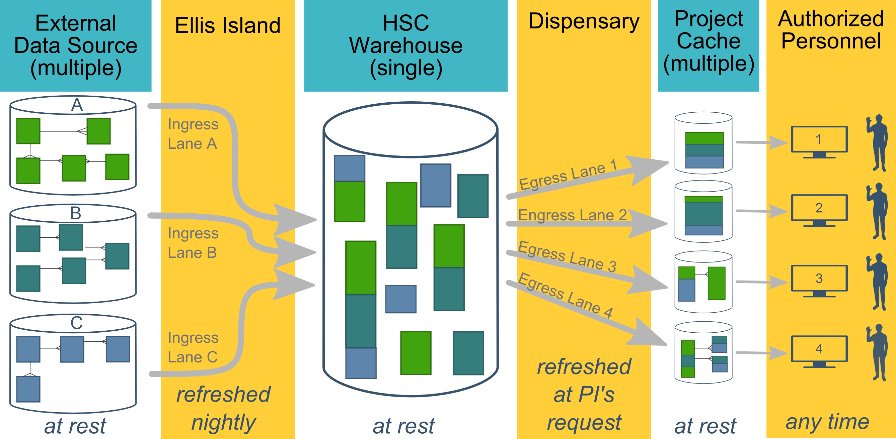
Ecosystem Architecture
Data Source (column 1): contains unique info
Warehouse (column 3): contains copy after manipulation
Project Cache (column 5): contains copy of copy after a lot of manipulation
Notes:
The entire ecosystem can be represented by these six columns. The EMR and other collection databases sit in the 1st column and feed the warehouse in the third. This movement is automated. Inside the warehouse, the info from the different sources are combined. Different patients can be placed in the same table. Perhaps more importantly, records for a single patient that are scattered across different sources are linked.
When a investigation is approved by the IRB, we can develop a tiny database in REDCap that contains the dataset needed for their analysis (5th column). There are a few reasons why REDCap is preferred. First, it’s more secure and scalable than distributing loose Excel files. Second, REDCap has a lot of momentum and adoption, so it’s become familiar to a lot of people on campus. The same software system the clinical researcher learned (for example) for randomized trials is leverage here for these observational studies. Although the research/QA methodology is very different, the software is the same. We expect this familiarity to grow on campus, especially as systems like Qualtrics become less available.

Slide 3

HSC DATA TYPES
Patient Data
Inpatient/Meditech
Outpatient/Centricity
Dozens of departmental sources
Billing and Claims Data
Biomedical Research Data
Employee Data
Administrative Cost Data
Student Data
Notes:
Growing data enterprise
Data integration is an important subject for our clinical operations and our research enterprise as we continue to evolve our methods for integrating data across our two largest data streams: clinic EMR and hospital EMR.
Two notable informatics tools have been developed to tackle this challenge: A CDW for quality improvement evaluations and research and through a partnership with the non-profit org MyHealth and OU’s Dept of Med Informatics in Tulsa, an HIE to facilitate point of care, data informed decision-making not only at OU but across the entire state.

Slide 4
HSC DATA ENTERPRISE
Prairie Outpost Clinical Data Warehouse (contact: Ashley Thumann)
Integrates patient data from dozens of sources which include Centricity and MediTech
REDCap (contact: Thomas Wilson, Pravina Kota)
Management tool that can be used for Big & Small data
Outpatient EMR: GE Centricity (contact: Matthew Atkins)
Inpatient EMR: MEDITECH (contact: Allen Smith)
MyHealth Access Network, Health Information Exchange System (contact: David Kendrick)
Integrates data from 4,000+ providers and 3+ million patients from all other the state of Oklahoma
Biospecimen repository (contact: OSCTR)
OK-INBRE Bioinformatics (contact: Dave Dyer)
Laboratory for Molecular Biology and Cytometry Research (contact: Allison Gillaspy)
IT Data Services (contacts: Jeff Wall, Melissa Nestor)
Notes:
Clinic + Hospital data: Clinic records from 2007 to present covering 1.3+ million unique clinic patients
Hospital records from 1995 to present approaching 1 million unique patients
Combined clinical and hospital visits of 41+ million
Growing data enterprise
Data integration is an important subject for our clinical operations and our research enterprise as we continue to evolve our methods for integrating data across our two largest data streams: clinic EMR and hospital EMR.
Two notable informatics tools have been developed to tackle this challenge: A CDW for quality improvement evaluations and research and through a partnership with the non-profit org MyHealth and OU’s Dept of Med Informatics in Tulsa, an HIE to facilitate point of care, data informed decision-making not only at OU but across the entire state.
Nestor’s group does the following:
Getting access to Tools
Helping with Power BI
Introducing User Groups
Assisting in the Creation of Reports, Dashboards, and Visualizations

Slide 5
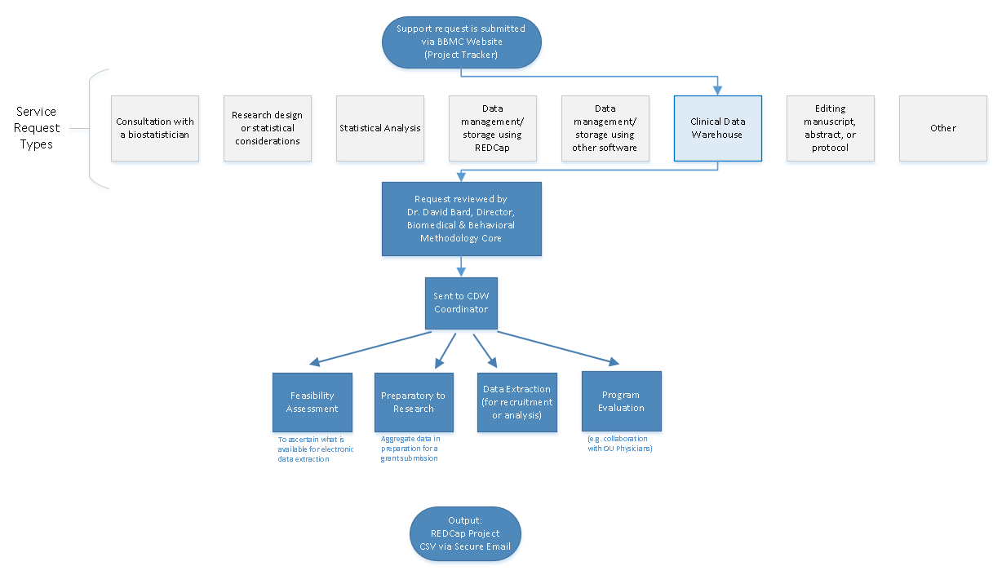

Slide 6
IRB Guidance
Requests that are preparatory to research must be submitted to the IRB/University Privacy Board for review and approval.
Program Evaluation, CQI, & Feasibility Assessments:
If PHI is NOT included, it is generally not considered human subjects research.
A determination of human subjects research (DHSR) may be submitted to the IRB.
Aggregate data* may be provided without an IRB submission.
The following activities are NOT human subjects research:
Classroom evaluation activities when assessment involves regular classroom activities and the results of the evaluation process are intended to be used for the sole purpose of enhancing teaching practices of the instructor
Quality improvement activities designed to enhance functionality of a department or campus program provided that results are not intended to be shared outside of the University
Program evaluations
Public health practice surveillance activities

Slide 7
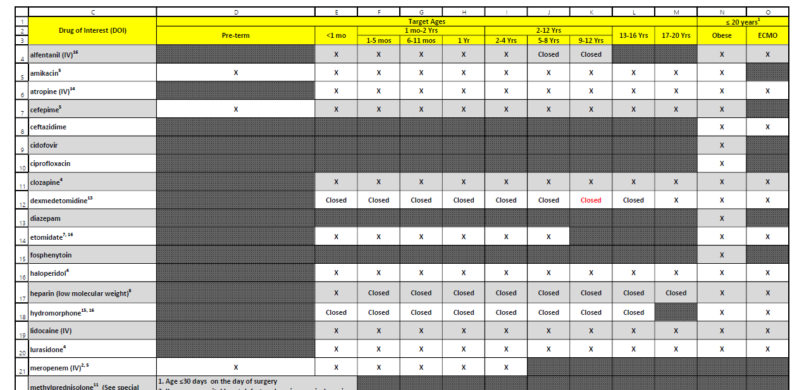
POPS: Pharmacokinetics of Understudied Drugs Administered to Children per Standard of Care
Primary Aim: Evaluate the PK of understudied drugs currently being administered to children
This study is part of the Oklahoma Pediatric Clinical Trial Network (OPCTN), which is a site for the NIH-funded ECHO IDeA States Pediatric Clinical Trials Network (ISPCTN).
Enrollment Criteria: Child must be receiving an understudied drug of interest (DOIs) per standard of care as prescribed by their treating caregiver, and meet an age range or condition (pre-term, obese, or on ECMO) open for enrollment.

Slide 8
Resource Efficiency: fewer patients, quicker review, less redundancy
2019-01-12 Inpatient Extract
Finds patients who received a drug of interest
109 unique patients
Record review: ~15 min/pt
~1,635 minutes
2019-01-13 Inpatient Extract
112 unique patients @15 min/pt (forgets yesterday)
2019-01-12 Inpatient Screening Report
Finds patients who received a drug of interest and meet an age range or condition currently open for enrollment
31 unique patients
Record review: ~5 min/pt
~155 minutes
2019-01-13 Inpatient Screening Report
6 new patients @5 min/pt (remembers yesterday)

Slide 9
Benefits of 20x Efficiency
Better efficiency allows us to spin and cover a larger web. (We should probably transition to the term “filter”.)
Instead of focusing on a subset of dx & location, our report covers the entire space.
We try to aggressively
Cover the entire space
Prune known ineligible cases (ie, Cut from 113 to 31 to 6 unique inpatients)

Slide 10
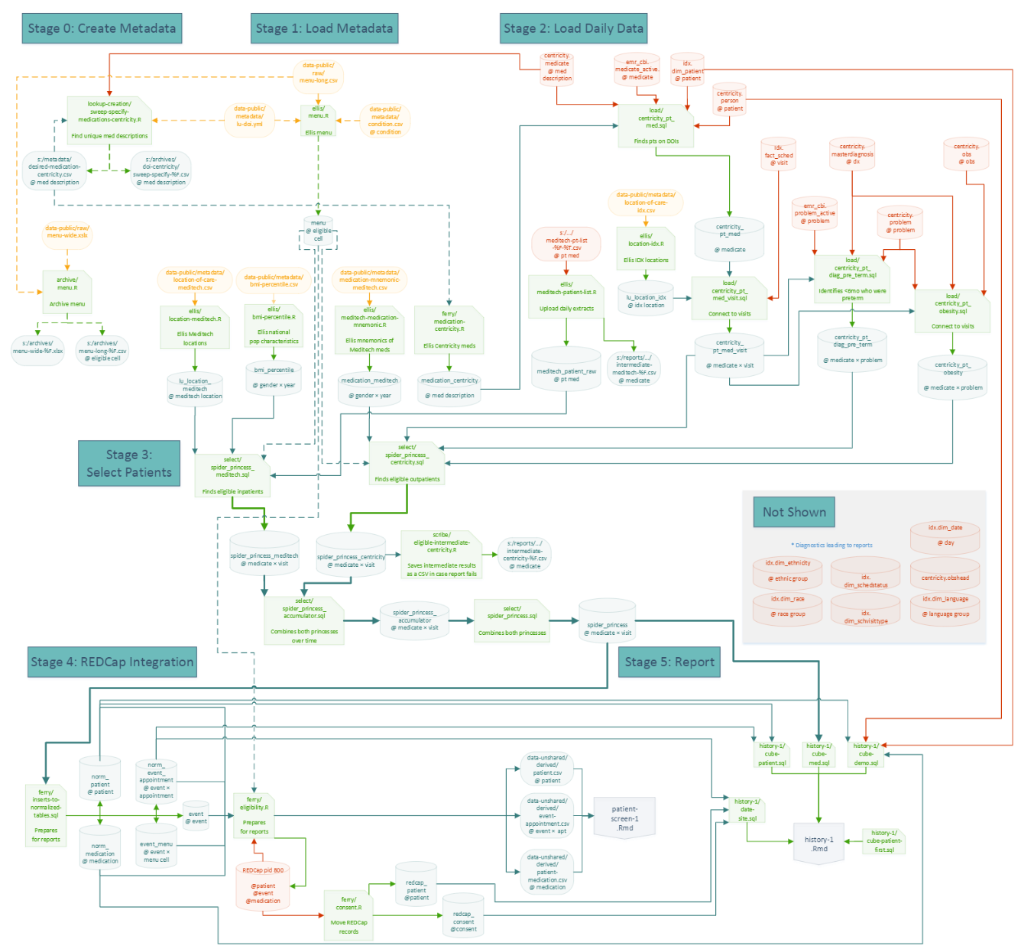

Slide 11
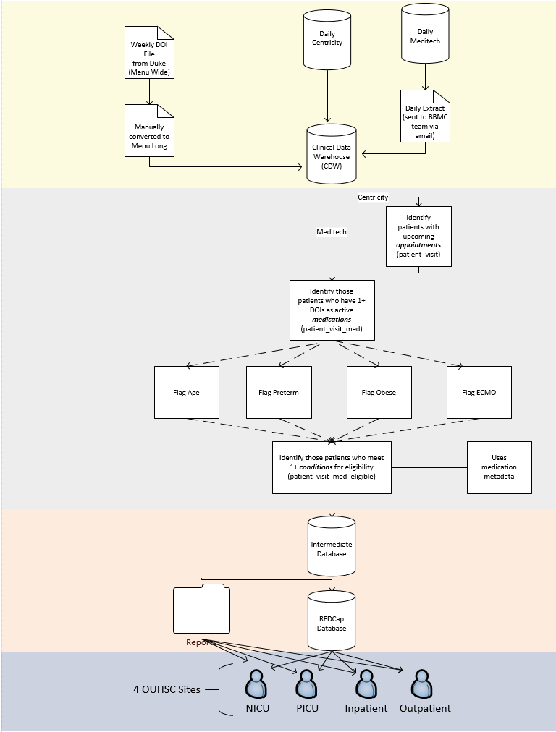

Slide 12
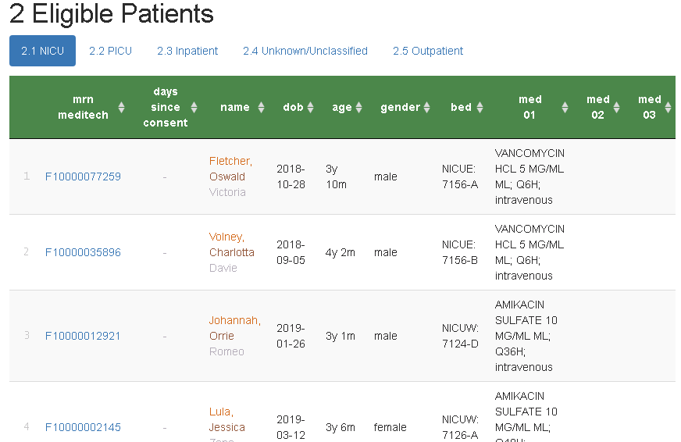
Screening Report (for inpatients)
Hyperlinks to REDCap
Consent stop watch
Filter, search, & sort
(← Fake patients)

Slide 13
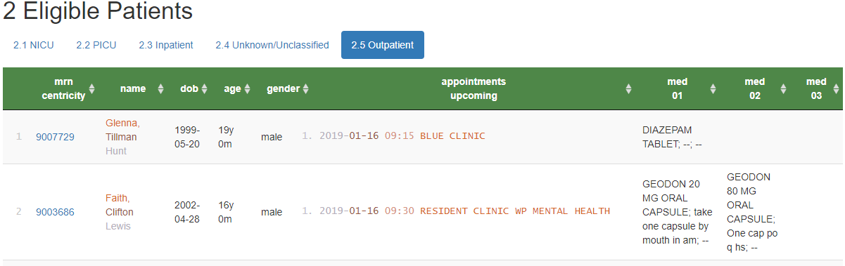
Screening Reports (for outpatients)
Shows upcoming appointments of potentially eligible patients
Location of care
Appt Date & time
Qualifying medication (e.g., Diazepam)
Qualifying condition (e.g., obese, 24 months old)
Similar inpatient process was developed
Eligible Patients for POPS

Slide 14
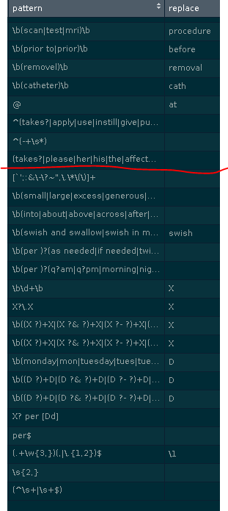
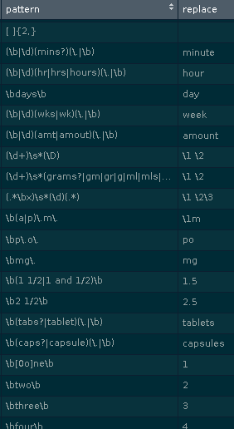
Collapsing/Standardizing Med Instructions
Use regular expressions to match free-text, and replaces with a ‘better’ value.
Correct misspellings
Remove junk
Standardize format (eg, space between `5mg`)
Standardize term (eg, `cap`, `caps`, &`capsule` to capsules`)
Remove info irrelevant to eligibility below the red line (eg, `1mg` and `2mg` becomes `X mg`)
Reduces 130k entries to 46k

Slide 15
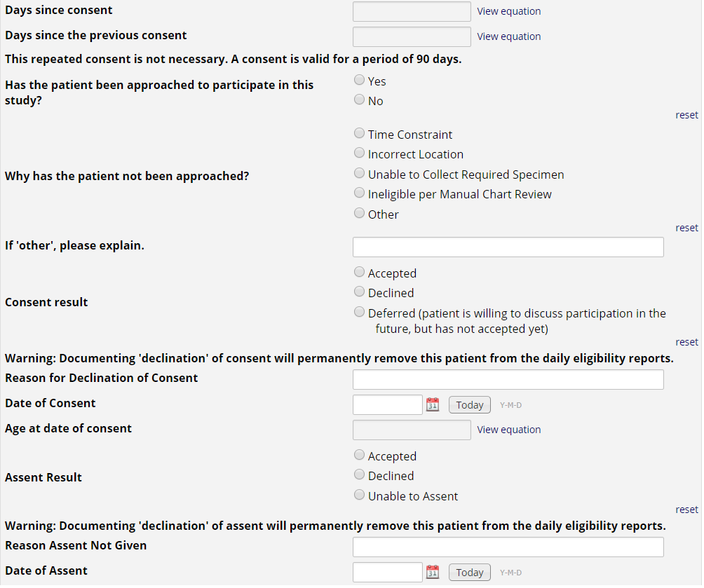
REDCap Project
Research nurses use the MRN hyperlink on the eligibility report to document approached/consent/assent in REDCap.
If a patient or guardians ‘declines’ consent or assent, the patient is removed from future eligibility reports.
This also allows us to create summary stats for the investigators to monitor progress, address issues with resource allocation, etc.

Slide 16
VDORA: Vitamin D Supplementation in Children With Obesity-Related Asthma
Objective: To determine the pharmacokinetics of Vitamin D supplementation in children who have asthma and are overweight or obese.
This study is part of the Oklahoma Pediatric Clinical Trial Network (OPCTN), which is a site for the NIH-funded ECHO IDeA States Pediatric Clinical Trials Network (ISPCTN).
Enrollment Criteria: Child must be between the ages of 6 and 17, have a diagnosis of asthma, documentation of obesity, and meet additional inclusion criteria such as ‘an ability to swallow pills’.

Slide 17
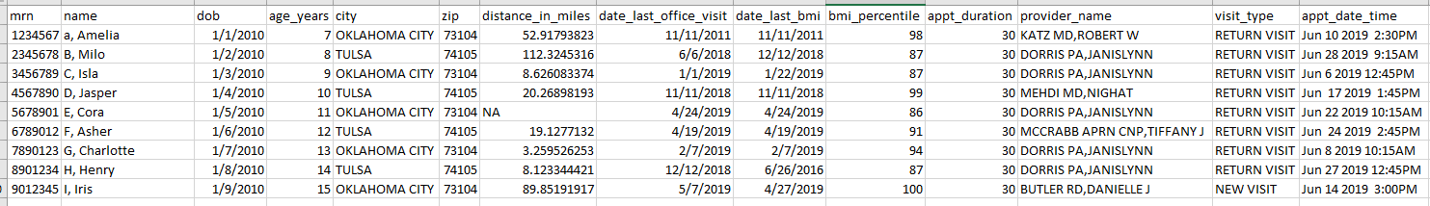
appt.csv
(Fake patients)

Slide 18
Resource Efficiency: fewer patients, quicker review, less redundancy
Manual Screening Process
Obtain a list of appointments scheduled the following week
Review each medical record using the inclusion/exclusion checklist:
Other criteria
Age
Diagnosis of asthma
Documentation of obesity
Email providers for review/input
Volume: 130 charts
Time: 240 minutes
Automated Screening Process
Review select medical records for:
Other criteria
Email providers for review/input
Volume: 24 charts (screened out 106)
Time: 45 minutes

Slide 19
PROSpect: PRone and OScillation PEdiatric Clinical Trial
Two-by-two factorial, response-adaptive multi-center randomized clinical trial.
Primary Aim: To provide evidence to support best ventilation practices in critically ill children with severe PARDS defined per PALICC guidelines.
Enrollment Criteria: Pediatric patients >= 2 weeks of age and <18 years of age, intubated and mechanically ventilated, with severe PARDS for <48 hours per PALICC guidelines.
henry-intubate-1

Slide 20
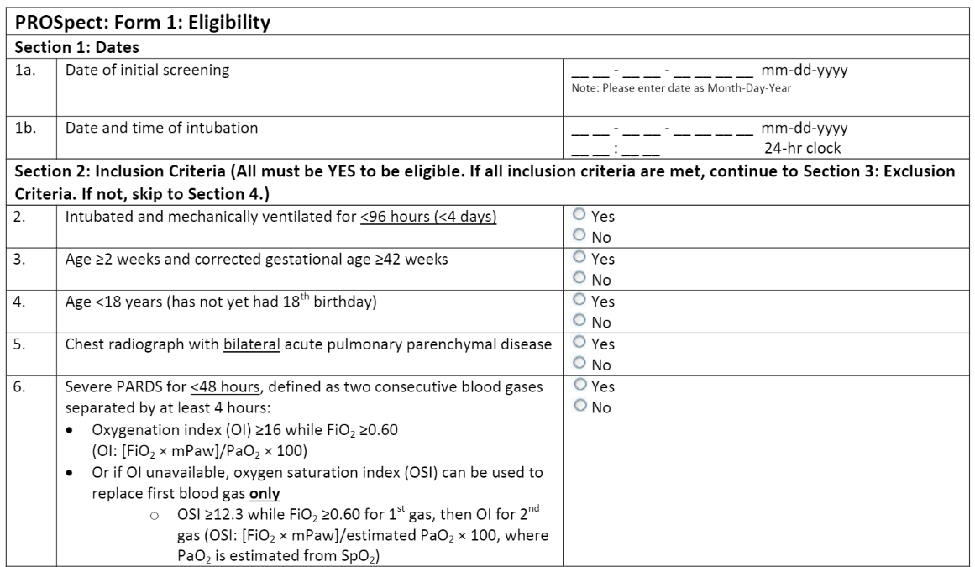
PROSpect: PRone and OScillation PEdiatric Clinical Trial
Exclusion criteria: previous enrollment in PROSpect, perinatal related lung disease, congenital diaphragmatic hernia or congenital/acquired diaphragm paralysis, respiratory failure explained by cardiac failure or fluid overload, cyanotic heart disease, cardiomyopathy, primary pulmonary hypertension, intubated for status asthmaticus, obstructive airway disease, active air leak, bronchiolitis obliterans, post hematopoietic stem cell transplant, post lung transplant, home ventilator or home oxygen dependent…

Slide 21
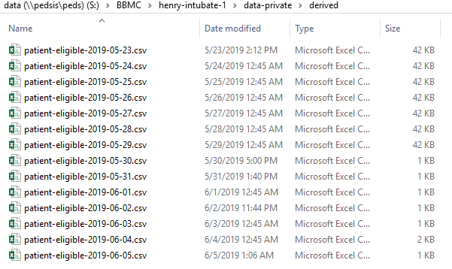
PROSpect: PRone and OScillation PEdiatric Clinical Trial

Slide 22
A Nationally Representative Drug Utilization Study of OxyContin in Children Age 17 Years and Younger
Multicenter retrospective, observational cohort study
Primary Aim: Conduct a nationally representative drug utilization study of sufficient detail to characterize OxyContin use in children.
Enrollment Criteria: Age < 18 years at the time of OxyContin prescription and prescribed at least one dose of OxyContin as an inpatient or outpatient between 01/01/2011 and 12/31/2017.

Slide 23
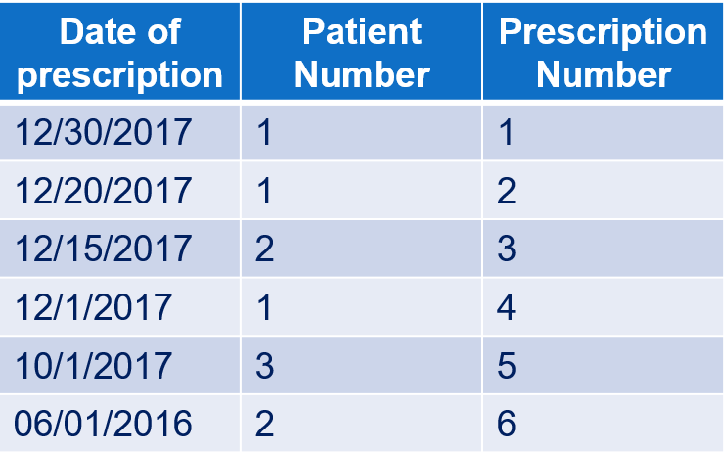
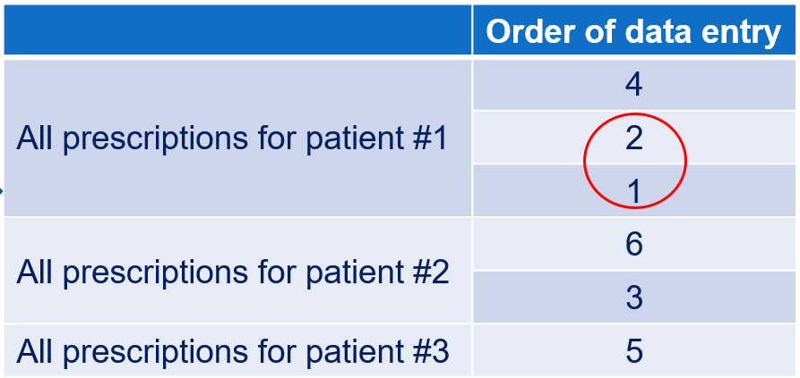
A Nationally Representative Drug Utilization Study of OxyContin in Children Age 17 Years and Younger
Inpatient EMR – Meditech
Outpatient EMR – Centricity
Data Manipulation was required to aid the study team in determining the order of participant and prescription data entry based on the following criteria:
Identify the most recent OxyContin prescription recorded for an inpatient or an outpatient, then
Identify the patient who received this prescription
Enter ALL OxyContin prescriptions the patient received in the study period
Proceed to the next most recent OxyContin prescription received by a different patient and repeat the process.

Slide 24
A Nationally Representative Drug Utilization Study of OxyContin in Children Age 17 Years and Younger
Describe process w/o CDW

Slide 25
Mathematica: Assessing a Clinical Quality Measure for ADHD of Symptom Change in Order to Detect Symptom Reduction and to Examine Differences Across Clinics
To assist ONC with the continued development, electronic specification, testing and maintenance of the electronic clinical quality measure (eCQM)
As a test site, OUHSC provided input and patient-level data to assess the scientific acceptability (reliability and validity), importance (performance gap), feasibility, and usability of a clinical quality-of-care measure, which may be used in federal quality measurement programs.
Enrollment Criteria: Pediatric patients 4 - 18 years of age, with a visit during the measurement period, who have an active diagnosis of ADHD, and have documentation of the mean inattentive and/or hyperactive subtype scores for their baseline screening.
henry-intubate-1

Slide 26
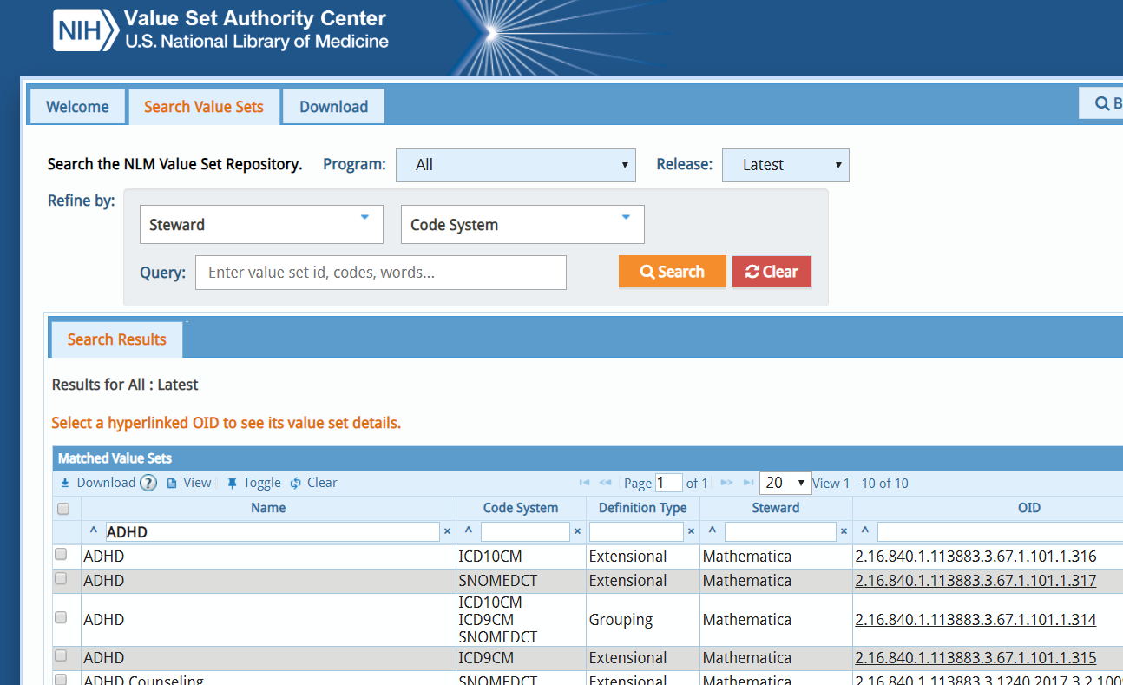
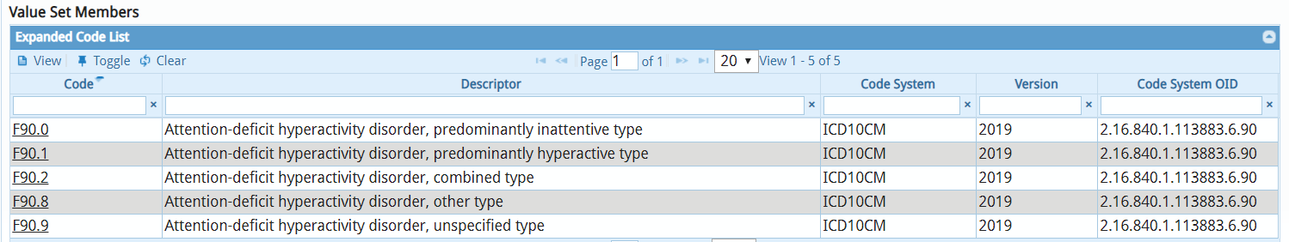
Mathematica
This project required the application of value sets, defined as lists of codes and corresponding terms, from NLM-hosted standard clinical vocabularies (SNOMED, RxNorm, LOINC, and others) that define clinical concepts to support interoperable health information exchange.

Slide 27
Long-term Clinical Outcomes of Pharmacist-led Care in Type 2 Diabetes Mellitus
This was a multi-center, retrospective cohort study.
Primary Aim: To determine the long-term clinical outcomes of pharmacist-led care in comparison to non-pharmacist led care in type 2 diabetes.
Change in HgbA1c from start date up to 5 years of follow-up
Time to patient-specific HgbA1c goal
Duration of HgbA1c at or below patient-specific goal from initial attainment of goal until loss of goal
Percentage of time at which HgbA1c is at or below patient-specific goal
Yearly completion of select components of the comprehensive diabetes medical evaluation
Enrollment Criteria: Patients ages 18 years or greater, presenting for an initial appointment related to the management of Type II DM between January 1, 2008 and December 31, 2011. Included patients will be followed for a 5-year period. Patients are excluded if pregnant, if continuous care is not maintained for a period of 9 months, or if initial HgbA1c <= 7.0%.
henry-intubate-1

Slide 28
Long-term Clinical Outcomes of Pharmacist-led Care in Type 2 Diabetes Mellitus
For each cohort, the following datasets were provided:
A list of included patients and relevant demographics
The 5-year study period was defined for each included patient, where the start date was determined by the patient’s initial presentation for management of Type II DM.
A comprehensive appointment history
Active diagnoses
Active medications
Clinical outcomes to include HbgA1c, blood pressure, diabetic eye and foot exams, influenza and pneumococcal vaccines, lipid profile, and nephropathy

Slide 29
An assessment of a newly initiated transitions of care clinic at an academic health center
Retrospective, observational study
Study Aims:
(1) all-cause hospital admissions 1 year pre- and post-transitions of care clinic intervention
(2) 30-day all-cause readmissions pre- and post-transitions of care clinic intervention
(3) all-cause emergency department (ED) utilization 1 year pre- and post-transitions of care clinic
intervention
(4) cost analysis of an existing transitions of care clinic
Enrollment criteria: All patients, ages 18 and older, who received care from the Transition of Care (ToC) Clinic between June 12, 2017 and January 12, 2018.
henry-intubate-1

Slide 30
An assessment of a newly initiated transitions of care clinic at an academic health center
Evaluate the frequency of hospital admission, 30-day readmission, and ED utilization 1 year prior to each patients’s initial ToC visit in comparison to the the same outcomes after the patient’s initial visit in the ToC service.
Demographic variables: inpatient and outpatient medical record number, patient name, account number, date of birth, gender, race, ethnicity, insurance, and zip code
Inpatient variables: date of admission, date of discharge, length of stay, discharge diagnoses (1-50), DRG, place of service, charges, payments
Outpatient variables:
Appointments: date and time, type, reason, provider, duration, status
Medications: medication name, generic name, start date, stop date
Diagnoses: ICD code, code description, start date, stop date
Invoices: invoice number, location of care, provider name, charge, payments, diagnoses, cpt codes
henry-intubate-1

Slide 31
Implementation of Post-Partum Depression Screening in a General Pediatric Clinic
CQI project with administrative outcome measures
Investigators requested recurring reports to:
monitor compliance with utilization of the PHQ-9 screener at select appointments
assess the prevalence of PPD in new mothers
Inclusion criteria: well child check appointments for children ages 1 day to 6 months of age.
Variables provided:
Medical record number
Date of service
Provider name
Screened performed (Y/N) & date
Declination of screen
Score
Severity
Summary
Resources Provided
Comments
Count of previous screens administered
Last screen date
henry-intubate-1

Slide 32
Clinical Trials & Other Research Studies Supported by the CDW
Short Name | PI | Department
Asthma Outcomes | M. Naifeh | Pediatrics
Pediatric Diabetic Ketoacidosis | M. Marin | Pediatrics
Anxiety & Depression Education | A. Bax | Pediatrics
Obesity in Foster Care | N. Torres-Garcia | Pediatrics
Posterior Cruciate Ligament Avulsions | S. Algan | Orthopedics
Avulsion Fractures (Tibia & Fibula) | S. Algan | Orthopedics
Avulsion Fractures (Femur) | S. Algan | Orthopedics
STI Screening | R. Leasure | Infectious Disease
Interstitial Cystits Pain | L. Quiroz | Women's Health
Pharmacist-Led Care | T. Truong | Pharmacy
POPS | C. Allen | Pediatrics
NAMCS | S. Gillaspy | Pediatrics
Preschool Behavior | A. Bax | Pediatrics
Psychology Consults | S. Gillaspy | Pediatrics
Chronic Hypertension in Pregnancy | R. Edwards | Women's Health
High Blood Pressure in Children | N. Connolley | Pediatrics
Sickle Cell Disease Transition Program | A. Sinha | Pediatrics
Brain Tumors | J. Battiste | Cancer Center
Pelvic Floor Disorders | L. Quiroz | Women's Health
Cancer Patient Navigation Program | J. Vidrine | Cancer Center
Medical Homes for Youth in Foster Care | S. Gillaspy | Pediatrics
Short Name | PI | Department
Subtalar Arthrodesis | A. Haleem | Orthopedics
Pulmonary Hypertension | H. Bhardwaj | Cardiovasular
Pelvis & Acetabulum Fractures | D. Teague | Orthopedics
Spica Casting | W. Puffinbarger | Orthopedics
Fragile X Syndrome | L. Ethridge | Pediatrics
Splinting with Side Struts | T. Lewis | Orthopedics
Humeral Fractures | D. Chong | Orthopedics
Child Trauma Services | E. Risch | Pediatrics
Humeral Fractures | D. Teague | Orthopedics
Ashtma Population Management | D. Hahn | Pediatrics
Tobacco Exposure in Pediatrics | S. Gillaspy | Pediatrics
Utility of Chest X-Rays for Asthma in the ED | A. Bogie | Pediatrics
OxyContin Study | D. Hahn | Pediatrics
Transition of Care Clinic | T. Truong | Pharmacy
Lipid Screening | S. Gillaspy | Pediatrics
Sickle Cell Port Placement | A. Sinha | Pediatrics
Tranexamic Acid in Ankle Replacement | A. Haleem | Orthopedics
Newborn Metabolic Screenings | J. Lees | Pediatrics
Scapula Fractures | C. Pasque | Orthopedics
Adrenal Insufficiency | J. Lim | Endocrinology
Brain Metastases with Ovarian Cancer | J. Gillen | Cancer Center
Sever's Disease | S. Algan | Pediatrics

Slide 33
Commonly Requested CDW Support Services
Daily reports for rolling eligibility
Generating a list of candidates
Remembering study team’s assessment of eligibility as well as the participant’s response
Clinical outcomes for retrospective investigations
Administrative outcomes for CQI

Slide 34
Advantages of using CDW instead of manual chart review
Time efficiency in the long-run
With established in-house expertise, we could deliver a list within two weeks.

Slide 35
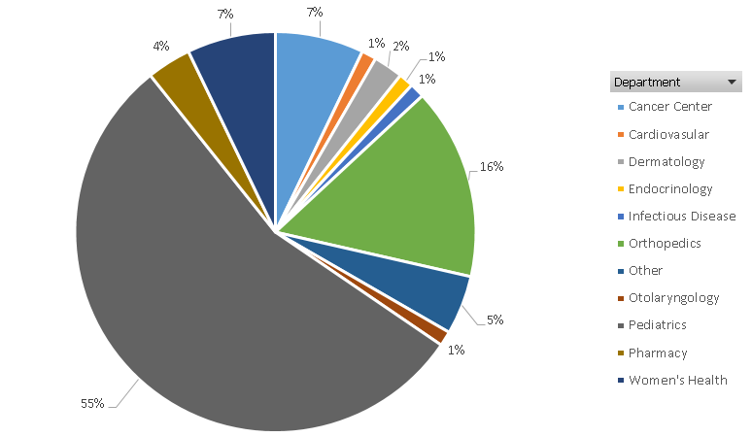
Since 2017, the CDW has facilitated more than 80 studies with 44 investigators.

