Slide 1







Leveraging the OUHSC Clinical Research Data Warehouse to Inform Research & Practice
Will Beasley, PhD
Ashley Thumann, MHA
Geneva Marshall, MS
Arnold Kanagwa, MS
David Bard, PhD
University of Oklahoma HSC
Biomedical & Behavioral Methodology Core (BBMC)
January 2024
Award Numbers: UG1OD024950 U54GM104938
Notes:
Hi I’m Will, and part of the Clinical Research Data Warehouse effort on campus. I started as a conventional statistician and researcher, and based on experience with integrating our investigations with state agency data , our group moved into the world of EMRs and warehouses.
I think these experiences have allowed our group to relate well with current PIs, as well as build a CRDW ecosystem that works well with research.

Slide 2
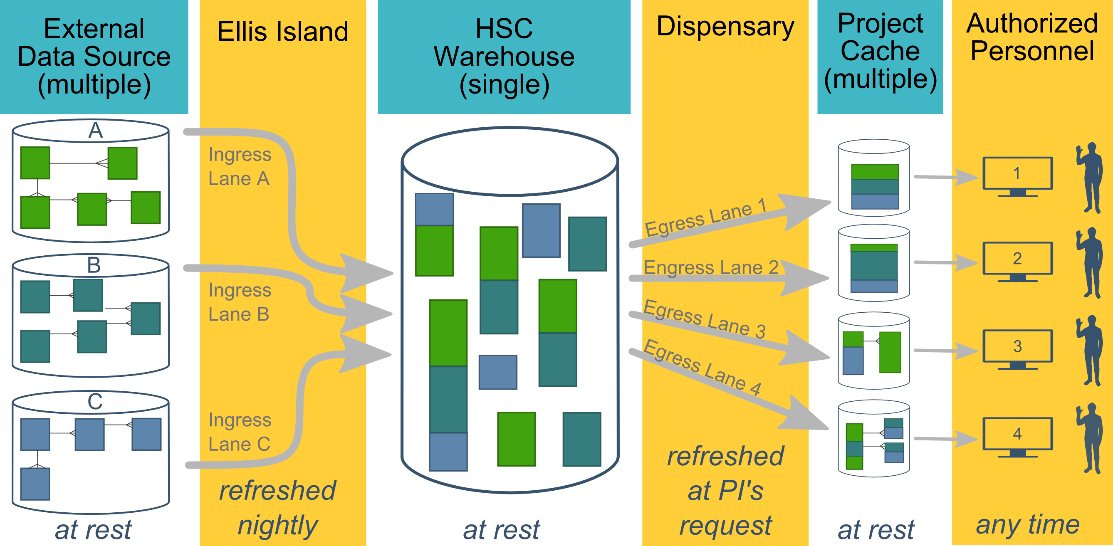
Ecosystem Architecture
CRDW (Clinical Research Data Warehouse)
Data Source (column 1): contains unique info
Warehouse (column 3): contains copy after manipulation
Project Cache (column 5): transformed to facilitate analyses of a specific research project
Notes:
The entire ecosystem can be represented by these six columns. The EMR and other collection databases sit in the 1st column and feed the warehouse in the third. This movement is automated. Inside the warehouse, the info from the different sources are staged & combined. Different patients can be placed in the same table. Perhaps more importantly, records for a single patient that are scattered across different sources are linked.
When an investigation is approved by the IRB, we can develop a tiny database in REDCap that contains the dataset needed for their analysis (5th column). There are a few reasons why REDCap is preferred. First, it’s more secure and scalable than distributing loose Excel files repeatedly for the same project. Second, REDCap has a lot of momentum and adoption, so it’s become familiar to a lot of people on campus --like those using it to collect research data.
We’ve always emphasized that we developed this to be as modular as possible. If someone could benefit from a few columns, they don’t have to commit to the whole thing. This modular approach has paid off, and I’ll return to that in the last few slides.

Slide 3
HSC Data Sources
Patient
Epic (we have the basics, and will be adding for a while)
Legacy Outpatient (Centricity)
Legacy Billing and Claims Data (GECB)
Legacy Inpatient (Meditech)
Dozens of departmental sources
Biomedical Research Data
Provider
External Agencies
Service Provided (by the Health Dept of Oklahoma)
Child Protective Services (Oklahoma Dept of Human Services)
Immunization (Health Dept of Oklahoma)
Vital Records (Health Dept of Oklahoma)
…
Multi-state collaborations (in the future)
Administrative Cost
Employee & Student
Notes:
Here are the data sources for the research projects that we’ve assisted with. Roughly in descending order of frequency.
Most of our projects involve inpatient EMRs, outpatient EMRs, and billing systems.
In some ways, our experience started with datasets from external collaborators, such as the Dept of Health, and grew from there.

Slide 4
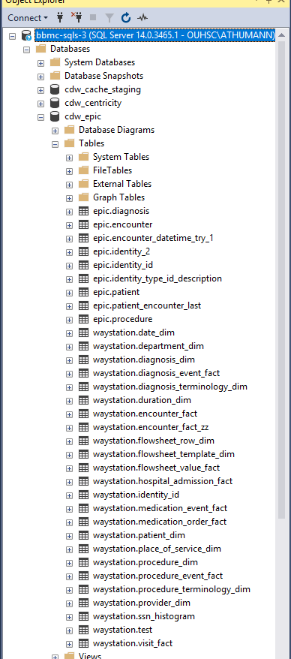
Integration of Epic
Current Tables – automatically updated nightly
Patient
Diagnosis
Encounter
Procedure
In Development
Medication
Medication OrderFlowsheet
Future
Labs
Orders
Immunizations
Notes:
Here are the data sources for the research projects that we’ve assisted with. Roughly in descending order of frequency.
Most of our projects involve inpatient EMRs, outpatient EMRs, and billing systems.
In some ways, our experience started with datasets from external collaborators, such as the Dept of Health, and grew from there.

Slide 5
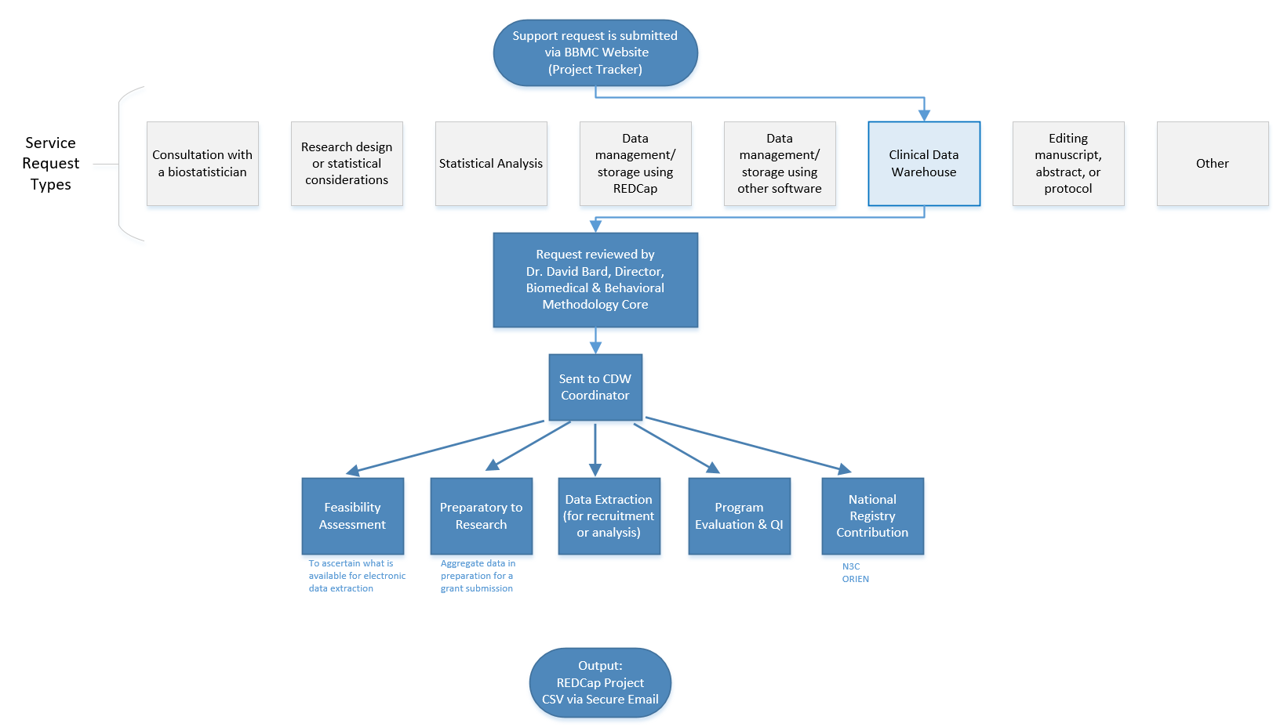
Typical Workflow for a
CRDW Research project
by the BBMC
Submit a request at:
ouhsc.edu/bbmc/
then ‘Request Support’
Notes:
Our group, the BBMC, is a core of ~6 faculty statisticians and another ~10 staff with skills in health administration, analysis, research, and data science.
When we receive a request involving the CRDW, it’s reviewed by a triage team and assigned to a mix of people. We assist with the project (ideally while the proposal is being written –not after it’s submitted). Some of the time we’re also the statisticians, and some of the time the PI has their own statistician or is collaborating with a group like BERD.
For a one-time retrospective research project, the output is usually a secured CSV. For a project requiring rolling enrollment, we deploy updates every morning with REDCap and dynamic html reports.
I have few friends managing the CRDWs of other universities. When we compare our situations, the biggest differences arise from the fact that our CDW was created by a group that’s primarily statisticians & researchers, as opposed to being created by an IT group that brings in outside statisticians. Pros & cons to each origin story. If you see differences between our approach and other institutions, this is a big reason.

Slide 6
Two Definitions of “QI” –depends on your audience
There are two campus groups who query Epic & the EMRs
OUHSC has the BBMC (ie, us)
OUH has the DnA group (“Data and Analytics”, also known as “Health Informatics”)
“QI with intent to publish or present”
Routes to the OUHSC group
Go to https://ouhsc.edu/bbmc/ and click “Request BBMC Services”
Applies to most of your resident research projects
Typically has an IRB approval or IRB exemption letter
“QI to improve an internal process (with no intent to publish)”
Routes to the OUH group
Go to https://ouhealth.service-now.com/ (with your OUH account)
<-- Kacey, what would you like here? -->
No IRB approval is required for internal QI
Human subjects aren’t involved; data will not be shared outside OU

Slide 7
Commonly Requested CRDW Support Services
Feasibility assessment in preparation for research (20% of projects; 10% of CRDW staff time)
Static eligibility (70% of projects; 20% of CRDW staff time)
Virtually all projects require identification of a patient pool
Rolling eligibility (30% of projects; 30% of CRDW staff time)
Remember study team’s assessment of eligibility as well as the participant’s response
Daily automation requires stability & good logging; e.g., a 3 hour delay might mean zero subjects are enrolled
Clinical outcomes for retrospective investigations (50% of projects; 30% of CRDW staff time)
Administrative outcomes for quality improvement (10% of projects; 2% of CRDW staff time)
Program evaluation (20% of projects; 8% of CRDW staff time)
Notes:
Here are the services we provide. This roughly reflects the needs of the campus, but it’s not one-to-one. For example, I’m sure there are still a lot of manual chart reviews to create eligibility lists. Also, there are several groups on campus, like BERD, that are great at analyzing the outcomes once the datasets is delivered in a suitable format.
As PIs decide how big of a bite to take, some come to us to get a feel for the counts of patients meeting the conditions of interest. These tasks typically not too heavy, so we can complete most within a day.
One-time eligibility is requested a lot, partly because we’ve built a little reputation around it. And virtually all projects need that patient pool defined. To create this pool our code doesn’t change much between active studies and retrospective studies. We’ve designed our pipeline to reuse a lot.
If it’s not a one-time enrollment, it’s typically then an ongoing recruitment. That takes more time because a lot of factors need to be incorporated to keep it efficient for humans to process. And even if it took zero seconds to develop, that daily automation inevitably requires some maintenance as those eligibility lists are deployed every morning. Although most mornings, the automation is smooth and it’s a simple check for a human to review everything passed.
Clinical outcomes is what I thought would soak up the majority of our time, but that’s been fairly manageable so far.
And occasionally we get administrative and program eval tasks that fit inside a larger research project.

Slide 8
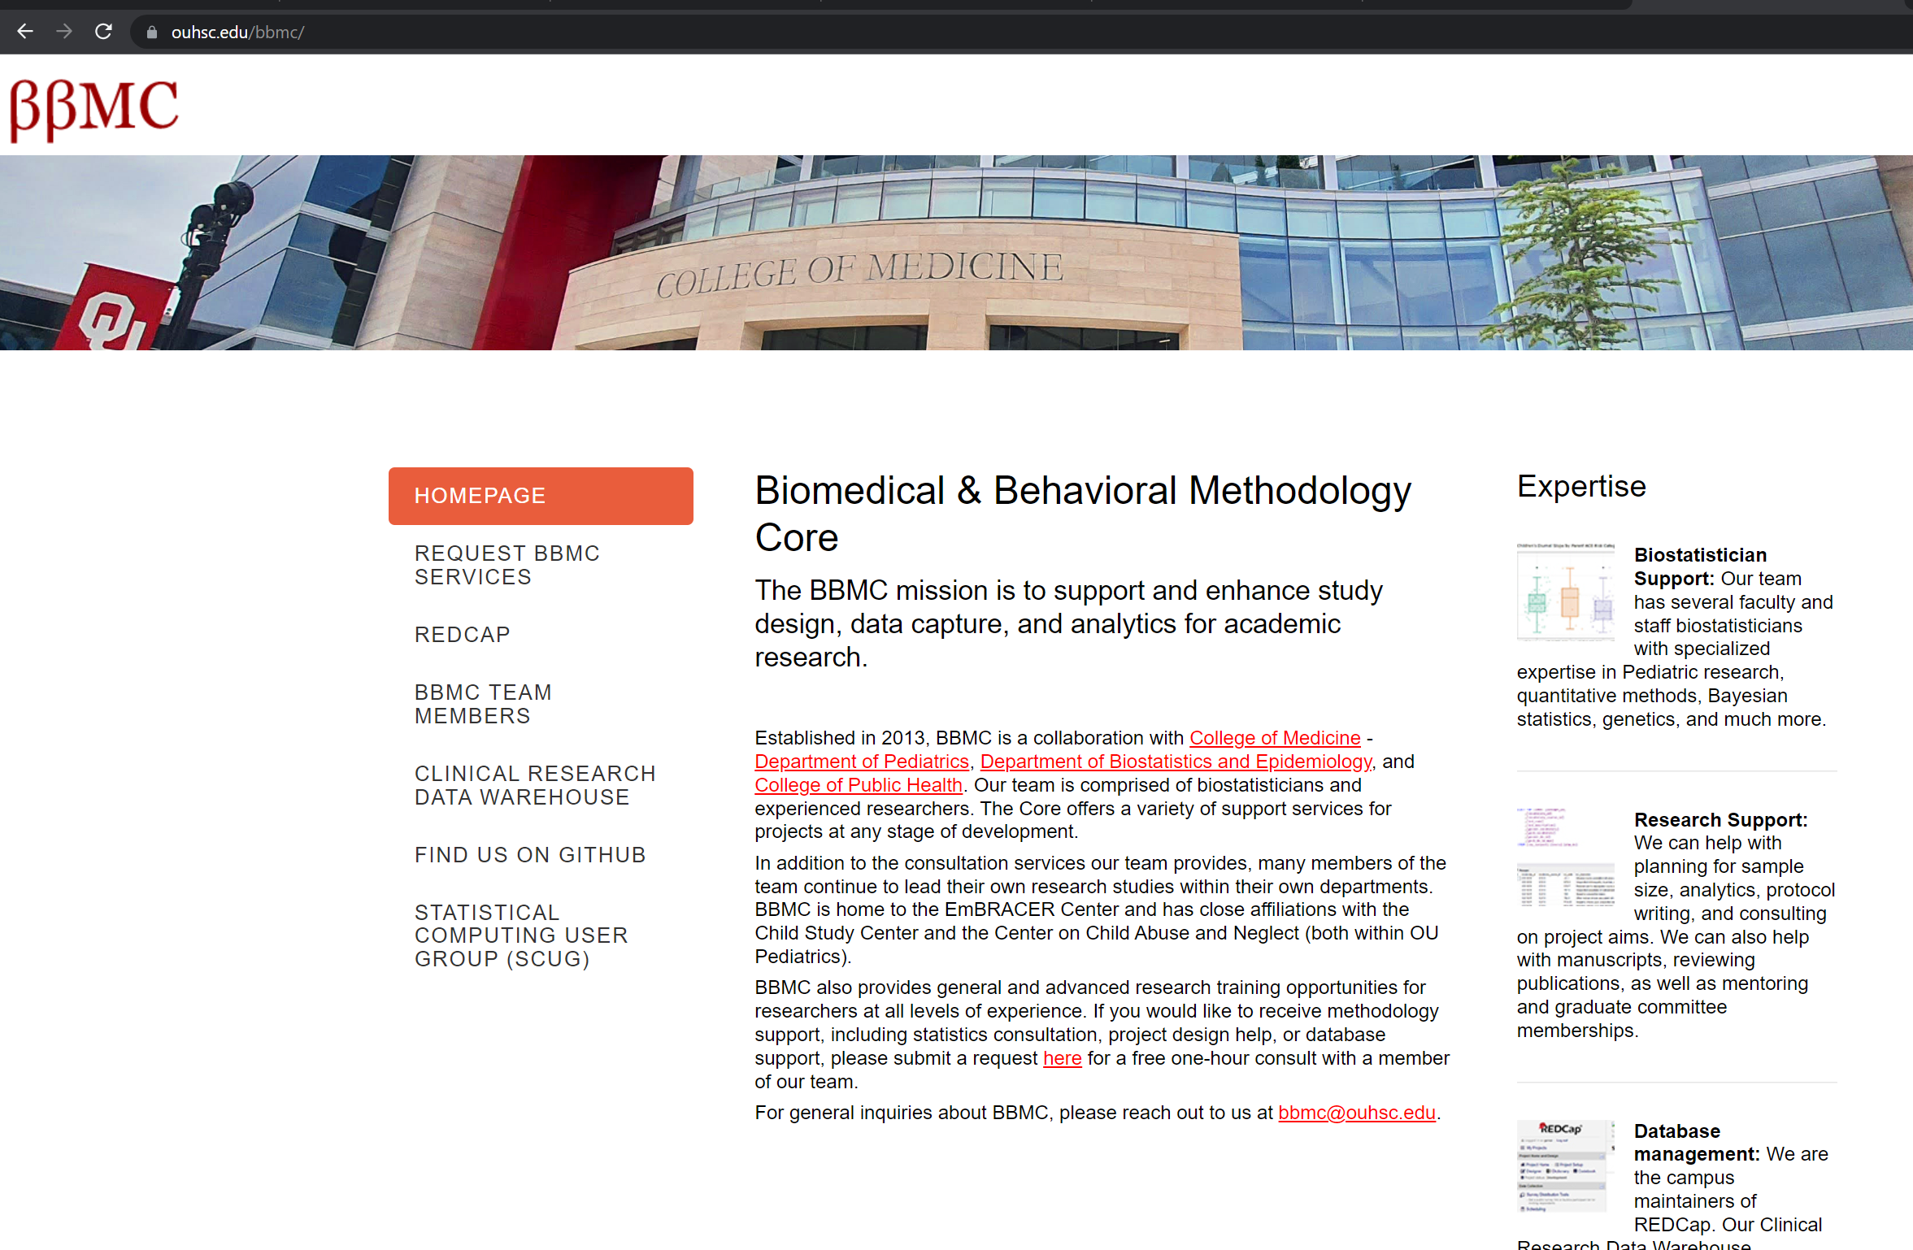
First go to: https://ouhsc.edu/bbmc/
Then click

Slide 9
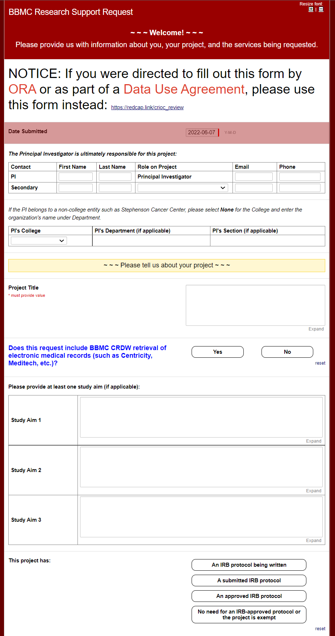
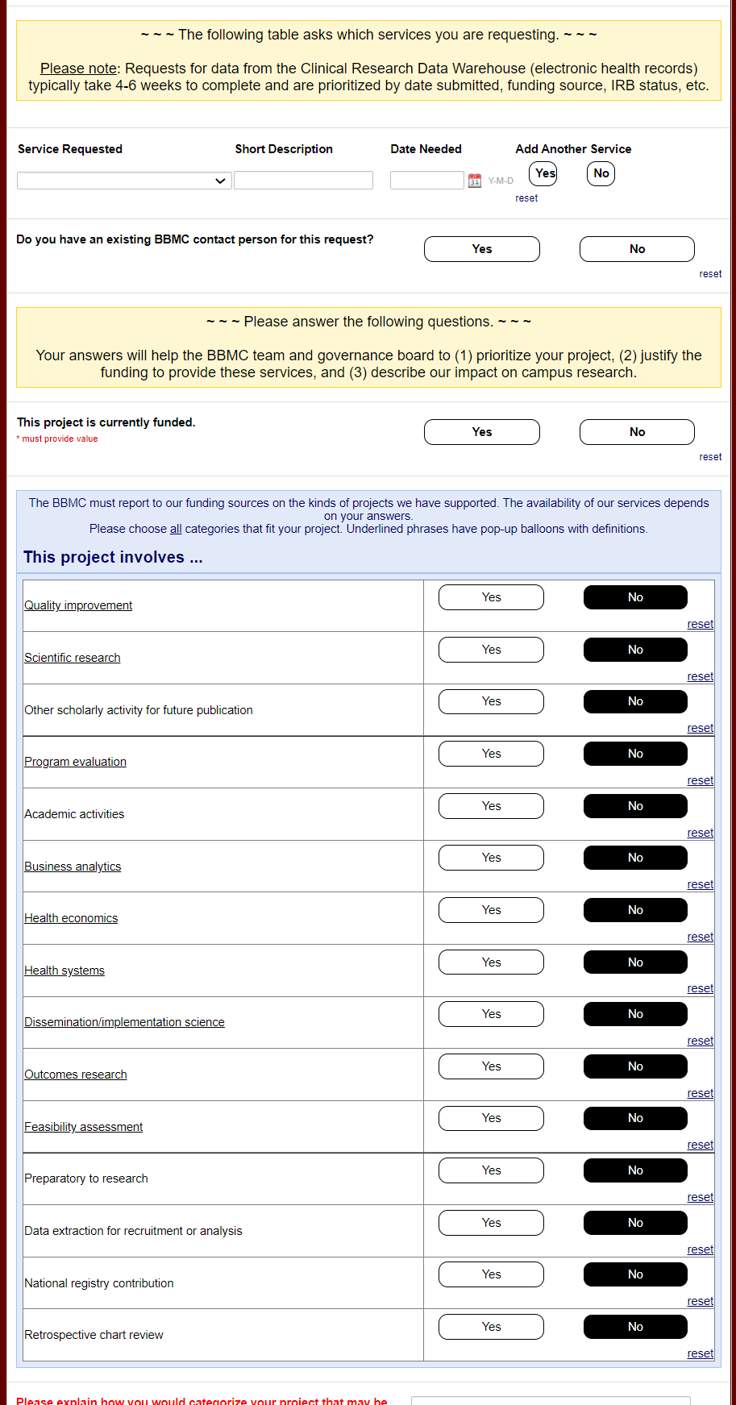
Then “CRDW”
Service
Reuqested
Then “Yes” to CRDW

Slide 10
Timeline for Requests
We strongly recommend that you submit your request to CRDW before the IRB.
We can help with the IRB language and avoid some of the common reasons the IRB rejects your initial application
We need 6+ weeks for basic requests. It doesn't take us 6 weeks, but we have a lot of people asking for data. Please don't initially approach us a week before your research month begins. There are a few cycles of communication between you and us (such as metadata files that specify the inclusion criteria meds and dxs).

Slide 11
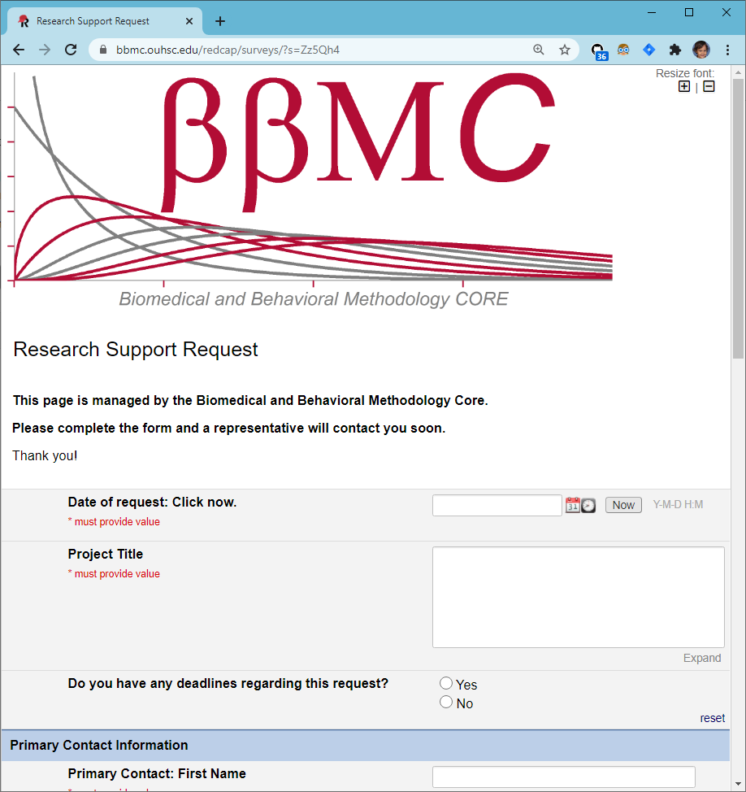
CRDW Typical Workflow
Intake via BBMC request form
Meet with investigator to determine data needs, feasibility
Back and forth with investigator
Develop Pipeline
Review with investigator and distribute via approved method
Structured vs. unstructured?
How well meet project needs with what’s available?
IRB considerations
Metadata files (such as identifying ICD codes, medications)
Verifying data formats
Automated daily data pulls
Varies vastly in complexity by project, data sources, etc.
CSV tables via SFT
Push to REDCap
Dashboards
Assign project to BBMC analyst based on skills, workload, & interests
Some projects may involve multiple analysts
Identifying locations and sources of data
SQL, R, & Python
Follows HIPAA & least privileges principles
BBMC Triage to services:
Feasibility
Program Evaluation
Recruitment
Retrospective Analysis
Facilitate Abstraction
Preparatory to Research
QI
Registry
Some may be very complex and/or rely on complicated code (e.g., Regular Expressions to extract structured data from unstructured notes, etc.). These requests can make completion take longer than usual.
Investigators are asked to add CRDW team to IRB application as KSP
CRDW team reviews & evaluates protocol to ensure data requested are authorized
Some have required modifications prior to release of data
This occasionally causes delays
Ideally, the IRB would implement a procedure to allow investigators to indicate utilization of CDRW upon initial approval without adding team as KSP (e.g., a check-box on the application indicating use of CDRW to extract data)

Slide 12
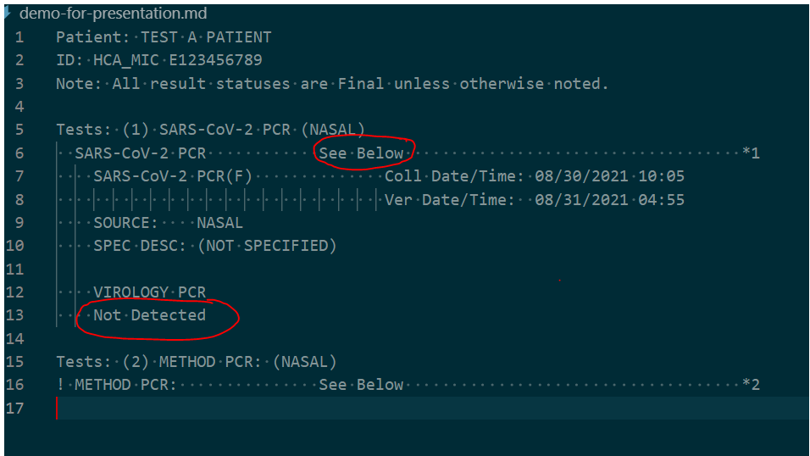
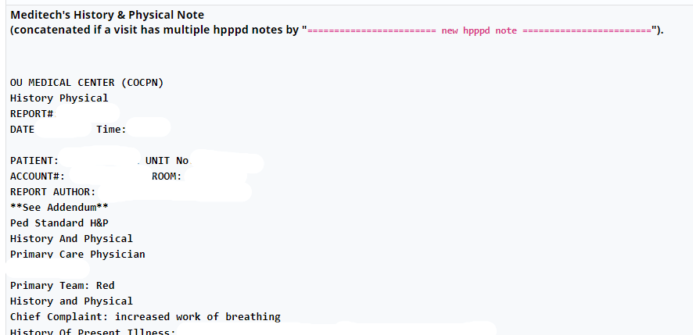
Data Formats
Structured (easier)
Unstructured (harder)
Patient demographics
Problem list or billed diagnoses (ICD-10)
Visits/encounters
Medications (GPI, RxNorm, NDC)
Most lab results (LOINC), but some are like this:
Diagnoses entered in the past medical history
Symptoms in HPI
Histories
Full notes
Some lab results
Radiology & pathology reports
Saved to the flowsheet
Has to be parsed out with regexes and programming (and funding)
Notes:
Data in the EMRs ranges from (1) nicely-structured tables where all the elements are neatly separated into their own columns to (2) free-text notes that are not consistent across records. For unfunded projects, elements that belong to a standard are the best. For instance, ICD codes are well-documented and consistently structured.
On the other hand, HPI is simply typed into a keyboard by some human that rarely enters it the same way twice. For unfunded projects, it’s typically best for us to extract the whole HPI paragraph, and you can manually review it and apply your clinical knowledge to determine the pieces relevant to your investigation.
For funded projects, we have some tools that can parse semi-structured reports (eg, pull the left ventricular ejection fraction from an echo report). In the future, we’ll have “EMERSE”, which is a medical informatics tools that helps extract structured info from free-text notes.

Slide 13
Encouraging Secure Data Practices
Our goal is to deliver the data extracts to researchers in a way that makes it easy for them to follow best practices.
Delivery of PHI, depending on the dataset and researcher
SFT for one-time transfers
HSC file servers for recurring transfers
REDCap for recruiting projects (users manually enter data as we refresh info daily)
Never email
Common mitigations include
Withholding PHI fields
Obfuscating PHI fields (e.g., birth year instead of birth date)
Pre-calculating fields to avoid PHI (e.g., we calculate the age at visit, instead of sending visit & birth dates)

Slide 14
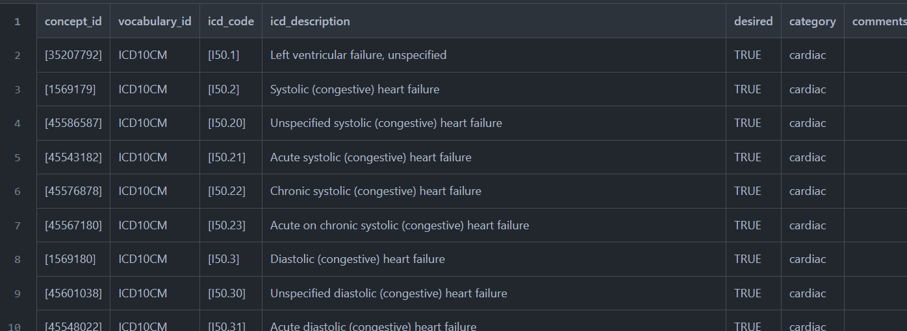
Using Metadata to Transfer your Clinical Knowledge into the Workflow
The CRDW team requests specific codes (eg, ICDs). The typical steps are
You send us some keywords (eg, “ventricular” and “heart”)
We sweep the code list and send you ~100 possibilities.
You specify the ~30 exact codes that reflect the inclusion criteria
Some projects also use a “category” variable (eg, “acute” vs “chronic” failure)

Slide 15
N3C: National COVID Cohort Collaborative
60+ US institutions from 20+ statues contribute EHR data in an OMOP model
Datasets are accessible only through a browser to NIH’s cluster
Spark, Python, R
Lots of governance steps, but not as many as you’d think
We believe this type of collaboration will be important in the future
We’re recruiting OU collaborators
particularly statisticians, data scientists, and clinicians
tell us if anyone has a research question, or want to join an existing project

Slide 16

Thank you
Will Beasley, PhD
Ashley Thumann, MHA
Geneva Marshall, MS
Arnold Kanagwa, MS
David Bard, PhD
University of Oklahoma HSC
Biomedical & Behavioral Methodology Core (BBMC)
Award Numbers: UG1OD024950 U54GM104938

Slide 17
Ecosystem Architecture
Prairie Outpost – CRDW (Clinical Research Data Warehouse)
https://github.com/OuhscBbmc/prairie-outpost-public
Data Source (column 1): contains unique info
Warehouse (column 3): contains copy after manipulation
Project Cache (column 5): transformed to facilitate analyses of a specific research project
Notes:
The entire ecosystem can be represented by these six columns. The EMR and other collection databases sit in the 1st column and feed the warehouse in the third. This movement is automated. Inside the warehouse, the info from the different sources are staged & combined. Different patients can be placed in the same table. Perhaps more importantly, records for a single patient that are scattered across different sources are linked.
When an investigation is approved by the IRB, we can develop a tiny database in REDCap that contains the dataset needed for their analysis (5th column). There are a few reasons why REDCap is preferred. First, it’s more secure and scalable than distributing loose Excel files repeatedly for the same project. Second, REDCap has a lot of momentum and adoption, so it’s become familiar to a lot of people on campus --like those using it to collect research data.
We’ve always emphasized that we developed this to be as modular as possible. If someone could benefit from a few columns, they don’t have to commit to the whole thing. This modular approach has paid off, and I’ll return to that in the last few slides.

Slide 18
Extra Slides

Slide 19
Contributing to External Registries
Regarding decisions around data that leave OU …should there be policies involving
Only for a clearly defined research purpose (combined QI + research registry participation – e.g. NSQIP, TQIP, etc. - should be handled by OUH)
Deidentification or limited data set
Not-for-profit requirement of the business associate (Beasley doesn’t like this restriction)
Anything outside the stated review purview can still come to committee for recommendation before be passed to the OUH Leadership and data governance bodies

Slide 20
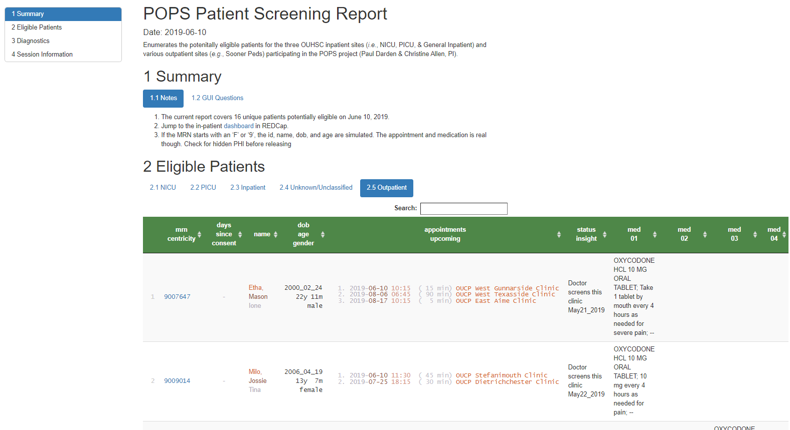
Sample Rolling Eligibility Report

Slide 21
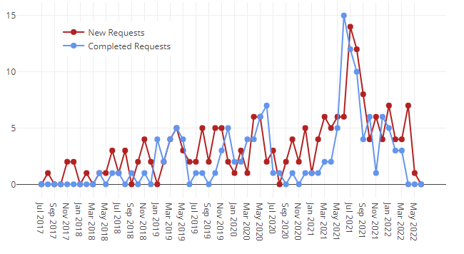
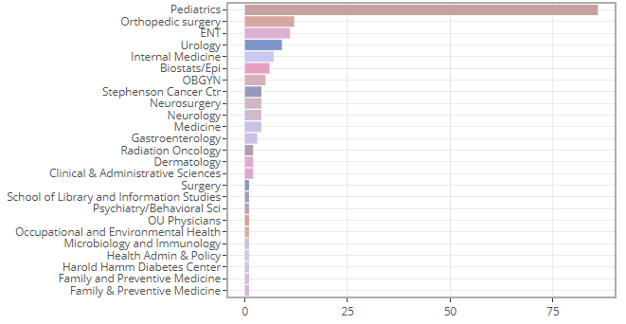
Since 2017, the CRDW has provided support for more than 194 projects.
We currently 44 active projects.
Most requests are submitted by the below departments or specialties.
Chart & table last updated Feb 2021
Notes:
Our projects have been spread across several research groups. We haven’t done much marketing, so it makes sense that the majority come from our own department.

Slide 22
Clinical Trials & Other Research Studies Supported by the CRDW since 2017; page 1
Short Name | PI | Department/Specialty
Asthma Outcomes | M. Naifeh | Pediatrics
Pediatric Diabetic Ketoacidosis | M. Marin | Pediatrics
Anxiety & Depression Education | A. Bax | Pediatrics
Obesity in Foster Care | N. Torres-Garcia | Pediatrics
Posterior Cruciate Ligament Avulsions | S. Algan | Orthopedics
Avulsion Fractures (Tibia & Fibula) | S. Algan | Orthopedics
Avulsion Fractures (Femur) | S. Algan | Orthopedics
STI Screening | R. Leasure | Infectious Disease
Interstitial Cystits Pain | L. Quiroz | Women's Health
Pharmacist-Led Care | T. Truong | Pharmacy
POPS | C. Allen | Pediatrics
NAMCS | S. Gillaspy | Pediatrics
Preschool Behavior | A. Bax | Pediatrics
Psychology Consults | S. Gillaspy | Pediatrics
Chronic Hypertension in Pregnancy | R. Edwards | Women's Health
High Blood Pressure in Children | N. Connolley | Pediatrics
Sickle Cell Disease Transition Program | A. Sinha | Pediatrics
Molecular Alterations in Brain Tumors | J. Battiste | Cancer Center
Pelvic Floor Disorders | L. Quiroz | Women's Health
Cancer Patient Navigation Program | J. Vidrine | Cancer Center
Medical Homes for Youth in Foster Care | S. Gillaspy | Pediatrics
Short Name | PI | Department/Specialty
Subtalar Arthrodesis | A. Haleem | Orthopedics
Pulmonary Hypertension | H. Bhardwaj | Cardiovasular
Pelvis & Acetabulum Fractures | D. Teague | Orthopedics
Spica Casting | W. Puffinbarger | Orthopedics
Fragile X Syndrome | L. Ethridge | Pediatrics
Splinting with Side Struts | T. Lewis | Orthopedics
Humeral Fractures | D. Chong | Orthopedics
Child Trauma Services | E. Risch | Pediatrics
Humeral Fractures | D. Teague | Orthopedics
Asthma Population Management | D. Hahn | Pediatrics
Tobacco Exposure in Pediatrics | S. Gillaspy | Pediatrics
Utility of Chest X-Rays for Asthma in the ED | A. Bogie | Pediatrics
OxyContin Study | D. Hahn | Pediatrics
Transition of Care Clinic | T. Truong | Pharmacy
Lipid Screening | S. Gillaspy | Pediatrics
Sickle Cell Port Placement | A. Sinha | Pediatrics
Tranexamic Acid in Ankle Replacement | A. Haleem | Orthopedics
Newborn Metabolic Screenings | J. Lees | Pediatrics
Scapula Fractures | C. Pasque | Orthopedics
Adrenal Insufficiency | J. Lim | Endocrinology
Brain Metastases with Ovarian Cancer | J. Gillen | Cancer Center
Sever's Disease | S. Algan | Pediatrics
Notes:
Here’s a quick list of the CDW projects so far. Some were wrapped up in less than a day. Some, like POPS, have been ongoing for 2 years.

Slide 23
Clinical Trials & Other Research Studies Supported by the CRDW since 2017; page 2
Short Name | PI | Department/Specialty
Brain Tumor Database | S. Sung | Cancer Center
Immunization Data Restructure | D. Bratzler | OUP
Off-Label Drug Use in Children | C. Allen | Pediatrics
Continuity of Care | P. Darden | Pediatrics
Prescribing Practices for Psychotropic Medications | S. Gillaspy | Pediatrics
Lactation Services for Diabetic Mothers | B. Mannel | Women’s Health
Supplementation of LPI | J. Dilley | Women’s Health
PCOS in Psoriasis | P. Allen | Dermatology
Assessment of Medication Problems | T. Truong | Pharmacy
Cancer Genetic Syndrome | J. Walker | Cancer Center
Maternal Depression Screening | M. Dunlap | Pediatrics
PROSpect Study | E. Henry | Pediatrics
Behavioral Health in the ED | R. Johnson | Pediatrics
Stem Cell Transplant Study | R. Shah | Pediatrics
Outcomes of Adalilumab in Colitis | J. Tung | Pediatrics
Mohs Surgery for High Risk cSCC | L. Collins | Dermatology
Electronic Cigarettes in Youth with Asthma | T. Wagener | Pediatrics
Vasoplegic Syndrome | C. Allen | Pediatrics
Patterns of Care Among Children with Cancer | Janitz | Epidemiology
Preoperative Airway Evaluation | D. Mann | ORL
Osteoporosis Prevention in Cancer Patients | J. Walker | Cancer Center
Short Name | PI | Department/Specialty
Radial Neck Fractures | TR Lewis | Orthopedics
High Grade VAIN | K. Smith | Women’s Health
E-Cigarette and Tobacco Use During Pregnancy | Cohn | Cancer Center
Analysis of C. Diff Toxins | P. Lang | Immunology
Inpatient Transition of Care Pharmacist | T. Truong | Pharmacy
Children with Medical Complexity | M. Akande | Pediatrics
Outcomes of Patients with Merkel Cell Carcinoma | C. Henson | Cancer Center
Glucocorticoid Receptor Antagonism in the Treatment of Cushing Syndrome | J. Lim | Endocrinology
Influenza A and Sialadenitis | R. Johnson | Pediatrics
Surgical Complications in Patients with Spinal Muscular Atrophy | Chong | Orthopedics
Tissue Eosinophil Count in IBD Patients | J. Tung | Pediatrics
Bone Health Study | S. Krishnan | Pediatrics
Association between Urinary Parameters and Urological Issues | Pal | Pediatrics
Synthetic Cartilage Implant vs Osteochondral Autologous Transfer for Advanced Hallux Rigidus | Haleem | Orthopedics
Outcomes of External Fixation with the Ilizarov Frame in Complex Ankle and Hindfoot Fusions | Haleem | Orthopedics
Effect of Surgical Treatment of Vesicoureteral Reflux on Stone Passage Rates | Rensing | Urology
Tobacco and Marijuana Exposure Among Youth | M. Naifeh | Pediatrics

Slide 24
Clinical Trials & Other Research Studies Supported by the CRDW since 2017; page 3
Short Name | PI | Department/Specialty
Hereditary thrombotic thrombocytopenic purpura (HTTP) | J. Journeycake | Pediatrics
Neonatal Venous Thromboembolism | J. Journeycake | Pediatrics
Evaluation of Hematologic Parameters in Patients on PARPi Therapy | K. Moore | Gyn Onc
Hip Fracture Repair | D. Teague | Orthopedics
Anterior Cruciate Ligament Reconstruction | S. Algan | Orthopedics
Bone-Grafting for Glenoid Deficiency | C. White | Orthopedics
Hospital Admission Rates for Children Living with Asthma | M. Akande | Pediatrics
Hearing Screens | J. Butcher | Pediatrics
Cesarean Scar Ectopic Pregnancy | H. Burks | Reproductive Medicine
Urologic Trauma Study | J. Furr | Urology
Oral Cavity Cancer | C. Henson | Cancer Center
Moberg Advancement Flap for Soft-Tissue Loss of the Thumb | T. Lehman | Orthopedics
Reduce Postoperative Hemorrhage | J. Sanclement | ORL
Anti-Incontinence Procedures | J. Furr | Urology
Acute Anosmia in Patients with COVID-19 | G. Krempl | ORL
Cervical Spondylotic Myelopathy (CSM) | Z. Smith | Neurosurgery
Sellar and Parasellar Tumors | I. Dunn | Neurosurgery
Short Name | PI | Department/Specialty
Detection and Management of Bladder Cancer | S. Patel | Urology
Survey of Patients Regarding Care Utilization During COVID-19 | D. Hahn | Pediatrics
Circumcision Complications Requiring Surgical Revision | D. Frimberger | Urology
Genetic Counseling Services for Children with Neurodevelopmental Disorders | Wadley | Genetics
ECO-RESET | R. Harty | Gastroenterology
Vasopressor Use in Microvascular Free-Flap Reconstruction of the Head and Neck | N. Vasan | ORL
Genetic Testing for the BRCA gene | I. Shim | Genetics
Bronchiolitis | A. Sparkman | Pediatrics
Mirikizumab in Patients with Moderately to Severely Active Crohn's Disease | H. Bitar | Gastroenterology
Renal Cell Carcinoma | J. Heinlen | Urology
Stress Hydrocortisone in Pediatric Septic Shock (SHIPSS) | C. Allen | Pediatrics
Severe Neurologic Injury Outcomes during COVID 19 Crisis (NCC COVID 19 OUTCOMES) | D. Masoom | Neurology
Implementation of pain protocol and outcome of sickle cell patients | L. Rooms | Pediatrics
ORIEN Project; Total Cancer Care Protocol | A. Tripathi | Cancer Center
Registry
Registry

Slide 25
Clinical Trials & Other Research Studies Supported by the CRDW since 2017; page 4
Short Name | PI | Department/Specialty
National COVID Cohort Collaborative (N3C): A National Resource for Shared Analytics | D. Bard | OUHSC
Predictors of Sever Sepsis in Patients with Intestinal Failure | C. Knoles | Pediatrics
Relationship Between Pretreatment Anxiety/Depression & Patient Decision-Making in Prostate Cancer Treatment | J. Heinlen | Urology
Quality of Life of Ethnically Diverse Black Prostate Cancer Survivors: Development of a Conceptual Model Using Grounded Theory | M. Ogunsanya | Pharmacy
Clinical Presentations, Laboratory Findings, Treatment, and Outcomes of Pediatric COVID-19 Patients | Bogie | Pediatrics
PEMCRC Anaphylaxis Study | Bogie | Pediatrics
Analysis of Pediatric Migraine Treatment | Bogie | Pediatrics
Impact of COVID-19 on Distress Levels in Cancer Patients | R. Funk-Lawler | Psychiatry
Pituitary Adenoma Patient Outcomes | I. Dunn | Neurosurgery
Oncologic Outcomes in Renal Cell Carcinoma | B. Cross | Urology
Using ML to Quantify Molecular Phenotypes | K. Jones | Harold Hamm Diabetes Center
Improving Detection & Management of Bladder Cancer | D. Parker | Urology
Neuromodulation of Inflammation to Treat Heart Failure with Preserved Ejection Fraction (TIN HF) | S. Stavrakis | Cardiology
Management of Asthma | M. Naifeh | Pediatrics
VTE Automated Surveillance | A. Wendelboe | Public Health
Oklahoma COVID19 Registry and Repository | N. Agudelo | Infectious Disease
Short Name | PI | Department/Specialty
Patterns of Clinical Deterioration in Critically Ill Children | S. Brown | Pediatrics
Incidence & Risk Factors of NSAID Use in Post-Operative Patients | H. Bitar | Gastroenterology
Tube Complications in Pediatric Patients with Congenital Heart Disease | C. Hunter | Pediatrics
Medical marijuana legalization in Oklahoma: effects on neonatal exposure to opiates | Makkar | Pediatrics
PROSpect: Prone and Oscillation Pediatric Clinical Trial COVID-19 Supplement | E. Henry | Pediatrics
Addressing Epidemiologic Gaps in Immune Thrombocytopenia: Pregnant and African American Patients | D. Terrell | Public Health
TBD | A. Paul | Neurology
TBD | H. Wu | Pulmonary, Critical Care, and Sleep Medicine
Promoting Human Papillomavirus Vaccine Uptake in High-Risk Adults (Uptake 2) | T. Bui | Family and Preventive Medicine
External Validation of an AI-Based ECG Tool to Identify Cardiomyopathy in Women of Reproductive Age | M. Williams | Obstetrics and Gynecology
Aggregate Counts of COVID-19/MIS-C Patients | P. Darden | Pediatrics
Fluid Management in Acute Respiratory Distress Syndrome due to COVID 19 | S. Dauok | Pulmonary, Critical Care, and Sleep Medicine
TBD | C. Cross | Pulmonary, Critical Care, and Sleep Medicine
Registry
Registry

Slide 26
IRB and Privacy Review Guidance
Requests that are preparatory to research must be submitted to the IRB/University Privacy Board for review and approval.
Program Evaluation, CQI, & Feasibility Assessments:
If PHI is NOT included, it is generally not considered human subjects research.
A determination of human subjects research (DHSR) may be submitted to the IRB.
Aggregate data may be provided without an IRB submission.
The following activities are NOT human subjects research:
Classroom evaluation activities when assessment involves regular classroom activities and the results of the evaluation process are intended to be used for the sole purpose of enhancing teaching practices of the instructor
Quality improvement activities designed to enhance functionality of a department or campus program provided that results are not intended to be shared outside of the University
Program evaluations
Public health practice surveillance activities
Notes:
In short, we work closely with the oversight boards to maintain compliance & improve efficiency. A new governance board is being created that’s co-chair by the informatics heads of the hospital and of the clinics. I’m excited that this will speed up parts of our process for those studies that don’t require an IRB.
[8 min cumulative]

Slide 27
CRDW Faculty & Staff
David Bard, PhD, Chief Research Information Officer
Will Beasley, PhD, BBMC Director of Informatics
Geneva Marshall, MS, MHR joined the CRDW team in August 2020 after spending 8 years supporting academic research led by Drs. Bard and Beasley. Her experience includes the expansion and upkeep of a data pipeline using R and SQL to combine datasets for programs evaluation, as well as creating and streamlining a common set of procedures in R for data analysis. Geneva anticipates graduating OSU in May with a MS in Business Analytics specializing in Data Science.
Nellie Oliver, MBA, MPH is a biostatistician by training with over 15 years of experience leading projects and analyzing data across various settings, including academic hospital settings, medical credentialing, health insurance, and others. Prior to joining OUHSC in June 2021, Nellie served as a Senior Data Analyst and a Project Manager at the Care Management department of Blue Cross and Blue Shield of North Carolina.
Ashley Thumann, MHA has 15 years of healthcare administration experience. Prior to joining the CRDW team in October 2017, she served as a Clinics Administrator and Quality Manager for OU Physicians. Ashley has end-user experience with many of the data systems on campus and is the CRDW’s primary liaison with investigators.

Slide 28
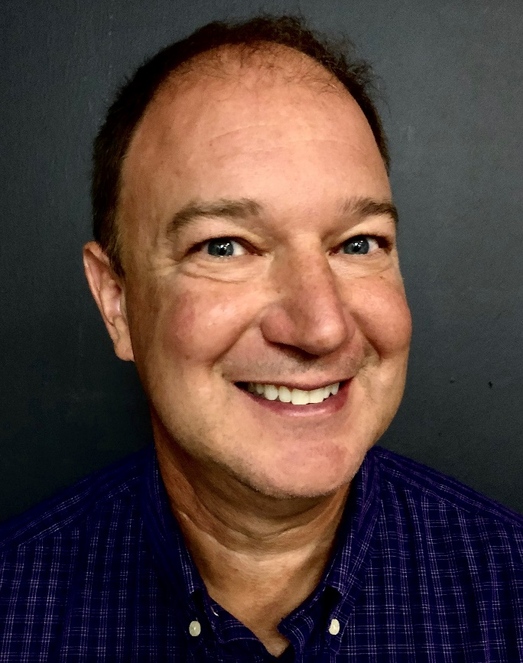
OUM BI Team
Jimmie Hackworth
Sr. Meditech Reporting Analyst in the Business Intelligence area of the Information Technology Department.
Meditech expert hired a few months ago to support Meditech while campus’s focus is pulled toward Epic.
Works with Ashley, Will, & Geneva to design daily extracts that populated the Meditech portion of the CRDW warehouse.
Since October, meets with us weekly to review our progress and discuss the upcoming week’s enhancements (eg, adding columns or tables)
For every 1 problem that he solves, there are probably another 10 that he anticipates that the CRDW team is never aware of.
His approach has become our model for how we want to ingest future data sources.
Notes:
Here are the data sources for the research projects that we’ve assisted with. Roughly in descending order of frequency.
Most of our projects involve inpatient EMRs, outpatient EMRs, and billing systems.
In some ways, our experience started with datasets from external collaborators, such as the Dept of Health, and grew from there.

Slide 29
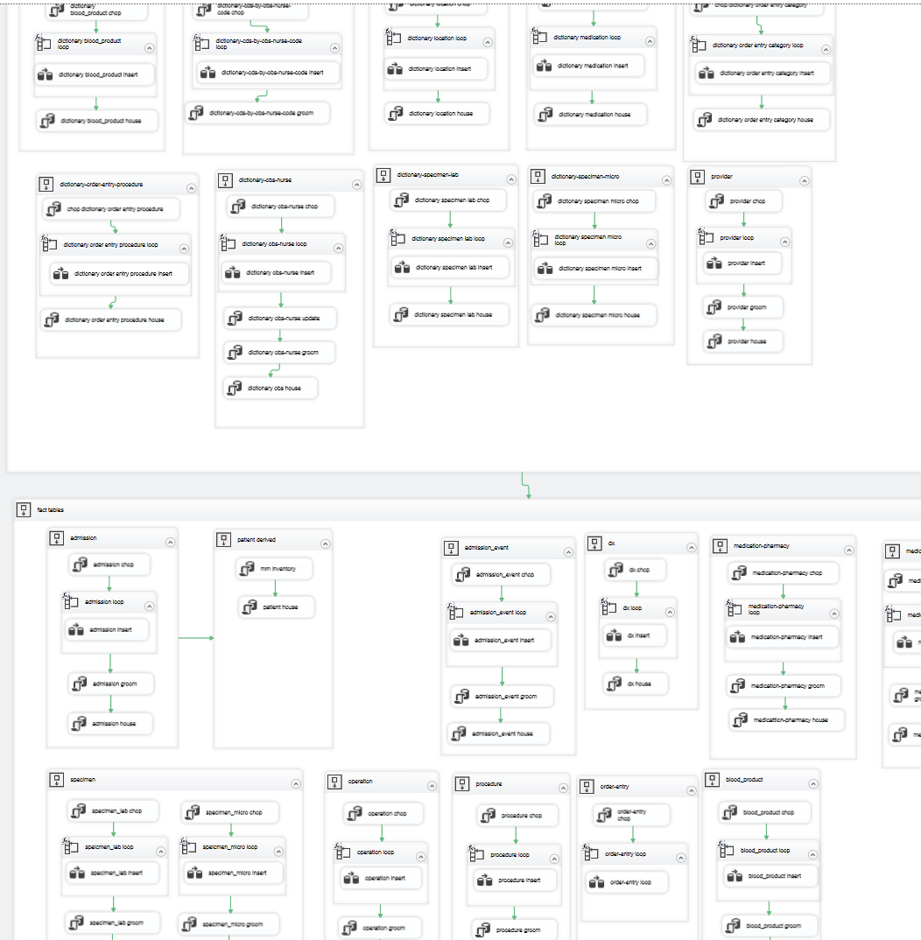
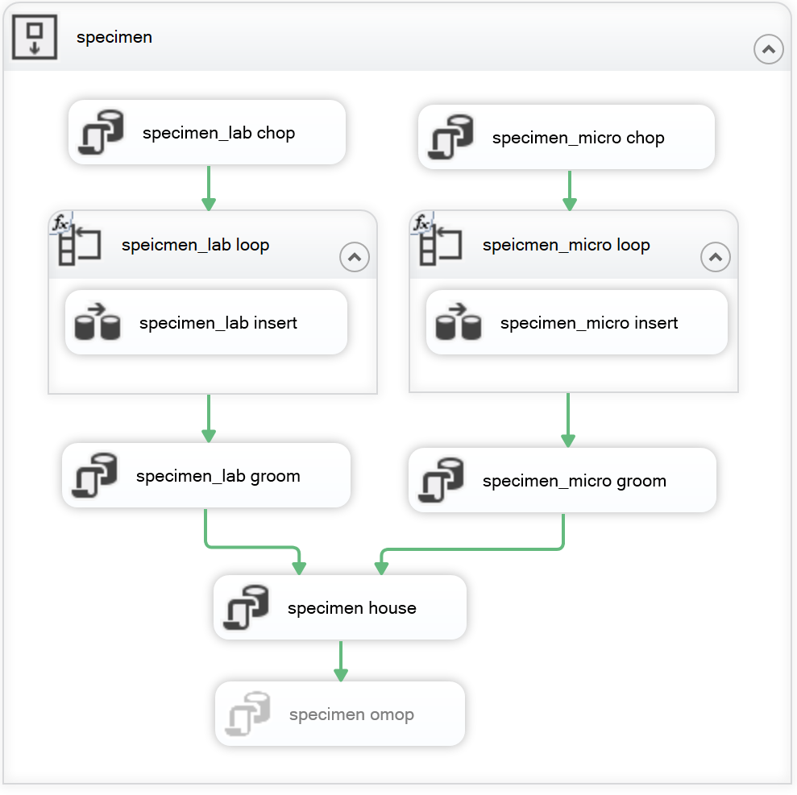
Meditech Warehouse ETL

Slide 30
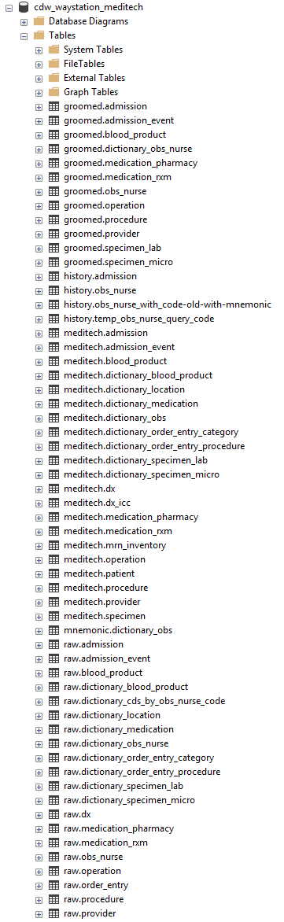
Meditech in the CRDW
Pipeline
Text files are saved to OUM’s ftp server around 1am.
CRDW downloads, grooms, & ingests them into the warehouse.
Data available by 5:30am every morning.
Tables/views available: patient, visit, visit event, diagnosis, lab, operation, procedure, blood product, obs, order entry, & medication.
Tables to develop: images, room history
Occasional requests still require the OUH BI Team (for elements that aren’t frequently used in research)
Role in the future Data Lake

Slide 31
Meditech in the CRDW
The CRDW now receives daily Meditech feeds (starting spring 2021).
Research-related requested for Meditech have changed hands
Until spring 2021, requests were routed to the “OU Health BI Team” using OUH’s ticketing system.
Now it’s routed to us (an OUHSC team), and we query our own warehouse.

Slide 32
Establish Thresholds for Tier 2 Governance Review
All CRDW requests must be submitted to the IRB, but some may warrant additional review by this board. Our proposed thresholds are:
Count of included patients exceeds 10,000, or
PI requests a new method for delivery of PHI (e.g., automated exports to a new OSDH FTP server), or
Recipients of PHI are external to OUHSC, or
CRDW team has concerns about broad language in the protocol or study application (e.g., “relevant medical history”, “clinical documentation”, “outcomes”), or
Extracted CRDW dataset contributes to a registry (internal or multi-site).
Does this board want to review sensitive & confidential fields beyond IRB’s?
If so, how can organize these additional reviews to avoid delays post-IRB approval?
For example, a checkbox in iRIS for each threshold triggers the review submission

Slide 33
Development of CRDW Policies & Procedures
Tier 0 (no approval required)
Feasibility assessment: these are typically last minute requests on the tail end of a grant proposal. Common masking guidelines are followed, such as all cell sizes are 20+.
Tier 1 (IRB approved conventional research)
Tier 2 (IRB and Governance Board approved)
Tier 3 (TBD)
The CRDW is infrequently contracted to provide operational support, such as transforming immunization records in preparation for Epic implementation.

Slide 34
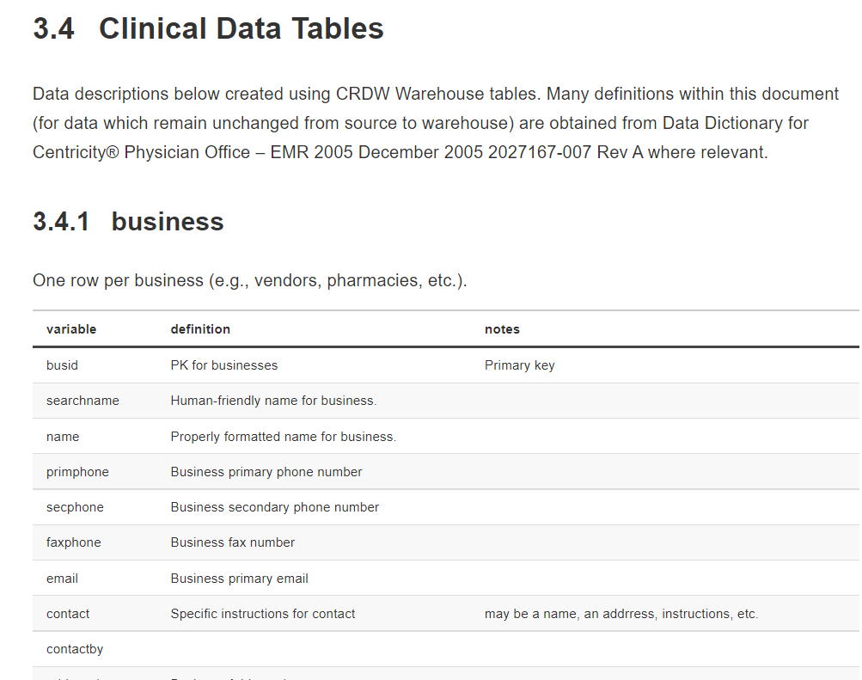
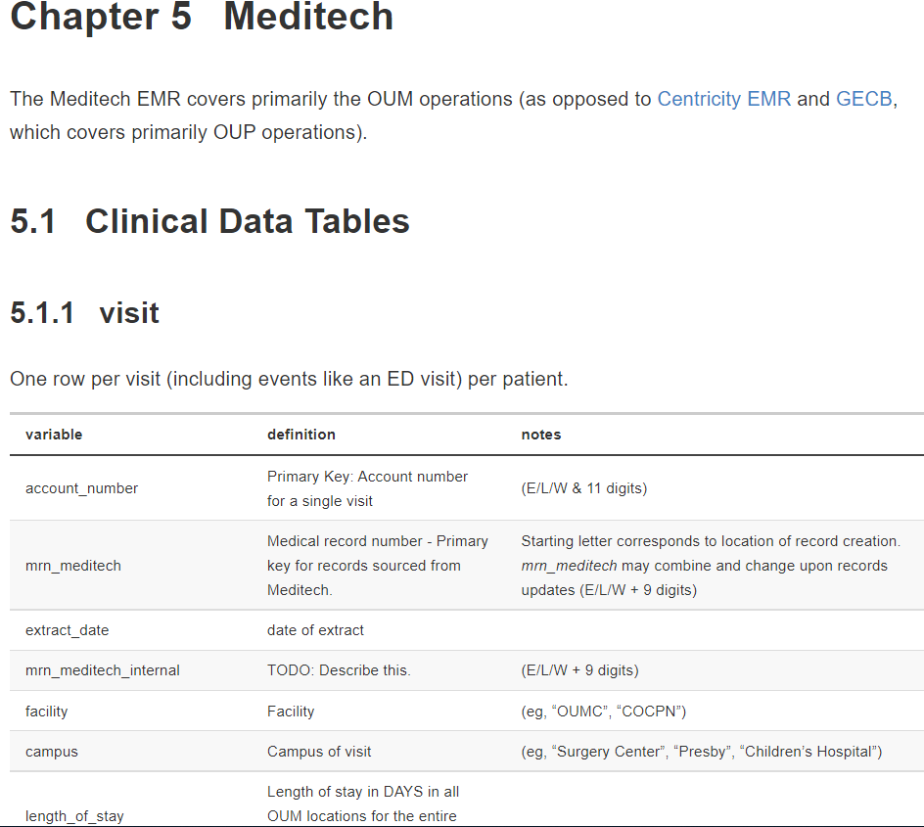
CRDW Documentation
GE Centricity EMR
Meditech
https://github.com/OuhscBbmc/cdw-doc-1

Slide 35
Requested Resources to Further Develop the CRDW
Ideally, IRB would implement a procedure to allow for CDRW upon initial approval without adding staff to KSP (e.g., a check-box on the application indicating use of CDRW to obtain data).
Routine meetings with an OUM Clinical Information Specialist / Application Analyst (someone like Megan Posada).
We would like read-only access to the other Meditech warehouse (being developed by CereCore). This would help validate our version of the warehouse, and occasionally fill-in holes for requests not covered by our research-focused warehouse.
Ticketing system to manage incoming CRDW requests
OMOP’s Atlas Reporting Tool (https://www.ohdsi.org/atlas-a-unified-interface-for-the-ohdsi-tools/)
TriNetX (https://trinetx.com/)
Spark (https://spark.apache.org/)
Completed:
Meditech Compiled HTML Help

