Slide 1







Data Management & Sharing (DMS) Policy and the Clinical Research Data Warehouse
Will Beasley, PhD
Ashley Thumann, MHA
Arnold Kanagwa, MS
David Bard, PhD
University of Oklahoma HSC
Biomedical & Behavioral Methodology Core (BBMC)
February 2023
Award Numbers: UG1OD024950 U54GM104938
Notes:
Hi I’m Will, and part of the Clinical Research Data Warehouse effort on campus. I started as a conventional statistician and researcher, and based on experience with integrating our investigations with state agency data , our group moved into the world of EMRs and warehouses.
I think these experiences have allowed our group to relate well with current PIs, as well as build a CRDW ecosystem that works well with research.

Slide 2
Bottom Line
I am a huge proponent of reproducibility.
Every project of mine since 2011 has included a public Zenodo posting of code & data, except for projects where PHI is required for the analysis (not just for the manipulation).
A lot of EMR-based research is almost always in this second category.
We can release it to a protected hosted platform (N3C, Superhero),
But not to a public hosted platform (eg, Dataverse, Zenodo)

Slide 3
Non-protected Data
Works well for fields like biology
No risk of committing a crime, but sometimes stakeholders are reluctant to reveal proprietary info
Sharing Code (and smallish datasets)
Short list: GitHub, Zenodo, Open Science Framework, (and maybe manuscript’s supplemental)
Ideally the reproducer just clicks “run” and the whole manipulation & analysis run. Getting the right software version can be tricky years late.
Sharing Data
Short list: Dataverse and many others in Sogol’s slide 22 that allow the data more findable/tag-able/searchable
I imagine different academic fields will have different preferences

Slide 4
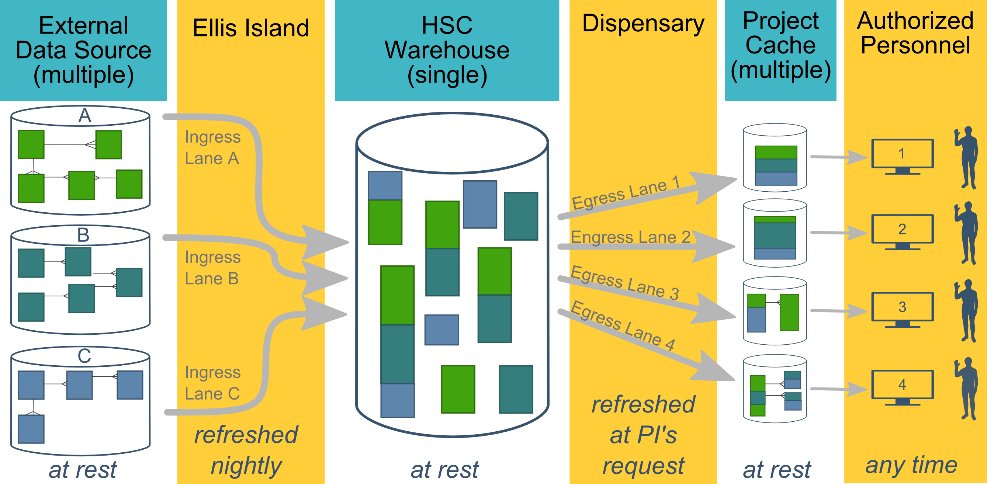
Ecosystem Architecture
CRDW (Clinical Research Data Warehouse)
Data Source (column 1): contains unique info
Warehouse (column 3): contains copy after manipulation
Project Cache (column 5): transformed to facilitate analyses of a specific research project
Notes:
The entire ecosystem can be represented by these six columns. The EMR and other collection databases sit in the 1st column and feed the warehouse in the third. This movement is automated. Inside the warehouse, the info from the different sources are staged & combined. Different patients can be placed in the same table. Perhaps more importantly, records for a single patient that are scattered across different sources are linked.
When an investigation is approved by the IRB, we can develop a tiny database in REDCap that contains the dataset needed for their analysis (5th column). There are a few reasons why REDCap is preferred. First, it’s more secure and scalable than distributing loose Excel files repeatedly for the same project. Second, REDCap has a lot of momentum and adoption, so it’s become familiar to a lot of people on campus --like those using it to collect research data.
We’ve always emphasized that we developed this to be as modular as possible. If someone could benefit from a few columns, they don’t have to commit to the whole thing. This modular approach has paid off, and I’ll return to that in the last few slides.

Slide 5
Protected Data
A lot tougher
Risk of committing a crime
Sharing Code
Short list: same as before
Only likely risks are exposing security config or occasional patient IDs used during debugging.
Sharing Data
I don’t have good general recommendations right now. It’s very specific to the funder and research project

Slide 6
Non-protected & Protected Data
Extra time & cost
Documenting of Code & Data Dictionary
Examples to help someone retrieve data & reproduce analysis
Platform for Storing & Hosting
De-identifying the medical/education data projects (if it’s made public) !! It’s not as simple as removing the 18 PII variables !!

Slide 7
Protected Data Repositories
In my experience, it’s usually not like Dataverse.
The have a very specific Data Model (all data tables & variables have strict definitions)
It takes a lot of time to translate our structure (eg Epic, Meditech) to their structure
In the future, hopefully more medical collaborations use CDMs (Common Data Models like OMOP or PCORnet), instead of creating one-off models

Slide 8
Links of Examples/Demos
https://github.com/LiveOak/sheik-microbial-grassland-warming-1
https://zenodo.org/record/439609#.Y_UodnbMIUE
https://github.com/LiveOak/LylesCoalbedMethane2/blob/main/utility/reproduce.R
https://osf.io/
https://osf.io/4zmdh/ (example project)
https://dataverse.org/
https://demo.dataverse.org/dataset.xhtml?persistentId=doi:10.70122/FK2/HXJVJU (example project)
https://github.com/IQSS/dataverse-client-r
https://ohdsi.github.io/CommonDataModel/cdm60.html
https://covid.cd2h.org/n3c
https://pcornet.org/news/pcornet-common-data-model/

