Slide 1







N3C: National COVID Cohort Collaborative
Will Beasley, PhD & David Bard, PhD
University of Oklahoma HSC, Biomedical & Behavioral Methodology Core (BBMC)
Jerrod Anzalone, MS
University of Nebraska Medical Center, Dept of Neurological Sciences
April 2022
Award Numbers: UG1OD024950 U54GM104938
Notes:
Hi I’m Will, and part of the Clinical Research Data Warehouse effort on campus. I started as a conventional statistician and researcher, and based on experience with integrating our investigations with state agency data , our group moved into the world of EMRs and warehouses.
I think these experiences have allowed our group to relate well with current PIs, as well as build a CRDW ecosystem that works well with research.

Slide 2
Demo
3 workbooks:
“Manipulation”: dedicated to preparing a dataset
“Explore”: descriptive stats
“Analysis”: models to test hypotheses

Slide 3
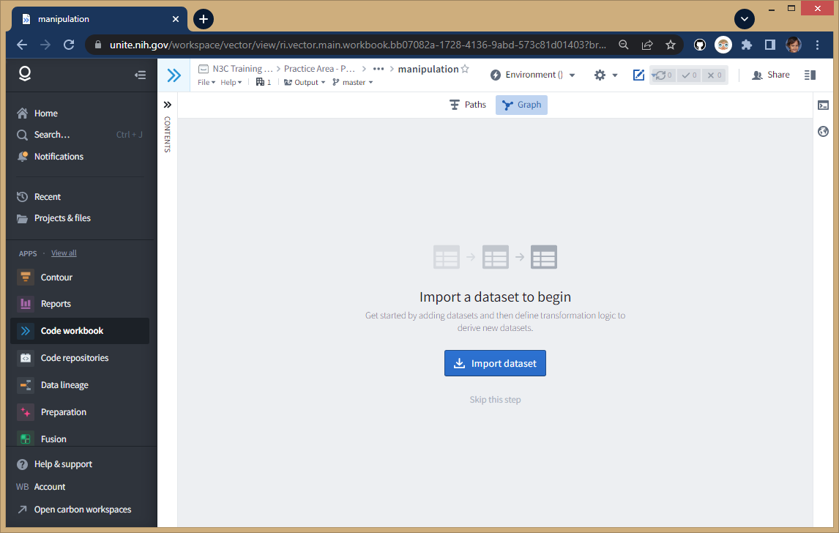
Start with a clean “workbook”
“N3C Training Area/Practice Area - Public and Example Data/will-beasley”
Create new workbook called “manipulation”

Slide 4
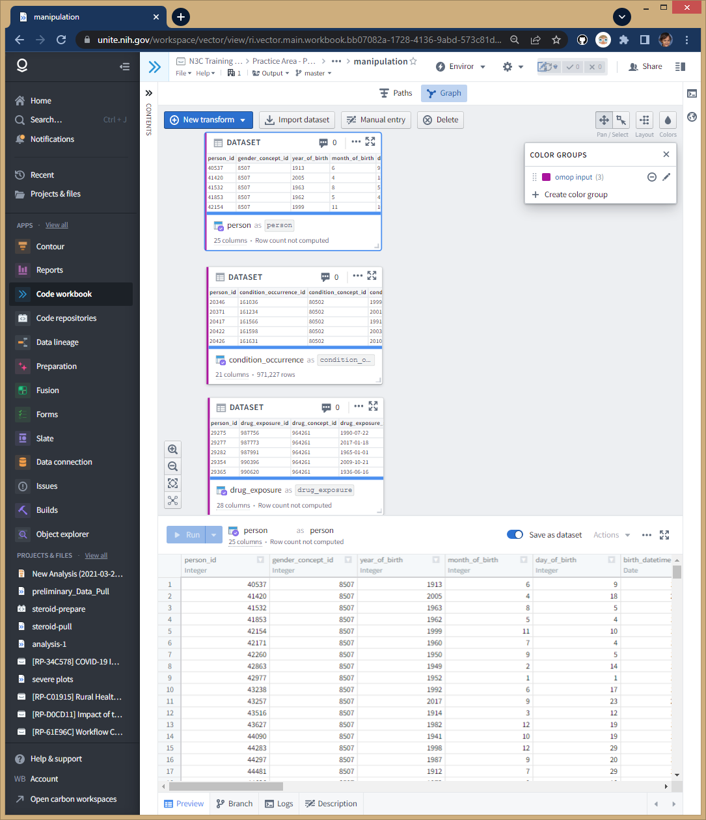
Import three tables
Blue Import Dataset button:
All -> Data Catalog -> Synthea Notional Data
person (1 row per patient)
drug_exposure (1 row per drug admin)
condition_occurrence (1 row per dx)
Purple label

Slide 5
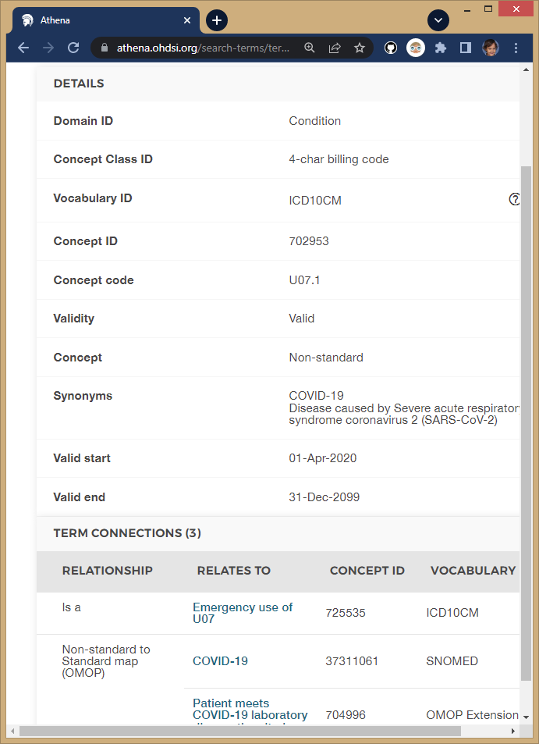
Find COVID concept id
Talk to clinician on your team and ask what ICD code(s) are appropriate (their response is “U07.1”)
Go to OMOP’s Athena tool: https://athena.ohdsi.org/
Enter “U07.1” and filter on ICD10CM vocab
Follow ICD10CM’s path to SNOMED
Copy the Concept ID of 37311061
Details are in chapter 5 of The Book of OHDSI https://ohdsi.github.io/TheBookOfOhdsi/

Slide 6
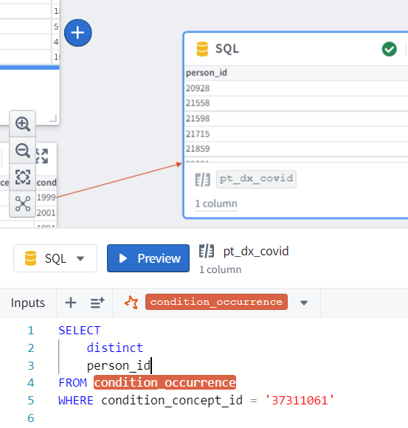
Designate Covid
1st iteration: unique patients
New SQL transform/node from condition_occurrence
SELECT
distinct
person_id
FROM condition_occurrence
WHERE
condition_concept_id = '37311061'

Slide 7
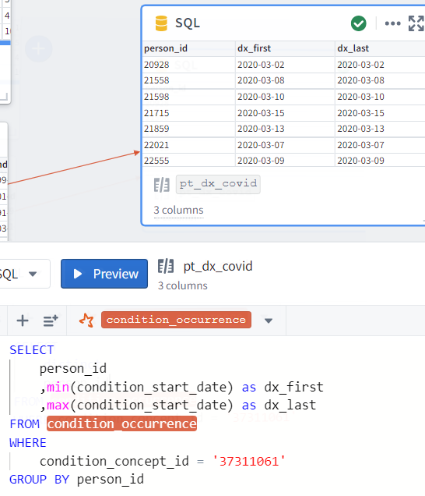
Designate Covid
2nd iteration: include characteristics
SELECT
person_id
,min(condition_start_date) as dx_first
,max(condition_start_date) as dx_last
FROM condition_occurrence
WHERE
condition_concept_id = '37311061'
GROUP BY person_id

Slide 8
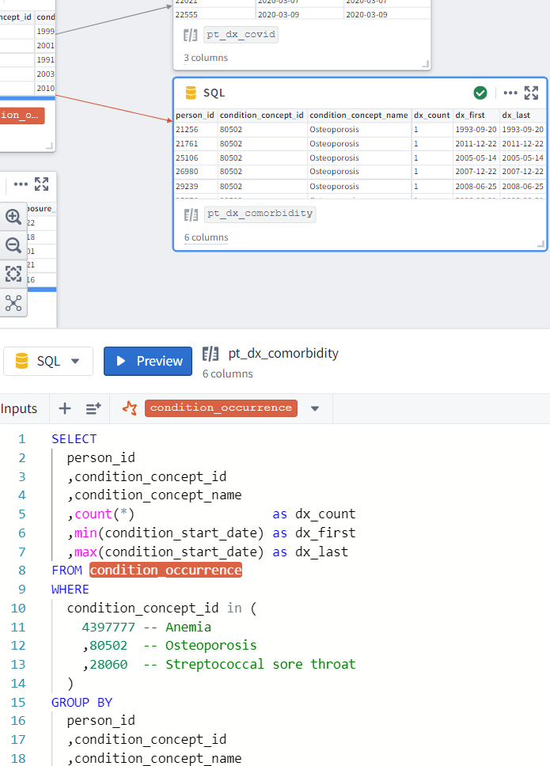
Isolate Comorbidities
New SQL transform/node from condition_occurrence
Anemia, Osteroporisis, & Strep
SELECT
person_id
,condition_concept_id
,condition_concept_name
,count(*) as dx_count
,min(condition_start_date) as dx_first
,max(condition_start_date) as dx_last
FROM condition_occurrence
WHERE
condition_concept_id in (
4397777 -- Anemia
,80502 -- Osteoporosis
,28060 -- Streptococcal sore throat
)
GROUP BY
person_id
,condition_concept_id
,condition_concept_name

Slide 9
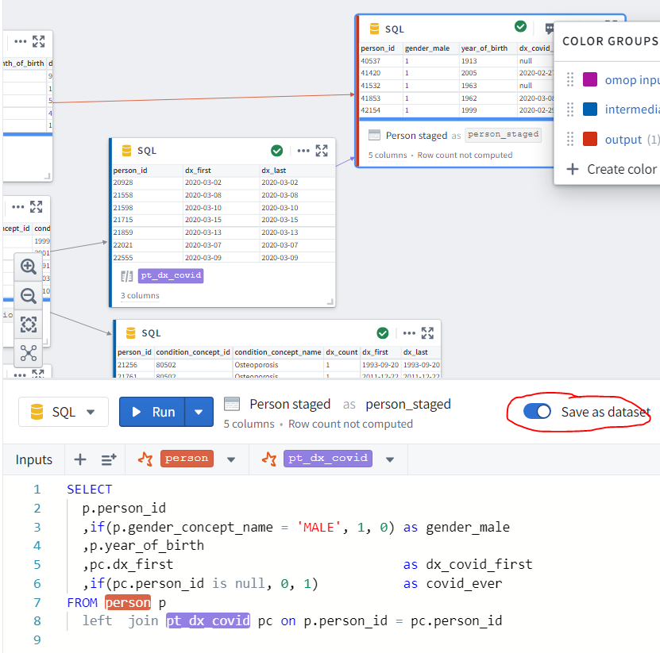
Join `person` & `pt_dx_covid`
New SQL transform/node pointing to two tables
Toggle the Save switch
Name “person_staged”
SELECT
p.person_id
,p.gender_concept_name as gender
,if(p.gender_concept_name = 'MALE', 1, 0) as gender_male
,p.year_of_birth
,pc.dx_first as dx_covid_first
,if(pc.person_id is null, 0, 1) as covid_ever
FROM person p
left join pt_dx_covid pc on p.person_id = pc.person_id

Slide 10
Start new Code Workbook
Named “analysis”
Import dataset
N3C Training Area/Practice …/will…/presentation…/workbook…/manipulation/Person Staged

Slide 11
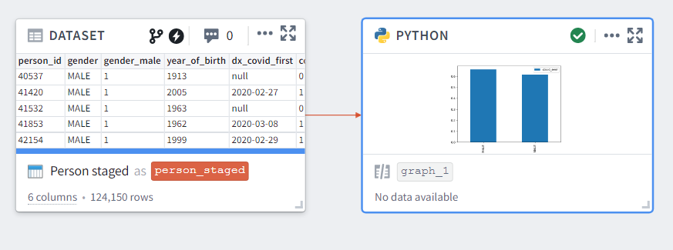
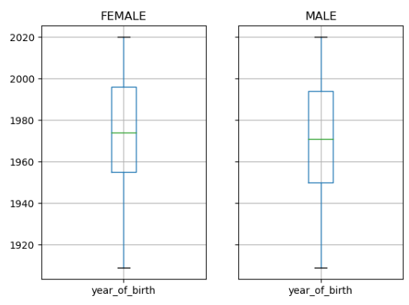
Python Transform
New Transform
Change `person_staged` to Pandas dataframe (Bottom-right panel)
def graph_1(person_staged):
import pandas as pd
import matplotlib.pyplot as plt
ds = person_staged
type(ds) # <class 'pandas.core.frame.DataFrame'>
ds.info()
ds[["gender", "year_of_birth"]].groupby(['gender']).boxplot()
plt.show()
ds[["gender", "covid_ever"]].groupby(['gender']).mean().plot(kind='bar')
plt.show()

Slide 12
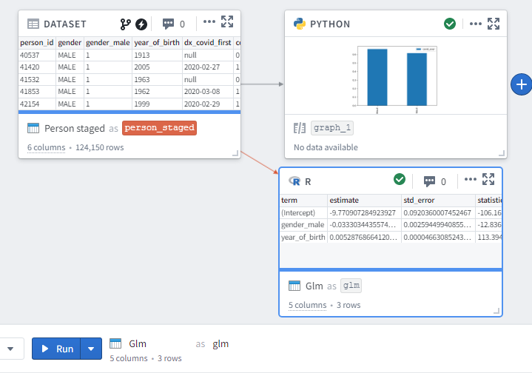
R Transform
New Transform
Change `person_staged` to R data.frame (Bottom-right panel)
glm <- function(person_staged) {
library(magrittr)
class(person_staged) # "data.frame"
ds <- person_staged m <-
lm(
formula = covid_ever ~ 1 + gender_male + year_of_birth,
family = "binomial",
data = ds
)
summary(m)
m %>%
broom::tidy()
}

Slide 13
Likely Improvements for Real Questions
Compare/limit dx dates
Outcomes should follow covid dx date.
?Should only pre-existing coughs be considered?
Explore site characteristics
You can’t tell what site is which
but you can look at quality on the characteristics in your study

Slide 14
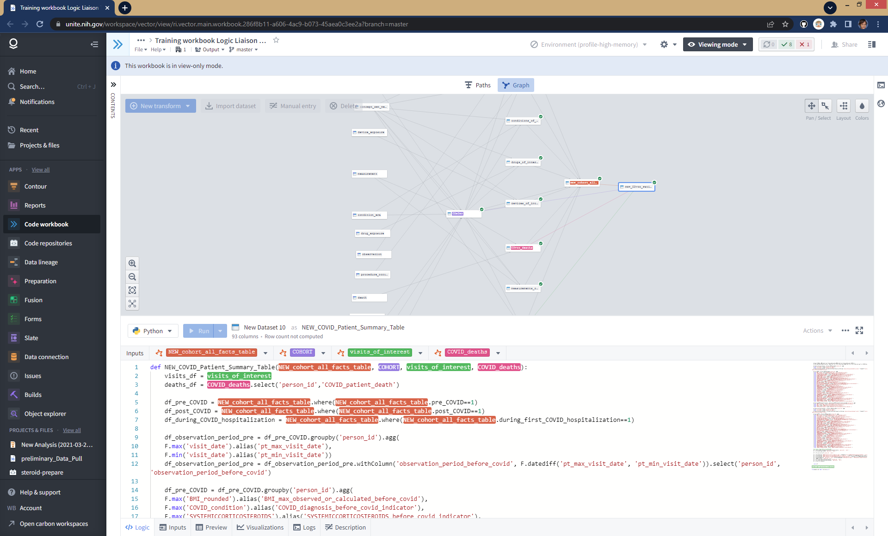
For real research projects, jump start with
These great templates are developed by the “Logic Liaison” group, primarily by Johanna Loomba and Andrea Zhou at UVA’s translational group (https://www.ithriv.org/)
Notes:
You can’t see the details, but can appreciate a lot of details are considered and provided. It will improve the quality of your dataset and save you at least a few days. And relevant to this audience, it will make you analyses more reproducible, because these groomed datasets are available and promoted to all N3C researchers.

Slide 15
Thank you
Will Beasley, PhD
Ashley Thumann, MHA
Geneva Marshall, MS, MHR
Nellie Oliver, MBA, MPH
David Bard, PhD
University of Oklahoma HSC
Biomedical & Behavioral Methodology Core (BBMC)
Award Numbers: UG1OD024950 U54GM104938

Slide 16
Extra Slides

