Slide 1







Leveraging the OUHSC Clinical Research Data Warehouse to Inform Research & Practice
Will Beasley, PhD
Ashley Thumann, MHA
Geneva Marshall, MS
Arnold Kanagwa, MS
David Bard, PhD
University of Oklahoma HSC
Biomedical & Behavioral Methodology Core (BBMC)
November 2024
Award Numbers: UG1OD024950 U54GM104938
Notes:
Hi I’m Will, and part of the Clinical Research Data Warehouse effort on campus. I started as a conventional statistician and researcher, and based on experience with integrating our investigations with state agency data , our group moved into the world of EMRs and warehouses.
I think these experiences have allowed our group to relate well with current PIs, as well as build a CRDW ecosystem that works well with research.

Slide 2
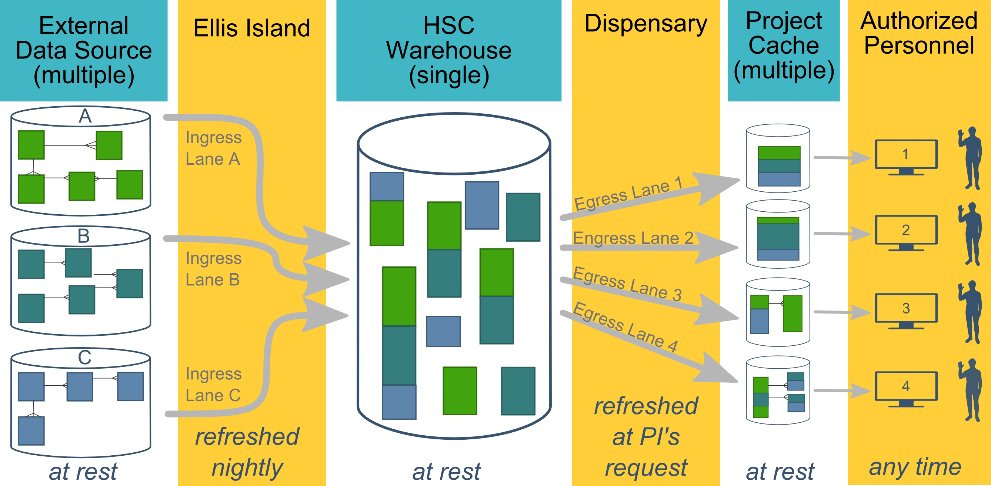
Ecosystem Architecture
CRDW (Clinical Research Data Warehouse)
https://github.com/OuhscBbmc/prairie-outpost-public
Data Source (column 1): contains unique info
Warehouse (column 3): contains copy after manipulation
Project Cache (column 5): transformed to facilitate analyses of a specific research project
Notes:
The entire ecosystem can be represented by these six columns. The EMR and other collection databases sit in the 1st column and feed the warehouse in the third. This movement is automated. Inside the warehouse, the info from the different sources are staged & combined. Different patients can be placed in the same table. Perhaps more importantly, records for a single patient that are scattered across different sources are linked.
When an investigation is approved by the IRB, we can develop a tiny database in REDCap that contains the dataset needed for their analysis (5th column). There are a few reasons why REDCap is preferred. First, it’s more secure and scalable than distributing loose Excel files repeatedly for the same project. Second, REDCap has a lot of momentum and adoption, so it’s become familiar to a lot of people on campus --like those using it to collect research data.
We’ve always emphasized that we developed this to be as modular as possible. If someone could benefit from a few columns, they don’t have to commit to the whole thing. This modular approach has paid off, and I’ll return to that in the last few slides.

Slide 3
HSC Data Sources
Patient
Epic (we have the basics, and will be adding for a while)
Legacy Outpatient (Centricity)
Legacy Billing and Claims Data (GECB)
Legacy Inpatient (Meditech)
Dozens of departmental sources
Biomedical Research Data
Provider
External Agencies
Service Provided (by the Health Dept of Oklahoma)
Child Protective Services (Oklahoma Dept of Human Services)
Immunization (Health Dept of Oklahoma)
Vital Records (Health Dept of Oklahoma)
…
Multi-state collaborations (in the future)
Administrative Cost
Employee & Student
Notes:
Here are the data sources for the research projects that we’ve assisted with. Roughly in descending order of frequency.
Most of our projects involve inpatient EMRs, outpatient EMRs, and billing systems.
In some ways, our experience started with datasets from external collaborators, such as the Dept of Health, and grew from there.

Slide 4
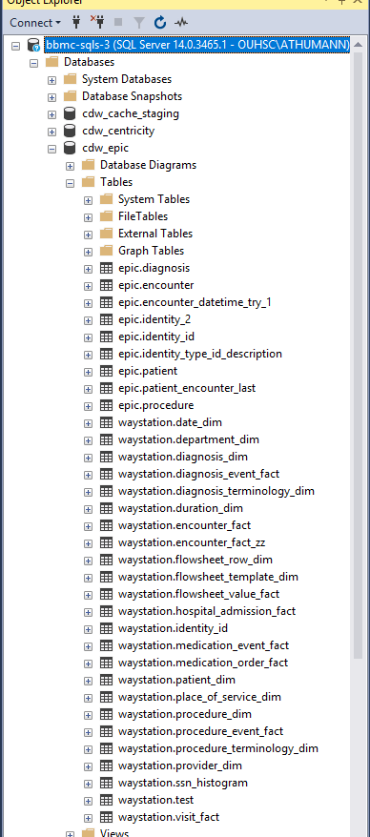
Integration of Epic
Current Tables – automatically updated nightly
Patient
Diagnosis
Encounter
Procedure
Medication
Flowsheet
Labs
Orders
Immunizations
Dozens more
Notes:
Here are the data sources for the research projects that we’ve assisted with. Roughly in descending order of frequency.
Most of our projects involve inpatient EMRs, outpatient EMRs, and billing systems.
In some ways, our experience started with datasets from external collaborators, such as the Dept of Health, and grew from there.

Slide 5
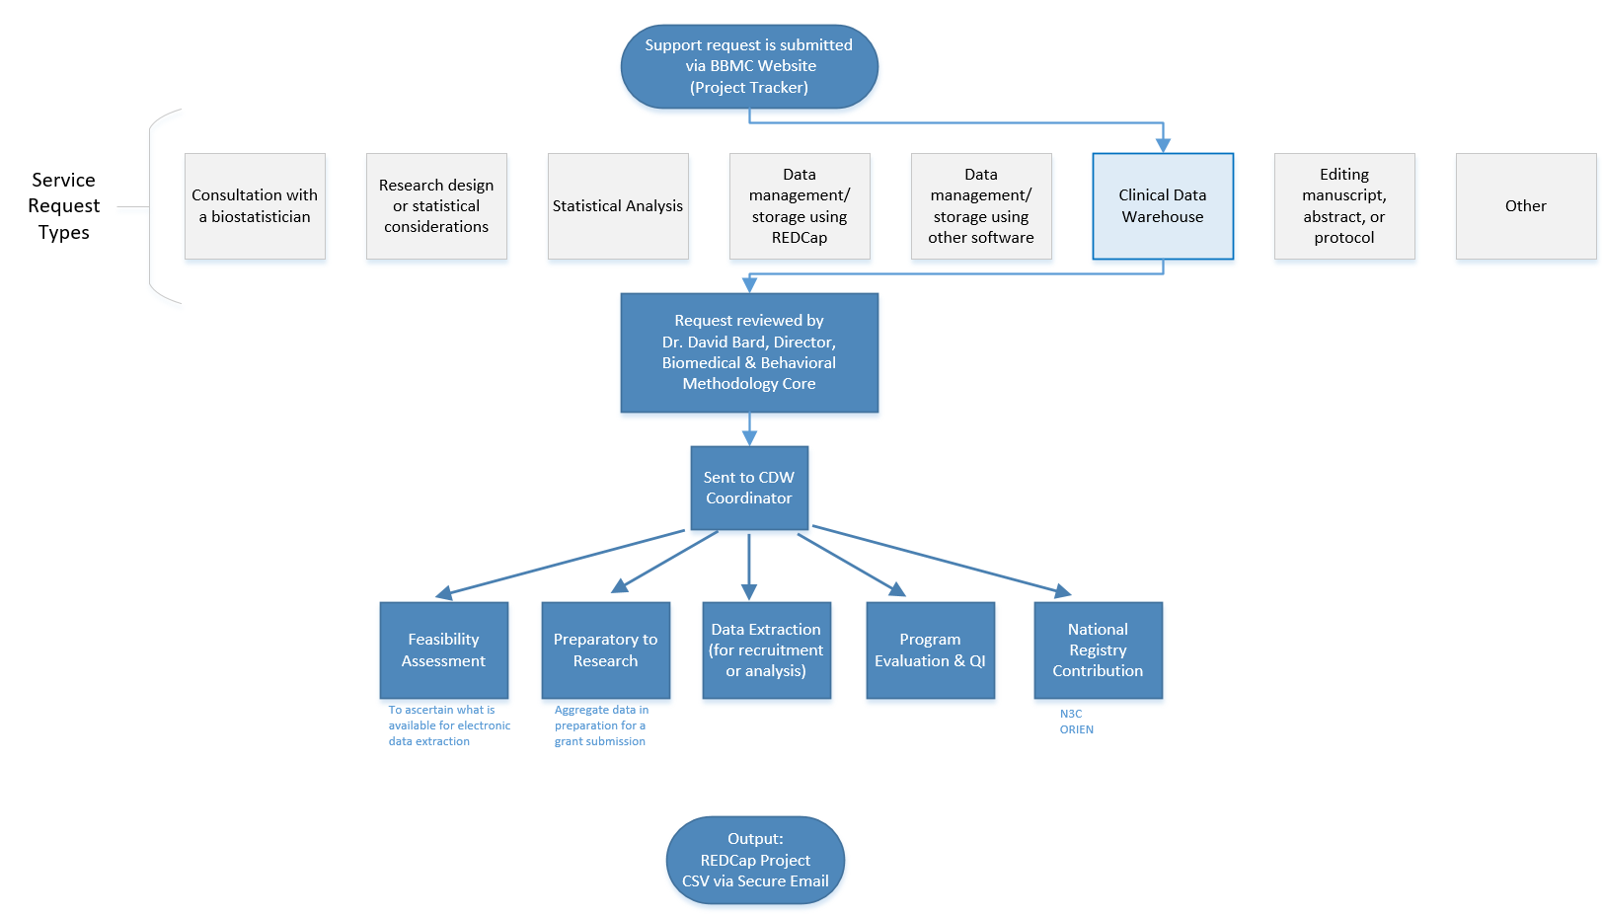
Typical Workflow for a
CRDW Research project
by the BBMC
Submit a request at:
ouhsc.edu/bbmc/
then ‘Request Support’
Notes:
Our group, the BBMC, is a core of ~6 faculty statisticians and another ~10 staff with skills in health administration, analysis, research, and data science.
When we receive a request involving the CRDW, it’s reviewed by a triage team and assigned to a mix of people. We assist with the project (ideally while the proposal is being written –not after it’s submitted). Some of the time we’re also the statisticians, and some of the time the PI has their own statistician or is collaborating with a group like BERD.
For a one-time retrospective research project, the output is usually a secured CSV. For a project requiring rolling enrollment, we deploy updates every morning with REDCap and dynamic html reports.
I have few friends managing the CRDWs of other universities. When we compare our situations, the biggest differences arise from the fact that our CDW was created by a group that’s primarily statisticians & researchers, as opposed to being created by an IT group that brings in outside statisticians. Pros & cons to each origin story. If you see differences between our approach and other institutions, this is a big reason.

Slide 6
Two Definitions of “QI” –depends on your audience
There are two campus groups who query Epic & the EMRs
OUHSC has the BBMC (ie, us)
OUH has the DnA group (“Data and Analytics”, also known as “Health Informatics”)
“QI with intent to publish or present”
Routes to the OUHSC group
Go to https://ouhsc.edu/bbmc/ and click “Request BBMC Services”
Applies to most of your resident research projects
Typically has an IRB approval or IRB exemption letter
“QI to improve an internal process (with no intent to publish)”
Routes to the OUH group
Go to https://ouhealth.service-now.com/ (with your OUH account)
No IRB approval is required for internal QI
Human subjects aren’t involved; data will not be shared outside OU

Slide 7
Commonly Requested CRDW Support Services
Feasibility assessment in preparation for research (20% of projects; 10% of CRDW staff time)
Static eligibility (70% of projects; 20% of CRDW staff time)
Virtually all projects require identification of a patient pool
Rolling eligibility (30% of projects; 30% of CRDW staff time)
Remember study team’s assessment of eligibility as well as the participant’s response
Daily automation requires stability & good logging; e.g., a 3 hour delay might mean zero subjects are enrolled
Clinical outcomes for retrospective investigations (50% of projects; 30% of CRDW staff time)
Administrative outcomes for quality improvement (10% of projects; 2% of CRDW staff time)
Program evaluation (20% of projects; 8% of CRDW staff time)
Notes:
Here are the services we provide. This roughly reflects the needs of the campus, but it’s not one-to-one. For example, I’m sure there are still a lot of manual chart reviews to create eligibility lists. Also, there are several groups on campus, like BERD, that are great at analyzing the outcomes once the datasets is delivered in a suitable format.
As PIs decide how big of a bite to take, some come to us to get a feel for the counts of patients meeting the conditions of interest. These tasks typically not too heavy, so we can complete most within a day.
One-time eligibility is requested a lot, partly because we’ve built a little reputation around it. And virtually all projects need that patient pool defined. To create this pool our code doesn’t change much between active studies and retrospective studies. We’ve designed our pipeline to reuse a lot.
If it’s not a one-time enrollment, it’s typically then an ongoing recruitment. That takes more time because a lot of factors need to be incorporated to keep it efficient for humans to process. And even if it took zero seconds to develop, that daily automation inevitably requires some maintenance as those eligibility lists are deployed every morning. Although most mornings, the automation is smooth and it’s a simple check for a human to review everything passed.
Clinical outcomes is what I thought would soak up the majority of our time, but that’s been fairly manageable so far.
And occasionally we get administrative and program eval tasks that fit inside a larger research project.

Slide 8
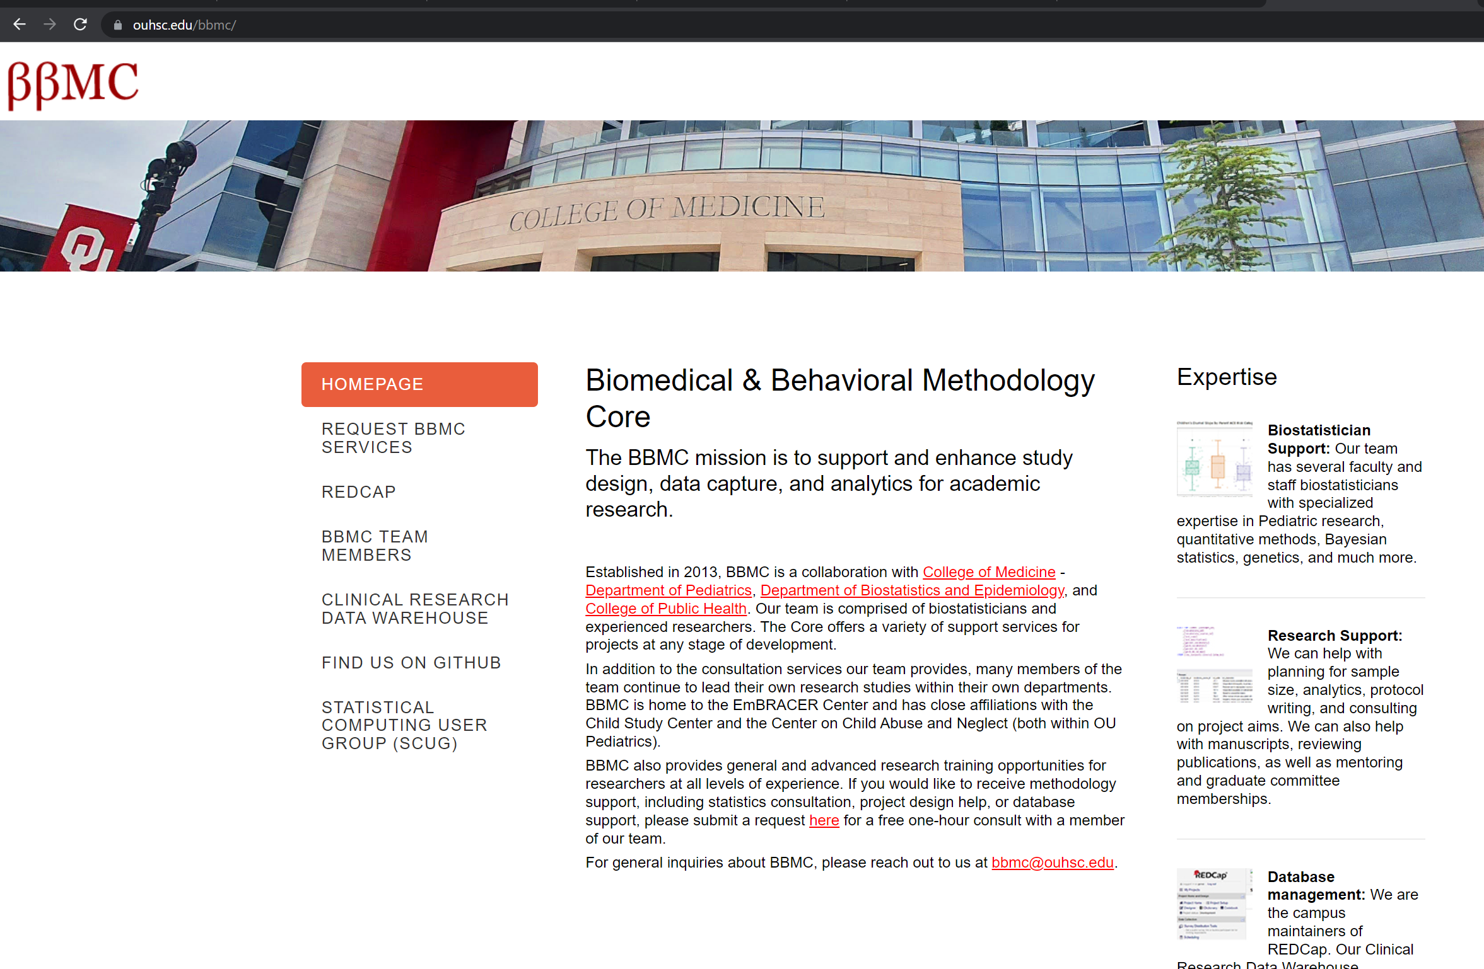
First go to: https://ouhsc.edu/bbmc/
Then click

Slide 9
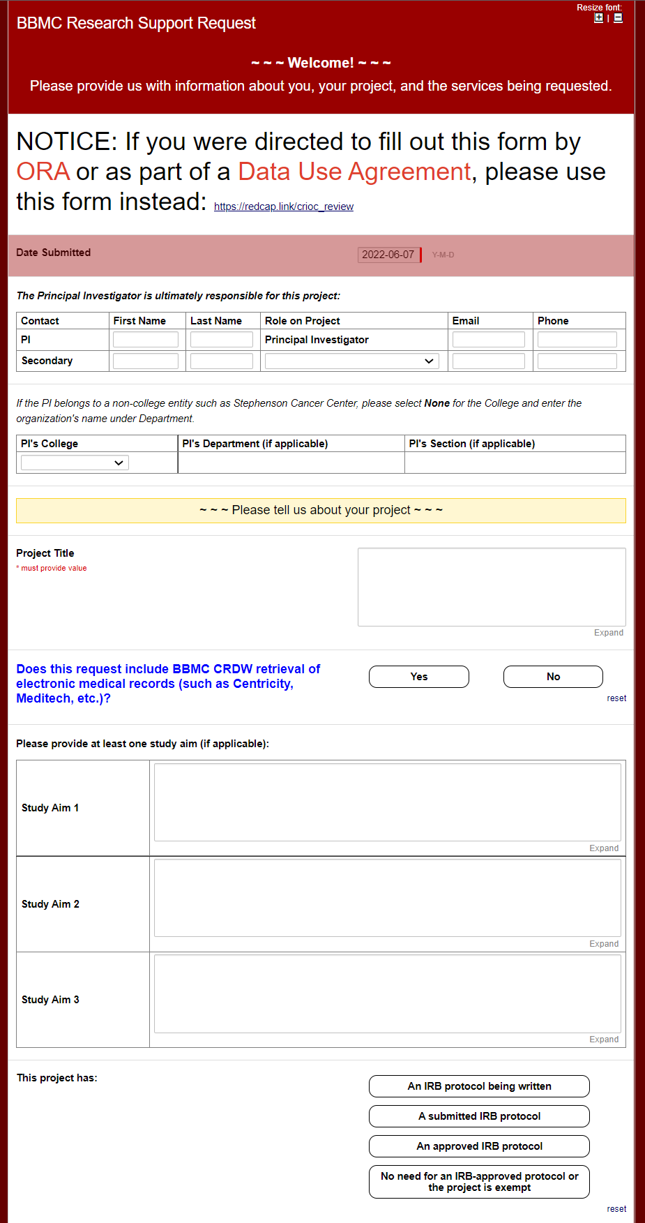
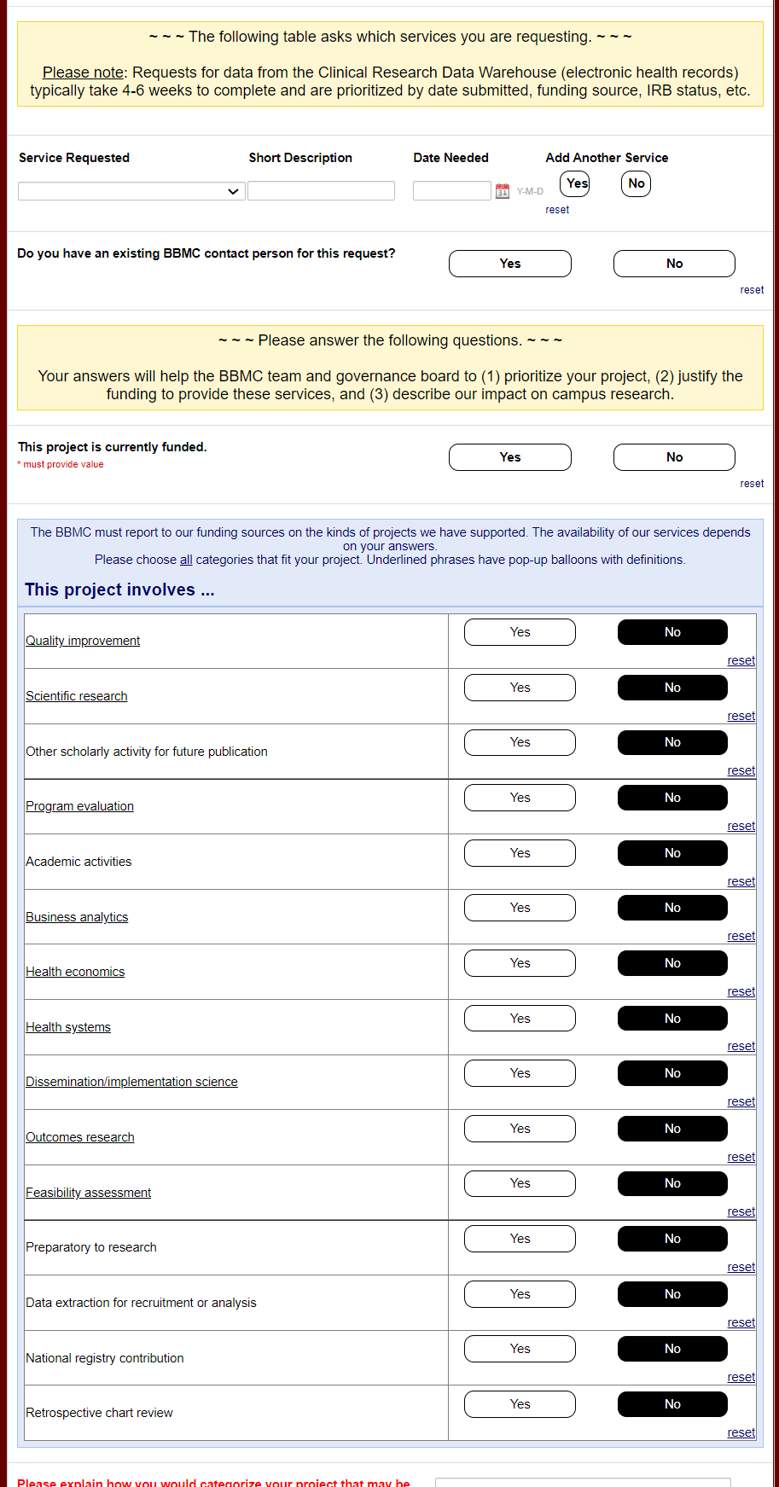
Then “CRDW”
Service
Reuqested
Then “Yes” to CRDW

Slide 10
Timeline for Basic Requests
We strongly recommend that you submit your request to CRDW before the IRB.
We can help with the IRB language and avoid some of the common reasons the IRB rejects your initial application
We need 6+ weeks for basic requests. It doesn't take us 6 weeks, but we have a lot of people asking for data. Please don't initially approach us a week before your research month begins. There are a few cycles of communication between you and us (such as metadata files that specify the inclusion criteria meds and dxs).

Slide 11
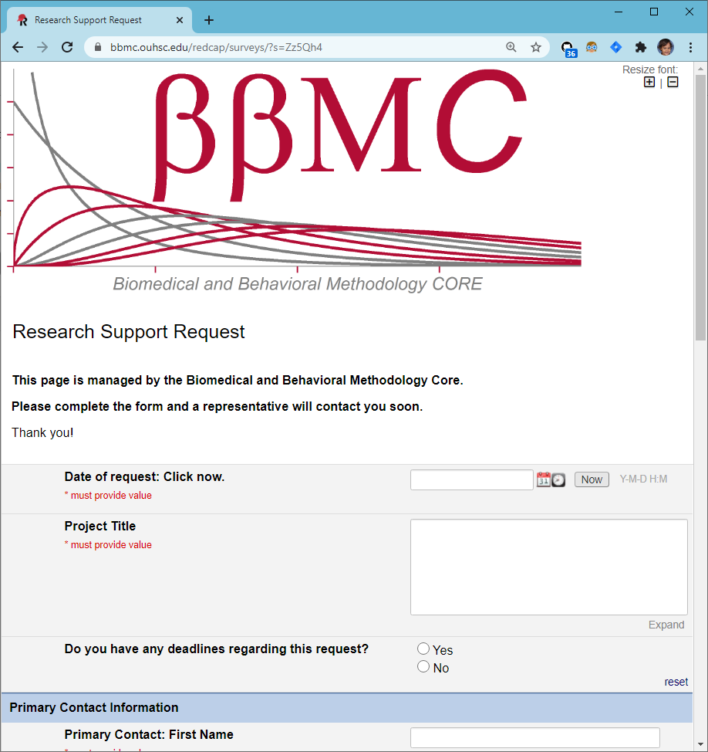
CRDW Typical Workflow
Intake via BBMC request form
Meet with investigator to determine data needs, feasibility
Back and forth with investigator
Develop Pipeline
Review with investigator and distribute via approved method
Structured vs. unstructured?
How well meet project needs with what’s available?
IRB considerations
Metadata files (such as identifying ICD codes, medications)
Verifying data formats
Automated daily data pulls
Varies vastly in complexity by project, data sources, etc.
CSV tables via SFT
Push to REDCap
Dashboards
Assign project to BBMC analyst based on skills, workload, & interests
Some projects may involve multiple analysts
Identifying locations and sources of data
SQL, R, & Python
Follows HIPAA & least privileges principles
BBMC Triage to services:
Feasibility
Program Evaluation
Recruitment
Retrospective Analysis
Facilitate Abstraction
Preparatory to Research
QI
Registry
Some may be very complex and/or rely on complicated code (e.g., Regular Expressions to extract structured data from unstructured notes, etc.). These requests can make completion take longer than usual.
Investigators are asked to add CRDW team to IRB application as KSP
CRDW team reviews & evaluates protocol to ensure data requested are authorized
Some have required modifications prior to release of data
This occasionally causes delays
Ideally, the IRB would implement a procedure to allow investigators to indicate utilization of CDRW upon initial approval without adding team as KSP (e.g., a check-box on the application indicating use of CDRW to extract data)

Slide 12
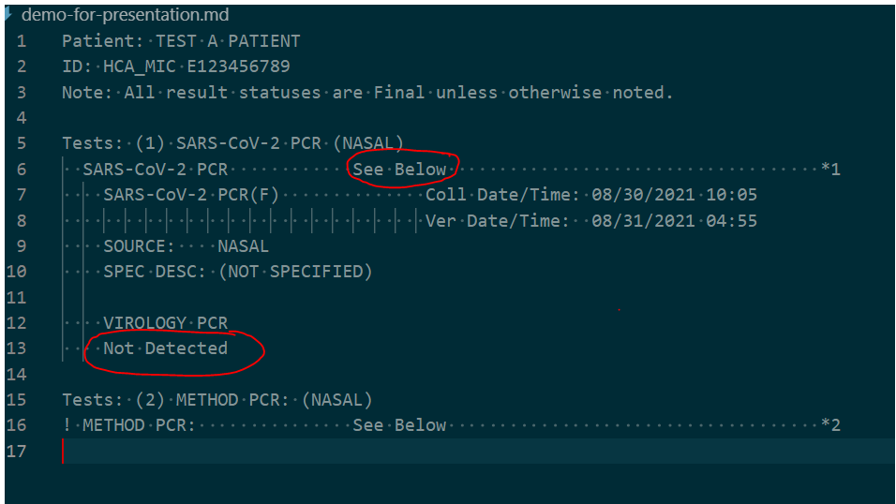
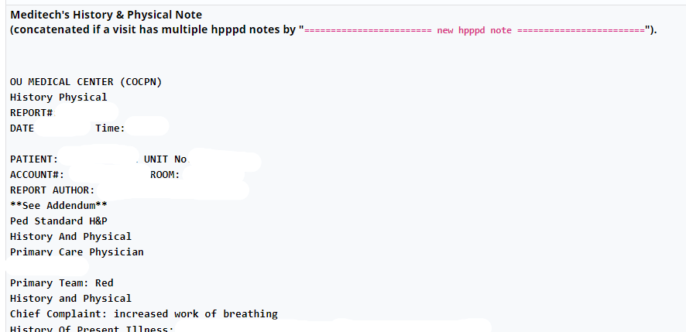
Data Formats
Structured (easier)
Unstructured (harder)
Patient demographics
Problem list or billed diagnoses (ICD-10)
Visits/encounters
Medications (GPI, RxNorm, NDC)
Most lab results (LOINC), but some are like this:
Diagnoses entered in the past medical history
Symptoms in HPI
Histories
Full notes
Some lab results
Radiology & pathology reports
Saved to the flowsheet
Has to be parsed out with regexes and programming (and funding)
Notes:
Data in the EMRs ranges from (1) nicely-structured tables where all the elements are neatly separated into their own columns to (2) free-text notes that are not consistent across records. For unfunded projects, elements that belong to a standard are the best. For instance, ICD codes are well-documented and consistently structured.
On the other hand, HPI is simply typed into a keyboard by some human that rarely enters it the same way twice. For unfunded projects, it’s typically best for us to extract the whole HPI paragraph, and you can manually review it and apply your clinical knowledge to determine the pieces relevant to your investigation.
For funded projects, we have some tools that can parse semi-structured reports (eg, pull the left ventricular ejection fraction from an echo report). In the future, we’ll have “EMERSE”, which is a medical informatics tools that helps extract structured info from free-text notes.

Slide 13
Encouraging Secure Data Practices
Our goal is to deliver the data extracts to researchers in a way that makes it easy for them to follow best practices.
Delivery of PHI, depending on the dataset and researcher
SFT for one-time transfers
OU file servers for recurring transfers
REDCap for recruiting projects (users manually enter data as we refresh info daily)
Never email
Common mitigations include
Withholding PHI fields
Obfuscating PHI fields (e.g., birth year instead of birth date)
Pre-calculating fields to avoid PHI (e.g., we calculate the age at visit, instead of sending visit & birth dates)

Slide 14
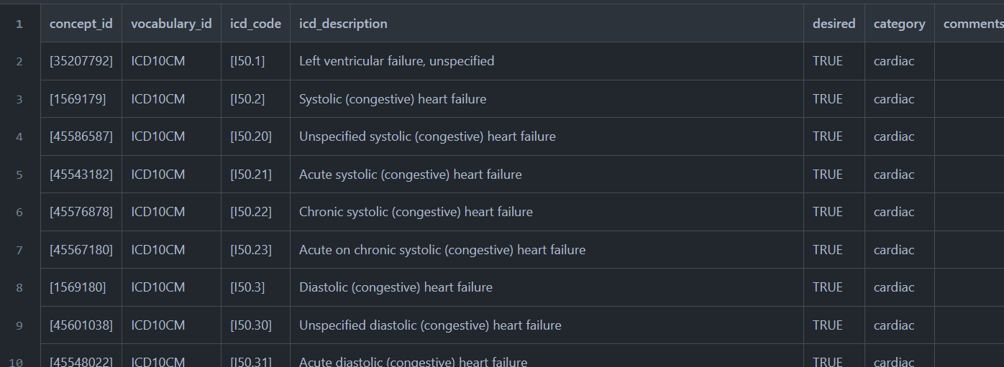
Using Metadata to Transfer your Clinical Knowledge into the Workflow
The CRDW team requests specific codes (eg, ICDs). The typical steps are
You send us some keywords (eg, “ventricular” and “heart”)
We sweep the code list and send you ~100 possibilities.
You specify the ~30 exact codes that reflect the inclusion criteria
Some projects also use a “category” variable (eg, “acute” vs “chronic” failure)

Slide 15
N3C: National COVID Cohort Collaborative
One of several examples of OU contributing EHR to a national investigation
80+ US institutions from 20+ states contribute EHR data in an OMOP model
Datasets are accessible only through a browser to NIH’s cluster
Spark, Python, R
Lots of governance steps, but not as many as you’d think
We believe this type of collaboration will be important in the future
Daily contributions during the pandemic
Patients connected across sites safely
Each site tokenized PII via PPRL (privacy preserving record linkage)

Slide 16
Ecosystem Architecture
CRDW (Clinical Research Data Warehouse)
https://github.com/OuhscBbmc/prairie-outpost-public
Data Source (column 1): contains unique info
Warehouse (column 3): contains copy after manipulation
Project Cache (column 5): transformed to facilitate analyses of a specific research project
Notes:
The entire ecosystem can be represented by these six columns. The EMR and other collection databases sit in the 1st column and feed the warehouse in the third. This movement is automated. Inside the warehouse, the info from the different sources are staged & combined. Different patients can be placed in the same table. Perhaps more importantly, records for a single patient that are scattered across different sources are linked.
When an investigation is approved by the IRB, we can develop a tiny database in REDCap that contains the dataset needed for their analysis (5th column). There are a few reasons why REDCap is preferred. First, it’s more secure and scalable than distributing loose Excel files repeatedly for the same project. Second, REDCap has a lot of momentum and adoption, so it’s become familiar to a lot of people on campus --like those using it to collect research data.
We’ve always emphasized that we developed this to be as modular as possible. If someone could benefit from a few columns, they don’t have to commit to the whole thing. This modular approach has paid off, and I’ll return to that in the last few slides.

Slide 17

Thank you
Will Beasley, PhD
Ashley Thumann, MHA
Geneva Marshall, MS
Arnold Kanagwa, MS
David Bard, PhD
University of Oklahoma HSC
Biomedical & Behavioral Methodology Core (BBMC)
Award Numbers: UG1OD024950 U54GM104938

