Slide 1







N3C: National COVID Cohort Collaborative
Will Beasley, PhD & David Bard, PhD
University of Oklahoma HSC, Biomedical & Behavioral Methodology Core (BBMC)
Jerrod Anzalone, MS
University of Nebraska Medical Center, Dept of Neurological Sciences
April 2022
Award Numbers: UG1OD024950 U54GM104938
Notes:
Hi I’m Will, and part of the Clinical Research Data Warehouse effort on campus. I started as a conventional statistician and researcher, and based on experience with integrating our investigations with state agency data , our group moved into the world of EMRs and warehouses.
I think these experiences have allowed our group to relate well with current PIs, as well as build a CRDW ecosystem that works well with research.

Slide 2
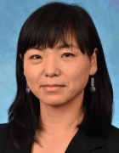
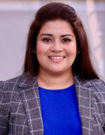
N3C Domain Team: Elder Impact https://covid.cd2h.org/elder
Mission: The Elder Impact Clinical Domain Team aims to complete a descriptive study to illustrate the impacts of COVID-19 on older adults and those with dementia/functional limitations. This includes (1) the use and safety of available COVID therapies in older patients, (2) the severity of COVID-19 among older adults with and without chronic diseases, and (3) the mental health impact of the COVID-19 pandemic on older adults.
Even if you don’t have programming or stat expertise, “we would love more members with a clinical and gerontology background to join”.
ss2894@rwjms.rutgers.edu
Leadership
Soko Setoguchi, MD, DrPH, FISPE
Rutgers University
Jessica Islam, PhD, MPH
Lineberger Comprehensive Cancer Center

Slide 3
Domain Team’s Current Project
While older adults represent 24% of overall infections in the US, almost 80% of COVID-related deaths occur in this age group. However, fewer studies have focused on vulnerable older adults, especially in those with signifying characteristics of older adults including multi-morbidity, polypharmacy, and reduced cognitive and physical function. It is also not clear if the overall excess risk in older adults is fully explained by known individual risk factors.
The project’s subaims include identifying:
how characteristics, management and outcome changed over time since March 2020.
cognitive function, physical function, multimorbidity, and polypharmacy collaborating.
Contact Soko Setoguchi at ss2894@rwjms.rutgers.edu

Slide 4
Demo
2 workbooks:
“Manipulation”: dedicated to preparing a dataset
“Analysis”: descriptive stats & models to test hypotheses

Slide 5
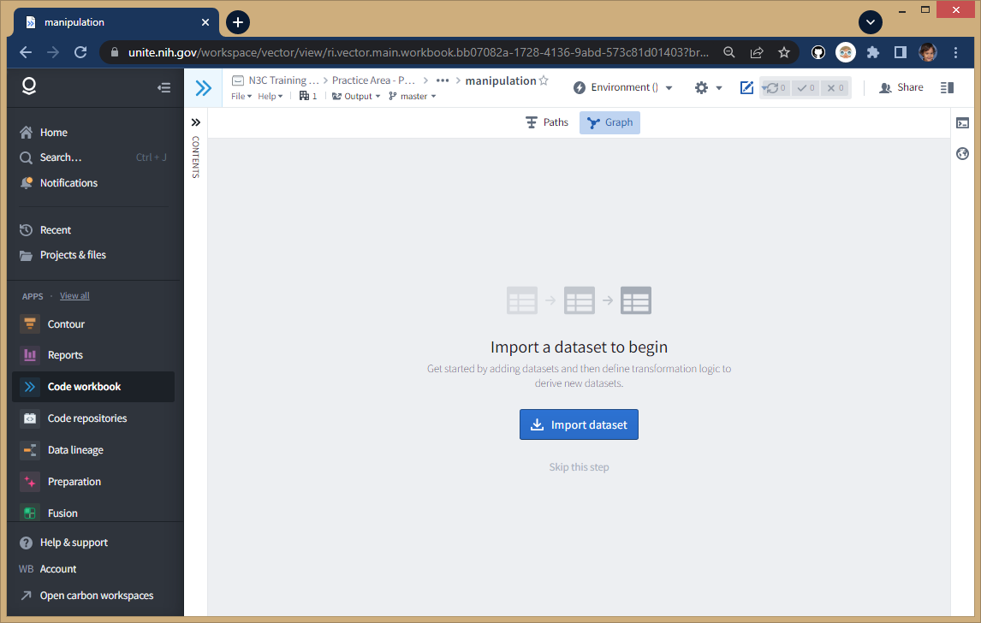
Start with a clean “workbook”
“N3C Training Area/Practice Area - Public and Example Data/will-beasley”
Create new workbook called “manipulation”
synthetic/fake patient data

Slide 6
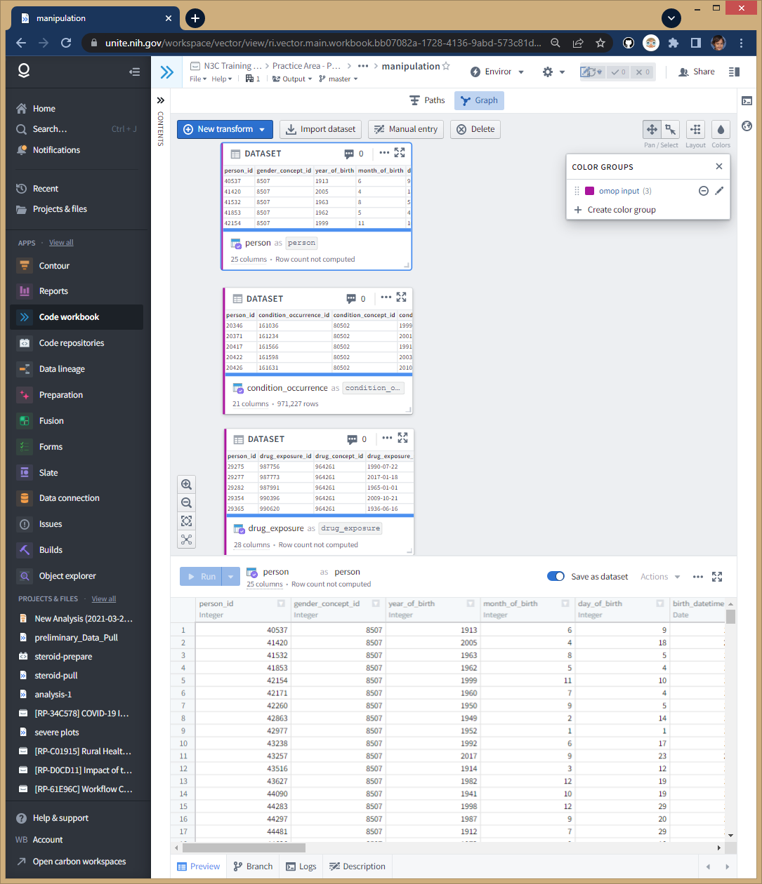
Import three tables
Blue Import Dataset button:
All -> Data Catalog -> Synthea Notional Data
person (1 row per patient)
drug_exposure (1 row per drug admin)
condition_occurrence (1 row per dx)
Purple label
synthetic/fake patient data

Slide 7
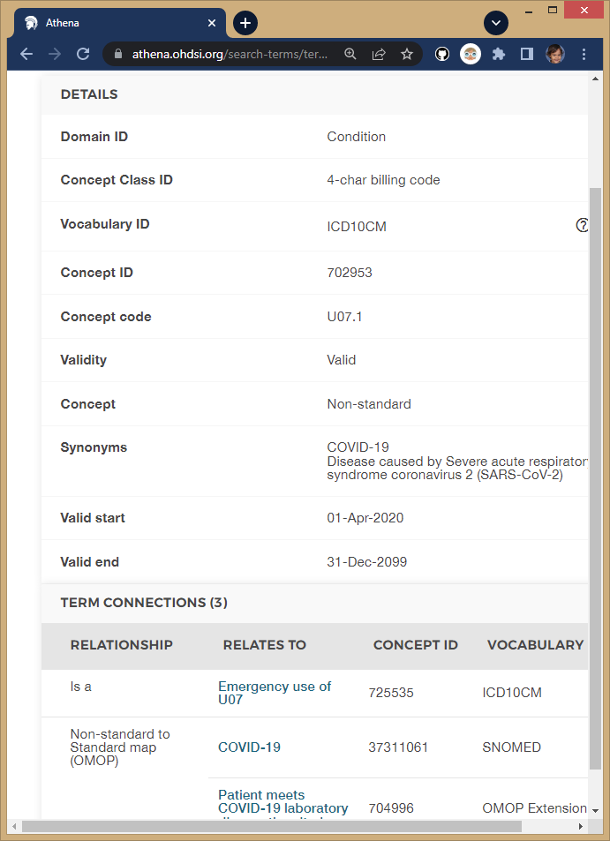
Find COVID concept id
Talk to clinician on your team and ask what ICD code(s) are appropriate (their response is “U07.1”)
Go to OMOP’s Athena tool: https://athena.ohdsi.org/
Enter “U07.1” and filter on ICD10CM vocab
Follow ICD10CM’s path to SNOMED
Copy the Concept ID of 37311061
Details are in chapter 5 of The Book of OHDSI https://ohdsi.github.io/TheBookOfOhdsi/

Slide 8
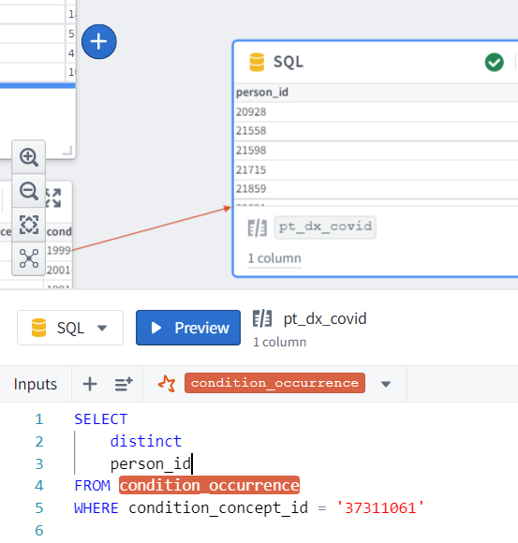
Designate Covid
1st iteration: unique patients
New SQL transform/node from condition_occurrence
SELECT
distinct
person_id
FROM condition_occurrence
WHERE
condition_concept_id = '37311061'
synthetic/fake patient data

Slide 9
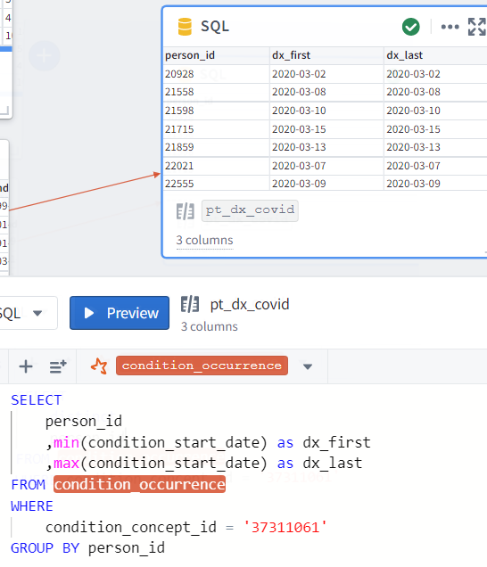
Designate Covid
2nd iteration: include characteristics
SELECT
person_id
,min(condition_start_date) as dx_first
,max(condition_start_date) as dx_last
FROM condition_occurrence
WHERE
condition_concept_id = '37311061'
GROUP BY person_id
synthetic/fake patient data

Slide 10
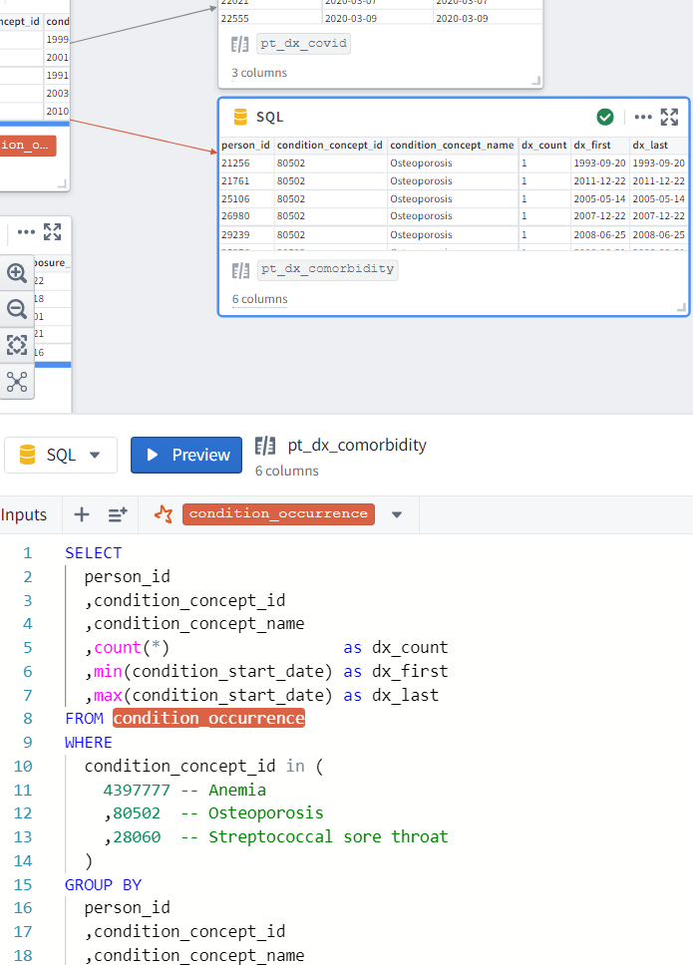
Isolate Comorbidities
New SQL transform/node from condition_occurrence
Anemia, Osteroporisis, & Strep
SELECT
person_id
,condition_concept_id
,condition_concept_name
,count(*) as dx_count
,min(condition_start_date) as dx_first
,max(condition_start_date) as dx_last
FROM condition_occurrence
WHERE
condition_concept_id in (
4397777 -- Anemia
,80502 -- Osteoporosis
,28060 -- Streptococcal sore throat
)
GROUP BY
person_id
,condition_concept_id
,condition_concept_name
synthetic/fake patient data

Slide 11
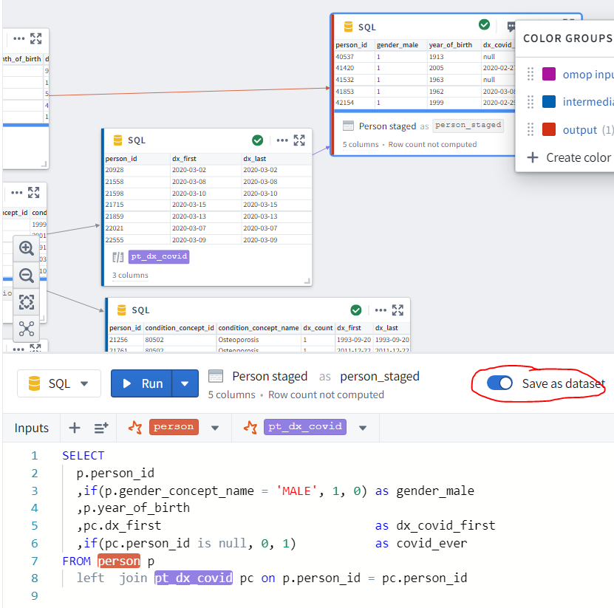
Join `person` & `pt_dx_covid`
New SQL transform/node pointing to two tables
Toggle the Save switch
Name “person_staged”
SELECT
p.person_id
,p.gender_concept_name as gender
,if(p.gender_concept_name = 'MALE', 1, 0) as gender_male
,p.year_of_birth
,pc.dx_first as dx_covid_first
,if(pc.person_id is null, 0, 1) as covid_ever
FROM person p
left join pt_dx_covid pc on p.person_id = pc.person_id
synthetic/fake patient data

Slide 12
Start new Code Workbook
Named “analysis”
Import dataset
N3C Training Area/Practice …/will…/presentation…/workbook…/manipulation/Person Staged

Slide 13
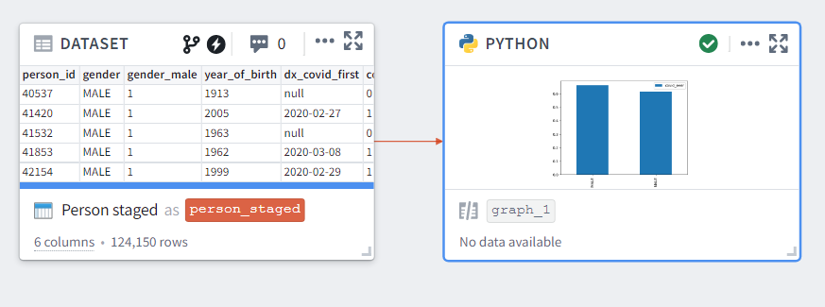
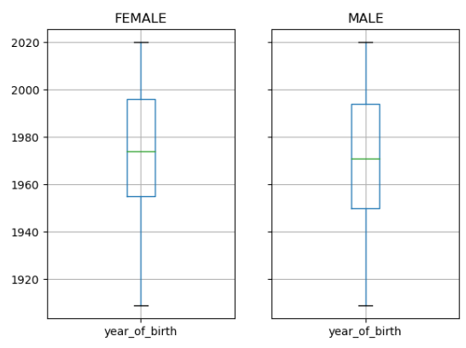
Python Transform
New Transform
Change `person_staged` to Pandas dataframe (Bottom-right panel)
def graph_1(person_staged):
import pandas as pd
import matplotlib.pyplot as plt
ds = person_staged
type(ds) # <class 'pandas.core.frame.DataFrame'>
ds.info()
ds[["gender", "year_of_birth"]].groupby(['gender']).boxplot()
plt.show()
ds[["gender", "covid_ever"]].groupby(['gender']).mean().plot(kind='bar')
plt.show()
synthetic/fake patient data

Slide 14
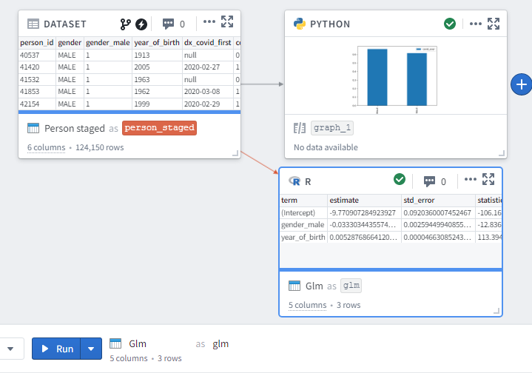
R Transform
New Transform
Change `person_staged` to R data.frame (Bottom-right panel)
glm <- function(person_staged) {
library(magrittr)
class(person_staged) # "data.frame"
ds <- person_staged m <-
lm(
formula = covid_ever ~ 1 + gender_male + year_of_birth,
family = "binomial",
data = ds
)
summary(m)
m %>%
broom::tidy()
}
synthetic/fake patient data

Slide 15
Likely Improvements/Complications for Real Questions
Compare/limit dx dates
Outcomes should follow covid dx date.
?Should only pre-existing coughs be considered?
Explore site characteristics
You can’t tell what site is which
but you can look at quality on the characteristics in your study

Slide 16
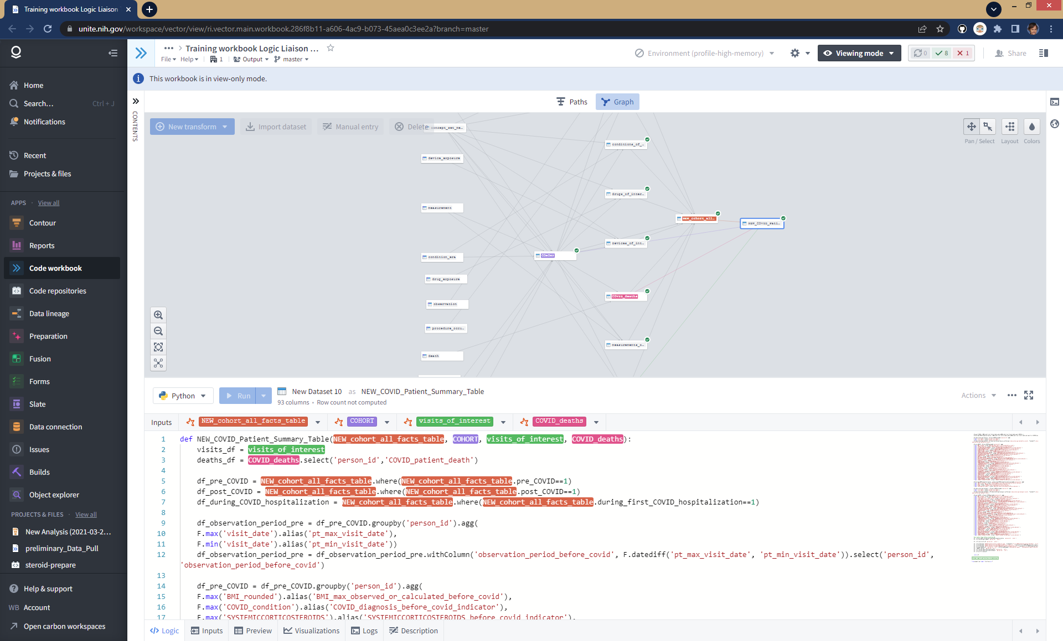
For real research projects, jump start with
https://unite.nih.gov/workspace/vector/view/ri.vector.main.workbook.286f8b11-a606-4ac9-b073-45aea0c3ee2a?branch=master
These great templates are developed by the “Logic Liaison” group, primarily by Johanna Loomba and Andrea Zhou at UVA’s translational group (https://www.ithriv.org/)
Notes:
You can’t see the details, but can appreciate a lot of details are considered and provided. It will improve the quality of your dataset and save you at least a few days. And relevant to this audience, it will make you analyses more reproducible, because these groomed datasets are available and promoted to all N3C researchers.

Slide 17
Thank you
Award Numbers: UG1OD024950 U54GM104938

Slide 18
Extra Slides

