Slide 1
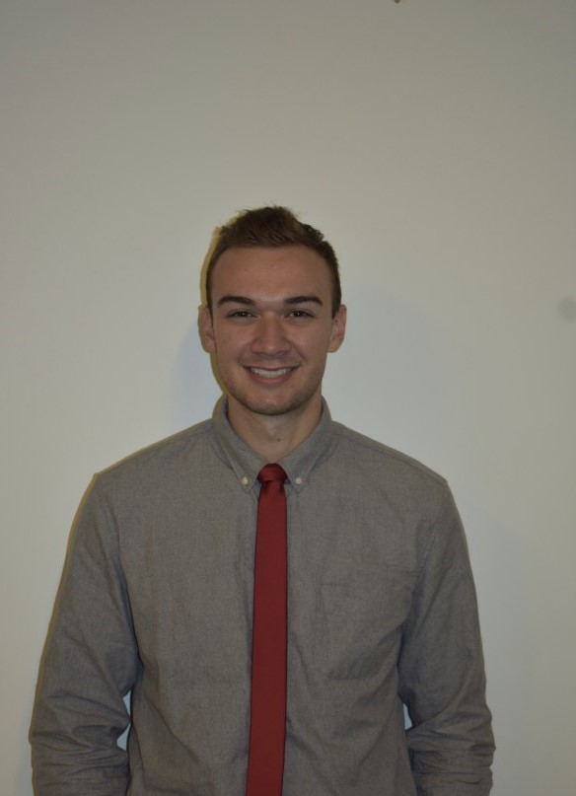
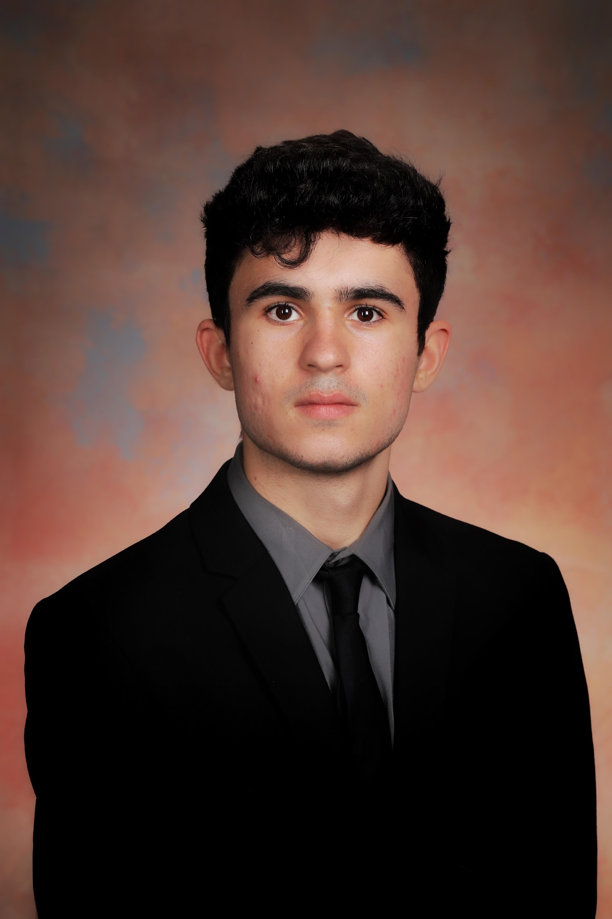

TMDB REVENUE PREDICTION
Phase 3: Feature Engineering + hyperparameter tuning
Group 2:
Alex Bzdel
Eric Gilbert
Michael Fornal
WWW.EVANA.COM

Slide 2

PRESENTATION OUTLINE
Project Description
Visual EDA
Our Pipelines
Results (RMSLE + Kaggle Submission)
Conclusion
WWW.EVANA.COM

Slide 3

PROJECT DESCRIPTION
TMDB Revenue Prediction

Slide 4
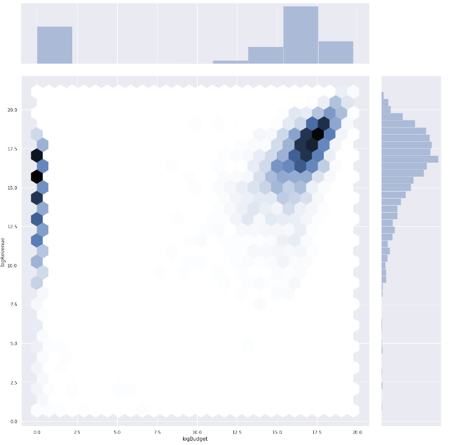
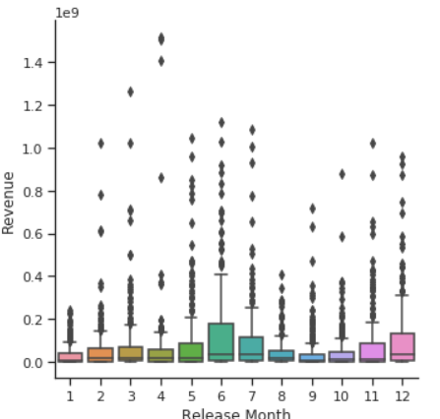
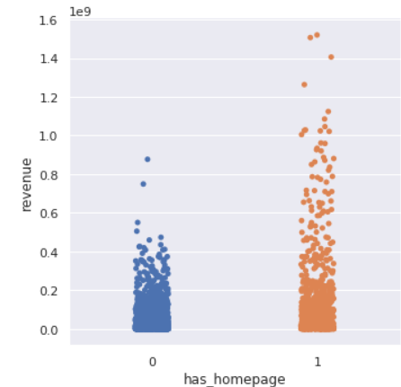
VISUAL EDA
Log Revenue
WWW.EVANA.COM
Log Budget

Slide 5
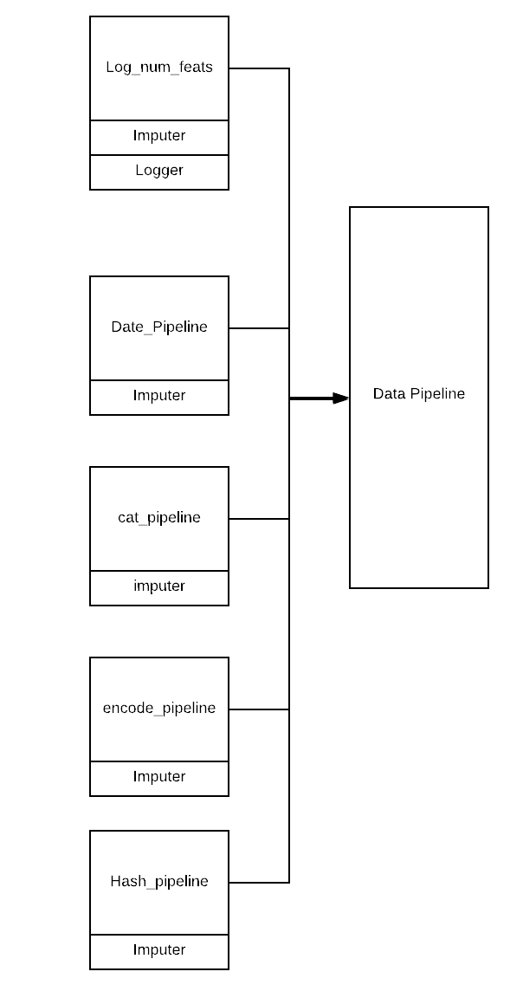
OUR PIPELINE
5 pipelines, each taking the features provided and running them through the functions listed, then leading into a main pipeline, for efficient data processing.

Slide 6
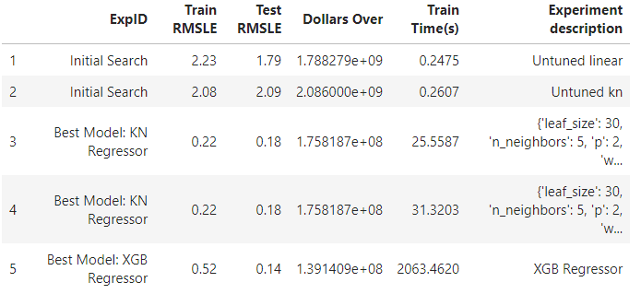
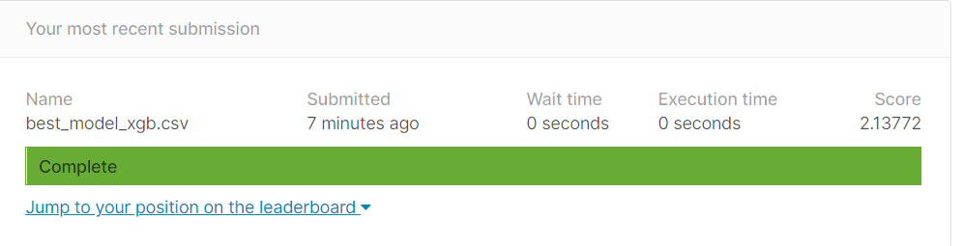
RESULTS
WWW.EVANA.COM

Slide 7
Conclusion
With all the work we have put into our pipelines and predictions, this is the best kaggle score we could have achieved within the time period of this project.

Slide 8
WWW.EVANA.COM
THANKS
FOR
WATCHING

