Slide 1
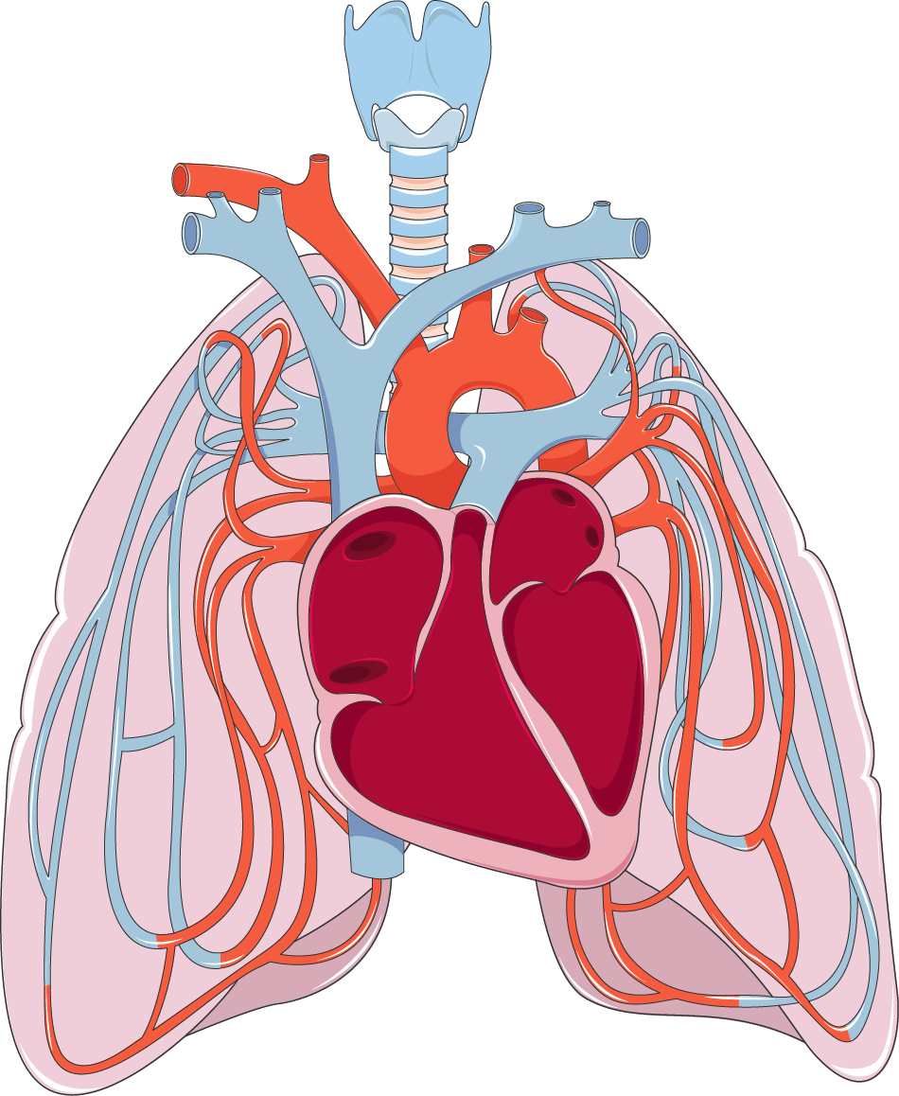
Multi-Agent Medical Diagnostic System for Chest X-Ray Classification
Presented By:
Mayssa Ben Soussia
Oumayma Jellali

Slide 2
Table of contents
01
02
03
PROBLEM STATEMENT
Dataset & Technical stack
04
05
06
MODELS & SYSTEM ARCHITECTURE
Agents
RAG VS GraphRAG VS Agentic GraphRAG
07
Neo4j Scenarios
08
DEMO
Conclusion & Perspectives

Slide 3
01
PROBLEM STATEMENT

Slide 4
Core Problem:
"How can we develop a reliable, explainable, and accessible AI system to assist in rapid chest X-ray classification for COVID-19 and pneumonia detection?"
Gap in Existing Solutions:
Most systems use single black-box models
Lack of explainability
Heavy computational requirements
No case-based reasoning
Main Objective:
Develop an intelligent multi-agent system for automated chest X-ray classification

Slide 5
02
Dataset & Technical stack

Slide 6
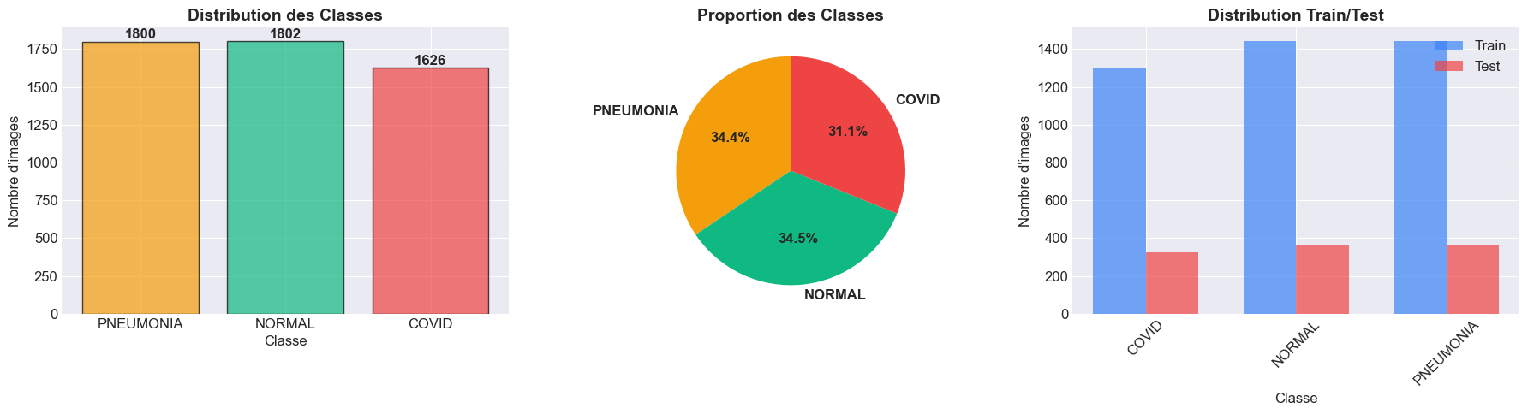
Dataset composition:
The three classes are used:Normal, Pneumonia, and Covid-19.
Image resizing:
All images were resized to 224×224 pixels and normalized between 0 and 1(Min–Max).
Dataset splitting:
80% for training,10% for validation,10% for testing

Slide 7
Technical stack
Category | Tools / Technologies | Description
Explainability Tools | SHAP, LIME, Grad-CAM | Model explainability and visualization methods.
Orchestration | CrewAI | Multi-agent coordination system.
Knowledge Graph | Neo4j 5.x, Cypher | Graph database and query language for relational data.
Web Development Stack | Flask 3.0+ (Backend), Bootstrap 5 (Frontend) | Full web framework for backend APIs and responsive UI.
Containerization | Docker | Run Neo4j in isolated, portable, and reproducible environments.

Slide 8
03
MODELS & SYSTEM ARCHITECTURE

Slide 9
Chosen Models:
Traditional ML: XGBoost
Deep Learning: MobileNetV2
Interpretable feature importance
Fast training and inference
Pre-trained on ImageNet
Transfer Learning:
-Freeze first 100 layers
-Fine-tune last 30 layers
Why Multiple Models?
Different perspectives reduce bias
Ensemble improves accuracy
Complementary strengths
Robust consensus

Slide 10
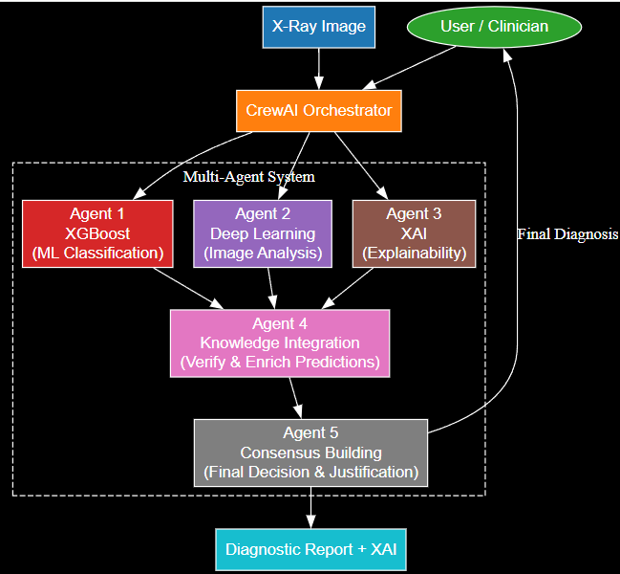
Step-by-Step Flow:
Image Upload → Patient ID + X-ray image
Preprocessing → Resize, normalize
Parallel Processing:
Agent 1: Extract features → XGBoost prediction
Agent 2: MobileNetV2 prediction
XAI Generation:
Agent 3: Grad-CAM, LIME, SHAP
Knowledge Storage:
Agent 4: Store in Neo4j graph
Consensus Building:
Agent 5: Aggregate predictions
Output → Final diagnosis + explanations

Slide 11
04
Agents

Slide 12
Agent 1 - XGBoost Classifier | Agent 2 -MobileNetV2 | Agent 3 - XAI Explainability | Agent 4 - Neo4j GraphRAG
-Role: Traditional ML Classification Specialist -Provide feature importance rankings -Output: Predicted class Confidence score Top 10 contributing features | -Role: Deep Learning Specialist -End-to-end image classification -Output: Predicted class Confidence score Class probabilities | -Role: Model Interpretation Specialist -Responsibilities: Generate visual explanations Identify important image regions Build clinical trust | -Role: Medical Knowledge Management Specialist -Responsibilities: Store diagnostic history Build medical knowledge graph Enable case-based reasoning
Notes:
Slide 23: Agent 3 - XAI Examples
Content:
COVID-19 Case Example:
Grad-CAM: Highlights bilateral ground-glass opacities
LIME: Shows lower lung fields as positive contributors
Interpretation: Model focuses on correct diagnostic regions
Normal Case Example:
Grad-CAM: Uniform low activation
LIME: No strong positive segments
Interpretation: No pathological patterns detected
Pneumonia Case Example:
Grad-CAM: Focal consolidation areas
LIME: Localized positive segments
Interpretation: Bacterial infiltration patterns
Clinical Value:
Validates model reasoning
Builds radiologist trust
Educational tool
Visuals: Real examples with X-rays + heatmaps side by side

Slide 13
Agent 5 - CrewAI Orchestrator :
-Role: Multi-Agent Coordinator & Consensus Builder
-Responsibilities:
Orchestration: Coordinate execution of all agents
Task Distribution: Assign tasks to specialized agents
Result Aggregation: Collect predictions from all agents
Consensus Building: Combine opinions into final decision
Conflict Resolution: Handle disagreements between agents
Report Generation: Create comprehensive diagnostic report

Slide 14
05
Neo4j Scenarios

Slide 15
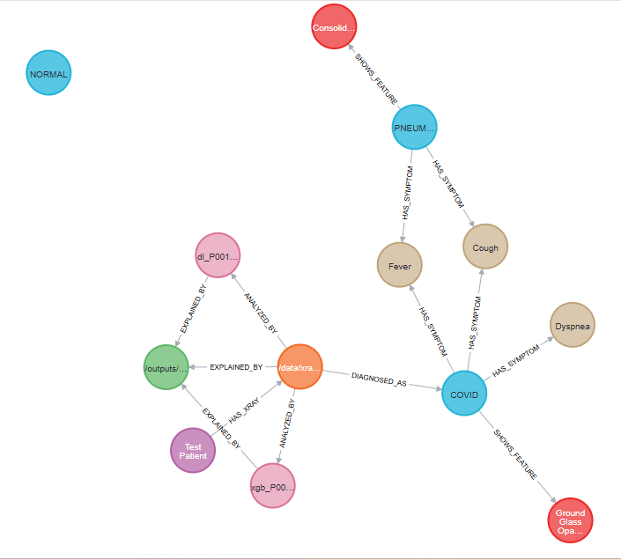
RadiographicFeature
Diagnosis
Symptom
Display all nodes and relationships
XAIExplanation
XRay

Slide 16
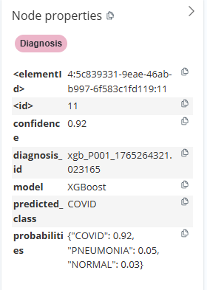
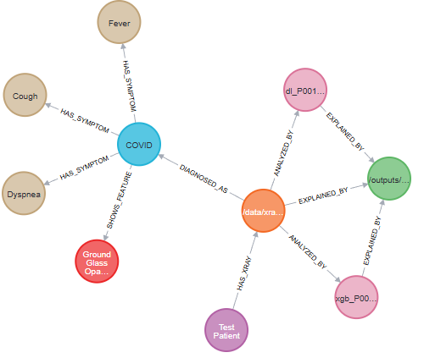
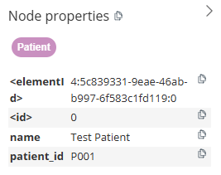
Graph centered on a patient

Slide 17
06
RAG VS GraphRAG VS Agentic GraphRAG

Slide 18
Feature | RAG | GraphRAG | Agentic GraphRAG (Ours)
Data Structure | Vector DB | Knowledge Graph | Knowledge Graph + Agents
Retrieval | Similarity search | Graph traversal | Agent-driven queries
Reasoning | None | Path-based | Multi-agent consensus
Relationships | No | Yes | Yes + contextual
Coordination | None | Manual | Automated (Agent 5)
Case-Based Reasoning | Limited | Good | Excellent

Slide 19

Demo:

Slide 20
Conclusion & Perspectives
A multi-agent system that enhances diagnostic accuracy
Transparent decisions thanks to integrated XAI
Knowledge graph adds context and improves reasoning
Final consensus ensures reliable and consistent outputs
Future work: Integrate more advanced models
Expand and enrich the medical knowledge graph

Slide 21
THANK YOU !

