Slide 1
Real-Time Nudity & Violence Image Detection
AI-Powered Content Moderation using Gemini 3 Flash Preview API
OUMBAREK Soufiane

Slide 2
Problem Statement
• Exposure to violent and explicit images online is increasing
• Teenagers are especially vulnerable to harmful content
• Manual moderation is slow and inefficient
• Many platforms lack real-time content filtering

Slide 3
Solution Approach
• Develop a real-time AI-based image detection system
• Analyze images using Gemini 3 Flash Preview API
• Classify content as Safe, Nudity, Violence, or Both
• Provide instant moderation feedback

Slide 4
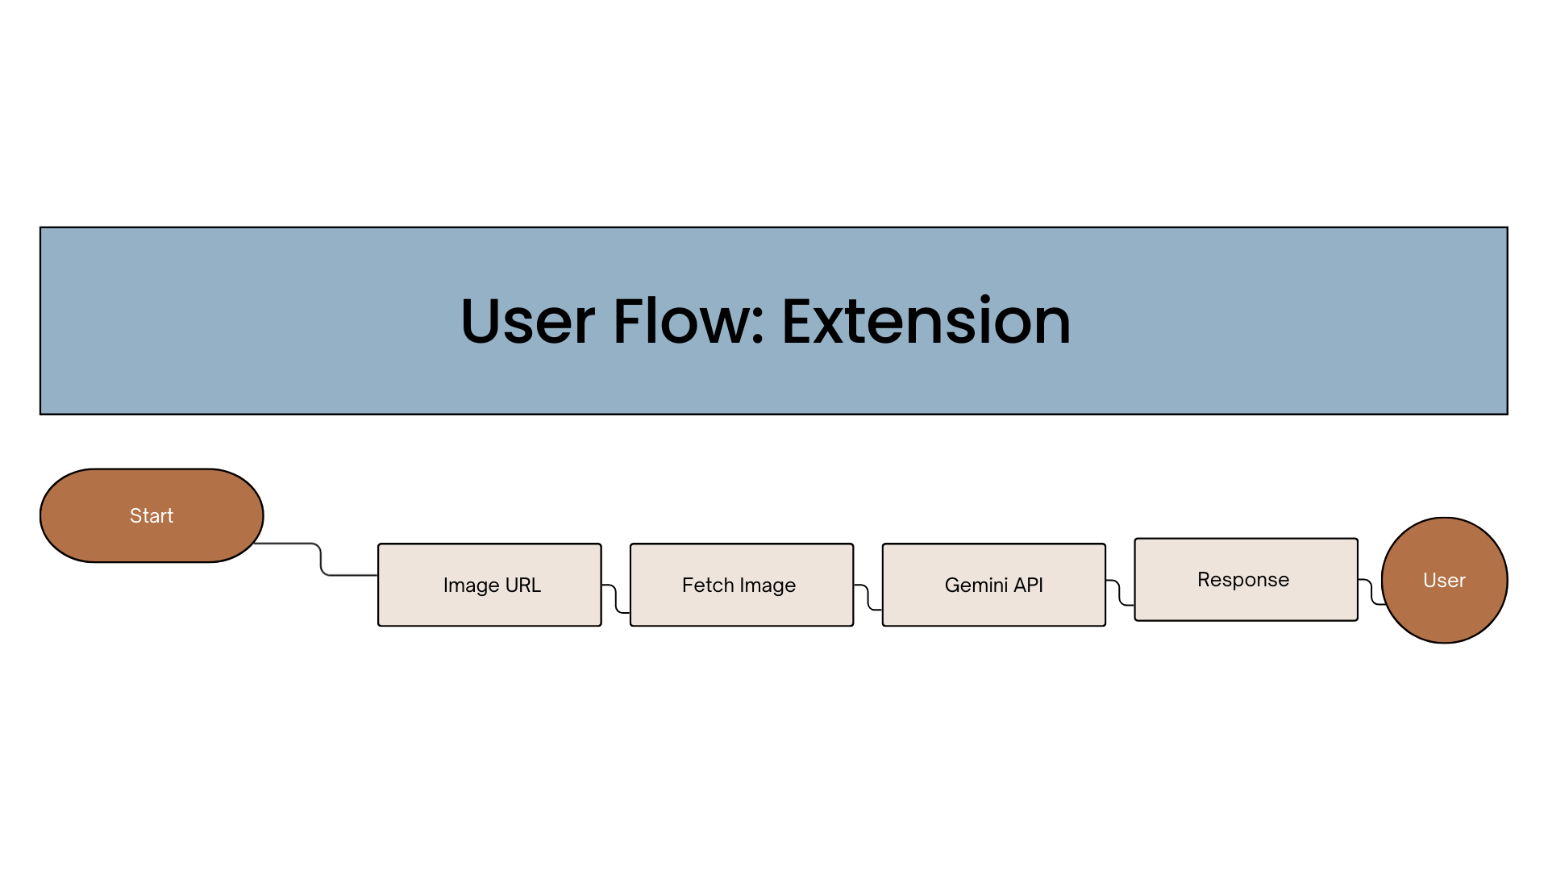
Architecture / Workflow

Slide 5




Technology Stack
• Frontend: React.js
• Backend: Node.js & Express.js
• AI Model: Gemini 3 Flash Preview API
• Version Control: GitHub

Slide 6
Challenges Faced
• Gemini 1.5 and 2.5 limitations
• API instability during testing
• Handling images directly from URLs
• Optimizing real-time performance

Slide 7
Accomplishments
• Successfully integrated Gemini 3 Flash Preview API
• Built working real-time detection prototype
• Implemented URL-based image processing
• Designed scalable moderation workflow

Slide 8
Expected Impact
• Safer digital environments for teenagers
• Faster automated content moderation
• Reduced exposure to harmful imagery
• Responsible and ethical AI implementation

Slide 9
What’s Next
• Improve detection accuracy
• Add video frame analysis
• Build admin moderation dashboard
• Deploy as scalable web service

