Slide 1

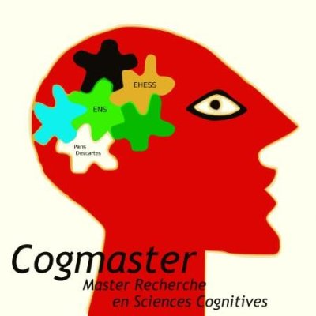


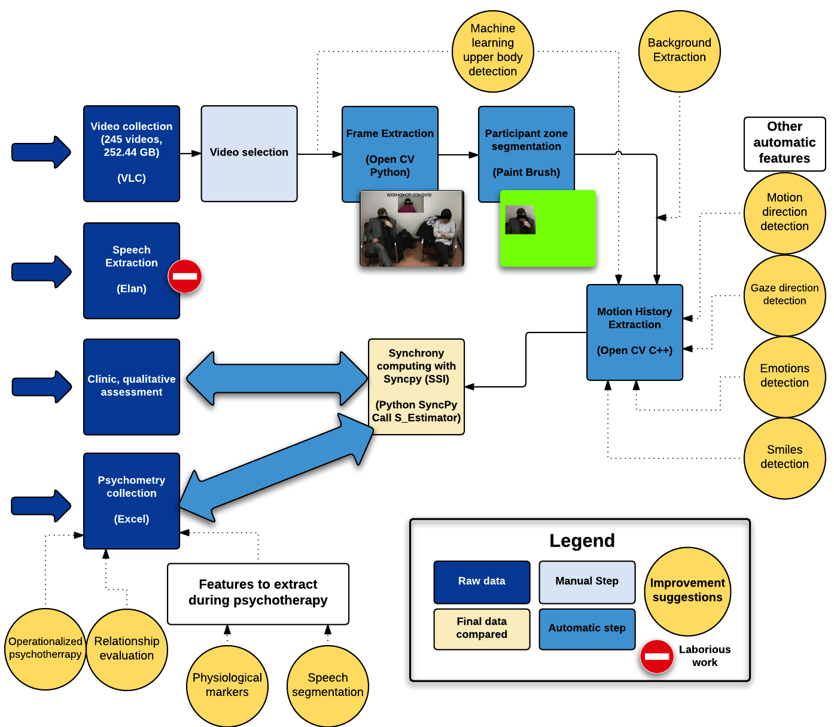
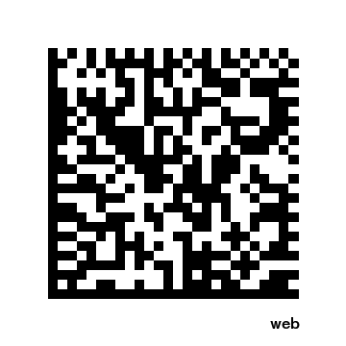
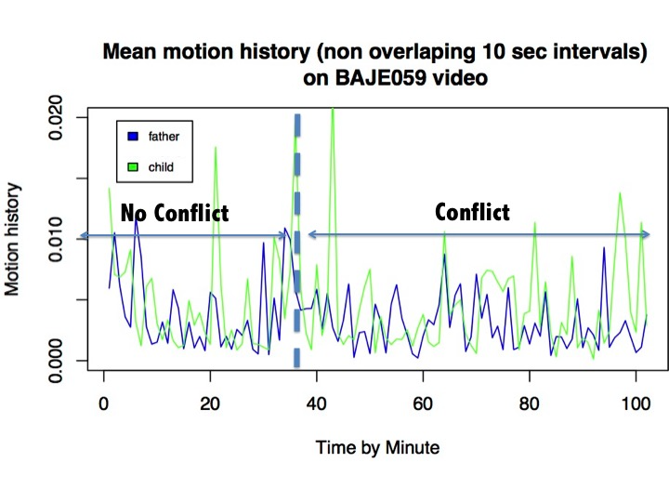
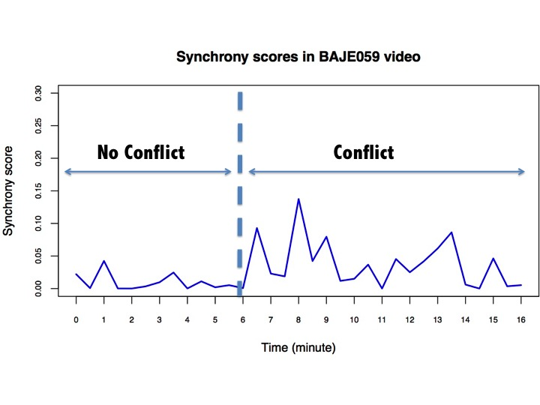
Extracting automatically social signals from psychotherapy sessions
Thomas Gargot^{1,2,*}, Giovana Varni², Jonathan Aigrain²,
Mohamed Chetouani², Michel Spodenkiewicz^{1,2}, David Cohen^{1,2}
1. Hôpital de la Pitié Salpêtrière, 2. Institut des Systèmes Intelligents et de la Robotique, Paris, France
* thomas_gargot@hotmail.com
Introduction and motivation
Psychotherapy is an important part of treatment of mental disorders alone or complementary with pharmacotherapy. Some techniques are now widely evidence-based and very cost effective (Layard & Clark, 2014).
Most of the studies are indirectly based on patient reported outcomes or problematic behaviors that are evaluated before and after the psychotherapy. Unfortunately, studies hardly control what is actually happening during psychotherapy, especially the interaction between the patient and the therapist that could be a predictor of the psychotherapy efficacy. Consequently, it is difficult to make precise links between theory and practice, control its application and understand which of its ingredients are the most important.
It is already feasible to annotate manually videos. However, this task is tedious. It can be either very repetitive (annotation of turn-taking or non-verbal behavior) or very technical (annotation of application of some specific techniques like in motivational interviewing (Moyers et al, 2015) and a potential source of bias.
In the future, an automatic feedback during the psychotherapy could also even help the therapists to reorganize a treatment.
Towards an automated research framework
Here we suggest a research framework (Fig 1.) to extract automatically social signals from psychotherapy videos. We focus on motor synchrony considered as a predictor of psychotherapy outcome in a first study (Ramseyer, 2011) and a relevant signal for the study of mother-child interactions. Varni et al. 2015 developped the SyncPy open source python library to help researchers and practitioners to automatically analyse synchrony. It could be possible to measure synchrony even in familial therapies. Other features could be quite easily extracted manually like direction of the body, gaze direction or smiles. Here, we show an example of a video before and during a conflictual talk between a girl with her father (Fig 2. and 3.).
With an interdiciplinary and open science approach, we developed some modules toward this goal that could be freely and easily re-used by other teams with their own databases or with other modules.
Perspectives
The next step is to design a specific database anticipating some technical problems (speech segmentation, overlapping of subjects, micro-movements) and define more precisely different conditions of psychotherapy that could be contrasted.
Project website
1. Procedure
http://bit.ly/syncpsy
Example on a conflict video
2. Motion history
2.
3. Synchrony score
3.
References
Layard, R., & Clark, D. M. (2014). Thrive: The power of evidence-based psychological therapies. Penguin UK.
Moyers, T. B., J. K. Manuel, and D. Ernst. "Motivational Interviewing Treatment Integrity Coding Manual 4.1." (2014).
Ramseyer, Fabian, et Wolfgang Tschacher. « Nonverbal synchrony in psychotherapy: Coordinated body movement reflects relationship quality and outcome ». Journal of Consulting and Clinical Psychology 79.3 (2011): 284‑295.
Varni, G., et al. "SyncPy: a Unified Open-source Analytic Library for Synchrony." Proceedings of the 1st Workshop on Modeling INTERPERsonal SynchrONy And infLuence. ACM, 2015.
No potential conflicts of interests

