Slide 1
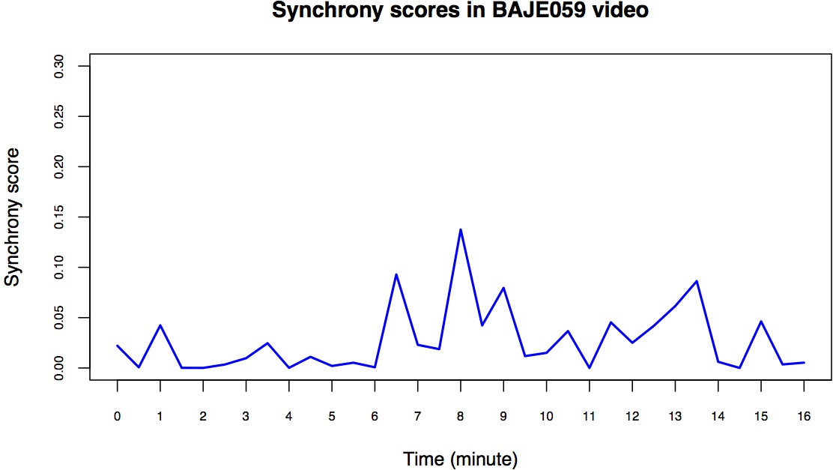
No Conflict
Conflict

Slide 2
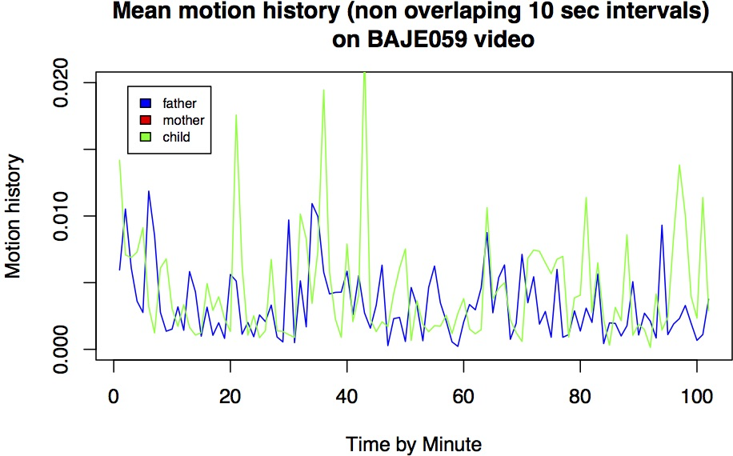
No Conflict
Conflict

