Slide 1

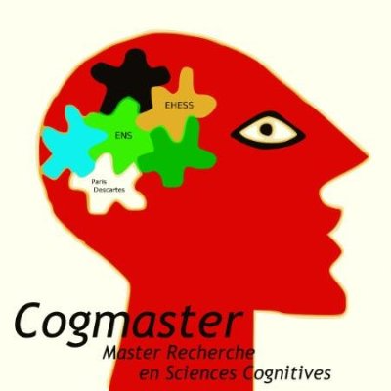

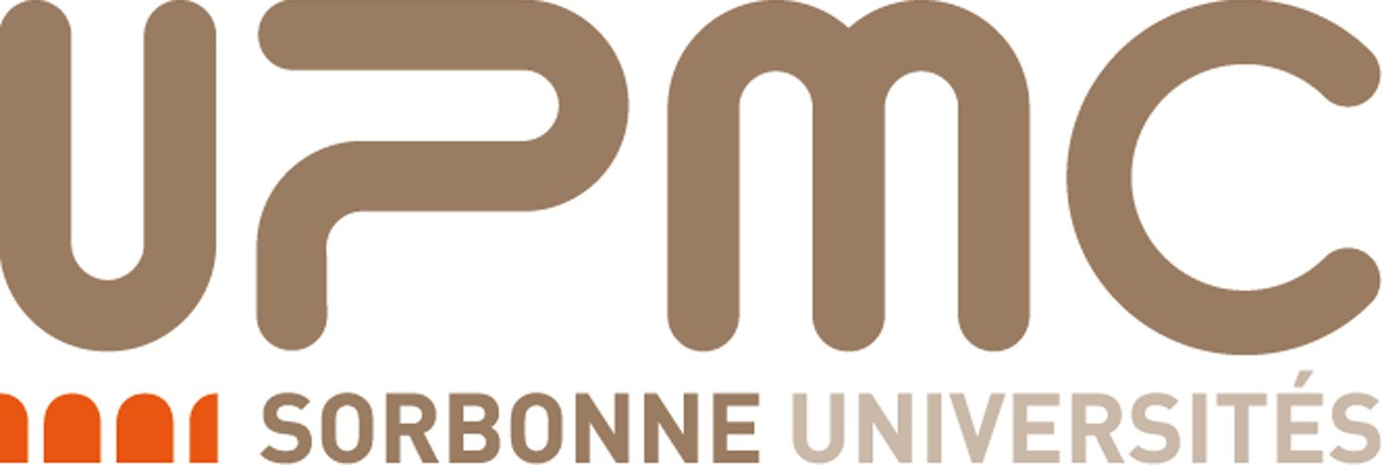
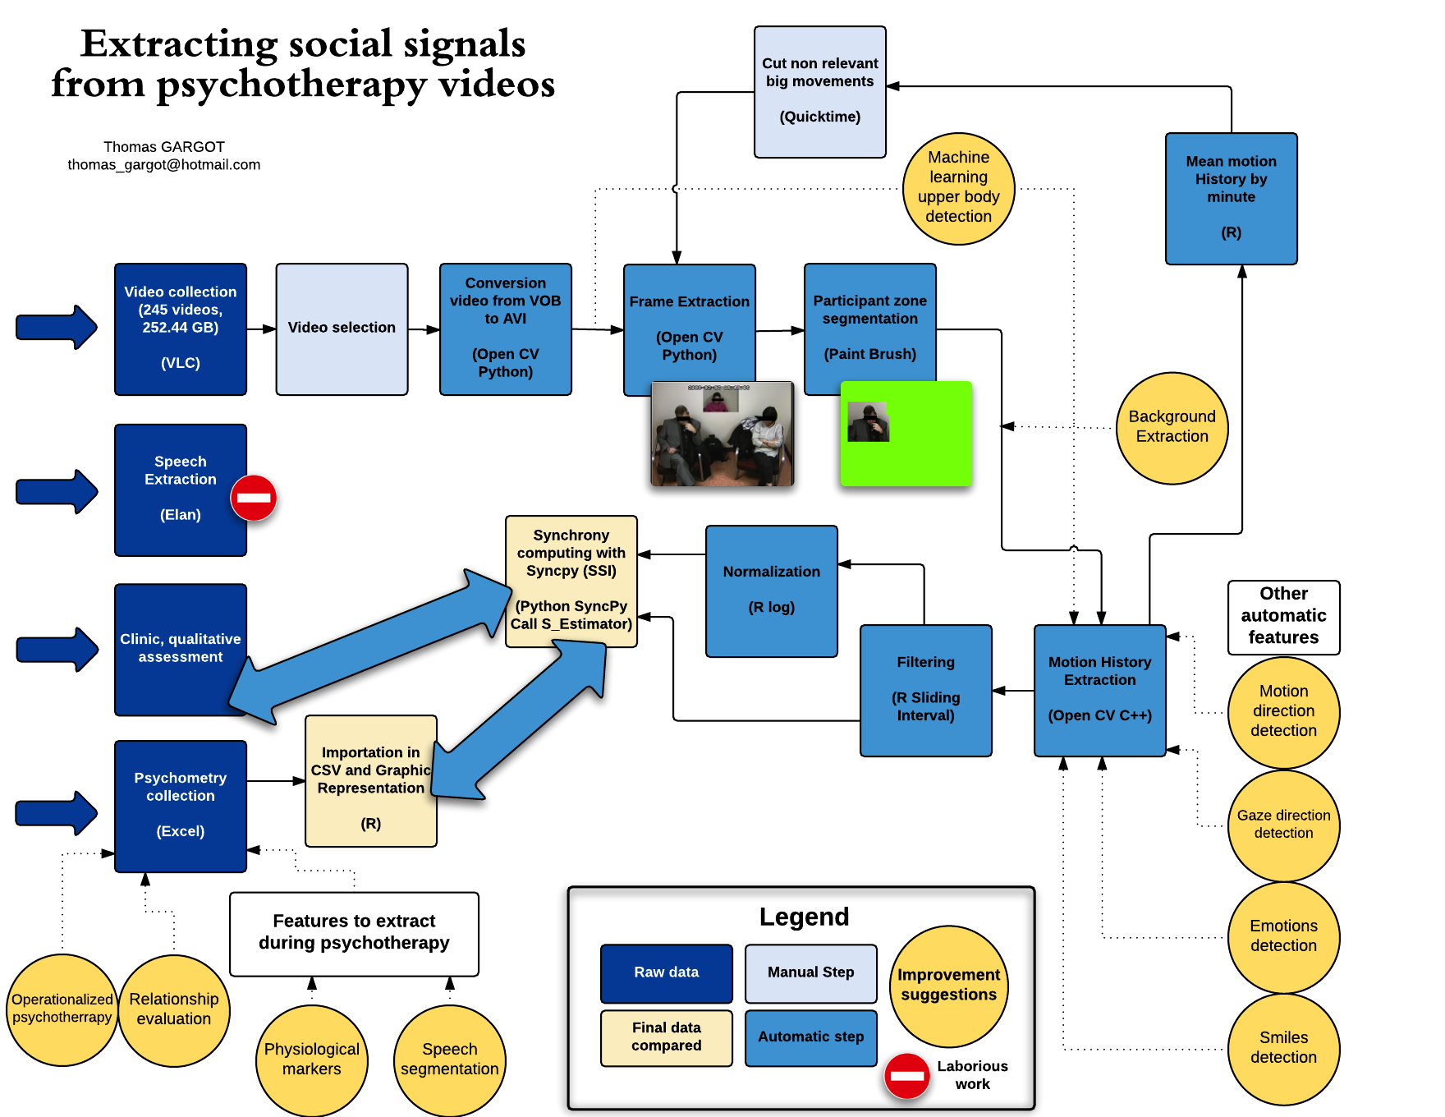
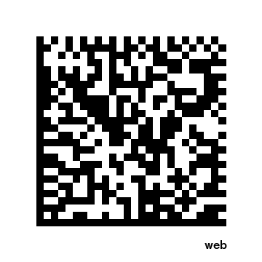
Extracting automatically social signal from psychotherapy sessions
Thomas Gargot^{1,2,*}, Giovana Varni², Jonathan Aigrain²,
Mohammed Chettouani², Michel Spodenkiewicz^{1,2}, David Cohen^{1,2}
1. Hôpital de la Pitié Salpêtrière, 2. Institut des Systèmes Intelligents et de la Robotique, Paris, France
* thomas_gargot@hotmail.com
Psychotherapy is an important part of treatment of mental disorders alone or complementary with pharmacotherapy. Somes techniques are now widely evidence-based and very cost effective (Layard & Clark, 2014).
Most of studies are indirectly based on patient reported outcomes or problematic behaviors that are evaluated before and after the psychotherapy. Unfortunatelly, studies hardly control what is directly happening during psychotherapy especially the interaction between the patient and the therapist that could be a predictor of the psychotherapy outcome. Consequently, it is difficult to control application of some techniques and to understand which of their ingredients are the most importants.
It is yet possible to annotate manually videos. However, this task is challenging since it can be either very repetitive (annotation of turn-taking or non-verbal behavior) or very technical (annotation of application of some specific techniques like in motivational interviewing (Moyers et al, 2015).
In the future, an automatic feedback of the psychotherapy could also even help a therapist to guide a treatment.
Here we suggest a research framework to extract automatically social signals from psychotherapy videos. We focused on motor synchrony since, it was found to be a predictor of psychotherapy outcome in a first study (Ramseyer, 2011) and one of us developped a free module to analyse synchrony (Varni et al, 2015). It could be possible to measure synchrony even in familial therapies. Other features could be quite easilly extracted manually like direction of the body, gaze direction or smiles.
The next step would be to design a specific database anticipating some technicals problems (speech segmentation, overlapping of subjects, micro-movements) and define more precisely different conditions of psychotherapy that could be contrasted.
Using an open science approach we developped some modules toward this goal that could be freely and easilly re-used by other teams in other databases or with other modules.
Project website
No potential conflicts of interests

