Slide 1
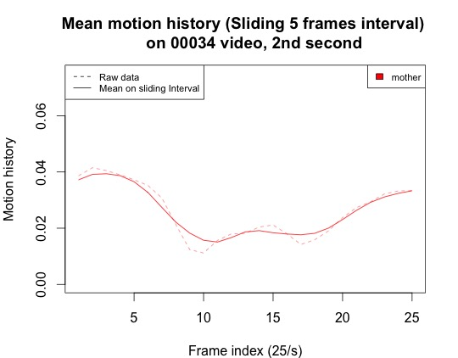
Mean 1
Filtering computation with sliding interval function
Mean 2
Mean 3
Shift (one frame)
Interval size

Slide 2
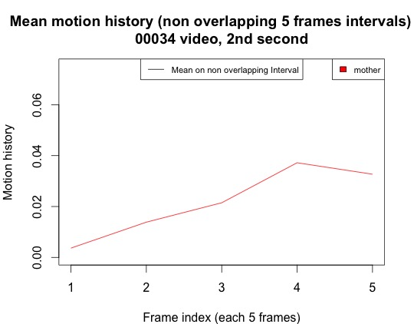
Filtering computation with MeanMotionByTime
function
Mean 1
Mean 2
Shift (5 frames)
Mean 3
Interval size

